Slide 1
DLL Design for Low Power and Jitter
Yanqing Zhang
yanqing@virginia.edu

Slide 2
Outline
DLL Quick Review
Seminal Papers
First “dual loop” with infinite phase capture range
First true dual loop architecture
Summary of DLL Design Issues
A Walk Through Time
The first all digital DLL (1999)
The first mixed mode DLL (1999)
Process variation problem
False lock problem
Fast lock acquisition
PFD jitter
CP jitter
Summary of DLL Design Space
Discussion Questions

Slide 3
Outline
DLL Quick Review
Seminal Papers
First “dual loop” with infinite phase capture range
First true dual loop architecture
Summary of DLL Design Issues
A Walk Through Time
The first all digital DLL (1999)
The first mixed mode DLL (1999)
Process variation problem
False lock problem
Fast lock acquisition
PFD jitter
CP jitter
Summary of DLL Design Space
Discussion Questions

Slide 4
DLL Quick Over/Re-View
VCDL
Vcont
PD
CP
LPF
Notes:
DLL=PLL without frequency synthesis. VCDL replaces VCO. Delay line instead of frequency generator. Used to generate multiple phases of same frequency of clock
Used to generate multiple phases of clock-same frequency
Advantage 1: less noise without VCO
Advantage 2: VCDL gain only, one less pole, more stability more relaxed
PD only, charge pump not necessary, but usually used for infinite gain

Slide 5
DLL Quick Over/Re-View
Advantages:
Doesn’t have jitter from VCO
VCDL pure gain→one less pole→stability relaxed→no zero
Disadvantages:
Reference noise feed through
Finite delay range, no new frequencies
Suspect to jitter from Vcont

Slide 6
Outline
DLL Quick Review
Seminal Papers
First “dual loop” with infinite phase capture range
First true dual loop architecture
Summary of DLL Design Issues
A Walk Through Time
The first all digital DLL (1999)
The first mixed mode DLL (1999)
Process variation problem
False lock problem
Fast lock acquisition
PFD jitter
CP jitter
Summary of DLL Design Space
Discussion Questions

Slide 7
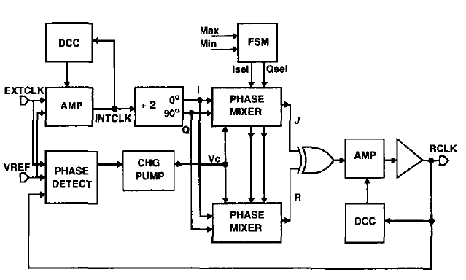
Dual Loop DLL Design
First ever ‘dual loop’ design
Infinite delay locking (2π)
Fully differential signals in loop
140 ps p2p jitter @ 250 MHz
65 mW @ 2.5 V
1 ps/mV supply sensitivity
Phase Interpolation
Freq Multiplying
Duty Cycle Correction (DCC)
[1]

Slide 8
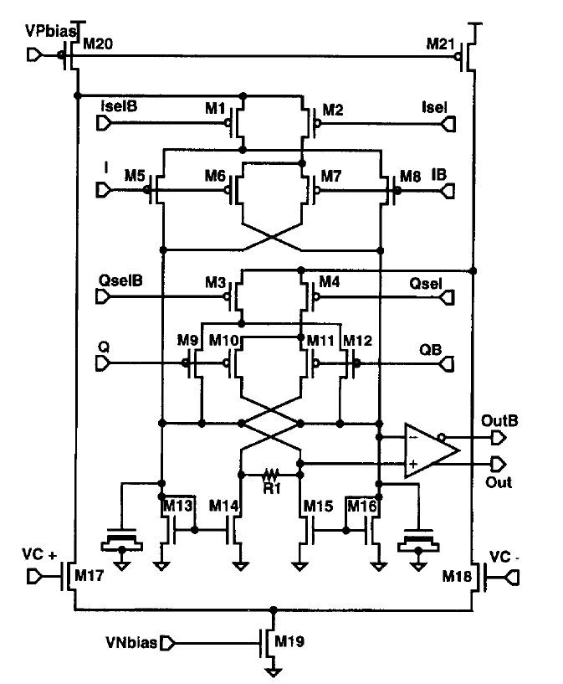
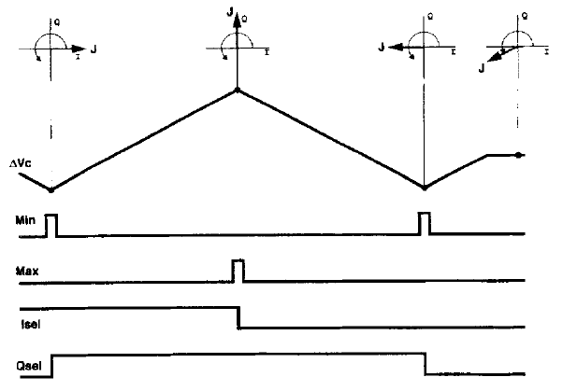
Dual Loop DLL Design
“I” weight
Phase Selects
Clock Signals
“Q” weight
Quadrature mixing
Fully differential→less supply sensitivity→less jitter
Slew rate limited
Phase gain induces dithering(jitter) when in lock
Differential controls
[1]

Slide 9
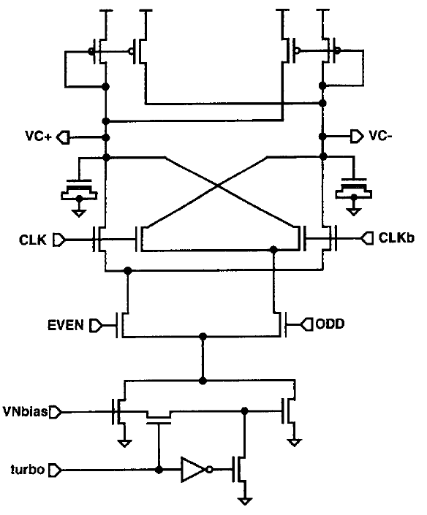
Dual Loop DLL Design
Load isolation
Fast lock acquisition
Fully differential
Voltage headroom limited→not for contemporary designs
Phase select signals
“turbo” for fast acquisition
[1]

Slide 10
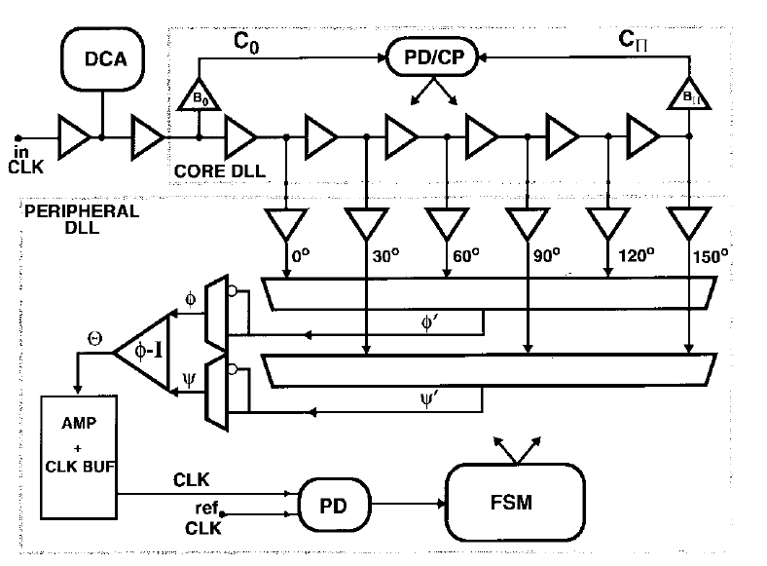
Dual Loop DLL Design (2)
“True” dual loop→coarse loop+fine loop
Quadrature mixing slew rate limited→jitter sensitive→interpolate smaller phases
Clocks buffered→less slew→less jitter
Stage to stage isolation or load matching→no data dependency jitter
PD offset identified as a problem
Mismatch/Variation in delay cells identified as a problem
[2]
Fully digital domain

Slide 11
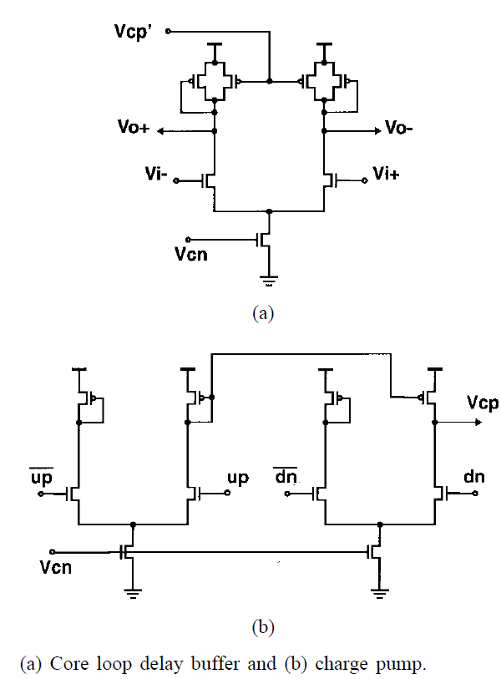
Dual Loop DLL Design (2)
All buffer delay elements differential for less supply sensitivity
Uses replica biasing for good linearity, wide operating range
Always static current
[2]

Slide 12
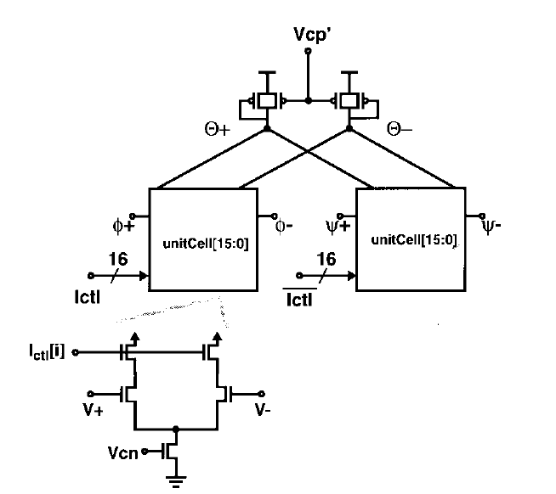
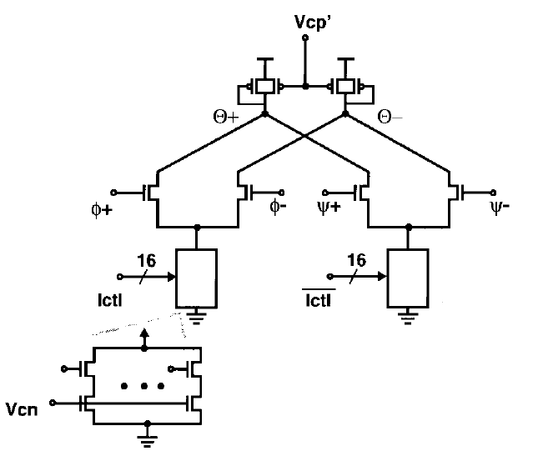
Dual Loop DLL Design (2)
[2]
[2]
Phase step must be small→small dithering amplitude→less jitter
Seamless phase transition
Gate-drain feedthrough vs. data dependency

Slide 13
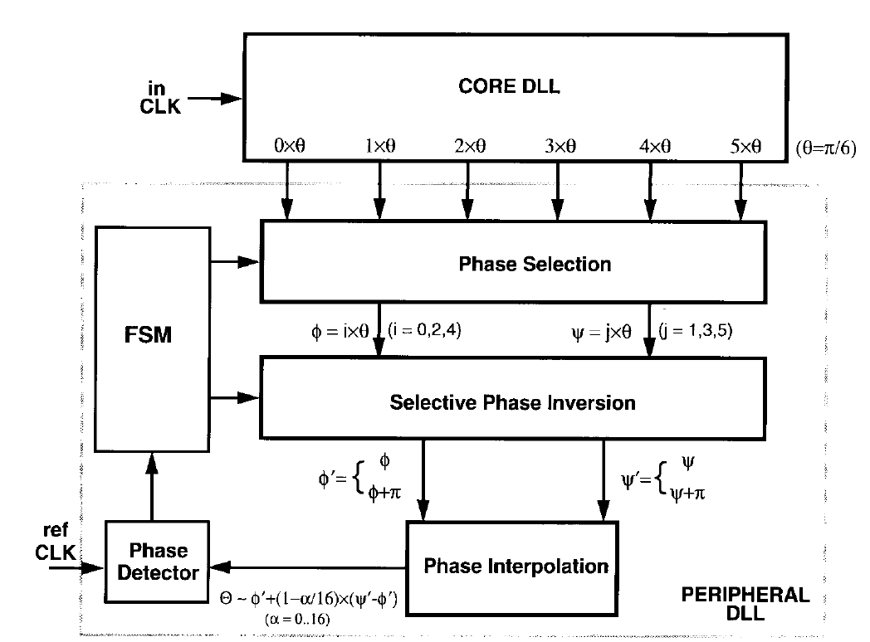
Dual Loop DLL Design (2)
[2]
80kHz-400MHz locking range
68 ps p2p jitter @250MHz
102 mW power dissipation @3.3V
0.4ps/mV supply sensitivity

Slide 14
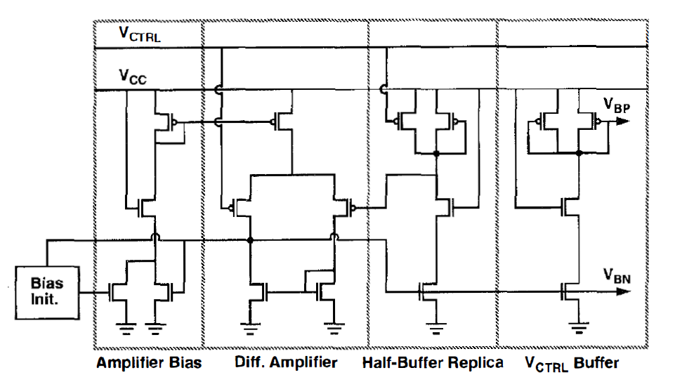
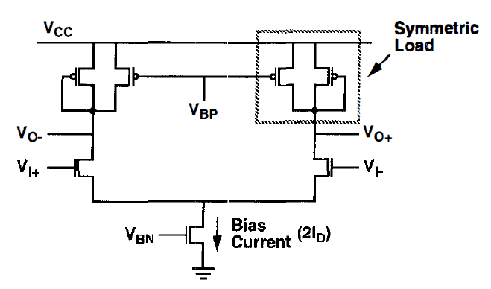
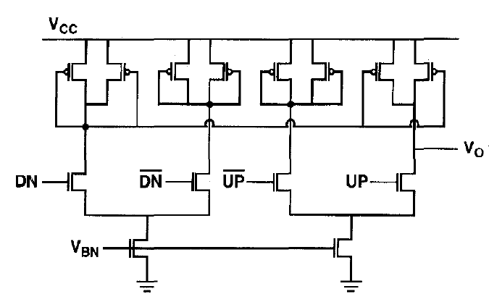
Self-biased Technique
[3]
Delay cell
Bias Circuit
[3]
Self-biased throughout DLL
Bias tracks changes in Vcc→constant current→constant delay→improved jitter
Charge pump current scales with frequency
Dead-zone improved due to fully symmetric topology
[3]
Charge Pump

Slide 15
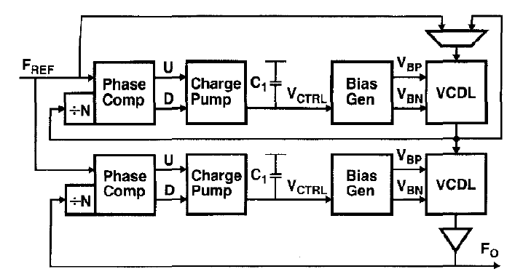
Self-biased Technique
262 ps p2p jitter @ 250 MHz
29 mW @ 2.5 V
Crudely designed “dual loop”
Shows tradeoff of design effort→less jitter→more power

Slide 16
Outline
DLL Quick Review
Seminal Papers
First “dual loop” with infinite phase capture range
First true dual loop architecture
Summary of DLL Design Issues
A Walk Through Time
The first all digital DLL (1999)
The first mixed mode DLL (1999)
Process variation problem
False lock problem
Fast lock acquisition
PFD jitter
CP jitter
Summary of DLL Design Space
Discussion Questions

Slide 17
Summary of DLL Design
Metrics of interest include:
P2p jitter
Power
Supply sensitivity
Operating range
Acquisition time
Sources of jitter include:
Supply/substrate induced
Reference feedthrough
Digital control resolution
Delay line resolution
Phase mixer capabilities
Vcont dithering
Process variation
Design issues include:
Jitter reduction in VCDL
PD accuracy and speed
CP current balance
Digital integration
Harmonic locking and startup
Duty cycle correction
Process variation control
Fast lock acquisition

Slide 18
Comparison for the Early Years
 | Operating Range | Main Frequency | P2p jitter | Power | Main Contribution | Year
[1] | 250 MHz | 250 MHz | 140 ps | 65 mW | Phase Interpolation for infinite delay lock | 1994
[2] | 80 kHz-400MHz | 250 MHz | 68 ps | 102 mW | True “coarse-fine” dual loop | 1997
[3] | 2.5 kHz-400MHz | 250 MHz | 262 ps | 29 mW | Self-biased technique | 1996
Observation: the less jitter, the more power
K=jitter^{α}×power^{β} a more fair comparison metric?
Notes:
Rest of papers to: spark interest, good paper to go to if ur looking into a certain subject
History of DLLs, jitter and power
Don’t give away all their secrets

Slide 19
Outline
DLL Quick Review
Seminal Papers
First “dual loop” with infinite phase capture range
First true dual loop architecture
Summary of DLL Design Issues
A Walk Through Time
The first all digital DLL (1999)
The first mixed mode DLL (1999)
Process variation problem
False lock problem
Fast lock acquisition
PFD jitter
CP jitter
Summary of DLL Design Space
Discussion Questions

Slide 20
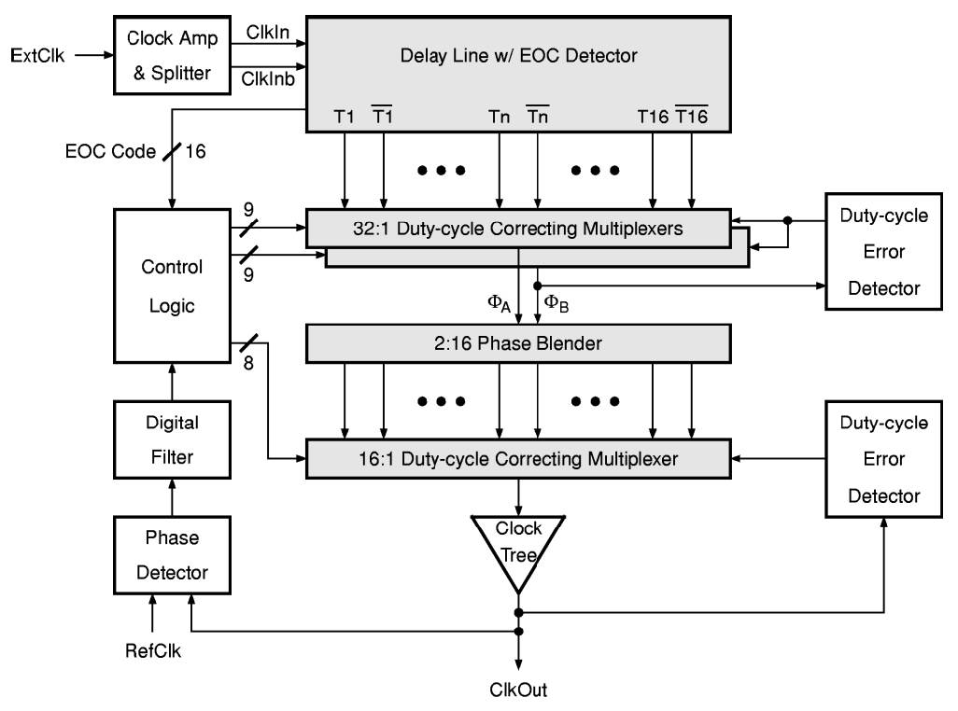
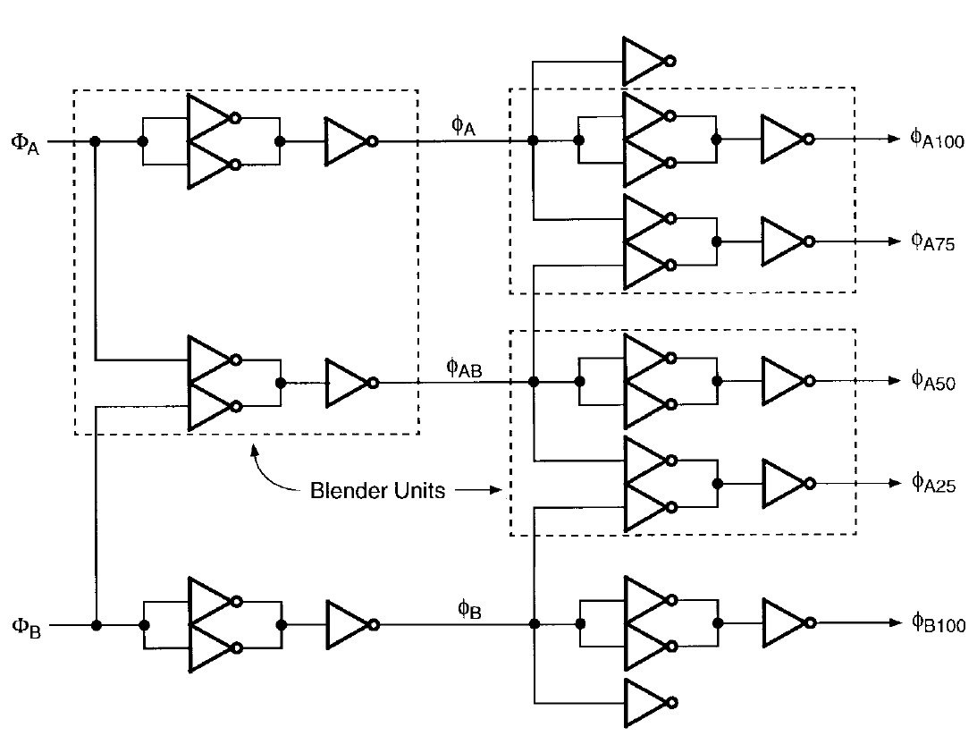
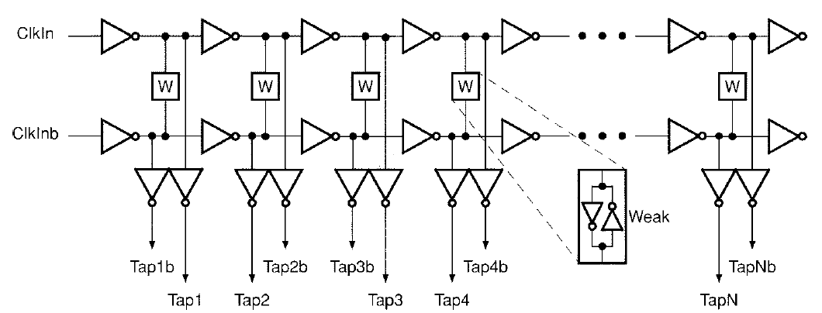
Pseudo “All-digital” DLL
Aside from DCC, all digital
Digital “differential” delay line
Shorter line brings lower power, less jitter accumulation
Latch coupling decreases PVT variation
Better resolution
State controlled loop→power down mode
256 ps p2p jitter @400MHz
340 mW @ 3.3 V
Doesn’t address supply noise….
[4]

Slide 21
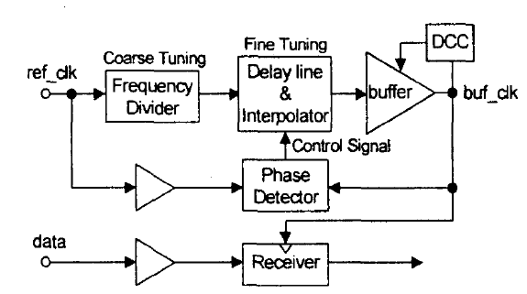
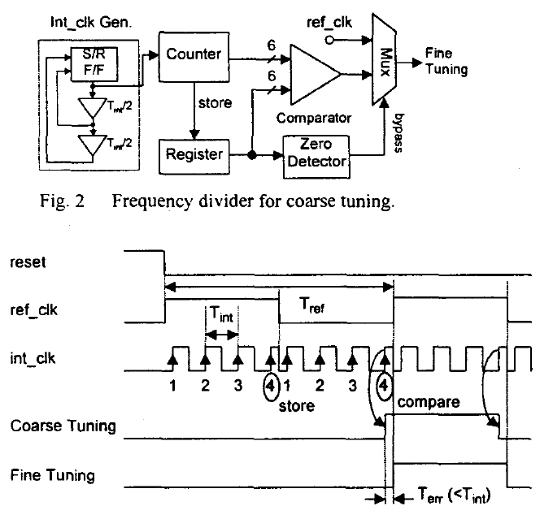
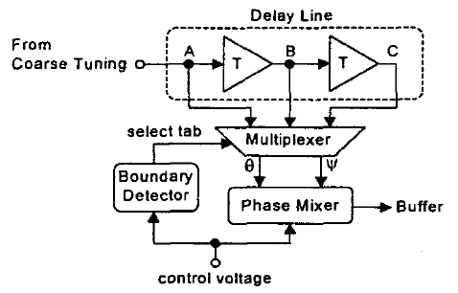
Mixed-mode DLL
Digital coarse+analog fine
Counter less area and power than digital delay line
Several jitter suppression methods
Counting averages out reference feedthrough jitter
Low gain in fine loop reduces Vcont jitter
Differential elements in fine loop reduce supply jitter
Fast lock acquisition from digital coarse loop
No multiple phases….
Only for CDR and deskewing
114 ps p2p jitter @300MHz
70 mW @ 3.3V
[5]

Slide 22
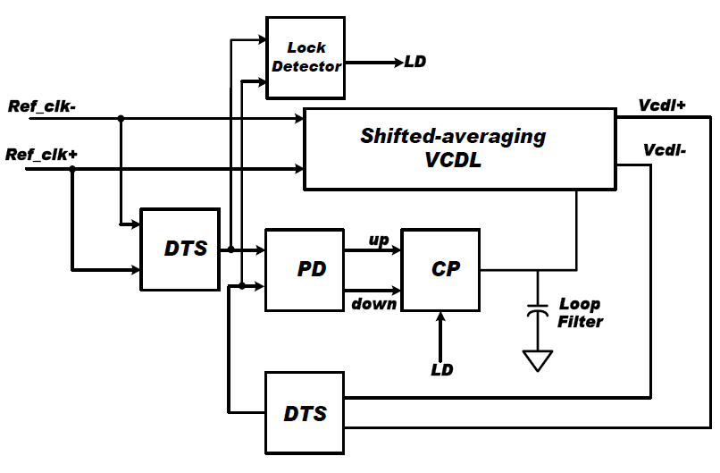
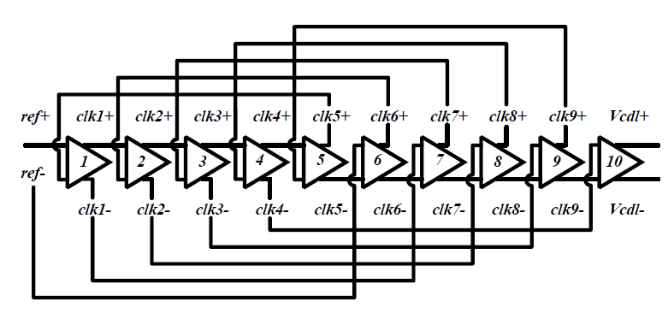
Process Variation Suppression
Cross fed signals suppress effects of process variations in multiple clock phase generation
26 ps p2p jitter @150 MHz
[6]

Slide 23
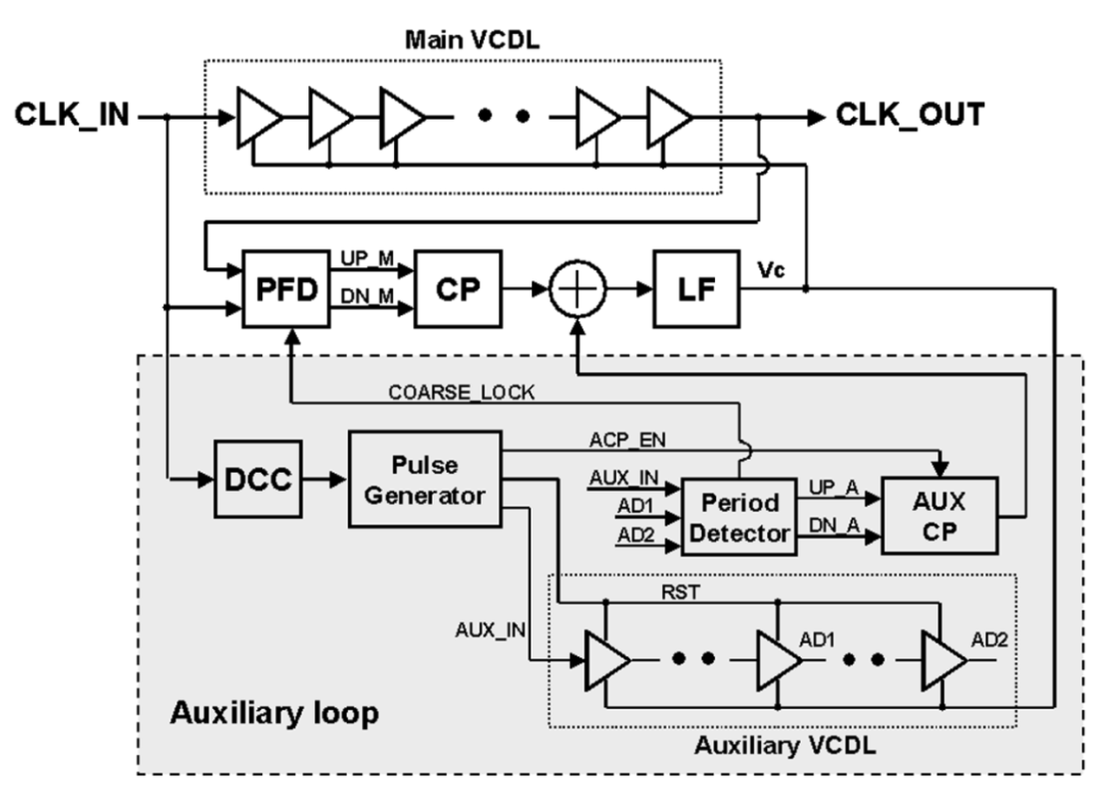
False Lock Problem
Auxiliary loop for automatic cycle detection
“Standard” practices to reduce jitter in VCDL
Aux loop can power down
Low gain CP to reduce jitter and power
56 ps p2p jitter @ 133 MHz
30 mW @ 2.5V
[7]

Slide 24
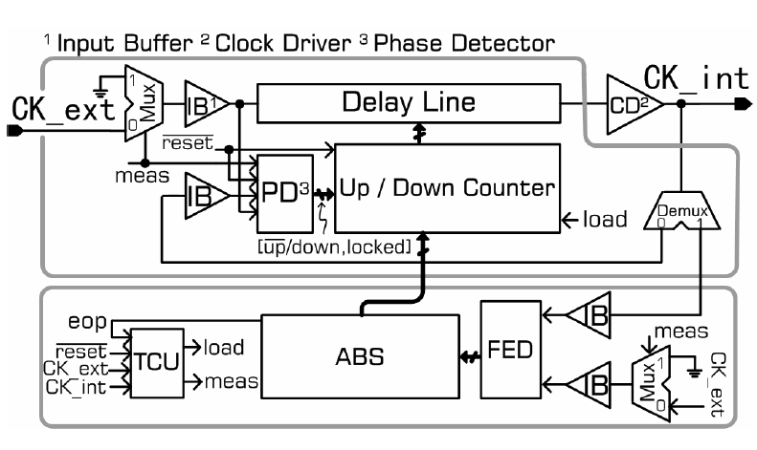
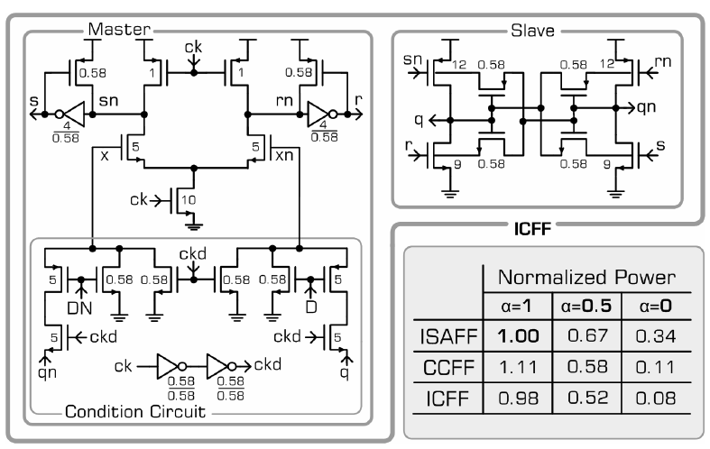
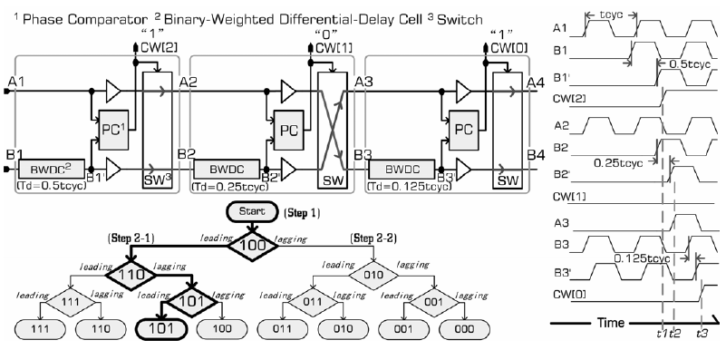
Fast Lock Acquisition
One shot asynchronous fast lock circuit
Control word stored to save power
FF power saved by ICFF
Fine delay unit resolution to reduce resolution jitter
Delay unit cap based→less supply sensitivity
30 ps p2p jitter @ 100 MHz
0.3 mW @ 1 V
[8]

Slide 25
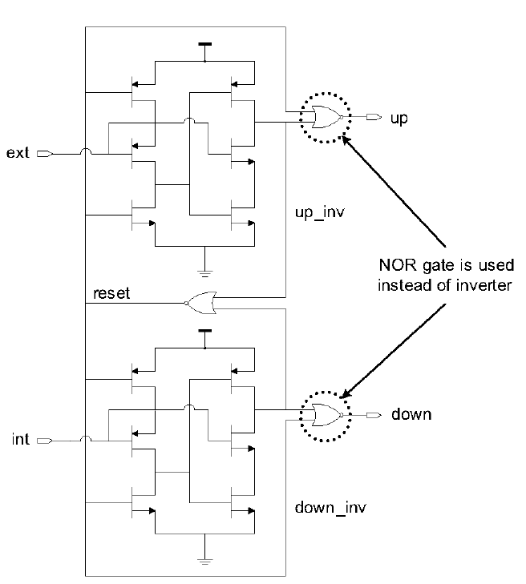
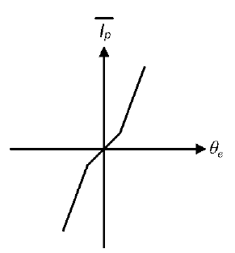
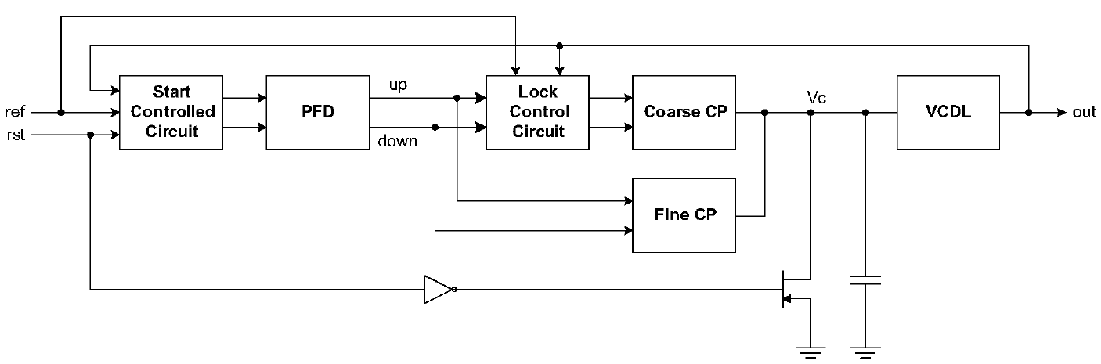
PFD Jitter
“One shot” jitter reduced with improved PFD
less jitter on Vcont
Subdued more with smaller gain CP
58 ps p2p jitter @ 100 MHz
15 mW @ 1.8V
[9]

Slide 26
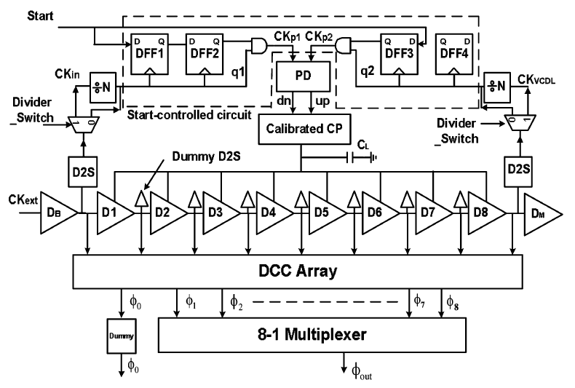

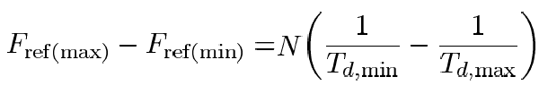
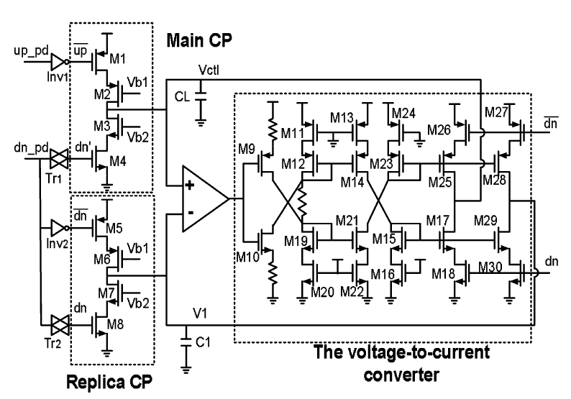
Charge Pump Calibration
Freq synthesis (if N, M prime)
Short, differential delay line = low power (5 GHz)
Calibrated CP
CP injects much noise into system
Short channel effects
Switching imbalance
Current matching
Calibrated vs. uncalibrated = 1 ps vs. 20 ps
Diff amp must be designed carefully
A main source of jitter
8 ps p2p jitter @ 5 GHz
36 mW @ 1.2V
[10]

Slide 27
Outline
DLL Quick Review
Seminal Papers
First “dual loop” with infinite phase capture range
First true dual loop architecture
Summary of DLL Design Issues
A Walk Through Time
The first all digital DLL (1999)
The first mixed mode DLL (1999)
Process variation problem
False lock problem
Fast lock acquisition
PFD jitter
CP jitter
Summary of DLL Design Space
Discussion Questions

Slide 28
Comparison Across the Years
 | Operating Range | Main Frequency | P2p jitter | Power | Main Contribution | Year
[1] | 250 MHz | 250 MHz | 140 ps | 65 mW | Phase Interpolation for infinite delay lock | 1994
[2] | 80 kHz-400 MHz | 250 MHz | 68 ps | 102 mW | True “coarse-fine” dual loop | 1997
[3] | 2.5 kHz-400 MHz | 250 MHz | 262 ps | 29 mW | Self-biased technique | 1996
[4] | 300,400 MHz | 400 MHz | 245 ps | 340 mW | Pseudo “All-digital” | 1999
[5] | 4-400 MHz | 300 MHz | 114 ps | 70 mW | Mixed-mode dual loop, jitter suppression | 1999
[6] | 150 MHz | 150 MHz | 26 ps | ?? | Process mismatch induced jitter | 2003
[7] | 30-200 MHz | 133 MHz | 56 ps | 30 mW | False lock problem | 2004
[8] | ?? | 100 MHz | 30 ps | 0.3 mW | Fast lock acquisition | 2005
[9] | 50-150 MHz | 100 MHz | 58 ps | 15 mW | PFD one shot jitter, dynamic charge pump gain | 2007
[10] | 0.5-5 GHz | 5 GHz | 8 ps | 36 mW | Charge pump calibration | 2008

Slide 29
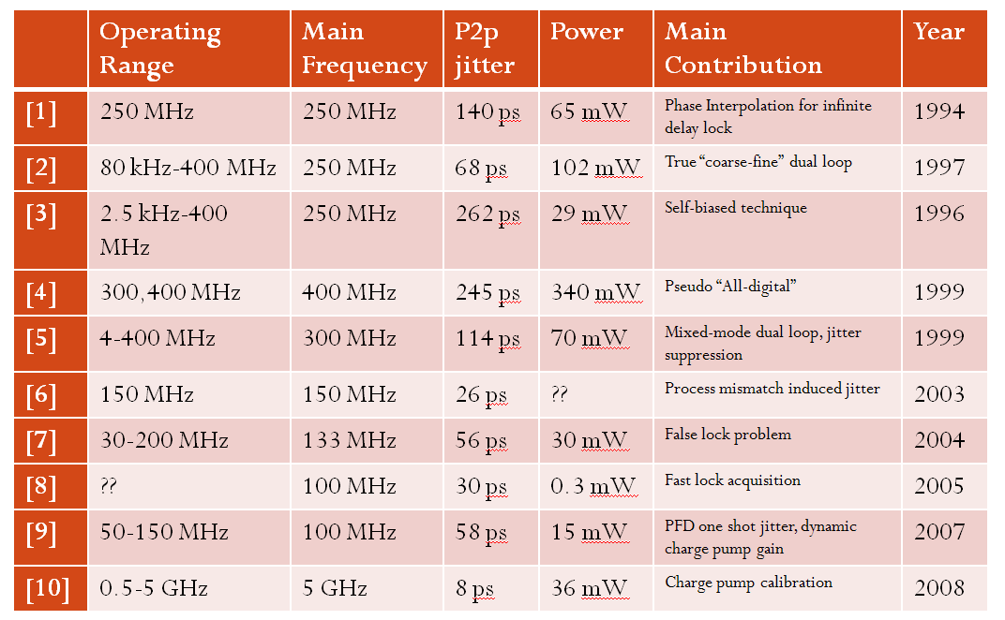
Summary of Trends
Through time, power has decreased, jitter has decreased, frequency increases…how is this possible?
Some advances inherent: process scaling, voltage scaling
Some advances effort of designers: differential components, digital integration, etc.

Slide 30
Summary of Trends
There are so many issues ([1]-[10]), how do I know what the significance of each is?
No way to ‘isolate’ a variable (no pare-to curve imminent)
What is a reasonable metric of comparison?
Is it fair to say that a jitter of 250 ps for 100MHz lock is bad?
Is it fair to say consuming 3x power @10GHz is bad when compared @100 MHz?
Should attempt to ‘normalize’ some metric…

Slide 31
Summary of Trends
 | P2p jitter | Frequency | Power | % Jitter/Freq | xPower | Main Contribution
[1] | 140 ps | 250 MHz | 65 mW | 3.5% | 2.27 mW | Phase Interpolation for infinite delay lock
[2] | 68 ps | 250 MHz | 102 mW | 1.7% | 1.73 mW | True “coarse-fine” dual loop
[3] | 262 ps | 250 MHz | 29 mW | 6.55% | 1.89 mW | Self-biased technique
[4] | 245 ps | 400 MHz | 340 mW | 9.8% | 33.3 mW | Pseudo “All-digital”
[5] | 114 ps | 300 MHz | 70 mW | 3.42% | 2.39 mW | Mixed-mode dual loop, jitter suppression
[6] | 26 ps | 150 MHz | ?? | 0.39% | ?? | Process mismatch induced jitter
[7] | 56 ps | 133 MHz | 30 mW | 0.74% | 0.22 mW | False lock problem
[8] | 30 ps | 100 MHz | 0.3 mW | 0.3% | .0009 mW | Fast lock acquisition
[9] | 58 ps | 100 MHz | 15 mW | 0.58% | 0.08 mW | PFD one shot jitter, dynamic charge pump gain
[10] | 8 ps | 5 GHz | 36 mW | 4% | 1.44 mW | Charge pump calibration

Slide 32
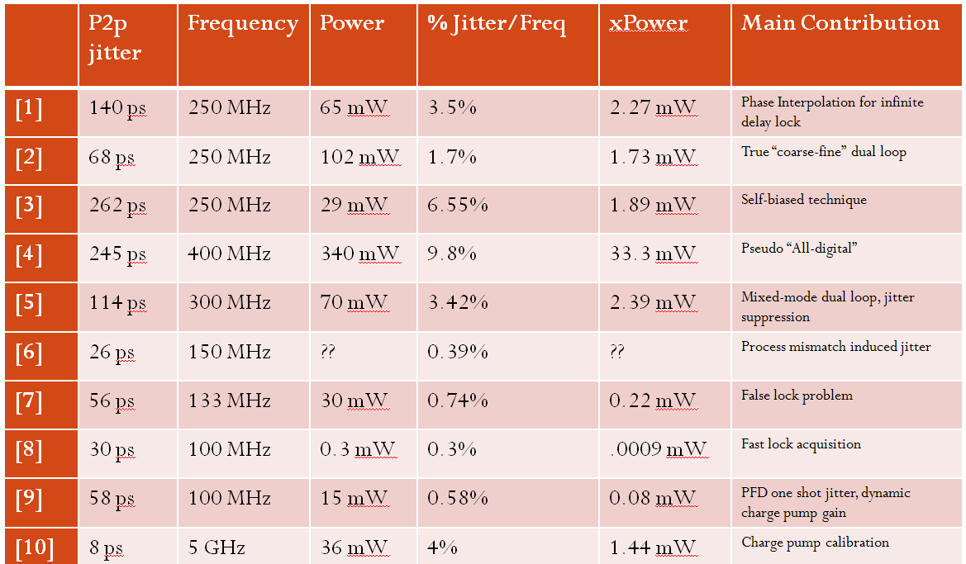
Summary of Trends
Where is the design space now?
Power efficiency of lower frequencies extremely good→space for lower power sacrificing jitter
Efficiency of RF frequencies similar to a decade ago→pioneering research space

Slide 33
Summary of Trends
So what is the general design strategy?
Choose a jitter constraint suitable to the application frequency range
There are three main places to control jitter: choosing the right architecture, the charge pump, the VCDL

Slide 34
Outline
DLL Quick Review
Seminal Papers
First “dual loop” with infinite phase capture range
First true dual loop architecture
Summary of DLL Design Issues
A Walk Through Time
The first all digital DLL (1999)
The first mixed mode DLL (1999)
Process variation problem
False lock problem
Fast lock acquisition
PFD jitter
CP jitter
Summary of DLL Design Space
Discussion Questions

Slide 35
Discussion Questions
What are the assumptions made on the reference clock?
What are some of the sources of noise?
Why is duty cycle important?
Which blocks are the most important? Think in terms of: power consumption, jitter suppression.
How far can digital integration go? Which applications are suitable for digital DLLs?

