Slide 1
DWC DDRn PHY Training Firmware APP
2020.09.08

Slide 2
01. Introduction 02. Hardware Training Architecture 03. Loading,Configuring and Running the Firmware 04. 1D Training Steps 05. 2D Training Steps

Slide 3
Introduction
The firmware is precompiled C code executed by a micro-controller (also known as the PMU) embedded inside the PHY Utility Block (PUB).
The PHY training firmware is partitioned into two major pieces, 1D training and 2D training.
1D training: Takes an untrained system and optimizes the delay margins at a fixed set of reference voltages
2D training: Takes a working system and further optimizes it for both delay and voltage margin.
The 2D training steps are optional, and should be used in systems that need further optimization of the delay and Vref (e.g. at very high transfer rates)
1D Training | DD4 | LPDDR4/4X
CA Delay | - No training | - Per-nibble
CAVref | N/A | - Per-timing group - Per-pstate
Read Gate (RxEn) | - Per-nibble where applicable (x4 mode) - Per-timing group - Per-pstate | - Per-byte - Per-timing group - Per-pstate
Notes:
Supported Training Features

Slide 4
Introduction
1D Traing | DD4 | LPDDR4/4X
TxDQS ↔ Memclk (Write Leveling) | - Per-nibble where applicable (x4 mode) - Per-timing group - Per-pstate | - Per-byte - Per-timing group - Per-pstate
Tx VrefDq | - No training | - No training
RxDQ ↔ RxDQ (Read Deskew) | - Per-bit - Per-timing group - Trained only at the highest bit-rate pstate | - Per-bit - Per-timing group - Trained only at the highest bit-rate pstate
RxDQS ↔ RxDQ (Read 1D) | - Per-nibble - Per-timing group - Per-pstate | - Per-nibble - Per-timing group - Per-pstate
Rx VrefDQ (Quick Rd2D) | - per-bit - Trained only at the highest bit-rate pstate | - per-bit - Trained only at the highest bit-rate pstate
Data Buffer DWL | - Per-nibble - Per-CS - Per-pstate | N/A

Slide 5
Introduction
1D Traing | DD4 | LPDDR4/4X
Data Buffer MREP | - Per-nibble - Per-CS - Per-pstate | N/A
Data Buffer MWD | - Per-nibble - Per-CS - Per-pstate | N/A
Data Buffer MRD | - Per-nibble - Per-CS - Per-pstate | N/A
Max Read Latency | - Per-pstate - 1 value returned for the worst case (latest) trained timing group | - Per-pstate - 1 value returned for the worst case (latest) trained timing group

Slide 6
Introduction
2D Traing | DD4 | LPDDR4/4X
TxDQ ↔ TxDQS (Write 2D) | - Per-bit - Per-timing group | - Per-bit - Per-timing group
Tx VrefDQ (Write 2D) | - Per-device - Per-timing group | - Per-timing group
Tx Equalization (FFE) | - Per-phy | N/A
RxDQS ↔ RxDQ (Read 2D) | - Per-nibble - Per-timing group | - Per-nibble - Per-timing group
Rx VrefDQ (Read 2D) | - per-bit | - per-bit
Rx Equalization (DFE) | - per-bit | N/A

Slide 7
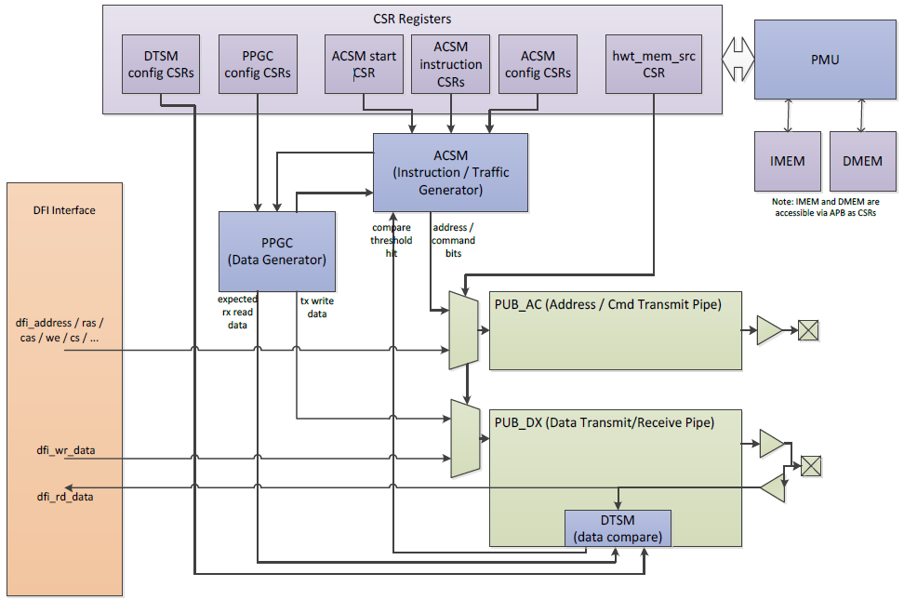
Hardware Training(HWT) Architecture
Notes:
The dedicated training hardware can be broken down into 4 major pieces:
• PMU (Programmable Microcontroller Unit): One instance per PHY. This is the microcontroller that runs the training firmware. It has dedicated instruction and data SRAMs that are used for the training code and data structures during training. These memories are accessible over the APB bus, like the other PHY internal control registers. The PMU has access to the internal PHY control registers, which allows it to control the rest of the dedicated hardware and program the trained PHY state.
• ACSM (Address-Command State Machine): One instance per PHY. As the name suggests, the ACSM’s purpose is to drive the address/command bus in sync with the DTSM.
• DTSM (Data-Training State Machine): Nine instances per DBYTE or one instance per DQ bit. Used to compare received data with an expected pattern. Each DTSM keeps track of how many failures and successes it has seen and can be programmed to automatically set flags when the fail or success counts pass separately programmable thresholds. The DTSM also controls automatic adjustments to trainable delays.
• PPGC (PRBS Pattern Generator-Checker): One instance per PHY. On write commands, the PPGC provides write data to the DTSM. On read commands, the PPGC tells the DTSM what should have previously been written into the memory location being read.

Slide 8
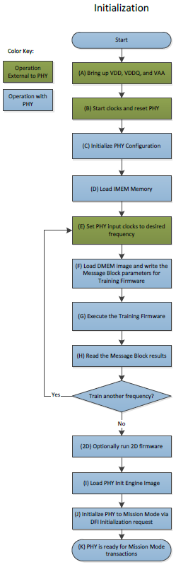
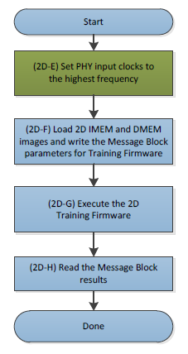
Loading,Configuring and Running the Firmware
During the PHY initialization process, the following high-level steps are run to train the PHY:
The training firmware is loaded
The firmware is configured with the information that it needs to run
The firmware is run
The training results are read back
Loading the firmware is accomplished by accessing the PMU SRAMs over the APB bus. The SRAMs are mapped into the APB address space starting at address 0x50000 for the instruction memory and 0x54000 for the data memory. The PMU firmware requires 32KB of instruction memory and 16KB of data memory.
Notes:
(.bin files)
(.incv files)
The instruction memory image contains the executable training code. The data memory image contains data structures that the instruction memory image needs to run.
There are separate instruction and data images for the 1D steps and the 2D steps. For a given frequency, the 1D instruction image must be run before the 2D instruction image. To save time reloading the 1D instruction image, it is suggested that the user run the 1D steps for all frequencies and then load and run the 2D steps for the frequencies that require it.

Slide 9
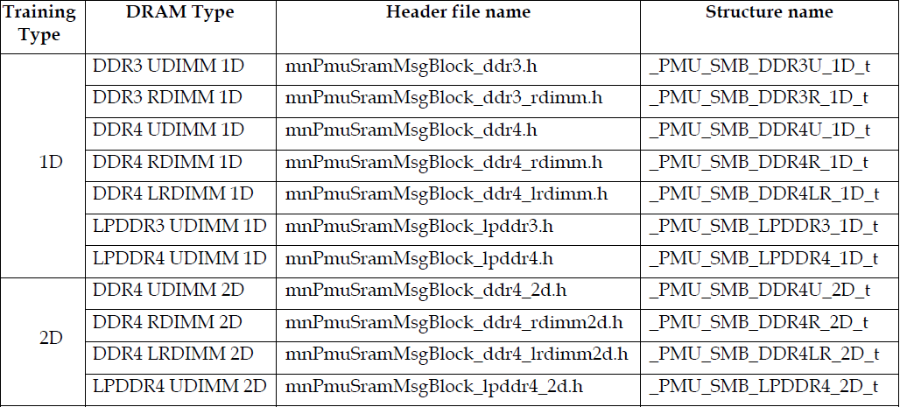
Loading,Configuring and Running the Firmware
Configuring the firmware via the message block，The table below lists all the message block definitions:
Notes:
The message block should be configured with all required inputs prior to the execution of training and cannot be accessed through the APB bus while firmware training is running. Once training is done, the message block can be accessed to retrieve the training information calculated by the firmware.

Slide 10
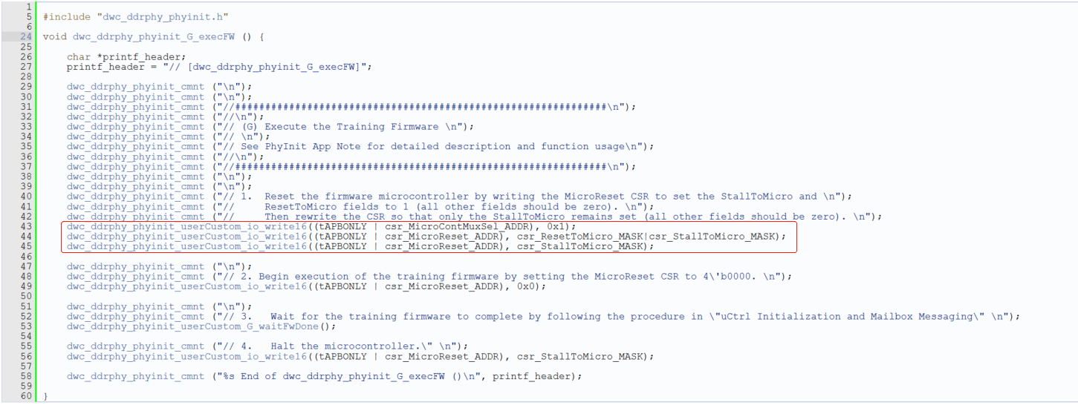
Loading,Configuring and Running the Firmware
Running the firmware is simply a process of taking the PMU out of reset and stall. The firmware image will then be run.

Slide 11
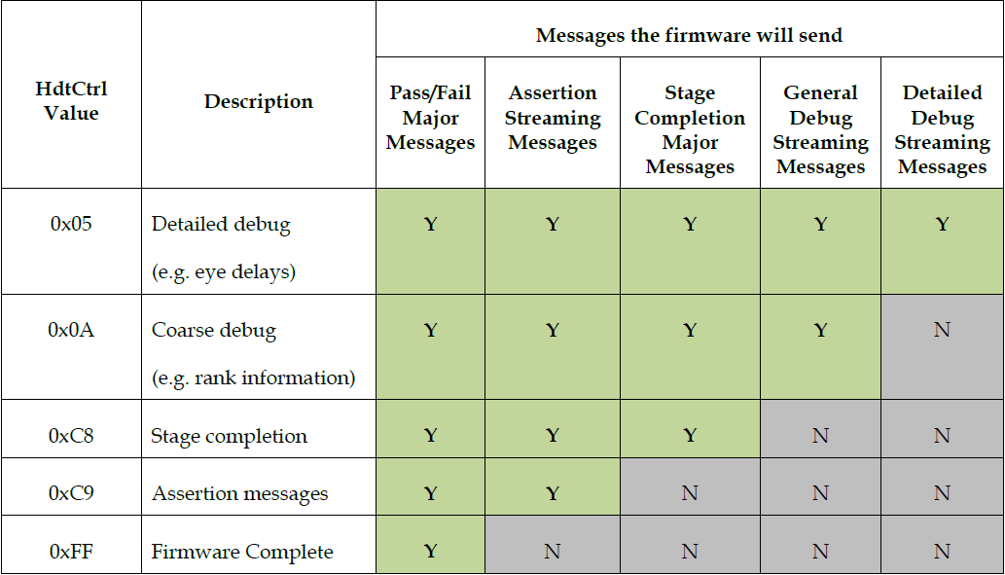
Loading,Configuring and Running the Firmware
The number of messages that the firmware passes back to the user is controllable with a message block field (HdtCtrl).
If HdtCtrl is set to a value other than 0xFF, major and streaming messages will need to be processed and the mailbox must be polled and the messages retrieved. Failure to process the messages will result in the firmware stalling while waiting for the message to be acknowledged.
Reading the training results via the message block
Notes:
Once the firmware is running, it will pass messages back to the user to indicate overall completion, completion of individual steps and additional debug messages. These messages are passed back via the mailbox facility. The number and types of messages sent are configurable.
The protocol for using these registers can be broken down into the following steps:
1. Poll the UctWriteProtShadow, looking for a 0
2. When a 0 is seen, read the UctWriteOnlyShadow register to get the major message number. If reading a streaming message, also read the UctDatWriteOnlyShadow register.
3. Write the DctWriteProt to 0 to acknowledge the receipt of the message
4. Poll the UctWriteProtShadow, looking for a 1
5. When a 1 is seen, write the DctWriteProt to 1 to complete the protocol
6. Go to step 1.
The start of a streaming message is signaled by the major message “0x8”. Streaming messages are made up of several pieces of mail and provide more verbose debug information to customers as the firmware is executing. After the customer has acknowledged receiving a major message of 0x8, the firmware will immediately send a 32-bit message, called a string index, through the mailbox. String indices are decoded by referencing the appropriate DRAM image specific strings file that comes with each release.

Slide 12
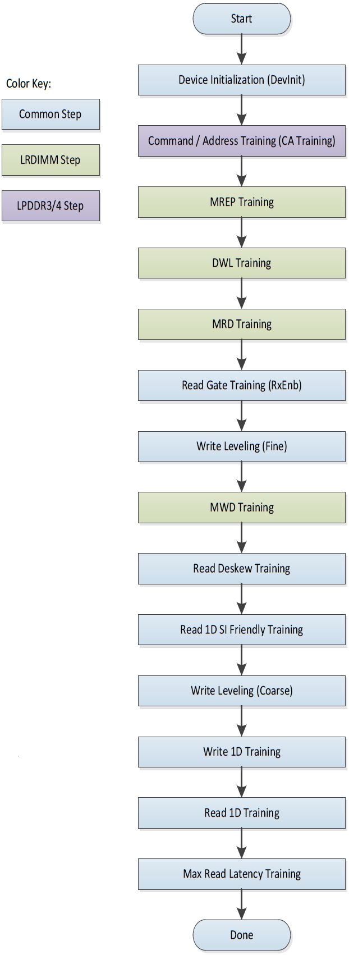
1D Training Steps(Overview)
The major 1D training stages, in order of execution, are:
Device Initialization
Command / Address Training (LPDDR3/4 only)
MREP, DWL and MRD Training (LRDIMM only)
Read Gate Training
Write Leveling (broken into a Fine and Coarse step)
MWD Training (LRDIMM only)
Read Deskew
Read Training (broken into SI friendly and full steps)
Write Training
Max Read Latency Training
Note:The LPDDR3 and LPDDR4 steps only apply to the firmware for the DWC V2 MULTIPHY. The LRDIMM steps only apply to the DWC DDR43 PHY.
Notes:
One dimensional training, or 1D training, is a group of training stages that optimize a system’s delays at a set of user-provided reference voltages. Each training step focuses on a specific delay, building off earlier steps to eventually result in a fully trained system.

Slide 13
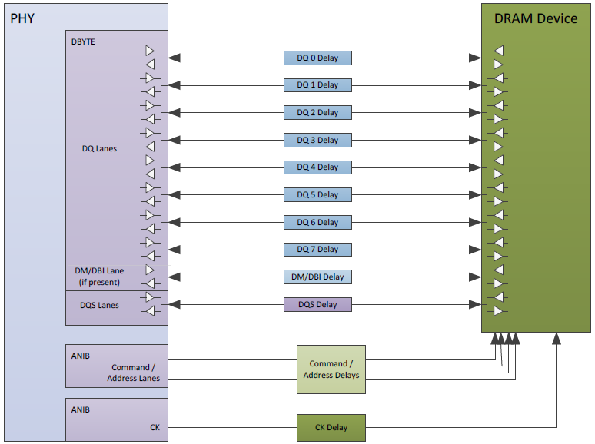
1D Training Steps(Overview)
Notes:
The training process is designed to compensate for delays in the system, both board and DRAM. The various delays can be seen in the diagram below:
The diagram shows the signals from a single DBYTE and ANIB instance. A second ANIB instance is included to show that the delays for the CK signals are grouped to allow control independently from the command and address signals. The delays in the boxes outside of the PHY and the DRAM Device represent board, connector, package, and other system related delays.

Slide 14
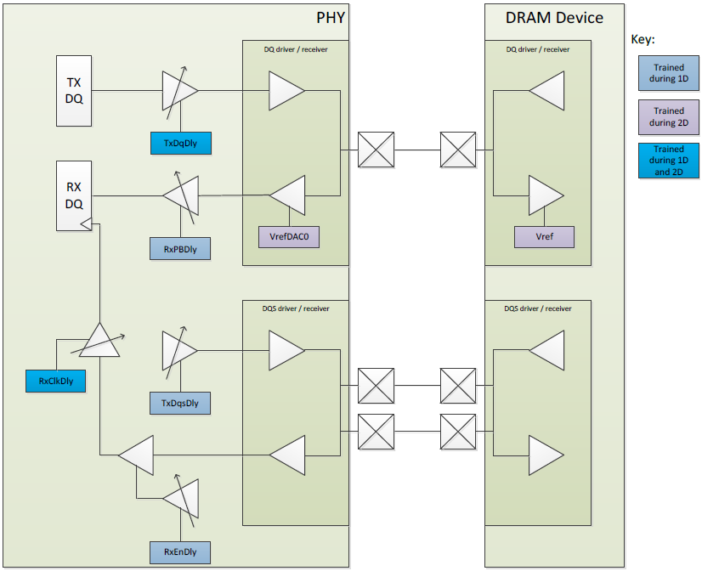
1D Training Steps(Overview)
Notes:
The values that are trained in the PHY and DRAM can be seen in the following diagram:
This diagram shows single DQ and single DQS lane, and the trainable delay and Vref values in both the PHY and the DRAM devices.
DRAM Vref values are only trained in 2D training. The phy’s vrefDAC0 is optionally trained in 1D training.

Slide 15
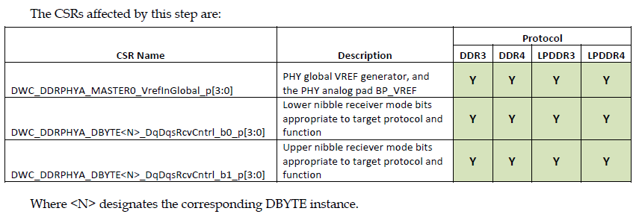
1D Training Steps(DevInit)
Device initialization performs the basic initialization of the PHY and DRAM that is required before any training stage is run. Initialization includes tasks such as locking the internal PLL and DLLs to the current input clock, and calculates the parameters to accelerate future lock operations, resetting the DRAMS, and writing the appropriate MRs. Training may modify the initial MRs from the values provided in the messageblock to avoid putting the DRAMs into an untrainable state.
Notes:
The 1D training flowchart indicates in what order the steps are started. In the case where CA Training is performed (LP3/LP4 only), DevInit is overlapped with CA Training. DevInit is started, then CA training is performed, then DevInit is finished. The messages for step completion may indicate that the steps finished in the opposite order as indicated by the flowchart. This is expected because of the organization of the firmware.

Slide 16
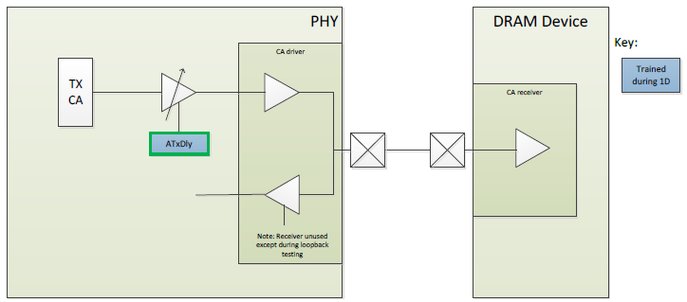
1D Training Steps(CA Training)
This step is supported for LPDDR3 and LPDDR4 only. During CA training, the DRAM is put into a mode where the Command/Address lines are sampled and fed back on the DQ lines.
Note: This value is not altered by training(DDR3/DDR4), but may be altered manually by the user.

Slide 17
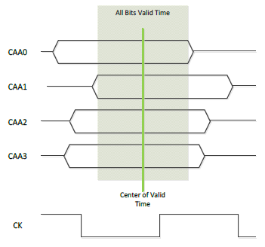
1D Training Steps(CA Training)

Slide 18
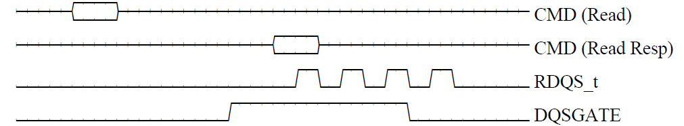
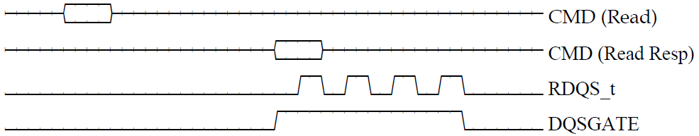
1D Training Steps(Rxen)
The goal of read gate training (aka RxEn training) is to determine the round-trip latency between the PHY and the DRAM.
CSRs→RxEnDly Delays→(CK Delay,DOS Delay)
Notes:
The basic idea behind read enable training is to line the DQS gate, also called RX enable, up with the first rising edge of DQS for the read. After this alignment, a required setup time is subtracted from the aligned RX enable, placing the RX enable delay just before the first rising edge of DQS.
This step compensates for the delay for the read command to reach each DRAM device and have the DQS pulse for the read return to the PHY (highlighted in green below). This delay does include all DRAM DQS related parameters such as tDQSCK. This delay does not include the read CAS latency, which is known ahead of time.

Slide 19

1D Training Steps(Write Leveling Training <fine & coarse>)
The goal of write leveling fine phase training is to align DQS rising edge with the MEMCLK rising edge at each DRAM device. Write Leveling fine phase training is required to compensate for any analog phase differences between MEMCLK and DQS distribution.
CSRs→TxDqsDly Delays→(CK Delay,DOS Delay)
Notes:
This fine training ensures that the edges are aligned correctly, but not necessarily at the correct WCAS latency. The coarse part of the Write Leveling training will calculate the delay to ensure the edges align with the correct WCAS latency.
TX DQS was phase aligned to MEMCLK during write leveling fine phase training, but TX DQS latency may not match CAS write latency. As TX DQS delay is already phase aligned, it can be incorrect by some integer multiple of MEMCLK periods, as shown below.

Slide 20
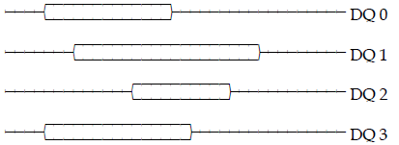
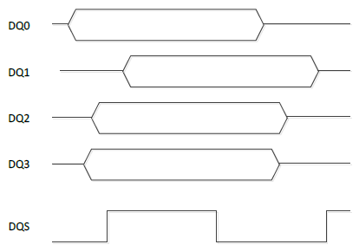
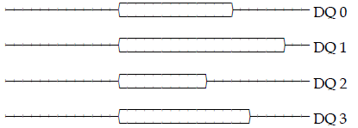
1D Training Steps(Read DQ Deskew)
Read DQ deskew training compensates for delay differences, primarily caused by board routing and DRAM DQ output skew, among the DQ lanes during reads.
CSRs→RxPBDly Delays→(DQ Delay,DM/DBI Delay)

Slide 21
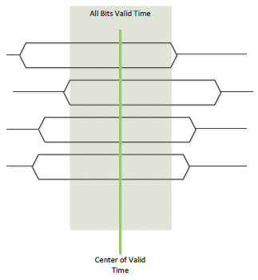
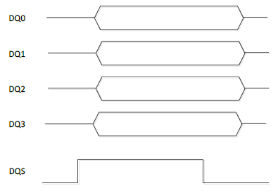
1D Training Steps(Read 1D Training<SI friendly & Optimized Delay Centering>)
The Read 1D fine training is done so that reads can be trained to work and perform further training to
properly train the write operations. (this step of training by programming a pattern into an MPR )
This training stage(optimized delay centering) is almost the same as the Read 1D (SI friendly) delay centering presented previously, but using longer more complex data patterns known as PRBS patterns.
CSRs→RxClkDly Delays→(DQ Delay,DM/DBI Delay,DQS Delay)
Notes:
The Read 1D fine training is done so that reads can be trained to work and perform further training to properly train the write operations. The result of this training is not guaranteed to be optimal, but is guaranteed to work well enough to perform write training.
The firmware implements this step of training by programming a pattern into an MPR, then running an automatic eye search using the read clock delay.
If the system and board delays are known, the CSR settings can be calculated. Please see the description in the section on Read 1D Training (Signal integrity friendly) in section 0. The process for this step is the same as that step, except that a much longer and more complicated pattern is used to find the values.

Slide 22
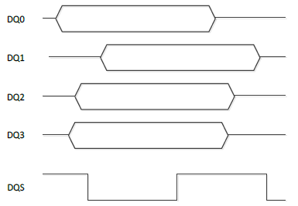
1D Training Steps(Write 1D Training<DQ/DQS Optimized Delay>)
The objective of this training is to center write DQ timing in the write DQS eye.(The write DQS timing was set in the Write Leveling steps.)
CSRs→TxDqDly Delays→(DQ Delay,DM/DBI Delay,DQS Delay)
Notes:
At this point, we can safely read back arbitrary data from DRAM, even if read training is not perfectly centered on the read eye. The objective of this training is to center write DQ timing in the write DQS eye. (The write DQS timing was set in the Write Leveling steps.) The PHY has per-lane write DQ adjustment, allowing all lanes to simultaneously train to their own value.

Slide 23
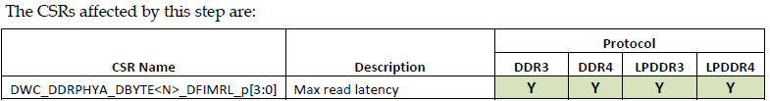
1D Training Steps(Max Read Latency Training)
When reading data from the drams, the received data is temporarily buffered in an internal receive data FIFO. After a short period, called the read latency, the data in the FIFO is guaranteed to be valid. The read latency training stage finds the smallest read latency that works for all FIFOS in the PHY, limiting system memory latency.
CSRs→DFIMRL
Notes:
The training is done by setting the read latency very low, then incrementing it while repeatedly performing reads. Most of these reads will fail because the read latency is too small. Eventually, as the read latency approaches the minimum correct value, reads on some bytes will begin to pass. Once are passing on all bytes, the firmware will stop searching and add a user-programmable offset passed in through the messageblock field “DFIMRLMargin”. By default, the phy will train all max read latency CSR’s in the phy to the same value, ensuring all data is aligned on the DFI interface. Customers can choose to have the DFI MRL delay trained per byte by setting the PerByteMaxRdLat bit in the messageblock before training, but if this feature is enabled then there will be skew between the data returned on the DFI interface.

Slide 24
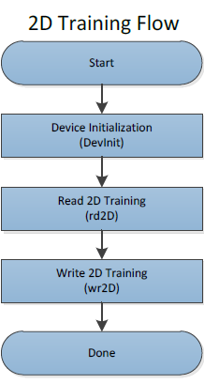
2D Training Steps(Overview)
The major 2D training stages, in order of execution, are:
Device Initialization
Read 2D
Write 2D
Note:2D training is only supported when training LPDDR4 and DDR4 systems.
Notes:
Two-dimensional training, or 2D training, is a group of training stages that can be run after 1D training to further refine the system’s pstate 0 delay and voltage settings. Each 2D training step focuses on a specific pair of delays and voltages, fully measuring the per-lane passing regions, before choosing the best combinations of voltage and delay margin based on the user’s inputs.

Slide 25
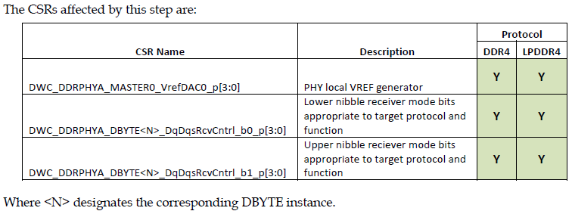
2D Training Steps(DevInit)
Device initialization performs the basic initialization of the PHY and DRAM that is required before any 2D training stage is run. Initialization includes tasks such as re-locking the internal PLL and DLLs, resetting the DRAMs (except in LRDIMM), and writing the appropriate MRs. Training may modify the initial MRs from the values provided in the messageblock to avoid putting the DRAMs into an untrainable state.

Slide 26
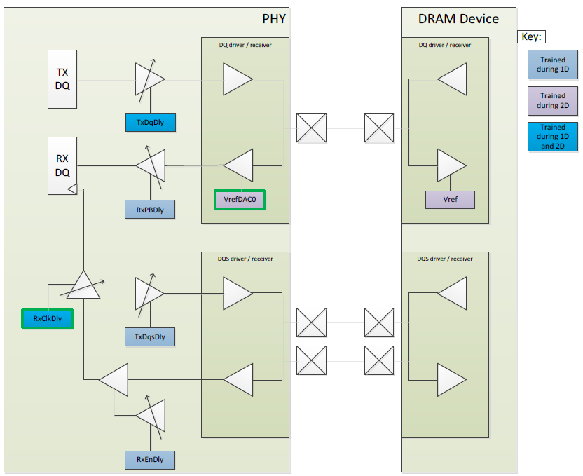
2D Training Steps(Read 2D Training)
Like read 1D training, the objective of read 2d training is to center the read DQS timing in the read DQ passing region. However, unlike 1D training, which only considered delay margin, read 2D optimizes for both delay and voltage margin.
For 2D training to optimize both margins, a full two-dimensional read passing region is collected for each lane and timing group by systematically varying the per-lane RxClkDly delay through a wide variety of VrefDAC0 settings, recording all failures.

Slide 27
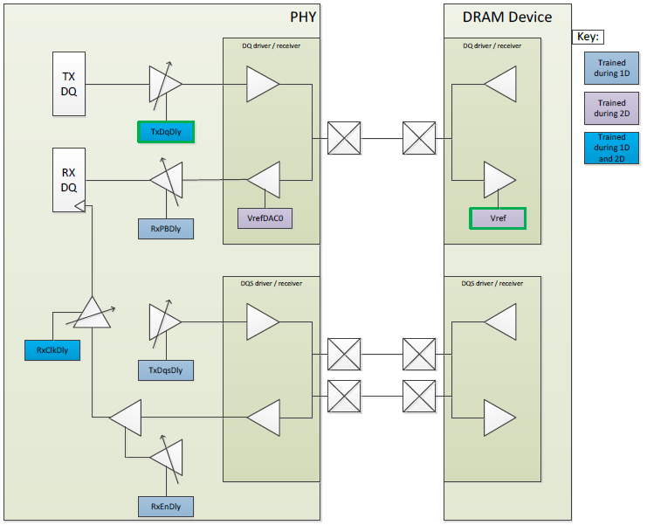
2D Training Steps(Write 2D Training)
Like write 1D training, the objective of write 2d training is to center the write DQ timing in the write DQS passing region. However, unlike 1D training, which only considered delay margin, write 2D optimizes for both delay and voltage margin.
For 2D training to optimize both margins, a full two-dimensional write passing region is collected for each lane and timing group by systematically varying the per-lane TxDqDly delay through a wide variety of DRAM VrefDQ settings, recording all failures

