Slide 1
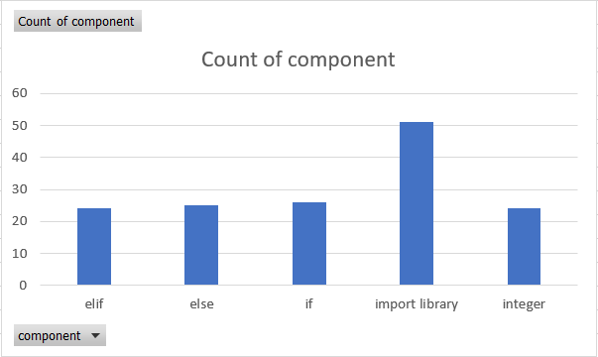
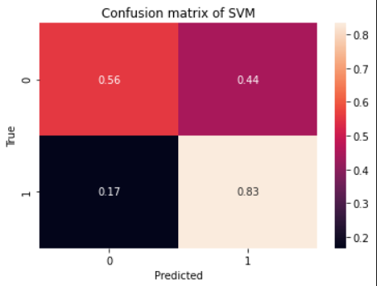
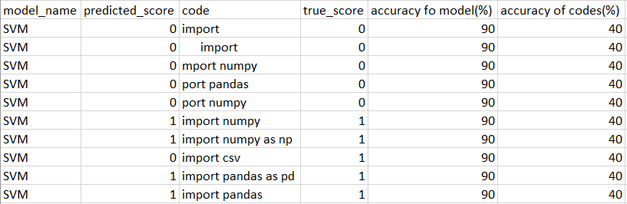
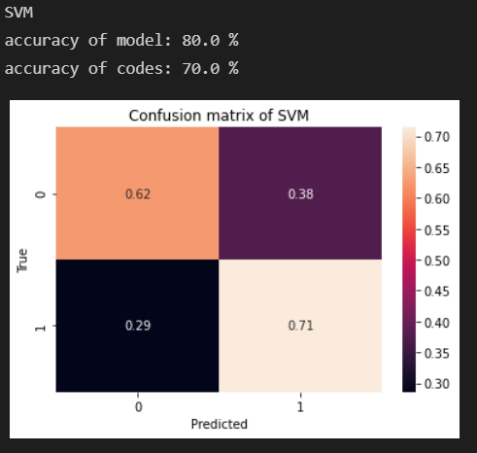
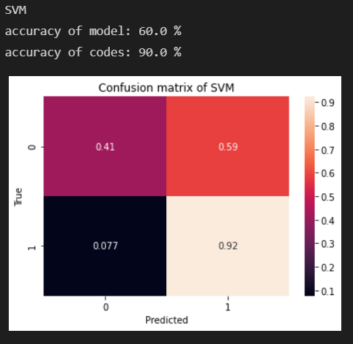
Static Code Analyzer for Python
Hong Xin
Introduction
Data
Analysis
Goal:
The goal of this project is to build a static codes analyzer that finds syntax errors in python without executing the source codes.
Training set:
Confusion Matrix of import library:
Classifiers:
Logistic Regression
Naive Bayes
KNN
SVM
Decision Tree
Analysis:
Size & Accuracy: Importing library has the most number of data entries and the highest prediction accuracy.
Size VS Accuracy: The size of if, else, and elif is about the same as the size of Integer. However, the accuracy of integer is the highest
Comparing to less complicated syntax errors, more complicated syntax errors required a bigger dataset to achieve the same accuracy level
Best Classifier: The prediction that is made by SVM is highest
Product Goals
Users:
I want to find syntax errors in my python codes
Instruction:
Copy and paste python codes to a CSV file. Each line of code will be placed in a cell. The program will read the CSV file. It will identify if a line of code contains syntax errors. The program will then calculate the accuracy of the predictive model and the accuracy of the codes.
Testing set (Test_import.csv)
System Components
Confusion Matrix of integer:
Confusion Matrix of if_else_elif:
Code
Model.ipynb
Data
Dataset
dataset.csv
Test
test_if_else_elif.csv
test_import.csv
test_integer.csv
Visualization
Next Steps
Create a Machine Learning to automatically generate syntax errors for various programming languages
If not, keep generating more datasets for complicated syntax errors and achieve 80% of accuracy

