Slide 1
Sprint2
Hong Xin

Slide 2
Starting...
What is the goal?
Build static code analyzers that identifies 7 types of errors for Android apps based on user selection

Slide 3
Starting...
What is the goal?
Build static code analyzers that identifies 7 types of errors for Android apps based on user selection
Runtime errors.
Logic errors.
Compilation errors.
Syntax errors.
Interface errors.
Resource errors.
Arithmetic errors.

Slide 4
Starting...
What is the goal?
Build static code analyzers that identifies 7 types of errors for Android apps based on user selection
Runtime errors.
Logic errors.
Compilation errors.
Syntax errors.
Interface errors.
Resource errors.
Arithmetic errors.
Why do we care?
automatically vs manually
Customize analyzer based on different types of errors

Slide 5
Definition of Architecture
Phase 1: Build a simple Android App, ToDoList.
Notes:
Runtime errors.
Logic errors.
Compilation errors.
Syntax errors.
Interface errors.
Resource errors.
Arithmetic errors.

Slide 6
Definition of Architecture
Phase 1: Build a simple Android App, ToDoList.
Phase 2: Use featured vectors to train different types of classifiers. Then, select the best classifier for each type of error.
Notes:
Runtime errors.
Logic errors.
Compilation errors.
Syntax errors.
Interface errors.
Resource errors.
Arithmetic errors.

Slide 7
Definition of Architecture
Phase 1: Build a simple Android App, ToDoList.
Phase 2: Use featured vectors to train different types of classifiers. Then, select the best classifier for each type of error.
Phase 3: Find source codes of a complicated app or build a complicated app. Then, further train those classifiers based on 7 types of errors
Notes:
Runtime errors.
Logic errors.
Compilation errors.
Syntax errors.
Interface errors.
Resource errors.
Arithmetic errors.

Slide 8
Definition of Architecture
Phase 1: Build a simple Android App, ToDoList.
Phase 2: Use featured vectors to train different types of classifiers. Then, select the best classifier for each type of error.
Phase 3: Find source codes of a complicated app or build a complicated app. Then, further train those classifiers based on 7 types of errors
Phase 4: (Final product) A static code analyzers that identifies 7 types of programing errors for Android apps based on user’s selection of errors
Notes:
Runtime errors.
Logic errors.
Compilation errors.
Syntax errors.
Interface errors.
Resource errors.
Arithmetic errors.

Slide 9
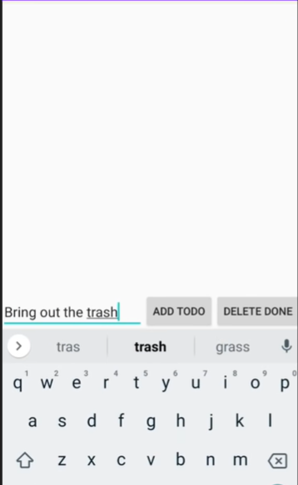
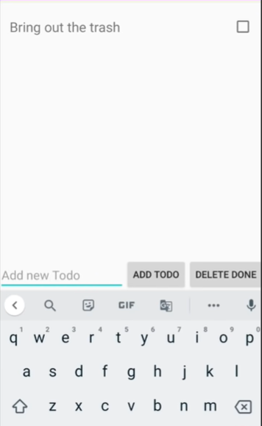
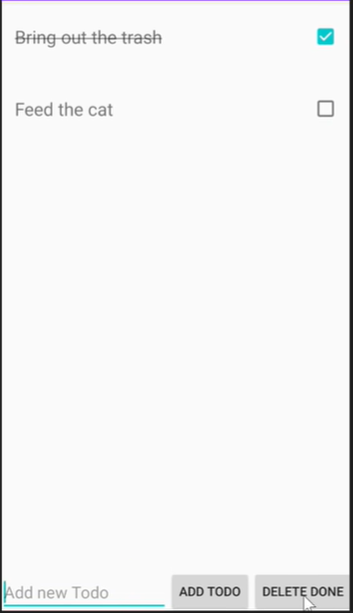
ToDoList

Slide 10
Phase 1 is Done
The basic features for ToDoList app were done
Phase 2 in progress
In the process of training classifiers for 7 types of errors
Logistic Regression.
Naive Bayes.
K-Nearest Neighbors.
Decision Tree.

Slide 11
Sprint 3
Finish phase 2
Train 7 classifiers for 7 errors
Finish or make significant progress in phase 3
Find or build a more complicated android app
Keep training 7 classifiers
Thinking about phase 4
How to the final product will be presented

Slide 12
Questions?

