Slide 1
Sprint1
Hong Xin

Slide 2
Starting...
What is the goal?
Build static codes analyzers that finds bugs for different types of Android apps

Slide 3
Starting...
What is the goal?
Build static codes analyzers that finds bugs for different types of Android apps
Why do we care?
automatically vs manually
Customize analyzer based on different types of Android apps

Slide 4
Literature Review
Mokhov, Serguei A., et al. “The Use of NLP Techniques in Static Code Analysis to Detect Weaknesses and Vulnerabilities.” Advances in Artificial Intelligence, 2014, pp. 326–332., https://doi.org/10.1007/978-3-319-06483-3_33.
Koc, Ugur, et al. “Learning a Classifier for False Positive Error Reports Emitted by Static Code Analysis Tools.” Proceedings of the 1st ACM SIGPLAN International Workshop on Machine Learning and Programming Languages, 2017, https://doi.org/10.1145/3088525.3088675.
Yuksel, Ulas, and Hasan Istanbul. “Automated Classification of Static Code Analysis Alerts: A Case StudyUlas.” IEEE Xplore, https://ieeexplore.ieee.org/abstract/document/6676950?casa_token=R0ISduUXE6QAAAAA%3AIHh0SaNNLt7DM0gJ-CIE8Ub1BHM4XkBuxdOV3V49N45coxwnAbv5GH1N-92RoLKi8jenCYU.
Sayfullina, Luiza. “The Impact of Classifier Configuration and Classifier Combination on Bug Localization.” IEEE Xplore, https://ieeexplore.ieee.org/abstract/document/6520844?casa_token=k3I1u19_QbEAAAAA%3AojLcRxP78VNdID_1fF0Q-vIEcWlPTwHkolSbFA-EAyPkSAwZG8jWuQjc0uaJ7reBafExKQs.
Alikhashashneh, Enas, et al. “Using Software Engineering Metrics to Evaluate the Quality of Static Code Analysis Tools.” IEEE Xplore, https://ieeexplore.ieee.org/abstract/document/8367641?casa_token=ryK5GA8rT2MAAAAA%3AuTbDRYOc5HvhMPVbnmlUp-T1WzZoUXJHdIHJ2Nx-Q3c6XRizo9EhAkrjvxQGf2c7Mmvcb0k.

Slide 5
User stories and MVP
User Stories
Anyone who want to exam codes from an Android app
MVP
Classifier reads through codes (embeddings or a text file)
Classifier marks the errors or bugs in the codes

Slide 6
Logistics
Build a simple Android app from scratch
Kotlin and Android Studio

Slide 7
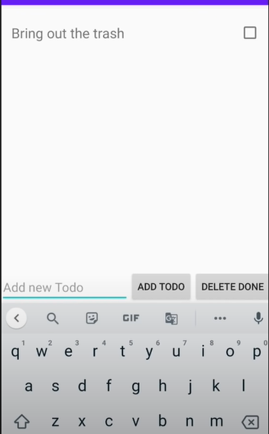
Logistics
Build a simple Android app from scratch
Kotlin and Android Studio
To-Do App

Slide 8
Logistics
Build a simple Android app from scratch
Kotlin and Android Studio
To-Do App
Add new ToDo
Cross out ToDo
Delete ToDo

Slide 9
Logistics
Build a simple Android app from scratch
Kotlin and Android Studio
Kotlin: a programming language that interoperates with Java
Android Studio: development environment

Slide 10
Logistics
Build a simple Android app from scratch
Kotlin and Android Studio
Implement existing static Android app analyzers on the source codes
Detekt

Slide 11
Logistics
Build a simple Android app from scratch
Kotlin and Android Studio
Implement existing static Android app analyzers on the source codes
Detekt
A static analysis tool
analyze and flag the code that breaks rules
Complexity reports based on...
complexity of the program
amount of code smells

Slide 12
Logistics
Build a simple Android app from scratch
Kotlin and Android Studio
Implement existing static Android app analyzers on the source codes
Detekt
Phase1 : Build ML classifiers that measure the accuracy of Detekt

Slide 13
Logistics
Build a simple Android app from scratch
Kotlin and Android Studio
Implement existing static Android app analyzers on the source codes
Detekt
Phase1 : Build ML classifiers that measure the accuracy of Detekt
Extract feature vectors from Android apps with and without bugs

Slide 14
Logistics
Build a simple Android app from scratch
Kotlin and Android Studio
Implement existing static Android app analyzers on the source codes
Detekt
Phase1 : Build ML classifiers that measure the accuracy of Detekt
Extract feature vectors from Android apps with and without bugs
Possibly creating an error generator
Phrase 2: Use vectors to train classifiers that distinguishes error from Android apps

Slide 15
Logistics
Build a simple Android app from scratch
Kotlin and Android Studio
Implement existing static Android app analyzers on the source codes
Detekt
Phase1 : Build ML classifiers that measure the accuracy of Detekt
Extract feature vectors from Android apps with and without bugs
Possibly creating an error generator
Phrase 2: Use vectors to train classifiers that distinguishes error from Android apps
Evaluate the performance and compare to Detekt
Pick the classifier with the highest accuracy

Slide 16
Logistics
Build a simple Android app from scratch
Kotlin and Android Studio
Implement existing static Android app analyzers on the source codes
Detekt
Phase1 : Build ML classifiers that measure the accuracy of Detekt
Extract feature vectors from Android apps with and without bugs
Possibly creating an error generator
Phrase 2: Use vectors to train classifiers that distinguishes error from Android apps
Evaluate the performance and compare to Detekt
Pick the classifier with the highest accuracy
Build a different type of Android app, then repeat the above process

Slide 17
Questions?

