Slide 1
Sprint4
Hong Xin

Slide 2
Starting...
What is the goal?
Build a static code analyzer that identifies syntax errors for python
Training Model
Use python source codes online to train models
Generate dataset manually for specific scenarios to further train models
Import libraries (ex. pandas)
Define variables (ex. X=1, Y =[])
For loop, while loop, and if statement (ex. Identify the existence of “:” and “return”)

Slide 3
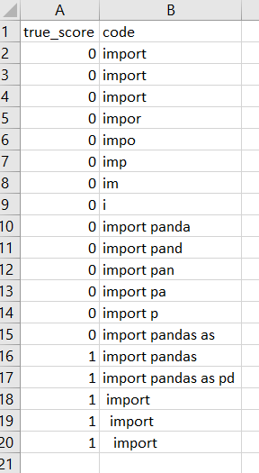
Dataset for “import pandas”

Slide 4
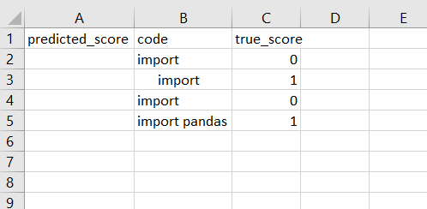
Prediction

Slide 5
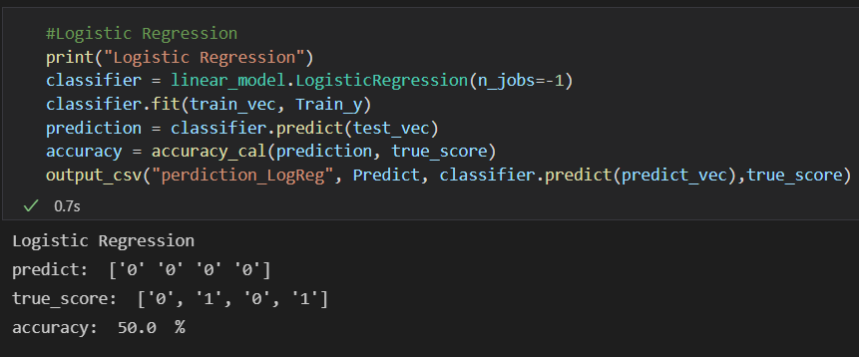
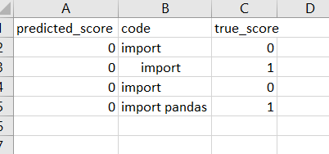
Logistic Regression

Slide 6
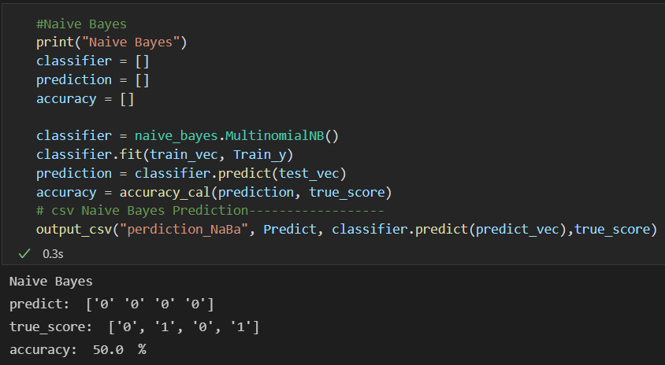
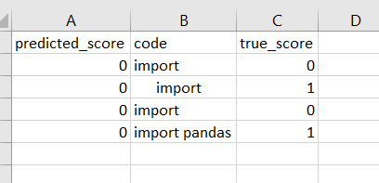
Naive Bayes

Slide 7
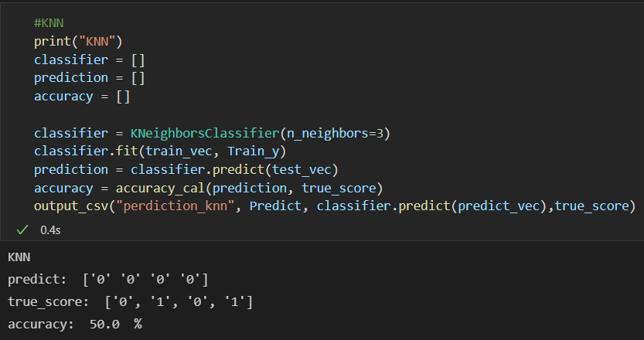
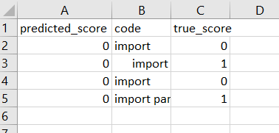
KNN

Slide 8
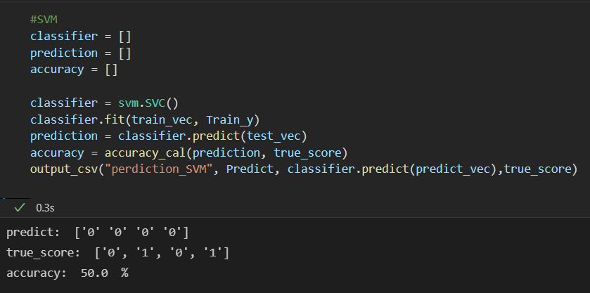
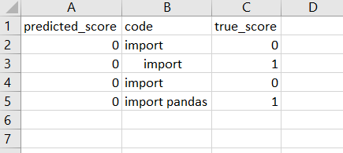
SVM

Slide 9
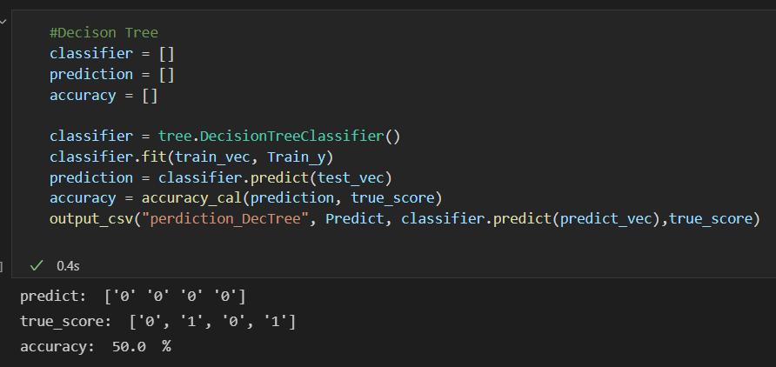
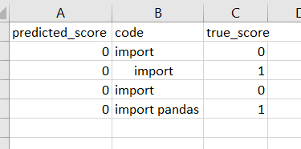
Decision Tree

Slide 10
In progress
Keep expanding the size of current dataset
Compare the accuracy and run time of all models
Add visualization and validation to the each model
Poster

Slide 11
Questions?

