Slide 1

Analysis of the number of days an animal spends in the shelter
Group17
Reporter: Jiaxiang LI ;Yutong LU ; Yunxi ZHANG

Slide 2

CONTENTS
Analysis Aims
1
Exploratory Data Analysis
2
Model And Results
3
Conclusion
4
Future Work
5

Slide 3

1.Analysis Aims
2.Exploratory Data Analysis
3.Model And Results
4.Conclusion
5.Future
Work
Aims of the analysis
Aim:
Research into the number of days an animal spends in the shelter is expected to help shelters make better decisions.
Problem Statement:
Which factors influence the number of days an animal spends in the shelter before its final outcome is decided?

Slide 4
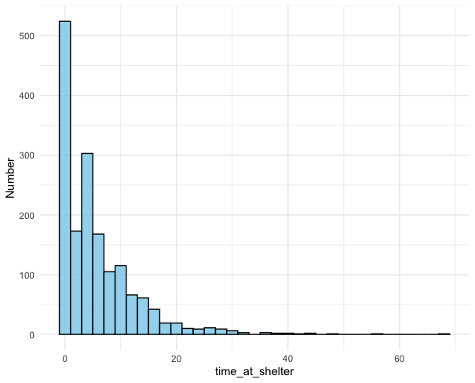
1.Analysis Aims
2.Exploratory Data Analysis
3.Model And Results
4.Conclusion
5.Future
Work
Data Overview
Key variables：
Animal_type – The type of animal admitted to the shelter
Month – Month the animal was admitted, recorded numerically with January=1
Year. – Year the animal was admitted to the shelter.
Intake_type – Reason for the animal being admitted to the shelter
Outcome_type – Final outcome for the admitted animal
Chip_Status – Did the animal have a microchip with owner information?
Time_at_Shelter – Days spent at the shelter between being admitted and the final outcome.
Histogram of the number of days an animal spends in the shelter
The chart shows a right-skewed distribution, with most animals staying 0-10 days and few staying beyond 30 days.

Slide 5
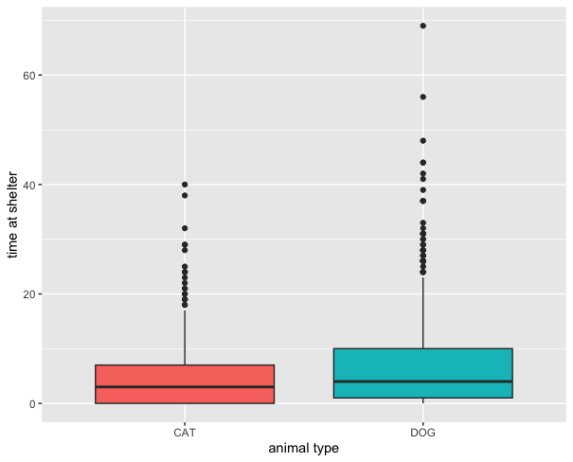
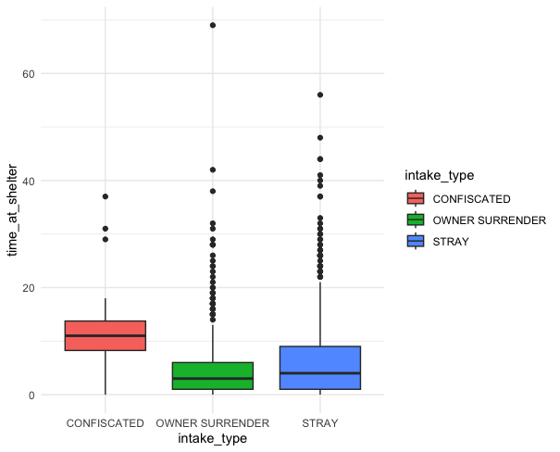
1.Analysis Aims
2.Exploratory Data Analysis
3.Model And Results
4.Conclusion
5.Future
Work
Data Overview
Boxplot of time_at_shelter and animal_
type
Boxplot of time_at_shelter and intake_
type
Cats have a lower median stay than dogs, but dogs show a wider distribution with longer stays.
The median of confiscated animals was significantly higher than that of the other two groups, indicating that confiscated animals stayed concentrated and longer.

Slide 6
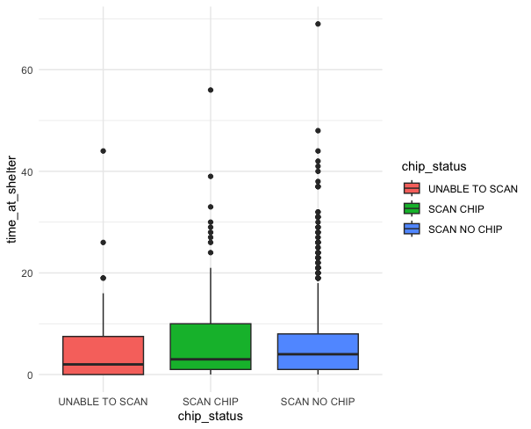
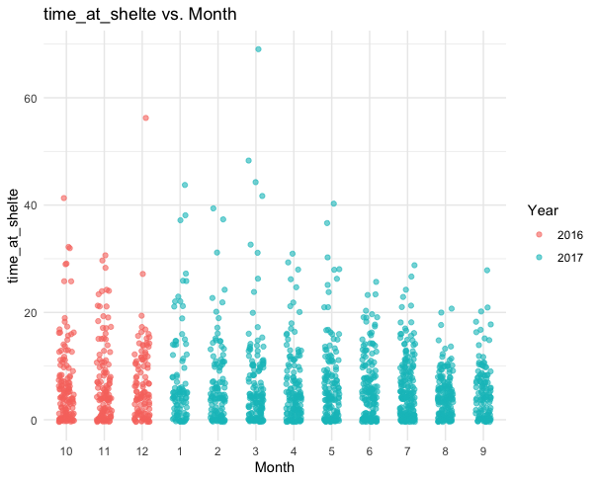
1.Analysis Aims
2.Exploratory Data Analysis
3.Model And Results
4.Conclusion
5.Future
Work
Data Overview
Boxplot of time_at_shelter and chip_
status
Scatter plot
of time_at_
shelter and
intake_
type
The medians were similar across chip statuses, suggesting comparable shelter stays. However, the IQR was wider for scanned animals, indicating greater data dispersion.
The dataset spans from October 2016 to September 2017 with complete monthly data. Animal shelter stays were mostly short (under 20 days) and showed no significant seasonal variation.

Slide 7
Poisson Regression
1.Analysis Aims
2.Exploratory Data Analysis
3.Model And Results
4.Conclusion
5.Future
Work
 | Pr
(Intercept) | < 2e-16 ***
animal_typeDOG | 4.70e-09 ***
month_ordered | < 2e-16 ***
intake_typeOWNER SURRENDER | < 2e-16 ***
intake_typeSTRAY | < 2e-16 ***
chip_statusSCAN CHIP | 6.58e-07 ***
chip_statusSCAN NO CHIP | 7.55e-12 ***
AIC: 15692
Serious
Overdispersion！
Dropped
Dispersion 8.01>>1.5

Slide 8
Negative binomial regression model
1.Analysis Aims
2.Exploratory Data Analysis
3.Model And Results
4.Conclusion
5.Future
Work
 | Pr
(Intercept) | < 2e-16 ***
intake_typeOWNER SURRENDER | 2.10e-09 ***
intake_typeSTRAY | 1.88e-05 ***
month_ordered | 7.66e-05 ***
chip_statusSCAN CHIP | 0.03571 *
chip_statusSCAN NO CHIP | 0.00491 **
animal_typeDOG | 0.09949 .
Stepwise used to select optimal variables
Poisson
AIC: 15692
AIC: 9440
Negative binomial regression model

Slide 9
Negative binomial regression model
1.Analysis Aims
2.Exploratory Data Analysis
3.Model And Results
4.Conclusion
5.Future
Work
 | Pr
(Intercept) | < 2e-16 ***
intake_typeOWNER SURRENDER | 3.68e-10 ***
intake_typeSTRAY | 1.27e-05 ***
month_ordered | 5.00e-05 ***
chip_statusSCAN CHIP | 0.01969 *
chip_statusSCAN NO CHIP | 0.00323 **
After excluding animal_type, it performs similarly but is simplified
include animal_type
AIC: 9440
AIC: 9440.6
Exclude animal_type

Slide 10
1.Analysis Aims
2.Exploratory Data Analysis
3.Model And Results
4.Conclusion
5.Future
Work
Zero-Inflated Negtive Binomial Model
ZINB
Count Model
Zero-Inflation Model
B
Negative binomial regression
Logistic regression
Animal truly entered
Models the number of days spent in the shelter
Structural Zeros
Animals that never truly entered the shelter system(e.g.returned before admission)
Excess zeros in time_at_shelter

Slide 11
1.Analysis Aims
2.Exploratory Data Analysis
3.Model And Results
4.Conclusion
5.Future
Work
Zero-Inflated Negtive Binomial Model
Count model
These animals tend to stay fewer days. Stray animals stay exp(-0.346) ≈ 0.71 times as long.
OWNER SURRENDER and STRAY have significant negative coefficients
Estimates how many days an animal stays in the shelter (if it truly entered)
 | Estimate | Pr
(Intercept) | 2.513081 | < 2e-16 ***
intake_typeOWNER SURRENDER | -0.657431 | 6.47e-09 ***
intake_typeSTRAY | -0.345890 | 0.001047 **
month_ordered | -0.026263 | 0.000668 ***
chip_statusSCAN CHIP | -0.012541 | 0.938263
chip_statusSCAN NO CHIP | 0.033997 | 0.823711
animal_typeDOG | 0.030271 | 0.664766
Log(theta) | 0.359465 | 4.38e-08 ***
animals arriving later in the year tend to stay shorter.
For each later month, time in shelter decreases by 2.7%.
month_ordered is also significantly negative
chip_status and animal_typeDOG are not significant
have little impact on length of stay.
AIC = 9335.147 lowest among three model

Slide 12
1.Analysis Aims
2.Exploratory Data Analysis
3.Model And Results
4.Conclusion
5.Future
Work
Zero-Inflated Negtive Binomial Model
Zero-inflation model
Animals with chip-related info are less likely to be structural zeros.
Having a scannable chip reduces odds of being a structural zero by exp(-1.37) ≈ 0.25.
Models the probability that a zero is a structural zero – animal didn’t really enter the shelter
SCAN CHIP and SCAN NO CHIP have significant negative coefficients
 | Estimate | Pr
(Intercept) | -12.35866 | 0.923125
intake_typeOWNER SURRENDER | 12.14699 | 0.924438
intake_typeSTRAY | 12.36739 | 0.923071
month_ordered | 0.04147 | 0.106656
chip_statusSCAN CHIP | -1.36654 | 0.000202***
chip_statusSCAN NO CHIP | -1.59158 | 3.01e-07 ***
animal_typeDOG | -0.49316 | 0.016035 *
Dogs are less likely to be structural zeros.
Dogs are exp(-0.49) ≈ 0.61 times as likely as cats to be structural zeros.
animal_typeDOG is significant and negative
intake_type and month_ordered are not significant here.
Have little impact on structural zero.
AIC = 9335.147 lowest among three model

Slide 13
1.Analysis Aims
2.Exploratory Data Analysis
3.Model And Results
4.Conclusion
5.Future
Work
Model Comparison
The Zero-Inflated Negative Binomial (ZINB) model has the lowest AIC of 9335, indicating the best fit.
It captures both overdispersion and excess zeros, which the Poisson and NB models cannot fully handle.
-39.8%
-1.1%

Slide 14
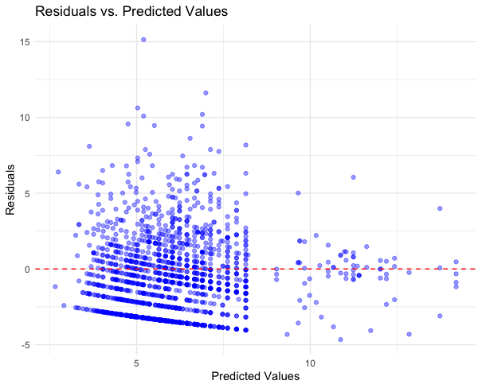
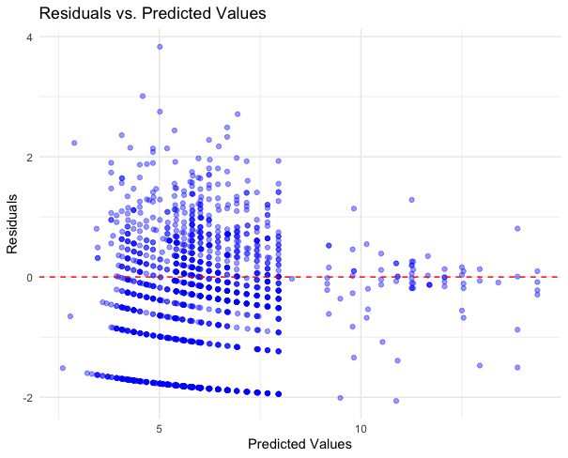
1.Analysis Aims
2.Exploratory Data Analysis
3.Model And Results
4.Conclusion
5.Future
Work
Residual Plot
Model1 : Possion
Model2 : nb_model_2
Residual variability is higher at lower predicted values, indicating excessive dispersion, consistent with the previously calculated dispersion parameter.
The variance of the residuals is generally in the range of -2 to +2. The negative binomial regression model basically solves the overdispersion problem.

Slide 15
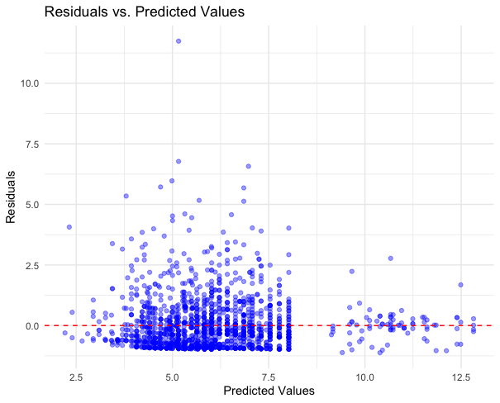
1.Analysis Aims
2.Exploratory Data Analysis
3.Model And Results
4.Conclusion
5.Future
Work
Residual Plot
Model3 :
Zero-flated_model
The residual plot highlights useful insights, confirming the presence of dispersion and validating the need for a more flexible model.

Slide 16
1.Analysis Aims
2.Exploratory Data Analysis
3.Model And Results
4.Conclusion
5.Future
Work
Key Findings Summary
Distribution
This report examines animal shelter stays, showing a right-skewed distribution with most animals staying under 10 days.
Using Poisson and Negative Binomial models with predictors like intake_type, animal_type, chip_status, and month, we found that owner-surrendered or stray animals stay shorter, dogs stay slightly longer, and chip status and intake month have weaker effects.
Predictors
Given many zero-day stays, a Zero-Inflated Negative Binomial model provided the best fit, distinguishing structural zeros from regular counts for deeper insight.
Modeling

Slide 17
1.Analysis Aims
2.Exploratory Data Analysis
3.Model And Results
4.Conclusion
5.Future
Work
Limitations & Future Work
Problem statment
The dataset contains a large number of zero values.
Multiple explanatory variables are present.
GLM does not fit well.
Proposed solution
Explore ANN as an alternative predictive model.
Investigate methods for transforming non-numerical variables into numerical ones.
Consider whether the frequency of observer occurrences can serve as a conversion criterion.

Slide 18

THANKS!

