Slide 1
ASC Violation Datasets

Slide 2
Synthetic Simple Task Performance
Binary classification with one specified accounting rule
85.68%
Class | Precision | Recall | F1
Violation | 86.13% | 84.39% | 85.25%
No violation | 85.27% | 86.92% | 86.09%
Accuracy
8,801 samples / 50 rules
4,353 violation
4,448 no violation
Macro F1 85.67%
Balanced accuracy 85.66%
8,613 valid predictions, 7,380 correct. 188 failures excluded.
Full-set accuracy, counting failures as incorrect: 83.85%.
2
Notes:
Source: user-provided Latest Benchmark Result (1).pptx. Dataset clarifications use the verified dataset inventory and experiment summaries from this project. Reported benchmark percentages are retained.

Slide 3
Synthetic Simple: Baseline Comparison
Model performance on the same task and evaluation set
Baseline | Accuracy | Precision | Recall | F1
DeepSeek V4 Flash | 82.72% | 81.36% | 86.33% | 84.27%
ChatGPT 5.5 | 85.68% | 85.70% | 85.66% | 85.67%
Qwen 8B | 62.35% | 63.44% | 61.24% | 62.33%
Precision, recall and F1 use the violation class. All values are percentages.
3
Notes:
Baseline results are placeholders to be filled after evaluation. A dash does not represent zero. Confirm the exact model identifier for Qwen 8B before reporting results.

Slide 4
Synthetic Medium Task Performance
Identify one violated rule, or no violation, from the statement and candidate rules
78.59%
Statement | Samples | Correct | Accuracy
Balance sheet | 1,410 | 1,192 | 84.56%
Cash flow | 1,372 | 1,102 | 80.30%
Income | 1,301 | 924 | 70.99%
Equity | 826 | 640 | 77.44%
Overall | 4,909 | 3,858 | 78.59%
ChatGPT accuracy
74.81% DeepSeek accuracy
4,909 samples
4,140 violation / 769 no violation
49 rules across the catalog
8, 13 or 15 candidates per sample
Highest accuracy: balance sheet
Lowest accuracy: income statement
4
Notes:
Source: user-provided Latest Benchmark Result (1).pptx. Dataset clarifications use the verified dataset inventory and experiment summaries from this project. Reported benchmark percentages are retained. The source contains conflicting balance-sheet correct counts: 1,192 on slide 3 and 1,182 on slide 4. This deck uses 1,192, consistent with the reported overall count of 3,858. Percentages are reported values and are not recalculated from these counts.

Slide 5
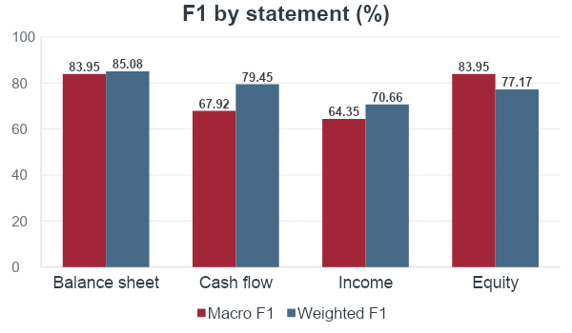
Synthetic Medium: Performance by Statement
Macro scores give each rule equal weight
Statement | Macro P | Macro R
Balance sheet | 86.49% | 83.99%
Cash flow | 69.70% | 68.91%
Income | 67.31% | 64.99%
Equity | 86.24% | 87.90%
Overall | 77.15% | 76.60%
Overall macro F1 75.28% Weighted F1 78.51%
Weighted F1 gives more weight to rules with more ground-truth samples.
5
Notes:
Source: user-provided Latest Benchmark Result (1).pptx. Dataset clarifications use the verified dataset inventory and experiment summaries from this project. Reported benchmark percentages are retained.

Slide 6
Synthetic Medium: Baseline Comparison
Model performance on the same task and evaluation set
Baseline | Accuracy | Macro P | Macro R | Macro F1 | Weighted F1
DeepSeek V4 Flash | 74.42% | 75.31% | 74.19% | 73.36% | 75.35%
ChatGPT 5.5 | 78.59% | 77.15% | 76.60% | 75.28% | 78.51%
Qwen 8B | 62.32% | 63.15% | 65.63% | 61.44% | 65.44%
Macro scores give each class equal weight. All values are percentages.
6
Notes:
Baseline results are placeholders to be filled after evaluation. A dash does not represent zero. Confirm the exact model identifier for Qwen 8B before reporting results.

Slide 7
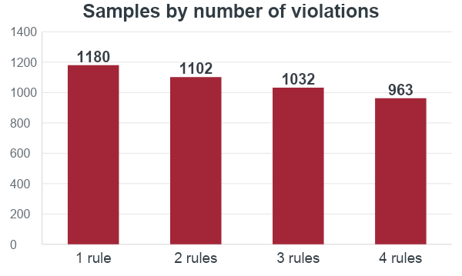
Synthetic Hard: Task and Dataset
Identify all violated rules across four financial statements
4,277
Samples, all with violations
49 candidate rules per sample
Candidate rule coverage
Balance sheet 15 / Cash flow 13
Income 13 / Equity 8
27.59% 25.77% 24.13% 22.52%
7
Notes:
Source: user-provided Latest Benchmark Result (1).pptx. Dataset clarifications use the verified dataset inventory and experiment summaries from this project. Reported benchmark percentages are retained.

Slide 8
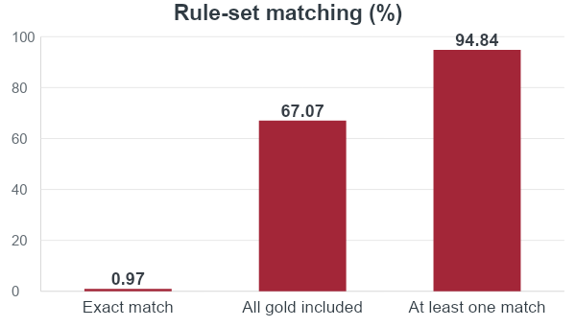
Synthetic Hard Task Performance
High partial coverage, but few predictions match the complete rule set
Metric | Micro | Macro
Precision | 38.52% | 51.53%
Recall | 83.65% | 70.96%
F1 | 52.75% | 56.90%
Weighted F1 68.42%
“All gold included” allows extra predicted rules. Exact match requires the same rule set.
Micro pools rule decisions. Macro averages scores equally across rules.
8
Notes:
Source: user-provided Latest Benchmark Result (1).pptx. Dataset clarifications use the verified dataset inventory and experiment summaries from this project. Reported benchmark percentages are retained.

Slide 9
Synthetic Hard: Baseline Comparison
Model performance on the same task and evaluation set
Baseline | Exact match | Micro F1 | Macro F1 | Weighted F1
DeepSeek V4 Flash | 0.78% | 50.33% | 52.71% | 63.11%
ChatGPT 5.5 | 0.97% | 52.75% | 56.90% | 68.42%
Qwen 8B | 0.31% | 40.12% | 41.33% | 49.87%
Exact match is accuracy over complete label sets. All values are percentages.
9
Notes:
Baseline results are placeholders to be filled after evaluation. A dash does not represent zero. Confirm the exact model identifier for Qwen 8B before reporting results.

Slide 10
Real World Simple Task Performance
Financial statements and notes, with one specified rule, form a binary decision
67.39%
Class | Precision | Recall | F1
Violation | 81.65% | 46.45% | 59.22%
No violation | 61.58% | 89.15% | 72.84%
Accuracy
1,554 samples
805 violation / 749 no violation
46.45% violation recall
More than half of violations are missed.
Missed violations dominate errors
Historical benchmark cohort: 1,554 samples. The current released dataset has 1,197 samples.
10
Notes:
Source: user-provided Latest Benchmark Result (1).pptx. Dataset clarifications use the verified dataset inventory and experiment summaries from this project. Reported benchmark percentages are retained. The source reports 400 false negatives among 747 evaluated violations and 78 false positives. Those evaluated counts differ from the dataset composition (805/749), so this slide uses the reported class rates and identifies the historical cohort.

Slide 11
Real World Simple: Baseline Comparison
Model performance on the same task and evaluation set
Baseline | Accuracy | Precision | Recall | F1
DeepSeek V4 Flash | 67.39% | 75.42% | 61.38% | 64.57%
ChatGPT 5.5 | 65.32% | 73.35% | 59.71% | 65.28%
Qwen 8B | 47.51% | 52.19% | 45.21% | 50.17%
Precision, recall and F1 use the violation class. All values are percentages.
11
Notes:
Baseline results are placeholders to be filled after evaluation. A dash does not represent zero. Confirm the exact model identifier for Qwen 8B before reporting results.

Slide 12
Real World Hard Task Performance
Identify all violated rules, or no violation, using statements, notes and 98 candidate rules
2.13%
Metric | Micro | Macro
Precision | 3.66% | 5.52%
Recall | 22.81% | 10.10%
F1 | 6.31% | 5.49%
Exact match
888 samples / 98 rules
459 violation (51.69%)
429 no violation (48.31%)
Weighted F1 15.46%
Low precision indicates many extra rule predictions.
Micro pools rule decisions. Macro gives each rule equal weight.
Exact match compares complete label sets, including no violation.
12
Notes:
Source: user-provided Latest Benchmark Result (1).pptx. Dataset clarifications use the verified dataset inventory and experiment summaries from this project. Reported benchmark percentages are retained. Experiment checkpoint audit: these metrics correspond to 94 evaluated cases, with two exact matches; 888 is the full dataset size. Rule-level micro and macro metrics exclude NON_VIOLATION.

Slide 13
Real World Hard: Baseline Comparison
Model performance on the same task and evaluation set
Baseline | Exact match | Micro F1 | Macro F1 | Weighted F1
DeepSeek V4 Flash | 1.88% | 5.79% | 4.99% | 13.71%
ChatGPT 5.5 | 2.13% | 6.31% | 5.49% | 15.46%
Qwen 8B | 0.32% | 3.22% | 2.64% | 10.37%
Exact match is accuracy over complete label sets. All values are percentages.
13
Notes:
Baseline results are placeholders to be filled after evaluation. A dash does not represent zero. Confirm the exact model identifier for Qwen 8B before reporting results.

