Slide 1
1
The Human Body: An Orientation: Part A

Slide 2
Overview of Anatomy and Physiology
Anatomy
  Study of structure
Subdivisions:
  Gross or macroscopic (e.g., regional, systemic, and surface anatomy)
  Microscopic (e.g., cytology and histology)
  Developmental (e.g., embryology)

Slide 3
Overview of Anatomy and Physiology
To study anatomy
  Mastery of anatomical terminology
  Observation
  Manipulation
  Palpation
  Auscultation

Slide 4
Overview of Anatomy and Physiology
Physiology
  Study of the function of the body
  Subdivisions based on organ systems
  (e.g., renal or cardiovascular physiology)
  Often focuses on cellular and molecular level
    Body's abilities depend on chemical reactions in individual cells

Slide 5
Overview of Anatomy and Physiology
To study physiology
  Ability to focus at many levels (from systemic to cellular and molecular)
  Study of basic physical principles (e.g., electrical currents, pressure, and movement)
  Study of basic chemical principles

Slide 6
Principle of Complementarity
Anatomy and physiology are inseparable
  Function always reflects structure
  What a structure can do depends on its specific form

Slide 7
Levels of Structural Organization
Chemical
  Atoms and molecules (chapter 2); and organelles (chapter 3)
Cellular
  Cells (chapter 3)
Tissue
  Groups of similar cells (chapter 4)
Organ
  Contains two or more types of tissues
Organ System
  Organs that work closely together
Organismal
  All organ systems

Slide 8
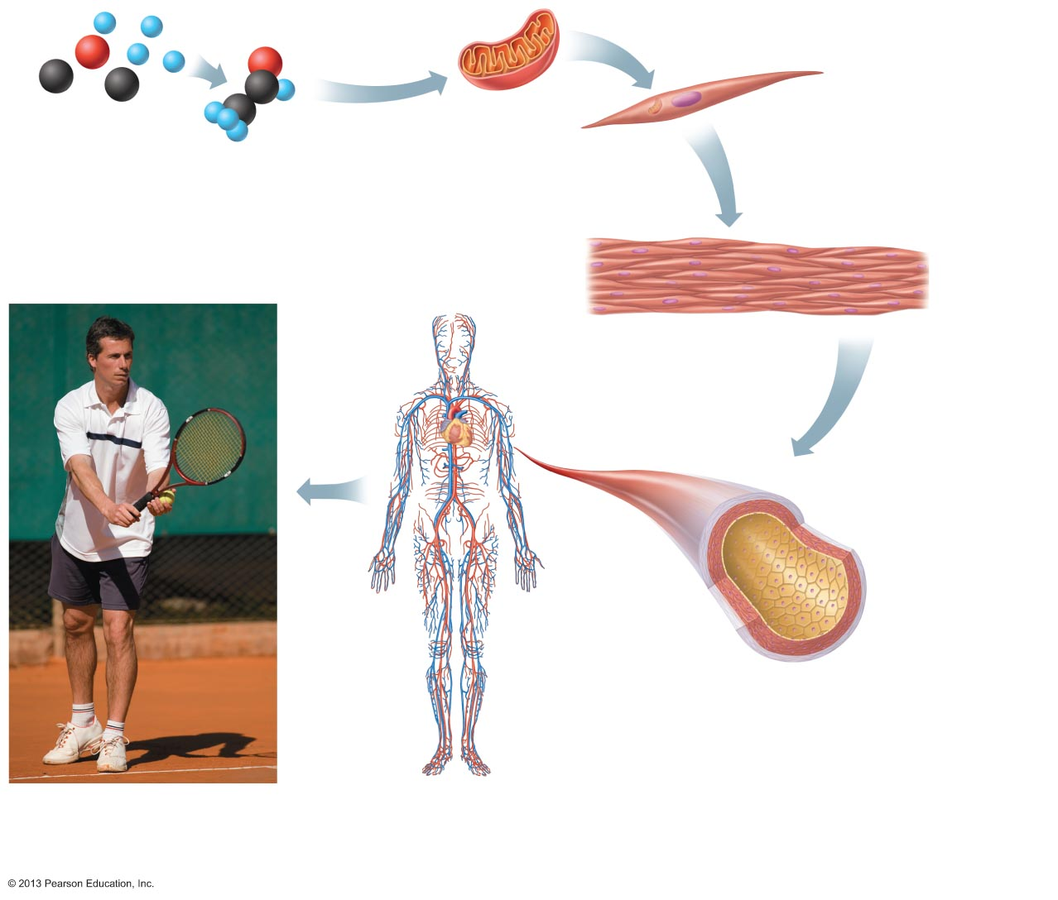
Figure 1.1 Levels of structural organization.
Slide 1
Atoms
Molecule
Organelle
Smooth muscle cell
Chemical level
Atoms combine to
form molecules.
Cellular level
Cells are made up
of molecules.
Smooth muscle tissue
Cardiovascular
system
Heart
Tissue level
Tissues consist of
similar types of cells.
Blood
vessels
Blood vessel (organ)
Smooth muscle tissue
Connective tissue
Epithelial
tissue
Organ level
Organs are made up of different types
of tissues.
Organismal level
The human organism is made
up of many organ systems.
Organ system level
Organ systems consist of different
organs that work together closely.

Slide 9
Figure 1.1 Levels of structural organization.
Slide 2
Atoms
Molecule
Chemical level
Atoms combine to
form molecules.

Slide 10
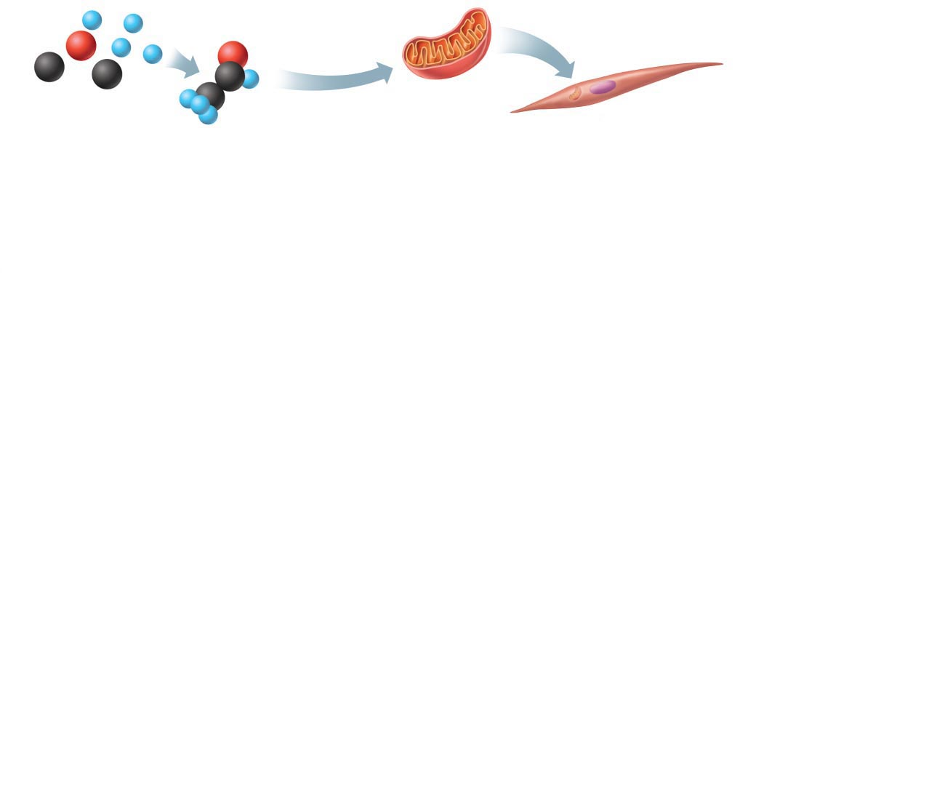
Figure 1.1 Levels of structural organization.
Slide 3
Atoms
Molecule
Organelle
Smooth muscle cell
Chemical level
Atoms combine to
form molecules.
Cellular level
Cells are made up
of molecules.

Slide 11
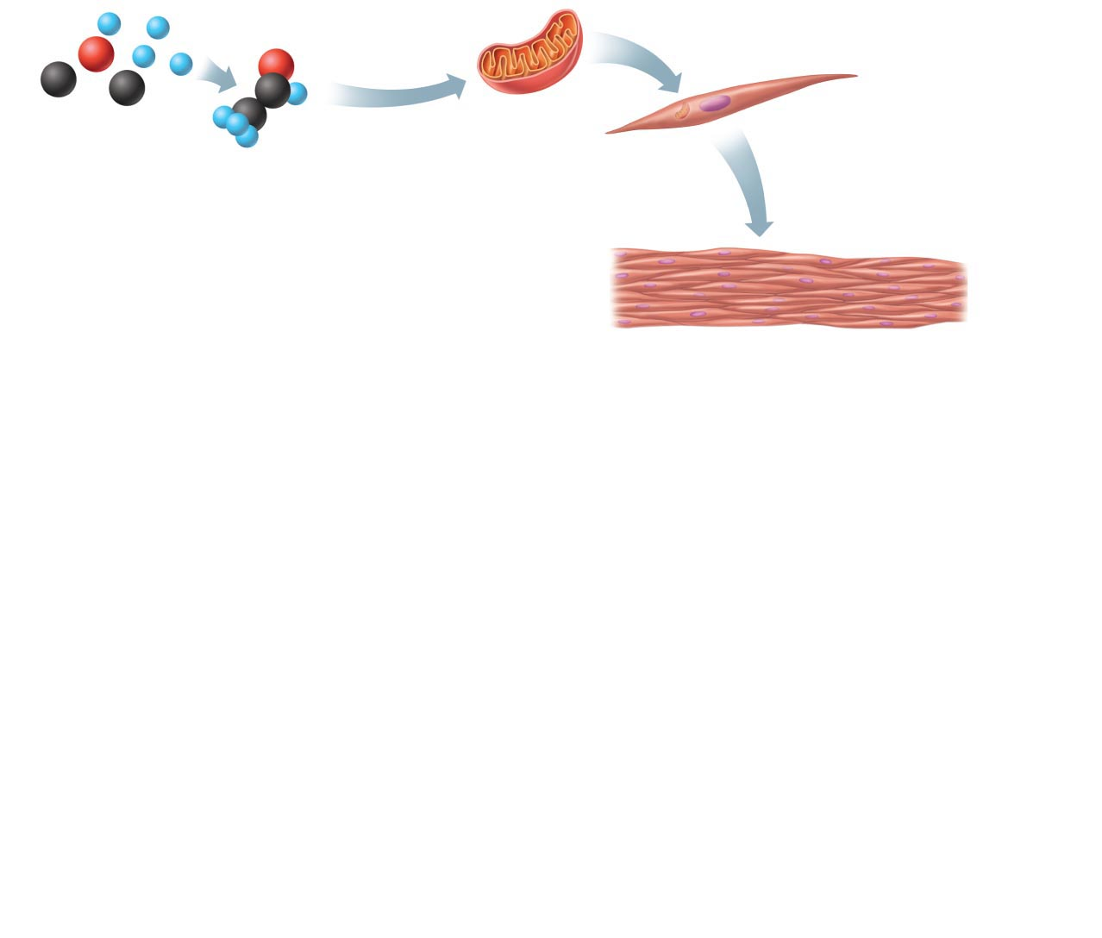
Figure 1.1 Levels of structural organization.
Slide 4
Atoms
Molecule
Organelle
Smooth muscle cell
Chemical level
Atoms combine to
form molecules.
Cellular level
Cells are made up
of molecules.
Smooth muscle tissue
Tissue level
Tissues consist of
similar types of cells.

Slide 12
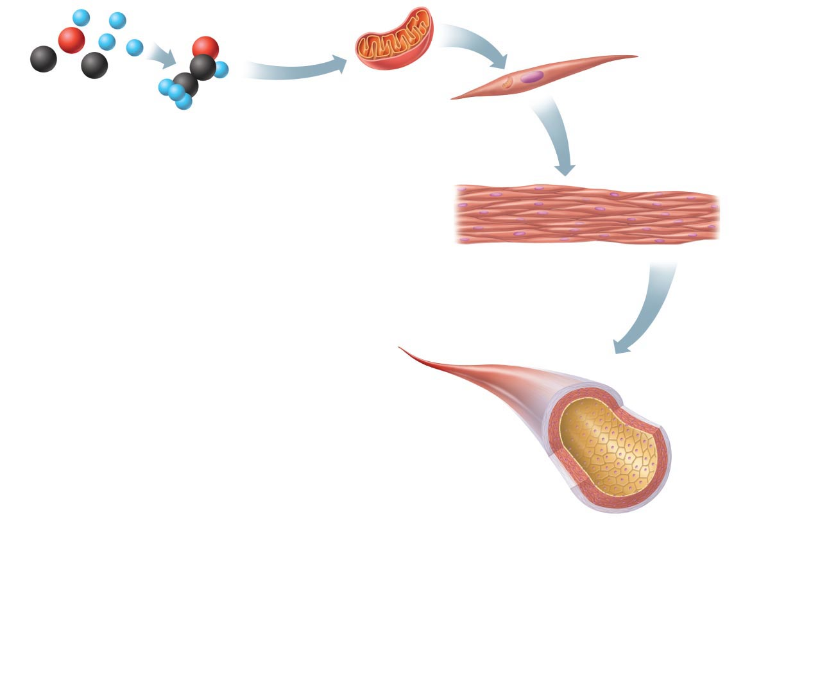
Figure 1.1 Levels of structural organization.
Slide 5
Atoms
Molecule
Organelle
Smooth muscle cell
Chemical level
Atoms combine to
form molecules.
Cellular level
Cells are made up
of molecules.
Smooth muscle tissue
Tissue level
Tissues consist of
similar types of cells.
Blood vessel (organ)
Smooth muscle tissue
Connective tissue
Epithelial
tissue
Organ level
Organs are made up of different types
of tissues.

Slide 13
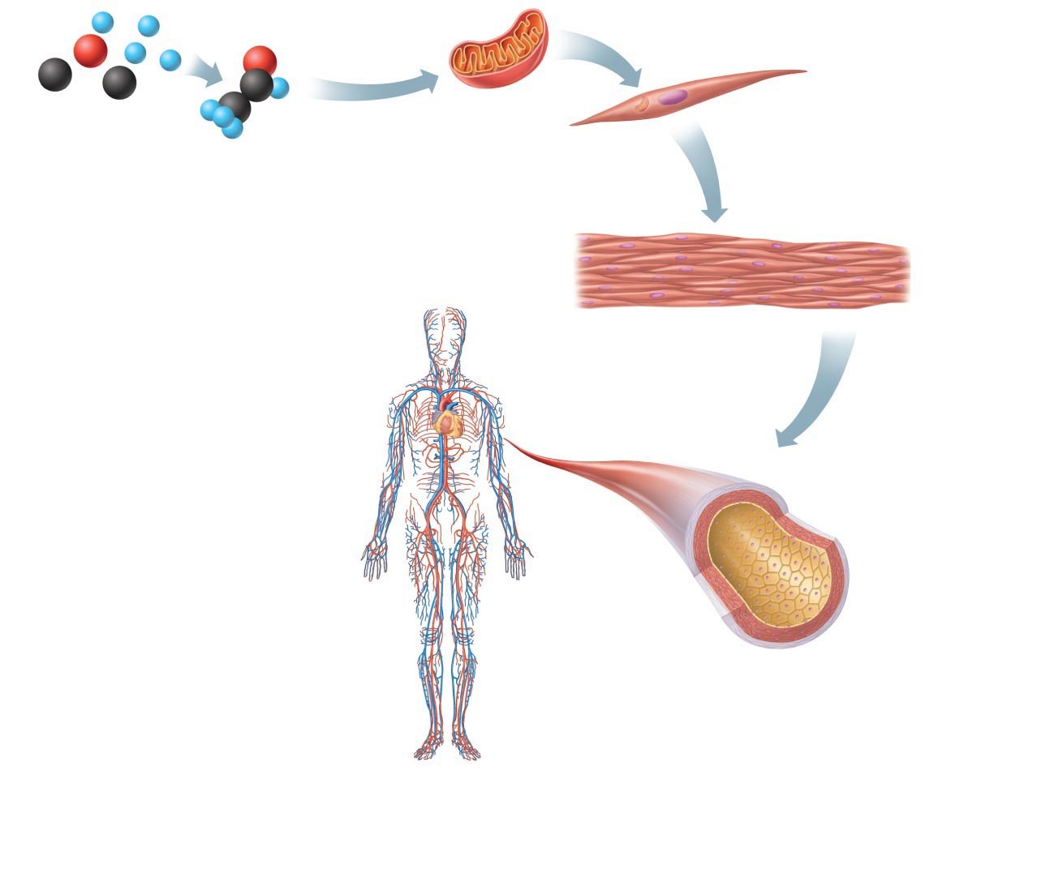

Figure 1.1 Levels of structural organization.
Slide 6
Atoms
Molecule
Organelle
Smooth muscle cell
Chemical level
Atoms combine to
form molecules.
Cellular level
Cells are made up
of molecules.
Smooth muscle tissue
Cardiovascular
system
Heart
Tissue level
Tissues consist of
similar types of cells.
Blood
vessels
Blood vessel (organ)
Smooth muscle tissue
Connective tissue
Epithelial
tissue
Organ level
Organs are made up of different types
of tissues.
Organ system level
Organ systems consist of different
organs that work together closely.

Slide 14
Figure 1.1 Levels of structural organization.
Slide 7
Atoms
Molecule
Organelle
Smooth muscle cell
Chemical level
Atoms combine to
form molecules.
Cellular level
Cells are made up
of molecules.
Smooth muscle tissue
Cardiovascular
system
Heart
Tissue level
Tissues consist of
similar types of cells.
Blood
vessels
Blood vessel (organ)
Smooth muscle tissue
Connective tissue
Epithelial
tissue
Organ level
Organs are made up of different types
of tissues.
Organismal level
The human organism is made
up of many organ systems.
Organ system level
Organ systems consist of different
organs that work together closely.

Slide 15
Necessary Life Functions
Maintaining boundaries
Movement
Responsiveness
Digestion
Metabolism
Dispose of wastes
Reproduction
Growth

Slide 16
Necessary Life Functions
Maintaining boundaries between internal and external environments
  Plasma membranes
  Skin
Movement (contractility)
  Of body parts (skeletal muscle)
  Of substances (cardiac and smooth muscle)

Slide 17
Necessary Life Functions
Responsiveness
  Ability to sense and respond to stimuli
  Withdrawal reflex
  Control of breathing rate
Digestion
  Breakdown of ingested foodstuffs
  Absorption of simple molecules into blood

Slide 18
Necessary Life Functions
Metabolism
  All chemical reactions that occur in body cells
  Catabolism and anabolism
Excretion
  Removal of wastes from metabolism and digestion
  Urea, carbon dioxide, feces

Slide 19
Necessary Life Functions
Reproduction
  Cellular division for growth or repair
  Production of offspring
Growth
  Increase in size of a body part or of organism

Slide 20
Interdependence of Body Cells
Humans are multicellular
  To function, must keep individual cells alive
  All cells depend on organ systems to meet their survival needs
All body functions spread among different organ systems
Organ systems cooperate to maintain life
  Note major organs and functions of the 11 organ systems (fig. 1.3)

Slide 21
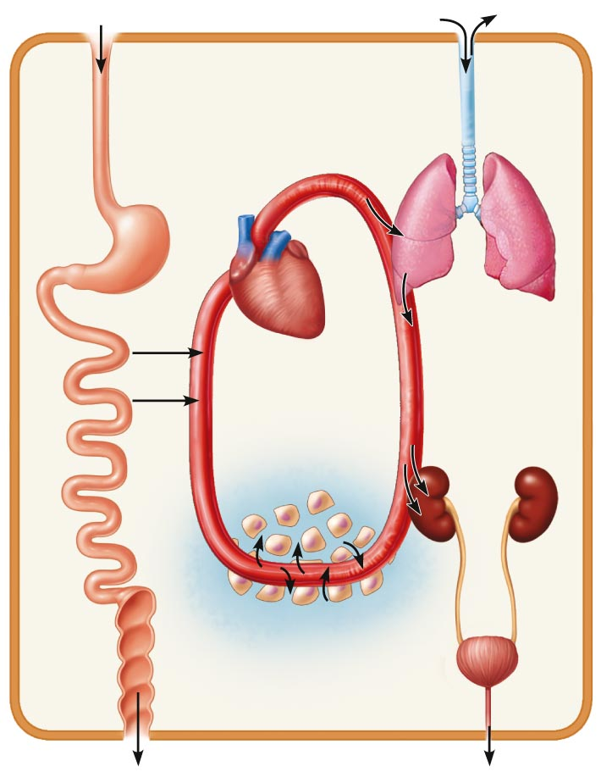
Figure 1.2 Examples of interrelationships among body organ systems.
Digestive system
Takes in nutrients, breaks them
down, and eliminates unabsorbed
matter (feces)
Respiratory system
Takes in oxygen and
eliminates carbon dioxide
Food
O₂
CO₂
Cardiovascular system
Via the blood, distributes oxygen
and nutrients to all body cells and
delivers wastes and carbon
dioxide to disposal organs
Blood
CO₂
O₂
Heart
Urinary system Eliminates
nitrogenous
wastes and
excess ions
Nutrients
Interstitial fluid
Nutrients and wastes pass between blood and cells
via the interstitial fluid
Integumentary system Protects the body as a whole from the external environment
Feces
Urine

Slide 22
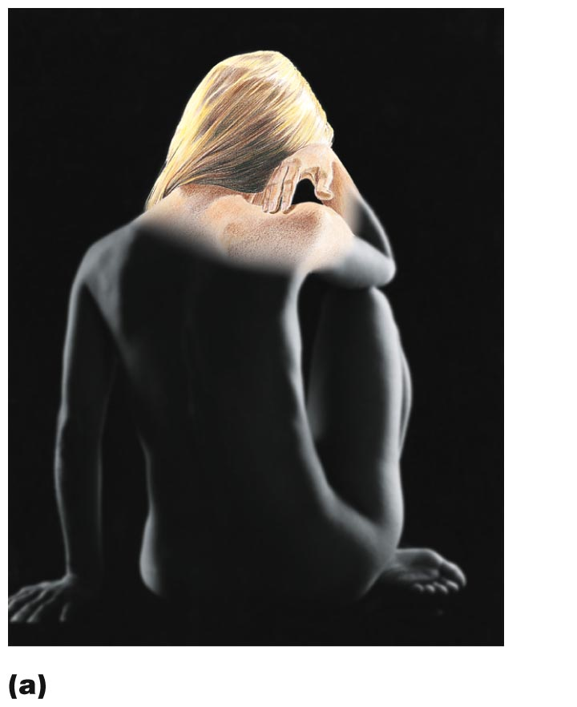
Figure 1.3a The body’s organ systems and their major functions.
Hair
Skin
Nails
Integumentary System
Forms the external body covering,
and protects deeper tissues from injury.
Synthesizes vitamin D, and houses
cutaneous (pain, pressure, etc.)
receptors and sweat and oil glands.

Slide 23
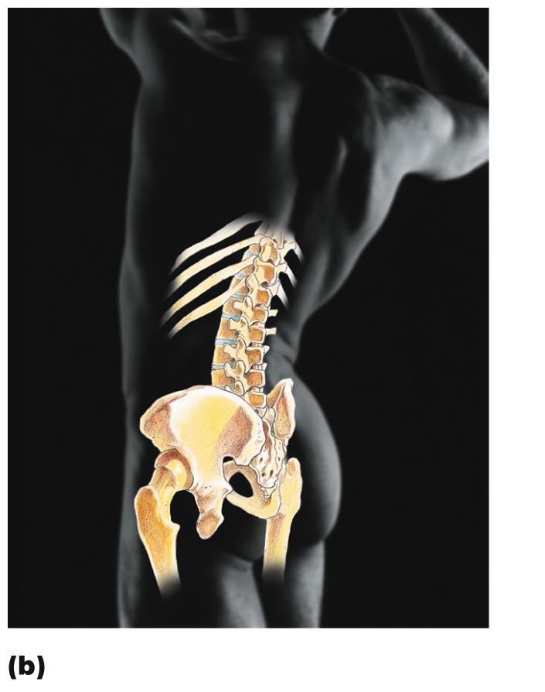
Figure 1.3b The body’s organ systems and their major functions.
Bones
Joint
Skeletal System
Protects and supports body organs,
and provides a framework the muscles
use to cause movement. Blood cells
are formed within bones. Bones store minerals.

Slide 24
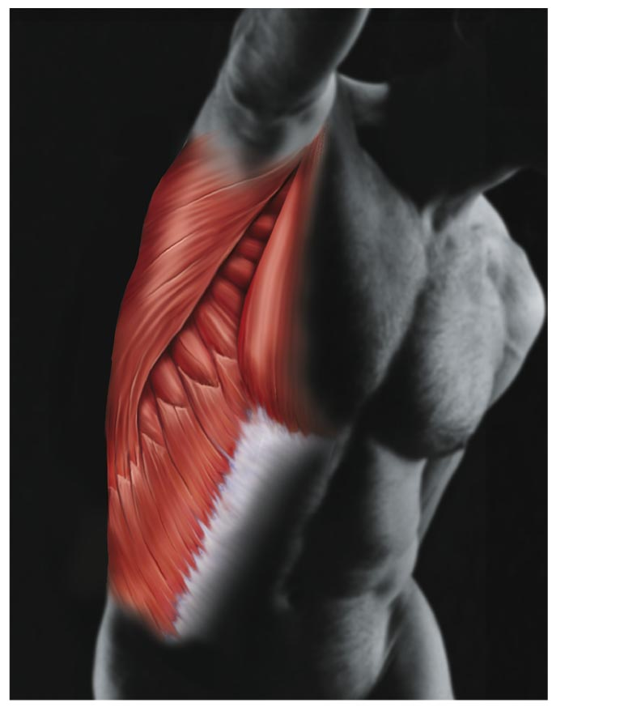
Figure 1.3c The body’s organ systems and their major functions.
Skeletal
muscles
(c)
Muscular System
Allows manipulation of the environment,
locomotion, and facial expression.
Maintains posture, and produces heat.

Slide 25
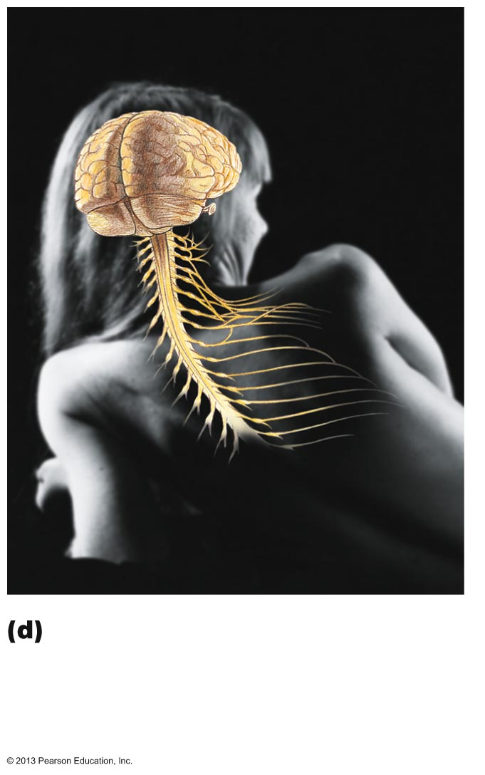
Figure 1.3d The body’s organ systems and their major functions.
Brain
Nerves
Spinal
cord
Nervous System
As the fast-acting control system of
the body, it responds to internal and
external changes by activating
appropriate muscles and glands.

Slide 26
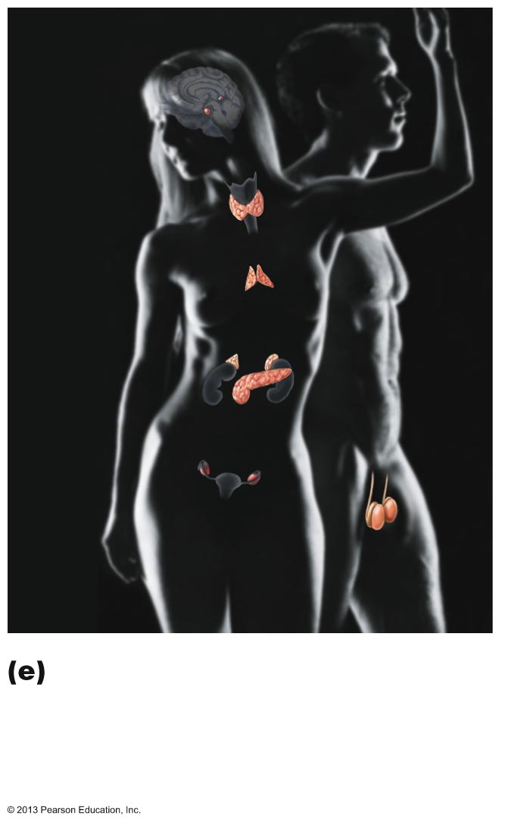
Figure 1.3e The body’s organ systems and their major functions.
Pineal gland
Pituitary
gland
Thyroid
gland
Thymus
Adrenal
gland
Pancreas
Testis
Ovary
Endocrine System
Glands secrete hormones that
regulate processes such as growth,
reproduction, and nutrient use
(metabolism) by body cells.

Slide 27
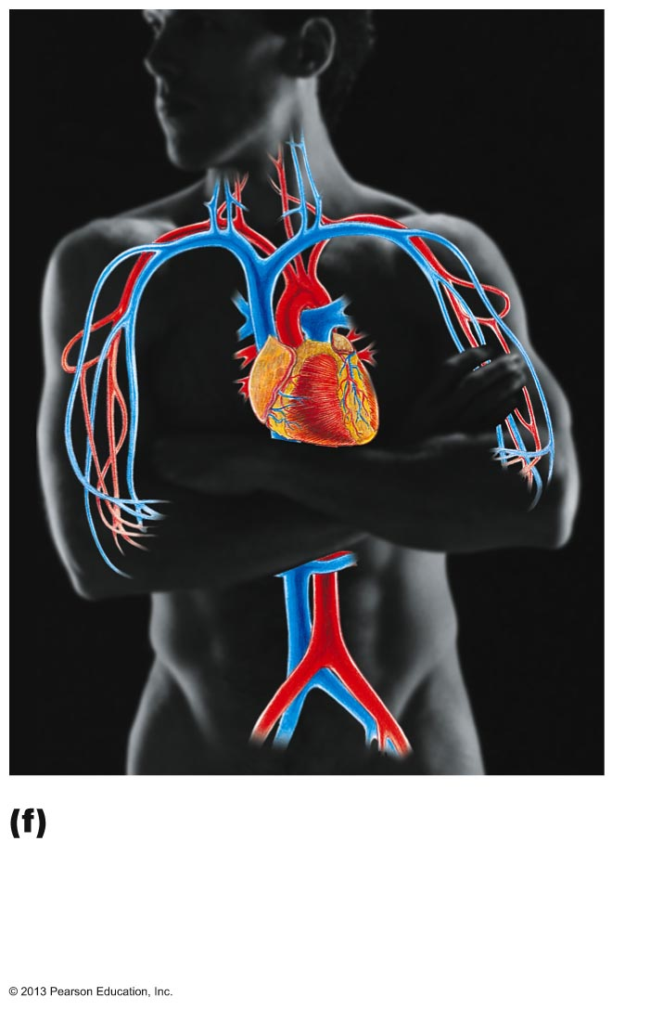
Figure 1.3f The body’s organ systems and their major functions.
Heart
Blood
vessels
Cardiovascular System
Blood vessels transport blood,
which carries oxygen, carbon dioxide,
nutrients, wastes, etc. The heart
pumps blood.

Slide 28
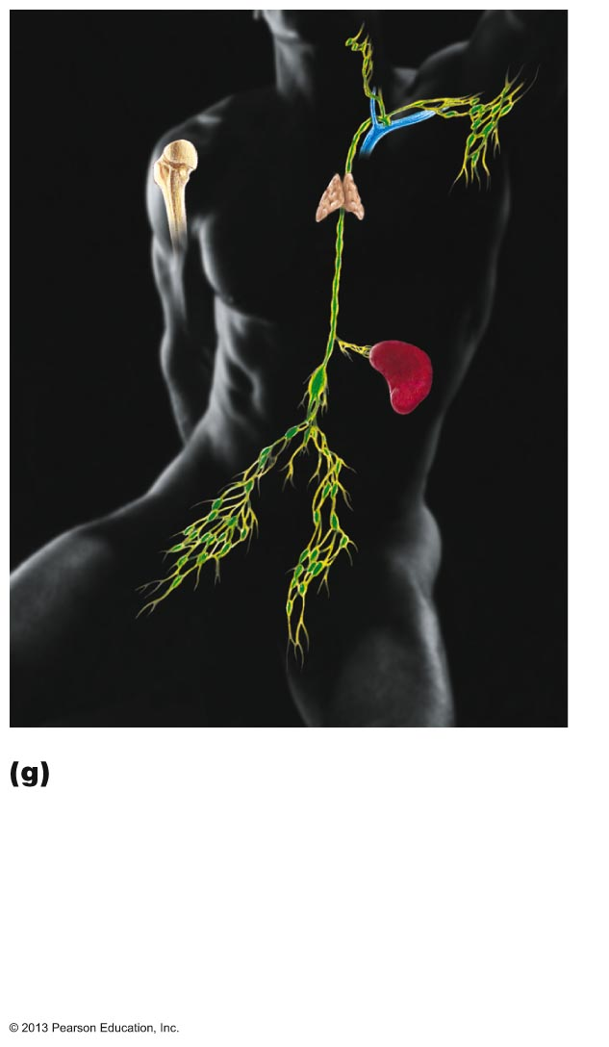
Figure 1.3g The body’s organ systems and their major functions.
Red bone
marrow
Thymus
Lymphatic
vessels
Thoracic
duct
Spleen
Lymph nodes
Lymphatic System/Immunity
Picks up fluid leaked from blood vessels
and returns it to blood. Disposes
of debris in the lymphatic stream.
Houses white blood cells (lymphocytes)
involved in immunity. The immune
response mounts the attack against
foreign substances within the body.

Slide 29
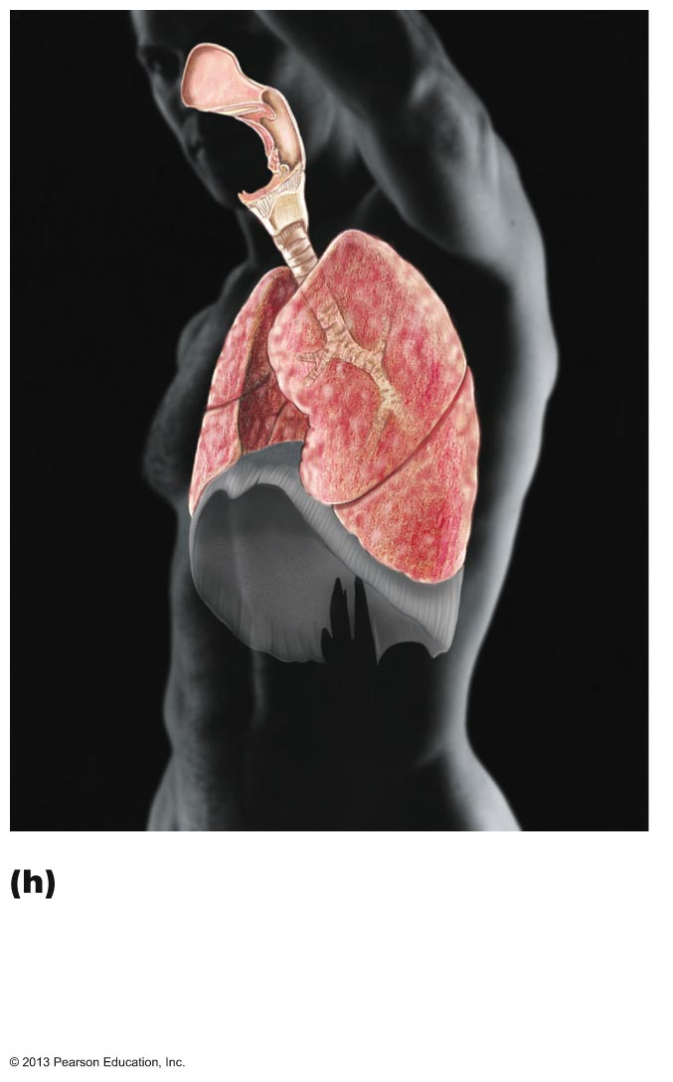
Figure 1.3h The body’s organ systems and their major functions.
Nasal
cavity
Pharynx
Larynx
Bronchus
Trachea
Lung
Respiratory System
Keeps blood constantly supplied with
oxygen and removes carbon dioxide.
The gaseous exchanges occur through
the walls of the air sacs of the lungs.

Slide 30
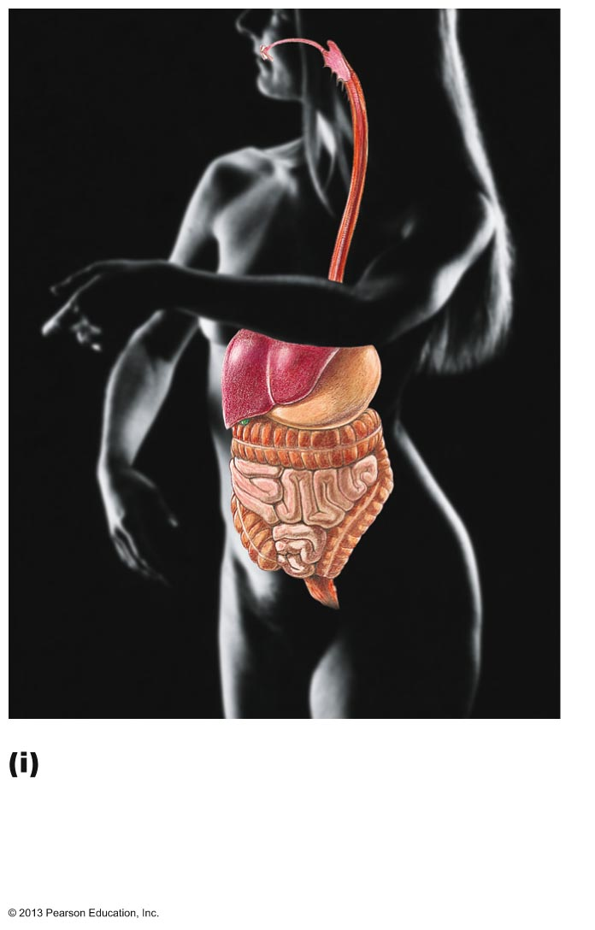
Figure 1.3i The body’s organ systems and their major functions.
Oral cavity
Esophagus
Liver
Stomach
Small
Intestine
Large
Intestine
Rectum
Anus
Digestive System
Breaks down food into absorbable units
that enter the blood for distribution to
body cells. Indigestible foodstuffs are
eliminated as feces.

Slide 31
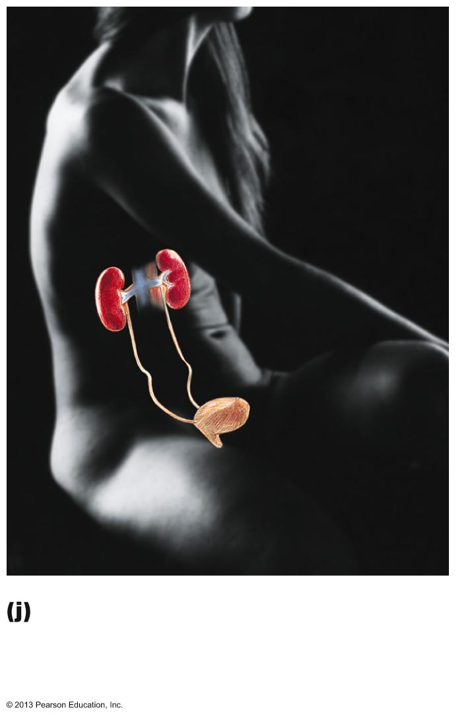
Figure 1.3j The body’s organ systems and their major functions.
Kidney
Ureter
Urinary
bladder
Urethra
Urinary System
Eliminates nitrogenous wastes from the
body. Regulates water, electrolyte and
acid-base balance of the blood.

Slide 32
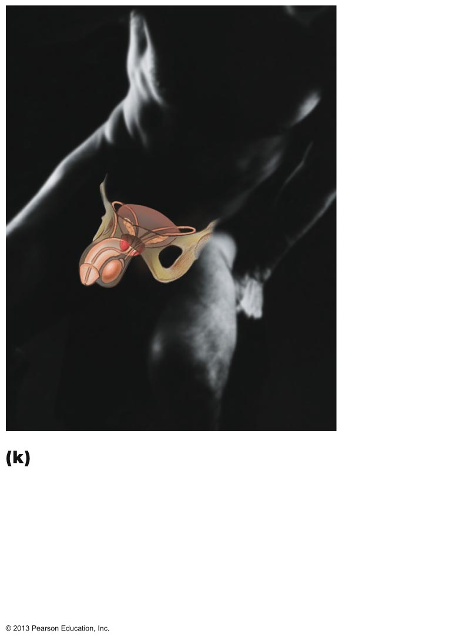
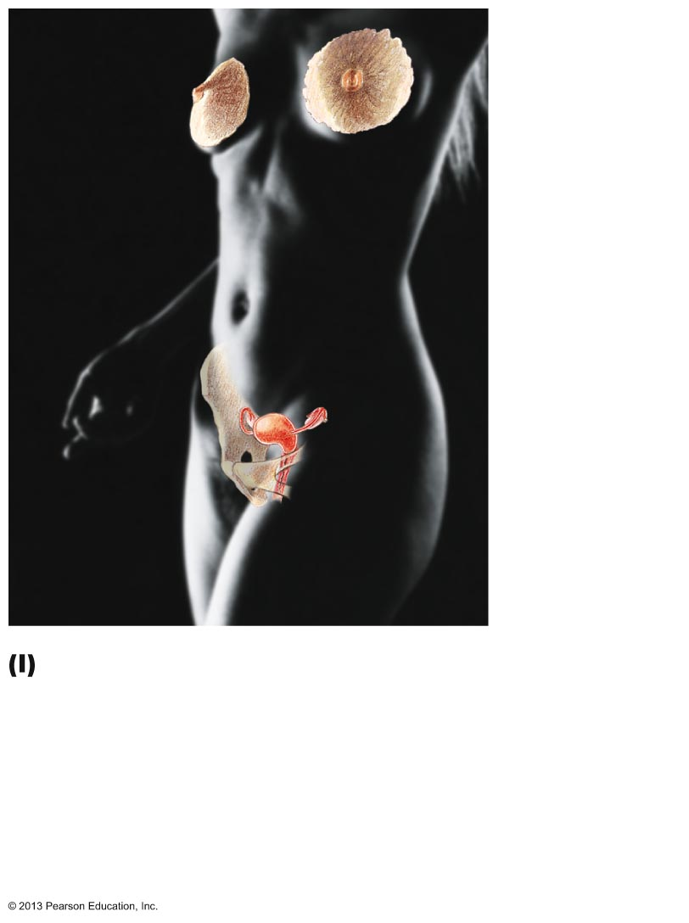
Figure 1.3k–l The body’s organ systems and their major functions.
Mammary
glands (in
breasts)
Prostate
gland
Ovary
Penis
Testis
Ductus
deferens
Scrotum
Uterus
Uterine
tube
Vagina
Male Reproductive System
Overall function is production of offspring. Testes
produce sperm and male sex hormone, and male
ducts and glands aid in delivery of sperm to the
female reproductive tract. Ovaries produce eggs
and female sex hormones. The remaining female
structures serve as sites for fertilization and
development of the fetus. Mammary glands of
female breasts produce milk to nourish the newborn.
Female Reproductive System
Overall function is production of offspring. Testes
produce sperm and male sex hormone, and male
ducts and glands aid in delivery of sperm to the
female reproductive tract. Ovaries produce eggs
and female sex hormones. The remaining female
structures serve as sites for fertilization and
development of the fetus. Mammary glands of female
breasts produce milk to nourish the newborn.

Slide 33
Survival Needs
Appropriate amounts necessary for life
  Too little or too much harmful
Nutrients
Oxygen
Water
Normal body temperature
Appropriate atmospheric pressure

Slide 34
Survival Needs
Nutrients
  Chemicals for energy and cell building
  Carbohydrates, fats, proteins, minerals, vitamins
Oxygen
  Essential for energy release (ATP production)

Slide 35
Survival Needs
Water
  Most abundant chemical in body
  Environment of chemical reactions
  Fluid base for secretions and excretions
Normal body temperature
  37° C
  Affects rate of chemical reactions
Appropriate atmospheric pressure
  For adequate breathing and gas exchange in lungs

Slide 36
Homeostasis
Homeostasis
  Maintenance of relatively stable internal conditions despite continuous changes in environment
  A dynamic state of equilibrium
  Maintained by contributions of all organ systems

Slide 37
Homeostatic Control Mechanisms
Involve continuous monitoring and regulation of all factors that can change (variables)
Communication necessary for monitoring and regulation
  Functions of nervous and endocrine systems
Nervous and endocrine systems accomplish communication via nerve impulses and hormones

Slide 38
Components of a Control Mechanism
Receptor (sensor)
  Monitors environment
  Responds to stimuli (something that causes changes in controlled variables)
Control center
  Determines set point at which variable is maintained
  Receives input from receptor
  Determines appropriate response
Effector
  Receives output from control center
  Provides the means to respond
  Response either reduces (negative feedback) or enhances stimulus (positive feedback)

Slide 39
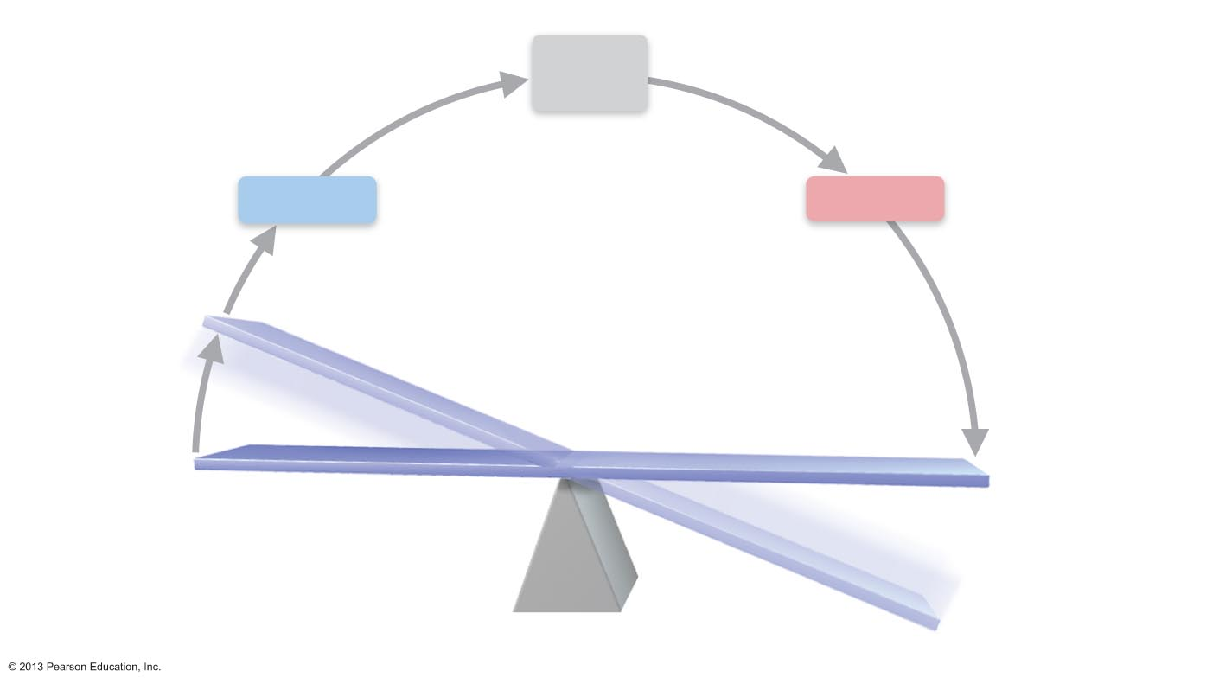
Figure 1.4 Interactions among the elements of a homeostatic control system maintain stable internal conditions.
Slide 1
3
4
Input: Information
sent along afferent
pathway to control
center.
Output: Information sent
along efferent pathway to
effector.
Control
Center
Afferent
pathway
Efferent
pathway
Receptor
Effector
2
Receptor
detects
change.
5
Response
of effector
feeds back to
reduce the
effect of
stimulus and
returns
variable
to homeostatic
level.
1
IMBALANCE
Stimulus
produces
change in
variable.
BALANCE
IMBALANCE

Slide 40
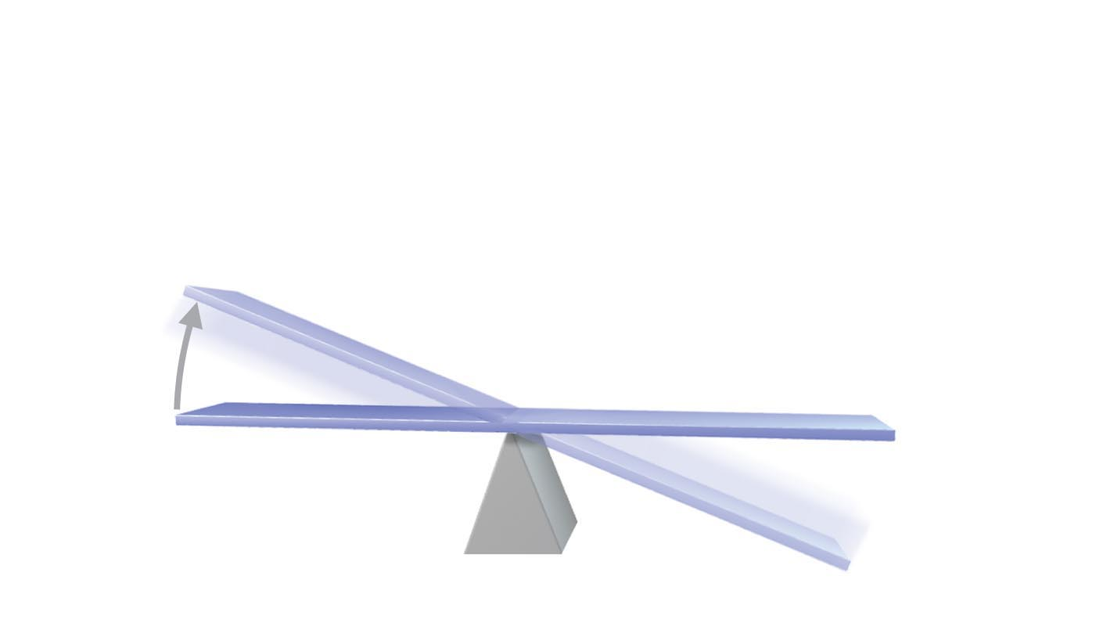
Figure 1.4 Interactions among the elements of a homeostatic control system maintain stable internal conditions.
Slide 2
1
IMBALANCE
Stimulus
produces
change in
variable.
BALANCE
IMBALANCE

Slide 41
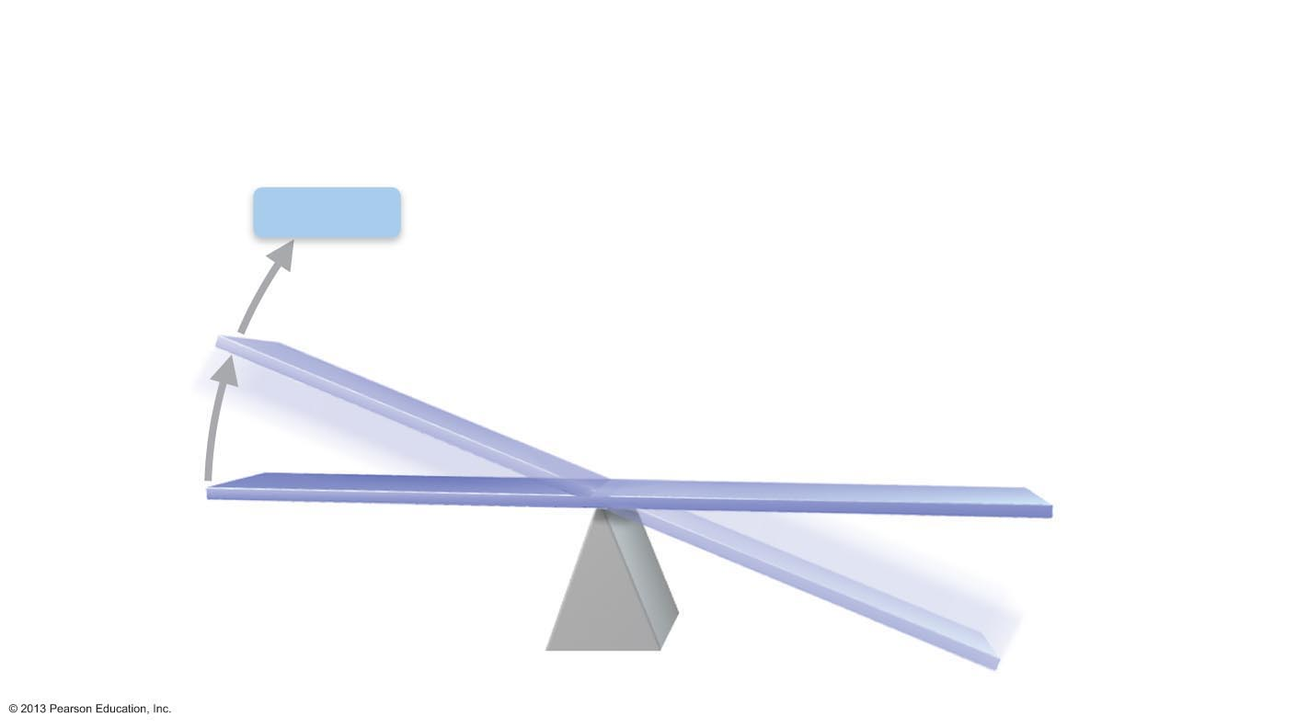
Figure 1.4 Interactions among the elements of a homeostatic control system maintain stable internal conditions.
Slide 3
Receptor
2
Receptor
detects
change.
1
IMBALANCE
Stimulus
produces
change in
variable.
BALANCE
IMBALANCE

Slide 42
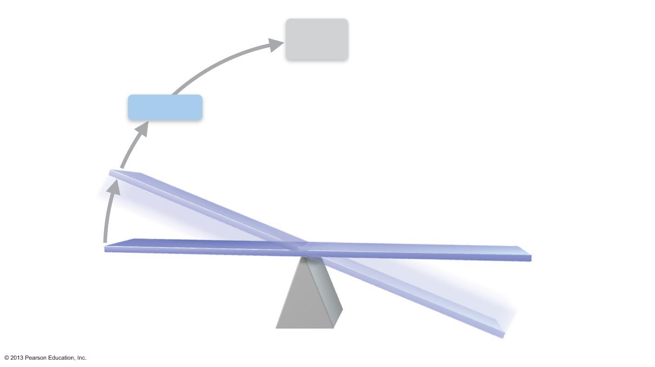
Figure 1.4 Interactions among the elements of a homeostatic control system maintain stable internal conditions.
Slide 4
3
Input: Information
sent along afferent
pathway to control
center.
Control
Center
Afferent
pathway
Receptor
2
Receptor
detects
change.
1
IMBALANCE
Stimulus
produces
change in
variable.
BALANCE
IMBALANCE

Slide 43
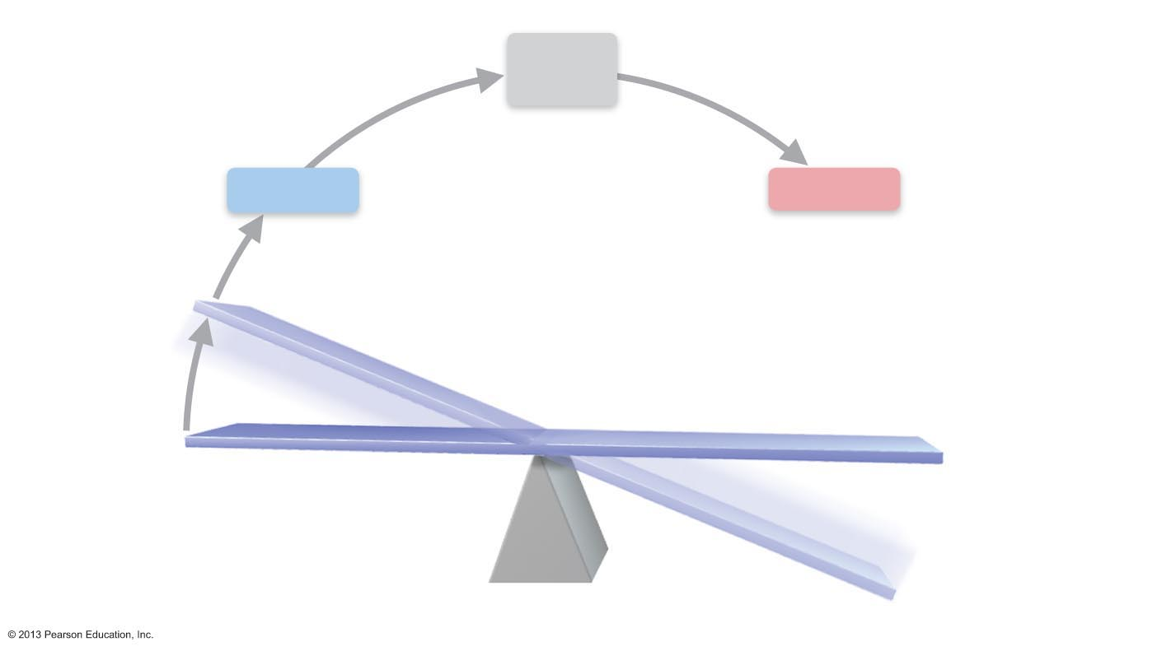
Figure 1.4 Interactions among the elements of a homeostatic control system maintain stable internal conditions.
Slide 5
3
4
Input: Information
sent along afferent
pathway to control
center.
Output: Information sent
along efferent pathway to
effector.
Control
Center
Afferent
pathway
Efferent
pathway
Receptor
Effector
2
Receptor
detects
change.
1
IMBALANCE
Stimulus
produces
change in
variable.
BALANCE
IMBALANCE

Slide 44

Figure 1.4 Interactions among the elements of a homeostatic control system maintain stable internal conditions.
Slide 6
3
4
Input: Information
sent along afferent
pathway to control
center.
Output: Information sent
along efferent pathway to
effector.
Control
Center
Afferent
pathway
Efferent
pathway
Receptor
Effector
2
Receptor
detects
change.
5
Response
of effector
feeds back to
reduce the
effect of
stimulus and
returns
variable
to homeostatic
level.
1
IMBALANCE
Stimulus
produces
change in
variable.
BALANCE
IMBALANCE

Slide 45
Negative Feedback
Most feedback mechanisms in body
Response reduces or shuts off original stimulus
  Variable changes in opposite direction of initial change
Examples
  Regulation of body temperature (a nervous system mechanism)
  Regulation of blood glucose by insulin (an endocrine system mechanism)

Slide 46
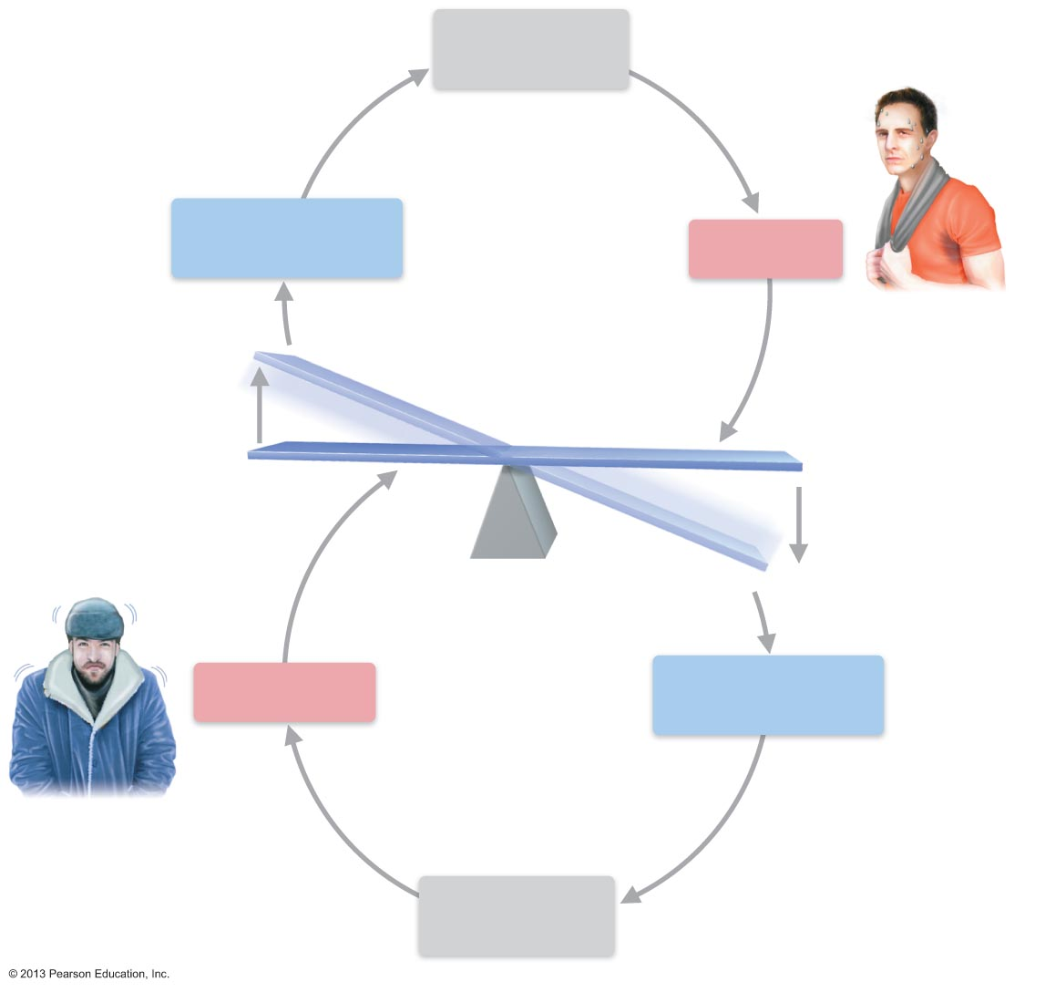
Figure 1.5 Body temperature is regulated by a negative feedback mechanism.
Control Center
(thermoregulatory
center in brain)
Afferent
pathway
Efferent
pathway
Receptors
Temperature-sensitive
cells in skin and brain)
Effectors
Sweet glands
Sweat glands activated
Response
Evaporation of sweat
Body temperature falls;
stimulus ends
Body temperature
rises
IMBALANCE
Stimulus: Heat
BALANCE
Stimulus: Cold
Response
Body temperature rises;
stimulus ends
Body temperature
falls
IMBALANCE
Effectors
Skeletal muscles
Receptors
Temperature-sensitive
cells in skin and brain
Efferent
pathway
Afferent
pathway
Shivering begins
Control Center
(thermoregulatory
center in brain)

Slide 47
Negative Feedback:
Regulation of Blood Glucose by Insulin
Receptors sense increased blood glucose (blood sugar)
Pancreas (control center) secretes insulin into the blood
Insulin causes body cells (effectors) to absorb more glucose, which decreases blood glucose levels

Slide 48
Positive Feedback
Response enhances or exaggerates original stimulus
May exhibit a cascade or amplifying effect
Usually controls infrequent events that do not require continuous adjustment
  Enhancement of labor contractions by oxytocin (chapter 28)
  Platelet plug formation and blood clotting

Slide 49
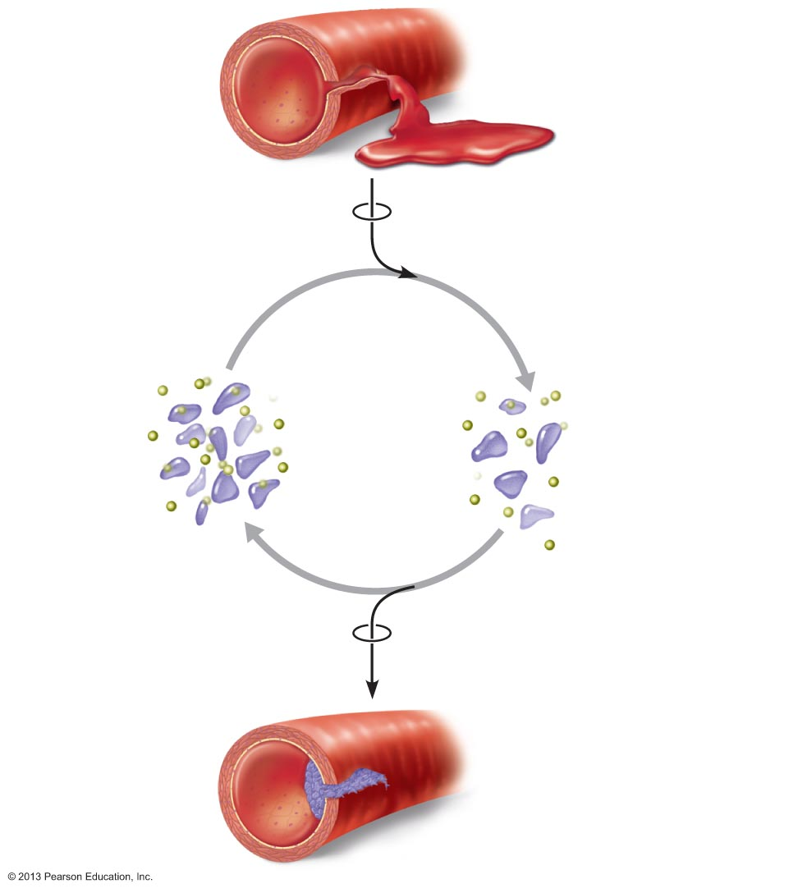
Figure 1.6 A positive feedback mechanism regulates formation of a platelet plug.
Slide 1
1
Break or tear
occurs in blood
vessel wall.
Positive feedback
cycle is initiated.
3
2
Released
chemicals
attract more
platelets.
Platelets
adhere to site and
release chemicals.
Positive
feedback
loop
Feedback cycle ends
when plug is formed.
4
Platelet plug
is fully formed.

Slide 50
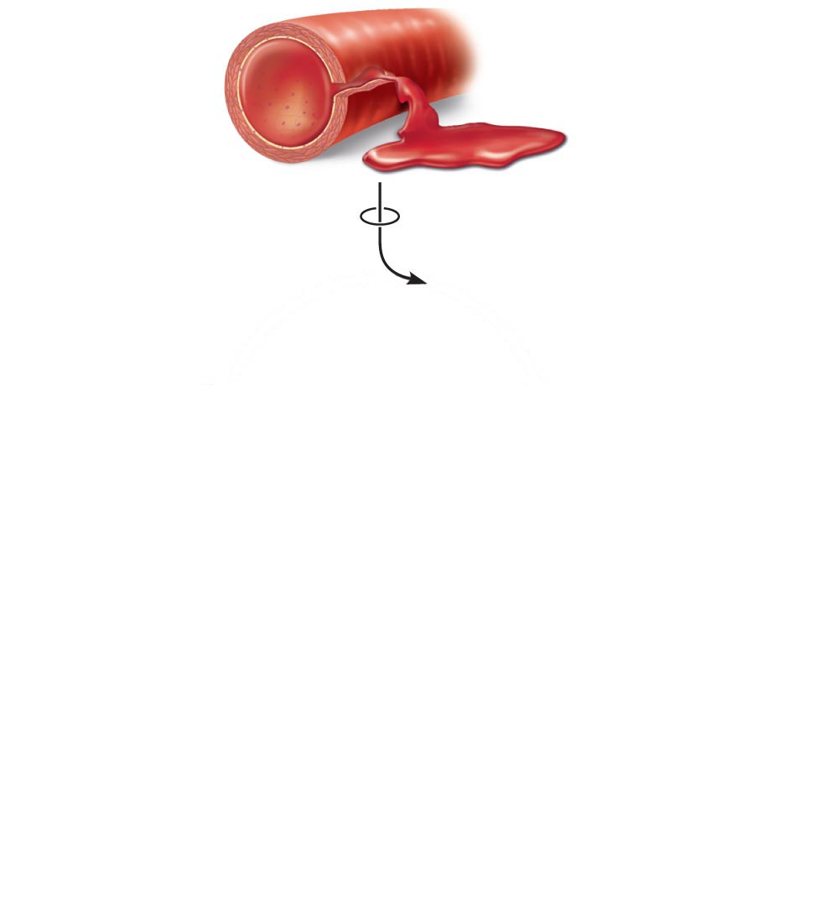
Figure 1.6 A positive feedback mechanism regulates formation of a platelet plug.
Slide 2
1
Break or tear
occurs in blood
vessel wall.
Positive feedback
cycle is initiated.

Slide 51
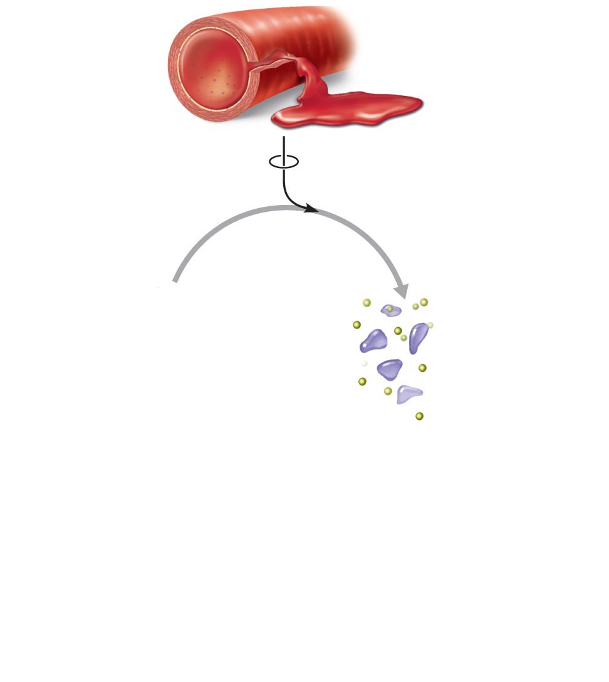
Figure 1.6 A positive feedback mechanism regulates formation of a platelet plug.
Slide 3
1
Break or tear
occurs in blood
vessel wall.
Positive feedback
cycle is initiated.
2
Platelets
adhere to site and
release chemicals.

Slide 52
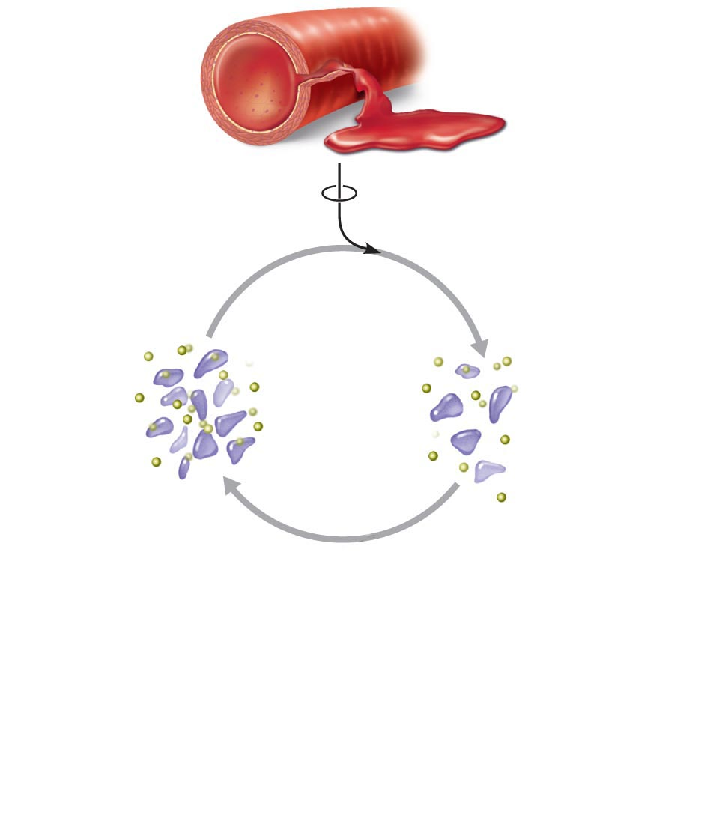
Figure 1.6 A positive feedback mechanism regulates formation of a platelet plug.
Slide 4
1
Break or tear
occurs in blood
vessel wall.
Positive feedback
cycle is initiated.
3
2
Released
chemicals
attract more
platelets.
Platelets
adhere to site and
release chemicals.
Positive
feedback
loop

Slide 53
Figure 1.6 A positive feedback mechanism regulates formation of a platelet plug.
Slide 5
1
Break or tear
occurs in blood
vessel wall.
Positive feedback
cycle is initiated.
3
2
Released
chemicals
attract more
platelets.
Platelets
adhere to site and
release chemicals.
Positive
feedback
loop
Feedback cycle ends
when plug is formed.
4
Platelet plug
is fully formed.

Slide 54
Homeostatic Imbalance
Disturbance of homeostasis
  Increases risk of disease
  Contributes to changes associated with aging
    Control systems less efficient
  If negative feedback mechanisms overwhelmed
    Destructive positive feedback mechanisms may take over (e.g., heart failure)

