Slide 1
1
The Human Body: An Orientation: Part B

Slide 2
Anatomical Position
Standard anatomical body position
  Body erect
  Feet slightly apart
  Palms facing forward
    Thumbs point away from body
Always use directional terms as if body is in anatomical position
Right and left refer to body being viewed, not those of observer

Slide 3
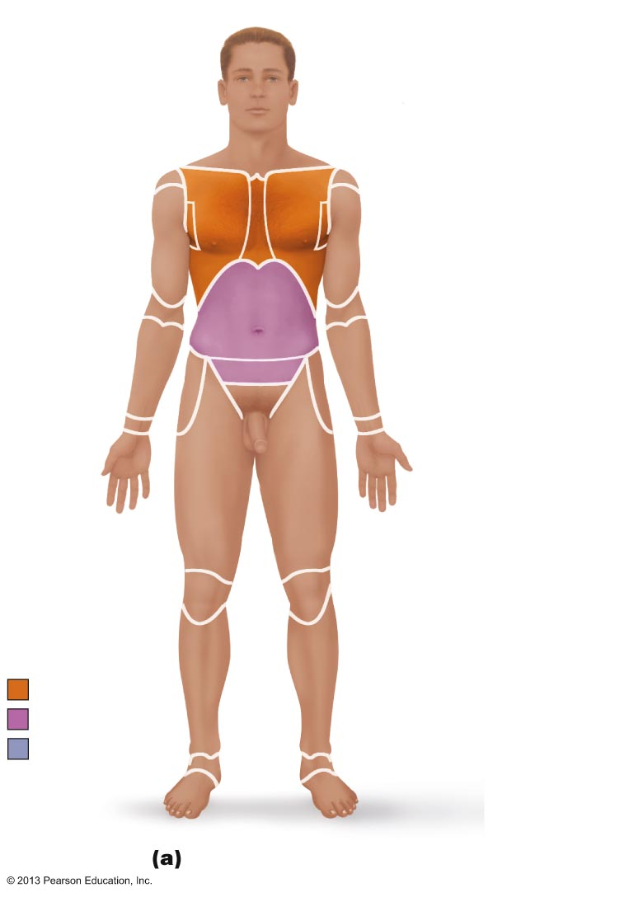
Figure 1.7a Regional terms used to designate specific body areas.
Cephalic
Frontal
Orbital
Nasal
Oral
Upper limb
Mental
Acromial
Cervical
Brachial (arm)
Thoracic
Antecubital
Sternal
Antebrachial
Axillary
(forearm)
Mammary
Carpal (wrist)
Abdominal
Umbilical
Manus (hand)
Pelvic
Pollex
Inguinal
(groin)
Palmar
Digital
Lower limb
Coxal (hip)
Pubic
(genital)
Femoral (thigh)
Patellar
Crural (leg)
Fibular or peroneal
Thorax
Pedal (foot)
Abdomen
Tarsal (ankle)
Back (Dorsum)
Metatarsal
Digital
Hallux
Anterior/Ventral

Slide 4
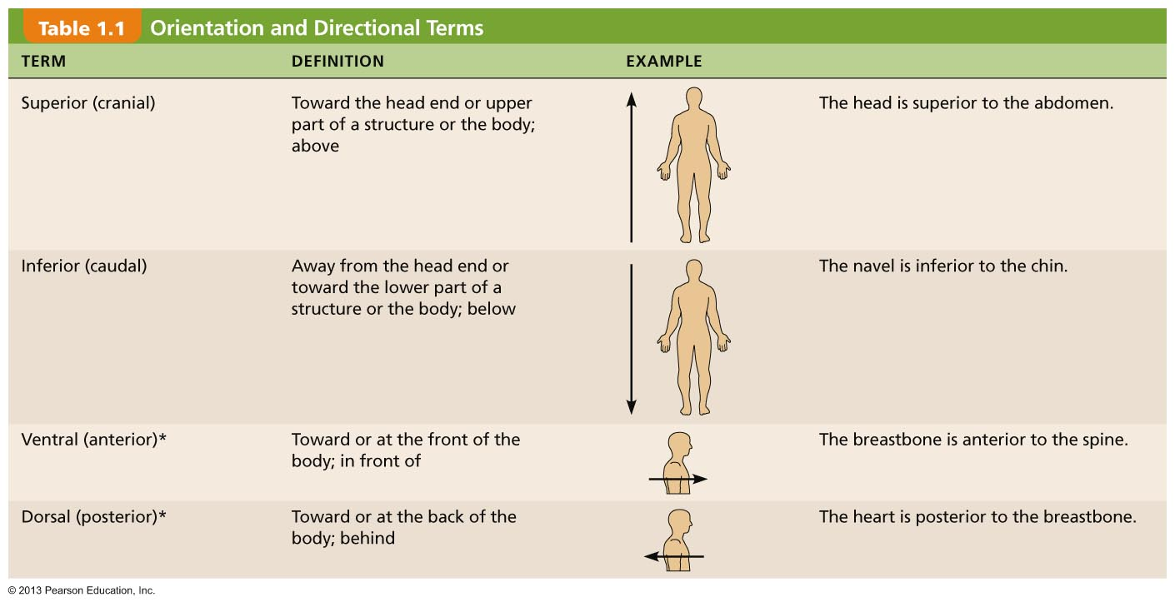
Table 1.1 Orientation and Directional Terms (1 of 3)

Slide 5
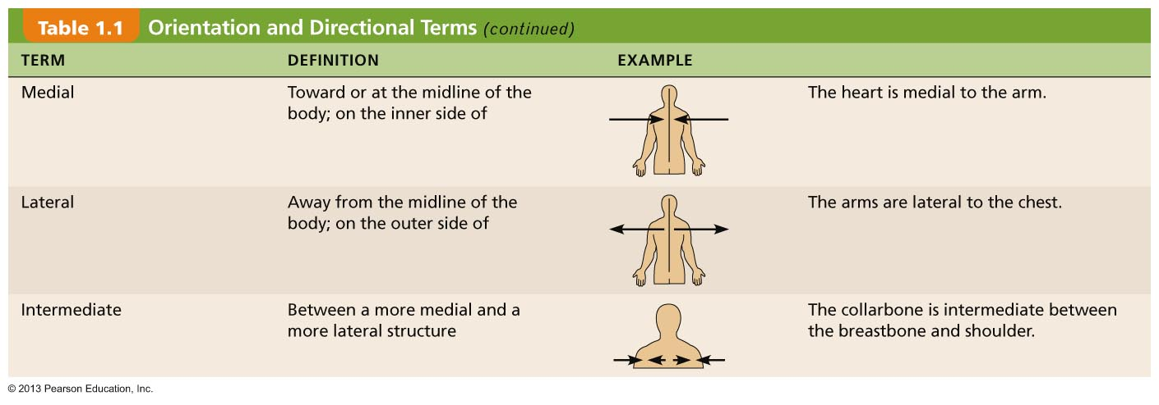
Table 1.1 Orientation and Directional Terms (2 of 3)

Slide 6
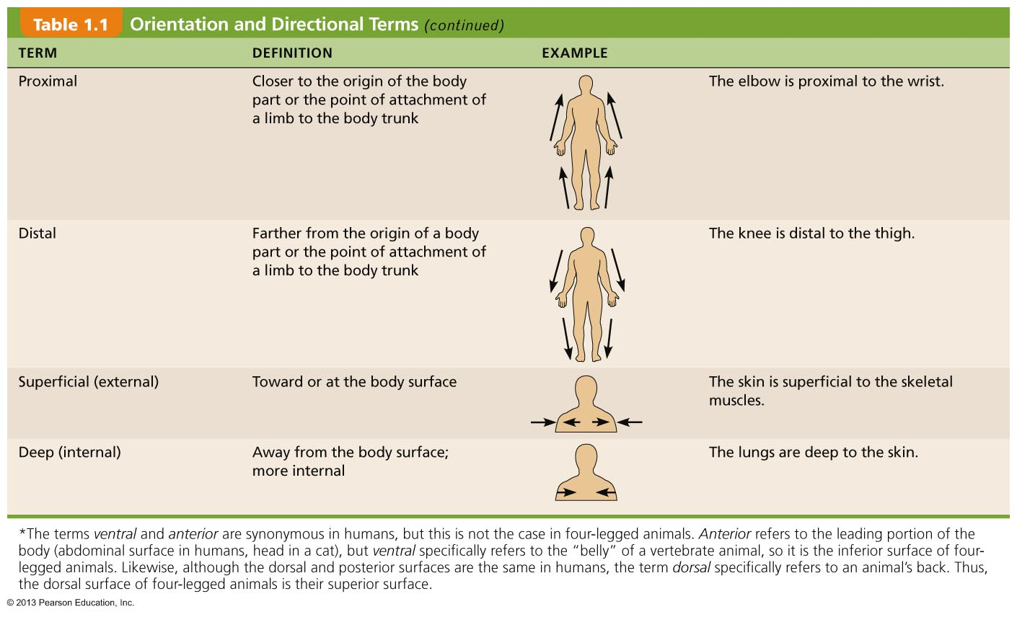
Table 1.1 Orientation and Directional Terms (3 of 3)

Slide 7
Regional Terms
Two major divisions of body
  Axial
    Head, neck, and trunk
  Appendicular
    Limbs
Regional terms designate specific areas within body divisions

Slide 8
Figure 1.7a Regional terms used to designate specific body areas.
Cephalic
Frontal
Orbital
Nasal
Oral
Upper limb
Mental
Acromial
Cervical
Brachial (arm)
Thoracic
Antecubital
Sternal
Antebrachial
Axillary
(forearm)
Mammary
Carpal (wrist)
Abdominal
Umbilical
Manus (hand)
Pelvic
Pollex
Inguinal
(groin)
Palmar
Digital
Lower limb
Coxal (hip)
Pubic
(genital)
Femoral (thigh)
Patellar
Crural (leg)
Fibular or peroneal
Thorax
Pedal (foot)
Abdomen
Tarsal (ankle)
Back (Dorsum)
Metatarsal
Digital
Hallux
Anterior/Ventral

Slide 9
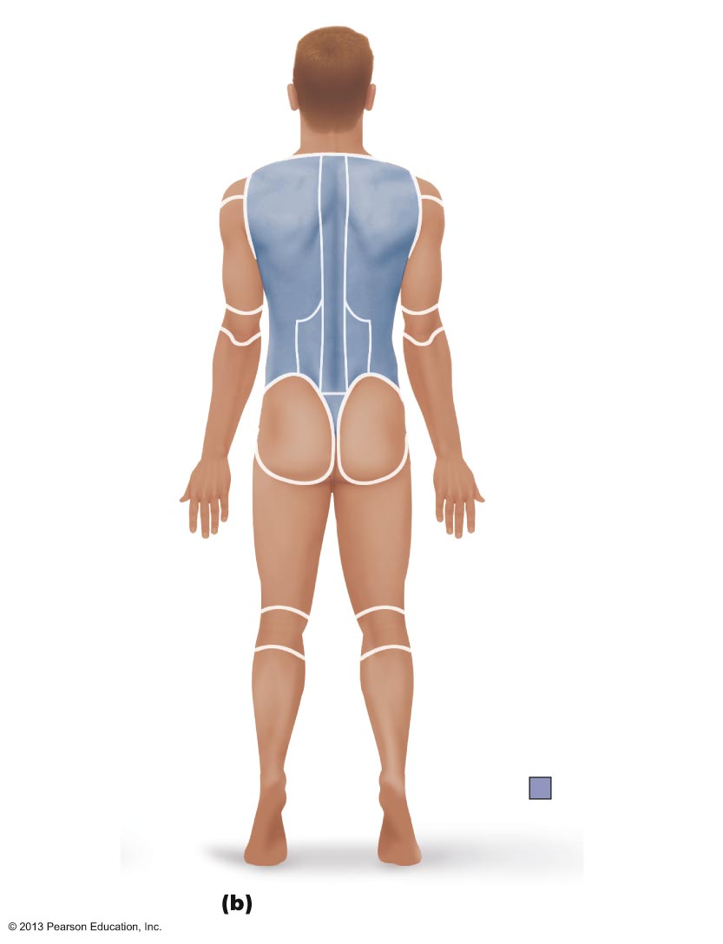
Figure 1.7b Regional terms used to designate specific body areas.
Cephalic
Otic
Occipital (back
of head)
Upper limb
Acromial
Cervical
Brachial (arm)
Olecranal
Back (dorsal)
Antebrachial
Scapular
(forearm)
Vertebral
Lumbar
Manus (hand)
Sacral
Metacarpal
Gluteal
Digital
Lower limb
Perineal (between
anus and external
genitalia)
Femoral (thigh)
Popliteal
Sural (calf)
Fibular or peroneal
Pedal (foot)
Calcaneal
Back (Dorsum)
Plantar
Posterior/Dorsal

Slide 10
Anatomical Variability
Humans differ externally and internally
  90% of all structures present in body match description in textbook
  Nerve or blood vessel may be out of place
  Small muscle may be missing
Extreme variations inconsistent with life

Slide 11
Body Planes and Sections
Body plane
  Flat surface along which body or structure may be cut for anatomical study
Sections
  Cuts or sections made along a body plane

Slide 12
Body Planes
Three most common
  Lie at right angles to each other
  Sagittal plane
  Frontal (coronal) plane
  Transverse (horizontal) plane

Slide 13
Sagittal Plane
Sagittal plane
  Divides body vertically into right and left parts
  Produces a sagittal section if cut along this plane
  Midsagittal (median) plane
    Lies on midline
  Parasagittal plane
    Not on midline

Slide 14
Body Planes
Frontal (coronal) plane
  Divides body vertically into anterior and posterior parts
  Produces a frontal or coronal section
Transverse (horizontal) plane
  Divides body horizontally (90° to vertical plane) into superior and inferior parts
  Produces a cross section
Oblique section
  Result of cuts at angle other than 90° to vertical plane

Slide 15
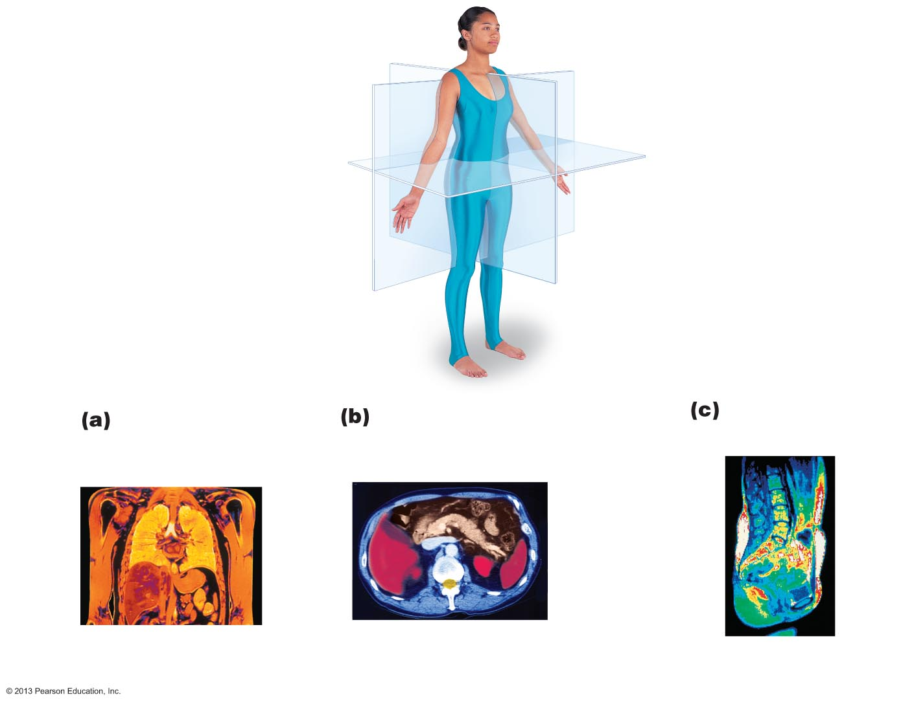
Figure 1.8 Planes of the body with corresponding magnetic resonance imaging (MRI) scans.
Frontal plane
Median (midsagittal) plane
Transverse plane
Frontal section
(through torso)
Transverse section
(through torso,
inferior view)
Median section
(midsagittal)
Pancreas
Aorta
Arm
Spleen
Left and
right lungs
Liver
Heart
Liver
Spinal cord
Body wall
Rectum
Intestines
Stomach
Subcutaneous fat layer
Vertebral column

Slide 16
Body Cavities
Two sets of internal body cavities
  Closed to environment
Provide different degrees of protection to organs
Dorsal body cavity
Ventral body cavity

Slide 17
Dorsal Body Cavity
Protects nervous system
Two subdivisions:
  Cranial cavity
    Encases brain
  Vertebral cavity
    Encases spinal cord

Slide 18
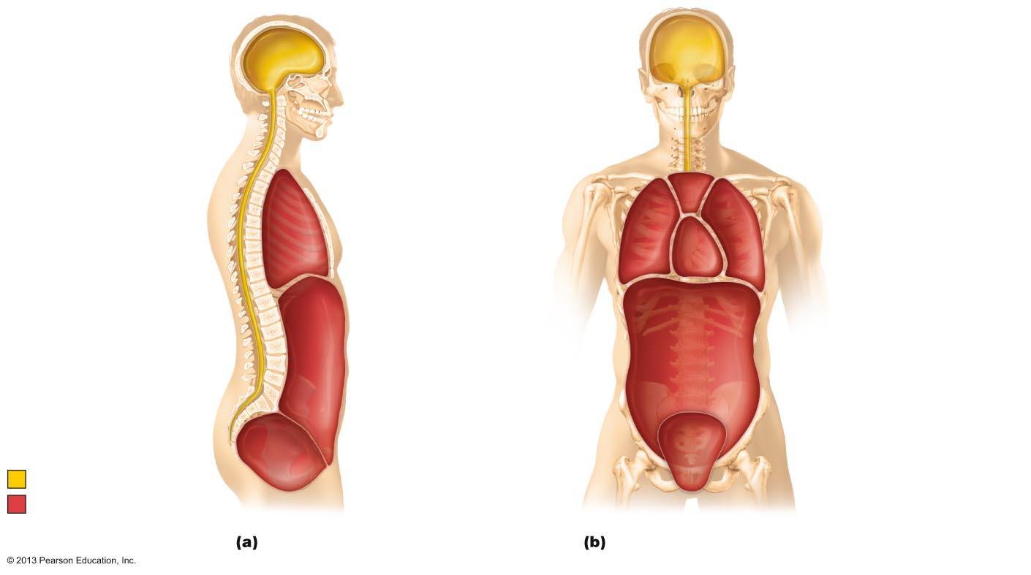
Figure 1.9 Dorsal and ventral body cavities and their subdivisions.
Cranial cavity
(contains brain)
Cranial cavity
Vertebral cavity
Superior
mediastinum
Dorsal
body
cavity
Thoracic
cavity
(contains heart and lungs)
Pleural
cavity
Pericardial cavity within
the mediastinum
Vertebral cavity
(contains spinal
cord)
Diaphragm
Ventral body cavity
(thoracic and abdominopelvic cavities)
Abdominal cavity
(contains digestive viscera)
Abdomino-pelvic cavity
Pelvic cavity
(contains urinary bladder, reproductive organs, and rectum)
Dorsal body cavity
Ventral body cavity
Lateral view
Anterior view

Slide 19
Ventral Body Cavity
Houses internal organs (viscera)
Two subdivisions (separated by diaphragm)
  Thoracic cavity
  Abdominopelvic cavity

Slide 20
Ventral Body Cavity
Thoracic cavity subdivisions
  Two pleural cavities
    Each surrounds a lung
  Mediastinum
    Contains pericardial cavity
    Surrounds thoracic organs
  Pericardial cavity
    Encloses heart

Slide 21
Ventral Body Cavity
Abdominopelvic cavity subdivisions
  Abdominal cavity
    Contains stomach, intestines, spleen, and liver
  Pelvic cavity
    Contains urinary bladder, reproductive organs, and rectum

Slide 22
Figure 1.9 Dorsal and ventral body cavities and their subdivisions.
Cranial cavity
(contains brain)
Cranial cavity
Vertebral cavity
Superior
mediastinum
Dorsal
body
cavity
Thoracic
cavity
(contains heart and lungs)
Pleural
cavity
Pericardial cavity within
the mediastinum
Vertebral cavity
(contains spinal
cord)
Diaphragm
Ventral body cavity
(thoracic and abdominopelvic cavities)
Abdominal cavity
(contains digestive viscera)
Abdomino-pelvic cavity
Pelvic cavity
(contains urinary bladder, reproductive organs, and rectum)
Dorsal body cavity
Ventral body cavity
Lateral view
Anterior view

Slide 23
Membranes in Ventral Body Cavity
Serous membrane or serosa
  Thin, double-layered membranes
    Parietal serosa lines internal body cavity walls
    Visceral serosa covers internal organs (viscera)
  Layers separated by slit-like cavity filled with serous fluid
    Fluid secreted by both layers of membrane

Slide 24
Serous Membranes
Named for specific cavity and organs with which associated
Each has parietal and visceral layers
Pericardium
  Heart
Pleurae
  Lungs
Peritoneum
  Abdominopelvic cavity

Slide 25
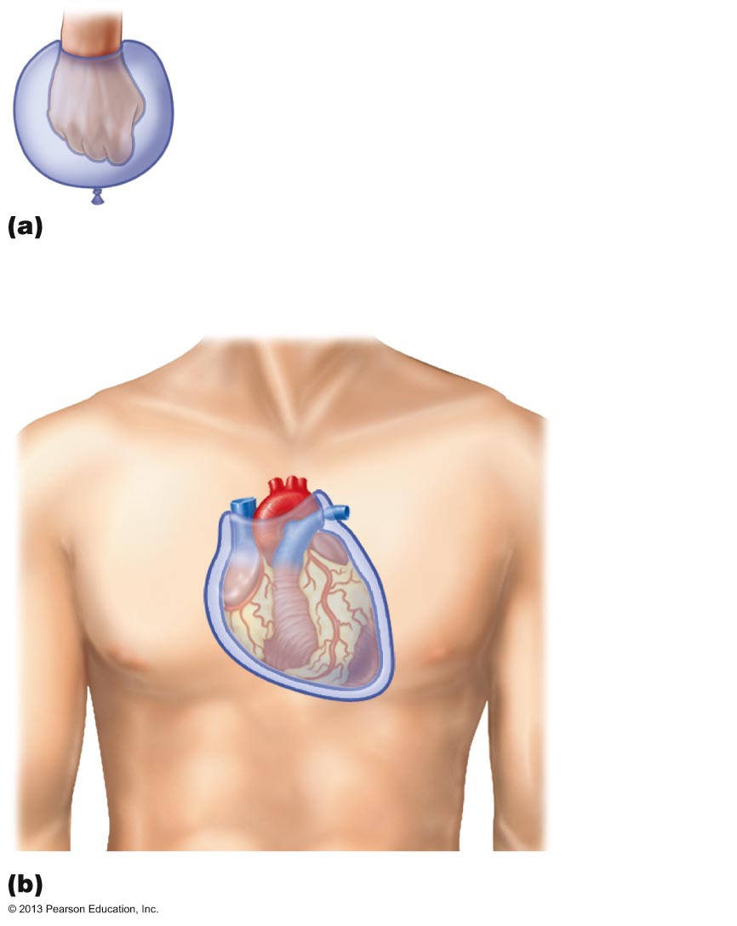
Figure 1.10 Serous membrane relationships.
Outer balloon wall
(comparable to parietal serosa)
Air (comparable to serous cavity)
Inner balloon wall
(comparable to visceral serosa)
A fist thrust into a flaccid balloon demonstrates
the relationship between the parietal and visceral
serous membrane layers.
Heart
Parietal
pericardium
Pericardial
space with
serous fluid
Visceral
pericardium
The serosae associated with the heart.

Slide 26
Abdominopelvic Quadrants
Divisions used primarily by medical personnel

Slide 27
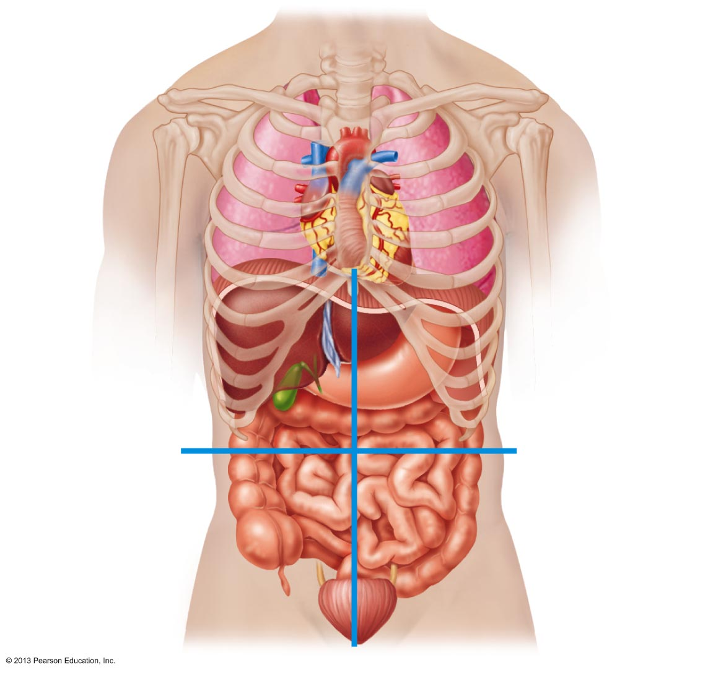
Figure 1.11 The four abdominopelvic quadrants.
Right upper
quadrant
(RUQ)
Left upper
quadrant
(LUQ)
Right lower
quadrant
(RLQ)
Left lower
quadrant
(LLQ)

Slide 28
Abdominopelvic Regions
Nine divisions used primarily by anatomists

Slide 29
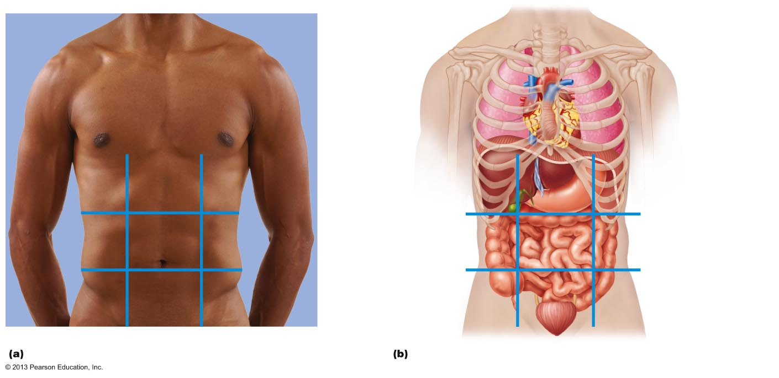
Figure 1.12 The nine abdominopelvic regions.
Right
hypochondriac
region
Left
hypochondriac
region
Liver
Diaphragm
Epigastric
region
Spleen
Gallbladder
Stomach
Right
lumbar
region
Left
lumbar
region
Ascending colon of
large intestine
Transverse colon
of large intestine
Umbilical
region
Small intestine
Descending colon
of large intestine
Right iliac
(inguinal)
region
Hypogastric
(pubic)
region
Left iliac
(inguinal)
region
Cecum
Appendix
Initial part of
sigmoid colon
Urinary bladder
Nine regions delineated by four planes
Anterior view of the nine regions showing the superficial organs

Slide 30
Other Body Cavities
Exposed to environment
  Oral and digestive cavities
  Nasal cavity
  Orbital cavities
  Middle ear cavities
Not exposed to environment
  Synovial cavities

