Slide 1
2
Chemistry Comes
Alive: Part A

Slide 2
Matter
Matter—anything that has mass and occupies space
  Weight—pull of gravity on mass
3 states of matter
  Solid—definite shape and volume
  Liquid—changeable shape; definite volume
  Gas—changeable shape and volume

Slide 3
Energy
Capacity to do work or put matter into motion
Types of energy
  Kinetic—energy in action
  Potential—stored (inactive) energy
Energy can be transferred from potential to kinetic energy
PLAY
Animation: Energy concepts

Slide 4
Forms of Energy
Chemical energy
  Stored in bonds of chemical substances
Electrical energy
  Results from movement of charged particles
Mechanical energy
  Directly involved in moving matter
Radiant or electromagnetic energy
  Travels in waves (e.g., visible light, ultraviolet light, and x-rays)

Slide 5
Energy form Conversions
Energy may be converted from one form to another
Energy conversion is inefficient
  Some energy is “lost” as heat (partly unusable energy)

Slide 6
Composition of Matter: Elements
Elements
  Matter is composed of elements
  Elements cannot be broken into simpler substances by ordinary chemical methods
  Each has unique properties
    Physical properties
      Detectable with our senses, or are measurable
    Chemical properties
      How atoms interact (bond) with one another

Slide 7
Composition of Matter
Atoms
  Unique building blocks for each element
  Give each element its physical & chemical properties
  Smallest particles of an element with properties of that element
Atomic symbol
  One- or two-letter chemical shorthand for each element

Slide 8
Major Elements of the Human Body
Four elements make up 96.1% of body mass
Element
Carbon
Hydrogen
Oxygen
Nitrogen
Atomic symbol
C
H
O
N

Slide 9
Lesser Elements of the Human Body
9 elements make up 3.9% of body mass
    Element
    Calcium
    Phosphorus
    Potassium
    Sulfur
    Sodium
    Chlorine
    Magnesium
    Iodine
    Iron
Atomic symbol
Ca
P
K
S
Na
Cl
Mg
I
Fe

Slide 10
Trace Elements of the Human Body
Very minute amounts
11 elements make up < 0.01% of body mass
  Many are part of, or activate, enzymes
For example:
Element
Chromium
Copper
Fluorine
Manganese
Silicon
Zinc
Atomic symbol
Cr
Cu
F
Mn
Si
Zn

Slide 11
Atomic Structure
Atoms are composed of subatomic particles
  Protons, neutrons, electrons
Protons and neutrons found in nucleus
Electrons orbit nucleus in an electron cloud

Slide 12
Atomic Structure: The Nucleus
Almost entire mass of the atom
Neutrons
    Carry no charge
    Mass = 1 atomic mass unit (amu)
Protons
    Carry positive charge
    Mass = 1 amu

Slide 13
Atomic Structure: Electrons
Electrons in orbitals within electron cloud
  Carry negative charge
  1/2000 the mass of a proton (0 amu)
  Number of protons and electrons always equal

Slide 14
Models of the Atom
Planetary model—simplified; outdated
  Incorrectly depicts fixed circular electron paths
  But useful for illustrations (as in the text)
Orbital model—current model used by chemists
  Probable regions of greatest electron density (an electron cloud)
  Useful for predicting chemical behavior of atoms

Slide 15
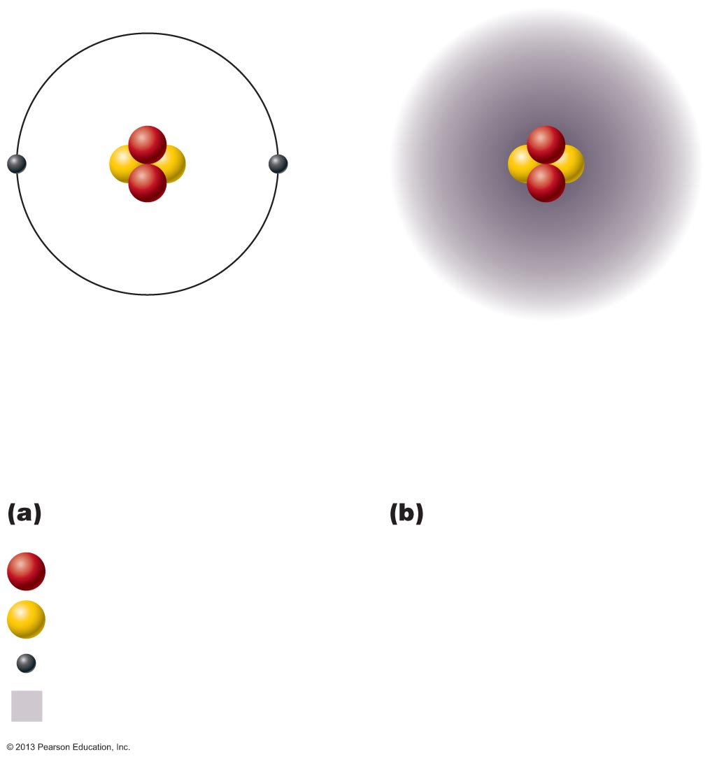
Figure 2.1 Two models of the structure of an atom.
Nucleus
Nucleus
Helium atom
Helium atom
2 protons (p⁺)
2 protons (p⁺)
2 neutrons (n⁰)
2 neutrons (n⁰)
2 electrons (e–)
2 electrons (e–)
Planetary model
Orbital model
Proton
Neutron
Electron
Electron
cloud

Slide 16
Identifying Elements
Different elements contain different numbers of subatomic particles
  Hydrogen has 1 proton, 0 neutrons, and 1 electron
  Lithium has 3 protons, 4 neutrons, and 3 electrons

Slide 17
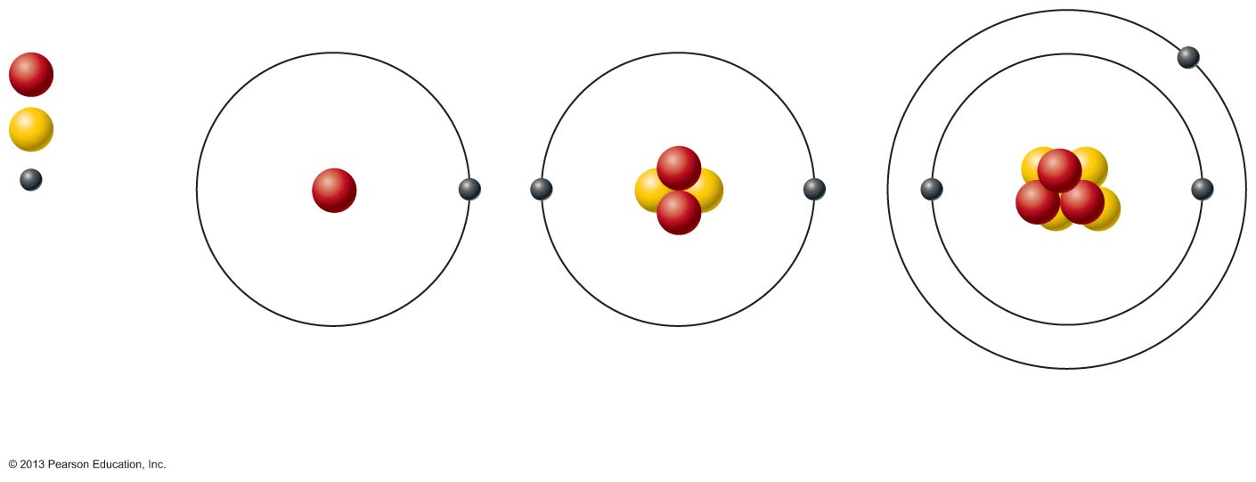
Figure 2.2 Atomic structure of the three smallest atoms.
Proton
Neutron
Electron
Hydrogen (H)
(1p⁺; 0n⁰; 1e–)
Helium (He)
(2p⁺; 2n⁰; 2e–)
Lithium (Li)
(3p⁺; 4n⁰; 3e–)

Slide 18
Identifying Elements:
Atomic Number and Mass Number
Atomic number = Number of protons in nucleus
  Written as subscript to left of atomic symbol
    Ex. ₃Li
Mass number
  Total number of protons and neutrons in nucleus
    Total mass of atom
  Written as superscript to left of atomic symbol
    Ex. ⁷Li

Slide 19
Identifying Elements:
Isotopes and Atomic Weight
Isotopes
  Structural variations of atoms
  Differ in the number of neutrons they contain
  Atomic numbers same; mass numbers different
Atomic weight
  Average of mass numbers (relative weights) of all isotopes of an atom

Slide 20
Identifying Elements
  Atomic number, mass number, atomic weight
  Give “picture” of each element
  Allow identification

Slide 21
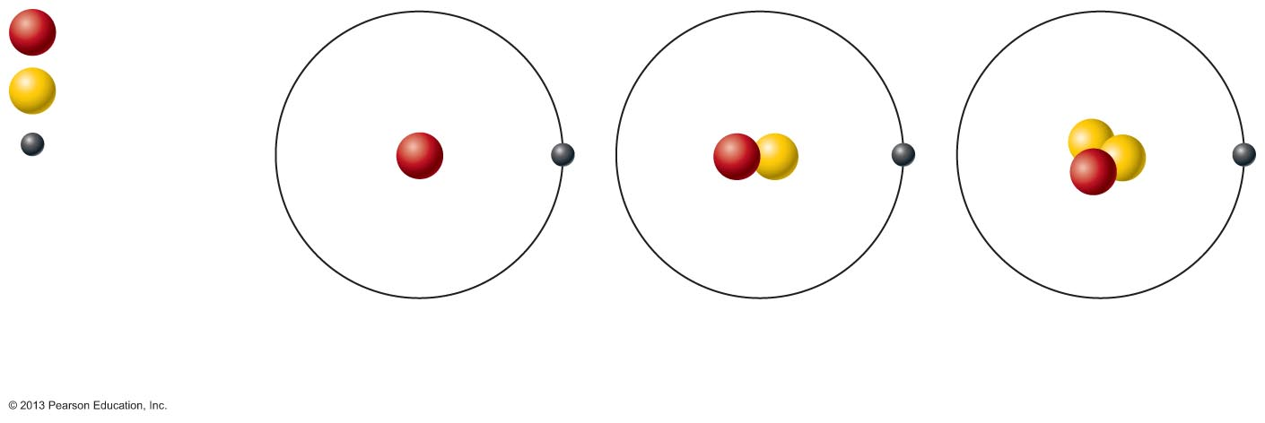
Figure 2.3 Isotopes of hydrogen.
Proton
Neutron
Electron
Hydrogen (¹H)
(1p⁺; 0n⁰; 1e–)
Deuterium (²H)
(1p⁺; 1n⁰; 1e–)
Tritium (³H)
(1p⁺; 2n⁰; 1e–)

Slide 22
Radioisotopes
Heavy isotopes decompose to more stable forms
  Spontaneous decay called radioactivity
  Similar to tiny explosion
  Can transform to different element
Can be detected with scanners

Slide 23
Radioisotopes
Valuable tools for biological research and medicine
  Share same chemistry as their stable isotopes
  Most used for diagnosis
All damage living tissue
  Some used to destroy localized cancers
  Radon from uranium decay causes lung cancer

Slide 24
Combining Matter: Molecules and Compounds
Most atoms chemically combined with other atoms to form molecules and compounds
  Molecule
    Two or more atoms bonded together (e.g., H₂ or C₆H₁₂O₆)
    Smallest particle of a compound with specific characteristics of the compound
  Compound
    Two or more different kinds of atoms bonded together (e.g., C₆H₁₂O₆ , but not H₂)

Slide 25
Mixtures
Most matter exists as mixtures
  Two or more components physically intermixed
Three types of mixtures
  Solutions
  Colloids
  Suspensions

Slide 26
Types of Mixtures: Solutions
Homogeneous mixtures
Most are true solutions in body
  Gases, liquids, or solids dissolved in water
  Usually transparent, e.g., atmospheric air or saline solution
Solvent
  Substance present in greatest amount
  Usually a liquid; usually water
Solute(s)
  Present in smaller amounts
Ex. If glucose is dissolved in blood, glucose is solute; blood is solvent

Slide 27
Concentration of True Solutions
Can be expressed as
  Percent of solute in total solution (assumed to be water)
    Parts solute per 100 parts solvent
  Milligrams per deciliter (mg/dl)
  Molarity, or moles per liter (M)
    1 mole of an element or compound = Its atomic or molecular weight (sum of atomic weights) in grams
    1 mole of any substance contains 6.02 × 10²³ molecules of that substance (Avogadro’s number)

Slide 28
Colloids and Suspensions
Colloids (AKA emulsions)
  Heterogeneous mixtures, e.g., cytosol
  Large solute particles do not settle out
  Some undergo sol-gel transformations
    e.g., cytosol during cell division
Suspensions
  Heterogeneous mixtures, e.g., blood
  Large, visible solutes settle out

Slide 29
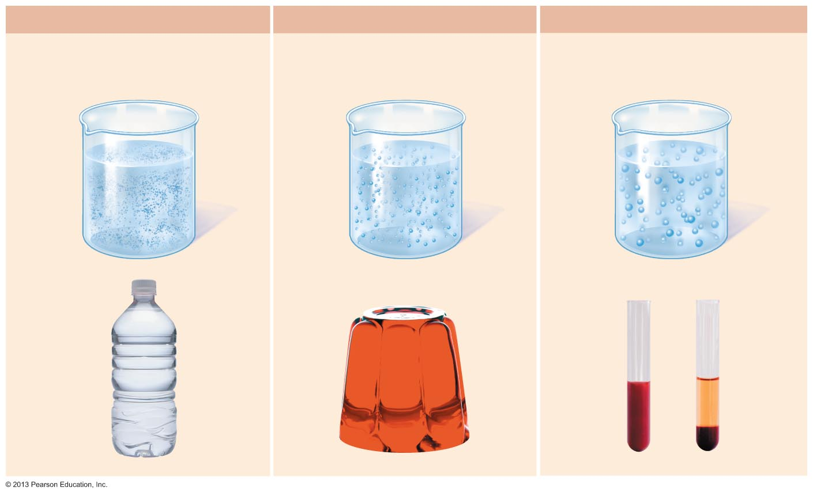
Figure 2.4 The three basic types of mixtures.
Solution
Colloid
Suspension
Solute particles are very tiny,
do not settle out or scatter light.
Solute particles are larger than
in a solution and scatter light;
do not settle out.
Solute particles are very large,
settle out, and may scatter light.
Solute
particles
Solute
particles
Solute
particles
Example
Example
Example
Mineral water
Jello
Blood
Plasma
Settled red
blood cells
Unsettled
Settled

Slide 30
Mixtures versus Compounds
Mixtures
  No chemical bonding between components
  Can be separated by physical means, such as straining or filtering
  Heterogeneous or homogeneous
Compounds
  Chemical bonding between components
  Can be separated only by breaking bonds
  All are homogeneous

Slide 31
Chemical Bonds
Chemical bonds are energy relationships between electrons of reacting atoms
Electrons can occupy up to seven electron shells (energy levels) around nucleus
Electrons in valence shell (outermost electron shell)
  Have most potential energy
  Are chemically reactive electrons
Octet rule (rule of eights)
  Except for the first shell (full with two electrons) atoms interact to have eight electrons in their valence shell

Slide 32
Chemically Inert Elements
Stable and unreactive
Valence shell fully occupied or contains eight electrons
Noble gases

Slide 33
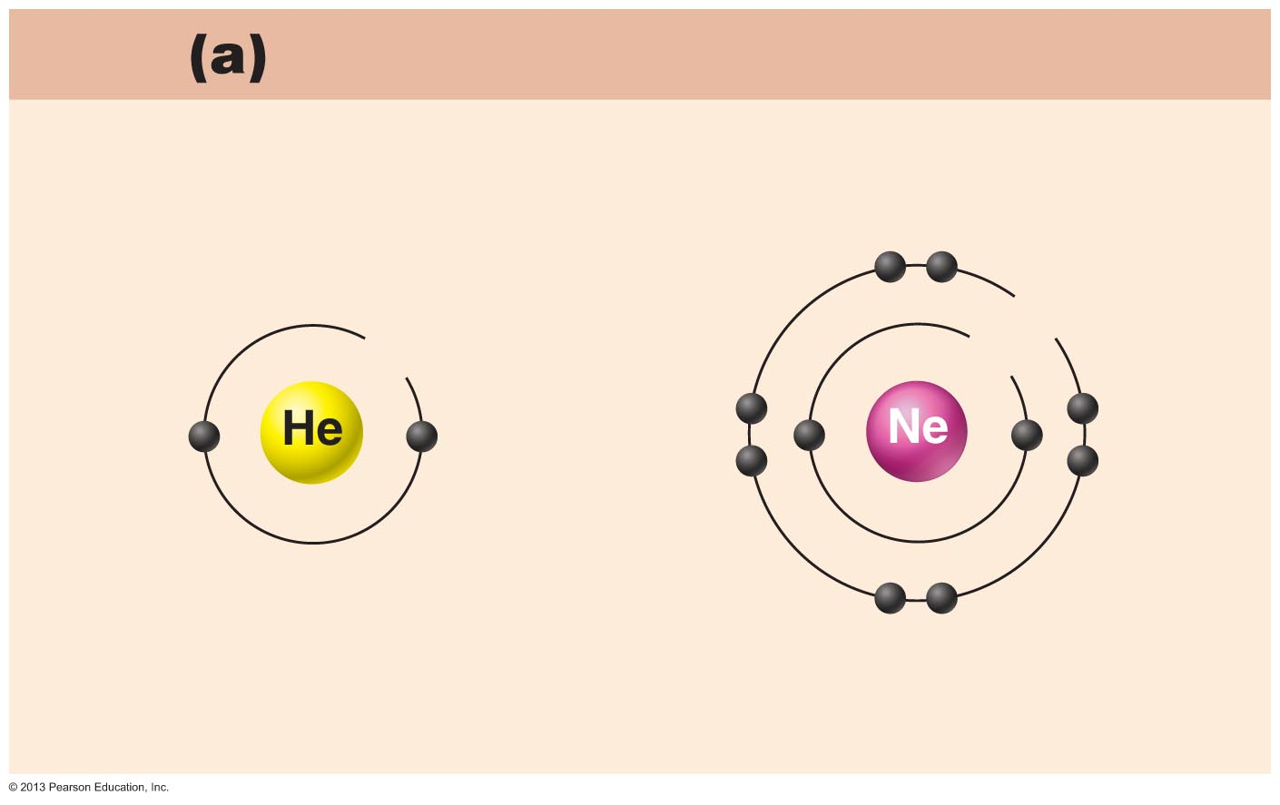
Figure 2.5a Chemically inert and reactive elements.
Chemically inert elements
Outermost energy level (valence shell) complete
8e
2e
2e
Helium (He)
(2p⁺; 2n⁰; 2e–)
Neon (Ne)
(10p⁺; 10n⁰; 10e–)

Slide 34
Chemically Reactive Elements
Valence shell not full
Tend to gain, lose, or share electrons (form bonds) with other atoms to achieve stability

Slide 35
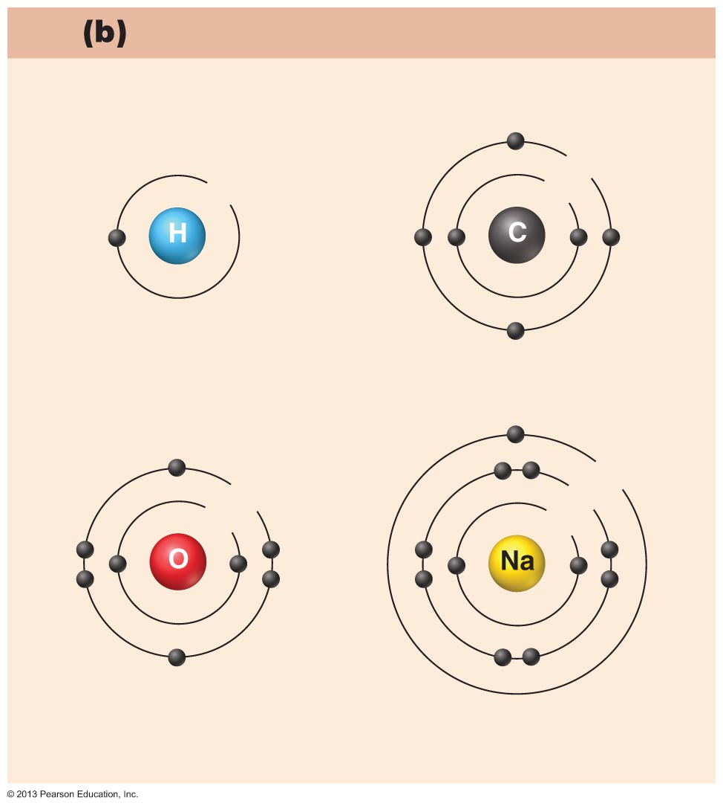
Figure 2.5b Chemically inert and reactive elements.
Chemically reactive elements
Outermost energy level (valence shell) incomplete
4e
1e
2e
Hydrogen (H)
(1p⁺; 0n⁰; 1e–)
Carbon (C)
(6p⁺; 6n⁰; 6e–)
1e
6e
8e
2e
2e
Oxygen (O)
(8p⁺; 8n⁰; 8e–)
Sodium (Na)
(11p⁺; 12n⁰; 11e–)

Slide 36
Types of Chemical Bonds
Three major types
  Ionic bonds
  Covalent bonds
  Hydrogen bonds

Slide 37
Ionic Bonds
Ions
  Atom gains or loses electrons and becomes charged
    # Protons ≠ # Electrons
Transfer of valence shell electrons from one atom to another forms ions
  One becomes an anion (negative charge)
    Atom that gained one or more electrons
  One becomes a cation (positive charge)
    Atom that lost one or more electrons
Attraction of opposite charges results in an ionic bond

Slide 38
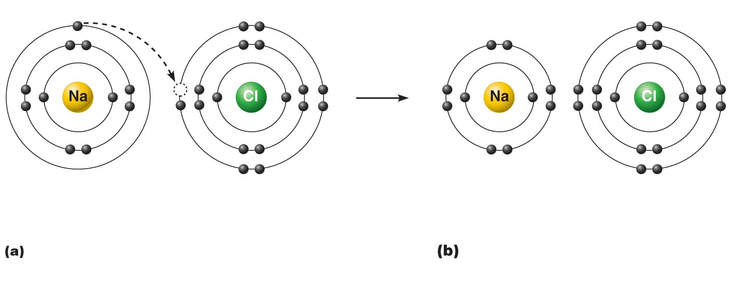
Figure 2.6a–b Formation of an ionic bond.
+
—
Sodium atom (Na)
(11p⁺; 12n⁰; 11e–)
Chlorine atom (Cl)
(17p⁺; 18n⁰; 17e–)
Sodium ion (Na⁺)
Chloride ion (Cl–)
Sodium chloride (NaCl)
Sodium gains stability by losing
one electron, and chlorine becomes
stable by gaining one electron.
After electron transfer,
the oppositely charged ions
formed attract each other.

Slide 39
Ionic Compounds
Most ionic compounds are salts
  When dry salts form crystals instead of individual molecules
  Example is NaCl (sodium chloride)

Slide 40
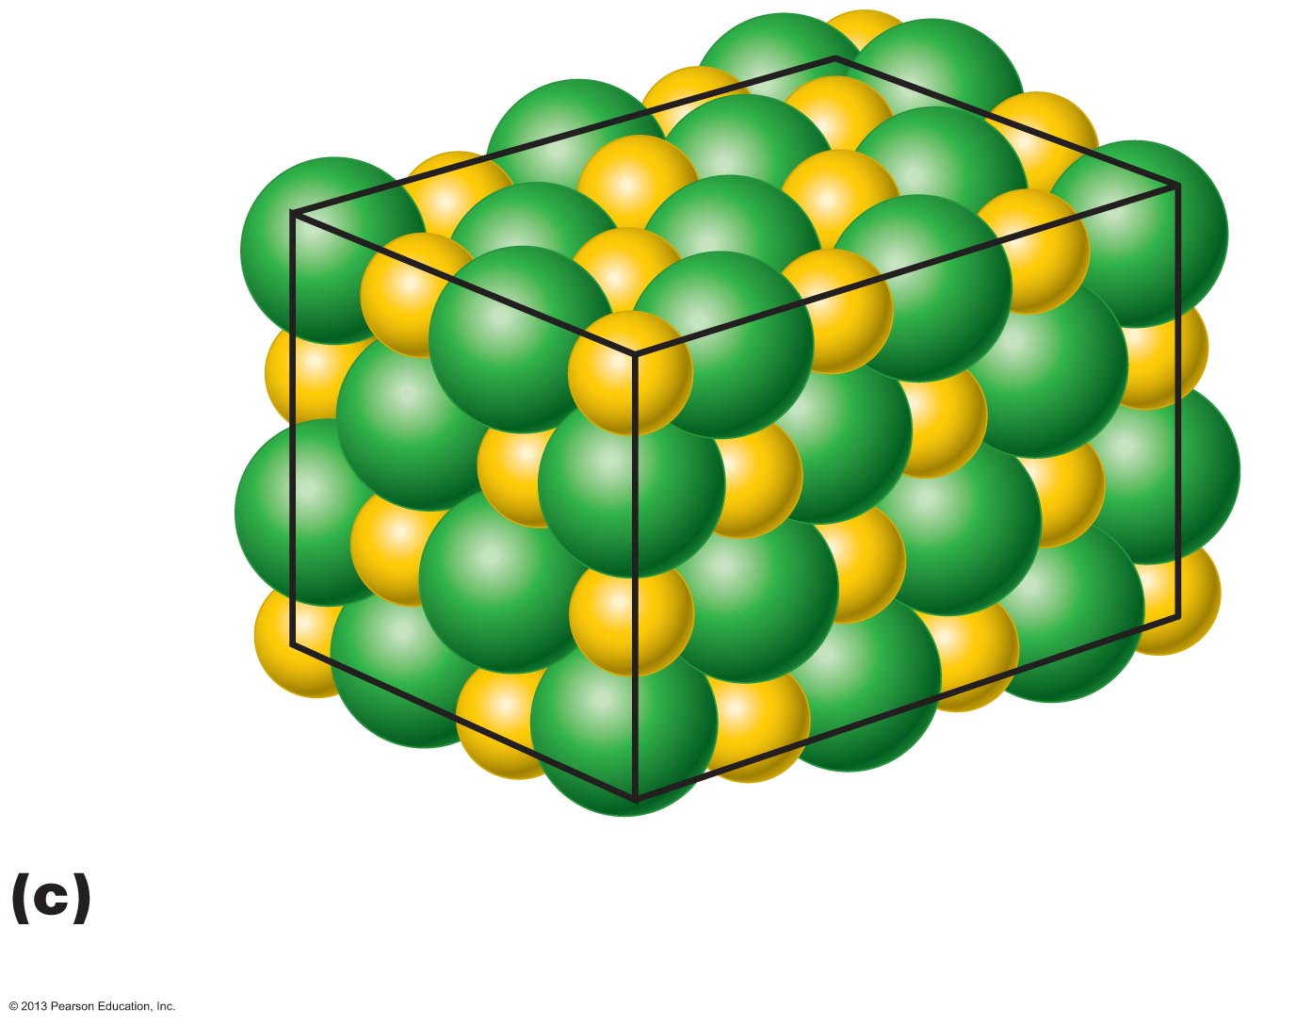
Figure 2.6c Formation of an ionic bond.
Cl–
Na⁺
Large numbers of Na⁺ and Cl– ions
associate to form salt (NaCl) crystals.

Slide 41
Covalent Bonds
Formed by sharing of two or more valence shell electrons
Allows each atom to fill its valence shell at least part of the time

Slide 42
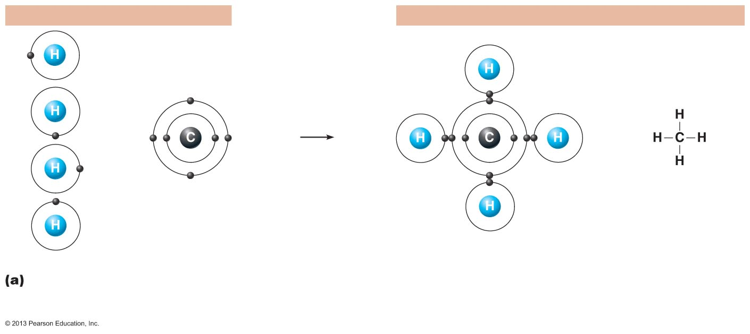
Figure 2.7a Formation of covalent bonds.
Reacting atoms
Resulting molecules
+
or
Structural formula
shows single bonds.
Hydrogen atoms
Carbon atom
Molecule of methane gas (CH₄)
Formation of four single covalent bonds:
Carbon shares four electron pairs with
four hydrogen atoms.

Slide 43
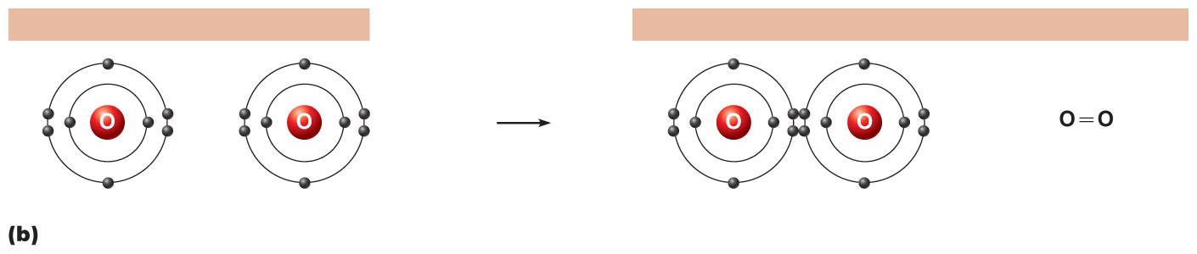
Figure 2.7b Formation of covalent bonds.
Reacting atoms
Resulting molecules
+
or
Structural formula
shows double bond.
Oxygen atom
Oxygen atom
Molecule of oxygen gas (O₂)
Formation of a double covalent bond: Two
oxygen atoms share two electron pairs.

Slide 44
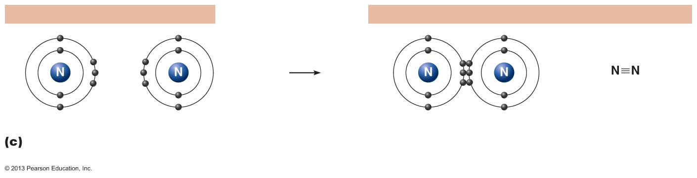
Figure 2.7c Formation of covalent bonds.
Reacting atoms
Resulting molecules
+
or
Structural formula
shows triple bond.
Nitrogen atom
Nitrogen atom
Molecule of nitrogen gas (N₂)
Formation of a triple covalent bond: Two
nitrogen atoms share three electron pairs.

Slide 45
Nonpolar Covalent Bonds
Electrons shared equally
Produces electrically balanced, nonpolar molecules such as CO₂

Slide 46
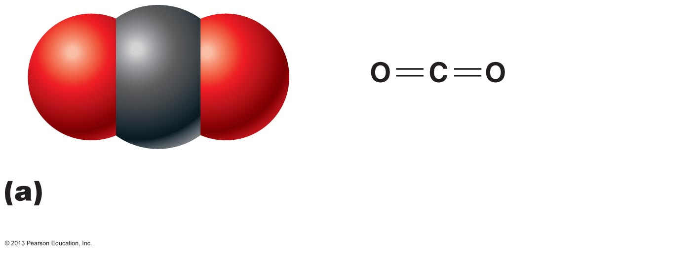
Figure 2.8a Carbon dioxide and water molecules have different shapes, as illustrated by molecular models.
Carbon dioxide (CO₂) molecules are
linear and symmetrical. They are nonpolar.

Slide 47
Polar Covalent Bonds
Unequal sharing of electrons produces polar (AKA dipole) molecules such as H₂O
  Atoms in bond have different electron-attracting abilities
Small atoms with six or seven valence shell electrons are electronegative,
e.g., oxygen
  Strong electron-attracting ability
Most atoms with one or two valence shell electrons are electropositive,
e.g., sodium

Slide 48
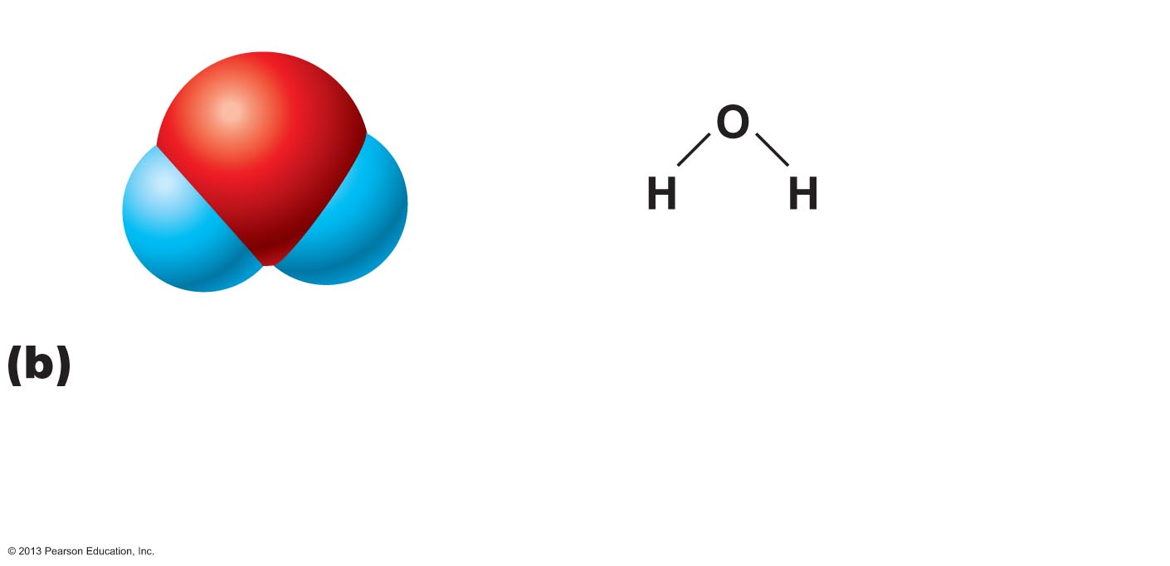
Figure 2.8b Carbon dioxide and water molecules have different shapes, as illustrated by molecular models.
δ–
δ⁺
δ⁺
V-shaped water (H₂O) molecules have two
poles of charge—a slightly more negative
oxygen end (δ–) and a slightly more positive
hydrogen end (δ⁺).

Slide 49
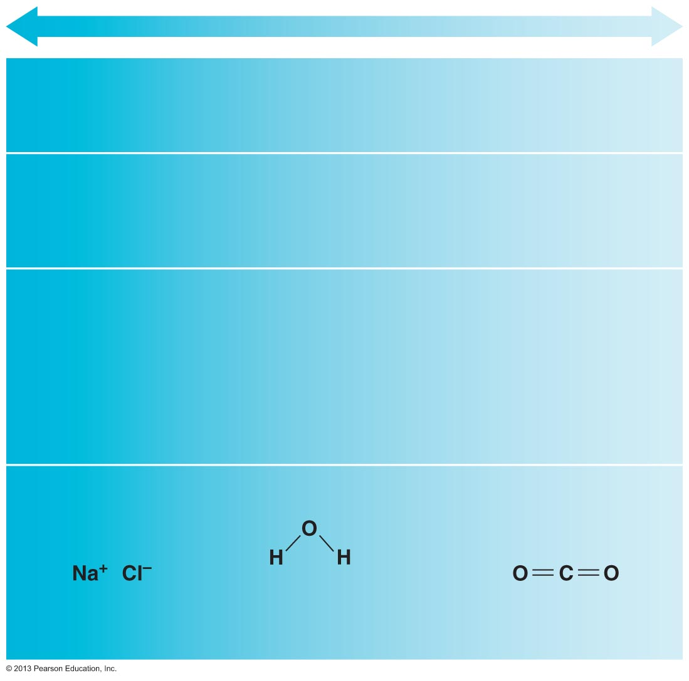
Figure 2.9 Ionic, polar covalent, and nonpolar covalent bonds compared along a continuum.
Ionic bond
Polar covalent
bond
Nonpolar
covalent bond
Complete
transfer of
electrons
Unequal sharing
of electrons
Equal sharing of
electrons
Separate ions
(charged
particies)
form
Slight negative
charge (δ–) at
one end of
molecule, slight
positive charge (δ⁺)
at other end
Charge balanced
among atoms
δ–
δ⁺
δ⁺
Sodium chloride
Water
Carbon dioxide

Slide 50
Hydrogen Bonds
Attractive force between electropositive hydrogen of one molecule and an electronegative atom of another molecule
  Not true bond
  Common between dipoles such as water
  Also act as intramolecular bonds, holding a large molecule in a three-dimensional shape
PLAY
Animation: Hydrogen bonds

Slide 51
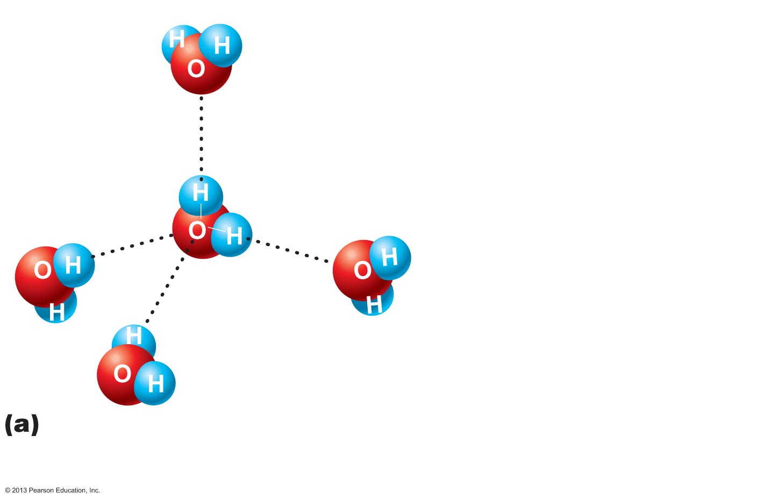
Figure 2.10a Hydrogen bonding between polar water molecules.
δ⁺
δ–
Hydrogen bond
(indicated by
dotted line)
δ⁺
δ⁺
δ–
δ–
δ–
δ⁺
δ⁺
δ⁺
δ–
The slightly positive ends (δ⁺) of the water molecules
become aligned with the slightly negative ends (δ–)
of other water molecules.

Slide 52
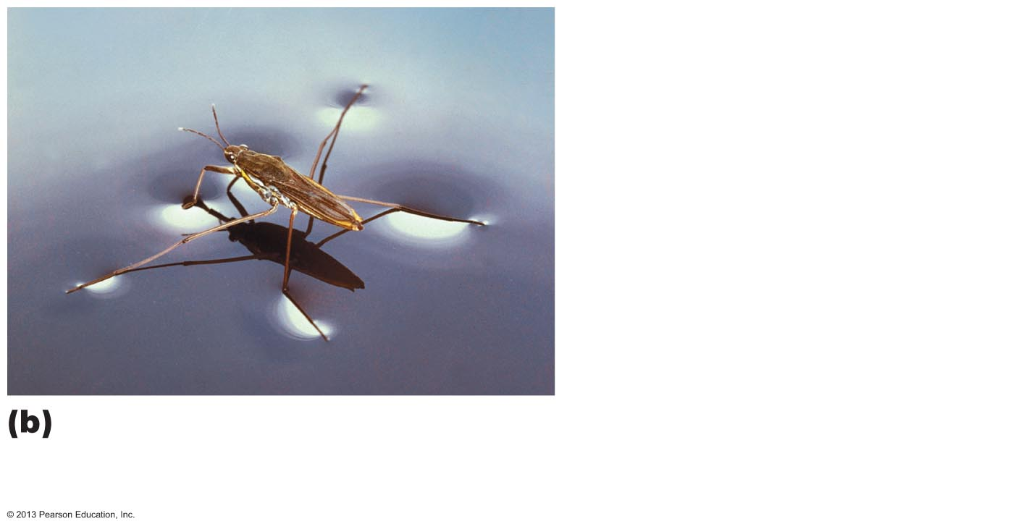
Figure 2.10b Hydrogen bonding between polar water molecules.
A water strider can walk on a pond because of the high
surface tension of water, a result of the combined
strength of its hydrogen bonds.

Slide 53
Chemical Reactions
Occur when chemical bonds are formed, rearranged, or broken
Represented as chemical equations using molecular formulas
  Subscript indicates atoms joined by bonds
  Prefix denotes number of unjoined atoms or molecules
Chemical equations contain
  Reactants
    Number and kind of reacting substances
  Chemical composition of the product(s)
  Relative proportion of each reactant and product in balanced equations

Slide 54
Examples of Chemical Equations
Reactants
H + H →
4H + C →
Product
H₂ (Hydrogen gas)
CH₄ (Methane)
Note: CH₄ is a molecular formula

Slide 55
Patterns of Chemical Reactions
Synthesis (combination) reactions
Decomposition reactions
Exchange reactions

Slide 56
Synthesis Reactions
A + B → AB
  Atoms or molecules combine to form larger, more complex molecule
  Always involve bond formation
  Anabolic

Slide 57
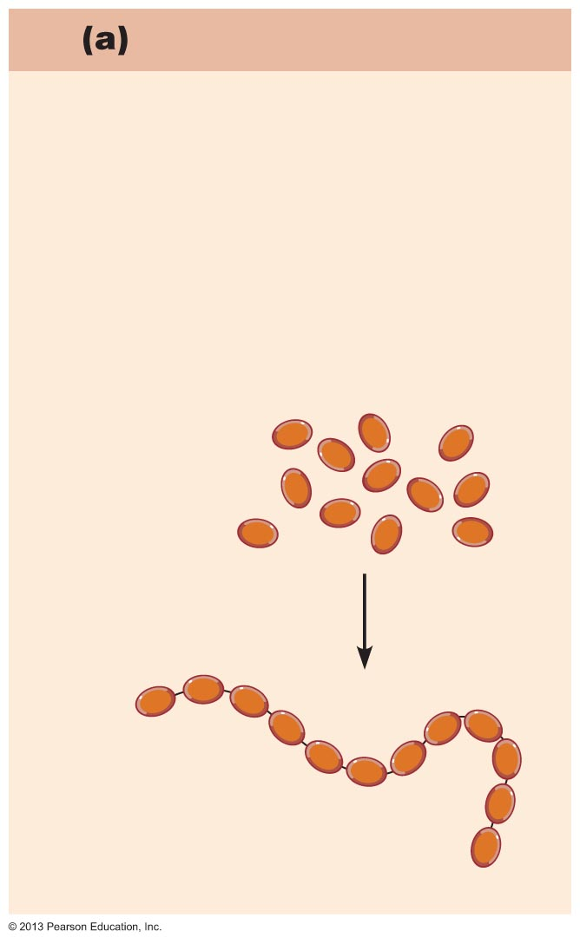
Figure 2.11a Patterns of chemical reactions.
Synthesis reactions
Smaller particles are bonded
together to form larger,
more complex molecules.
Example
Amino acids are joined together to
form a protein molecule.
Amino acid
molecules
Protein
molecule

Slide 58
Decomposition Reactions
AB → A + B
  Molecule is broken down into smaller molecules or its constituent atoms
    Reverse of synthesis reactions
  Involve breaking of bonds
  Catabolic

Slide 59
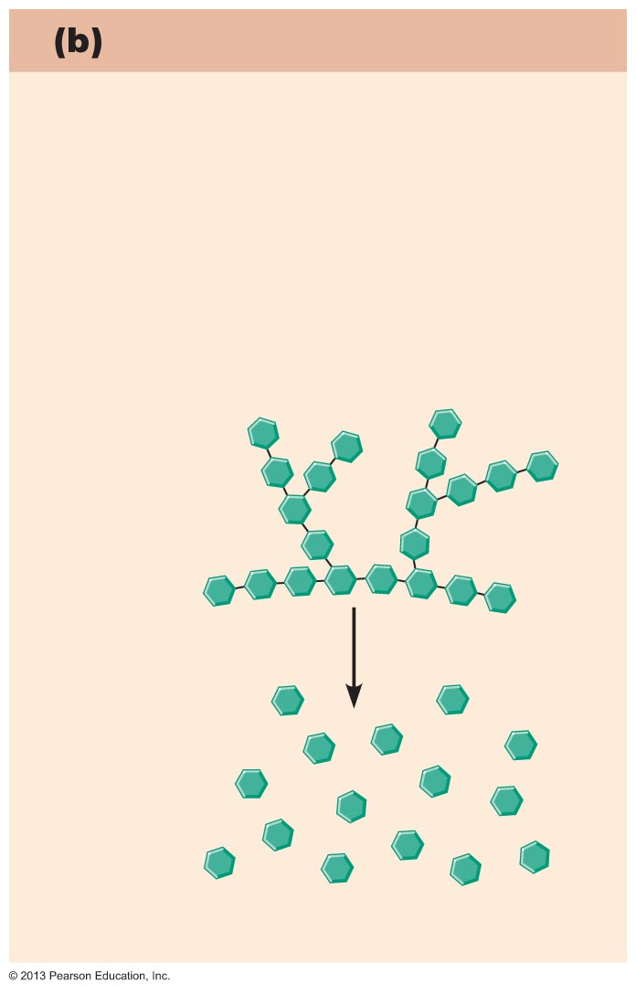
Figure 2.11b Patterns of chemical reactions.
Decomposition reactions
Bonds are broken in larger
molecules, resulting in smaller,
less complex molecules.
Example
Glycogen is broken down to release
glucose units.
Glycogen
Glucose
molecules

Slide 60
Exchange Reactions
AB + C → AC + B
  Also called displacement reactions
  Involve both synthesis and decomposition
  Bonds are both made and broken

Slide 61
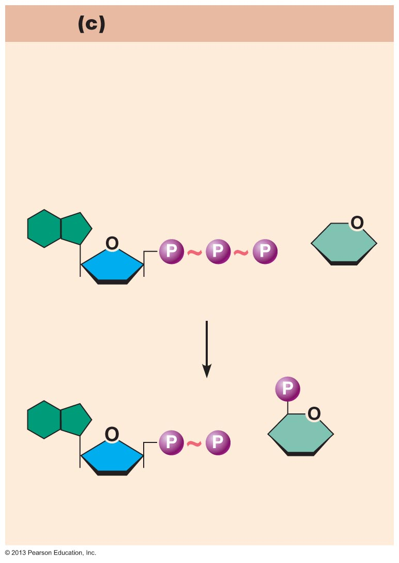
Figure 2.11c Patterns of chemical reactions.
Exchange reactions
Bonds are both made and broken
(also called displacement reactions).
Example
ATP transfers its terminal phosphate
group to glucose to form glucose-
phosphate.
+
Adenosine triphosphate (ATP)
Glucose
+
Adenosine diphosphate
(ADP)
Glucose-
phosphate

Slide 62
Oxidation-Reduction (Redox) Reactions
Are decomposition reactions
  Reactions in which food fuels are broken down for energy
Are also exchange reactions because electrons are exchanged between reactants
  Electron donors lose electrons and are oxidized
  Electron acceptors receive electrons and become reduced
C₆H₁₂O₆ + 6O₂ → 6CO₂ + 6H₂O + ATP
Glucose is oxidized; oxygen molecule is reduced

Slide 63
Energy Flow in Chemical Reactions
All chemical reactions are either exergonic or endergonic
  Exergonic reactions—net release of energy
    Products have less potential energy than reactants
    Catabolic and oxidative reactions
  Endergonic reactions—net absorption of energy
    Products have more potential energy than reactants
    Anabolic reactions

Slide 64
Reversibility of Chemical Reactions
All chemical reactions are theoretically reversible
  A + B → AB
  AB → A + B
Chemical equilibrium occurs if neither a forward nor reverse reaction is dominant
Many biological reactions are essentially irreversible
  Due to energy requirements
  Due to removal of products

Slide 65
Rate of Chemical Reactions
Affected by
  ↑ Temperature → ↑ Rate
  ↑ Concentration of reactant → ↑ Rate
  ↓ Particle size → ↑ Rate
  Catalysts: ↑ Rate without being chemically changed or part of product
    Enzymes are biological catalysts

