Slide 1
2
Chemistry Comes
Alive: Part B

Slide 2
Biochemistry
Study of chemical composition and reactions of living matter
All chemicals either organic or inorganic

Slide 3
Classes of Compounds
Inorganic compounds
    Water, salts, and many acids and bases
    Do not contain carbon
Organic compounds
    Carbohydrates, fats, proteins, and nucleic acids
    Contain carbon, usually large, and are covalently bonded
Both equally essential for life

Slide 4
Water in Living Organisms
Most abundant inorganic compound
  60%–80% volume of living cells
Most important inorganic compound
  Due to water’s properties

Slide 5
Properties of Water
High heat capacity
  Absorbs and releases heat with little temperature change
  Prevents sudden changes in temperature
High heat of vaporization
  Evaporation requires large amounts of heat
  Useful cooling mechanism

Slide 6
Properties of Water
Polar solvent properties
  Dissolves and dissociates ionic substances
  Forms hydration layers around large charged molecules, e.g., proteins (colloid formation)
  Body’s major transport medium

Slide 7
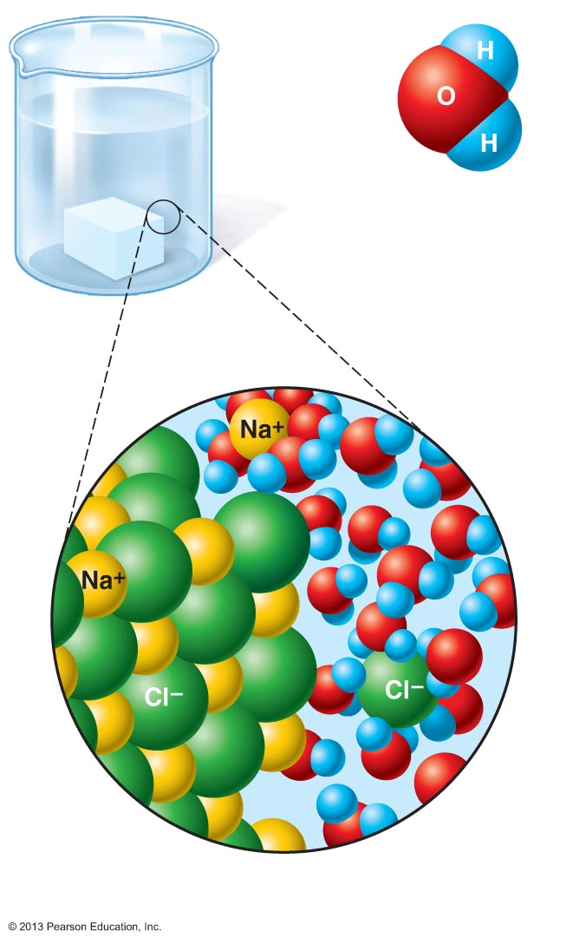
Figure 2.12 Dissociation of salt in water.
δ⁺
δ–
δ⁺
Water molecule
Salt
crystal
Ions in
solution

Slide 8
Properties of Water
Reactivity
  Necessary part of hydrolysis and dehydration synthesis reactions
Cushioning
  Protects certain organs from physical trauma, e.g., cerebrospinal fluid

Slide 9
Salts
Ionic compounds that dissociate into ions in water
  Ions (electrolytes) conduct electrical currents in solution
  Ions play specialized roles in body functions (e.g., sodium, potassium, calcium, and iron)
  Ionic balance vital for homeostasis
Contain cations other than H⁺ and anions other than OH–
Common salts in body
  NaCl, CaCO₃, KCl, calcium phosphates

Slide 10
Acids and Bases
Both are electrolytes
  Ionize and dissociate in water
Acids are proton donors
  Release H⁺ (a bare proton) in solution
  HCl → H⁺ + Cl–
Bases are proton acceptors
  Take up H⁺ from solution
    NaOH → Na⁺ + OH–
      OH– accepts an available proton (H⁺)
      OH– + H⁺ → H₂O

Slide 11
Some Important Acids and Bases in Body
Important acids
  HCl, HC₂H₃O₂ (HAc), and H₂CO₃
Important bases
  Bicarbonate ion (HCO₃–) and ammonia (NH₃)

Slide 12
pH: Acid-base Concentration
  Relative free [H⁺] of a solution measured on pH scale
  As free [H⁺] increases, acidity increases
    [OH–] decreases as [H⁺] increases
    pH decreases
  As free [H⁺] decreases alkalinity increases
    [OH–] increases as [H⁺] decreases
    pH increases

Slide 13
pH: Acid-base Concentration
pH = negative logarithm of [H⁺] in moles per liter
pH scale ranges from 0–14
Because pH scale is logarithmic
  A pH 5 solution is 10 times more acidic than a pH 6 solution

Slide 14
pH: Acid-base Concentration
Acidic solutions
  ↑ [H⁺], ↓ pH
  Acidic pH: 0–6.99
Neutral solutions
  Equal numbers of H⁺ and OH–
  All neutral solutions are pH 7
  Pure water is pH neutral
    pH of pure water = pH 7: [H⁺] = 10^{–7} m
Alkaline (basic) solutions
  ↓ [H⁺], ↑ pH
  Alkaline pH: 7.01–14

Slide 15
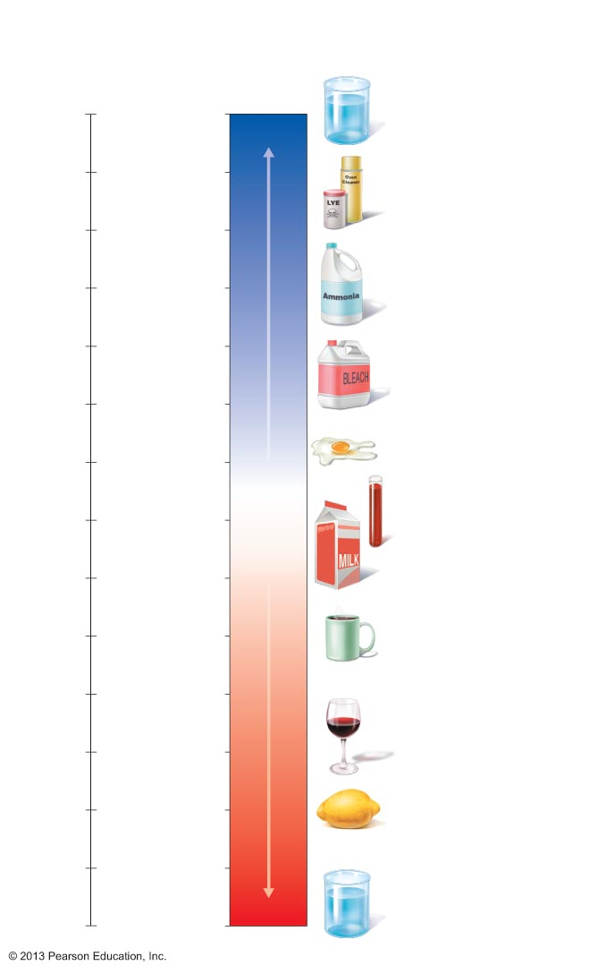
Figure 2.13 The pH scale and pH values of representative substances.
Concentration
(moles/liter)
[OH⁻]
[H⁺]
pH
Examples
10⁰
10⁻¹⁴
14
1M Sodium
hydroxide (pH=14)
10⁻¹
10⁻¹³
13
Oven cleaner, lye
(pH=13.5)
10⁻²
10⁻¹²
12
10⁻³
10⁻¹¹
11
Household ammonia
(pH=10.5–11.5)
Increasingly basic
10⁻⁴
10⁻¹⁰
10
Household bleach
(pH=9.5)
10⁻⁵
10⁻⁹
9
10⁻⁶
10⁻⁸
8
Egg white (pH=8)
7
Blood (pH=7.4)
10⁻⁷
10⁻⁷
Neutral
10⁻⁸
10⁻⁶
6
Milk (pH=6.3–6.6)
10⁻⁹
10⁻⁵
5
Black coffee (pH=5)
10⁻¹⁰
10⁻⁴
4
10⁻¹¹
10⁻³
Increasingly acidic
Wine (pH=2.5–3.5)
3
10⁻¹²
10⁻²
2
Lemon juice; gastric
juice (pH=2)
10⁻¹³
10⁻¹
1
10⁻¹⁴
10⁰
0
1M Hydrochloric
acid (pH=0)

Slide 16
Neutralization
Results from mixing acids and bases
  Displacement reactions occur forming water and a salt
  Neutralization reaction
    Joining of H⁺ and OH– to form water neutralizes solution

Slide 17
Acid-base Homeostasis
pH change interferes with cell function and may damage living tissue
Even slight change in pH can be fatal
pH is regulated by kidneys, lungs, and chemical buffers

Slide 18
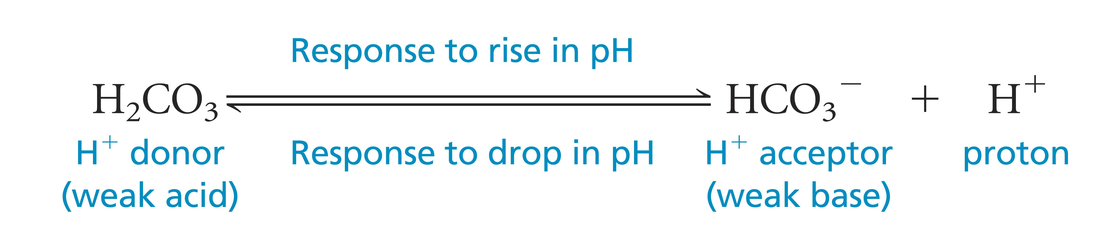
Buffers
Acidity reflects only free H⁺ in solution
  Not those bound to anions
Buffers resist abrupt and large swings in pH
  Release hydrogen ions if pH rises
  Bind hydrogen ions if pH falls
Convert strong (completely dissociated) acids or bases into weak (slightly dissociated) ones
Carbonic acid-bicarbonate system (important buffer system of blood):

Slide 19
Organic Compounds
Molecules that contain carbon
  Except CO₂ and CO, which are considered inorganic
  Carbon is electroneutral
    Shares electrons; never gains or loses them
    Forms four covalent bonds with other elements
Unique to living systems
Carbohydrates, lipids, proteins, and nucleic acids

Slide 20
Organic Compounds
Many are polymers
  Chains of similar units called monomers (building blocks)
Synthesized by dehydration synthesis
Broken down by hydrolysis reactions

Slide 21
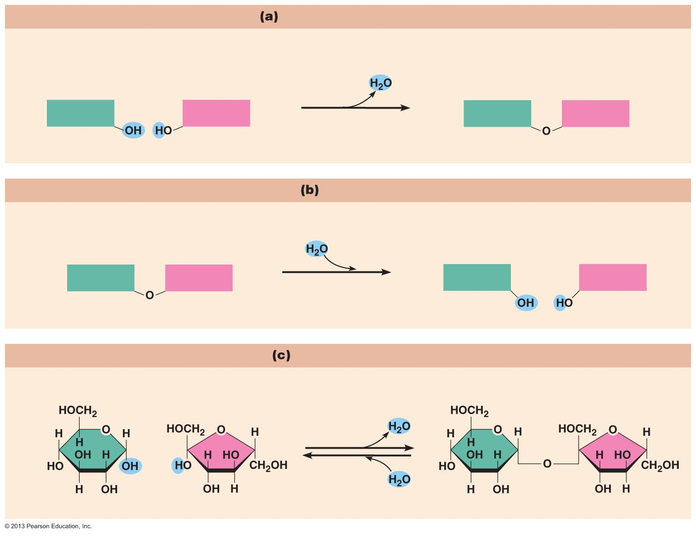
Figure 2.14 Dehydration synthesis and hydrolysis.
Dehydration synthesis
Monomers are joined by removal of OH from one monomer
and removal of H from the other at the site of bond formation.
Monomer 1
+
Monomer 2
Monomers linked by covalent bond
Hydrolysis
Monomers are released by the addition of a water molecule, adding OH to one monomer and H to the other.
Monomer 1
+
Monomer 2
Monomers linked by covalent bond
Example reactions
Dehydration synthesis of sucrose and its breakdown by hydrolysis
Water is
released
+
Water is
consumed
Glucose
Fructose
Sucrose

Slide 22
Carbohydrates
Sugars and starches
Polymers
Contain C, H, and O [(CH₂0)_{n}]
Three classes
  Monosaccharides – one sugar
  Disaccharides – two sugars
  Polysaccharides – many sugars

Slide 23
Carbohydrates
Functions of carbohydrates
  Major source of cellular fuel (e.g., glucose)
  Structural molecules (e.g., ribose sugar in RNA)

Slide 24
Monosaccharides
Simple sugars containing three to seven C atoms
(CH₂0)_{n} – general formula; n = # C atoms
Monomers of carbohydrates
Important monosaccharides
  Pentose sugars
    Ribose and deoxyribose
  Hexose sugars
    Glucose (blood sugar)

Slide 25
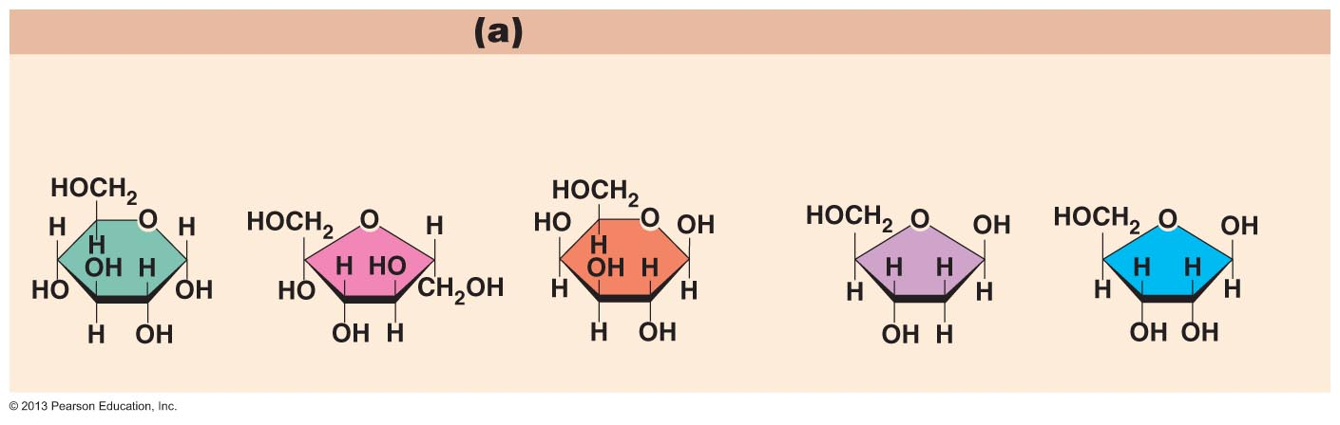
Figure 2.15a Carbohydrate molecules important to the body.
Monosaccharides
Monomers of carbohydrates
Example
Hexose sugars (the hexoses shown here are isomers)
Example
Pentose sugars
Glucose
Fructose
Galactose
Deoxyribose
Ribose

Slide 26
Disaccharides
Double sugars
Too large to pass through cell membranes
Important disaccharides
  Sucrose, maltose, lactose

Slide 27
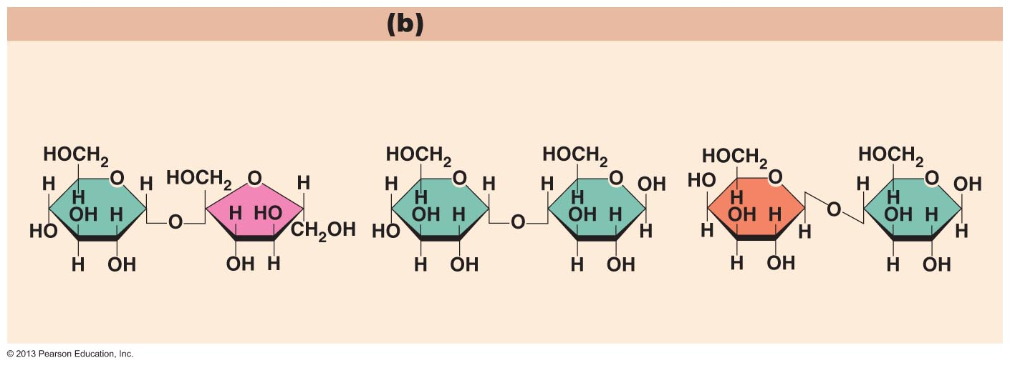
Figure 2.15b Carbohydrate molecules important to the body.
Disaccharides
Consist of two linked monosaccharides
Example
Sucrose, maltose, and lactose
(these disaccharides are isomers)
Glucose
Fructose
Glucose
Glucose
Galactose
Glucose
Sucrose
Maltose
Lactose
PLAY
Animation: Disaccharides

Slide 28
Polysaccharides
Polymers of monosaccharides
Important polysaccharides
  Starch and glycogen
Not very soluble

Slide 29
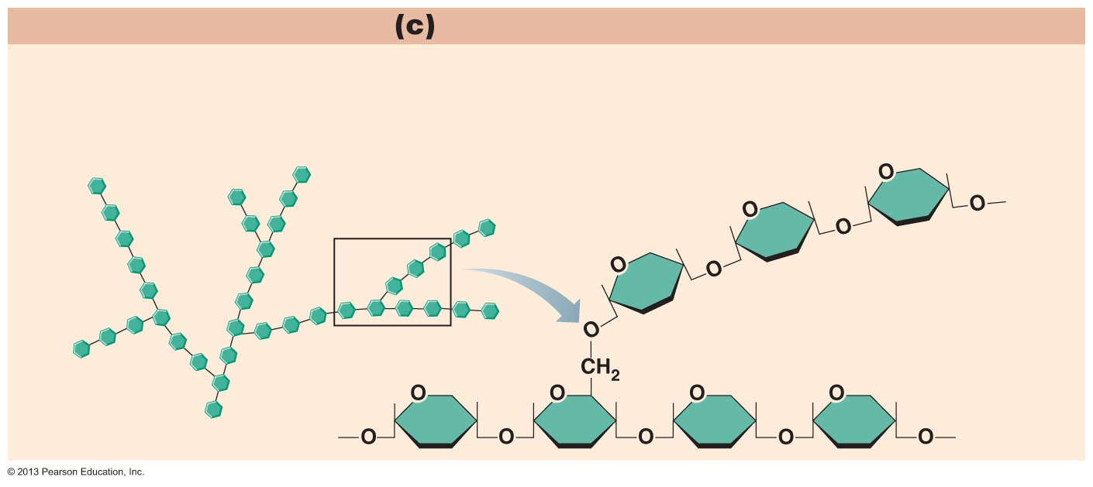
Figure 2.15c Carbohydrate molecules important to the body.
Polysaccharides
Long chains (polymers) of linked monosaccharides
Example
This polysaccharide is a simplified representation of
glycogen, a polysaccharide formed from glucose units.
Glycogen
PLAY
Animation: Polysaccharides

Slide 30
Lipids
Contain C, H, O (less than in carbohydrates), and sometimes P
Insoluble in water
Main types:
  Triglycerides or neutral fats
  Phospholipids
  Steroids
  Eicosanoids
PLAY
Animation: Fats

Slide 31
Triglycerides or Neutral Fats
Called fats when solid and oils when liquid
Composed of three fatty acids bonded to a glycerol molecule
Main functions
  Energy storage
  Insulation
  Protection

Slide 32
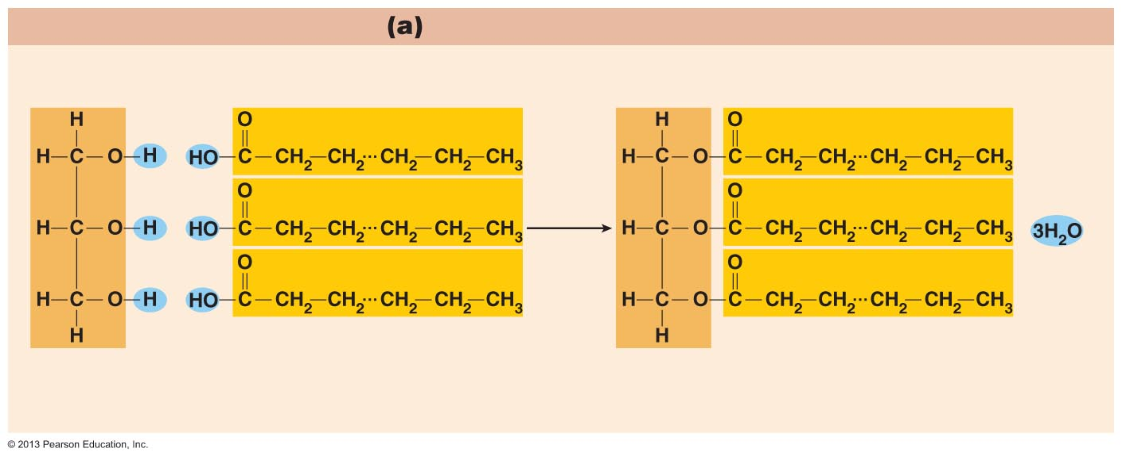
Figure 2.16a Lipids.
Triglyceride formation
Three fatty acid chains are bound to glycerol by dehydration synthesis.
+
+
Glycerol
3 fatty acid chains
Triglyceride, or neutral fat
3 water
molecules

Slide 33
Saturation of Fatty Acids
Saturated fatty acids
  Single covalent bonds between C atoms
    Maximum number of H atoms
  Solid animal fats, e.g., butter
Unsaturated fatty acids
  One or more double bonds between C atoms
    Reduced number of H atoms
  Plant oils, e.g., olive oil
  “Heart healthy”
Trans fats – modified oils – unhealthy
Omega-3 fatty acids – “heart healthy”

Slide 34
Phospholipids
Modified triglycerides:
  Glycerol + two fatty acids and a phosphorus (P) - containing group
“Head” and “tail” regions have different properties
Important in cell membrane structure

Slide 35
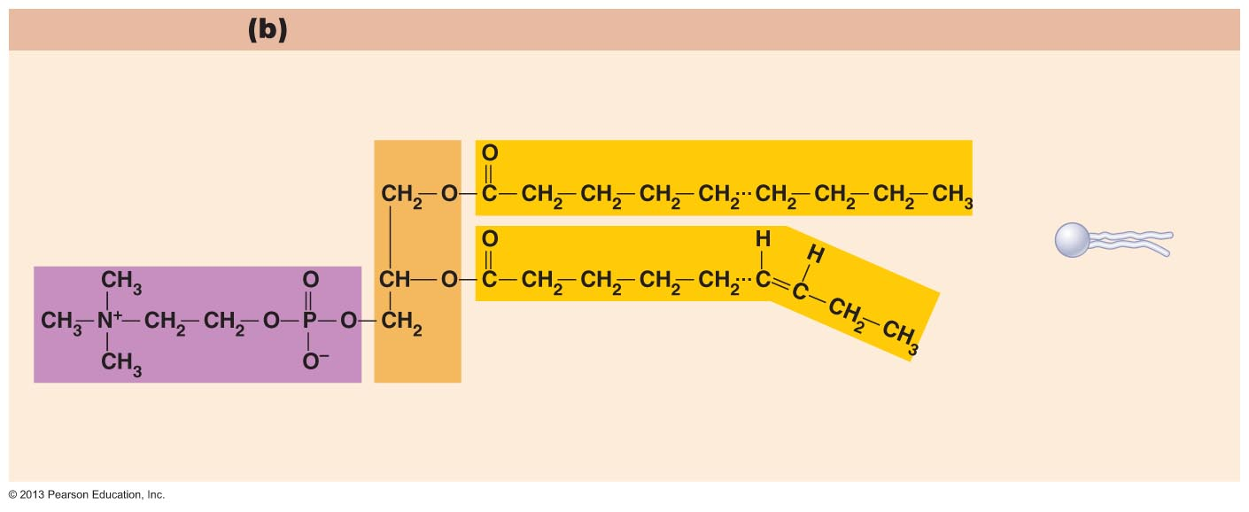
Figure 2.16b Lipids.
“Typical” structure of a phospholipid molecule
Two fatty acid chains and a phosphorus-containing group are attached to the glycerol backbone.
Example
Phosphatidylcholine
Polar “head”
Nonpolar “tail”
(schematic
phospholipid)
Phosphorus-containing
group (polar “head”)
Glycerol
backbone
2 fatty acid chains
(nonpolar “tail”)

Slide 36
Steroids
Steroids—interlocking four-ring structure
Cholesterol, vitamin D, steroid hormones, and bile salts
Most important steroid
  Cholesterol
    Important in cell membranes, vitamin D synthesis, steroid hormones, and bile salts

Slide 37
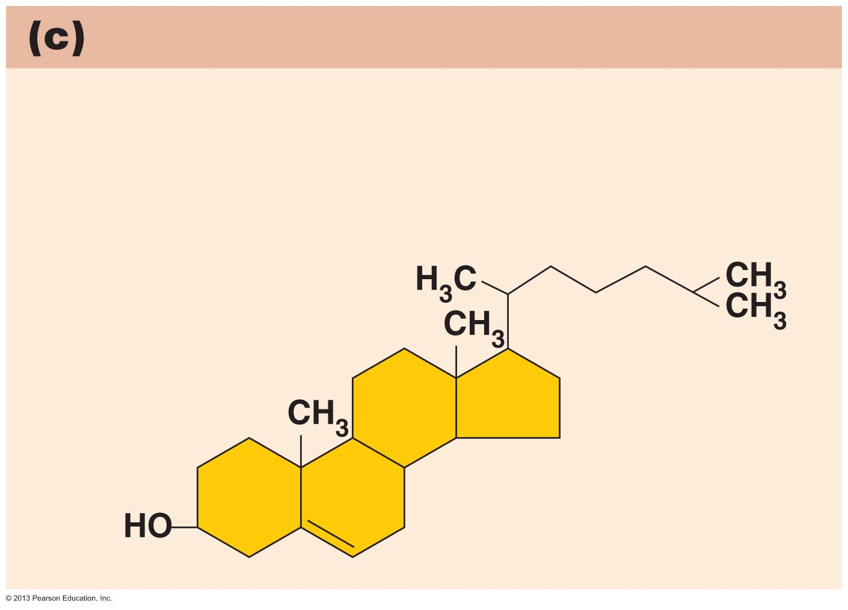
Figure 2.16c Lipids.
Simplified structure of a steroid
Four interlocking hydrocarbon rings
form a steroid.
Example
Cholesterol (cholesterol is the
basis for all steroids formed in the body)

Slide 38
Eicosanoids
Many different ones
Derived from a fatty acid (arachidonic acid) in cell membranes
Most important eicosanoid
  Prostaglandins
    Role in blood clotting, control of blood pressure, inflammation, and labor contractions

Slide 39
Other Lipids in the Body
Other fat-soluble vitamins
  Vitamins A, D, E, and K
Lipoproteins
  Transport fats in the blood

Slide 40
Proteins
Contain C, H, O, N, and sometimes S and P
Proteins are polymers
Amino acids (20 types) are the monomers in proteins
  Joined by covalent bonds called peptide bonds
  Contain amine group and acid group
  Can act as either acid or base
  All identical except for “R group” (in green on figure)

Slide 41
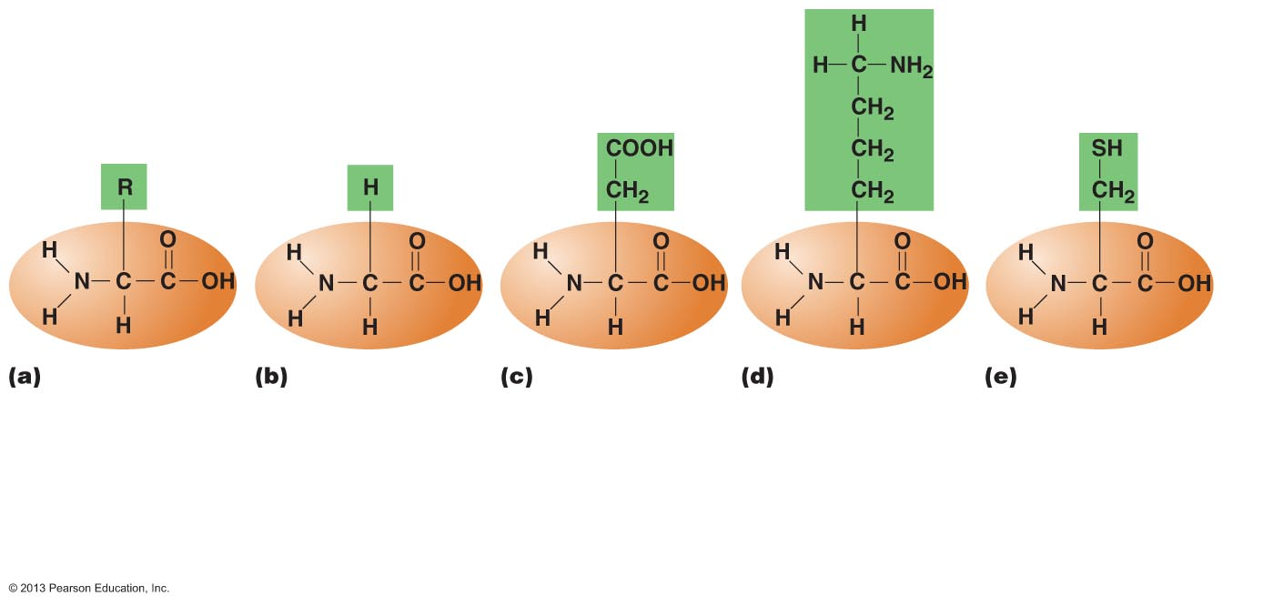
Figure 2.17 Amino acid structures.
Amine
group
Acid
group
Generalized
structure of all
amino acids.
Glycine
is the simplest
amino acid.
Aspartic acid
(an acidic amino
acid) has an acid
group (—COOH)
in the R group.
Lysine
(a basic amino
acid) has an amine
group (—NH₂) in
the R group.
Cysteine
(a basic amino acid)
has a sulfhydryl (—SH)
group in the R group,
which suggests that
this amino acid is likely
to participate in
intramolecular bonding.

Slide 42
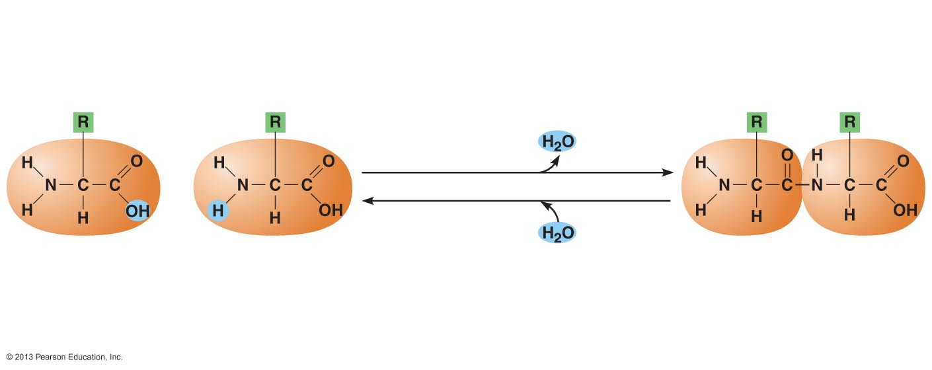
Figure 2.18 Amino acids are linked together by peptide bonds.
Dehydration synthesis:
The acid group of one amino
acid is bonded to the amine
group of the next, with loss
of a water molecule.
Peptide
bond
+
Amino acid
Amino acid
Dipeptide
Hydrolysis: Peptide bonds
linking amino acids together
are broken when water is
added to the bond.

Slide 43
Structural Levels of Proteins
PLAY
Animation: Introduction to protein structure

Slide 44
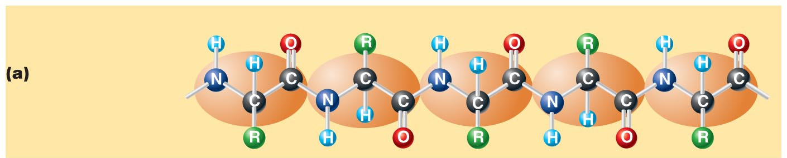
Figure 2.19a Levels of protein structure.
Amino acid
Amino acid
Amino acid
Amino acid
Amino acid
Primary structure:
The sequence of
amino acids forms
the polypeptide chain.
PLAY
Animation: Primary structure

Slide 45
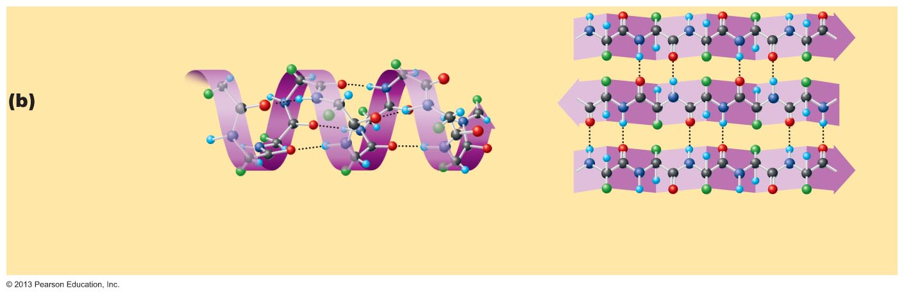
Figure 2.19b Levels of protein structure.
Secondary
structure:
The primary chain
forms spirals
(α-helices) and
sheets (β-sheets).
α-Helix: The primary chain is coiled
to form a spiral structure, which is
stabilized by hydrogen bonds.
β-Sheet: The primary chain “zig-zags”
back and forth forming a “pleated”
sheet. Adjacent strands are held
together by hydrogen bonds.
PLAY
Animation: Secondary structure

Slide 46
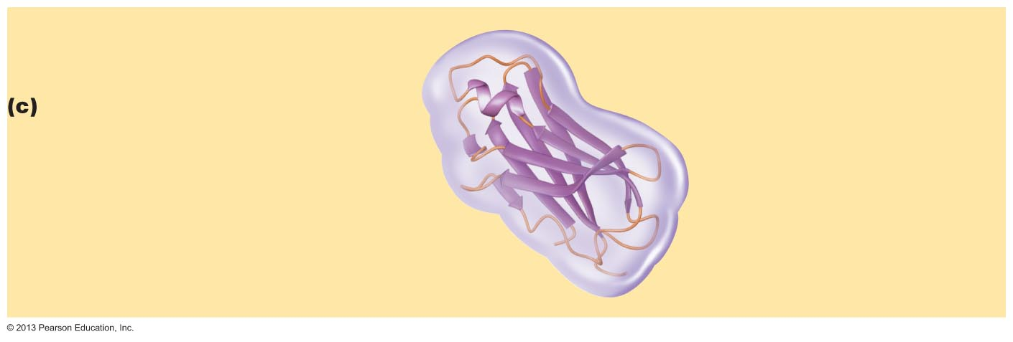
Figure 2.19c Levels of protein structure.
Tertiary structure:
Superimposed on secondary structure.
α-Helices and/or β-sheets are folded up
to form a compact globular molecule
held together by intramolecular bonds.
Tertiary structure of
prealbumin (transthyretin),
a protein that transports
the thyroid hormone
thyroxine in blood and
cerebrospinal fluid.
PLAY
Animation: Tertiary structure

Slide 47
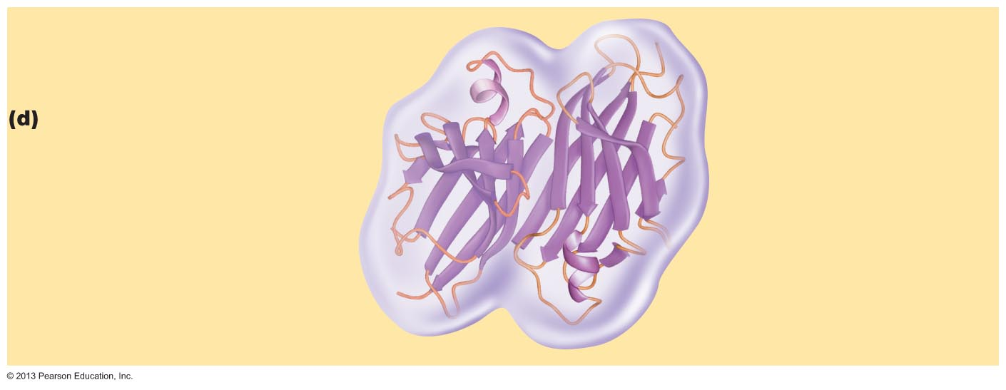
Figure 2.19d Levels of protein structure.
Quaternary structure:
Two or more polypeptide chains,
each with its own tertiary structure,
combine to form a functional
protein.
Quaternary structure of a
functional prealbumin
molecule. Two identical
prealbumin subunits join
head to tail to form the
dimer.
PLAY
Animation: Quaternary Structure

Slide 48
Fibrous and Globular Proteins
Fibrous (structural) proteins
  Strandlike, water-insoluble, and stable
  Most have tertiary or quaternary structure (3-D)
  Provide mechanical support and tensile strength
  Examples: keratin, elastin, collagen (single most abundant protein in body), and certain contractile fibers

Slide 49
Fibrous and Globular Proteins
Globular (functional) proteins
  Compact, spherical, water-soluble and sensitive to environmental changes
  Tertiary or quaternary structure (3-D)
  Specific functional regions (active sites)
  Examples: antibodies, hormones, molecular chaperones, and enzymes

Slide 50
Protein Denaturation
Denaturation
  Globular proteins unfold and lose functional, 3-D shape
    Active sites destroyed
  Can be cause by decreased pH or increased temperature
Usually reversible if normal conditions restored
Irreversible if changes extreme
  e.g., cooking an egg

Slide 51
Molecular Chaperones
Globular proteins
Ensure quick, accurate folding and association of other proteins
Prevent incorrect folding
Assist translocation of proteins and ions across membranes
Promote breakdown of damaged or denatured proteins
Help trigger the immune response

Slide 52
Molecular Chaperones
Stress proteins
  Molecular chaperones produced in response to stressful stimuli, e.g., O₂ deprivation
  Important to cell function during stress
  Can delay aging by patching up damaged proteins and refolding them

Slide 53
Enzymes
Enzymes
  Globular proteins that act as biological catalysts
    Regulate and increase speed of chemical reactions
  Lower the activation energy, increase the speed of a reaction (millions of reactions per minute!)

Slide 54
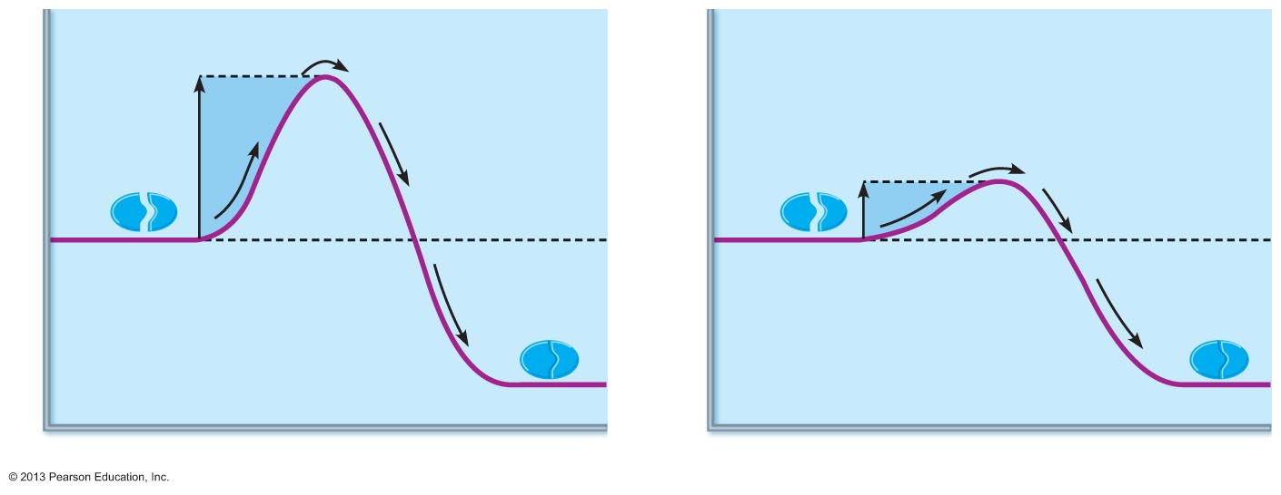
Figure 2.20 Enzymes lower the activation energy required for a reaction.
WITHOUT ENZYME
WITH ENZYME
Activation
energy
required
Less activation
energy required
Energy
Reactants
Energy
Reactants
Product
Product
Progress of reaction
Progress of reaction
PLAY
Animation: How enzymes work

Slide 55
Characteristics of Enzymes
Some functional enzymes (holoenzymes) consist of two parts
  Apoenzyme (protein portion)
  Cofactor (metal ion) or coenzyme (organic molecule often a vitamin)
Enzymes are specific
  Act on specific substrate
Usually end in -ase
Often named for the reaction they catalyze
  Hydrolases, oxidases

Slide 56
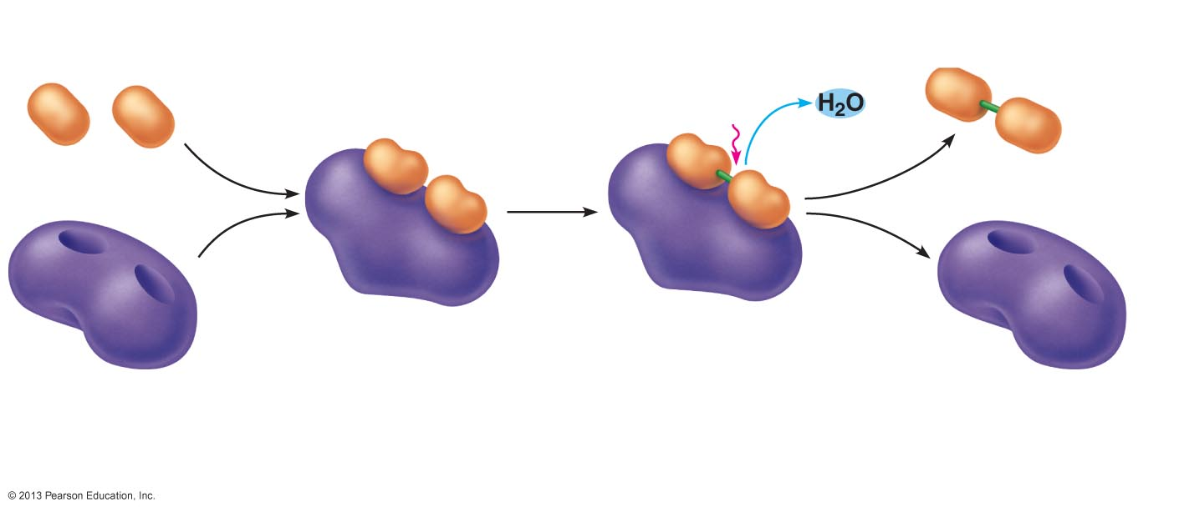
Figure 2.21 Mechanism of enzyme action.
Slide 1
Product (P)
e.g., dipeptide
Substrates (S)
e.g., amino acids
Energy is
absorbed;
bond is
formed.
Water is
released.
Peptide
bond
+
Active site
Enzyme-substrate
complex (E-S)
1
2
Enzyme (E)
Substrates bind at active
site, temporarily forming an
enzyme-substrate complex.
The E-S complex
undergoes internal
rearrangements that
form the product.
Enzyme (E)
3
The enzyme releases
the product of the
reaction.

Slide 57
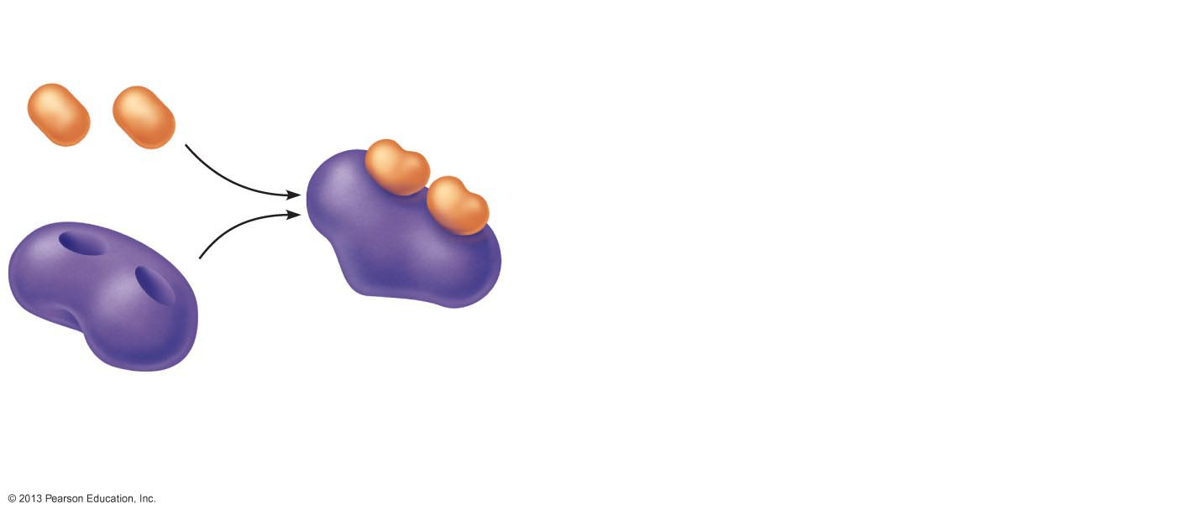
Figure 2.21 Mechanism of enzyme action.
Slide 2
Substrates (S)
e.g., amino acids
+
Active site
Enzyme-substrate
complex (E-S)
1
Substrates bind at active
site, temporarily forming an
enzyme-substrate complex.
Enzyme (E)

Slide 58
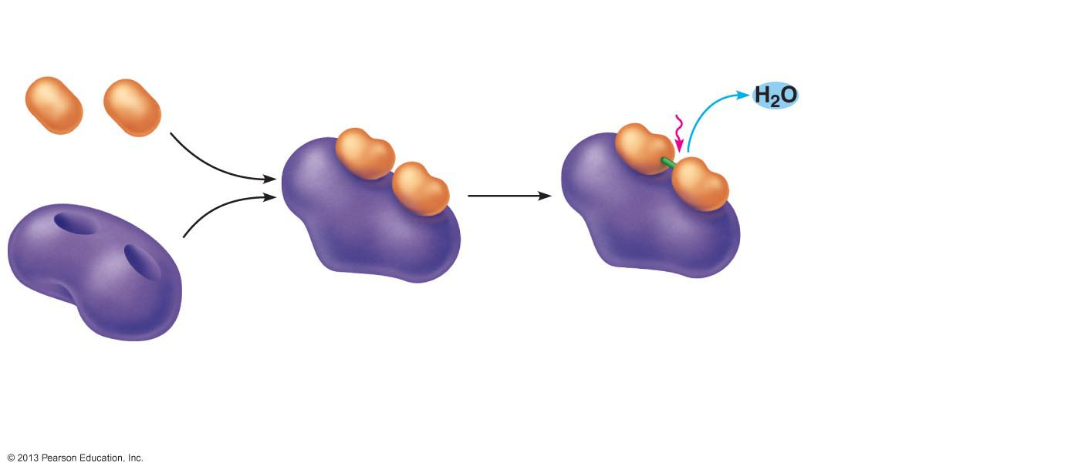
Figure 2.21 Mechanism of enzyme action.
Slide 3
Substrates (S)
e.g., amino acids
Energy is
absorbed;
bond is
formed.
Water is
released.
+
Active site
Enzyme-substrate
complex (E-S)
1
2
Substrates bind at active
site, temporarily forming an
enzyme-substrate complex.
The E-S complex
undergoes internal
rearrangements that
form the product.
Enzyme (E)

Slide 59
Figure 2.21 Mechanism of enzyme action.
Slide 4
Product (P)
e.g., dipeptide
Substrates (S)
e.g., amino acids
Energy is
absorbed;
bond is
formed.
Water is
released.
Peptide
bond
+
Active site
Enzyme-substrate
complex (E-S)
1
2
Enzyme (E)
Substrates bind at active
site, temporarily forming an
enzyme-substrate complex.
The E-S complex
undergoes internal
rearrangements that
form the product.
Enzyme (E)
3
The enzyme releases
the product of the
reaction.

Slide 60
Nucleic Acids
Deoxyribonucleic acid (DNA) and ribonucleic acid (RNA)
  Largest molecules in the body
Contain C, O, H, N, and P
Polymers
  Monomer = nucleotide
    Composed of nitrogen base, a pentose sugar, and a phosphate group

Slide 61
Deoxyribonucleic Acid (DNA)
Utilizes four nitrogen bases:
  Purines: Adenine (A), Guanine (G)
  Pyrimidines: Cytosine (C), and Thymine (T)
  Base-pair rule – each base pairs with its complementary base
    A always pairs with T; G always pairs with C
Double-stranded helical molecule (double helix) in the cell nucleus
Pentose sugar is deoxyribose
Provides instructions for protein synthesis
Replicates before cell division ensuring genetic continuity

Slide 62
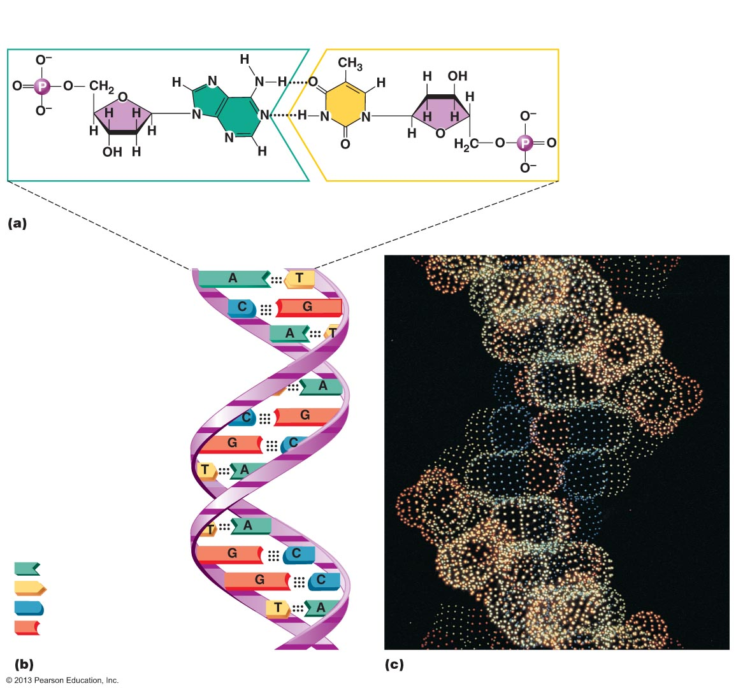
Figure 2.22 Structure of DNA.
Phosphate
Sugar:
Deoxyribose
Base:
Adenine (A)
Thymine (T)
Sugar
Phosphate
Adenine nucleotide
Thymine nucleotide
Hydrogen
bond
Deoxyribose
sugar
Sugar-
phosphate
backbone
Phosphate
Adenine (A)
Thymine (T)
Cytosine (C)
Guanine (G)

Slide 63
Ribonucleic Acid (RNA)
Four bases:
  Adenine (A), Guanine (G), Cytosine (C), and Uracil (U)
Pentose sugar is ribose
Single-stranded molecule mostly active outside the nucleus
Three varieties of RNA carry out the DNA orders for protein synthesis
  Messenger RNA (mRNA), transfer RNA (tRNA), and ribosomal RNA (rRNA)
PLAY
Animation: DNA and RNA

Slide 64
Adenosine Triphosphate (ATP)
Chemical energy in glucose captured in this important molecule
Directly powers chemical reactions in cells
Energy form immediately useable by all body cells
Structure of ATP
  Adenine-containing RNA nucleotide with two additional phosphate groups

Slide 65
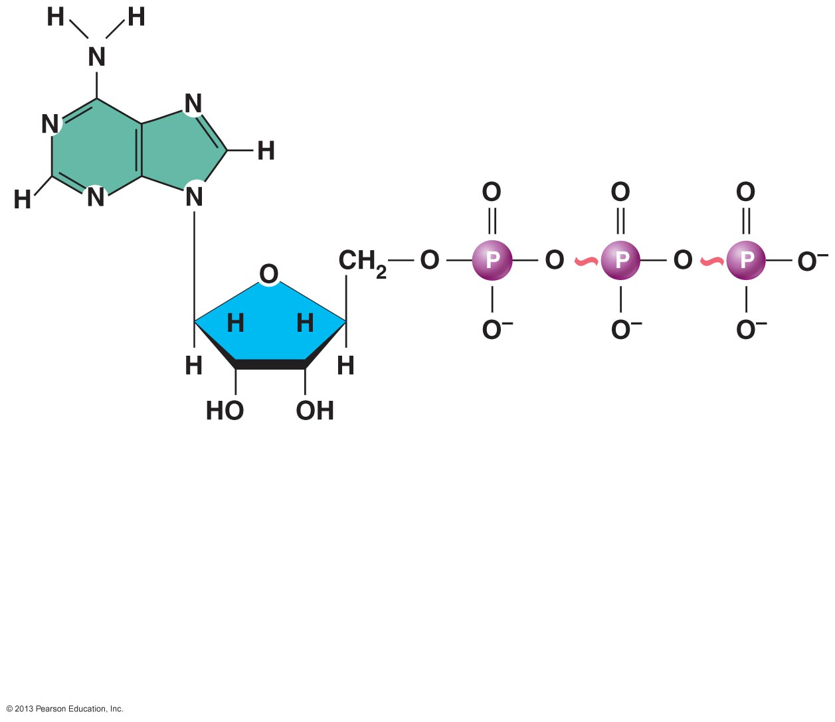
Figure 2.23 Structure of ATP (adenosine triphosphate).
High-energy phosphate
bonds can be hydrolyzed
to release energy.
Adenine
Phosphate groups
Ribose
Adenosine
Adenosine monophosphate (AMP)
Adenosine diphosphate (ADP)
Adenosine triphosphate (ATP)

Slide 66
Function of ATP
Phosphorylation
  Terminal phosphates are enzymatically transferred to and energize other molecules
  Such “primed” molecules perform cellular work (life processes) using the phosphate bond energy

Slide 67
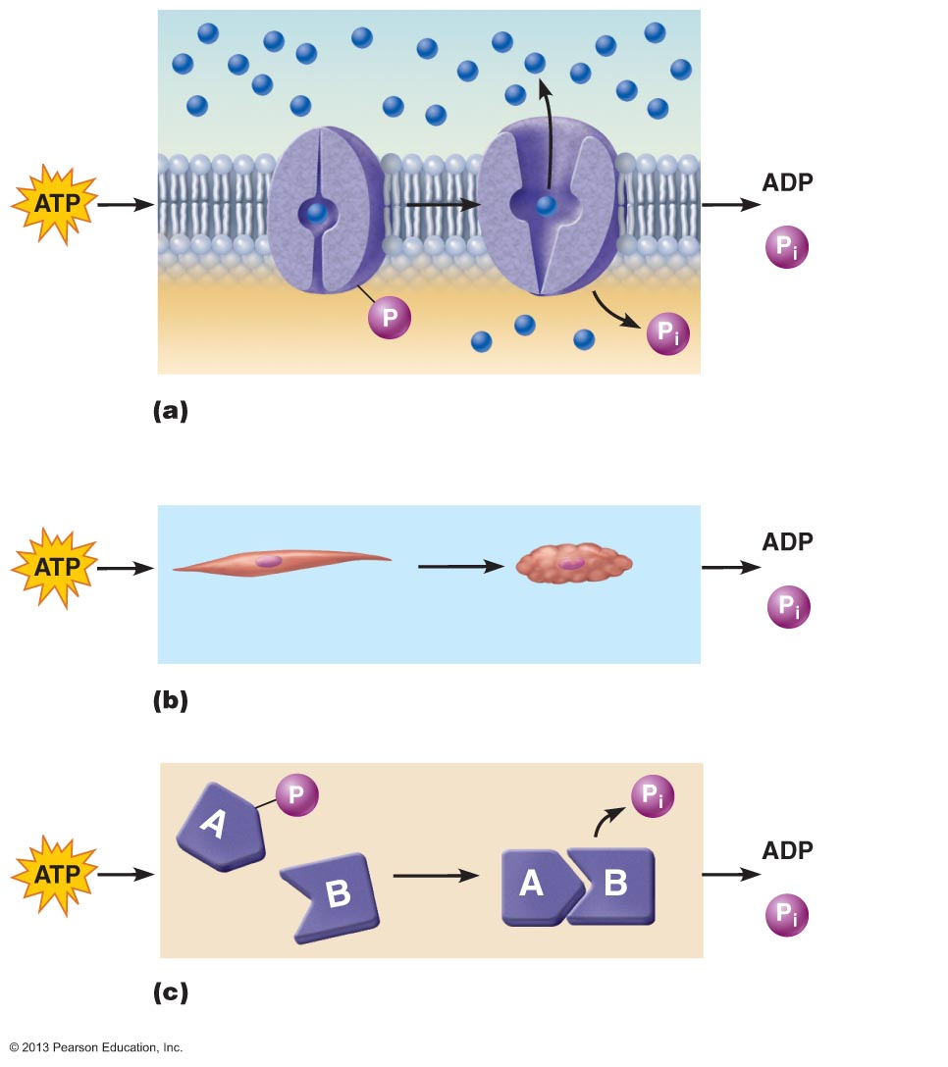
Figure 2.24 Three examples of cellular work driven by energy from ATP.
Solute
+
Membrane
protein
Transport work: ATP phosphorylates transport proteins,
activating them to transport solutes (ions, for example)
across cell membranes.
+
Relaxed smooth
muscle cell
Contracted smooth
muscle cell
Mechanical work: ATP phosphorylates contractile pro-
teins in muscle cells so the cells can shorten.
+
Chemical work: ATP phosphorylates key reactants, providing
energy to drive energy-absorbing chemical reactions.

