Slide 1
3
Cells: The Living Units: Part A

Slide 2
Cell Theory
Cell - structural and functional unit of life
Organismal functions depend on individual and collective cell functions
Biochemical activities of cells dictated by their shapes or forms, and specific subcellular structures
Continuity of life has cellular basis

Slide 3
Cell Diversity
Over 200 different types of human cells
Types differ in size, shape, subcellular components, and functions

Slide 4
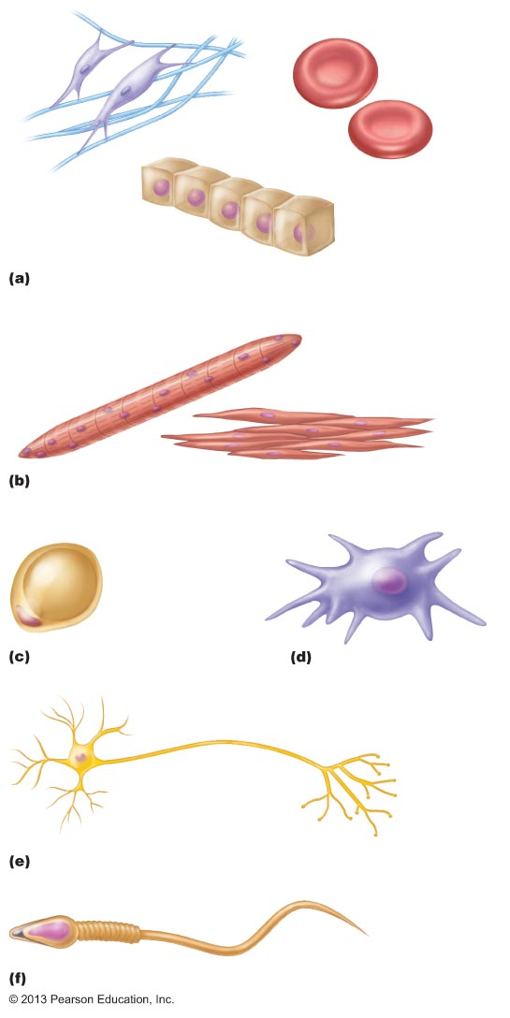
Figure 3.1 Cell diversity.
Erythrocytes
Fibroblasts
Epithelial cells
Cells that connect body parts, form linings, or transport
gases
Skeletal
muscle
cell
Smooth
muscle cells
Cells that move organs and body parts
Macrophage
Fat cell
Cell that stores nutrients
Cell that fights disease
Nerve cell
Cell that gathers information and controls body functions
Sperm
Cell of reproduction

Slide 5
Generalized Cell
All cells have some common structures and functions
Human cells have three basic parts:
  Plasma membrane—flexible outer boundary
  Cytoplasm—intracellular fluid containing organelles
  Nucleus—control center

Slide 6
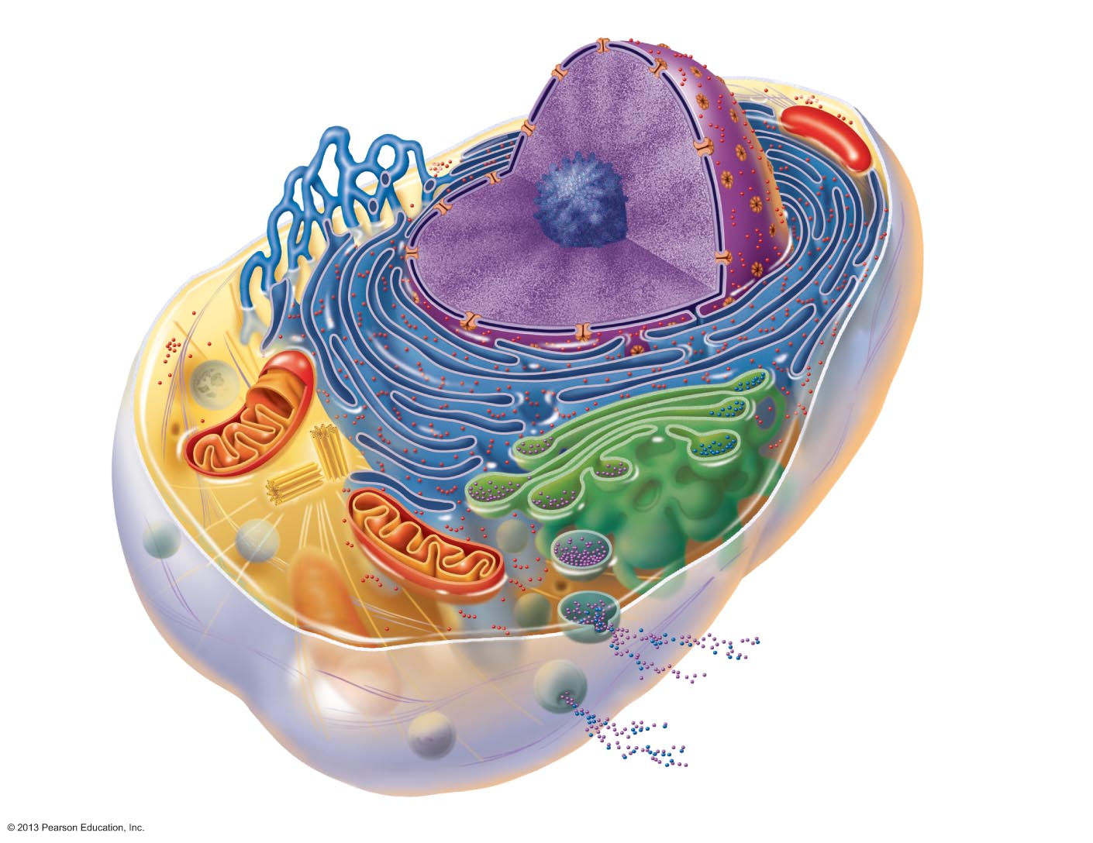
Figure 3.2 Structure of the generalized cell.
Chromatin
Nuclear envelope
Nucleolus
Nucleus
Smooth endoplasmic
reticulum
Plasma
membrane
Cytosol
Mitochon-
drion
Lysosome
Centrioles
Centro-
some
matrix
Rough
endoplasmic
reticulum
Ribosomes
Golgi apparatus
Secretion being released
from cell by exocytosis
Cytoskeletal
elements
• Microtubule
• Intermediate
filaments
Peroxisome

Slide 7
Plasma Membrane
Lipid bilayer and proteins in constantly changing fluid mosaic
Plays dynamic role in cellular activity
Separates intracellular fluid (ICF) from extracellular fluid (ECF)
  Interstitial fluid (IF) = ECF that surrounds cells
PLAY
Animation: Membrane Structure

Slide 8
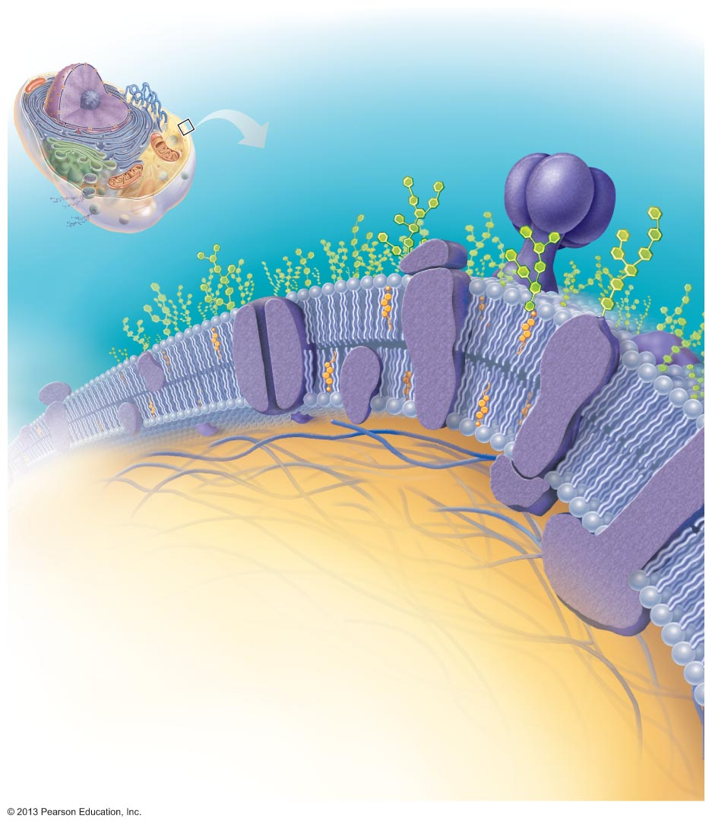
Figure 3.3 The plasma membrane.
Extracellular fluid
(watery environment
outside cell)
Polar head of
phospholipid
molecule
Cholesterol
Glycolipid
Glyco-
protein
Nonpolar tail
of phospholipid
molecule
Glycocalyx
(carbohydrates)
Lipid bilayer
containing
proteins
Outward-facing
layer of
phospholipids
Inward-facing
layer of
phospholipids
Cytoplasm
(watery environment
inside cell)
Integral
proteins
Filament of
cytoskeleton
Peripheral
proteins

Slide 9
Membrane Lipids
75% phospholipids (lipid bilayer)
  Phosphate heads: polar and hydrophilic
  Fatty acid tails: nonpolar and hydrophobic (Review Fig. 2.16b)
5% glycolipids
  Lipids with polar sugar groups on outer membrane surface
20% cholesterol
  Increases membrane stability

Slide 10
Membrane Proteins
Allow communication with environment
½ mass of plasma membrane
Most specialized membrane functions
Some float freely
Some tethered to intracellular structures
Two types:
  Integral proteins; peripheral proteins

Slide 11
Membrane Proteins
Integral proteins
  Firmly inserted into membrane (most are transmembrane)
  Have hydrophobic and hydrophilic regions
    Can interact with lipid tails and water
  Function as transport proteins (channels and carriers), enzymes, or receptors
PLAY
Animation: Transport Proteins

Slide 12
Membrane Proteins
Peripheral proteins
  Loosely attached to integral proteins
  Include filaments on intracellular surface for membrane support
  Function as enzymes; motor proteins for shape change during cell division and muscle contraction; cell-to-cell connections
PLAY
Animation: Structural Proteins
PLAY
Animation: Receptor Proteins

Slide 13
Figure 3.3 The plasma membrane.
Extracellular fluid
(watery environment
outside cell)
Polar head of
phospholipid
molecule
Cholesterol
Glycolipid
Glyco-
protein
Nonpolar tail
of phospholipid
molecule
Glycocalyx
(carbohydrates)
Lipid bilayer
containing
proteins
Outward-facing
layer of
phospholipids
Inward-facing
layer of
phospholipids
Cytoplasm
(watery environment
inside cell)
Integral
proteins
Filament of
cytoskeleton
Peripheral
proteins

Slide 14
Six Functions of Membrane Proteins
Transport
Receptors for signal transduction
Attachment to cytoskeleton and extracellular matrix

Slide 15
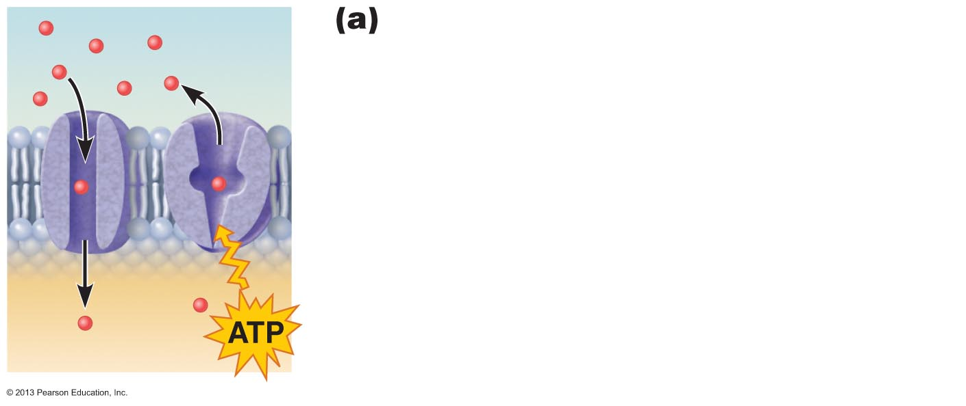
Figure 3.4a Membrane proteins perform many tasks.
Transport
• A protein (left) that spans the membrane
may provide a hydrophilic channel across
the membrane that is selective for a
particular solute.
• Some transport proteins (right) hydrolyze
ATP as an energy source to actively pump
substances across the membrane.
PLAY
Animation: Transport Proteins

Slide 16
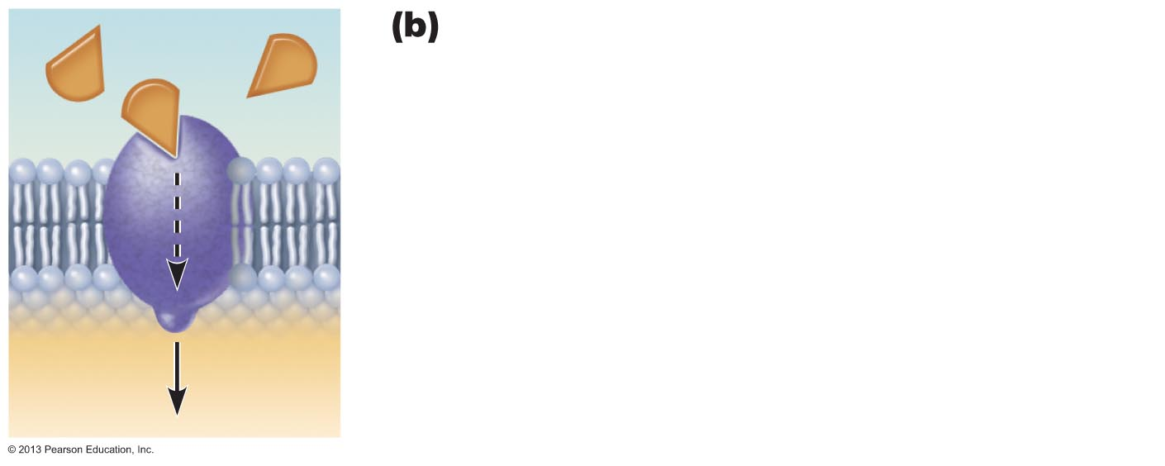
Figure 3.4b Membrane proteins perform many tasks.
Signal
Receptors for signal transduction
• A membrane protein exposed to the
outside of the cell may have a binding site
that fits the shape of a specific chemical
messenger, such as a hormone.
• When bound, the chemical messenger may
cause a change in shape in the protein that
initiates a chain of chemical reactions in the
cell.
Receptor
PLAY
Animation: Receptor Proteins

Slide 17
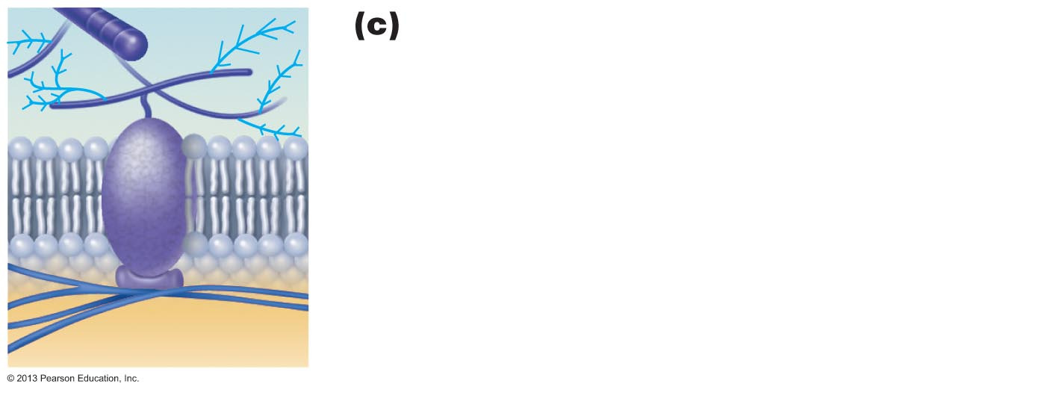
Figure 3.4c Membrane proteins perform many tasks.
Attachment to the cytoskeleton and
extracellular matrix
• Elements of the cytoskeleton (cell's internal
supports) and the extracellular matrix
(fibers and other substances outside the
cell) may anchor to membrane proteins,
which helps maintain cell shape and fix the
location of certain membrane proteins.
• Others play a role in cell movement or bind
adjacent cells together.

Slide 18
Six Functions of Membrane Proteins
Enzymatic activity
Intercellular joining
Cell-cell recognition

Slide 19
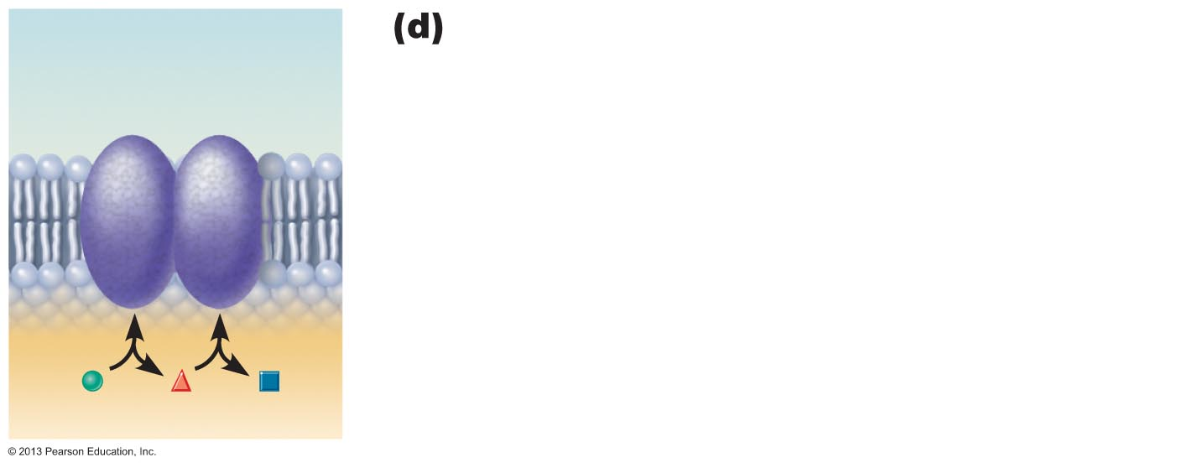
Figure 3.4d Membrane proteins perform many tasks.
Enzymatic activity
Enzymes
• A membrane protein may be an enzyme
with its active site exposed to substances in
the adjacent solution.
• A team of several enzymes in a membrane
may catalyze sequential steps of a metabolic
pathway as indicated (left to right) here.
PLAY
Animation: Enzymes
Figure 3.4d

Slide 20
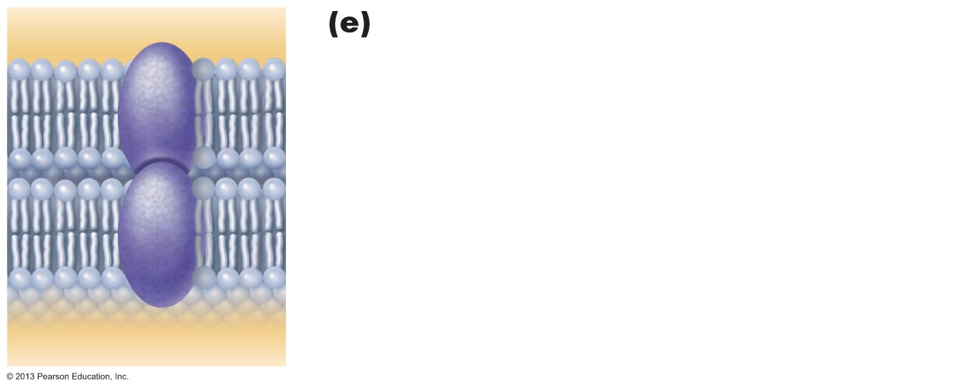
Figure 3.4e Membrane proteins perform many tasks.
Intercellular joining
• Membrane proteins of adjacent cells may
be hooked together in various kinds of
intercellular junctions.
• Some membrane proteins (cell adhesion
molecules or CAMs) of this group provide
temporary binding sites that guide cell
migration and other cell-to-cell interactions.
CAMs

Slide 21
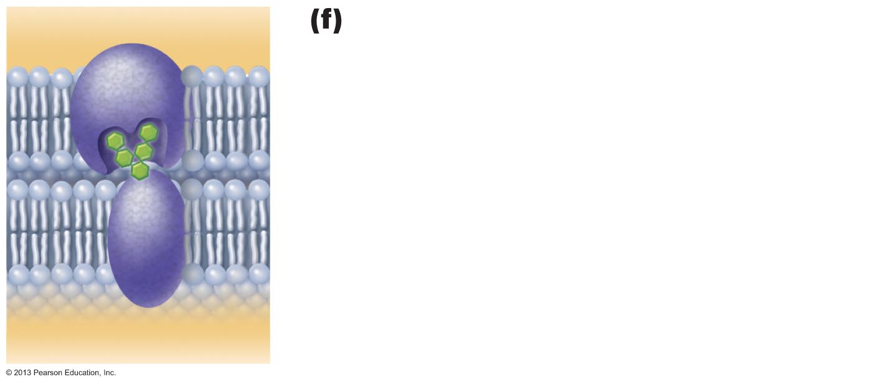
Figure 3.4f Membrane proteins perform many tasks.
Cell-cell recognition
• Some glycoproteins (proteins bonded to
short chains of sugars) serve as
identification tags that are specifically
recognized by other cells.
Glycoprotein

Slide 22
Lipid Rafts
~20% of outer membrane surface
Contain phospholipids, sphingolipids, and cholesterol
More stable; less fluid than rest of membrane
  May function as stable platforms for cell-signaling molecules, membrane invagination, or other functions

Slide 23
The Glycocalyx
"Sugar covering" at cell surface
  Lipids and proteins with attached carbohydrates (sugar groups)
Every cell type has different pattern of sugars
  Specific biological markers for cell to cell recognition
  Allows immune system to recognize "self" and "non self"
  Cancerous cells change it continuously

Slide 24
Cell Junctions
Some cells "free"
  e.g., blood cells, sperm cells
Some bound into communities
  Three ways cells are bound:
    Tight junctions
    Desmosomes
    Gap junctions

Slide 25
Cell Junctions: Tight Junctions
Adjacent integral proteins fuse → form impermeable junction encircling cell
  Prevent fluids and most molecules from moving between cells
Where might these be useful in body?

Slide 26
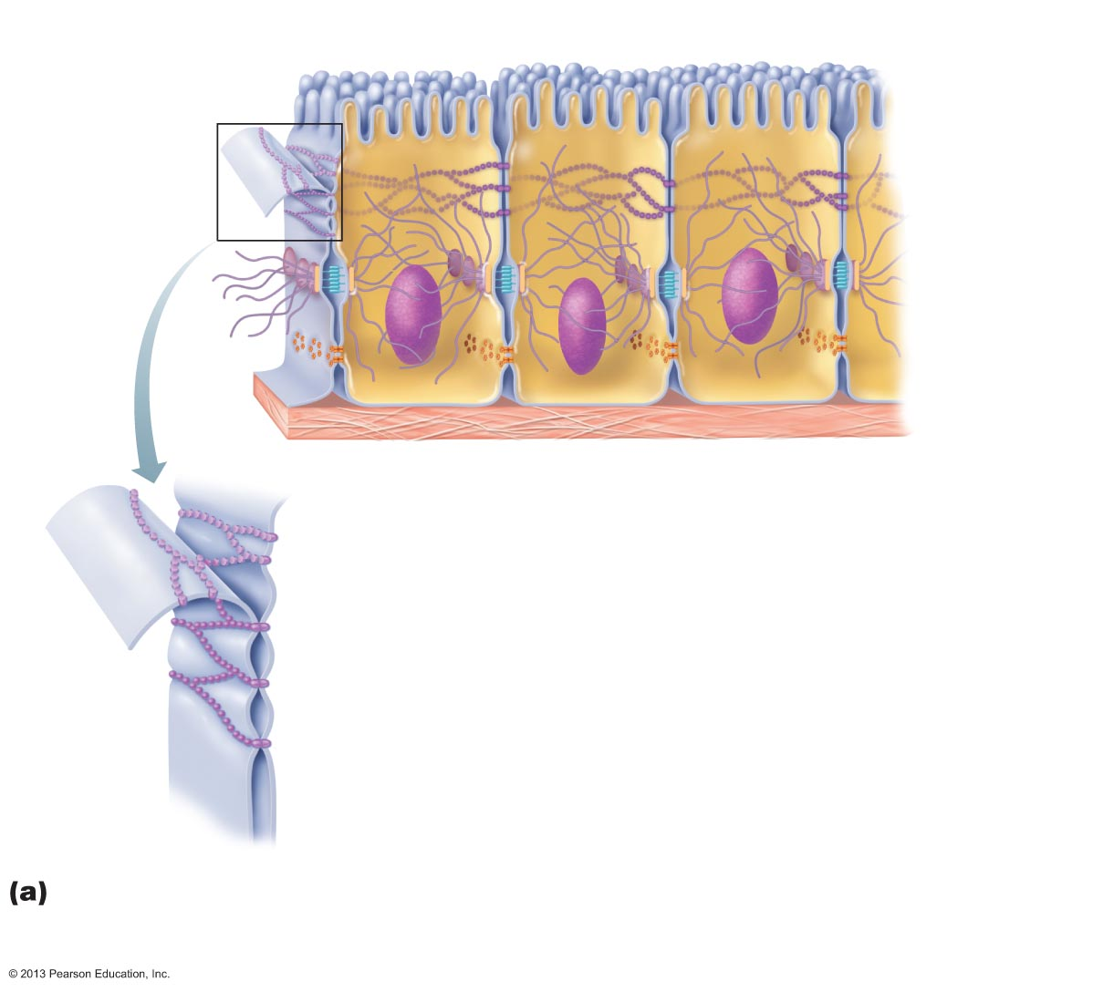
Figure 3.5a Cell junctions.
Plasma membranes
of adjacent cells
Microvilli
Intercellular
space
Basement membrane
Interlocking
junctional
proteins
Intercellular
space
Tight junctions: Impermeable junctions
prevent molecules from passing through
the intercellular space.

Slide 27
Cell Junctions: Desmosomes
"Rivets" or "spot-welds" that anchor cells together at plaques (thickenings on plasma membrane)
  Linker proteins between cells connect plaques
  Keratin filaments extend through cytosol to opposite plaque giving stability to cell
  Reduces possibility of tearing
Where might these be useful in body?

Slide 28
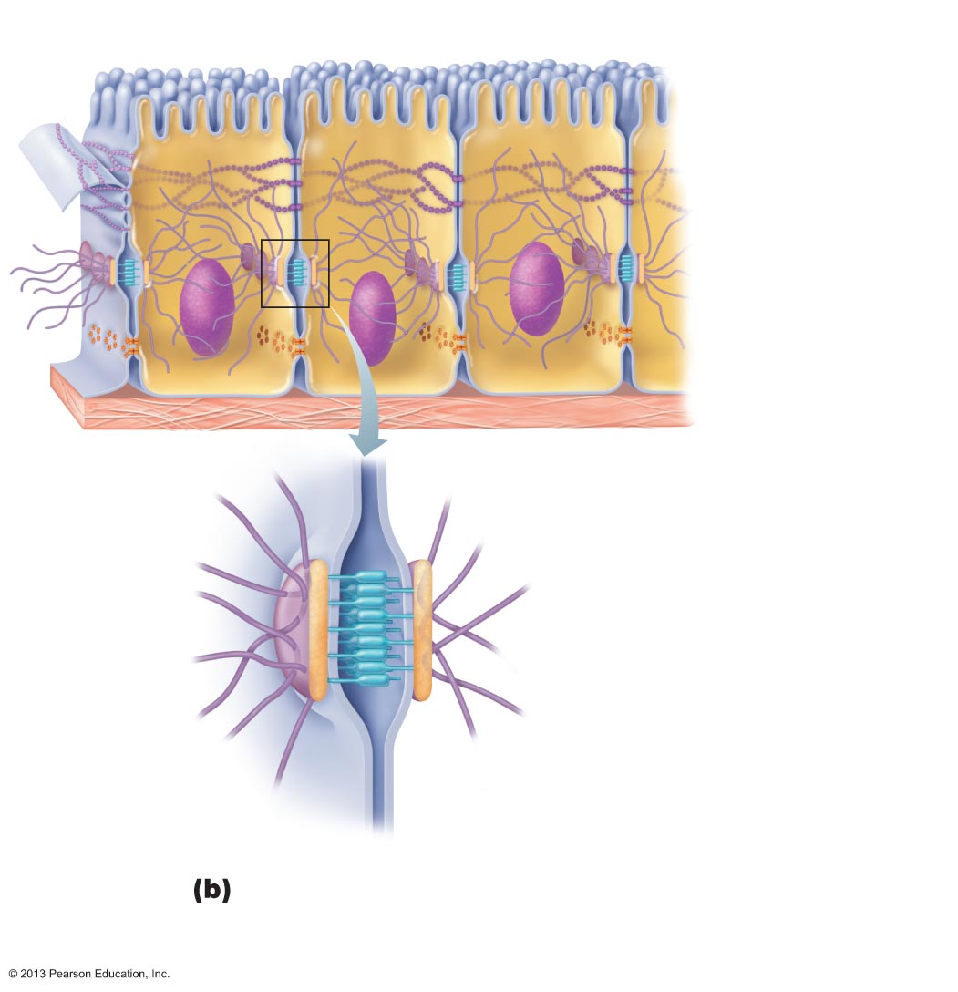
Figure 3.5b Cell junctions.
Plasma membranes
of adjacent cells
Microvilli
Intercellular
space
Basement membrane
Intercellular
space
Plaque
Linker
proteins
(cadherins)
Intermediate
filament
(keratin)
Desmosomes: Anchoring junctions bind adjacent cells together like a molecular “Velcro” and help form an internal tension-reducing network of fibers.

Slide 29
Cell Junctions: Gap Junctions
Transmembrane proteins form pores (connexons) that allow small molecules to pass from cell to cell
  For spread of ions, simple sugars, and other small molecules between cardiac or smooth muscle cells

Slide 30
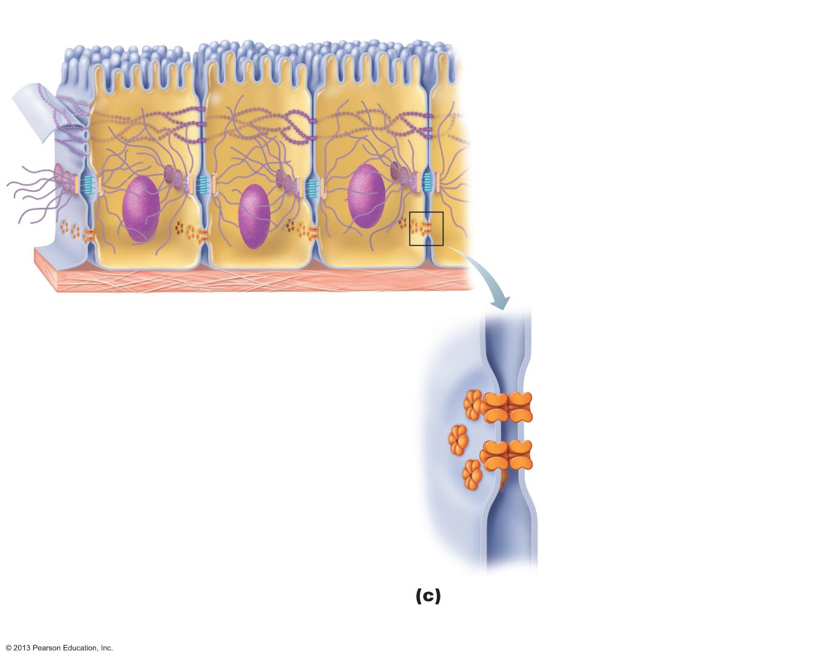
Figure 3.5c Cell junctions.
Plasma membranes
of adjacent cells
Microvilli
Intercellular
space
Basement membrane
Intercellular
space
Channel
between cells
(formed by
connexons)
Gap junctions: Communicating junctions
allow ions and small molecules to pass
for intercellular communication.

Slide 31
Plasma Membrane
Cells surrounded by interstitial fluid (IF)
  Contains thousands of substances, e.g., amino acids, sugars, fatty acids, vitamins, hormones, salts, waste products
Plasma membrane allows cell to
  Obtain from IF exactly what it needs, exactly when it is needed
  Keep out what it does not need

Slide 32
Membrane Transport
Plasma membranes selectively permeable
  Some molecules pass through easily; some do not
Two ways substances cross membrane
  Passive processes
  Active processes

Slide 33
Types of Membrane Transport
Passive processes
  No cellular energy (ATP) required
  Substance moves down its concentration gradient
Active processes
  Energy (ATP) required
  Occurs only in living cell membranes

Slide 34
Passive Processes
Two types of passive transport
  Diffusion
    Simple diffusion
    Carrier- and channel-mediated facilitated diffusion
    Osmosis
  Filtration
    Usually across capillary walls

Slide 35
Passive Processes: Diffusion
Collisions cause molecules to move down or with their concentration gradient
  Difference in concentration between two areas
Speed influenced by molecule size and temperature

Slide 36
Passive Processes
Molecule will passively diffuse through membrane if
  It is lipid soluble, or
  Small enough to pass through membrane channels, or
  Assisted by carrier molecule
PLAY
Animation: Membrane Permeability

Slide 37
Passive Processes: Simple Diffusion
Nonpolar lipid-soluble (hydrophobic) substances diffuse directly through phospholipid bilayer
  E.g., oxygen, carbon dioxide, fat-soluble vitamins
PLAY
Animation: Diffusion

Slide 38
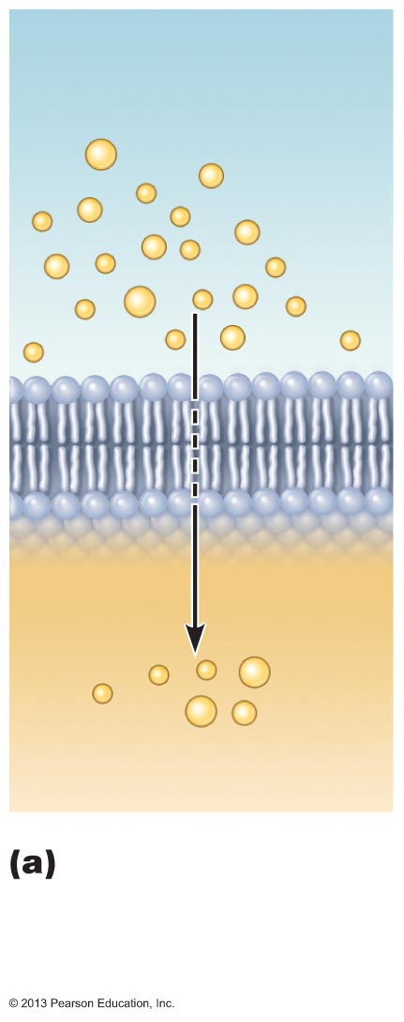
Figure 3.7a Diffusion through the plasma membrane.
Extracellular fluid
Lipid-
soluble
solutes
Cytoplasm
Simple diffusion of
fat-soluble molecules
directly through the
phospholipid bilayer

Slide 39
Passive Processes: Facilitated Diffusion
Certain lipophobic molecules (e.g., glucose, amino acids, and ions) transported passively by
  Binding to protein carriers
  Moving through water-filled channels

Slide 40
Carrier-Mediated Facilitated Diffusion
Transmembrane integral proteins are carriers
Transport specific polar molecules (e.g., sugars and amino acids) too large for channels
Binding of substrate causes shape change in carrier then passage across membrane
Limited by number of carriers present
  Carriers saturated when all engaged

Slide 41
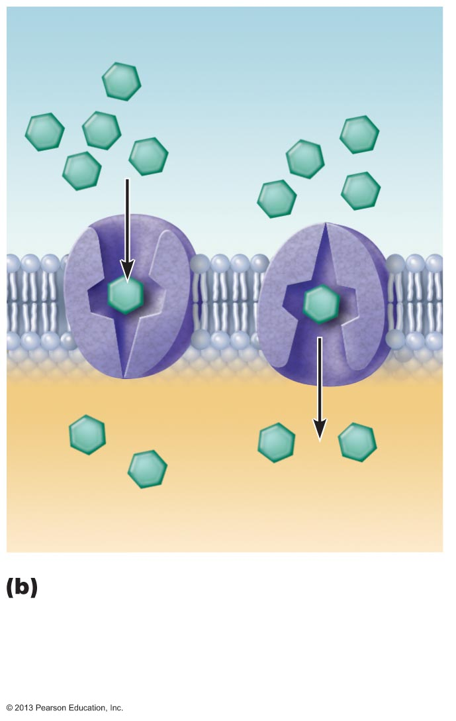
Figure 3.7b Diffusion through the plasma membrane.
Lipid-insoluble solutes
(such as sugars or
amino acids)
Carrier-mediated facilitated
Diffusion via protein carrier specific
for one chemical; binding of substrate
causes transport protein to change
shape

Slide 42
Channel-Mediated Facilitated Diffusion
Aqueous channels formed by transmembrane proteins
Selectively transport ions or water
Two types:
  Leakage channels
    Always open
  Gated channels
    Controlled by chemical or electrical signals

Slide 43
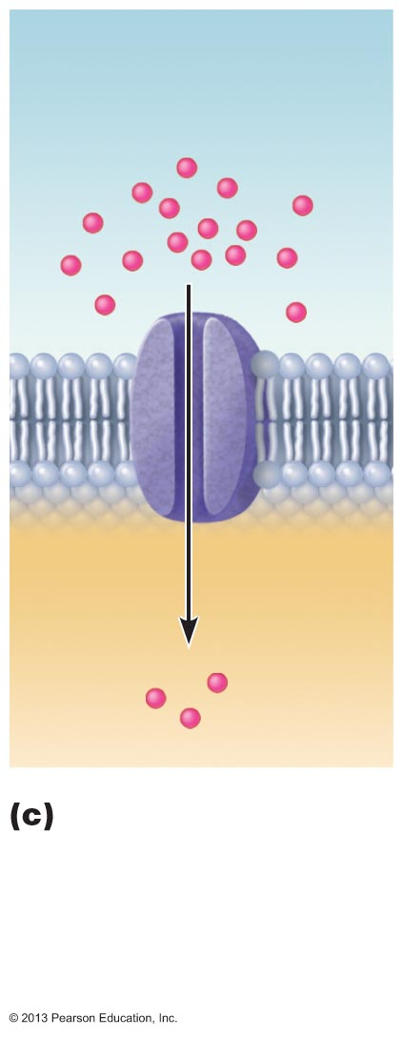
Figure 3.7c Diffusion through the plasma membrane.
Small lipid-
insoluble
solutes
Channel-mediated
facilitated diffusion
through a channel
protein; mostly ions
selected on basis of
size and charge

Slide 44
Passive Processes: Osmosis
Movement of solvent (e.g., water) across selectively permeable membrane
Water diffuses through plasma membranes
  Through lipid bilayer
  Through specific water channels called aquaporins (AQPs)
Occurs when water concentration different on the two sides of a membrane

Slide 45
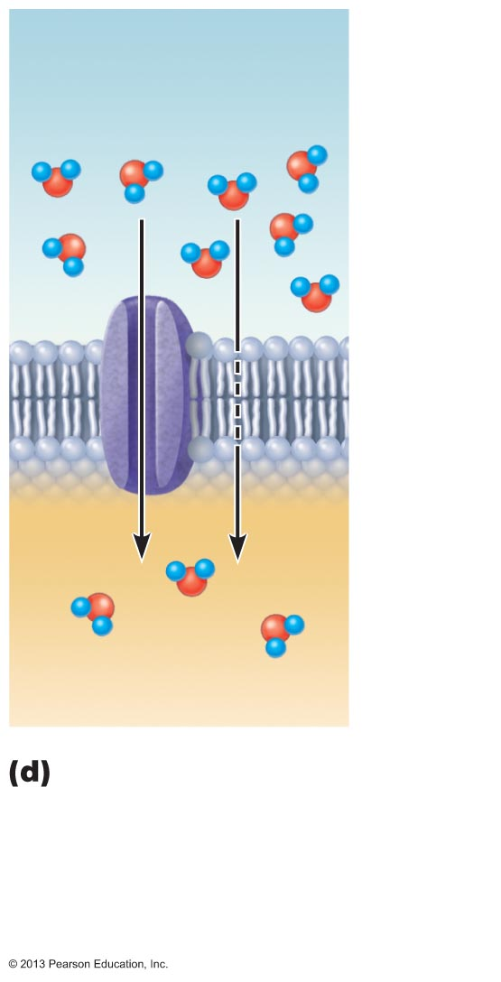
Figure 3.7d Diffusion through the plasma membrane.
Water
molecules
Lipid
bilayer
Aquaporin
Osmosis, diffusion of a
solvent such as water
through a specific
channel protein
(aquaporin) or through
the lipid bilayer

Slide 46
Passive Processes: Osmosis
Water concentration varies with number of solute particles because solute particles displace water molecules
Osmolarity - Measure of total concentration of solute particles
Water moves by osmosis until hydrostatic pressure (back pressure of water on membrane) and osmotic pressure (tendency of water to move into cell by osmosis) equalize

Slide 47
Passive Processes: Osmosis
When solutions of different osmolarity are separated by membrane permeable to all molecules, both solutes and water cross membrane until equilibrium reached
When solutions of different osmolarity are separated by membrane impermeable to solutes, osmosis occurs until equilibrium reached

Slide 48
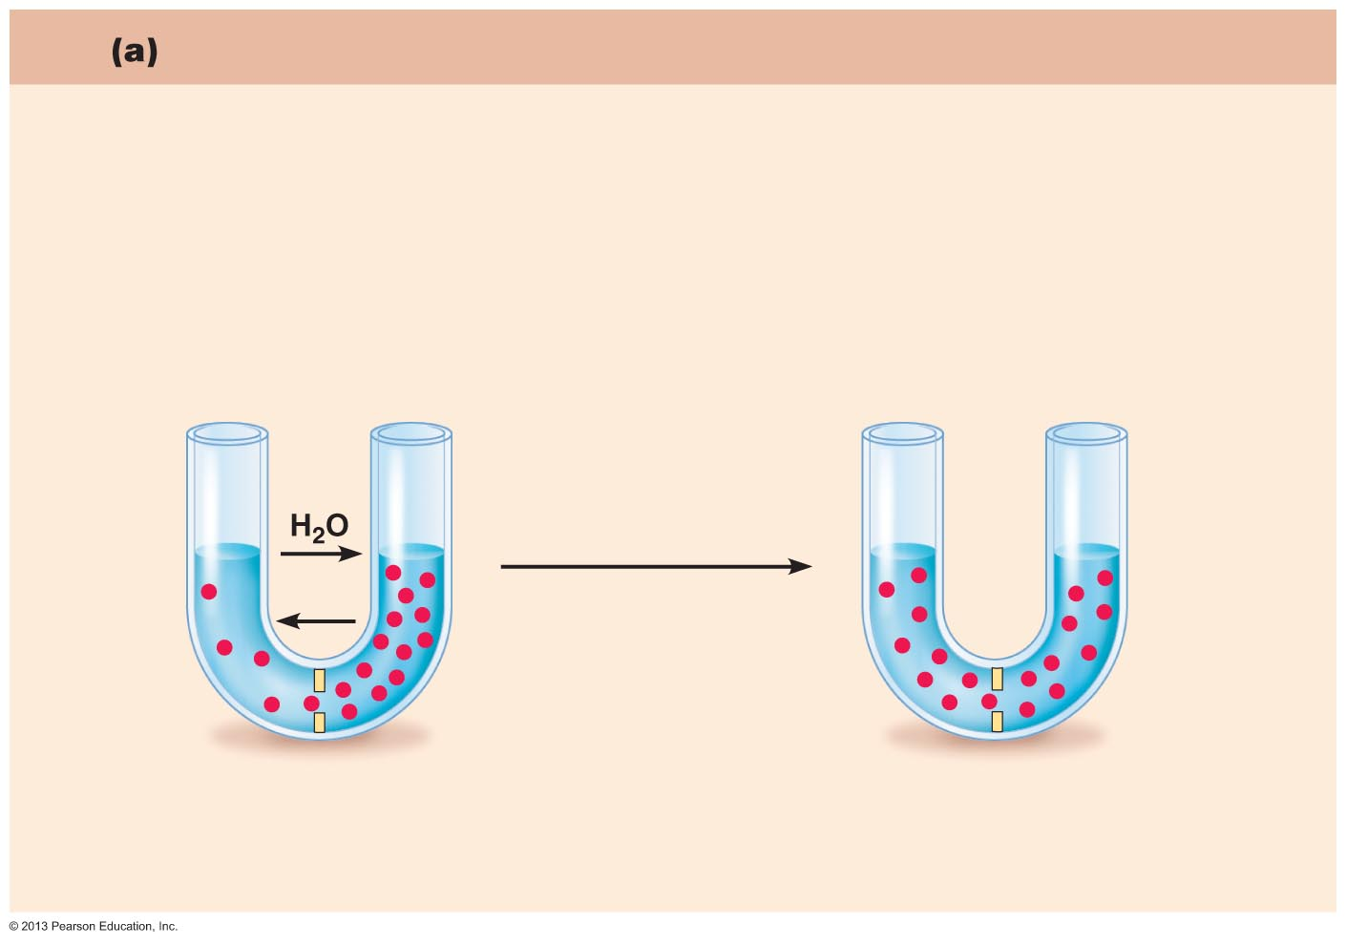
Figure 3.8a Influence of membrane permeability on diffusion and osmosis.
Membrane permeable to both solutes and water
Solute and water molecules move down their concentration gradients
in opposite directions. Fluid volume remains the same in both compartments.
Left
compartment:
Right
compartment:
Solution with
lower osmolarity
Solution with
greater osmolarity
Both solutions have the
same osmolarity: volume
unchanged
Solute
Freely
permeable
membrane
Solute
molecules
(sugar)

Slide 49
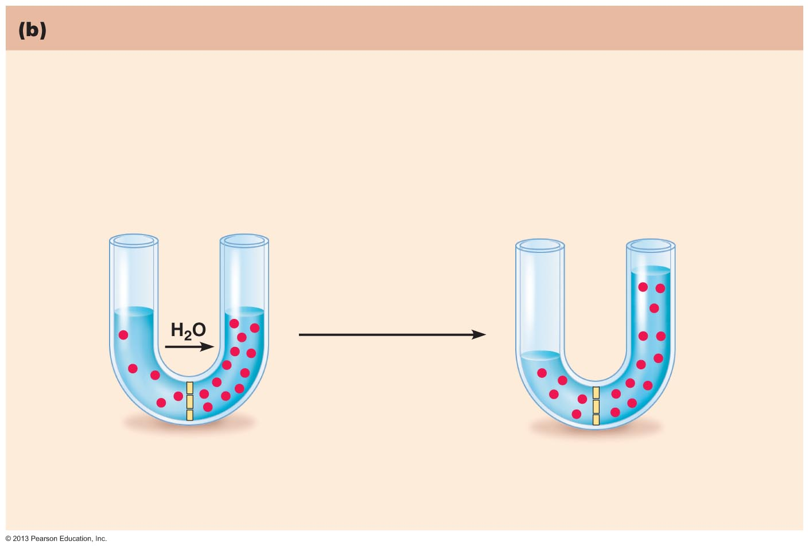
Figure 3.8b Influence of membrane permeability on diffusion and osmosis.
Membrane permeable to water, impermeable to solutes
Solute molecules are prevented from moving but water moves by osmosis.
Volume increases in the compartment with the higher osmolarity.
Both solutions have identical
osmolarity, but volume of the
solution on the right is greater
because only water is
free to move
Left
compartment
Right
compartment
Selectively
permeable
membrane
Solute
molecules
(sugar)

Slide 50
Importance of Osmosis
Osmosis causes cells to swell and shrink
Change in cell volume disrupts cell function, especially in neurons
PLAY
Animation: Osmosis

Slide 51
Tonicity
Tonicity: Ability of solution to alter cell's water volume
  Isotonic: Solution with same non-penetrating solute concentration as cytosol
  Hypertonic: Solution with higher non-penetrating solute concentration than cytosol
  Hypotonic: Solution with lower non-penetrating solute concentration than cytosol

Slide 52
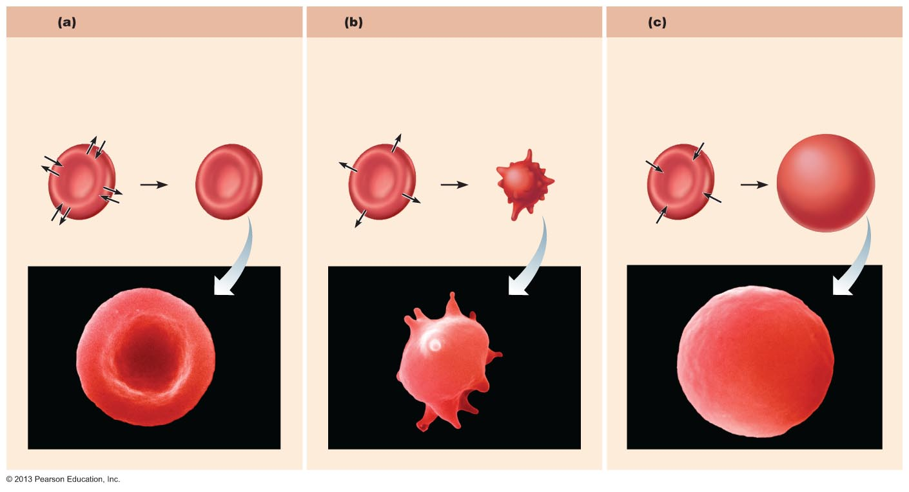
Figure 3.9 The effect of solutions of varying tonicities on living red blood cells.
Isotonic solutions
Hypertonic solutions
Hypotonic solutions
Cells retain their normal size and
shape in isotonic solutions (same
solute/water concentration as inside
cells; water moves in and out).
Cells lose water by osmosis and shrink
in a hypertonic solution (contains a
higher concentration of solutes
than are present inside the cells).
Cells take on water by osmosis until they
become bloated and burst (lyse) in a
hypotonic solution (contains a lower
concentration of solutes than are
present inside cells).

Slide 53
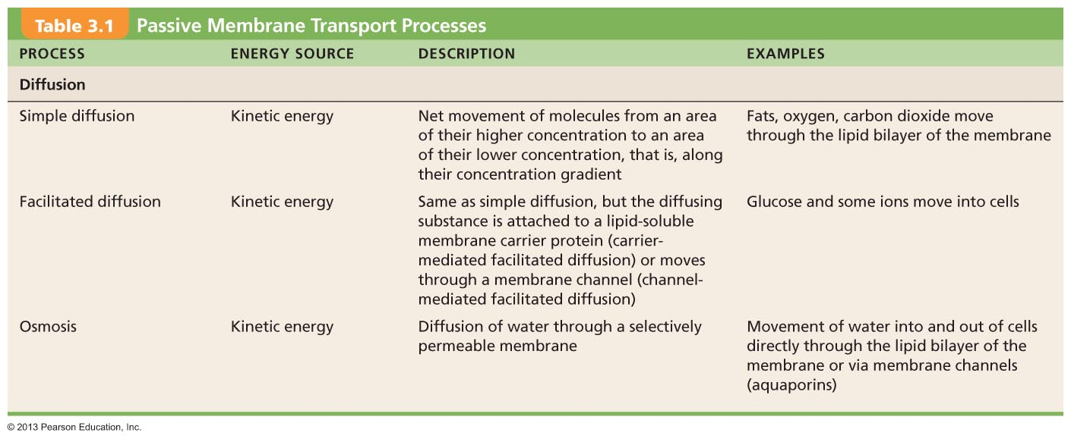
Table 3.1 Passive Membrane Transport Processes

