Slide 1
3
Cells: The Living Units: Part C

Slide 2
Cytoplasm
Located between plasma membrane and nucleus
  Composed of
    Cytosol
      Water with solutes (protein, salts, sugars, etc.)
    Organelles
      Metabolic machinery of cell; each with specialized function; either membranous or nonmembranous
    Inclusions
      Vary with cell type; e.g., glycogen granules, pigments, lipid droplets, vacuoles, crystals

Slide 3
Cytoplasmic Organelles
Membranous
  Mitochondria
  Peroxisomes
  Lysosomes
  Endoplasmic reticulum
  Golgi apparatus
Nonmembranous
  Cytoskeleton
  Centrioles
  Ribosomes
Membranes allow crucial compartmentalization

Slide 4
Mitochondria
Double-membrane structure with inner shelflike cristae
Provide most of cell's ATP via aerobic cellular respiration
  Requires oxygen
Contain their own DNA, RNA, ribosomes
Similar to bacteria; capable of cell division called fission

Slide 5
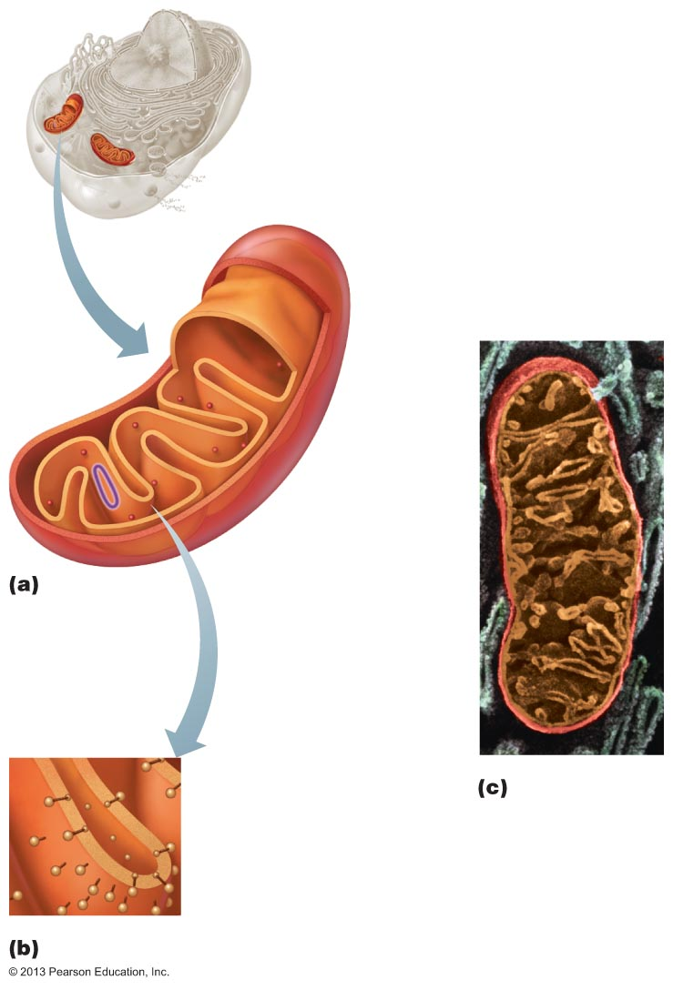
Figure 3.17 Mitochondrion.
Outer
mitochondrial
membrane
Ribosome
Mitochondrial
DNA
Inner
mitochondrial
membrane
Cristae
Matrix
Enzymes

Slide 6
Ribosomes
Granules containing protein and rRNA
Site of protein synthesis
Free ribosomes synthesize soluble proteins that function in cytosol or other organelles
Membrane-bound ribosomes (forming rough ER) synthesize proteins to be incorporated into membranes, lysosomes, or exported from cell

Slide 7
Endoplasmic Reticulum (ER)
Interconnected tubes and parallel membranes enclosing cisterns
Continuous with outer nuclear membrane
Two varieties:
  Rough ER
  Smooth ER

Slide 8
Rough ER
External surface studded with ribosomes
Manufactures all secreted proteins
Synthesizes membrane integral proteins and phospholipids
Assembled proteins move to ER interior, enclosed in vesicle, go to Golgi apparatus

Slide 9
Smooth ER
Network of tubules continuous with rough ER
Its enzymes (integral proteins) function in
  Lipid metabolism; cholesterol and steroid-based hormone synthesis; making lipids of lipoproteins
  Absorption, synthesis, and transport of fats
  Detoxification of drugs, some pesticides, carcinogenic chemicals
  Converting glycogen to free glucose
  Storage and release of calcium

Slide 10
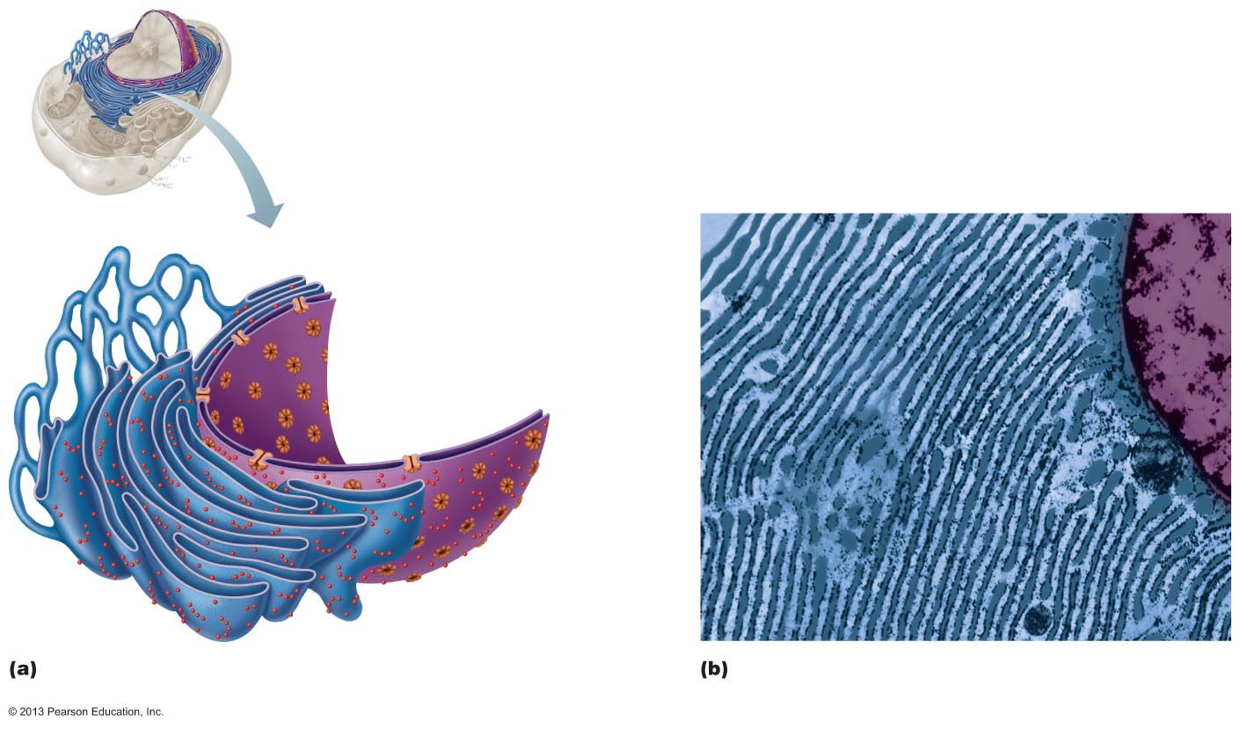
Figure 3.18 The endoplasmic reticulum.
Nucleus
Smooth ER
Nuclear
envelope
Rough ER
Ribosomes
Diagrammatic view of smooth and rough ER
Electron micrograph of smooth and rough
ER (25,000x)

Slide 11
Golgi Apparatus
Stacked and flattened membranous sacs
Modifies, concentrates, and packages proteins and lipids from rough ER
Transport vessels from ER fuse with convex cis face; proteins modified, tagged for delivery, sorted, packaged in vesicles

Slide 12
Golgi Apparatus
Three types of vesicles bud from concave trans face
  Secretory vesicles (granules)
    To trans face; release export proteins by exocytosis
  Vesicles of lipids and transmembrane proteins for plasma membrane or organelles
  Lysosomes containing digestive enzymes; remain in cell

Slide 13
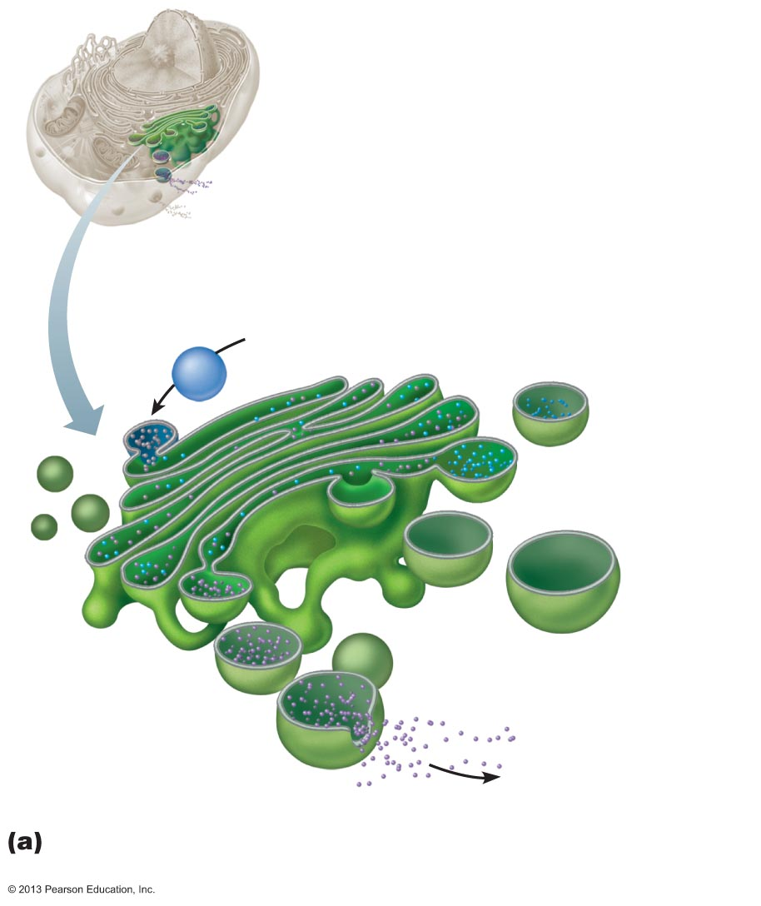
Figure 3.19a Golgi apparatus.
Cis face—
“receiving” side of
Golgi apparatus
Transport vesicle
from rough ER
Cisterns
New vesicles
forming
Transport
vesicle
from
trans face
Trans face—
“shipping” side of
Golgi apparatus
Secretory
vesicle
Many vesicles in the process of pinching off
from the Golgi apparatus.

Slide 14
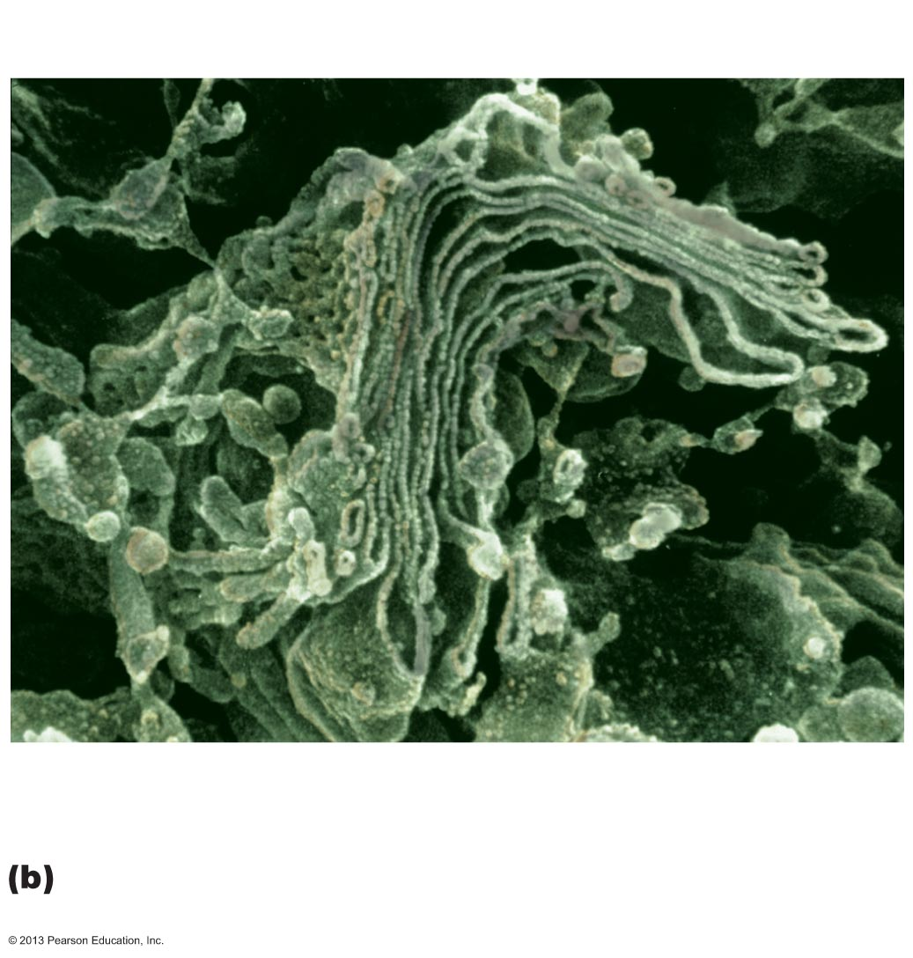
Figure 3.19b Golgi apparatus.
New vesicles forming
Golgi
apparatus
Transport vesicle at
the trans face
Electron micrograph of the Golgi apparatus
(90,000x)

Slide 15
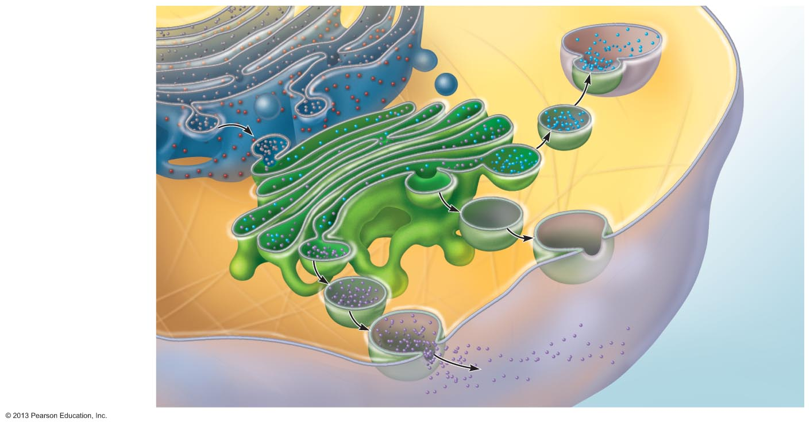
Figure 3.20 The sequence of events from protein synthesis on the rough ER to the final distribution of those proteins.
Slide 1
1
Rough ER
ER
membrane
Phagosome
Plasma
membra-
ne
Protein-conta-
ining vesicles
pinch off rough
ER and migrate
to fuse with
membranes of
Golgi apparatus.
Proteins in
cisterns
Pathway C:
Lysosome
containing acid
hydrolase
enzymes
2
Proteins are
modified within
the Golgi
compartments.
Vesicle
becomes
lysosome
3
Proteins are
then packaged
within different
vesicle types,
depending on
their ultimate
destination.
Secretory
vesicle
Pathway B:
Vesicle membrane
to be incorporated
into plasma
membrane
Golgi
apparatus
Pathway A:
Vesicle contents
destined for
exocytosis
Secretion by
exocytosis
Extracellular fluid

Slide 16
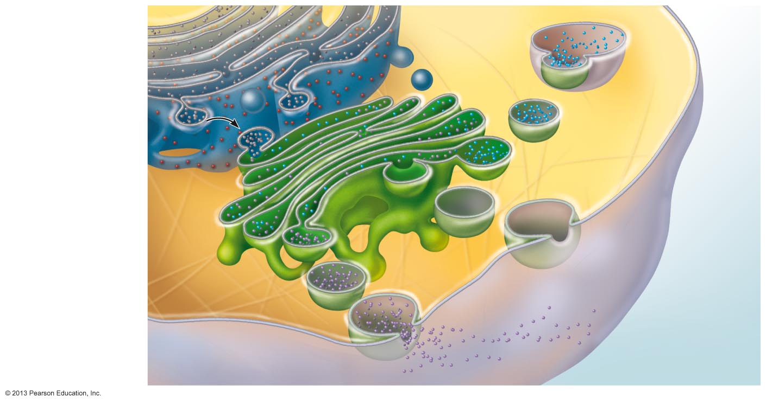
Figure 3.20 The sequence of events from protein synthesis on the rough ER to the final distribution of those proteins.
Slide 2
1
Rough ER
ER
membrane
Plasma
membra-
ne
Protein-conta-
ining vesicles
pinch off rough
ER and migrate
to fuse with
membranes of
Golgi apparatus.
Proteins in
cisterns
Golgi
apparatus
Extracellular fluid

Slide 17
Figure 3.20 The sequence of events from protein synthesis on the rough ER to the final distribution of those proteins.
Slide 3
1
Rough ER
ER
membrane
Plasma
membra-
ne
Protein-conta-
ining vesicles
pinch off rough
ER and migrate
to fuse with
membranes of
Golgi apparatus.
Proteins in
cisterns
2
Proteins are
modified within
the Golgi
compartments.
Golgi
apparatus
Extracellular fluid

Slide 18
Figure 3.20 The sequence of events from protein synthesis on the rough ER to the final distribution of those proteins.
Slide 4
1
Rough ER
ER
membrane
Phagosome
Plasma
membra-
ne
Protein-conta-
ining vesicles
pinch off rough
ER and migrate
to fuse with
membranes of
Golgi apparatus.
Proteins in
cisterns
Pathway C:
Lysosome
containing acid
hydrolase
enzymes
2
Proteins are
modified within
the Golgi
compartments.
Vesicle
becomes
lysosome
3
Proteins are
then packaged
within different
vesicle types,
depending on
their ultimate
destination.
Secretory
vesicle
Pathway B:
Vesicle membrane
to be incorporated
into plasma
membrane
Golgi
apparatus
Pathway A:
Vesicle contents
destined for
exocytosis
Secretion by
exocytosis
Extracellular fluid

Slide 19
Peroxisomes
Membranous sacs containing powerful oxidases and catalases
Detoxify harmful or toxic substances
Catalysis and synthesis of fatty acids
Neutralize dangerous free radicals (highly reactive chemicals with unpaired electrons)
  Oxidases convert to H₂O₂ (also toxic)
  Catalases convert H₂O₂ to water and oxygen

Slide 20
Lysosomes
Spherical membranous bags containing digestive enzymes (acid hydrolases)
  "Safe" sites for intracellular digestion
Digest ingested bacteria, viruses, and toxins
Degrade nonfunctional organelles
Metabolic functions, e.g., break down and release glycogen
Destroy cells in injured or nonuseful tissue (autolysis)
Break down bone to release Ca²⁺

Slide 21
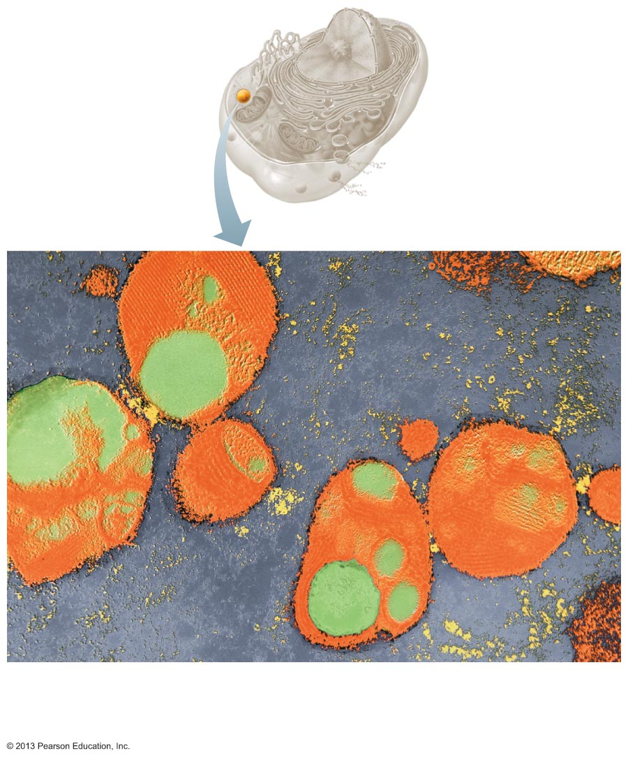
Figure 3.21 Electron micrograph of lysosomes (20,000x).
Lysosomes
Light green areas are regions
where materials are being digested.

Slide 22
Endomembrane System
Overall function
  Produce, degrade, store, and export biological molecules
  Degrade potentially harmful substances
Includes ER, Golgi apparatus, secretory vesicles, lysosomes, nuclear and plasma membranes

Slide 23
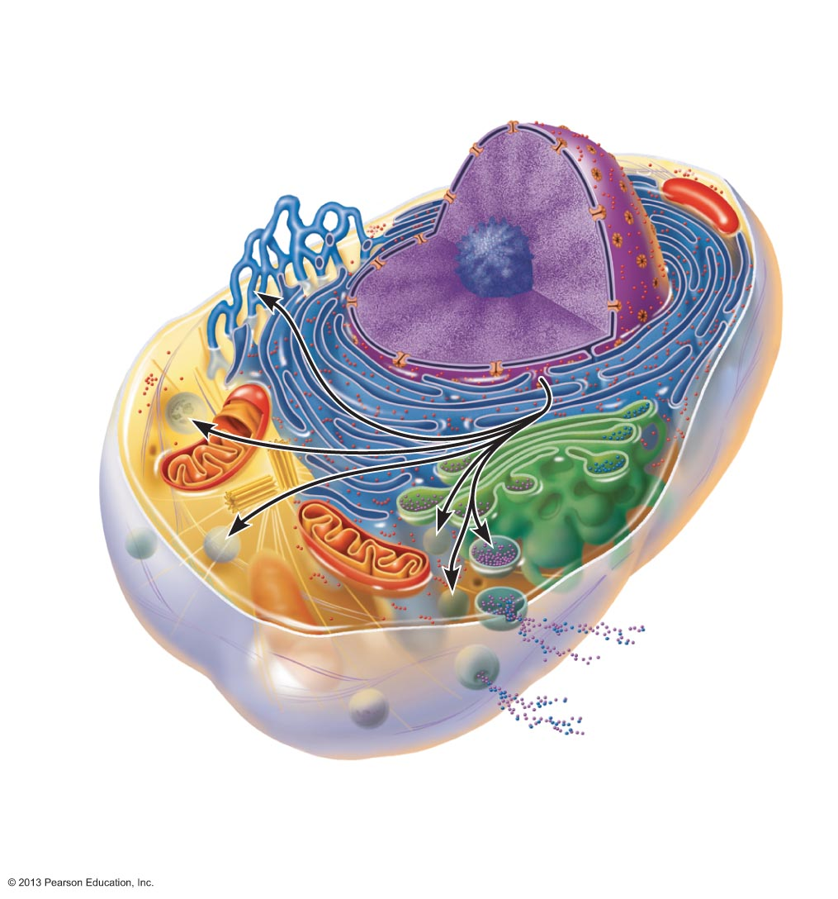
Figure 3.22 The endomembrane system.
Nuclear
envelope
Nucleus
Smooth ER
Rough ER
Golgi
apparatus
Secretory
vesicle
Transport
vesicle
Plasma
membrane
Lysosome

Slide 24
Endomembrane System
PLAY
Animation: Endomembrane System

Slide 25
Cytoskeleton
Elaborate series of rods throughout cytosol; proteins link rods to other cell structures
  Three types
    Microfilaments
    Intermediate filaments
    Microtubules

Slide 26
Microfilaments
Thinnest of cytoskeletal elements
Dynamic strands of protein actin
Each cell has a unique arrangement of strands
Dense web attached to cytoplasmic side of plasma membrane is called terminal web
  Gives strength, compression resistance
Involved in cell motility, change in shape, endocytosis and exocytosis

Slide 27
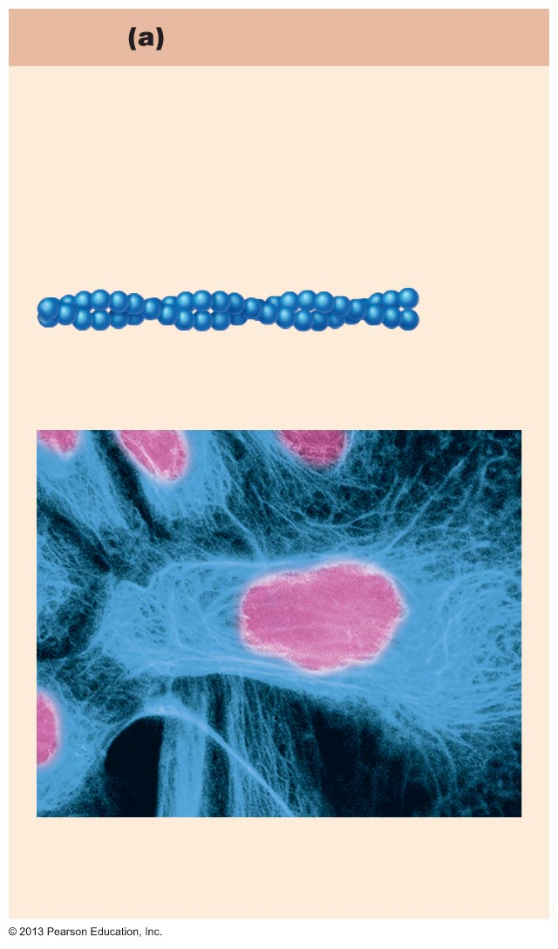
Figure 3.23a Cytoskeletal elements support the cell and help to generate movement.
Microfilaments
Strands made of spherical protein
subunits called actins
Actin subunit
7 nm
Microfilaments form the blue network
surrounding the pink nucleus
in this photo.

Slide 28
Intermediate Filaments
Tough, insoluble, ropelike protein fibers
Composed of tetramer fibrils
Resist pulling forces on cell; attach to desmosomes
E.g., neurofilaments in nerve cells; keratin filaments in epithelial cells

Slide 29
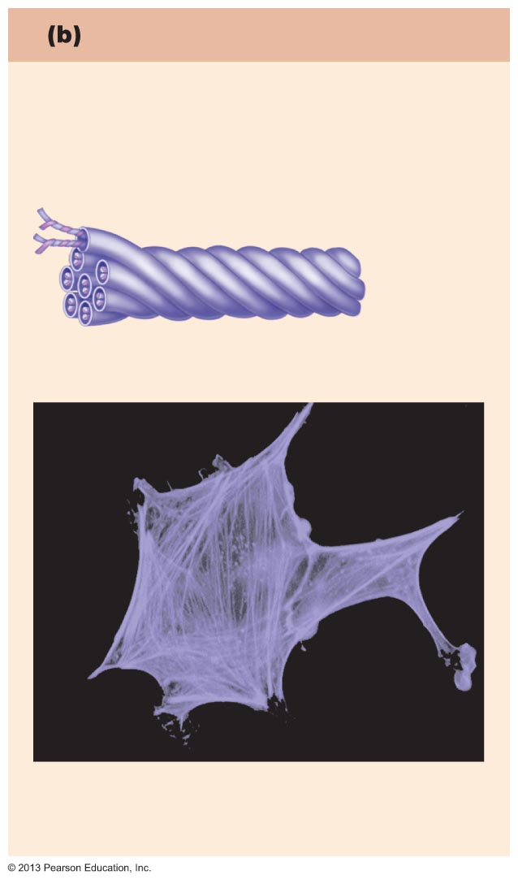
Figure 3.23b Cytoskeletal elements support the cell and help to generate movement.
Intermediate filaments
Tough, insoluble protein fibers
constructed like woven ropes
composed of tetramer (4) fibrils
Tetramer subunits
10 nm
Intermediate filaments form the purple
batlike network in this photo.

Slide 30
Microtubules
Largest of cytoskeletal elements; dynamic hollow tubes; most radiate from centrosome
Composed of protein subunits called tubulins
Determine overall shape of cell and distribution of organelles
Mitochondria, lysosomes, secretory vesicles attach to microtubules; moved throughout cell by motor proteins

Slide 31
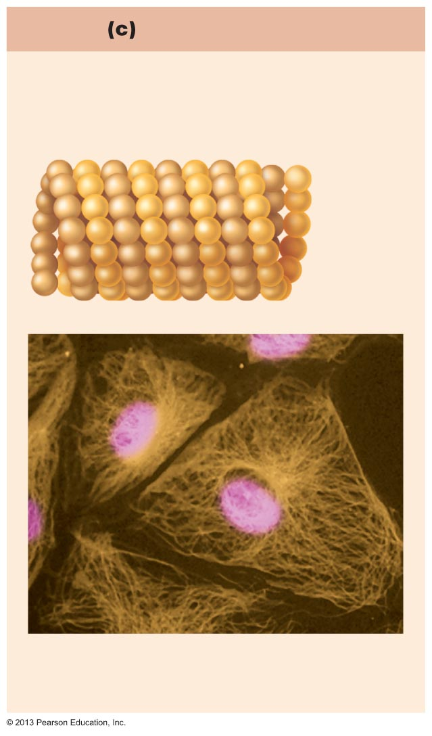
Figure 3.23c Cytoskeletal elements support the cell and help to generate movement.
Microtubules
Hollow tubes of spherical protein
subunits called tubulins
Tubulin subunits
25 nm
Microtubules appear as gold networks
surrounding the cells’ pink nuclei in
this photo.

Slide 32
Motor Proteins
Protein complexes that function in motility (e.g., movement of organelles and contraction)
Powered by ATP

Slide 33
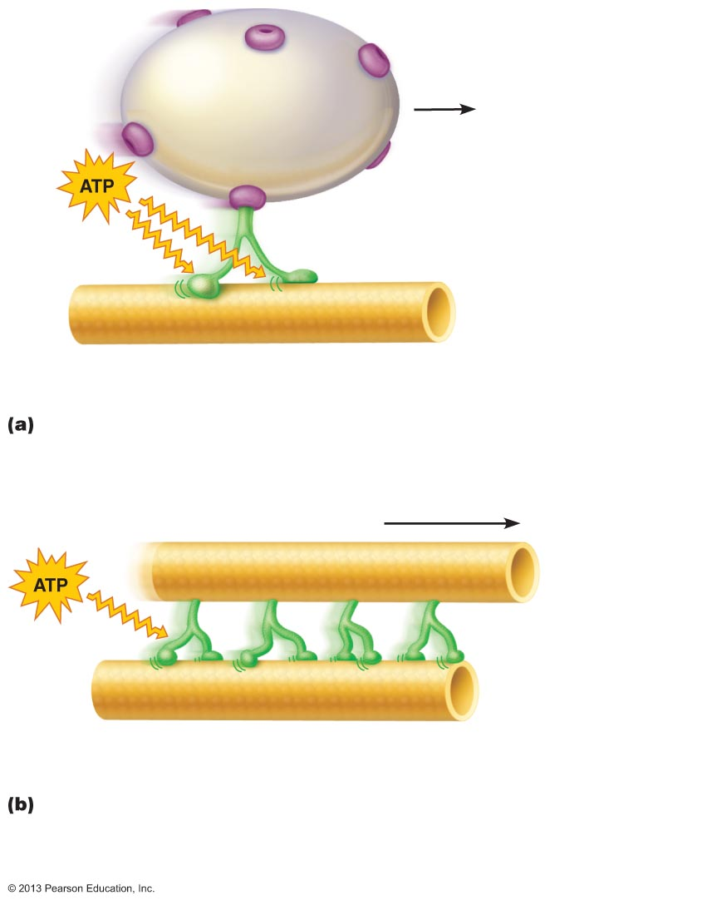
Figure 3.24 Microtubules and microfilaments function in cell motility by interacting with motor molecules powered by ATP.
Vesicle
Receptor for
motor molecule
Motor molecule
(ATP powered)
Microtubule
of cytoskeleton
Motor molecules can attach to receptors on
vesicles or organelles, and carry the organelles
along the microtubule “tracks” of the cytoskeleton.
Motor molecule
(ATP powered)
Cytoskeletal elements
(microtubules or microfilaments)
In some types of cell motility, motor molecules attached to one
element of the cytoskeleton can cause it to slide over another
element, which the motor molecules grip, release, and grip at a
new site. Muscle contraction and cilia movement work this way.

Slide 34
Centrosome and Centrioles
"Cell center" near nucleus
Generates microtubules; organizes mitotic spindle
Contains paired centrioles
  Barrel-shaped organelles formed by microtubules
Centrioles form basis of cilia and flagella

Slide 35
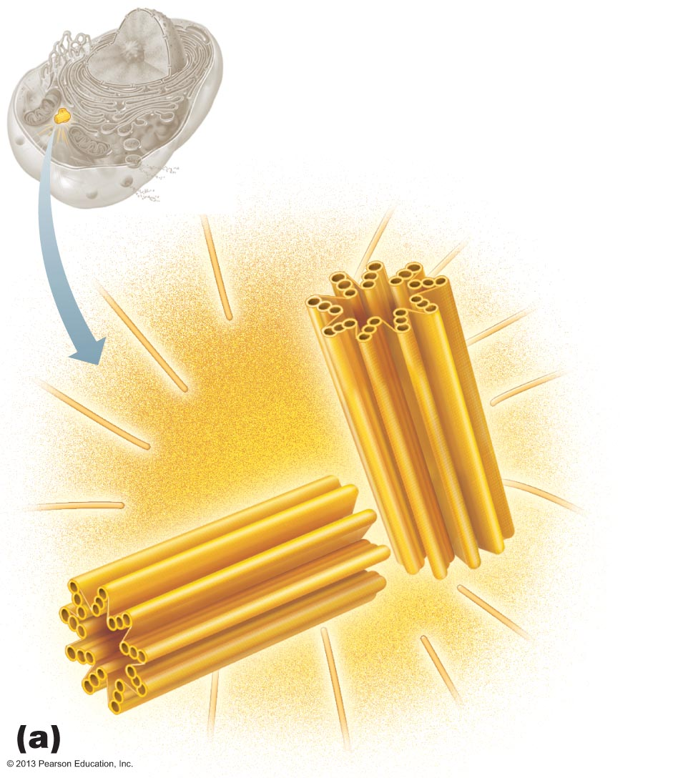
Figure 3.25a Centrioles.
Centrosome matrix
Centrioles
Microtubules

Slide 36
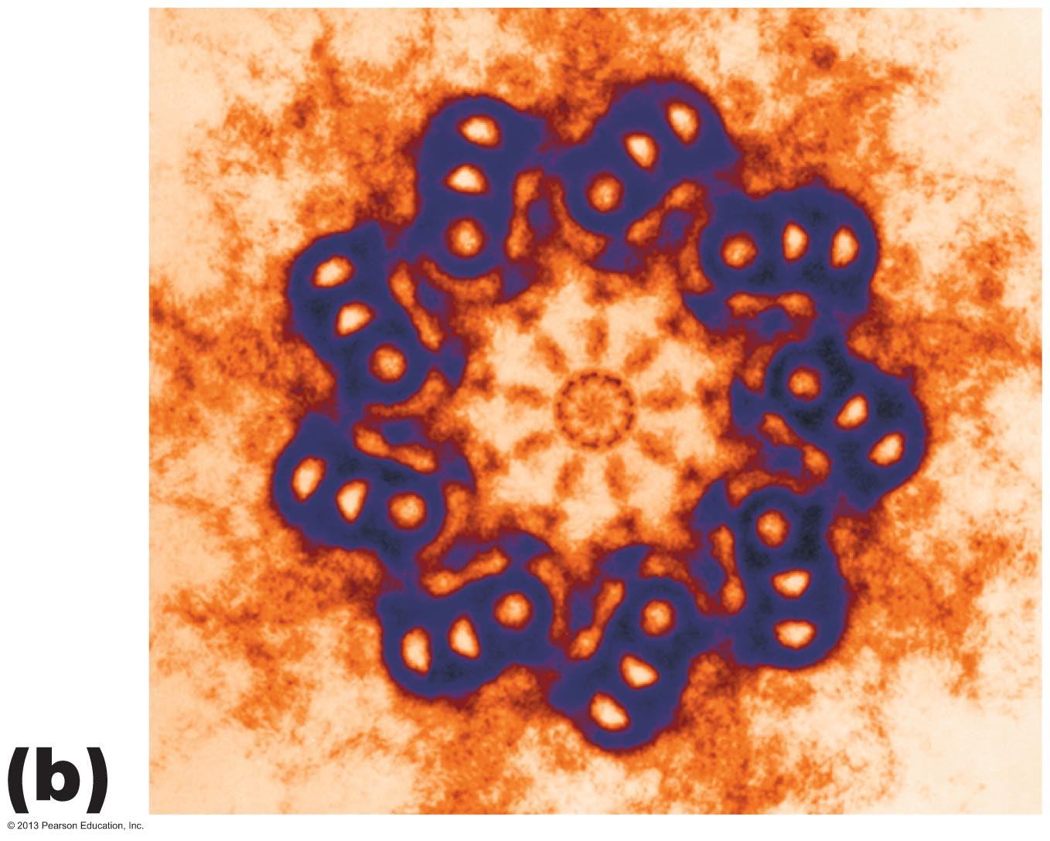
Figure 3.25b Centrioles.

Slide 37
Cellular Extensions
Cilia and flagella
  Whiplike, motile extensions on surfaces of certain cells
  Contain microtubules and motor molecules
  Cilia move substances across cell surfaces
  Longer flagella propel whole cells (tail of sperm)
PLAY
Animation: Cilia and Flagella

Slide 38
Cilia and Flagella
Centrioles forming base called basal bodies
Cilia movements alternate between power stroke and recovery stroke → current at cell surface
Primary cilia
  Single, nonmotile projection on most cells
  Probe environment for molecules receptors can recognize; coordinate intracellular pathways

Slide 39
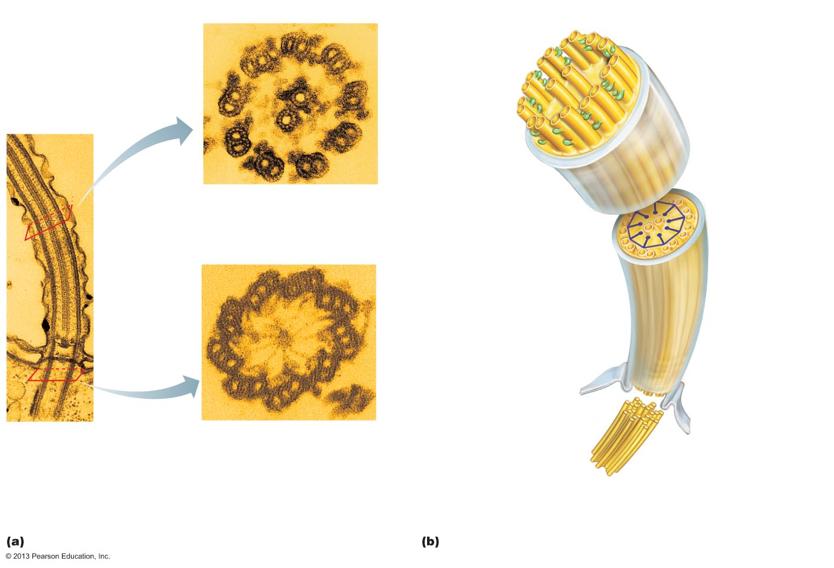
Figure 3.26 Structure of a cilium.
Outer microtubule
doublet
Dynein arms
The doublets
also have
Attached motor proteins, the
dynein arms.
Central
microtubule
Cross-linking
proteins between
outer doublets
Radial spoke
The outer
microtubule
doublets and the
two central
microtubules are
held together by
cross-linking
proteins and
radial spokes.
TEM
A cross section through the
cilium shows the “9 + 2”
arrangement of microtubules.
Microtubules
Cross-linking
proteins between
outer doublets
Radial spoke
Plasma
membrane
Plasma
membrane
Cilium
Basal body
Triplet
TEM
TEM
A longitudinal section of a
cilium shows microtubules
running the length of the
structure.
A cross section through the
basal body. The nine outer
doublets of a cilium extend into
a basal body where each
doublet joins another
microtubule to form a ring of
nine triplets.
Basal body
(centriole)

Slide 40
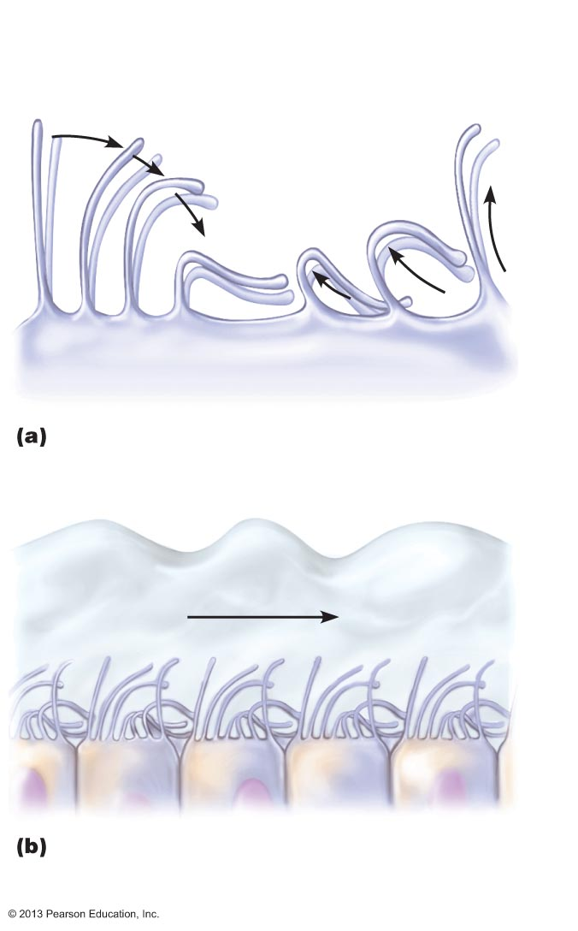
Figure 3.27 Ciliary function.
Power, or
propulsive, stroke
Recovery stroke, when cilium
is returning to its initial position
1
2
3
4
5
6
7
Phases of ciliary motion.
Layer of mucus
Cell surface
Traveling wave created by the activity of
many cilia acting together propels mucus
across cell surfaces.

Slide 41
Cellular Extensions
Microvilli
  Minute, fingerlike extensions of plasma membrane
  Increase surface area for absorption
  Core of actin filaments for stiffening

Slide 42
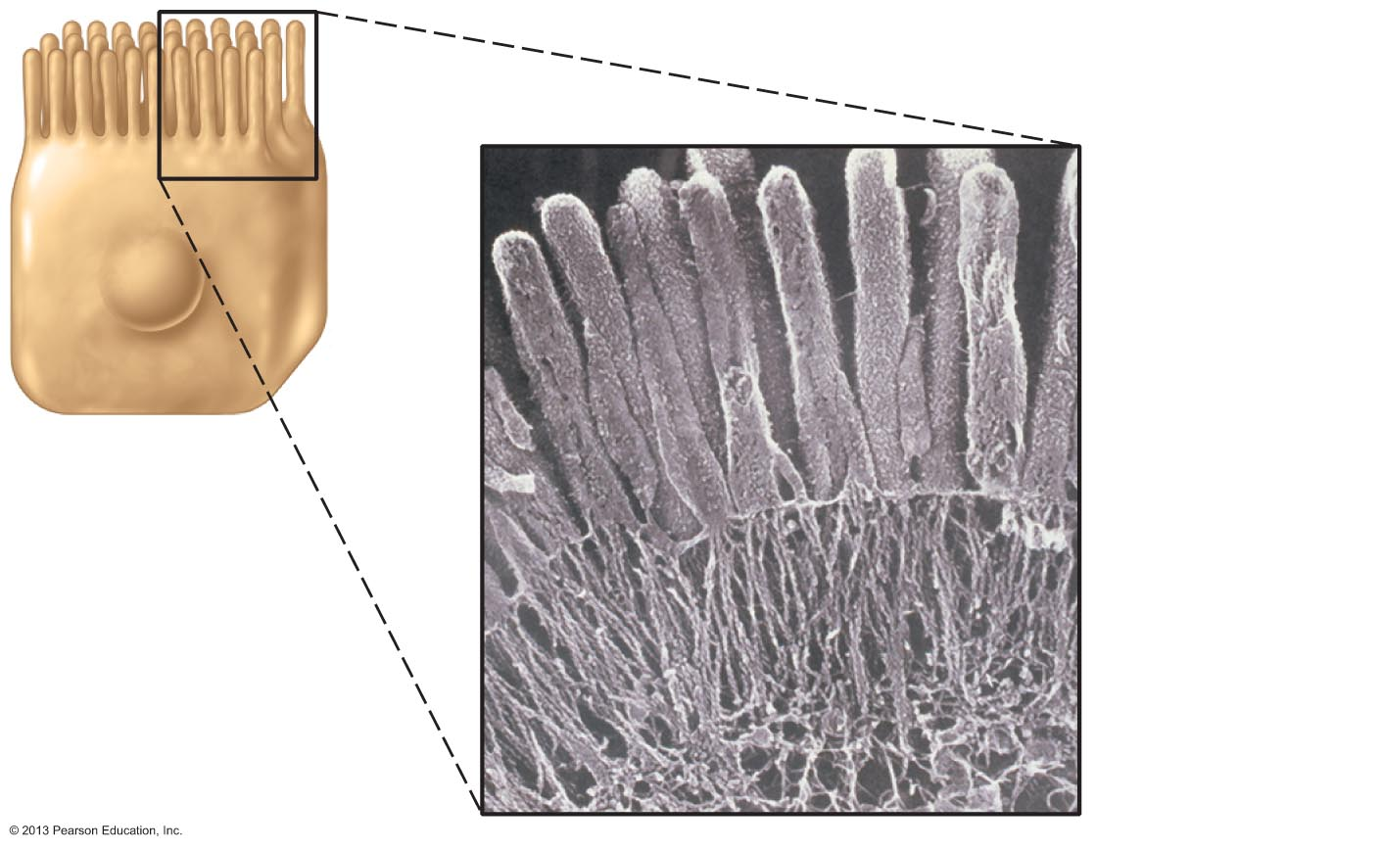
Figure 3.28 Microvilli.
Microvillus
Actin
filaments
Terminal
web

Slide 43
Nucleus
Largest organelle; genetic library with blueprints for nearly all cellular proteins
Responds to signals; dictates kinds and amounts of proteins synthesized
Most cells uninucleate; skeletal muscle cells, bone destruction cells, and some liver cells are multinucleate; red blood cells are anucleate
Three regions/structures

Slide 44
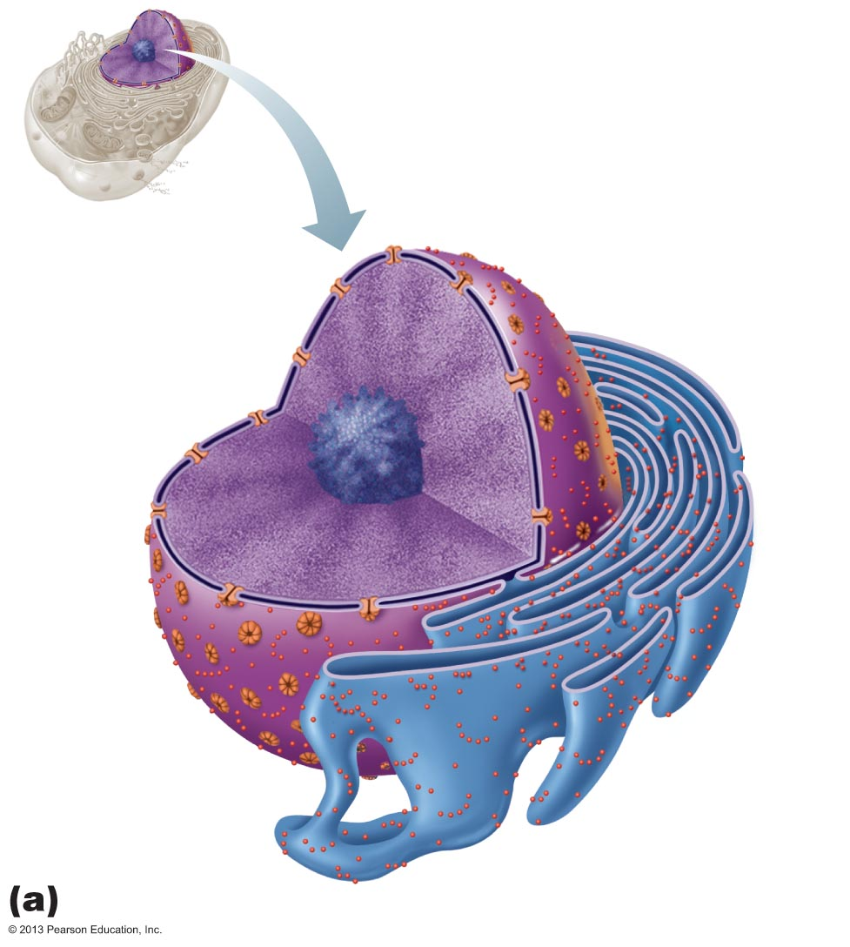
Figure 3.29a The nucleus.
Nuclear
pores
Nuclear
envelope
Nucleus
Chromatin
(condensed)
Nucleolus
Cisterns of
rough ER

Slide 45
The Nuclear Envelope
Double-membrane barrier; encloses nucleoplasm
Outer layer continuous with rough ER and bears ribosomes
Inner lining (nuclear lamina) maintains shape of nucleus; scaffold to organize DNA
Pores allow substances to pass; nuclear pore complex line pores; regulates transport of large molecules into and out of nucleus

Slide 46
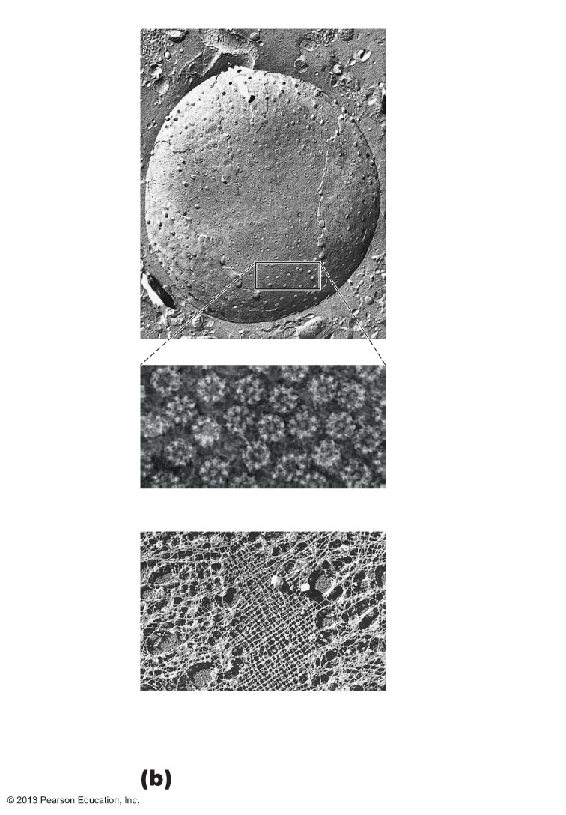
Figure 3.29b The nucleus.
Surface of nuclear envelope.
Fracture
line of outer
membrane
Nuclear
pores
Nucleus
Nuclear pore complexes. Each
pore is ringed by protein particles.
Nuclear lamina. The netlike lamina
composed of intermediate filaments
formed by lamins lines the inner surface
of the nuclear envelope.

Slide 47
Nucleoli
Dark-staining spherical bodies within nucleus
Involved in rRNA synthesis and ribosome subunit assembly
Associated with nucleolar organizer regions
  Contains DNA coding for rRNA
Usually one or two per cell

Slide 48
Chromatin
Threadlike strands of DNA (30%), histone proteins (60%), and RNA (10%)
Arranged in fundamental units called nucleosomes
Histones pack long DNA molecules; involved in gene regulation
Condense into barlike bodies called chromosomes when cell starts to divide

Slide 49
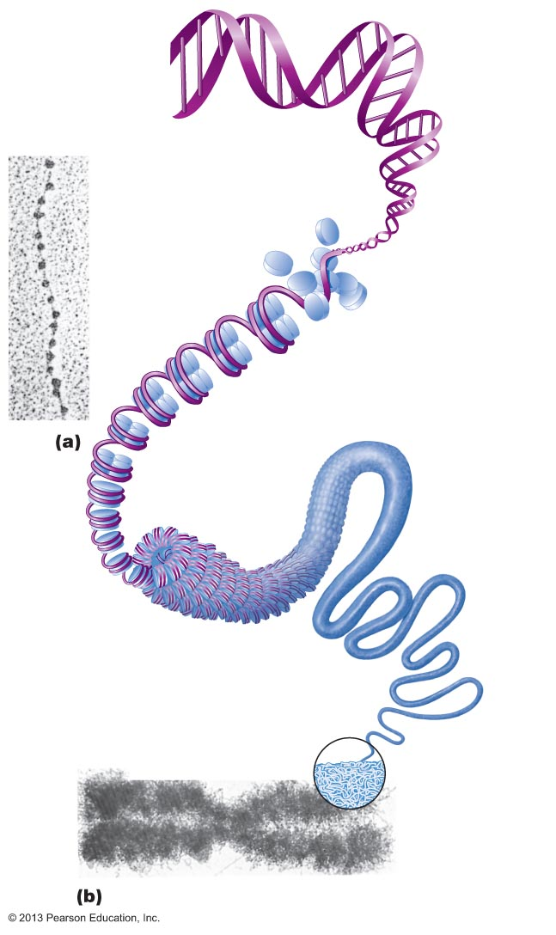
Figure 3.30 Chromatin and chromosome structure.
1 DNA
double
helix (2-nm
diameter)
Histones
2 Chromatin
(“beads on a string”)
structure with
nucleosomes
Linker DNA
Nucleosome (10-nm diameter;
eight histone proteins wrapped
by two winds of the DNA double
helix)
3 Tight helical fiber
(30-nm diameter)
4 Looped domain
structure (300-nm
diameter)
5 Chromatid
(700-nm diameter)
6 Metaphase
chromosome
(at midpoint
of cell division)
consists of two
sister
chromatids

