Slide 1
4
Tissue: The Living Fabric: Part A

Slide 2
Tissue: The Living Fabric
Individual body cells specialized
  Each type performs specific functions that maintain homeostasis
Tissues
  Groups of cells similar in structure that perform common or related function
Histology
  Study of tissues
© 2013 Pearson Education, Inc.

Slide 3
Types of Primary Tissues
Epithelial tissue
  Covers
Connective tissue
  Supports
Muscle tissue
  Produces movement
Nerve tissue
  Controls
© 2013 Pearson Education, Inc.

Slide 4
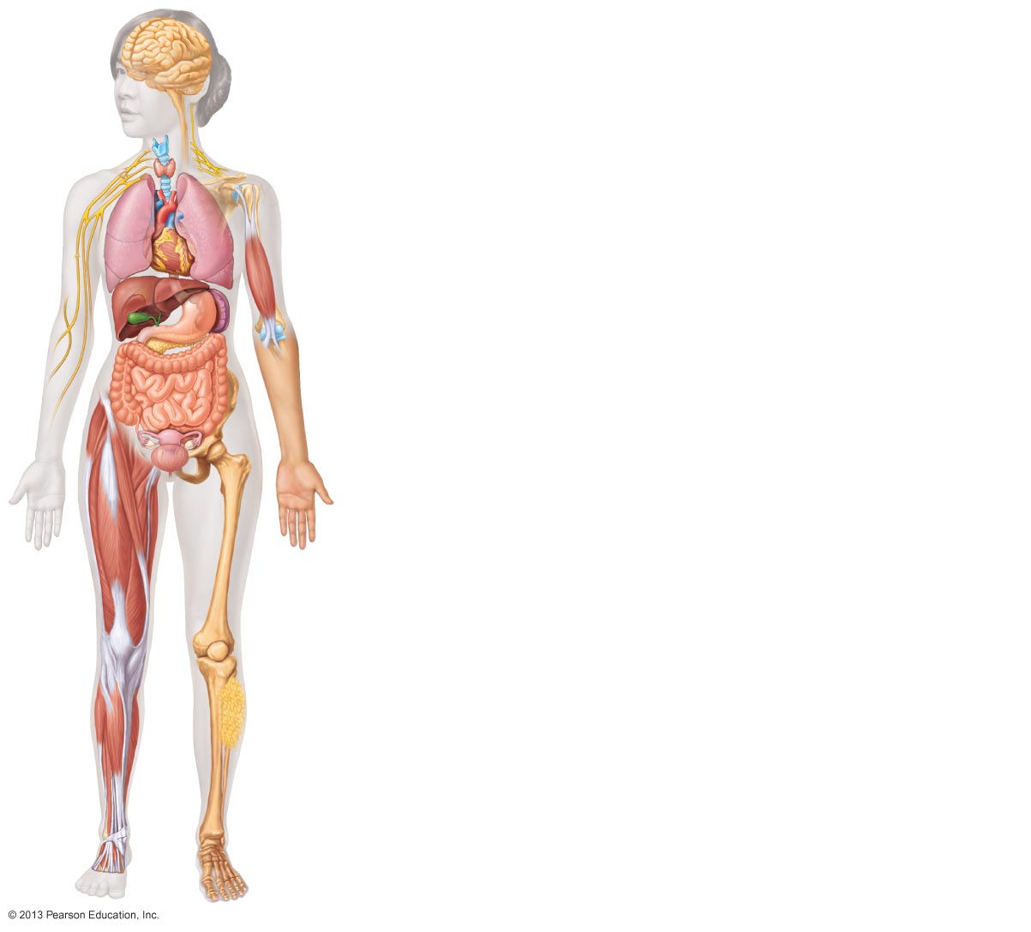
Figure 4.1 Overview of four basic tissue types: epithelial, connective, muscle, and nervous tissues.
Nervous tissue: Internal communication
• Brain
• Spinal cord
• Nerves
Muscle tissue: Contracts to cause movement
• Muscles attached to bones (skeletal)
• Muscles of heart (cardiac)
• Muscles of walls of hollow organs (smooth)
Epithelial tissue: Forms boundaries between different environments, protects, secretes, absorbs, filters
• Lining of digestive tract organs and other hollow organs
• Skin surface (epidermis)
Connective tissue: Supports, protects, binds other tissues together
• Bones
• Tendons
• Fat and other soft padding tissue
© 2013 Pearson Education, Inc.

Slide 5
Studying Human Tissue: Microscopy
Tissue is fixed
  Preserved
Cut
  Sliced thin enough to transmit light or electrons
Stained
  Enhances contrast
© 2013 Pearson Education, Inc.

Slide 6
Epithelial Tissue (Epithelium)
Form boundaries
Two main types (by location)
  Covering and lining epithelia
    On external and internal surfaces
  Glandular epithelia
    Secretory tissue in glands
© 2013 Pearson Education, Inc.

Slide 7
Epithelial Tissue Functions
Protection
Absorption
Filtration
Excretion
Secretion
Sensory reception
© 2013 Pearson Education, Inc.

Slide 8
Five Characteristics of Epithelial Tissues
Polarity
Specialized contacts
Supported by connective tissues
Avascular, but innervated分布神经
Can regenerate
© 2013 Pearson Education, Inc.

Slide 9
Characteristics of Epithelial Tissue: Polarity
Cells have polarity
  Apical surface (upper free) exposed to exterior or cavity
  Basal surface (lower, attached)
  Both surfaces differ in structure and function
© 2013 Pearson Education, Inc.

Slide 10
Apical Surface of Epithelial Tissues
May be smooth & slick
Most have microvilli (e.g., brush border of intestinal lining)
  Increase surface area
Some have cilia (e.g., lining of trachea)
© 2013 Pearson Education, Inc.

Slide 11
Basal Surface of Epithelial Tissues
Noncellular basal lamina
  Glycoprotein and collagen fibers lies adjacent to basal surface
  Adhesive sheet
  Selective filter
  Scaffolding for cell migration in wound repair
© 2013 Pearson Education, Inc.

Slide 12
Characteristics of Epithelial Tissue: Specialized Contacts
Covering and lining epithelial tissues fit closely together
  Form continuous sheets
Specialized contacts bind adjacent cells
  Lateral contacts
    Tight junctions
    Desmosomes
© 2013 Pearson Education, Inc.

Slide 13
Characteristics of Epithelial Tissue:
Connective Tissue Support
All are supported by connective tissue
Reticular lamina
  Deep to basal lamina
  Network of collagen fibers
Basement membrane
  Basal lamina + reticular lamina
  Reinforces epithelial sheet
  Resists stretching and tearing
  Defines epithelial boundary
© 2013 Pearson Education, Inc.

Slide 14
Characteristics of Epithelial Tissue: Avascular but Innervated
No blood vessels in epithelial tissue
  Must be nourished by diffusion from underlying connective tissues
Is supplied by nerve fibers
© 2013 Pearson Education, Inc.

Slide 15
Characteristics of Epithelial Tissue: Regeneration
High regenerative capacity
Stimulated by loss of apical-basal polarity and lateral contacts
  Some exposed to friction
  Some exposed to hostile substances
If adequate nutrients can replace lost cells by cell division
© 2013 Pearson Education, Inc.

Slide 16
Classification of Epithelia
All epithelial tissues have two names
  One indicates number of cell layers
    Simple epithelia = single layer of cells
    Stratified epithelia = two or more layers of cells
      Shape can change in different layers
  One indicates shape of cells
    Squamous
    Cuboidal
    Columnar
In stratified epithelia, epithelia classified by cell shape in apical layer
© 2013 Pearson Education, Inc.

Slide 17
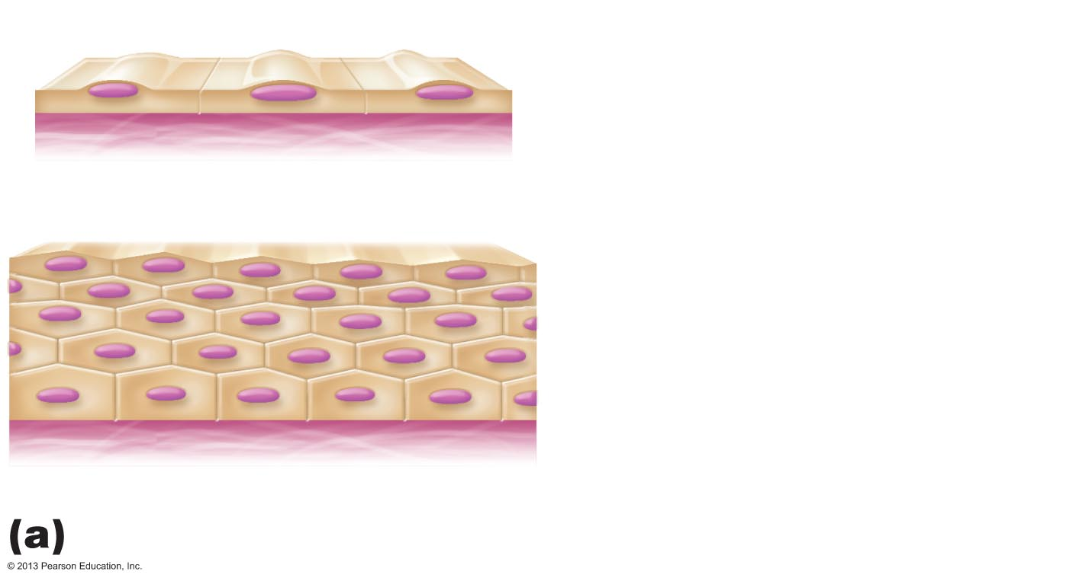
Figure 4.2a Classification of epithelia.
Apical surface
Basal surface
Simple
Apical surface
Basal surface
Stratified
Classification based on number of cell layers.
© 2013 Pearson Education, Inc.

Slide 18
Cells of Epithelial Tissues
Squamous cells
  Flattened and scalelike
  Nucleus flattened
Cuboidal cells
  Boxlike
  Nucleus round
Columnar cells
  Tall; column shaped
  Nucleus elongated
© 2013 Pearson Education, Inc.

Slide 19
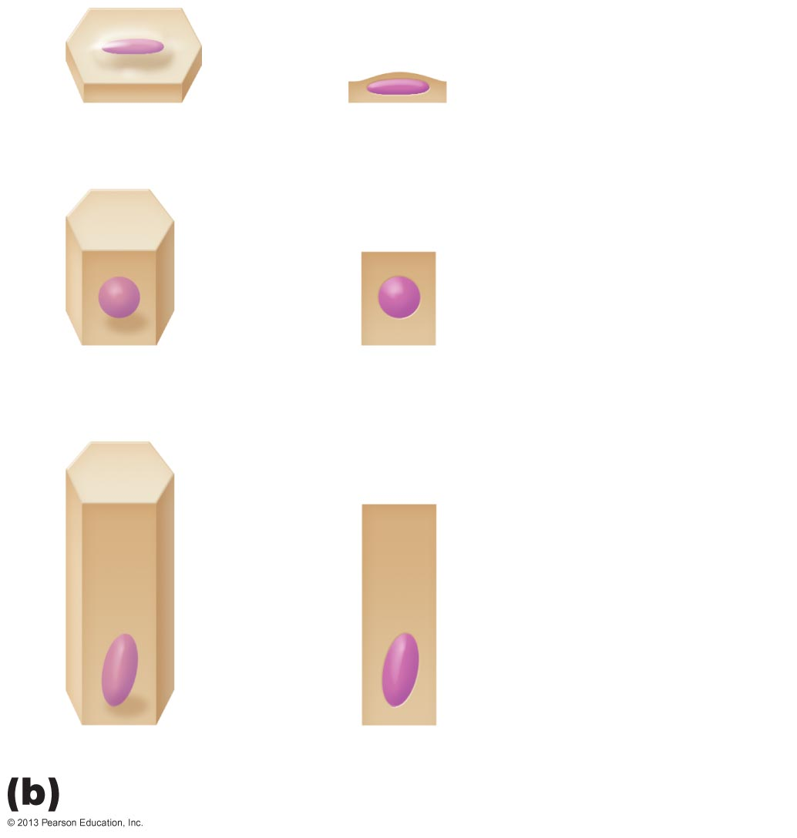
Figure 4.2b Classification of epithelia.
Squamous
Cuboidal
Columnar
Classification based on cell shape.
© 2013 Pearson Education, Inc.

Slide 20
Classification of Epithelia:
Simple Epithelia
Absorption
Secretion
Filtration
Very thin
© 2013 Pearson Education, Inc.

Slide 21
Simple Squamous Epithelium
Cells flattened laterally
Cytoplasm sparse
Function where rapid diffusion is priority
  i.e., kidney, lungs
Note description, function, location on next slide
© 2013 Pearson Education, Inc.

Slide 22
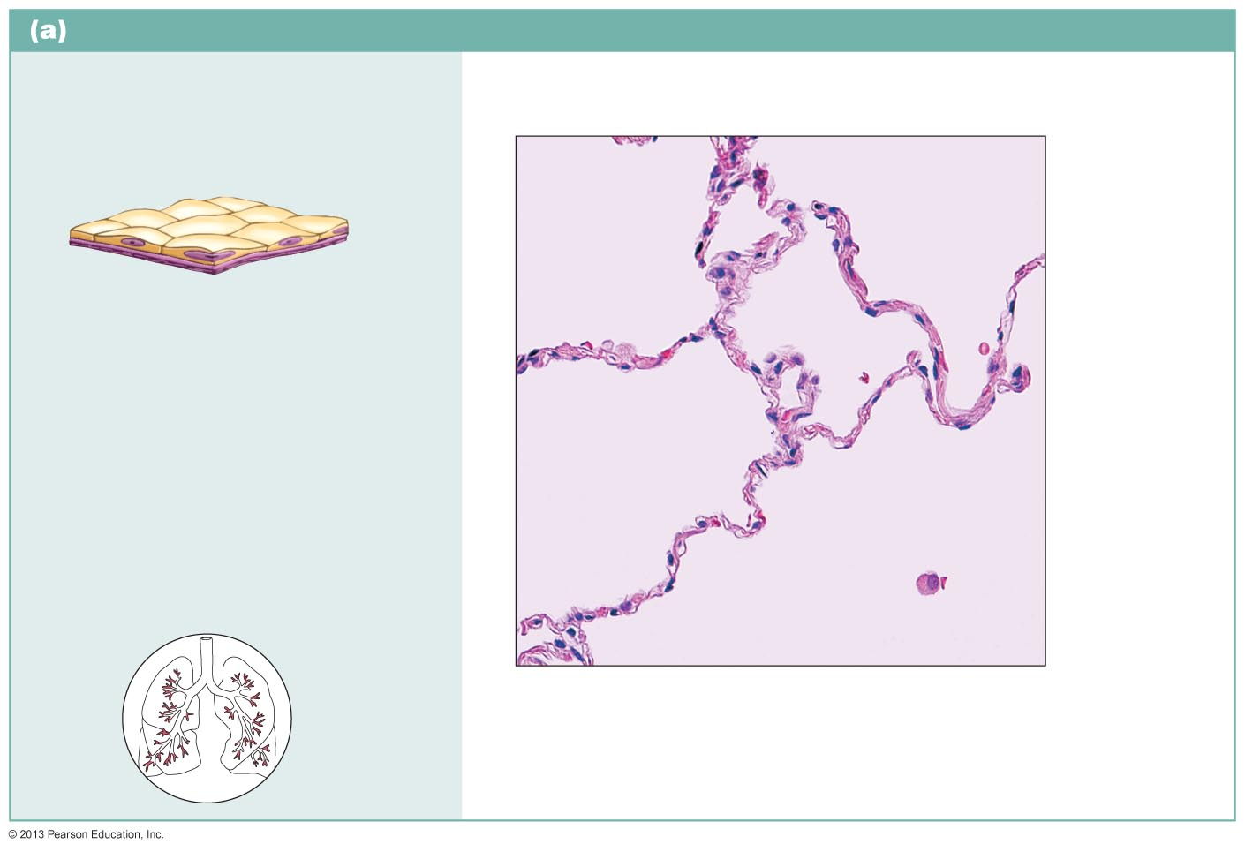
Figure 4.3a Epithelial tissues.
Simple squamous epithelium
Description: Single layer of flattened cells with disc-shaped central nuclei and sparse cytoplasm; the simplest of the epithelia.
Air sacs of lung tissue
Nuclei of squamous epithelial cells
Function: Allows materials to pass by diffusion and filtration in sites where protection is not important; secretes lubricating substances in serosae.
Location: Kidney glomeruli; air sacs of lungs; lining of heart, blood vessels, and lymphatic vessels; lining of ventral body cavity (serosae).
Photomicrograph: Simple squamous epithelium forming part of the alveolar (air sac) walls (140x).
© 2013 Pearson Education, Inc.

Slide 23
Simple Squamous Epithelium
Two other locations
  Endothelium
    The lining of lymphatic vessels, blood vessels, and heart
  Mesothelium
    The epithelium of serous membranes in the ventral body cavity
© 2013 Pearson Education, Inc.

Slide 24
Simple Cuboidal Epithelia
Single layer of cells
Secretion
Absorption
Forms walls of smallest ducts of glands and many kidney tubules
Note description, function, location on next slide
© 2013 Pearson Education, Inc.

Slide 25
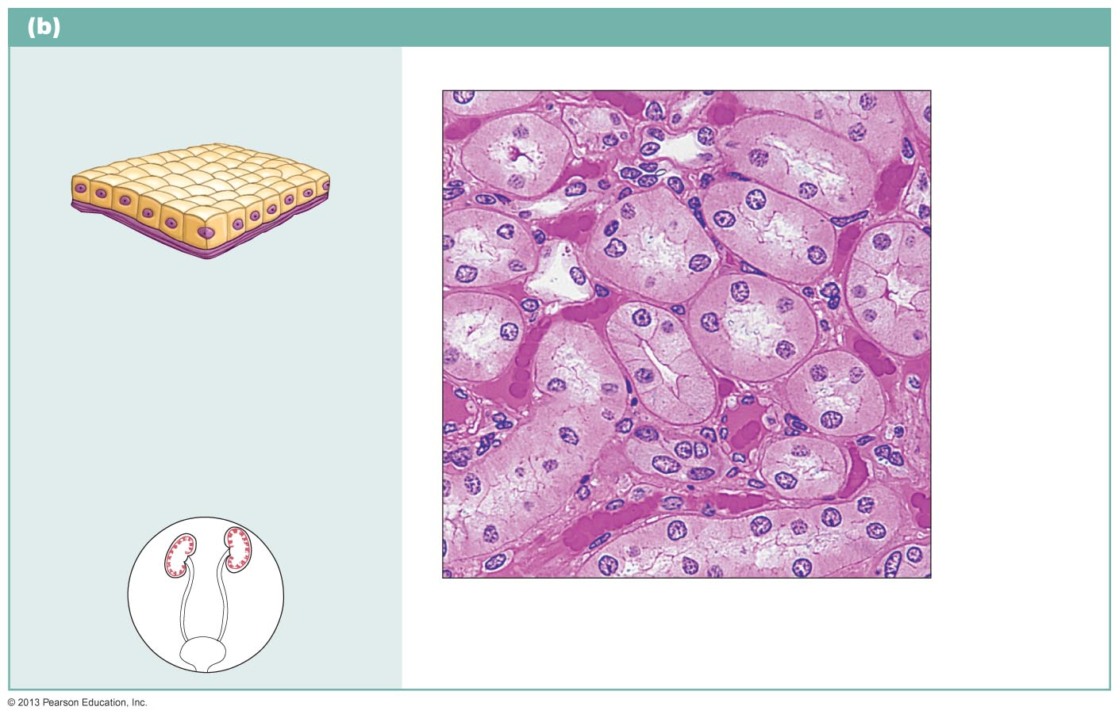
Figure 4.3b Epithelial tissues.
Simple cuboidal epithelium
Description: Single layer of
cubelike cells with large, spherical central nuclei.
Simple cuboidal epithelial cells
Nucleus
Function: Secretion and absorption.
Basement membrane
Location: Kidney tubules; ducts and secretory portions of small glands; ovary surface.
Connective tissue
Photomicrograph: Simple cuboidal epithelium in kidney tubules (430x).
© 2013 Pearson Education, Inc.

Slide 26
Simple Columnar Epithelium
Single layer of tall, closely packed cells
Absorption
Secretion
Note description, function, location on next slide
© 2013 Pearson Education, Inc.

Slide 27
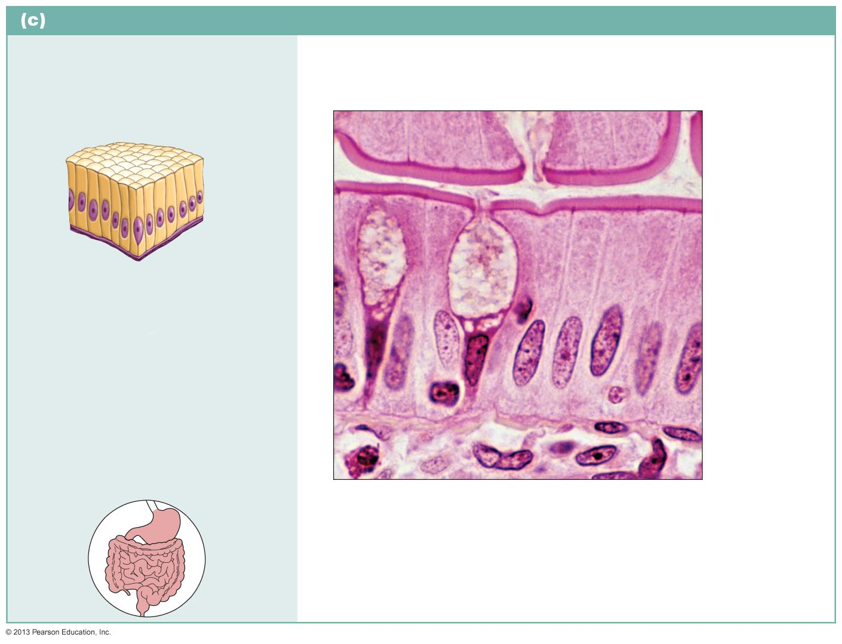
Figure 4.3c Epithelial tissues.
Simple columnar epithelium
Description: Single layer of tall cells with round to oval nuclei; some cells bear cilia; layer may contain mucus-secreting unicellular glands (goblet cells).
Microvilli
Simple columnar epithelial cell
Function: Absorption; secretion of mucus, enzymes, and other substances; ciliated type propels mucus (or reproductive cells) by ciliary action.
Mucus of goblet cell
Location: Nonciliated type lines most of the digestive tract (stomach to rectum), gallbladder, and excretory ducts of some glands; ciliated variety lines small bronchi, uterine tubes, and some regions of the uterus.
Basement membrane
Photomicrograph: Simple columnar
epithelium of the small intestine mucosa (660x).
© 2013 Pearson Education, Inc.

Slide 28
Pseudostratified Columnar Epitheliem
Cells vary in height
  Cell nuclei at different levels
  Appears stratified, but is not
  Secretion
  Absorption
  Note description, function, location on next slide
© 2013 Pearson Education, Inc.

Slide 29
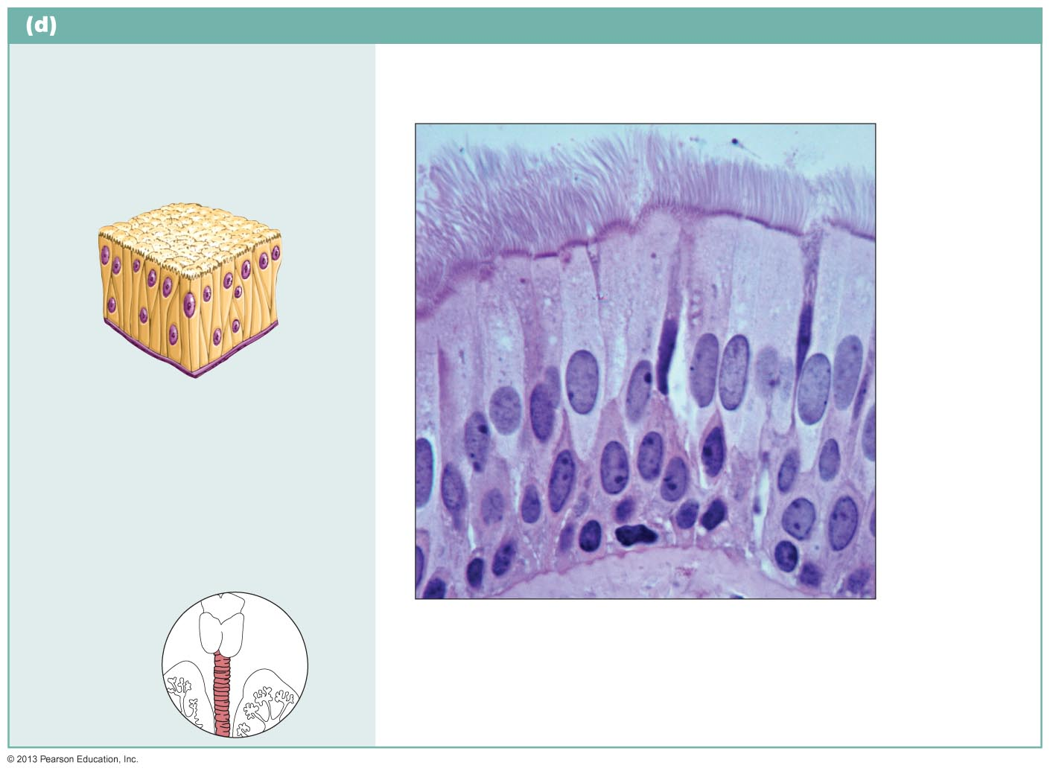
Figure 4.3d Epithelial tissues.
Pseudostratified columnar epithelium
Description: Single layer of cells of differing heights, some not reaching the free surface; nuclei seen at different levels; may contain mucus-secreting cells
and bear cilia.
Cilia
Pseudo-stratified epithelial layer
Function: Secrete substances, particularly mucus; propulsion of mucus by ciliary action.
Location: Nonciliated type in male’s sperm-carrying ducts and ducts of large glands; ciliated variety lines the trachea, most of the upper respiratory tract.
Basement membrane
Photomicrograph: Pseudostratified ciliated columnar epithelium lining the human trachea (800x).
Trachea
© 2013 Pearson Education, Inc.

Slide 30
Stratified Epithelial Tissues
Two or more cell layers
Regenerate from below
  Basal cells divide, cells migrate to surface
More durable than simple epithelia
Protection is major role
© 2013 Pearson Education, Inc.

Slide 31
Stratified Squamous Epithelium
Most widespread of stratified epithelia
Free surface squamous; deeper layers cuboidal or columnar
Located for wear and tear
Those farthest from basal layer (and therefore nutrients) less viable
Note description, function, location on next slide
© 2013 Pearson Education, Inc.

Slide 32
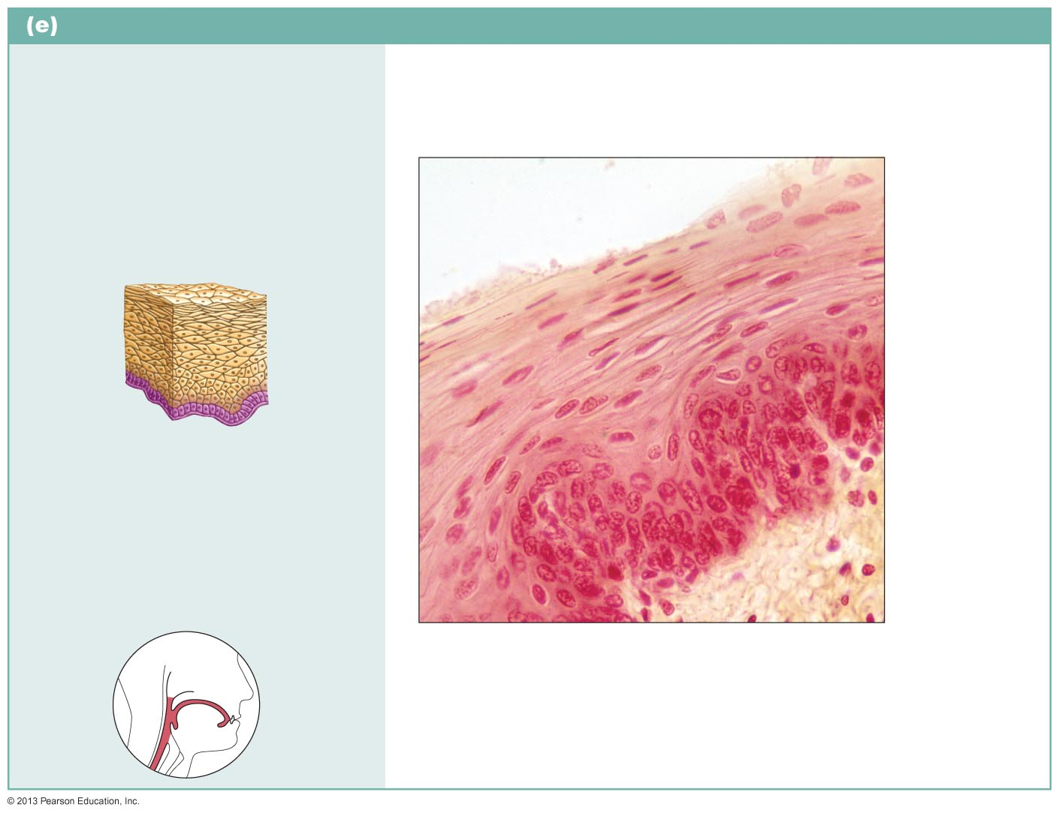
Figure 4.3e Epithelial tissues.
Stratified squamous epithelium
Description: Thick membrane composed of several cell layers; basal cells are cuboidal or columnar and metabolically active; surface cells are flattened (squamous); in the keratinized type, the surface cells are full of keratin and dead; basal cells are active in mitosis and produce the cells of the more superficial layers.
Stratified squamous epithelium
Function: Protects underlying tissues in areas subjected to abrasion.
Nuclei
Location: Nonkeratinized type forms the moist linings of the esophagus, mouth, and vagina; keratinized variety forms the epidermis of the skin, a dry membrane.
Basement membrane
Connective tissue
Photomicrograph: Stratified squamous epithelium lining the esophagus (285x).
© 2013 Pearson Education, Inc.

Slide 33
Stratified Cuboidal Epithelium
Quite rare
Found in some sweat and mammary glands
Typically two cell layers thick
© 2013 Pearson Education, Inc.

Slide 34
Stratified Columnar Epithelium
Limited distribution in body
Small amounts in pharynx, male urethra, and lining some glandular ducts
Also occurs at transition areas between two other types of epithelia
Only apical layer columnar
© 2013 Pearson Education, Inc.

Slide 35
Transitional Epithelium
Forms lining of hollow urinary organs
Basal layer cells are cuboidal or columnar
Ability to change shape with stretch
Apical cells vary in appearance
Note description, function, location on next slide
© 2013 Pearson Education, Inc.

Slide 36
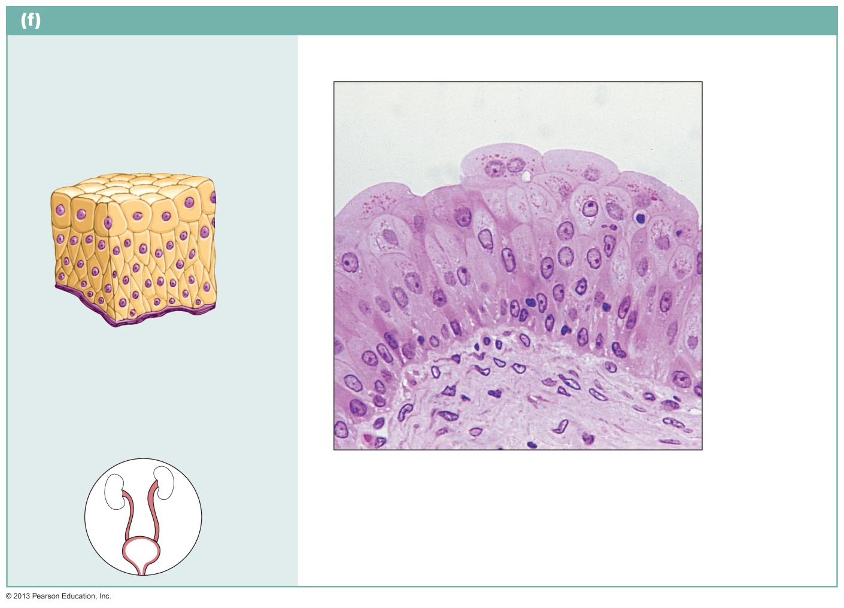
Figure 4.3f Epithelial tissues.
Transitional epithelium
Description: Resembles both stratified squamous and stratified cuboidal; basal cells cuboidal or columnar; surface cells dome shaped or squamouslike, depending on degree of organ stretch.
Transitional epithelium
Function: Stretches readily, permits stored urine to distend urinary organ.
Basement membrane
Location: Lines the ureters, bladder, and part of the urethra.
Connective tissue
Photomicrograph: Transitional epithelium lining the bladder, relaxed state (360x); note the bulbous, or rounded, appearance of the cells at the surface; these cells flatten and elongate when the bladder fills with urine.
© 2013 Pearson Education, Inc.

Slide 37
Glandular Epithelia
Gland
  One or more cells that makes and secretes an aqueous fluid called a secretion
Classified by
  Site of product release—endocrine or exocrine
  Relative number of cells forming the gland
    unicellular (e.g., goblet cells) or multicellular
© 2013 Pearson Education, Inc.

Slide 38
Endocrine Glands
Ductless glands
  Secretions not released into a duct
Secrete (by exocytosis) hormones that travel through lymph or blood to their specific target organs
Target organs respond in some characteristic way
© 2013 Pearson Education, Inc.

Slide 39
Exocrine Glands
Secretions released onto body surfaces (skin) or into body cavities
More numerous than endocrine glands
Secrete products into ducts
Examples include mucous, sweat, oil, and salivary glands
© 2013 Pearson Education, Inc.

Slide 40
Unicellular Exocrine Glands
The only important unicellular glands are mucous cells and goblet cells
Found in epithelial linings of intestinal and respiratory tracts
All produce mucin
  Dissolves in water to form mucus
    Slimy protective, lubricating coating
© 2013 Pearson Education, Inc.

Slide 41
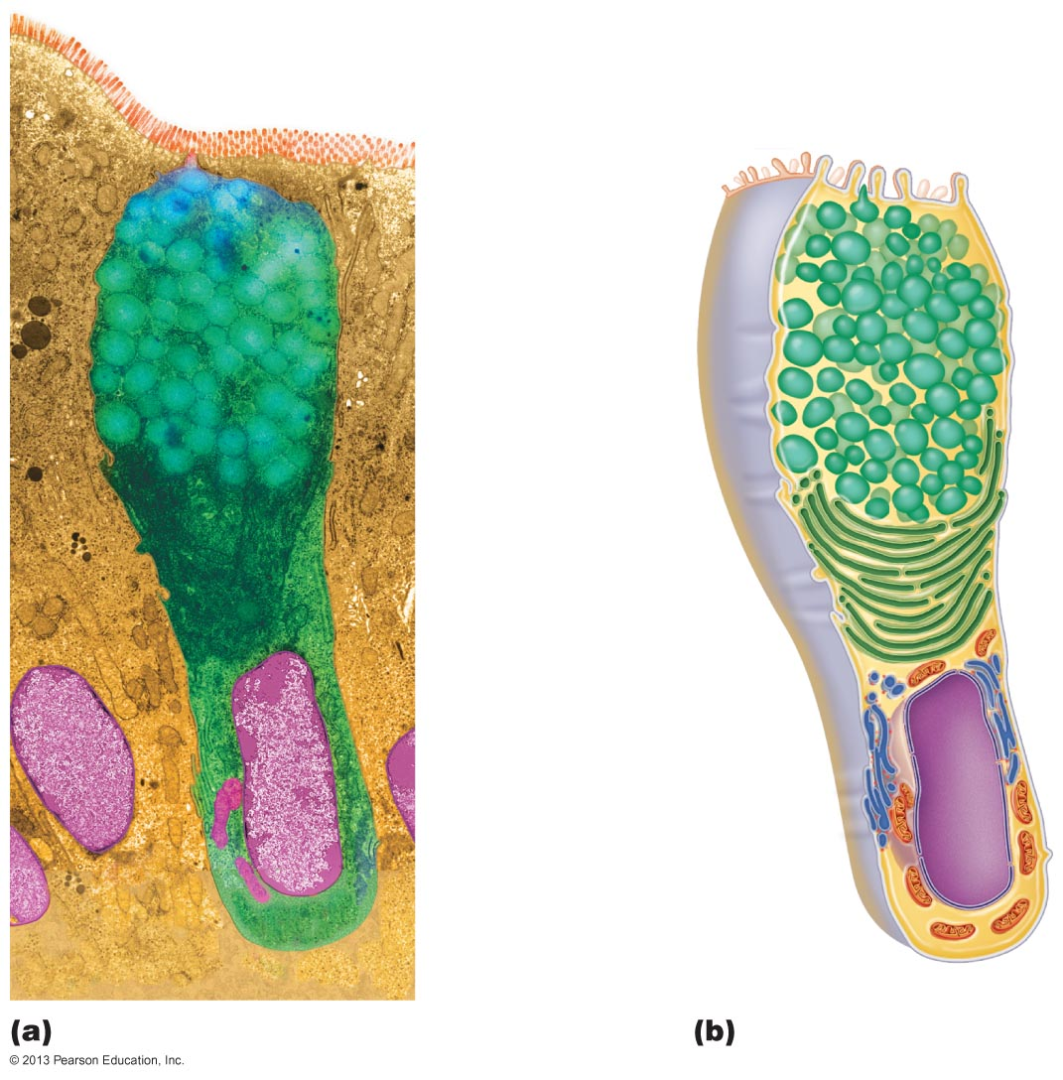
Figure 4.4 Goblet cell (unicellular exocrine gland).
Microvilli
Secretory vesicles containing mucin
Golgi apparatus
Rough ER
Nucleus
© 2013 Pearson Education, Inc.

Slide 42
Multicellular Exocrine Glands
Multicellular exocrine glands are composed of a duct and a secretory unit
Usually surrounded by supportive connective tissue
  Supplies blood and nerve fibers
  Extends into and divides gland into lobes
© 2013 Pearson Education, Inc.

Slide 43
Classification of Multicellular Glands
By structure and type of secretion
  Structure
    Simple glands (unbranced duct) or compound glands (branched duct)
    Cells tubular, alveolar, or tubuloalveolal
  Type of secretion
    Merocrine – most – secrete products by exocytosis as produced
    Holocrine – accumulate products within then rupture
    Apocrine – accumulates products within but only apex ruptures – controversy if exist in humans
© 2013 Pearson Education, Inc.

Slide 44
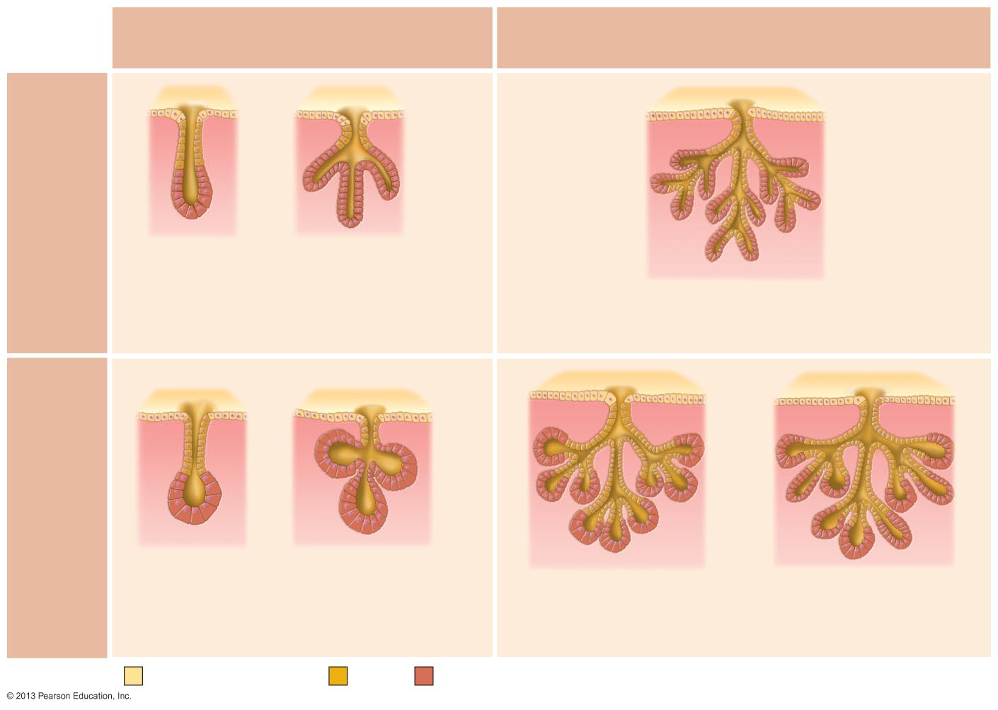
Figure 4.5 Types of multicellular exocrine glands.
Simple duct structure
(duct does not branch)
Compound duct structure
(duct branches)
Tubular secretory structure
Simple tubular Example
Intestinal glands
Simple branched tubular
Example
Stomach (gastric)
glands
Compound tubular
Example
Duodenal glands of small intestine
Alveolar secretory structure
Simple alveolar
Example
No important example in humans
Simple branched alveolar
Example
Sebaceous (oil) glands
Compound alveolar
Example
Mammary glands
Compound tubuloalveolar
Example
Salivary glands
Surface epithelium
Duct
Secretory epithelium
© 2013 Pearson Education, Inc.

Slide 45
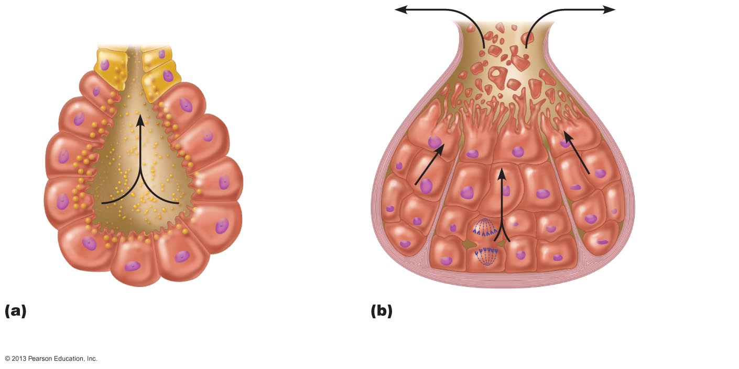
Figure 4.6 Chief modes of secretion in human exocrine glands.
Secretory
cell fragments
Secretory vesicles
Merocrine glands secrete their products by exocytosis.
In holocrine glands, the entire secretory cell ruptures, releasing secretions and dead cell fragments.
© 2013 Pearson Education, Inc.

