Slide 1
5
The Integumentary
System

Slide 2
Skin (Integument)
Consists of two distinct regions
  Epidermis—superficial region
    Epithelial tissue
  Dermis—underlies epidermis
    Mostly fibrous connective tissue
Hypodermis (superficial fascia)
  Subcutaneous layer deep to skin
  Not part of skin but shares some functions
  Mostly adipose tissue that absorbs shock & insulates
  Anchors skin to underlying structures – mostly muscles
© 2013 Pearson Education, Inc.

Slide 3
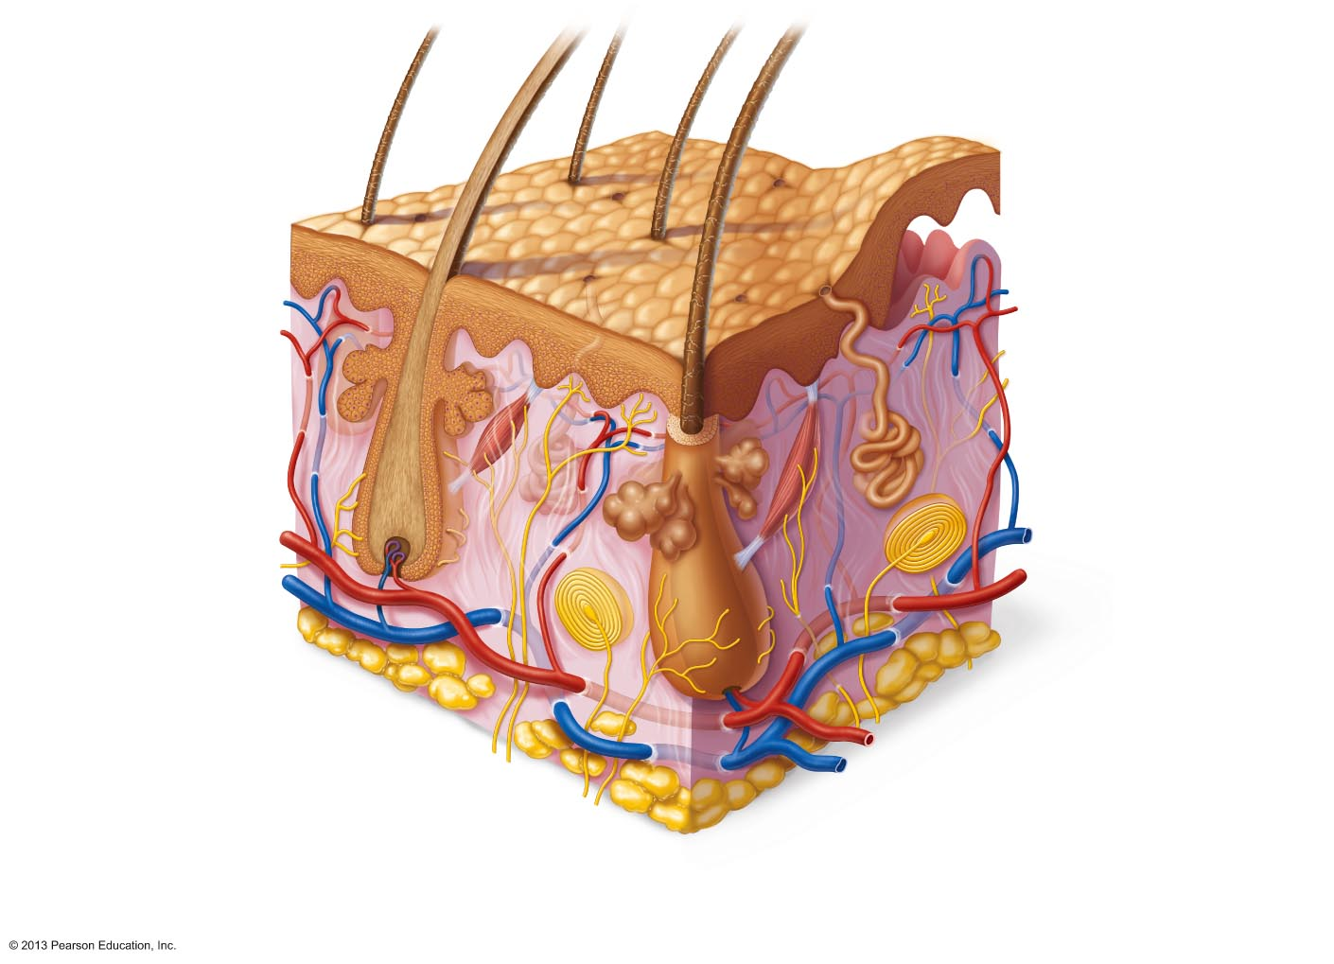
Figure 5.1 Skin structure.
Hair shaft
Dermal papillae
Epidermis
Subpapillary
plexus
Papillary
layer
Sweat pore
Appendages of
skin
Dermis
Reticular
layer
Eccrine sweat gland
Arrector pili muscle
Sebaceous (oil)
gland
Hair follicle
Hypodermis
(subcutaneous
tissue; not part
of skin)
Hair root
Nervous structures
Cutaneous plexus
Sensory nerve fiber
with free nerve endings
Adipose tissue
Lamellar corpuscle
Hair follicle receptor
(root hair plexus)
© 2013 Pearson Education, Inc.

Slide 4
Epidermis
Keratinized stratified squamous epithelium
Four or five distinct layers
  Stratum basale
  Stratum spinosum
  Stratum granulosum
  Stratum lucidum (only in thick skin)
  Stratum corneum
Four cell types
  Keratinocytes
  Melanocytes
  Dendritic (Langerhans) cells
  Tactile (Merkel) cells
© 2013 Pearson Education, Inc.

Slide 5
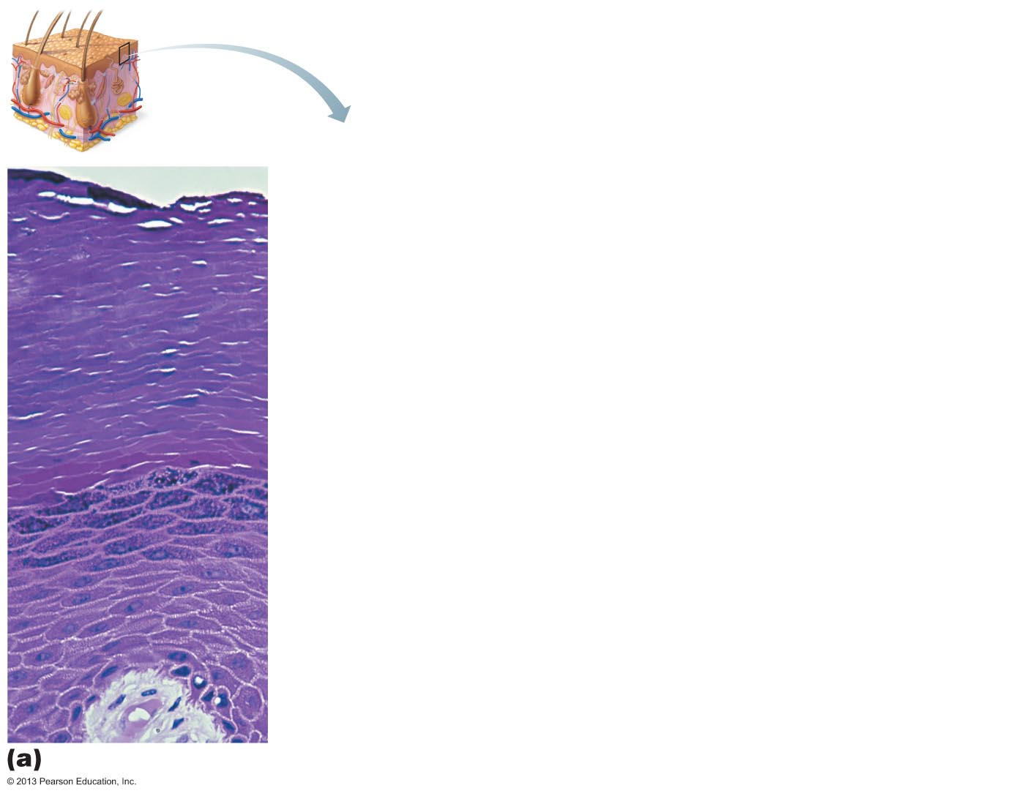
Figure 5.2a The main structural features of the skin epidermis.
Stratum corneum
Most superficial layer; 20–30 layers of dead cells, essentially
flat membranous sacs filled with keratin. Glycolipids in
extracellular space.
Stratum granulosum
Typically five layers of flattened cells, organelles deteriorating;
cytoplasm full of lamellar granules (release lipids) and
keratohyaline granules.
Stratum spinosum
Several layers of keratinocytes unified by desmosomes.
Cells contain thick bundles of intermediate filaments made of
pre-keratin.
Stratum basale
Deepest epidermal layer; one row of actively mitotic stem
cells; some newly formed cells become part of the more
superficial layers. See occasional melanocytes and dendritic
cells.
Dermis
© 2013 Pearson Education, Inc.

Slide 6
Cells of the Epidermis
Keratinocytes
  Produce fibrous protein keratin
  Most cells of epidermis
  Tightly connected by desmosomes
Melanocytes
  10–25% of cells in deepest epidermis表皮
  Produce pigment 色素 melanin 黑色素 – packaged into melanosomes[生]黑(色)素体
    Protect apical顶上的 surface of keratinocyte nucleus from UV damage
Dendritic (Langerhans 胰岛) cells
  Macrophages 巨噬细胞 – key activators of immune system
Tactile (Merkel) cells
  Sensory touch receptors
© 2013 Pearson Education, Inc.

Slide 7
Layers of the Epidermis:
Stratum Basale (Basal Layer)
Deepest epidermal layer
Also called stratum germinativum出芽的
Firmly attached to dermis
Single row of stem cells[医] 干细胞
  Actively mitotic [生]有丝分裂的；间接核分裂的
  Produces two daughter cells
    One cell journeys from basal layer to surface
      Takes 25–45 days
      Dies as moves toward surface
    One cell remains in stratum basale as stem cell
Melanocytes compose 10 – 25% of this layer
© 2013 Pearson Education, Inc.

Slide 8
Layers of the Epidermis:
Stratum Spinosum (Prickly Layer)
Several layers thick
Cells contain web-like system of intermediate prekeratin filaments attached to desmosomes
Abundant melanosomes and dendritic cells
© 2013 Pearson Education, Inc.

Slide 9
Layers of the Epidermis:
Stratum Granulosum (Granular Layer)
Thin - four to six cell layers
Cell appearance changes
  Cells flatten
  Nuclei and organelles disintegrate瓦解；崩溃
  Keratinization begins
    Cells accumulate keratohyaline granules小颗粒
      Help form keratin in upper layers
  Cell accumulate lamellar 多层的 granules
    Their water-resistant glycolipid slows water loss
Cells above this layer die
  Too far from dermal capillaries毛细管
© 2013 Pearson Education, Inc.

Slide 10
Layers of the Epidermis:
Stratum Lucidum (Clear Layer)
Only in thick skin
Thin, translucent 半透明的 band superficial to the stratum granulosum
A few rows of flat, dead keratinocytes
© 2013 Pearson Education, Inc.

Slide 11
Layers of the Epidermis:
Stratum Corneum (Horny Layer)
20–30 rows of dead, flat, anucleate keratinized membranous sacs
Three-quarters of epidermal [解][生]表皮的；外皮的 thickness
Though dead, its cells have functions
  Protect deeper cells from environment and water loss
  Protect from abrasion磨损 and penetration渗透
  Barrier against biological, chemical, and physical assaults
© 2013 Pearson Education, Inc.

Slide 12
Cell Differentiation in Epidermis
Cells change from stratum basale to stratum corneum
Accomplished by specialized form of apoptosis细胞凋亡
  Controlled cellular suicide
  Nucleus and organelles break down
  Plasma membrane thickens
  Allows cells to slough off as dandruff and dander
  Shed ~ 50,000 cells every minute
© 2013 Pearson Education, Inc.

Slide 13
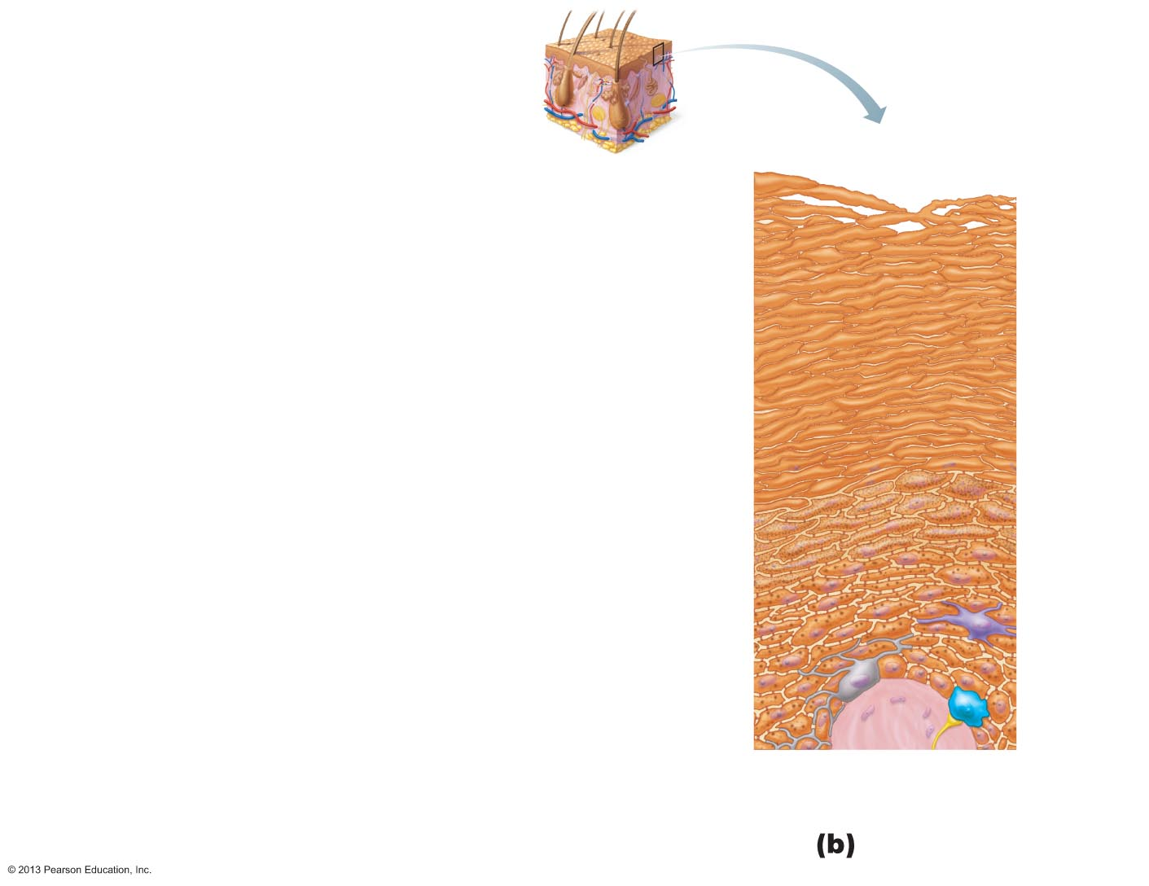
Figure 5.2b The main structural features of the skin epidermis.
Keratinocytes
Stratum corneum
Most superficial layer; 20–30 layers of dead cells,
essentially flat membranous sacs filled with keratin.
Glycolipids in extracellular space.
Stratum granulosum
Typically five layers of flattened cells, organelles
deteriorating; cytoplasm full of lamellar granules
(release lipids) and keratohyaline granules.
Stratum spinosum
Several layers of keratinocytes unified by desmosomes.
Cells contain thick bundles of intermediate filaments
made of pre-keratin.
Dendritic
cell
Sensory
nerve
ending
Dermis
Stratum basale
Deepest epidermal layer; one row of actively
mitotic stem cells; some newly formed cells
become part of the more superficial layers.
See occasional melanocytes and dendritic
cells.
Melanin
granule
Tactile
(Merkel) cell
Desmosomes
Melanocyte
© 2013 Pearson Education, Inc.

Slide 14
Dermis
Strong, flexible connective tissue
Cells
  Fibroblasts, macrophages, and occasionally mast cells and white blood cells
Fibers in matrix bind body together
  "Hide" used to make leather
Contains nerve fibers; blood and lymphatic vessels
Contains epidermal hair follicles; oil and sweat glands
Two layers
  Papillary
  Reticular
© 2013 Pearson Education, Inc.

Slide 15
Figure 5.1 Skin structure.
Hair shaft
Dermal papillae
Epidermis
Subpapillary
plexus
Papillary
layer
Sweat pore
Appendages of
skin
Dermis
Reticular
layer
Eccrine sweat gland
Arrector pili muscle
Sebaceous (oil)
gland
Hair follicle
Hypodermis
(subcutaneous
tissue; not part
of skin)
Hair root
Nervous structures
Cutaneous plexus
Sensory nerve fiber
with free nerve endings
Adipose tissue
Lamellar corpuscle
Hair follicle receptor
(root hair plexus)
© 2013 Pearson Education, Inc.

Slide 16
Layers of the Dermis:
Papillary Layer
Areolar connective tissue with collagen and elastic fibers and blood vessels
Loose tissue
  Phagocytes 吞噬细胞 can patrol for microorganisms微生物
Dermal papillae
  Superficial peglike projections
© 2013 Pearson Education, Inc.

Slide 17
Dermal Papillae
Most contain capillary 毛细管的 loops
Some contain Meissner's corpuscles (touch receptors)
Some contain free nerve endings (pain receptors)
In thick skin lie atop 在 ... 的顶上 dermal ridges that cause epidermal ridges
  Collectively ridges called friction ridges 趾掌脊(指纹
    Enhance gripping ability
    Contribute to sense of touch
    Pattern is fingerprints
© 2013 Pearson Education, Inc.

Slide 18
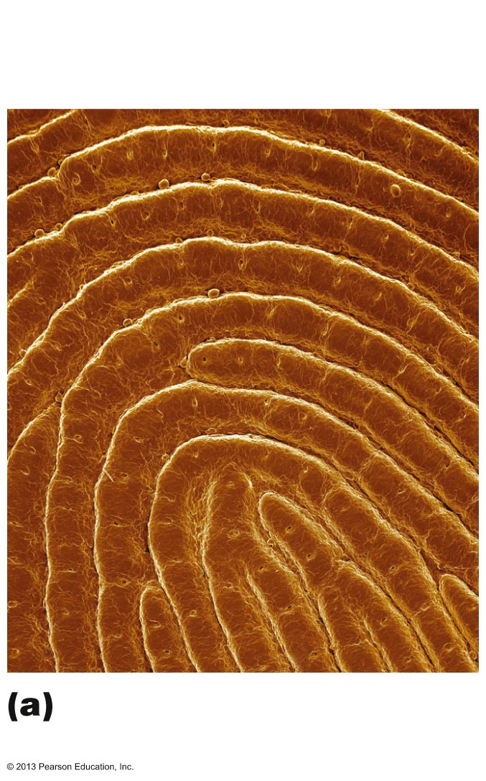
Figure 5.4a Dermal modifications result in characteristic skin markings.
Openings of
sweat gland ducts
Friction
ridges
Friction ridges of
fingertip (SEM 12x)
© 2013 Pearson Education, Inc.

Slide 19
Layers of the Dermis:
Reticular Layer
~80% of dermal thickness
Dense fibrous connective tissue
Elastic fibers provide stretch-recoil properties
Collagen fibers
  Provide strength and resiliency
  Bind water
  Cleavage lines皮纹线 because most collagen fibers parallel to skin surface
    Externally invisible
    Important to surgeons
    Incisions parallel to cleavage lines gap less and heal more readily
© 2013 Pearson Education, Inc.

Slide 20
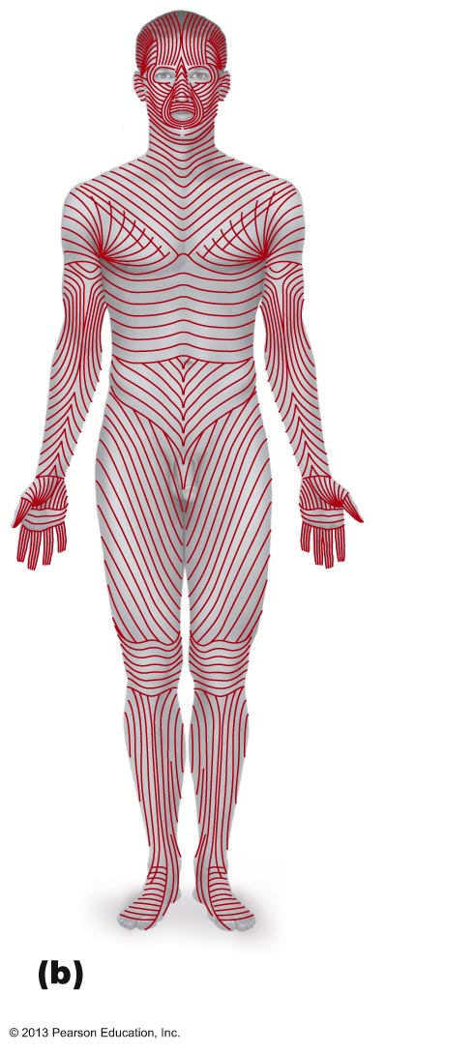
Figure 5.4b Dermal modifications result in characteristic skin markings.
Cleavage lines in the
reticular dermis
© 2013 Pearson Education, Inc.

Slide 21
Skin Markings
Flexure褶缝 lines
  Dermal folds at or near joints
  Dermis tightly secured to deeper structures
  Skin cannot slide easily for joint movement causing deep creases
  Visible on hands, wrists, fingers, soles, toes
© 2013 Pearson Education, Inc.

Slide 22
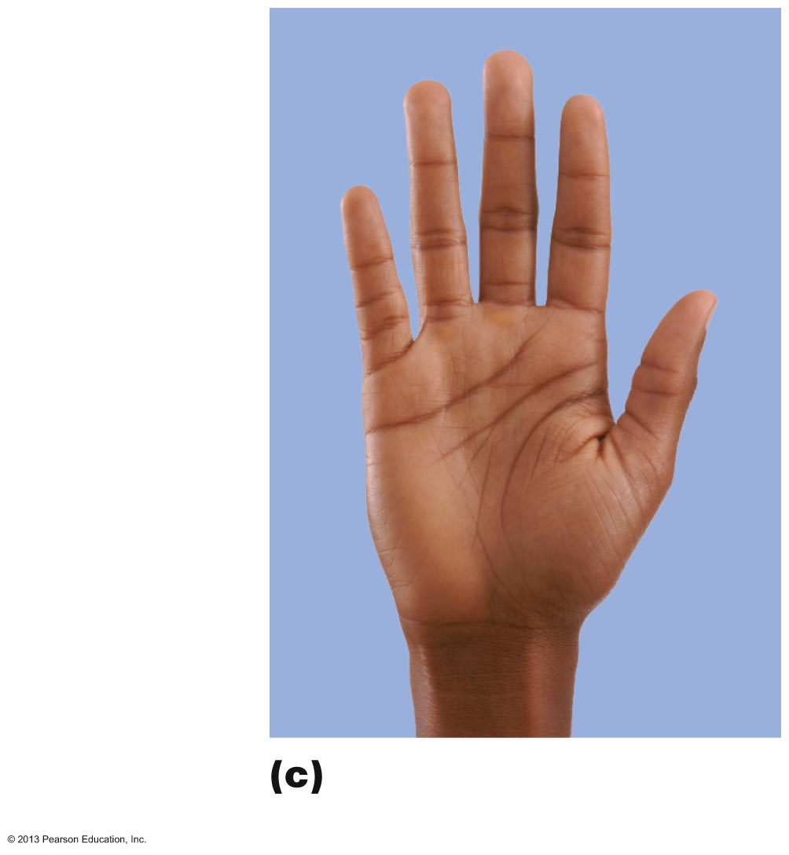
Figure 5.4c Dermal modifications result in characteristic skin markings.
Flexure lines
on digit
Flexure lines
on the palm
Flexure lines of the
hand
© 2013 Pearson Education, Inc.

Slide 23
Other Skin Markings
Striae细沟
  Silvery-white scars
  "Stretch marks" 腹纹,孕纹
  Extreme stretching causes dermal tears
Blister气泡
  From acute 剧烈的, short-term trauma
  Fluid-filled pocket that separates epidermal and dermal layers
© 2013 Pearson Education, Inc.

Slide 24
Skin Color
Three pigments contribute to skin color
  Melanin黑色素
    Only pigment made in skin
  Carotene胡萝卜素
  Hemoglobin血红蛋白
© 2013 Pearson Education, Inc.

Slide 25
Melanin
Two forms
  Reddish-yellow to brownish-black
Color differences due to amount and form
Produced in melanocytes黑素细胞
  Same relative number in all people
Migrates 转移 to keratinocytes to form "pigment shields" for nuclei
Freckles 雀斑 and pigmented moles
  Local accumulations of melanin
Sun exposure stimulates melanin production
Sunspots (tinea [医]癣 versicolor 杂色的) are fungal 由真菌引起的 infection; not related to melanin
© 2013 Pearson Education, Inc.

Slide 26
Carotene and Hemoglobin
Carotene
  Yellow to orange pigment
    Most obvious in palms and soles 脚底
  Accumulates in stratum corneum and hypodermis
  Can be converted to vitamin A for vision and epidermal health
Yellowish-tinge of some asians – carotene and melanin variations变异
Hemoglobin
  Pinkish 略带桃色的 hue 色调 of fair （皮肤、毛发等）浅色的 skin
© 2013 Pearson Education, Inc.

Slide 27
Skin Color in Diagnosis
Cyanosis紫绀
  Blue skin color - low oxygenation 氧化作用 of hemoglobin
Erythema [医]红斑 (redness)
  Fever, hypertension 高血压；过度紧张, inflammation, allergy
Pallor （脸色）苍白(blanching 烫白)
  Anemia 贫血症, low blood pressure, fear, anger
Jaundice 黄疸 (yellow cast)
  Liver disorder肝脏病变
Bronzing青铜色氧化
  Inadequate 不充分的 steroid 类固醇 hormones in Addison's disease爱迪生氏病,青铜色皮肤病
Bruises瘀青
  Clotted blood beneath skin
© 2013 Pearson Education, Inc.

Slide 28
Appendages of the Skin
Derivatives of the epidermis
  Hairs and hair follicles
  Nails
  Sweat glands
  Sebaceous (oil) glands
© 2013 Pearson Education, Inc.

Slide 29
Hair
Dead keratinized cells of hard keratin
  More durable than soft keratin of skin
Not in palms, soles, lips, nipples, portions of external genitalia 生殖器(尤指外阴部)
Functions include
  Warn of insects on skin
  Physical trauma
  Heat loss
  Sunlight
Hair pigments
  Melanins (yellow, rust 赤褐色, brown, black); trichosiderin 毛发铁色素 in red hair
  Gray/white hair: decreased melanin production, increased air bubbles in shaft
© 2013 Pearson Education, Inc.

Slide 30
Hair Follicles
Extend from epidermal surface to dermis
Two-layered wall - part dermis, part epidermis
Hair bulb毛球
  Expanded deep end
  Hair follicle receptor (root hair plexus)
  Sensory nerve endings - touch receptors
  Hair matrix
    Actively dividing area
Arrector pili竖毛肌
  Smooth muscle attached to follicle
  Responsible for "goose bumps"
Hair papilla
  Dermal tissue - blood supply
© 2013 Pearson Education, Inc.

Slide 31
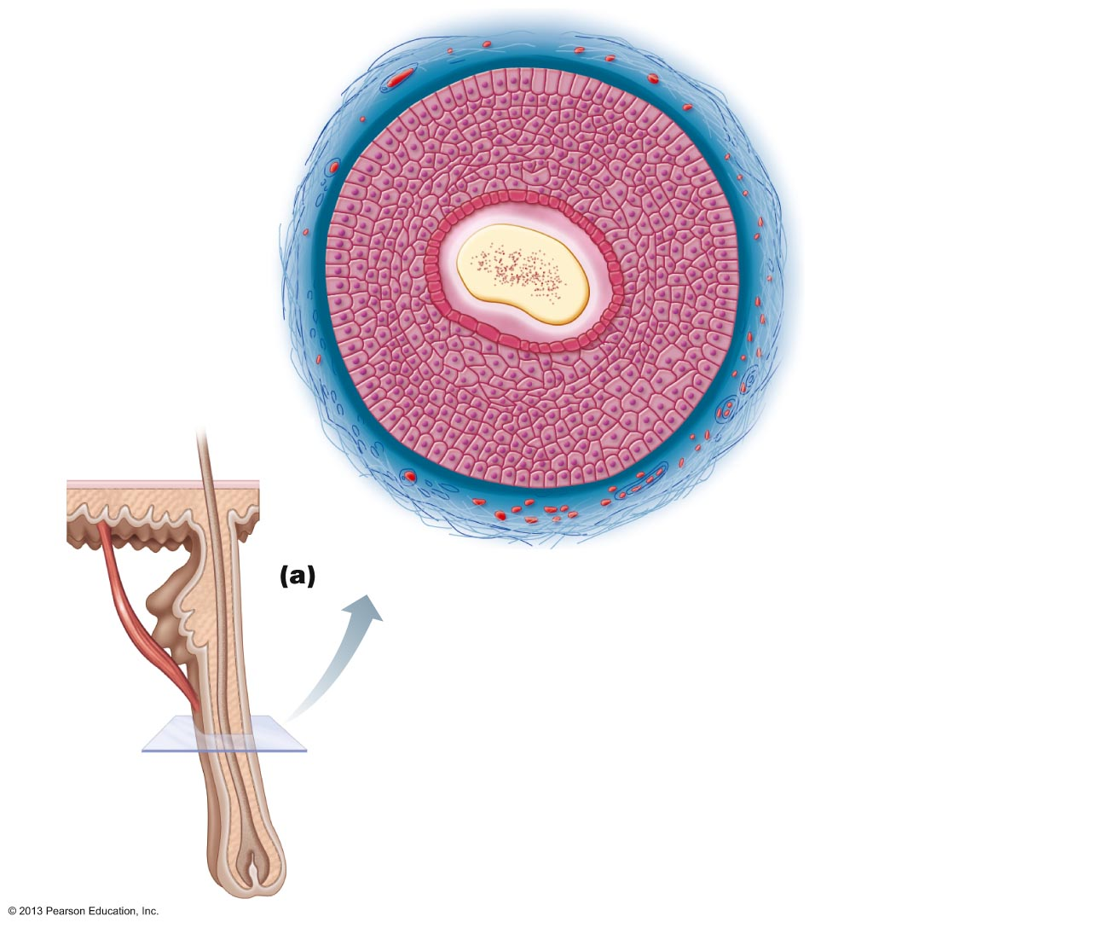
Figure 5.5a Skin appendages: Structure of a hair and hair follicle.
Follicle wall
•
Peripheral
connective tissue
(fibrous) sheath
•
Glassy membrane
•
Epithelial root sheath
External root sheath
•
Internal root sheath
•
Hair
•
Cuticle
Hair shaft
Cortex
•
•
Medulla
Diagram of a cross section of a hair within its follicle
Arrector
pili
Sebaceous
gland
Hair root
Hair bulb
© 2013 Pearson Education, Inc.

Slide 32
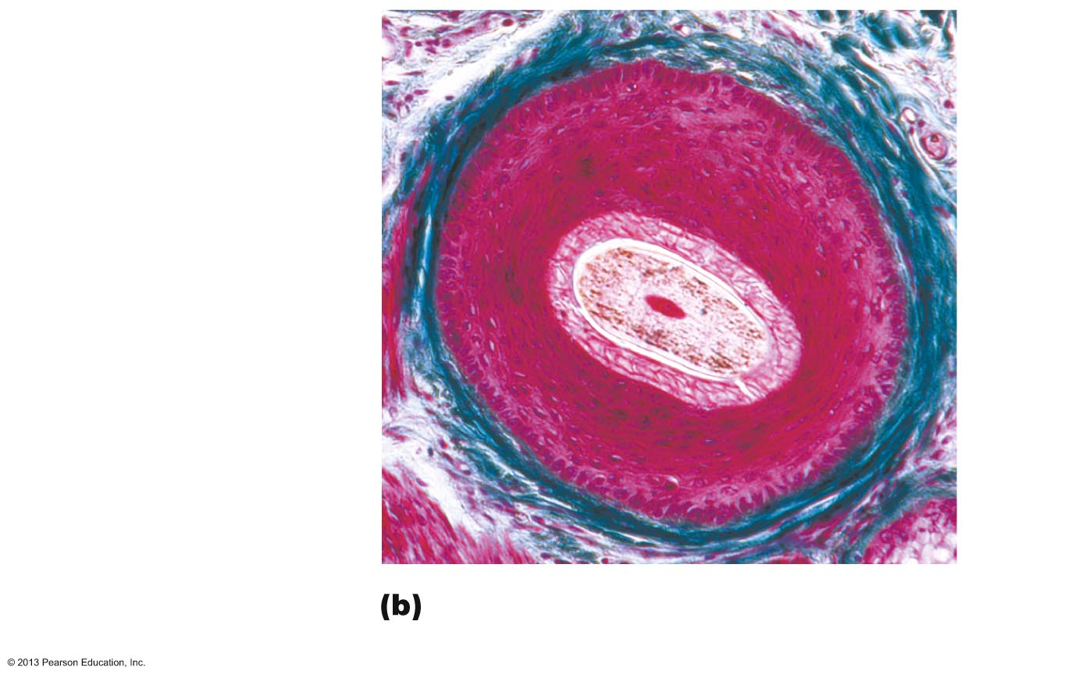
Figure 5.5b Skin appendages: Structure of a hair and hair follicle.
Follicle wall
•
Peripheral
connective tissue
(fibrous) sheath
•
Glassy membrane
•
Epithelial root sheath
•
External root sheath
•
Internal root sheath
Hair
•
Cuticle
•
Cortex
•
Medulla
Photomicrograph of a cross section of a
hair and hair follicle (100x)
© 2013 Pearson Education, Inc.

Slide 33
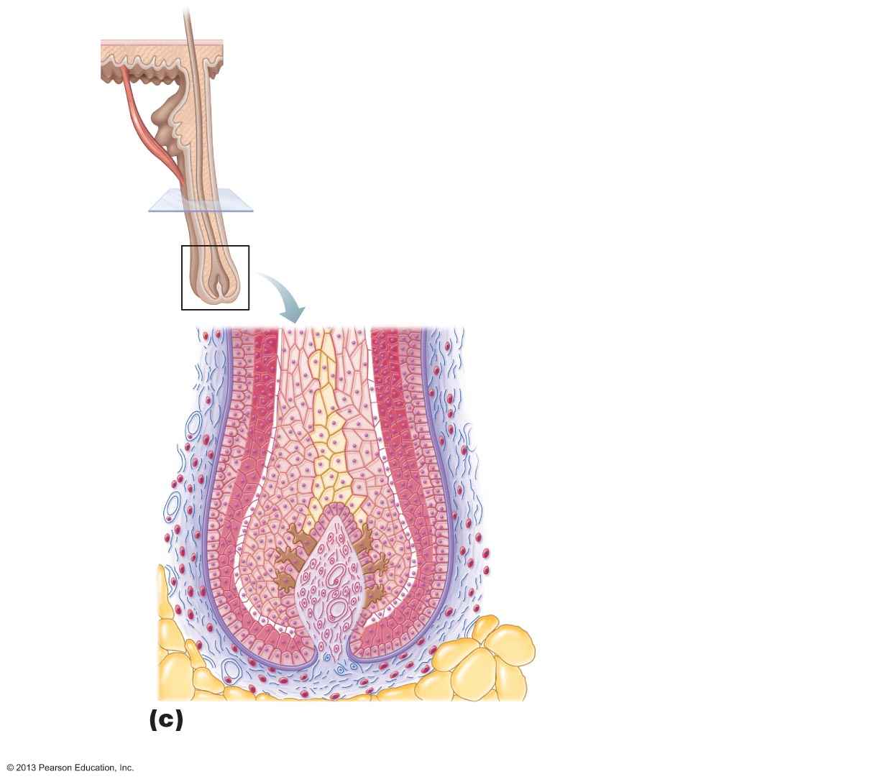
Figure 5.5c Skin appendages: Structure of a hair and hair follicle.
Hair shaft
Arrector
pili
Sebaceous
gland
Follicle wall
•
Hair root
Peripheral connective
tissue (fibrous) sheath
Hair bulb
•
Glassy membrane
•
Epithelial root sheath
•
External root sheath
•
Internal root sheath
Hair root
•
Cuticle
•
Cortex
•
Medulla
Hair matrix
Hair papilla
Melanocyte
Subcutaneous
adipose tissue
Diagram of a longitudinal view of the expanded hair
bulb of the follicle, which encloses the matrix
© 2013 Pearson Education, Inc.

Slide 34
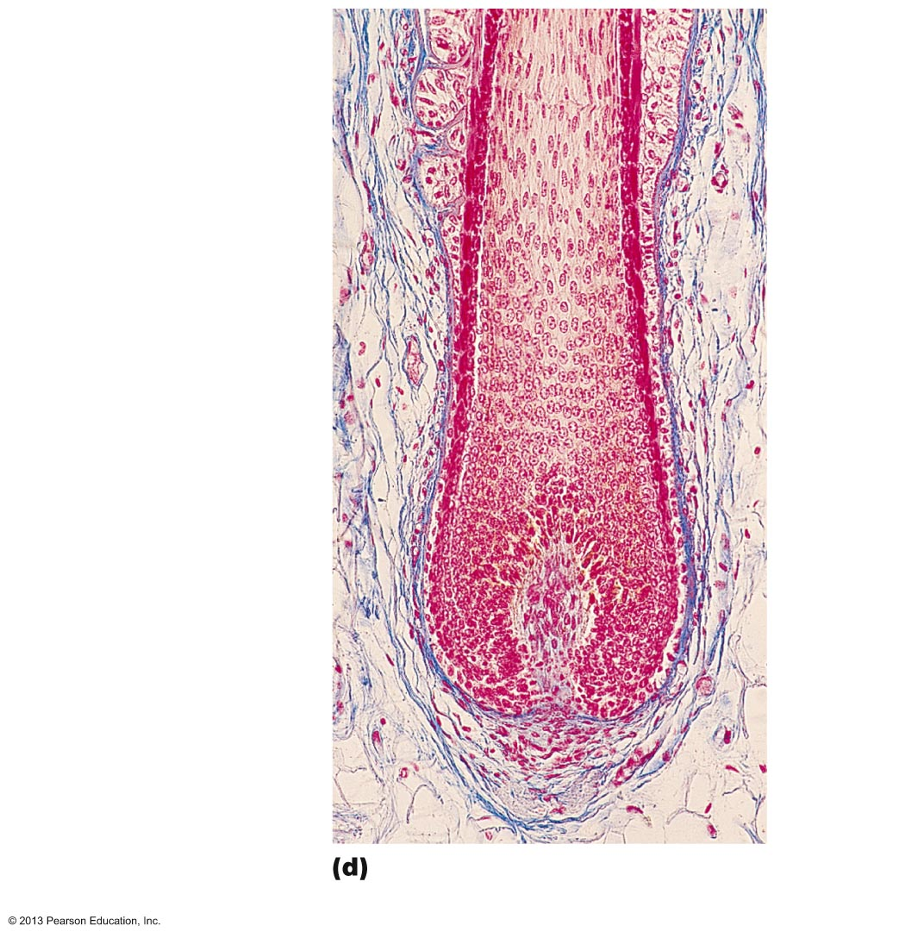
Figure 5.5d Skin appendages: Structure of a hair and hair follicle.
Follicle wall
•
Peripheral
connective tissue
(fibrous) sheath
•
Glassy membrane
•
Epithelial root sheath
•
External root sheath
Internal root sheath
•
Hair root
•
Cuticle
•
Cortex
•
Medulla
Hair matrix
Hair papilla
Subcutaneous
adipose tissue
Photomicrograph of longitudinal view
of the hair bulb in the follicle (160x)
© 2013 Pearson Education, Inc.

Slide 35
Types and Growth of Hair
Vellus hair[医] 毫毛
  Pale, fine body hair of children and adult females
Terminal hair
  Coarse, long hair of eyebrows, scalp
  At puberty
    Appear in axillary and pubic regions of both sexes
    Face and neck of males
Nutrition and hormones affect hair growth
Follicles cycle between active and regressive phases
Average 2.25 mm growth per week
Lose 90 scalp hairs daily
© 2013 Pearson Education, Inc.

Slide 36
Hair Thinning and Baldness
Alopecia秃头症
  Hair thinning in both sexes after a age 40
True (frank) baldness 光秃
  Genetically determined and sex-influenced condition
  Male pattern baldness caused by follicular 卵泡的 response to DHT (dihydrotestosterone) [生化]二氢睾酮
  Treatments
    Minoxidil 米诺地尔,长压定 (rogaine) and finasteride 非那司提(治疗良性前列腺增生) (propecia)
© 2013 Pearson Education, Inc.

Slide 37
Nails
Scalelike modifications of epidermis
Protective cover for distal, dorsal surface of fingers and toes
Contain hard keratin
Nail matrix
  Hair growth
© 2013 Pearson Education, Inc.

Slide 38
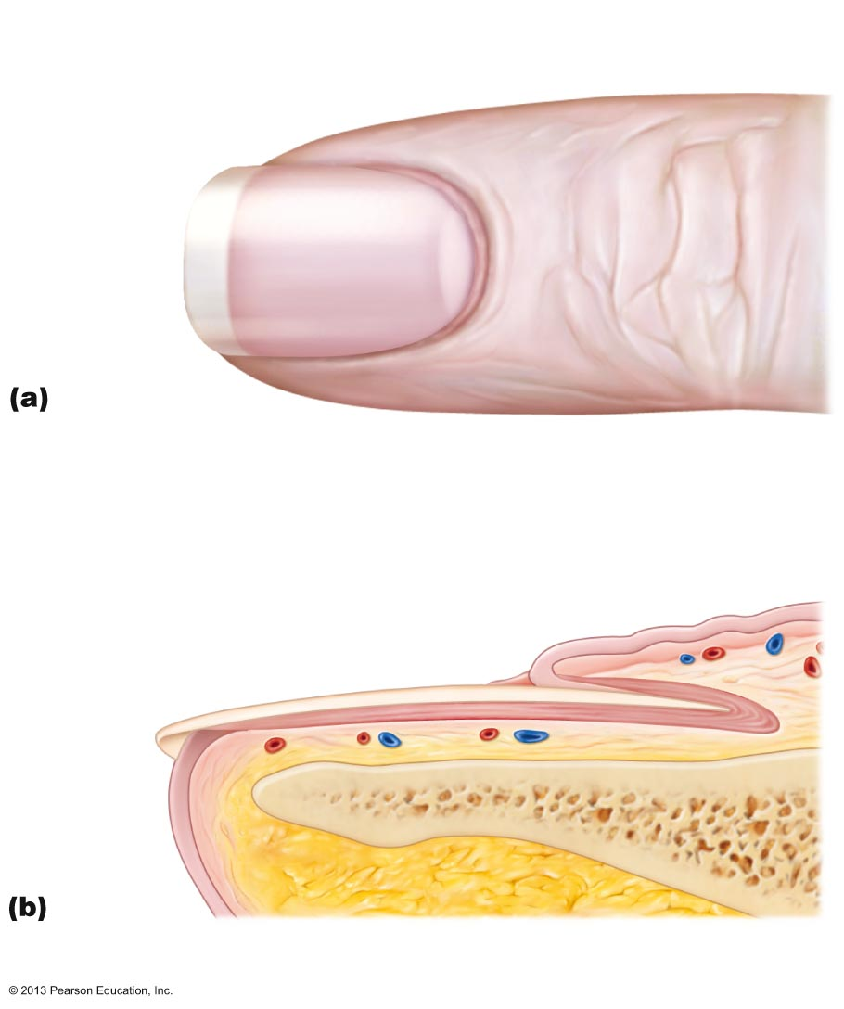
Figure 5.6 Skin appendages: Structure of a nail.
Lunule
Lateral
nail fold
Free edge
of nail
Body
of nail
Eponychium
(cuticle)
Root of nail
Proximal
nail fold
Nail
matrix
Hyponychium
Nail bed
Phalanx (bone of fingertip)
© 2013 Pearson Education, Inc.

Slide 39
Sweat Glands
Also called sudoriferous 分泌汗的 glands
All skin surfaces except nipples and parts of external genitalia
~3 million per person
Two main types
  Eccrine [生理]分泌腺的 (merocrine 局部分泌腺的) sweat glands
  Apocrine [医]顶浆分泌的 sweat glands
Contain myoepithelial [医] 肌上皮的 cells
  Contract upon nervous system stimulation to force sweat into ducts
© 2013 Pearson Education, Inc.

Slide 40
Eccrine Sweat Glands
Most numerous
Abundant on palms, soles, and forehead
Ducts connect to pores
Function in thermoregulation
  Regulated by sympathetic nervous system
Their secretion is sweat
  99% water, salts, vitamin c, antibodies, dermcidin (microbe-killing peptide), metabolic wastes
© 2013 Pearson Education, Inc.

Slide 41
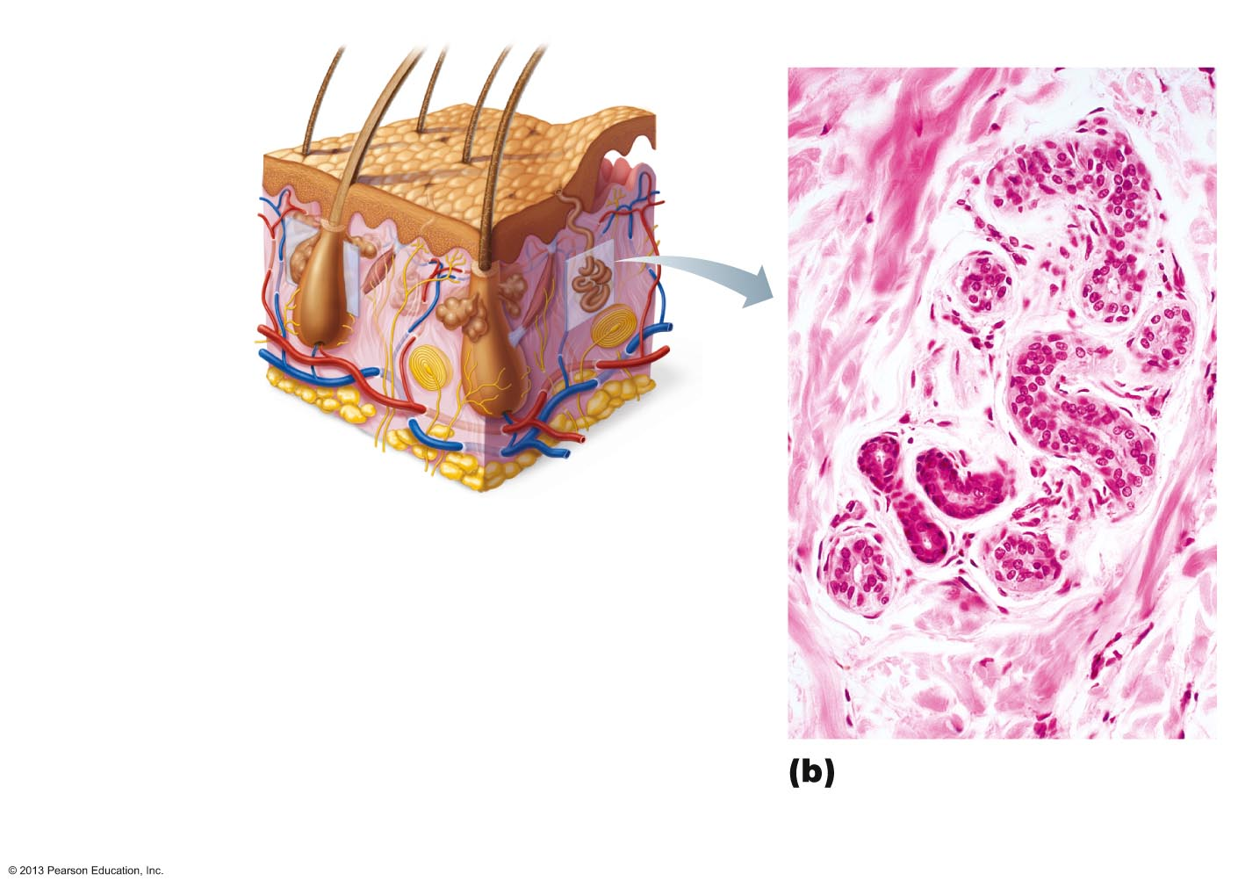
Figure 5.7b Photomicrograph of a sectioned eccrine gland (140x).
Sebaceous
gland
Sweat
pore
Eccrine
gland
Duct
Dermal connective
tissue
Secretory cells
Photomicrograph of a
sectioned eccrine
gland (140x)
© 2013 Pearson Education, Inc.

Slide 42
Apocrine Sweat Glands
Confined to axillary 腋窝的 and anogenital 肛门与生殖器 areas
Sweat + fatty substances + proteins
  Viscous; milky or yellowish
  Odorless until bacterial interaction → body odor
Larger than eccrine sweat glands
Ducts empty into hair follicles
Begin functioning at puberty
  Function unknown but may act as sexual scent gland
Modified apocrine glands
  Ceruminous 耳垢；耳屎 glands—lining of external ear canal; secrete cerumen (earwax)
  Mammary glands – secrete milk
© 2013 Pearson Education, Inc.

Slide 43
Sebaceous (Oil) Glands
Widely distributed
  Not in thick skin of palms and soles
Most develop from hair follicles and secrete into hair follicles
Relatively inactive until puberty
  Stimulated by hormones, especially androgens
Secrete sebum皮脂
  Oily holocrine secretion
  Bactericidal
  Softens hair and skin
© 2013 Pearson Education, Inc.

Slide 44
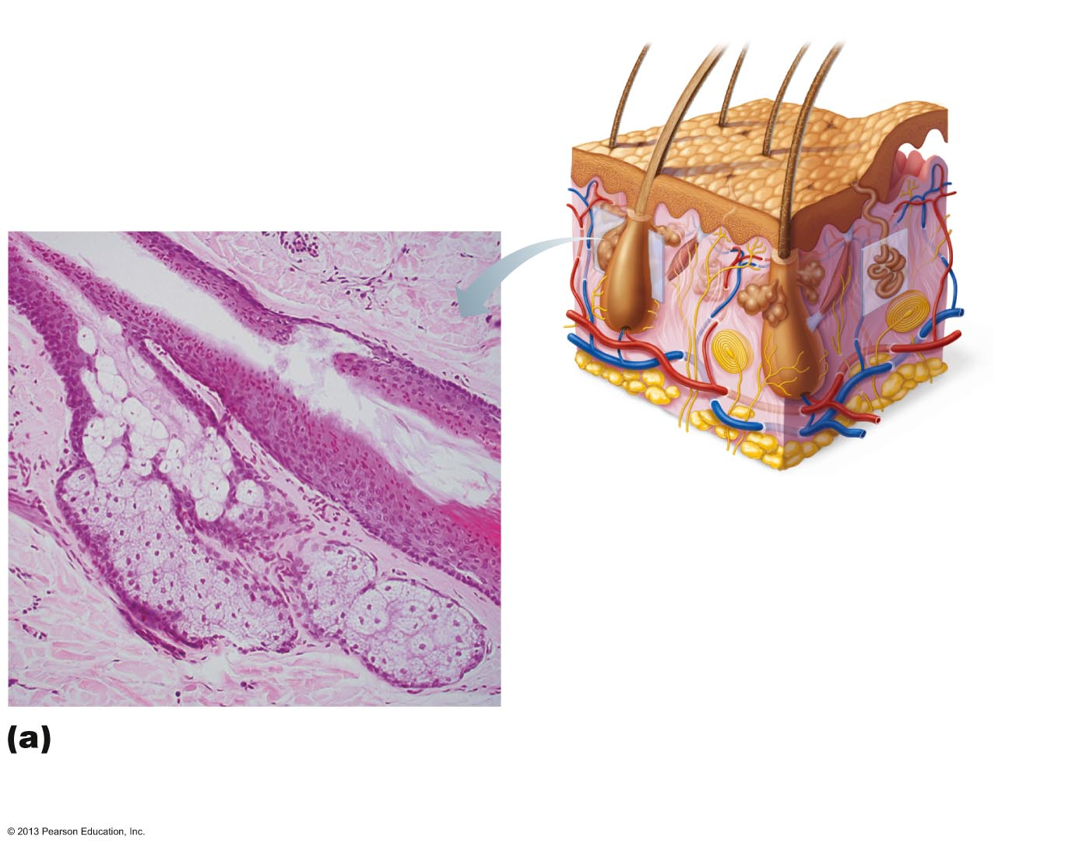
Figure 5.7a Photomicrograph of a sectioned sebaceous gland (90x).
Sebaceous
gland
Sweat
pore
Dermal
connective
tissue
Hair in
hair follicle
Sebaceous
gland duct
Eccrine
gland
Secretory cells
Photomicrograph of a
sectioned sebaceous
gland (90x)
© 2013 Pearson Education, Inc.

Slide 45
Functions of the Integumentary System
Protection
Body temperature regulation
Cutaneous皮肤的 sensation
Metabolic functions
Blood reservoir积蓄
Excretion
© 2013 Pearson Education, Inc.

Slide 46
Protection
Three types of barriers
  Chemical barriers
  Physical barriers
  Biological barriers
© 2013 Pearson Education, Inc.

Slide 47
Chemical Barriers
Skin secretions
  Low pH retards bacterial multiplication
  Sebum and defensins kill bacteria
Melanin
  Defense against UV radiation damage
© 2013 Pearson Education, Inc.

Slide 48
Physical Barriers
Flat, dead cells of stratum corneum surrounded by lipids
Keratin and glycolipids block most water and water- soluble substances
Limited penetration of skin
  Lipid-soluble substances
  Plant oleoresins (e.g., Poison ivy)
  Organic solvents
  Salts of heavy metals
  Some drugs
  Drug agents
© 2013 Pearson Education, Inc.

Slide 49
Biological Barriers
Biological barriers
  Dendritic cells of epidermis
    Present foreign antigens to white blood cells
  Macrophages of dermis
    Present foreign antigens to white blood cells
  DNA
    Its electrons absorb UV radiation
    Radiation converted to heat
© 2013 Pearson Education, Inc.

Slide 50
Functions of the Integumentary System
Body temperature regulation
  If body temperature normal ~500 ml/day of routine insensible perspiration (if environmental temperature below 31-32° C)
  If body temperature rises, dilation of dermal vessels and increased sweat gland activity (sensible perspiration) cool the body
  Cold external environment
    Dermal blood vessels constrict
    Skin temperature drops to slow passive heat loss
© 2013 Pearson Education, Inc.

Slide 51
Functions of the Integumentary System
Cutaneous sensations
  Cutaneous sensory receptors – part of nervous system – detect temperature, touch, and pain
  See figure 5.1
Metabolic functions
  Synthesis of vitamin D precursor and collagenase
  Chemical conversion of carcinogens and activate some hormones
Blood reservoir—up to 5% of body's blood volume
Excretion—nitrogenous wastes and salt in sweat
© 2013 Pearson Education, Inc.

Slide 52
Skin Cancer
Most skin tumors 肿瘤 are benign 良性的 (not cancerous) and do not metastasize (spread)
Risk factors
  Overexposure to UV radiation
  Frequent irritation of skin
Some skin lotions contain enzymes that can repair damaged DNA
Three major types of skin cancer
  Basal cell carcinoma
  Squamous cell carcinoma
  Melanoma[医]（恶性）黑素瘤
© 2013 Pearson Education, Inc.

Slide 53
Basal Cell Carcinoma
Least malignant; most common
Stratum basale cells proliferate and slowly invade dermis and hypodermis
Cured by surgical excision in 99% of cases
© 2013 Pearson Education, Inc.

Slide 54
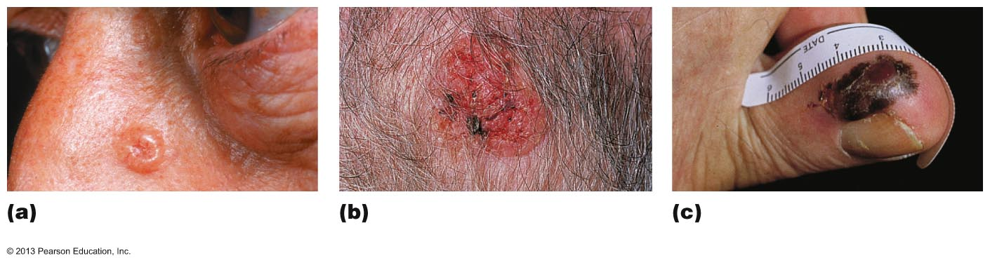
Figure 5.8 Photographs of skin cancers.
Basal cell carcinoma
Squamous cell
carcinoma
Melanoma
© 2013 Pearson Education, Inc.

Slide 55
Squamous Cell Carcinoma
Second most common type
Involves keratinocytes of stratum spinosum
Usually scaly reddened papule on scalp, ears, lower lip, and hands
Does metastasize
Good prognosis if treated by radiation therapy or removed surgically
© 2013 Pearson Education, Inc.

Slide 56
Melanoma
Cancer of melanocytes
Most dangerous
  Highly metastatic and resistant to chemotherapy
Treated by wide surgical excision accompanied by immunotherapy
Key to survival is early detection – ABCD rule
  A: asymmetry 不对称; the two sides of the pigmented area do not match
  B: border irregularity; exhibits indentations
  C: color; contains several (black, brown, tan, sometimes red or blue)
  D: diameter; larger than 6 mm (size of pencil eraser)
© 2013 Pearson Education, Inc.

Slide 57
Burns
Tissue damage caused by heat, electricity, radiation, certain chemicals
  Denatures proteins
  Kills cells
Immediate threat:
  Dehydration and electrolyte imbalance
    Leads to renal shutdown and circulatory shock
To evaluate burns
  Rule of nines
  Used to estimate volume of fluid loss
© 2013 Pearson Education, Inc.

Slide 58
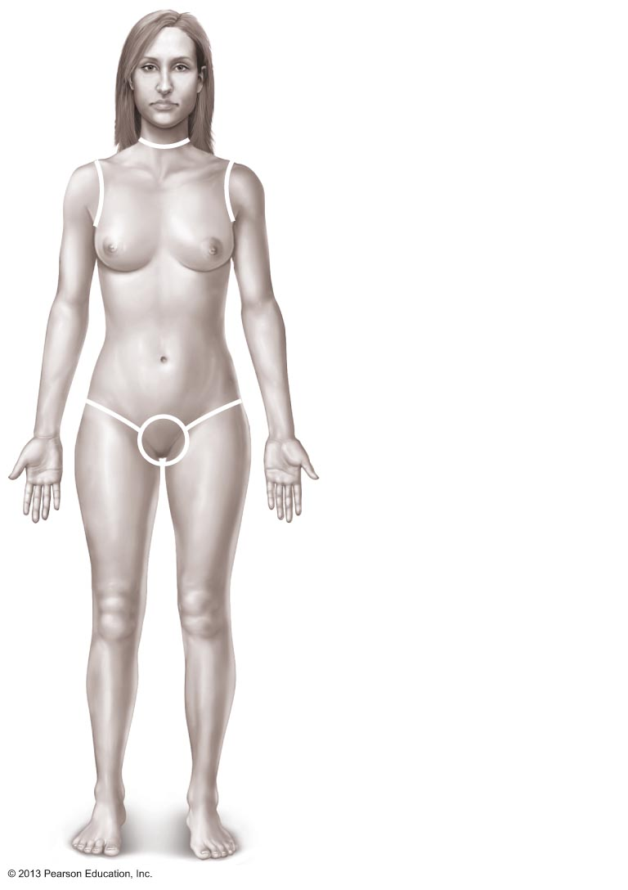
Figure 5.9 Estimating the extent and severity of burns using the rule of nines.
Totals
4¹/₂%
Anterior and posterior
head and neck, 9%
Anterior and posterior
upper limbs, 18%
4¹/₂%
Anterior
trunk,
18%
4¹/₂%
Anterior and posterior
trunk, 36%
9%
9%
(Perineum, 1%)
Anterior and posterior
lower limbs, 36%
100%
© 2013 Pearson Education, Inc.

Slide 59
Burns Classified by Severity
Partial-thickness burns
  First degree
    Epidermal damage only
      Localized redness, edema (swelling), and pain
  Second degree
    Epidermal and upper dermal damage
      Blisters appear
Full-thickness burns
  Third degree
    Entire thickness of skin involved
    Skin gray-white, cherry red, or blackened
    Not painful (nerve endings destroyed) or swollen
    Skin grafting usually necessary
© 2013 Pearson Education, Inc.

Slide 60
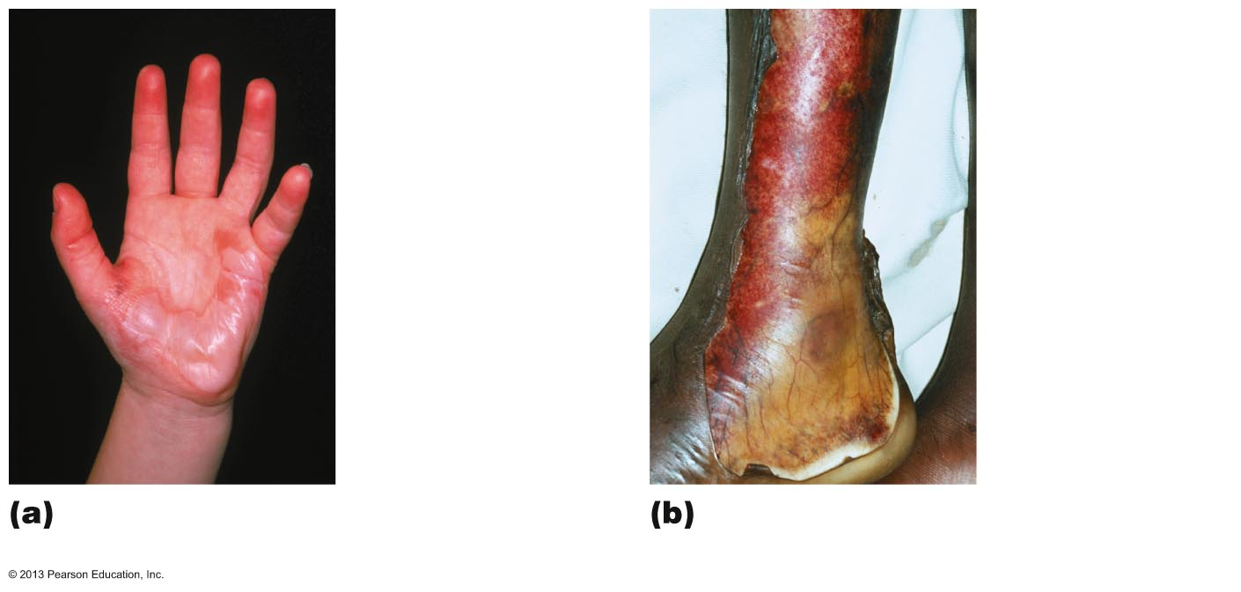
Figure 5.10 Partial thickness and full thickness burns.
1st-degree burn
3rd-degree burn
2nd-degree burn
Skin bearing partial thickness
burn (1st- and 2nd-degree burns)
Skin bearing full thickness
burn (3rd-degree burn)
© 2013 Pearson Education, Inc.

Slide 61
Severity and Treatment of Burns
Critical if
  >25% of body has second-degree burns
  >10% of body has third-degree burns
  Face, hands, or feet bear third-degree burns
Treatment includes
  Debridement (removal) of burned skin
  Antibiotics
  Temporary covering
  Skin grafts
© 2013 Pearson Education, Inc.

Slide 62
Developmental Aspects
Fetal胎儿的
  Ectoderm 外胚层 → epidermis; Mesoderm 中胚层 → dermis and hypodermis
  Lanugo 胎毛 coat: delicate hairs in 5th and 6th month
  Vernix caseosa 胎脂,胎垢: sebaceous gland secretion; protects skin of fetus
Infancy to adulthood
  Skin thickens; accumulates more subcutaneous fat
  Sweat and sebaceous gland activity increases
  Effects of cumulative environmental assaults show after age 30
  Scaling and dermatitis become more common
© 2013 Pearson Education, Inc.

Slide 63
Developmental Aspects
Aging skin
  Epidermal replacement slows, skin becomes thin, dry and itchy (decreased sebaceous gland activity)
  Subcutaneous fat and elasticity decrease, leading to cold intolerance and wrinkles
  Increased risk of cancer due to decreased numbers of melanocytes and dendritic cells
  Hair thinning
To delay
  UV protection, good nutrition, lots of fluids, good hygiene
© 2013 Pearson Education, Inc.

