Slide 1
Blood
Vessels
Lymphatic
Immune
System
Respiratory
100 pt
100 pt
100 pt
100 pt
Double
Jeopardy
200 pt
200 pt
200 pt
200 pt
300 pt
300 pt
300 pt
300 pt
400 pt
400 pt
400 pt
400 pt
500 pt
500 pt
500 pt
500 pt

Slide 2
The blood vessels that has valves

Slide 3
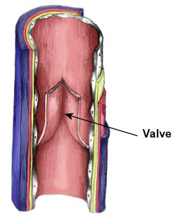
What are veins?

Slide 4
Function of TAF’s (tumor angiogenesis factors)

Slide 5
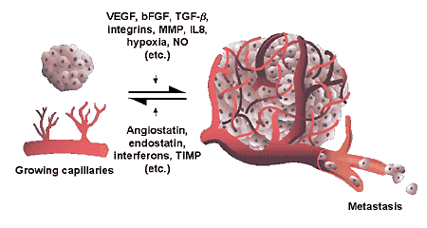
What stimulates blood vessel growth to a tumor?

Slide 6
An example of an elastic artery

Slide 7
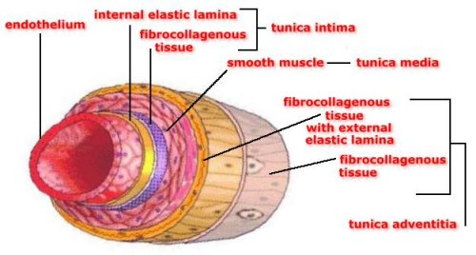
What is aorta, brachicephalic, common carotid, subclavian, vertebral, pulmonary, and common iliac?

Slide 8
The location of sinusoids

Slide 9
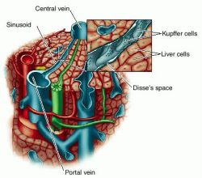
Where is the liver, red bone marrow, spleen and some endocrine glands?

Slide 10
The location of baroreceptors for regulating blood pressure

Slide 11
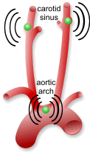
Where are the aorta and internal carotid?

Slide 12
The difference between interstitial fluid, lymph fluid and plasma

Slide 13
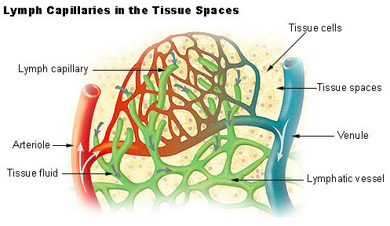
What is plasma has proteins, interstitial and lymph don’t and location?

Slide 14
Lymphatic fluid drains through the lymphatic duct back to the heart through the junction between the ____ & ____ vein.

Slide 15
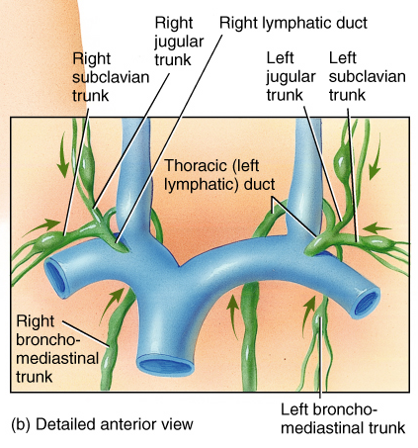
What is the junction between the subclavian and jugular vein?

Slide 16
Two main pumps that aid in returning lymph back to the heart

Slide 17
What is skeletal muscular pump and respiratory pump?

Slide 18
A virus infected lymphocyte, macrophage, and fibroblast produce this protein that induce synthesis of antiviral proteins that interfere with viral replication in neighboring cells

Slide 19
What is interferon?

Slide 20
Graves Disease and MS are types of these groups of diseases

Slide 21
What are autoimmune diseases?

Slide 22
The way a membrane attacking complex kills infected cells

Slide 23
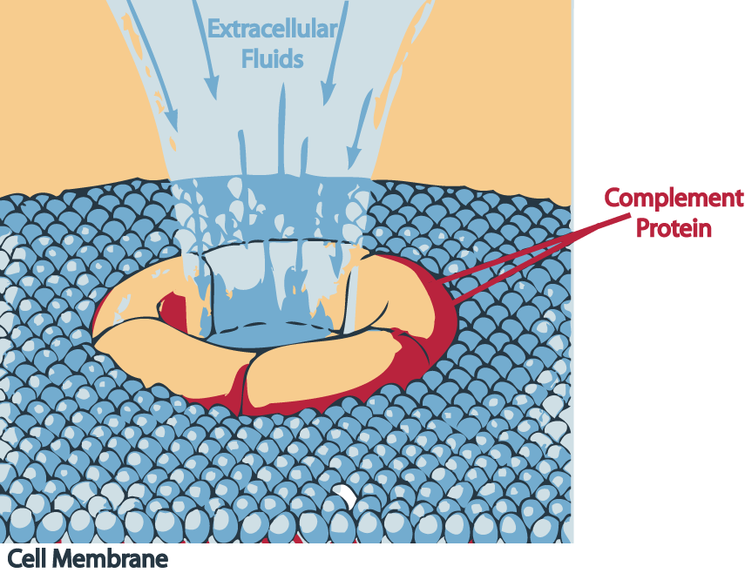
What is puts holes in the membrane and causes the cell to lyse?

Slide 24
This substance is released by damaged cells and intensifies the effects of histamines and kinins

Slide 25
What is prostaglandins?

Slide 26
Ingests microbes or any foreign particular matter, includes neutrophils and macrophages

Slide 27
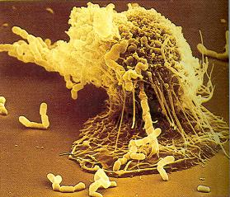
What is a phagocyte?

Slide 28
List 3 actions antibodies do to destroy foreign substances, viruses or bacteria

Slide 29
What are agglutination, neutralization, precipitation, activation of complement proteins, and enhance phagocytosis?
What are agglutination, neutralization, precipitation, activation of complement proteins, and enhance phagocytosis?

Slide 30
The specific leukocyte that the HIV virus targets

Slide 31
What is Helper T?

Slide 32
The name of a chemical substance found in aveolar fluid that reduces surface tension in alveoli

Slide 33
What is surfactants?

Slide 34
Calculation of vital capacity

Slide 35
What is
VC= TV+IRV+ERV?

Slide 36
N₂ gas coming out of solution in a diver ascending causes this condition

Slide 37
What is the bends or decompression sickness?

Slide 38
The effects of increasing acidity on the affinity of O₂ to bind to hemoglobin

Slide 39
What is decreases O₂’s binding ability?

Slide 40
Chemical’s that stimulate breathing

Slide 41
What is CO₂ and H⁺ ?

Slide 42
Double Jeopardy
What 4 veins return blood to the heart?

Slide 43
What are inferior vena cava, superior vena cava, pulmonary vein and coronary sinus?

