Slide 1
Vision
Hearing
Taste &
Smell
Production
Autonomic
100 pt
100 pt
100 pt
100 pt
100 pt
200 pt
200 pt
200 pt
200 pt
200 pt
300 pt
300 pt
300 pt
300 pt
300 pt
400 pt
400 pt
400 pt
400 pt
400 pt
500 pt
500 pt
500 pt
500 pt
Double
Jeopardy

Slide 2
The reason why a cornea can be transplanted

Slide 3
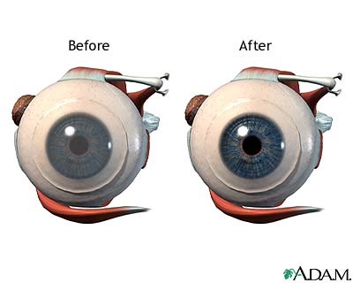
What is avascular?

Slide 4
The eye muscle that depresses the eye- to look down

Slide 5
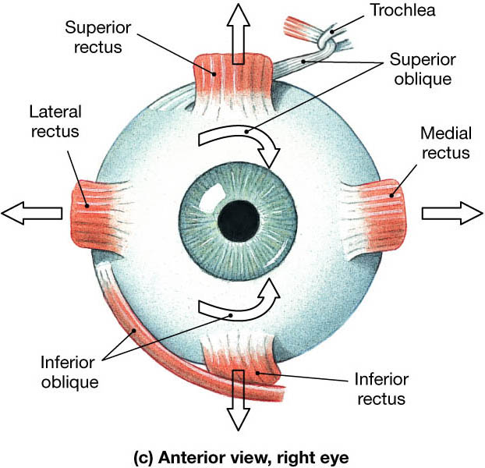
What is inferior rectus?

Slide 6
The area on the back of the retina that has the highest visual acuity

Slide 7
What is macula lutea or fovea centralis

Slide 8
A person with 20/120 vision

Slide 9
What is myopic or near sighted?

Slide 10
The region where the optic nerve originates and there are no receptor cells at this site

Slide 11
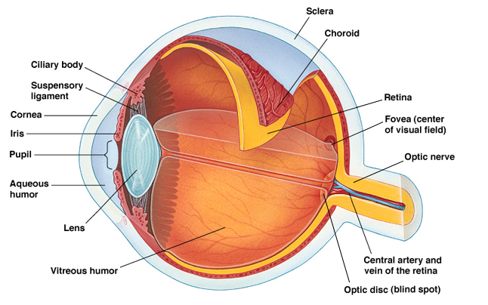
What is optic disk or blind spot?

Slide 12
Grains of calcium carbonate on the maculae

Slide 13
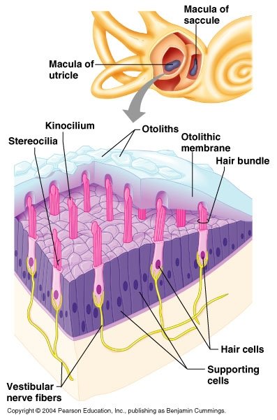
What is otolith?

Slide 14
Sacs found within the vestibule in the inner ear responsible for static equilibrium

Slide 15
What is the utricle and saccule?

Slide 16
Structure in the middle ear chamber that produces vibratory motion of the eardrum to oval window

Slide 17
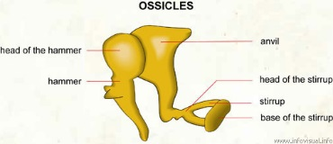
What are the bony ossicles (hammer (mallus), anvil (incus), stirup (stapes))?

Slide 18
Involved in equalizing the middle ear

Slide 19
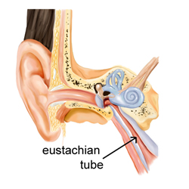
What is Eustachian tube?

Slide 20
The primary auditory cortex is located in this lobe

Slide 21
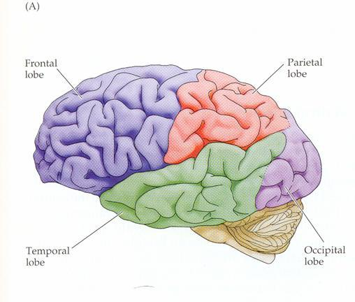
What is temporal?

Slide 22
Fungiform and circumvallate papillae

Slide 23
What are gustatory receptors (taste buds)?

Slide 24
Nicotine, quinine, and caffeine elicit this taste

Slide 25
What is bitter?

Slide 26
Loss of smell may be cured with this metallic ion

Slide 27
What is zinc?

Slide 28
The brain region associated with emotional response to taste and smell

Slide 29
What is limbic system or hypothalamus?

Slide 30
The cranial nerve associated with the posterior 1/3 of the tongue

Slide 31
What is glossophyrngeal?

Slide 32
Produces aqueous humor

Slide 33
What are cilliary bodies?

Slide 34
The membrane in the organ of corti that responds to sound waves and contains sensory hairs.

Slide 35
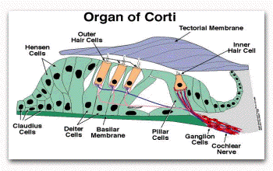
What is the basilar membrane?

Slide 36
Wax secreting glands in the outer ear

Slide 37
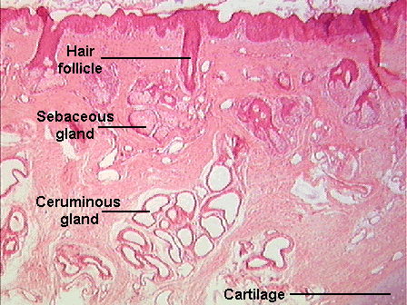
What are ceruminous glands?

Slide 38
The enzyme produced in the lacrimal glands that protects, moistens and lubricates the eye

Slide 39
What is lysozyme?

Slide 40
The name for a sebaceous gland in the eyelid that secretes an oil substance and keeps the eyelid from sticking to the eye

Slide 41
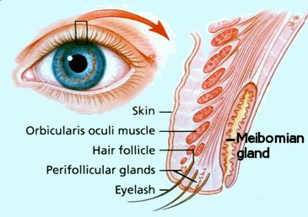
What are meibomian glands/tarsal?

Slide 42
The three D’s of the parasympathetic nervous system.

Slide 43
What is diuresis, defecation, digestion?

Slide 44
The thorocolumar division.

Slide 45
What is the sympathetic nervous system.

Slide 46
The neurotransmitter from the presympathetic ganglia.

Slide 47
What is Ach?

Slide 48
The sympathetic effect on the liver.

Slide 49
What is to convert glycogen to glucose?

Slide 50
Double Jeopardy
The most common cause of night blindness

Slide 51
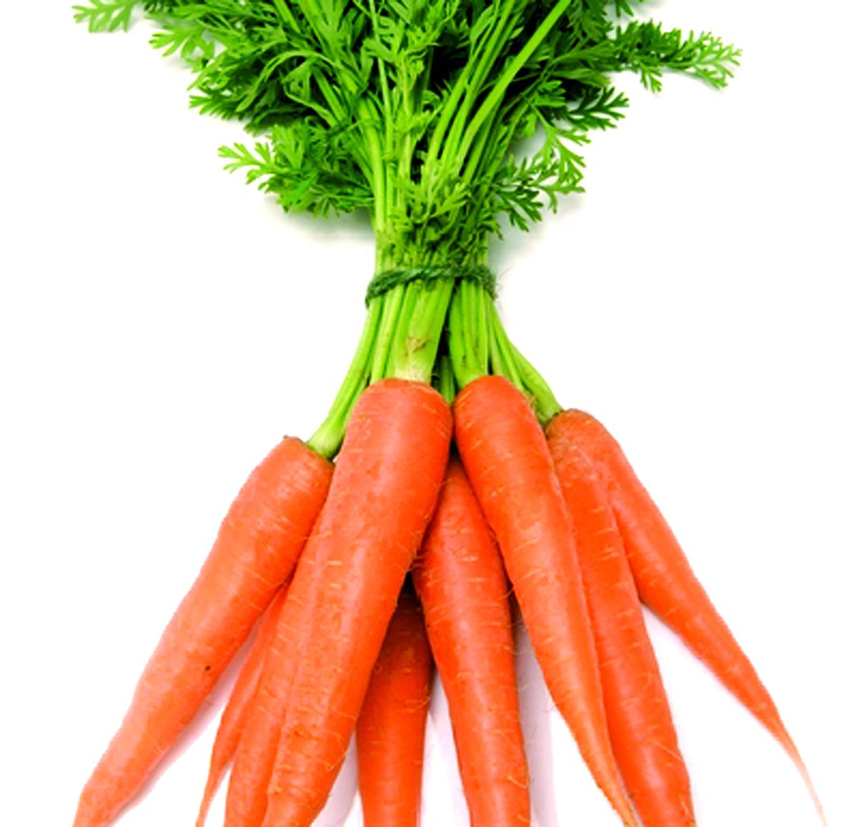
What is Vitamin A deficiency?

