Slide 1
Female
Repro
Male Repro
Development
ID
100 pt
100 pt
100 pt
100 pt
Double
Jeopardy
200 pt
200 pt
200 pt
200 pt
300 pt
300 pt
300 pt
300 pt
400 pt
400 pt
400 pt
400 pt
500 pt
500 pt
500 pt
500 pt

Slide 2
The 2 muscles that regulate the testes temperature

Slide 3
What are the
Cremaster muscle
Dartos muscle?

Slide 4
Spermatogenesis occurs in this structure

Slide 5
What is the seminiferous tubule?

Slide 6
These cells make up the blood testes barrier?

Slide 7
What are sertoli or sustenacular cells?

Slide 8
Cells that produce testosterone

Slide 9
What is leydig or interstitial cells?

Slide 10
Semen contains secretions from these 4 structures

Slide 11
What is
Seminiferous tubule (sperm)
Seminal vesicle
Bulbourethral gland (Cowper's)
Prostate gland

Slide 12
Four hormones produced by the corpus luteum

Slide 13
What are
Progesterone
Estrogen
Relaxin
Inhibin

Slide 14
The name for the secondary follicle before ovulation

Slide 15
What is Graffian, vescicular, or mature?

Slide 16
In oogenesis, the small cell produced by Meiosis I

Slide 17
What is the first polar body?

Slide 18
Fertilization occurs here

Slide 19
What is the fallopian tube, uterine tube or oviduct?

Slide 20
The surgical tying of the fallopian tubes

Slide 21
What is tubal ligation?

Slide 22
The SRY gene cause the release of this hormone from the sertoli cells

Slide 23
What is Mullerin Inhibiting Substance (MIS)?

Slide 24
A condition characterized by growth of endometrial tissue outside the uterus

Slide 25
What is endometriosis?

Slide 26
This layer of tissue develops into muscle, blood vessels and heart

Slide 27
What is mesoderm?

Slide 28
The wall of the yolk sac forms a small vascular outpocketing used for gas exchange

Slide 29
What is allantosis?

Slide 30
The neural tube develops into this

Slide 31
What is the brain and spinal cord?

Slide 32
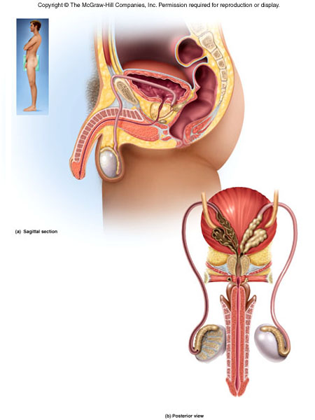
ID

Slide 33
What is the bulbourethral or cowper’s gland?

Slide 34
ID

Slide 35
What is the seminal vessicle?

Slide 36
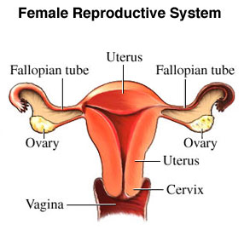
ID

Slide 37
What are the fimbrae?

Slide 38
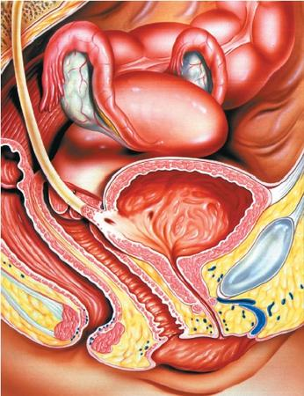
ID

Slide 39
What is the cervix?

Slide 40
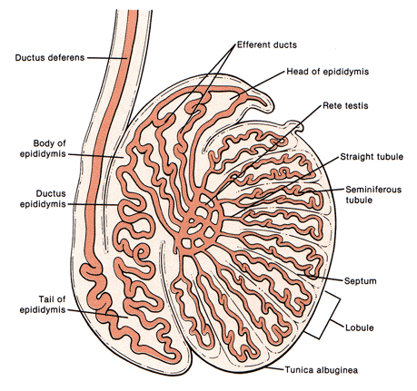
ID

Slide 41
What is the rete testes?

Slide 42
Double Jeopardy
Three conditions when amenorrhea would occur

Slide 43
What are
Pregnancy
Menopause
Overexercise
Anorexia?

