Slide 1
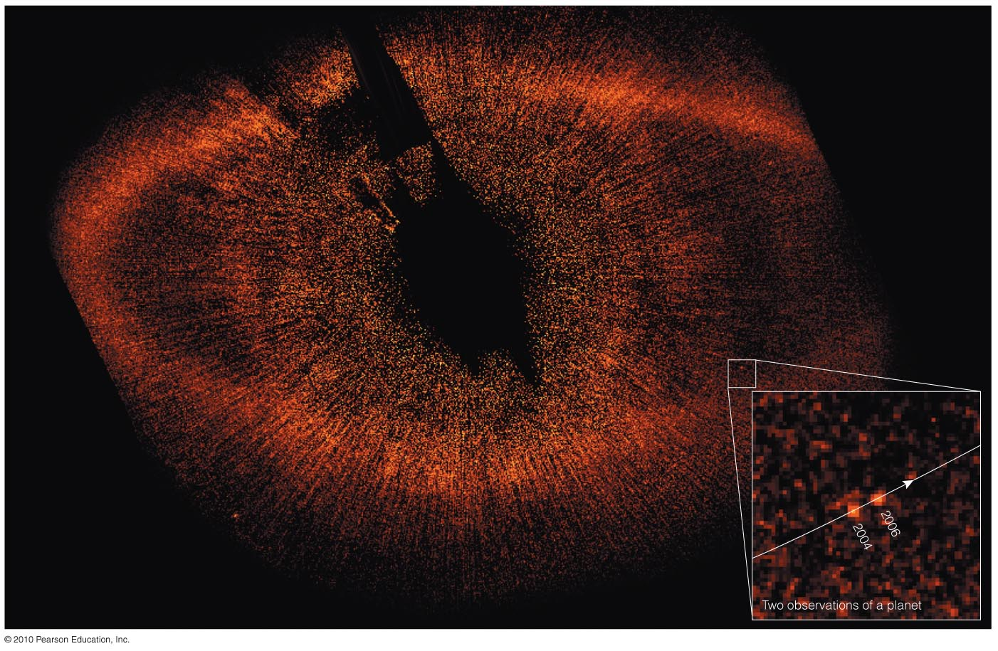
Chapter 13
Other Planetary Systems:
The New Science of Distant Worlds

Slide 2
13.1 Detecting Extrasolar Planets
Our goals for learning:
Why is it so difficult to detect planets around other stars?
How do we detect planets around other stars?

Slide 3
Why is it so difficult to detect planets around other stars?

Slide 4
Brightness Difference
A Sun-like star is about a billion times brighter than the light reflected from its planets.
This is like being in San Francisco and trying to see a pinhead 15 meters from a grapefruit in Washington, D.C.

Slide 5
Special Topic: How Did We Learn That Other Stars Are Suns?
Ancient observers didn’t think stars were like the Sun because Sun is so much brighter.
Christian Huygens (1629–1695) used holes drilled in a brass plate to estimate the angular sizes of stars.
His results showed that, if stars were like Sun, they must be at great distances, consistent with the lack of observed parallax.

Slide 6
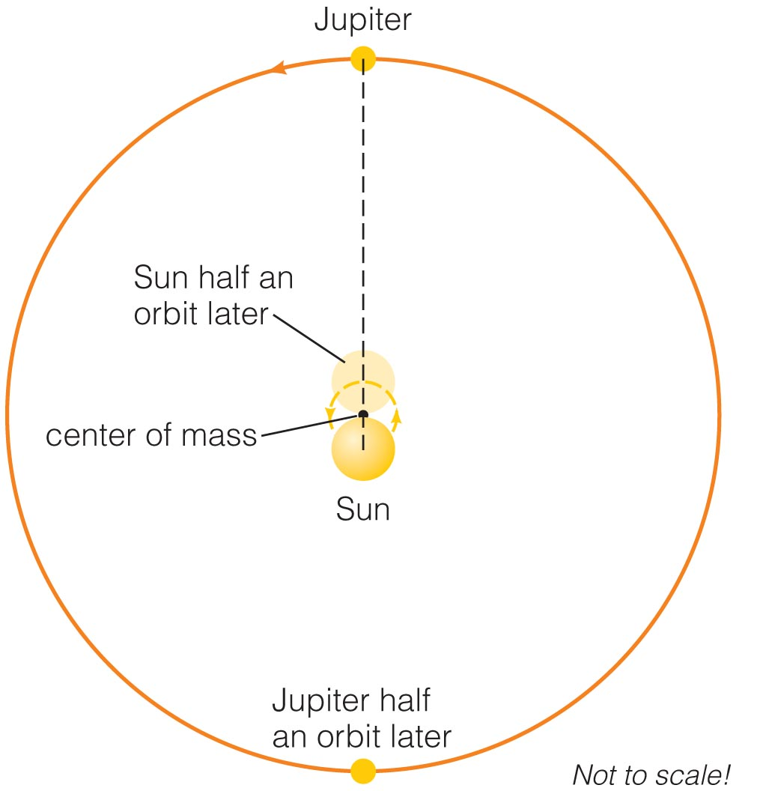
How do we detect planets around other stars?

Slide 7
Planet Detection
Direct: pictures or spectra of the planets themselves
Indirect: measurements of stellar properties revealing the effects of orbiting planets

Slide 8
Gravitational Tugs
The Sun and Jupiter orbit around their common center of mass.
The Sun therefore wobbles around that center of mass with same period as Jupiter.

Slide 9
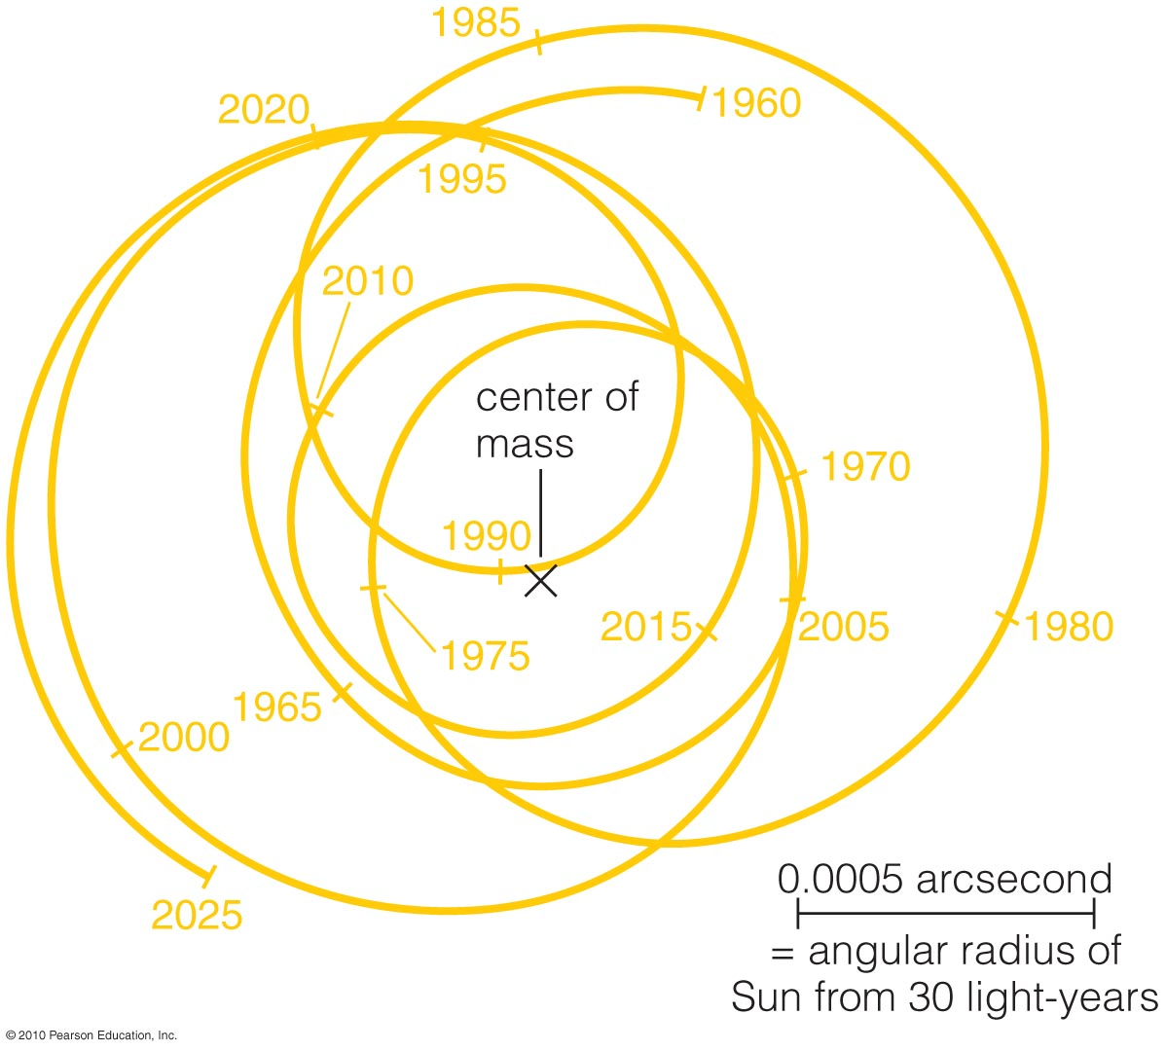
Gravitational Tugs
The Sun’s motion around the solar system’s center of mass depends on tugs from all the planets.
Astronomers around other stars that measured this motion could determine the masses and orbits of all the planets.

Slide 10
Astrometric Technique
We can detect planets by measuring the change in a star’s position on sky.
However, these tiny motions are very difficult to measure (~ 0.001 arcsecond).

Slide 11
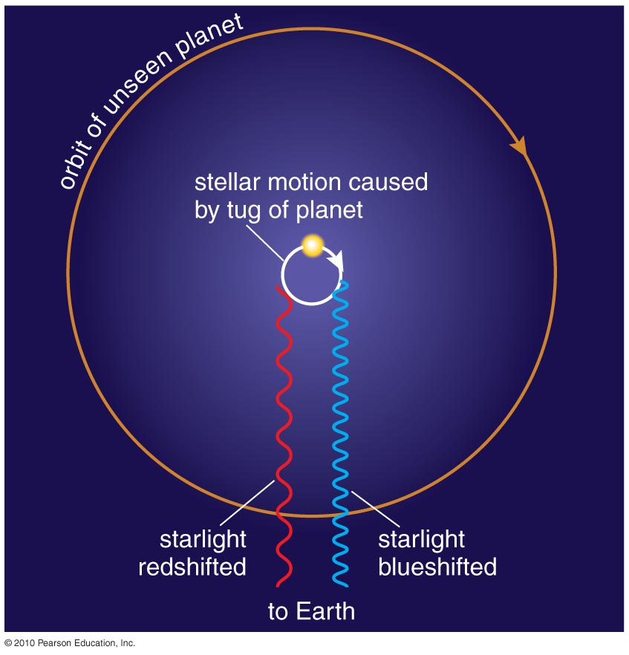
Doppler Technique
Measuring a star’s Doppler shift can tell us its motion toward and away from us.
Current techniques can measure motions as small as 1 m/s (walking speed!).

Slide 12
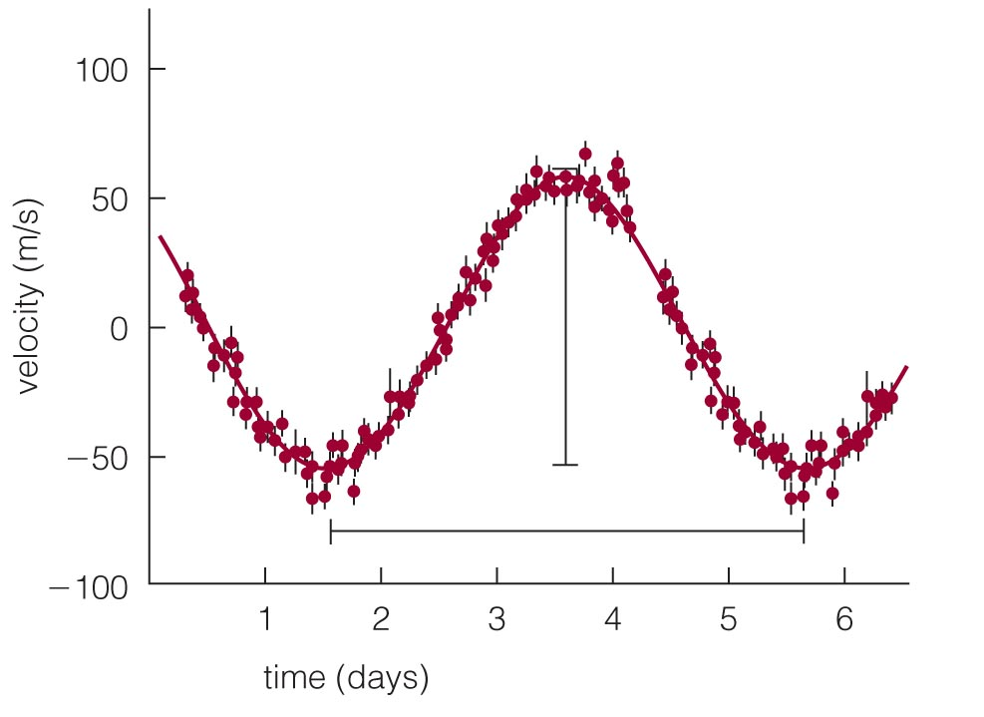
First Extrasolar Planet
Doppler shifts of the star 51 Pegasi indirectly revealed a planet with 4-day orbital period.
This short period means that the planet has a small orbital distance.
This was the first extrasolar planet to be discovered (1995).
Insert TCP 6e Figure 13.4a unannotated

Slide 13
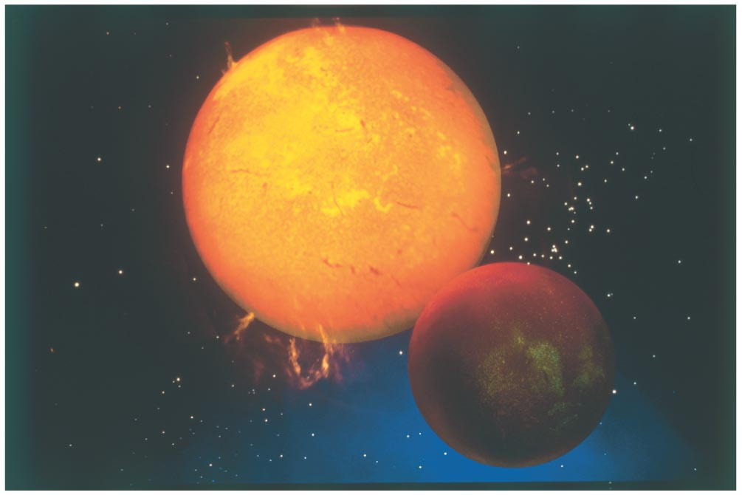
First Extrasolar Planet
Insert TCP 6e Figure 13.4b
The planet around 51 Pegasi has a mass similar to Jupiter’s, despite its small orbital distance.

Slide 14
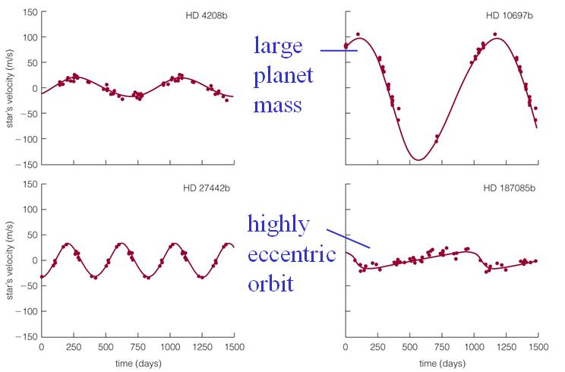
Other Extrasolar Planets
Doppler shift data tell us about a planet’s mass and the shape of its orbit.

Slide 15
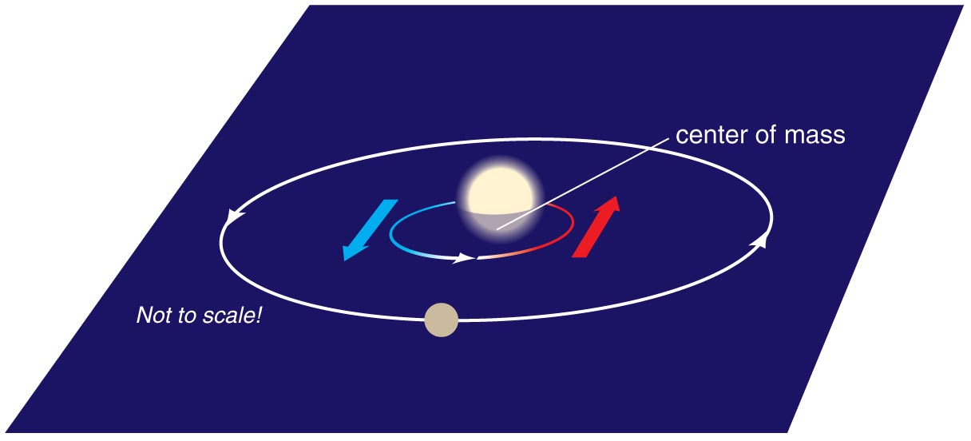
Planet Mass and Orbit Tilt
We cannot measure an exact mass for a planet without knowing the tilt of its orbit, because Doppler shift tells us only the velocity toward or away from us.
Doppler data give us lower limits on masses.

Slide 16
Thought Question
Suppose you found a star with the same mass as the Sun moving back and forth with a period of 16 months. What could you conclude?
It has a planet orbiting at less than 1 AU.
It has a planet orbiting at greater than 1 AU.
It has a planet orbiting at exactly 1 AU.
It has a planet, but we do not have enough information to know its orbital distance.
Notes:
Rocky material condensed everywhere.
B. The students often get confused by the differentiation ideas they’ve just
heard about in planet formation.
D. If a passing star ripped off asteroids, it would have stripped away comets
and planets too. (That may be one explanation for the truncation of the
Kuiper belt…)

Slide 17
Thought Question
Suppose you found a star with the same mass as the Sun moving back and forth with a period of 16 months. What could you conclude?
It has a planet orbiting at less than 1 AU.
It has a planet orbiting at greater than 1 AU.
It has a planet orbiting at exactly 1 AU.
It has a planet, but we do not have enough information to know its orbital distance.
Notes:
Rocky material condensed everywhere.
B. The students often get confused by the differentiation ideas they’ve just
heard about in planet formation.
D. If a passing star ripped off asteroids, it would have stripped away comets
and planets too. (That may be one explanation for the truncation of the
Kuiper belt…)

Slide 18
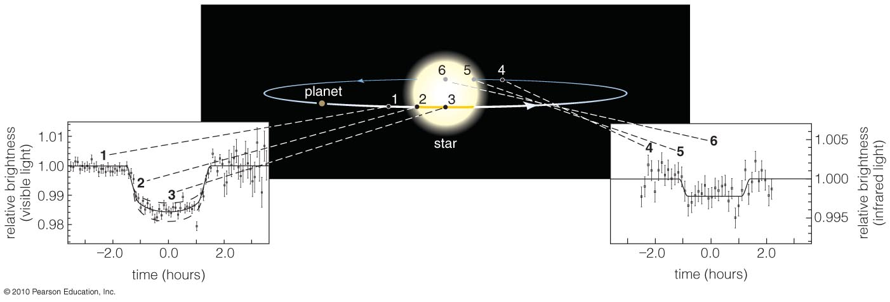

Transits and Eclipses
A transit is when a planet crosses in front of a star.
The resulting eclipse reduces the star’s apparent brightness and tells us planet’s radius.
No orbital tilt: accurate measurement of planet mass

Slide 19
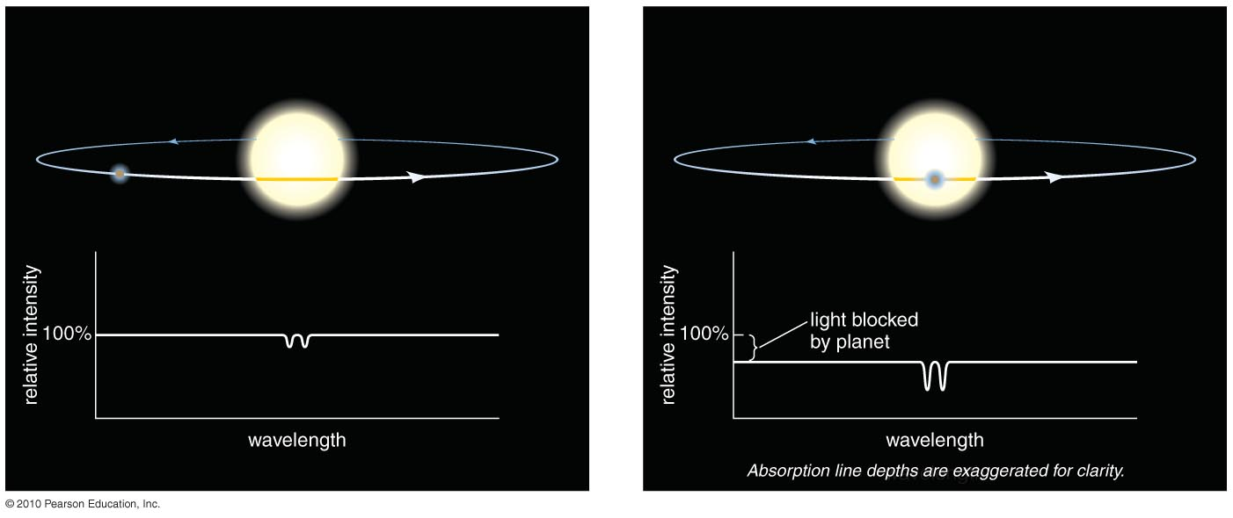
Spectrum During Transit
Change in spectrum during a transit tells us about the composition of planet’s atmosphere.

Slide 20
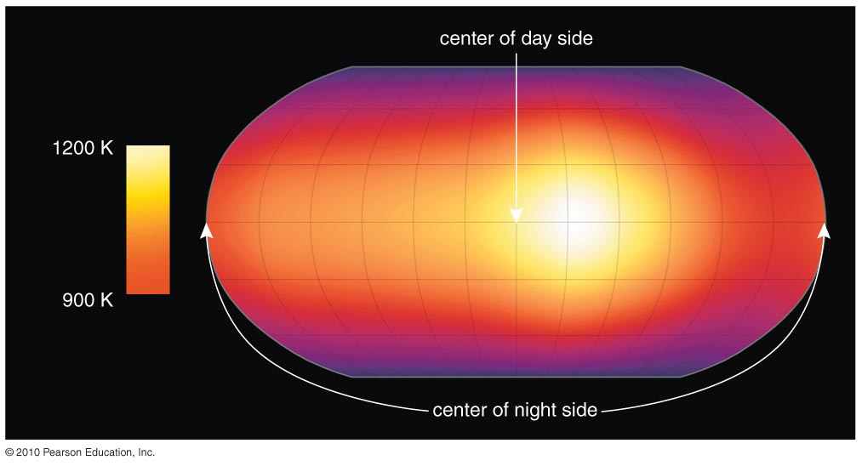
Surface Temperature Map
Measuring the change in infrared brightness during an eclipse enables us to map a planet’s surface temperature.

Slide 21
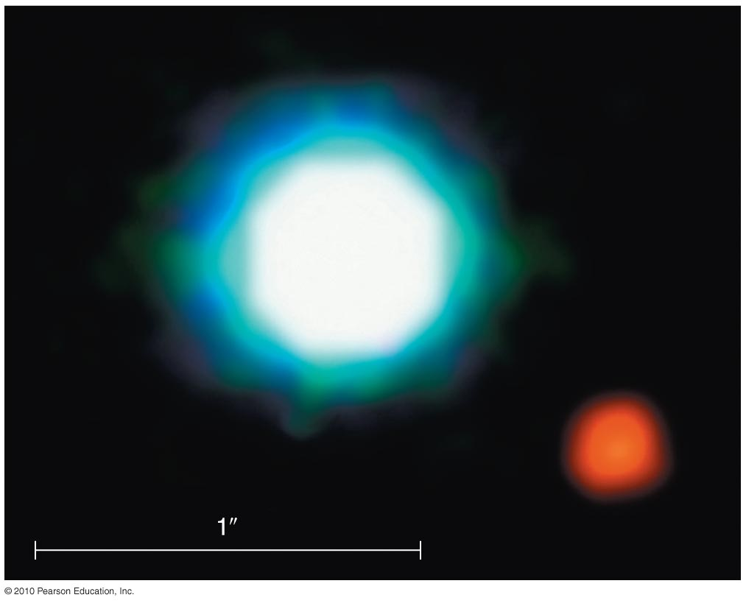
Direct Detection
Special techniques like adaptive optics are helping to enable direct planet detection.

Slide 22
Direct Detection
Techniques that help block the bright light from stars are also helping us to find planets around them.

Slide 23
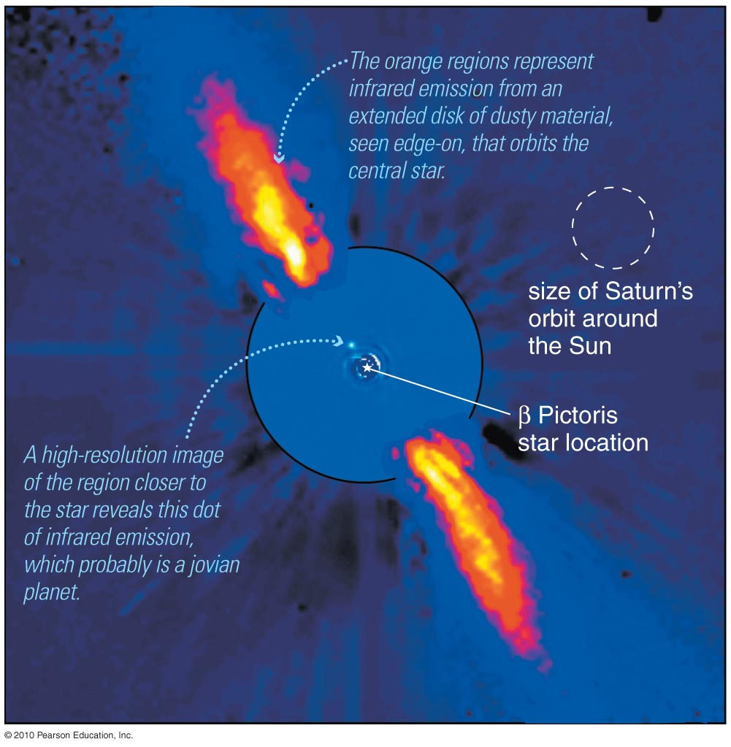
Direct Detection
Techniques that help block the bright light from stars are also helping us to find planets around them.

Slide 24
Other Planet-Hunting Strategies
Gravitational Lensing: Mass bends light in a special way when a star with planets passes in front of another star.
Features in Dust Disks: Gaps, waves, or ripples in disks of dusty gas around stars can indicate presence of planets.

Slide 25
What have we learned?
Why is it so difficult to detect planets around other stars?
  Direct starlight is billions of times brighter than the starlight reflected from planets.
How do we detect planets around other stars?
  A star’s periodic motion (detected through Doppler shifts) tells us about its planets.
  Transiting planets periodically reduce a star’s brightness.
  Direct detection is possible if we can reduce the glare of the star’s bright light.

Slide 26
13.2 The Nature of Extrasolar Planets
Our goals for learning:
What have we learned about extrasolar planets?
How do extrasolar planets compare with planets in our solar system?

Slide 27
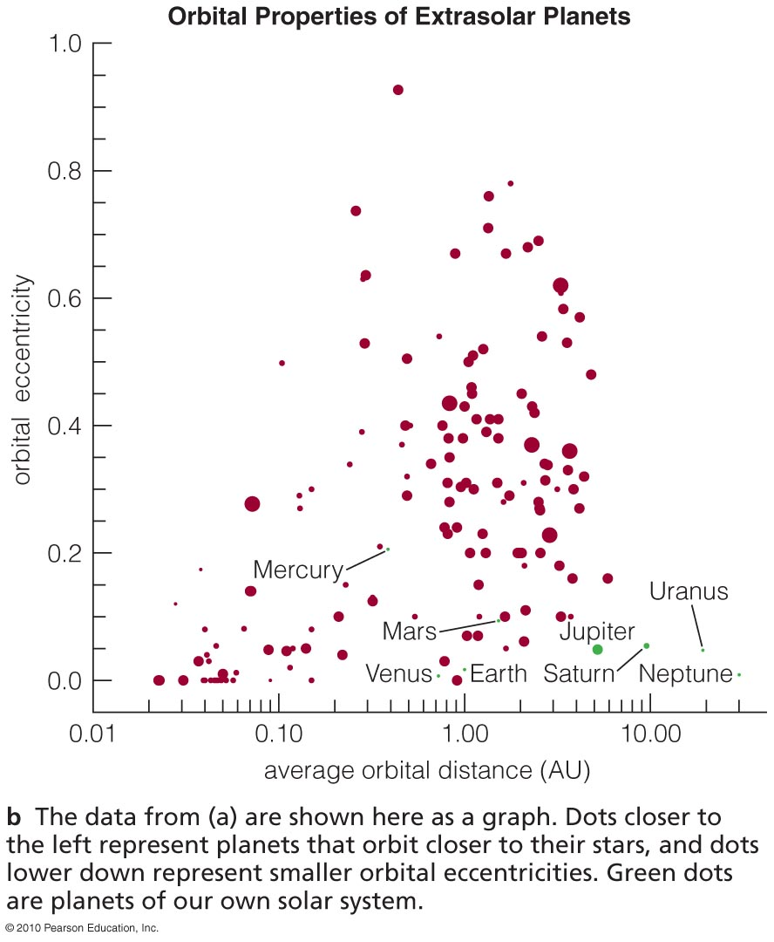
What have we learned about extrasolar planets?

Slide 28
Measurable Properties
Orbital period, distance, and Shape
Planet mass, size, and density
Composition

Slide 29
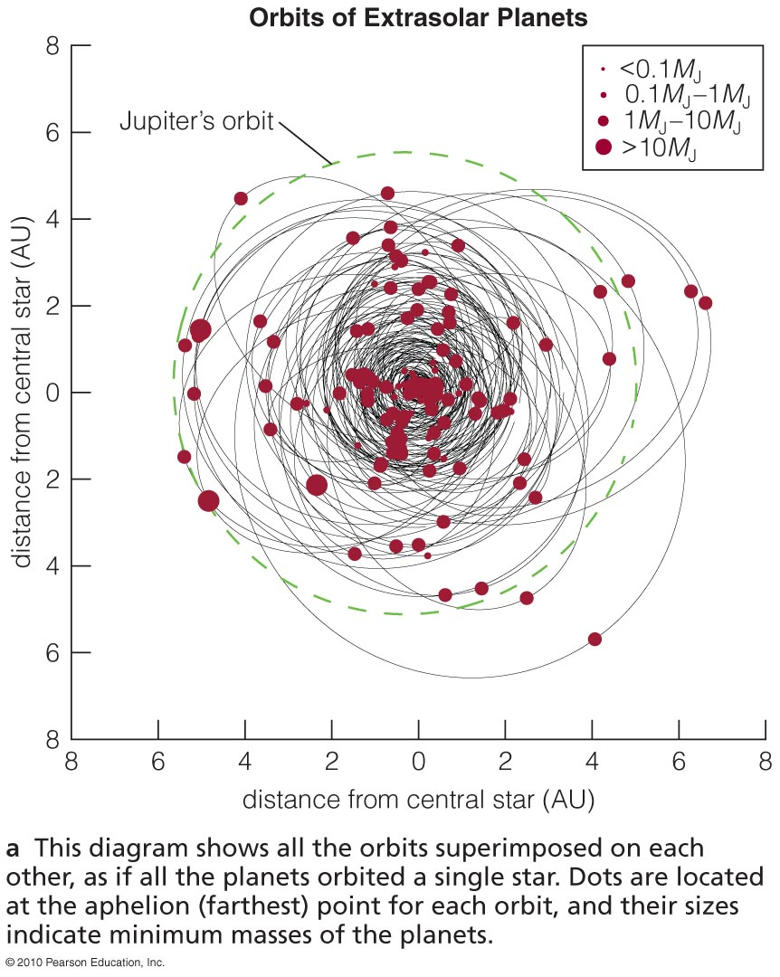
Orbits of Extrasolar Planets
Most of the detected planets have orbits smaller than Jupiter’s.
Planets at greater distances are harder to detect with the Doppler technique.

Slide 30
Orbits of Extrasolar Planets
Orbits of some extrasolar planets are much more elongated (have a greater eccentricity) than those in our solar system.

Slide 31
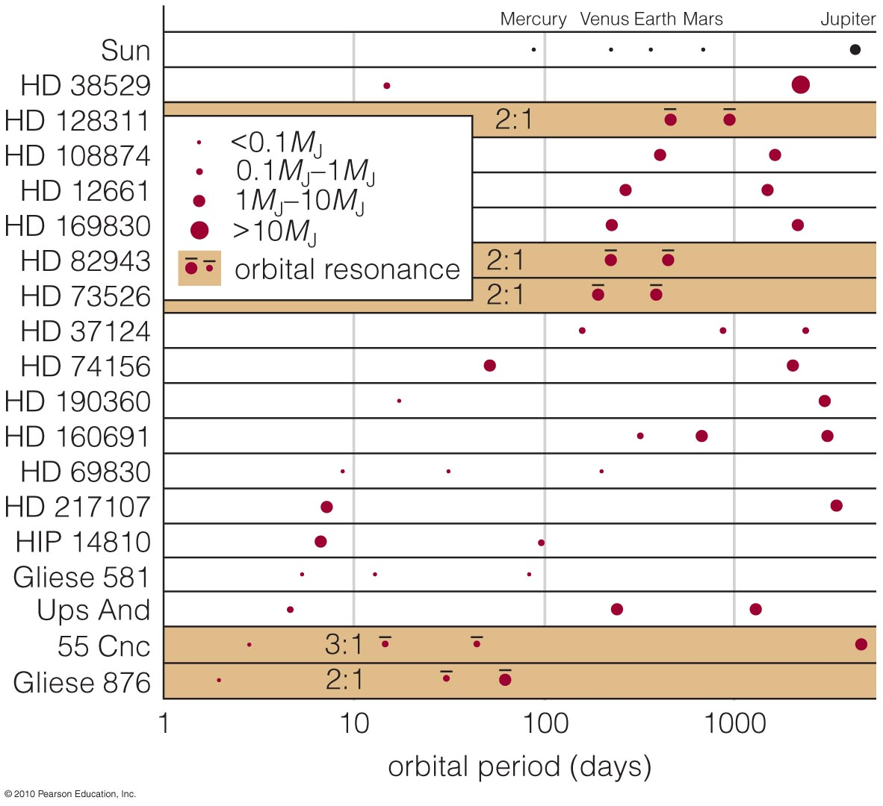
Multiple-Planet Systems
Some stars have more than one detected planet.

Slide 32
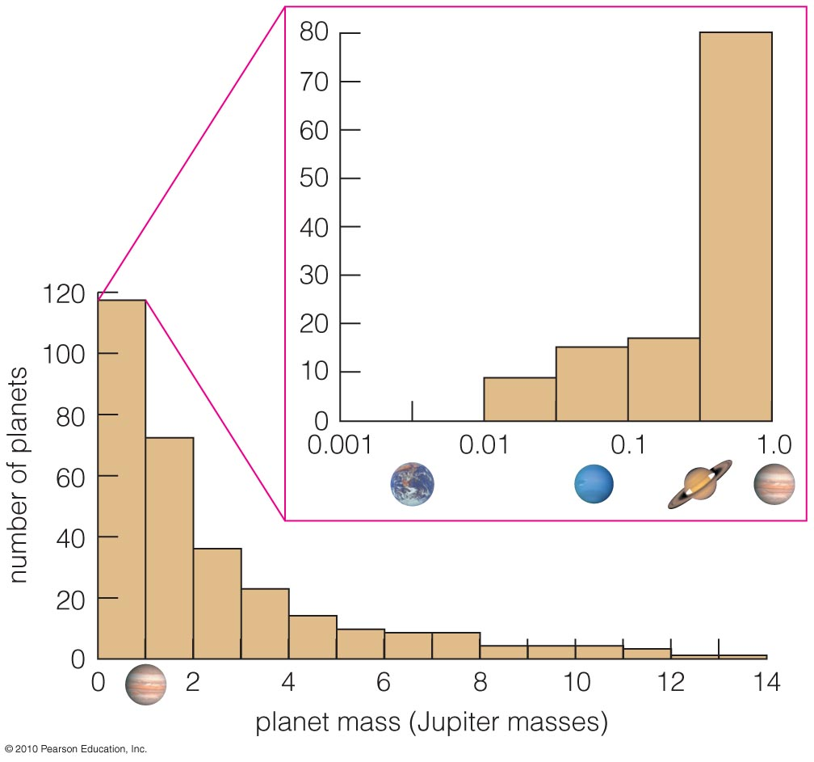
Orbits of Extrasolar Planets
Most of the detected planets have greater mass than Jupiter.
Planets with smaller masses are harder to detect with Doppler technique.

Slide 33
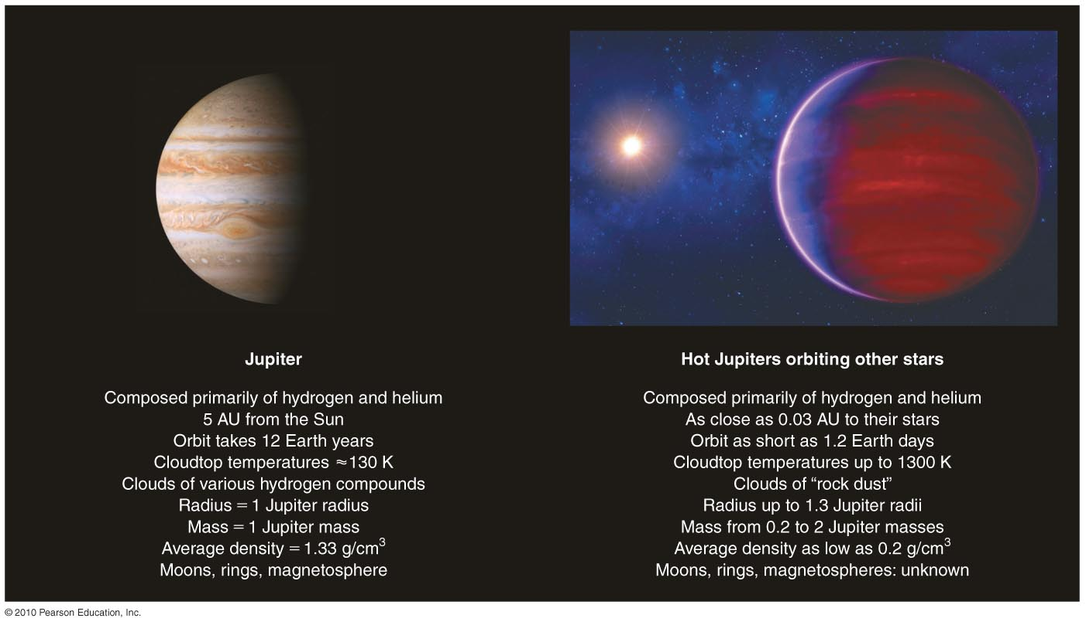
How do extrasolar planets compare with planets in our solar system?

Slide 34
Surprising Characteristics
Some extrasolar planets have highly elliptical orbits.
Some massive planets, called hot Jupiters, orbit very close to their stars.

Slide 35
Hot Jupiters

Slide 36
What have we learned?
What have we learned about extrasolar planets?
  Extrasolar planets are generally much more massive than Earth.
  They tend to have orbital distances smaller than Jupiter’s.
  Some have highly elliptical orbits.
How do extrasolar planets compare with planets in our solar system?
  Some hot Jupiters have been found.

Slide 37
13.3 The Formation of Other Solar Systems
Our goals for learning:
Can we explain the surprising orbits of many extrasolar planets?
Do we need to modify our theory of solar system formation?

Slide 38
Can we explain the surprising orbits of many extrasolar planets?

Slide 39
Revisiting the Nebular Theory
The nebular theory predicts that massive Jupiter-like planets should not form inside the frost line (at << 5 AU).
The discovery of hot Jupiters has forced reexamination of nebular theory.
Planetary migration or gravitational encounters may explain hot Jupiters.

Slide 40
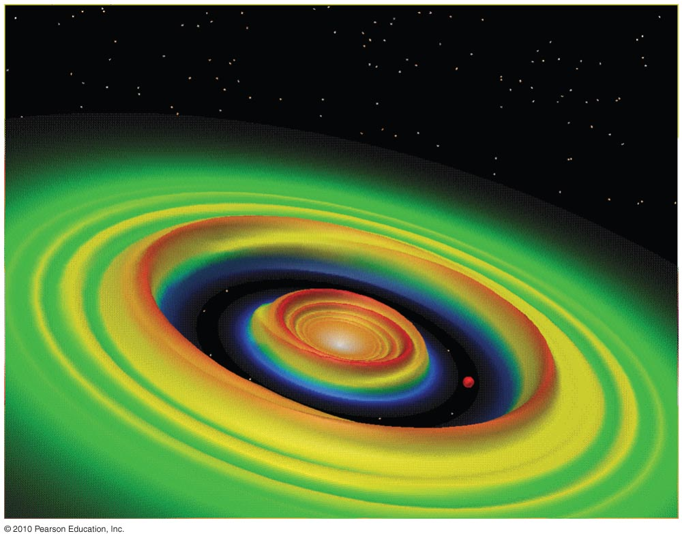
Planetary Migration
A young planet’s motion can create waves in a planet-forming disk.
Models show that matter in these waves can tug on a planet, causing its orbit to migrate inward.

Slide 41
Gravitational Encounters
Close gravitational encounters between two massive planets can eject one planet while flinging the other into a highly elliptical orbit.
Multiple close encounters with smaller planetesimals can also cause inward migration.

Slide 42
Orbital Resonances
Resonances between planets can also cause their orbits to become more elliptical.

Slide 43
Thought Question
What happens in a gravitational encounter that allows a planet’s orbit to move inward?
It transfers energy and angular momentum to another object.
The gravity of the other object forces the planet to move inward.
It gains mass from the other object, causing its gravitational pull to become stronger.
Notes:
Rocky material condensed everywhere.
B. The students often get confused by the differentiation ideas they’ve just
heard about in planet formation.
D. If a passing star ripped off asteroids, it would have stripped away comets
and planets too. (That may be one explanation for the truncation of the
Kuiper belt…)

Slide 44
Thought Question
What happens in a gravitational encounter that allows a planet’s orbit to move inward?
It transfers energy and angular momentum to another object.
The gravity of the other object forces the planet to move inward.
It gains mass from the other object, causing its gravitational pull to become stronger.
Notes:
Rocky material condensed everywhere.
B. The students often get confused by the differentiation ideas they’ve just
heard about in planet formation.
D. If a passing star ripped off asteroids, it would have stripped away comets
and planets too. (That may be one explanation for the truncation of the
Kuiper belt…)

Slide 45
Do we need to modify our theory of solar system formation?

Slide 46
Modifying the Nebular Theory
Observations of extrasolar planets have shown that the nebular theory was incomplete.
Effects like planetary migration and gravitational encounters might be more important than previously thought.

Slide 47
Planets: Common or Rare?
One in ten stars examined so far have turned out to have planets.
The others may still have smaller (Earth-sized) planets that current techniques cannot detect.

Slide 48
What have we learned?
Can we explain the surprising orbits of many extrasolar planets?
  Original nebular theory cannot account for the existence of hot Jupiters.
  Planetary migration or gravitational encounters may explain how Jupiter-like planets moved inward.
Do we need to modify our theory of solar system formation?
  Migration and encounters may play a larger role than previously thought.

Slide 49
13.4 Finding More New Worlds
Our goals for learning:
How will we search for Earth-like planets?

Slide 50
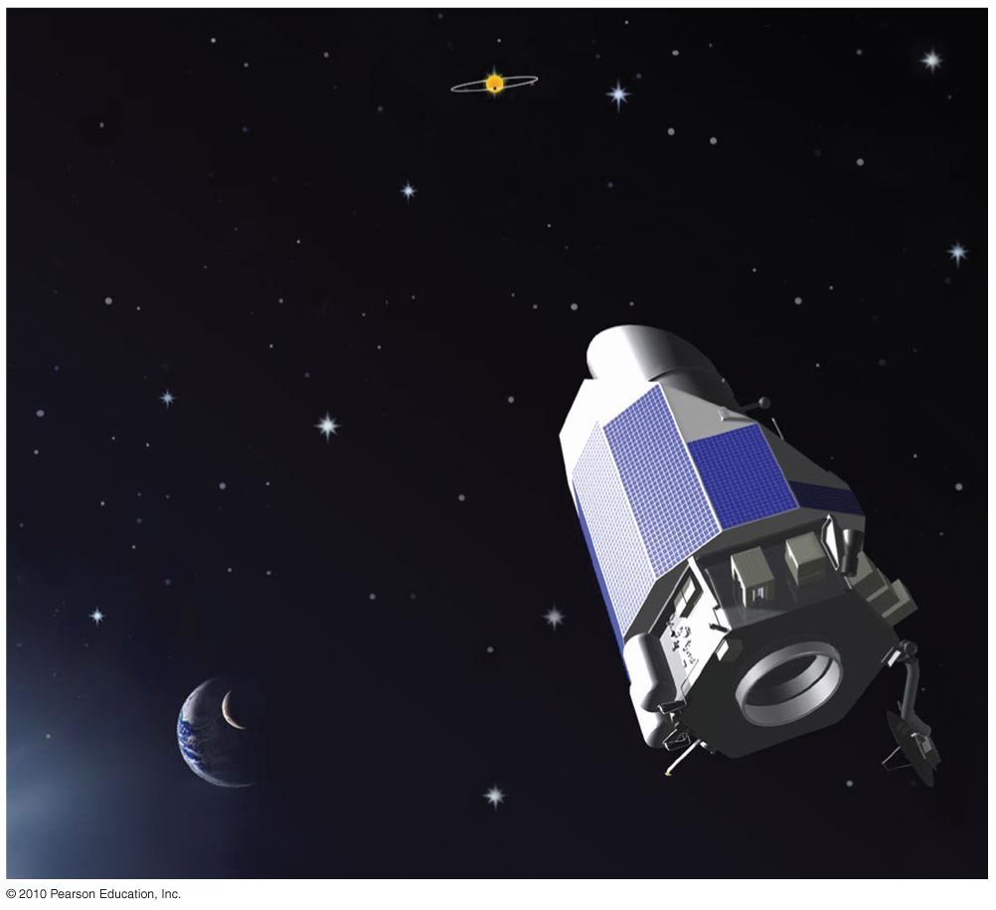
How will we search for Earth-like planets?
Insert TCP 6e Figure 13.18

Slide 51
Transit Missions
NASA’s Kepler mission was launched in 2008 to begin looking for transiting planets.
It is designed to measure the 0.008% decline in brightness when an Earth-mass planet eclipses a Sun-like star.

Slide 52
Astrometric Missions
GAIA: a European mission planned for 2011 that will use interferometry to measure precise motions of a billion stars
SIM: A NASA mission that will use interferometry to measure star motions even more precisely (to 10⁻⁶ arcseconds)

Slide 53
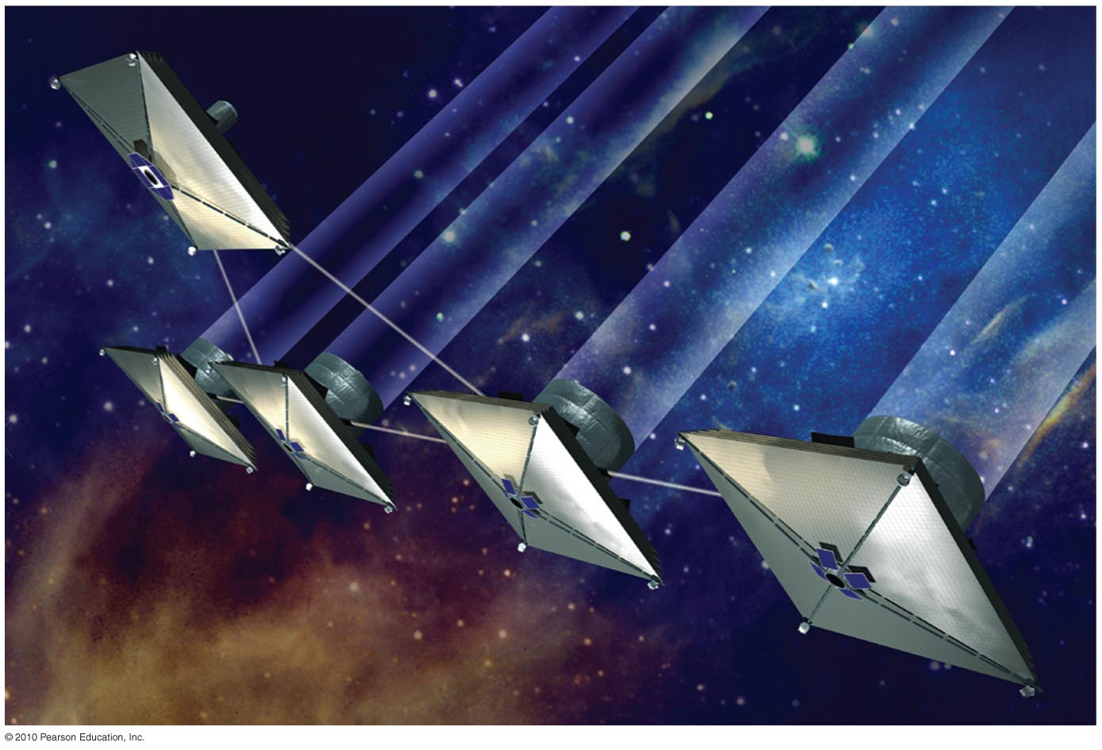
Direct Detection
Determining whether Earth-mass planets are really Earth-like requires direct detection.
Missions capable of blocking enough starlight to measure the spectrum of an Earth-like planet are being planned.
Mission concept for NASA’s
Terrestrial Planet Finder (TPF)

Slide 54
What have we learned?
How will we search for Earth-like planets?
  Transit missions will be capable of finding Earth-like planets that cross in front of their stars.
  Astrometric missions will be capable of measuring the “wobble” of a star caused by an orbiting Earth-like planet.
  Missions for direct detection of an Earth-like planet will need to use special techniques (like interferometry) for blocking starlight.

