Slide 1
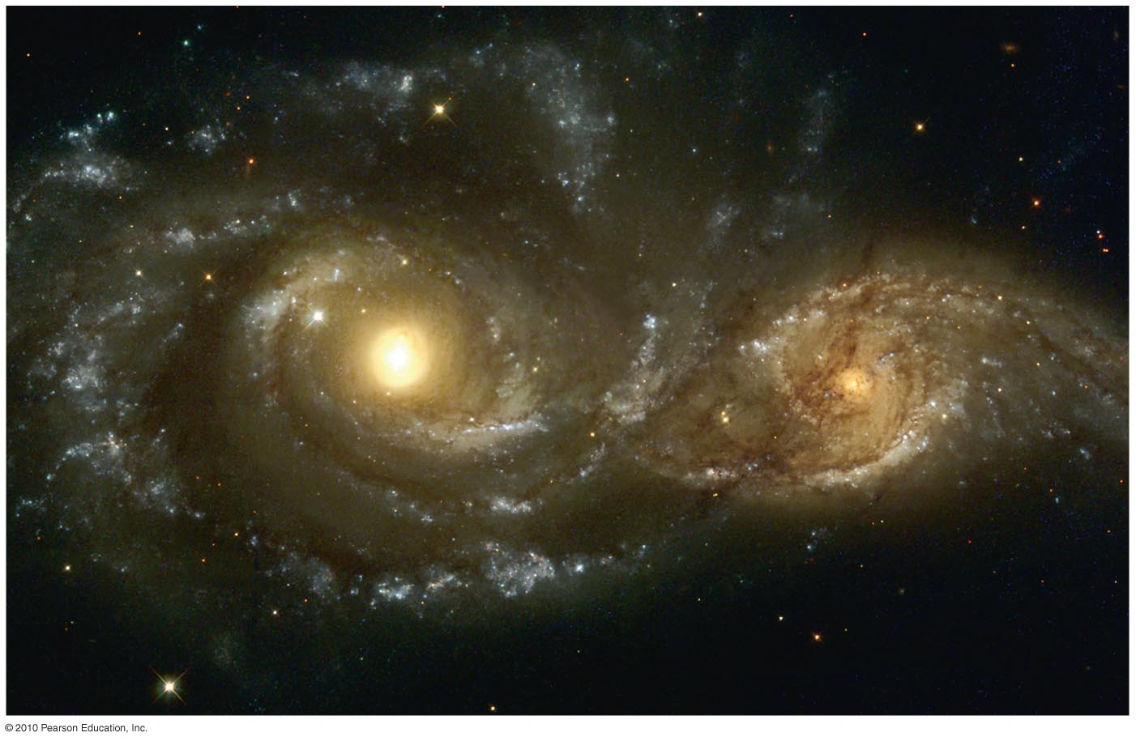
Chapter 4
Making Sense of the Universe: Understanding Motion, Energy, and Gravity

Slide 2
4.1 Describing Motion:
Examples from Daily Life
Our goals for learning:
How do we describe motion?
How is mass different from weight?

Slide 3
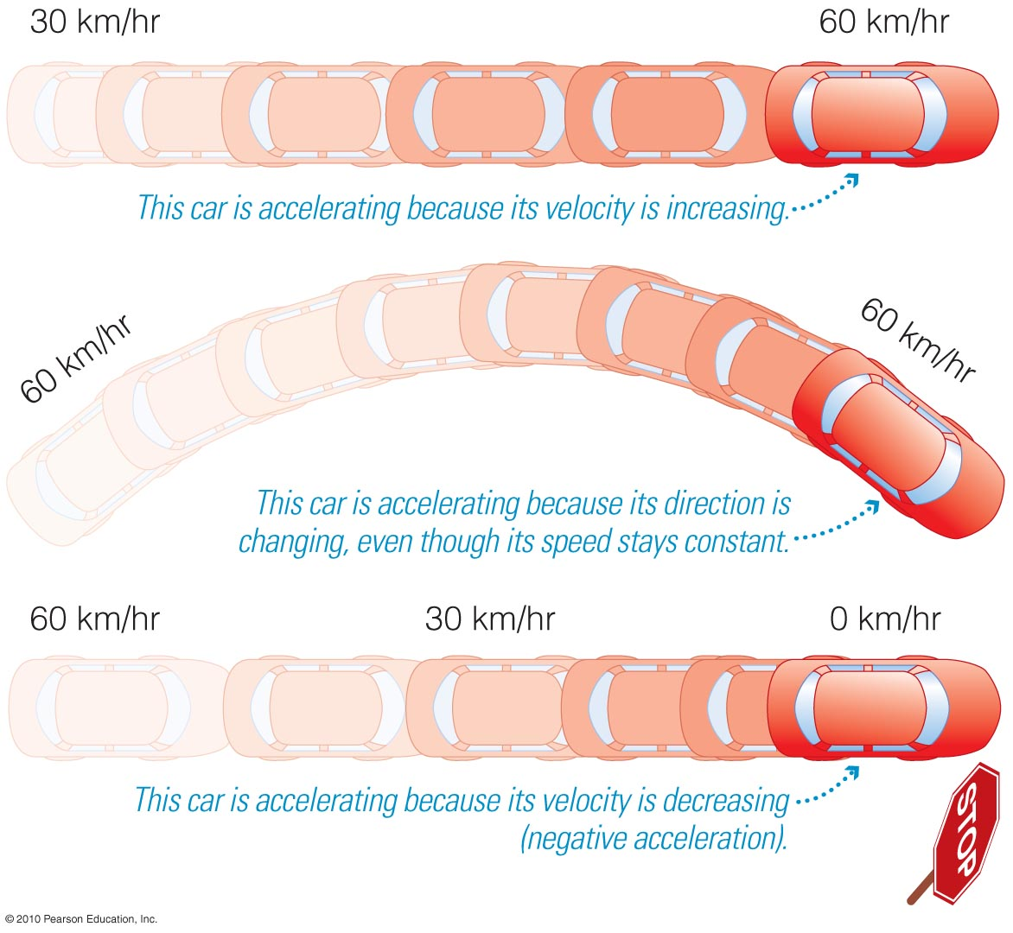
How do we describe motion?
Precise definitions to describe motion:
Speed: Rate at which object moves
Example: 10 m/s
Velocity: Speed and direction
Example: 10 m/s, due east
Acceleration: Any change in velocity units of speed/time (m/s²)
Notes:
Basic vocabulary of motion. Emphasize that turning, slowing, and speeding up are all examples of acceleration.

Slide 4
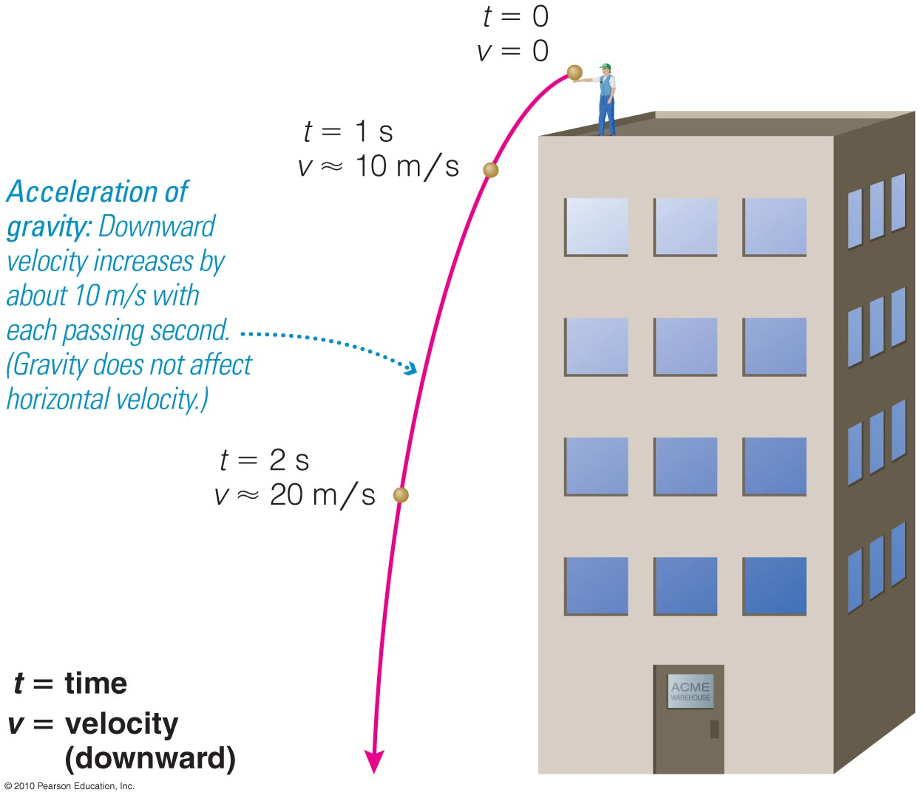
The Acceleration of Gravity
All falling objects accelerate at the same rate (not counting friction of air resistance).
On Earth, g ≈ 10 m/s²: speed increases 10 m/s with each second of falling.

Slide 5
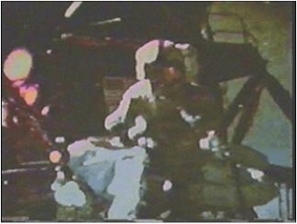
The Acceleration of Gravity (g)
Galileo showed that g is the same for all falling objects, regardless of their mass.
Apollo 15 demonstration
Notes:
When you show this video clip, be sure to point out what is going on since it is not easy to see…

Slide 6
Momentum and Force
Momentum = mass × velocity
A net force changes momentum, which generally means an acceleration (change in velocity).
Rotational momentum of a spinning or orbiting object is known as angular momentum.

Slide 7
Thought Question
For each of the following is there a net force? Y/N
A car coming to a stop
A bus speeding up
An elevator moving up at constant speed
A bicycle going around a curve
A moon orbiting Jupiter
Notes:
Use to check if students can figure out where a net force is acting. For bonus questions, ask if they can identify the forces.

Slide 8
Thought Question
For each of the following is there a net force? Y/N
A car coming to a stop: Y
A bus speeding up: Y
An elevator moving at constant speed: N
A bicycle going around a curve: Y
A moon orbiting Jupiter: Y

Slide 9
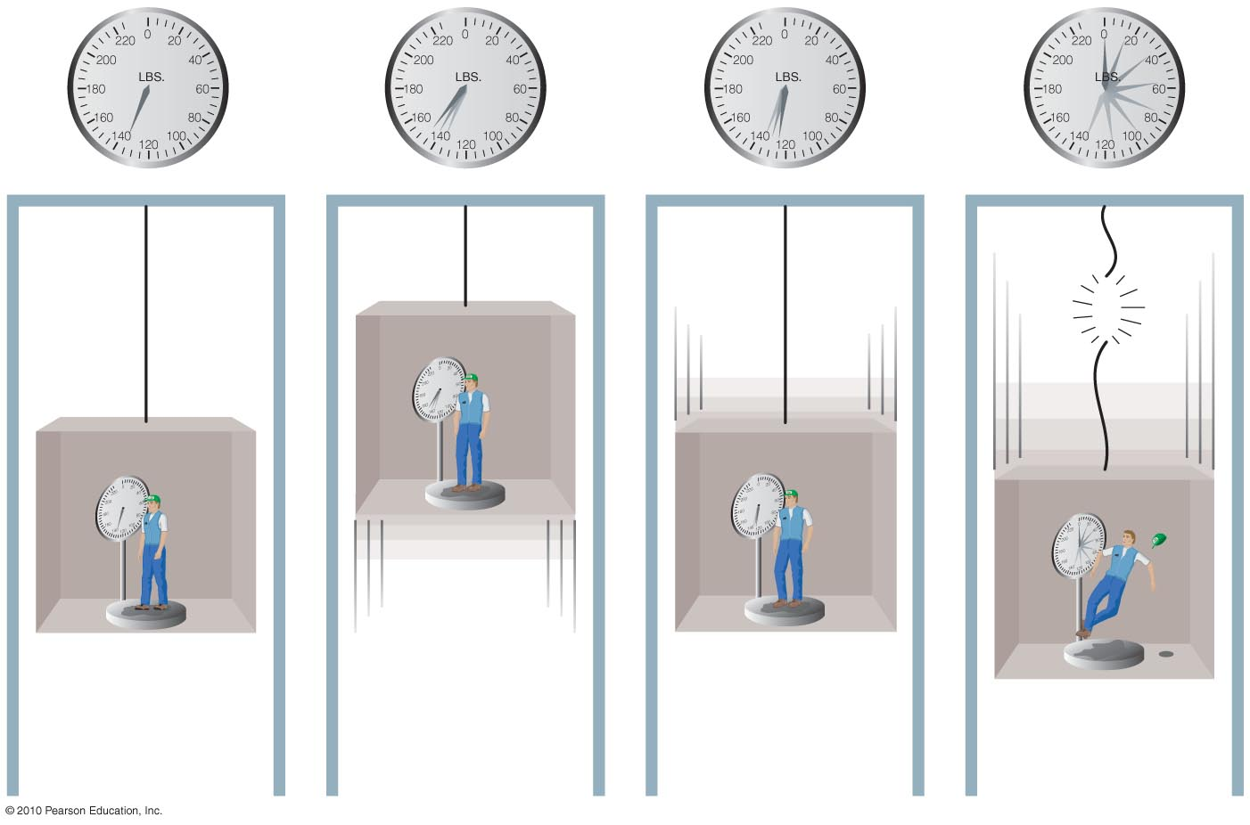

How is mass different from weight?
Mass – the amount of matter in an object
Weight – the force that acts upon an object
You are weightless in free-fall!

Slide 10
Thought Question
On the Moon:
My weight is the same, my mass is less.
My weight is less, my mass is the same.
My weight is more, my mass is the same.
My weight is more, my mass is less.

Slide 11
Thought Question
On the Moon:
My weight is the same, my mass is less.
My weight is less, my mass is the same.
My weight is more, my mass is the same.
My weight is more, my mass is less.

Slide 12
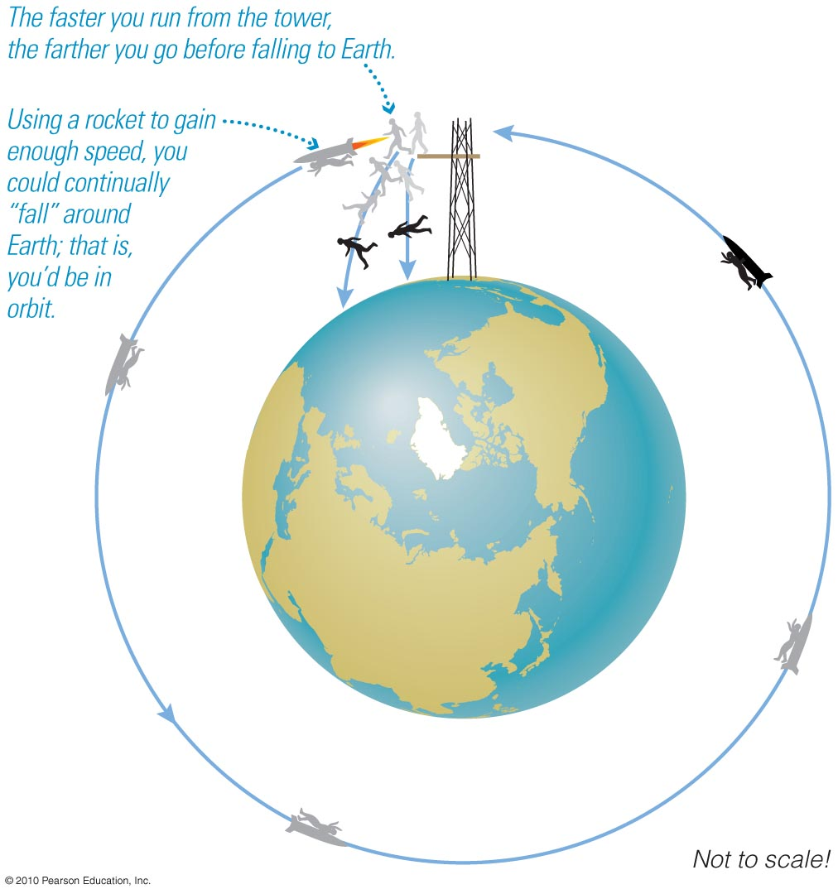
Why are astronauts weightless in space?
There is gravity in space.
Weightlessness is due to a constant state of free-fall.

Slide 13
What have we learned?
How do we describe motion?
  Speed = distance / time
  Speed and direction => velocity
  Change in velocity => acceleration
  Momentum = mass x velocity
  Force causes change in momentum, producing acceleration.

Slide 14
What have we learned?
How is mass different from weight?
  Mass = quantity of matter
  Weight = force acting on mass
  Objects are weightless in free-fall.

Slide 15
4.2 Newton’s Laws of Motion
Our goals for learning:
How did Newton change our view of the universe?
What are Newton’s three laws of motion?

Slide 16
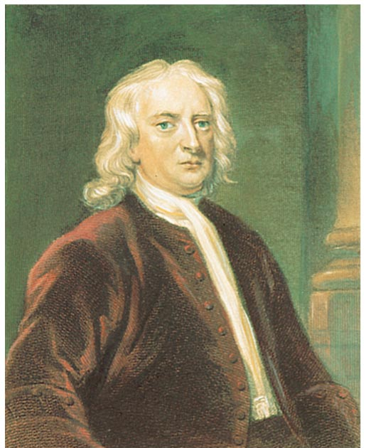
How did Newton change our view of the universe?
Realized the same physical laws that operate on Earth also operate in the heavens
  one universe
Discovered laws of motion and gravity
Much more: experiments with light, first reflecting telescope, calculus…
Sir Isaac Newton
(1642–1727)

Slide 17
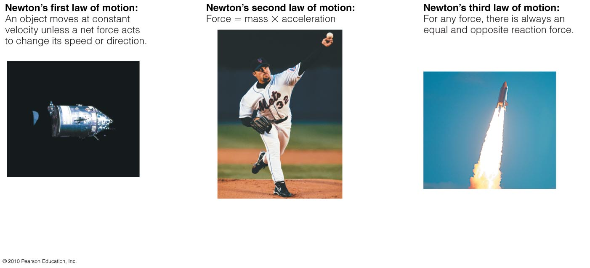
What are Newton’s three laws of motion?
Newton’s first law of motion: An object moves at constant velocity unless a net force acts to change its speed or direction.
Notes:
You may wish to discuss the examples in the book on p. 83-84.

Slide 18
Newton’s second law of motion:
Force = mass × acceleration

Slide 19
Newton’s third law of motion:
For every force, there is always an equal and opposite reaction force.

Slide 20
Thought Question
How does the force the Earth exerts on you compare with the force you exert on it?
Earth exerts a larger force on you.
You exert a larger force on Earth.
Earth and you exert equal and opposite forces on each other.

Slide 21
Thought Question
How does the force the Earth exerts on you compare with the force you exert on it?
Earth exerts a larger force on you.
You exert a larger force on Earth.
Earth and you exert equal and opposite forces on each other.

Slide 22
Thought Question
A compact car and a Mack truck have a head-on collision. Are the following true or false?
The force of the car on the truck is equal and opposite to the force of the truck on the car.
The momentum transferred from the truck to the car is equal and opposite to the momentum transferred from the car to the truck.
The change of velocity of the car is the same as the change of velocity of the truck.

Slide 23
Thought Question
A compact car and a Mack truck have a head-on collision. Are the following true or false?
The force of the car on the truck is equal and opposite to the force of the truck on the car. T
The momentum transferred from the truck to the car is equal and opposite to the momentum transferred from the car to the truck. T
The change of velocity of the car is the same as the change of velocity of the truck. F

Slide 24
What have we learned?
How did Newton change our view of the universe?
  He discovered laws of motion and gravitation.
  He realized these same laws of physics were identical in the universe and on Earth.
What are Newton’s three laws of motion?
  1. Object moves at constant velocity if no net force is acting.
  2. Force = mass × acceleration
  3. For every force there is an equal and opposite reaction force.

Slide 25
4.3 Conservation Laws in Astronomy
Our goals for learning:
Why do objects move at constant velocity if no force acts on them?
What keeps a planet rotating and orbiting the Sun?
Where do objects get their energy?

Slide 26
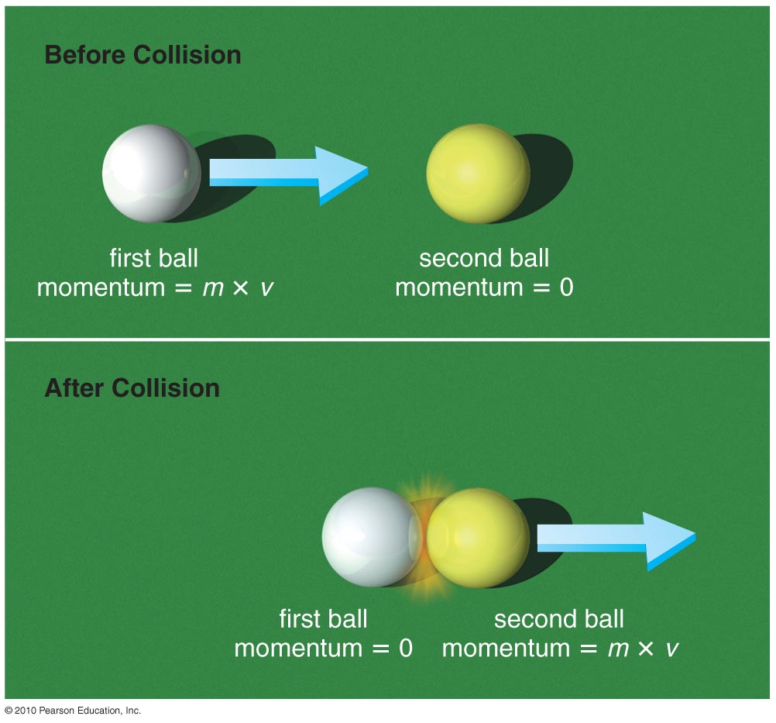
Why do objects move at constant velocity if no force acts on them?
Objects continue at constant velocity because of conservation if momentum.
The total momentum of interacting objects cannot change unless an external force is acting on them.
Interacting objects exchange momentum through equal and opposite forces.
Notes:
You may wish to discuss the examples given in the text on p. 79

Slide 27
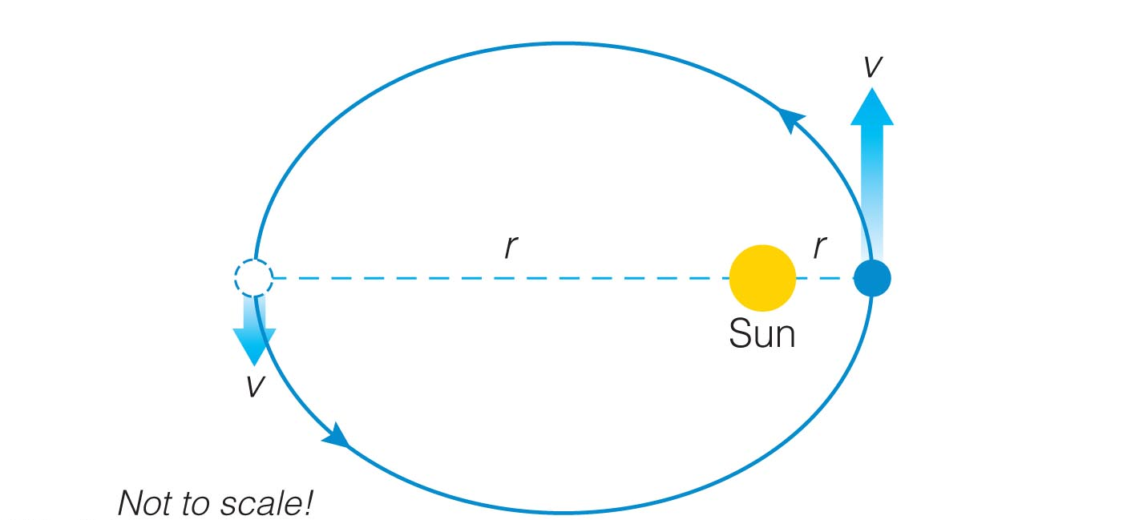
What keeps a planet rotating and orbiting the Sun?
Notes:
You may wish to go over this figure in some detail to be sure the idea is clear.

Slide 28
Conservation of Angular Momentum
Angular momentum = mass x velocity x radius
The angular momentum of an object cannot change unless an external twisting force (torque) is acting on it.
Earth experiences no twisting force as it orbits the Sun, so its rotation and orbit will continue indefinitely.
Notes:
You may wish to discuss the examples given in the text on p. 79

Slide 29
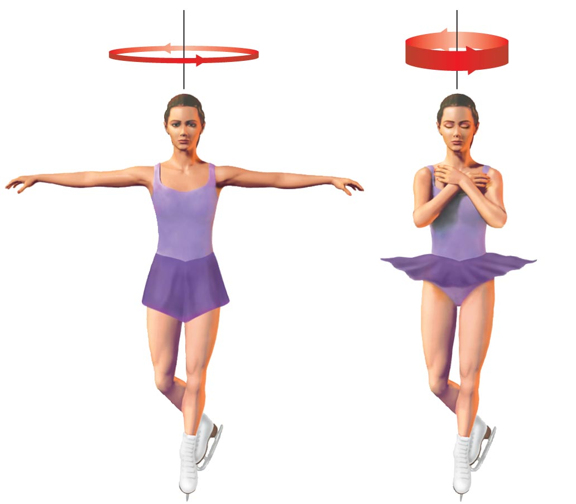
Angular momentum conservation also explains why objects
rotate faster as they shrink in radius.
Notes:
Discuss astronomical analogs: disks of galaxies, disks in which planets form, accretion disks…

Slide 30
Where do objects get their energy?
Energy makes matter move.
Energy is conserved, but it can:
  transfer from one object to another
  change in form
Notes:
Begin by defining energy…

Slide 31
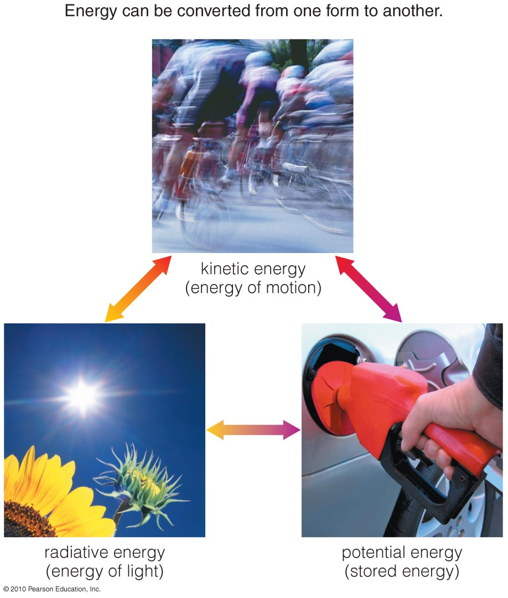
Basic Types of Energy
Kinetic (motion)
Radiative (light)
Potential (stored)
Energy can change type, but cannot be created or destroyed.

Slide 32
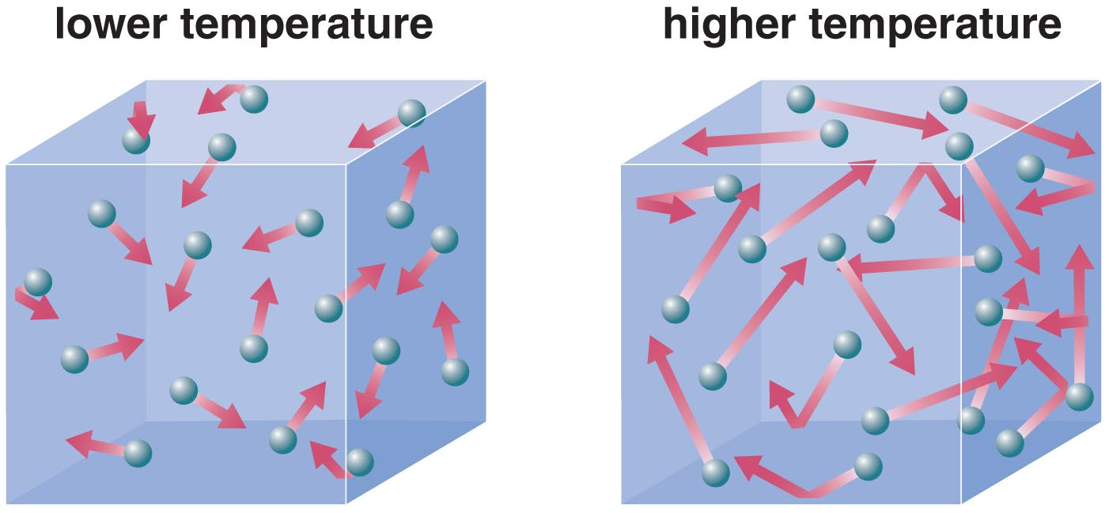
Thermal Energy: the collective kinetic energy of many particles
(for example, in a rock, in air, in water)
Thermal energy is related to temperature but it is NOT the same.
Temperature is the average kinetic energy of the many particles in a substance.
Notes:
Students sometimes get confused when we’ve said there are 3 basic types of energy (kinetic, potential, radiative) and then start talking about subtypes, so be sure they understand that we are now dealing with subcategories.

Slide 33
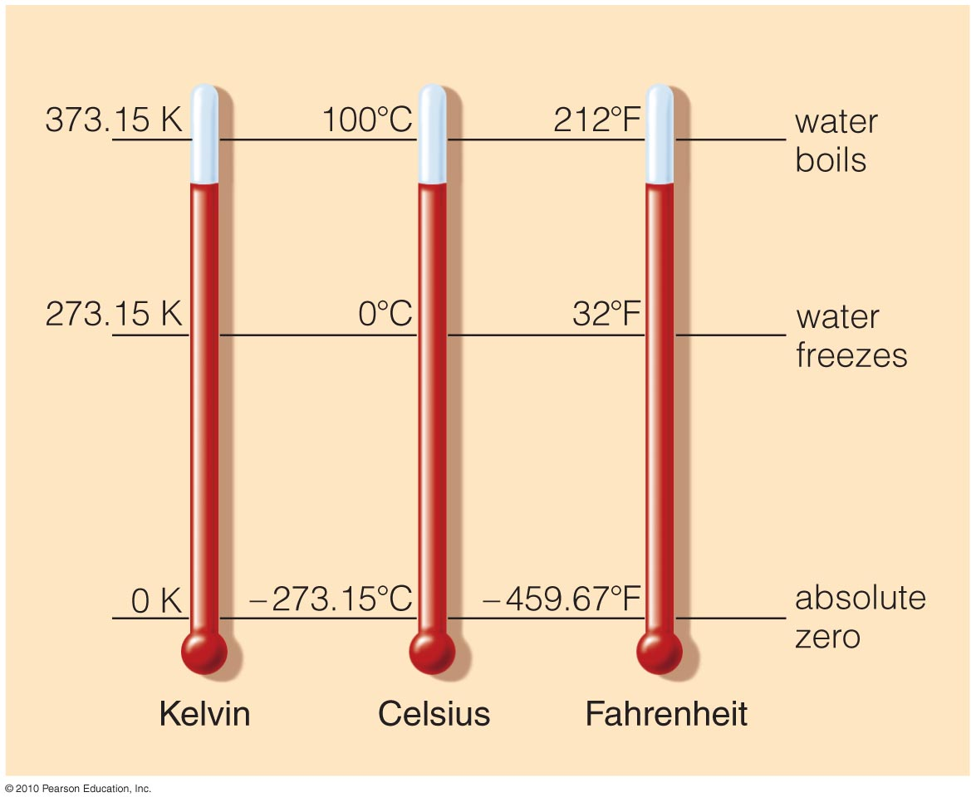
Temperature Scales
Notes:
Use this figure to review temperature scales.

Slide 34
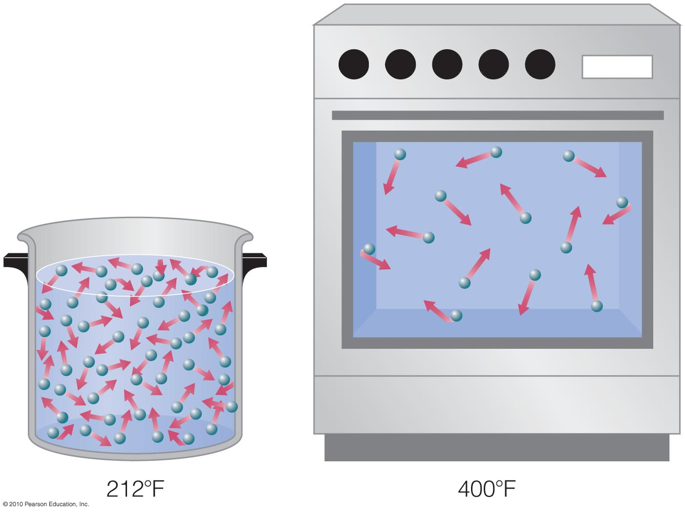
Thermal energy is a measure of the total kinetic energy of all
the particles in a substance. It therefore depends on both
temperature AND density.
Example:
Notes:
We’ve found this example of the oven and boiling water to be effective in explaining the difference between temperature and thermal energy. You may then wish to discuss other examples. You might also want to note that the temperature in low-Earth orbit is actually quite high, but astronauts get cold because of the low density.

Slide 35
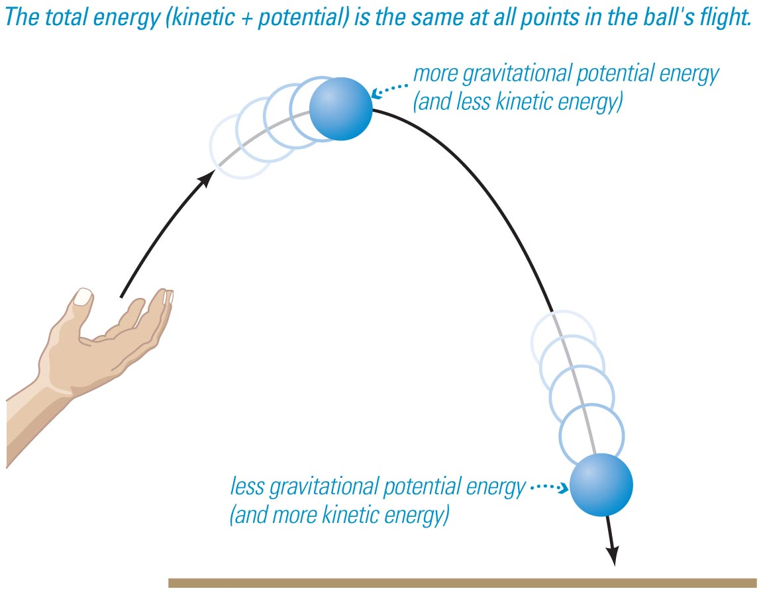
Gravitational Potential Energy
On Earth, depends on:
  object’s mass (m)
  strength of gravity (g)
  distance object could potentially fall
Notes:
We next discuss 2 subcategories of potential energy that are important in astronomy: gravitational potential energy (this and next slide) and mass-energy.

Slide 36
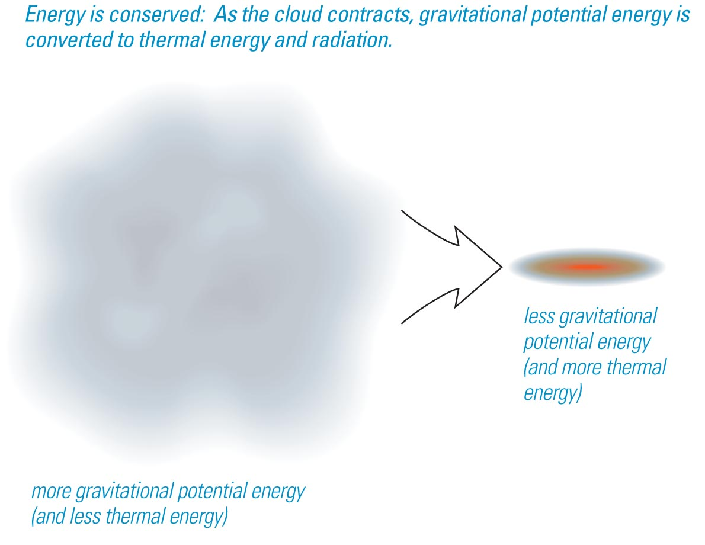
Gravitational Potential Energy
In space, an object or gas cloud has more gravitational energy when it is spread out than when it contracts.
A contracting cloud converts gravitational potential energy to thermal energy.
Notes:
We next discuss 2 subcategories of potential energy that are important in astronomy: gravitational potential energy (this and next slide) and mass-energy.

Slide 37
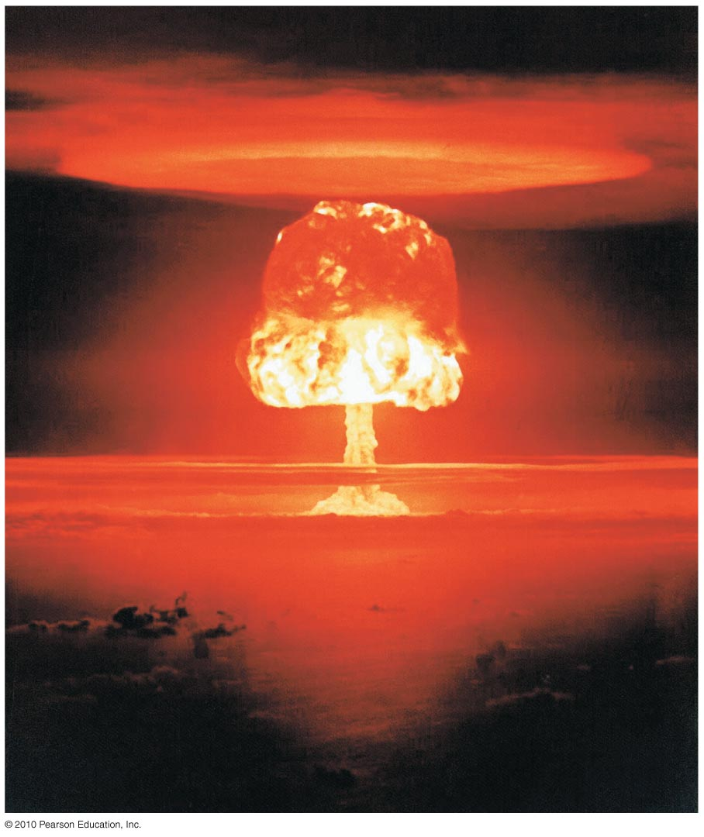
Mass-Energy
Mass itself is a form of potential energy:
E = mc²
A small amount of mass can release a great deal of energy (for example, an H-bomb).
Concentrated energy can spontaneously turn into particles (for example, in particle accelerators).

Slide 38
Conservation of Energy
Energy can be neither created nor destroyed.
It can change form or be exchanged between objects.
The total energy content of the universe was determined in the Big Bang and remains the same today.
Notes:
You might wish to go through the example tracing the energy of a baseball back through time, as described on p. 90 of the text.

Slide 39
What have we learned?
Why do objects move at constant velocity if no force acts on them?
  Conservation of momentum
What keeps a planet rotating and orbiting the Sun?
  Conservation of angular momentum
Where do objects get their energy?
  Conservation of energy: energy cannot be created or destroyed but only transformed from one type to another.
  Energy comes in three basic types: kinetic, potential, radiative.

Slide 40
4.4 The Universal Law of Gravitation
Our goals for learning:
What determines the strength of gravity?
How does Newton’s law of gravity extend Kepler’s laws?

Slide 41
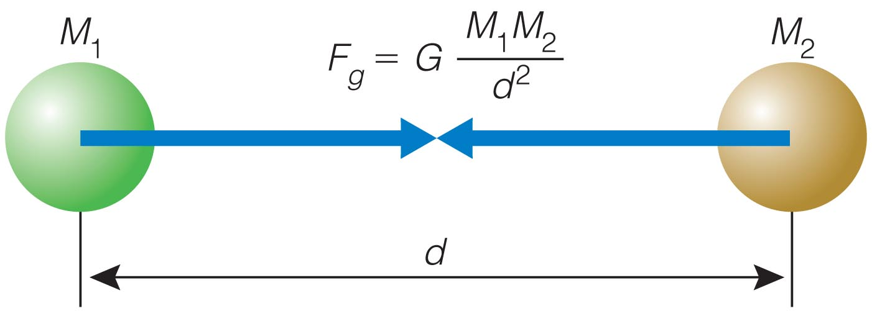
What determines the strength of gravity?
The universal law of gravitation:
Every mass attracts every other mass.
Attraction is directly proportional to the product of their masses.
Attraction is inversely proportional to the square of the distance between their centers.

Slide 42
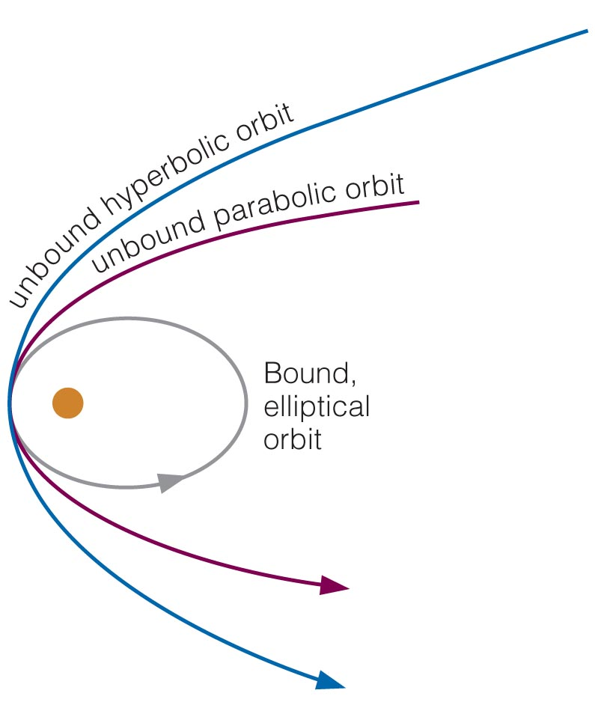
How does Newton’s law of gravity extend Kepler’s laws?
Kepler’s first two laws apply to all orbiting objects, not just planets.
Ellipses are not the only orbital paths. Orbits can be:
  bound (ellipses)
  unbound
    parabola
    hyperbola

Slide 43
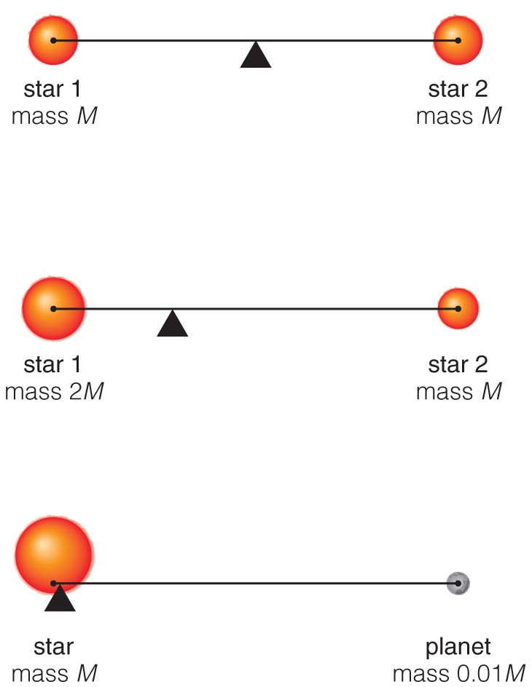
Center of Mass
Because of momentum conservation, orbiting objects orbit around their center of mass.
Notes:
We next discuss 2 subcategories of potential energy that are important in astronomy: gravitational potential energy (this and next slide) and mass-energy.

Slide 44
Newton and Kepler’s Third Law
Newton’s laws of gravity and motion showed that the relationship between the orbital period and average orbital distance of a system tells us the total mass of the system.
Examples:
  Earth’s orbital period (1 year) and average distance (1 AU) tell us the Sun’s mass.
  Orbital period and distance of a satellite from Earth tell us Earth’s mass.
  Orbital period and distance of a moon of Jupiter tell us Jupiter’s mass.
Notes:
Emphasize that this law allows us to measure the masses of distant objects — an incredibly powerful tool.

Slide 45
Newton’s Version of Kepler’s Third Law
p = orbital period
a = average orbital distance (between centers)
(M₁ + M₂) = sum of object masses
Notes:
Optional: use this slide if you wish to introduce the equation for Newton’s version of Kepler’s third law.

Slide 46
What have we learned?
What determines the strength of gravity?
  Directly proportional to the product of the masses (M × m)
  Inversely proportional to the square of the separation
How does Newton’s law of gravity allow us to extend Kepler’s laws?
  Applies to other objects, not just planets
  Includes unbound orbit shapes: parabola, hyperbola
  Can be used to measure mass of orbiting systems

Slide 47
4.5 Orbits, Tides, and the Acceleration of Gravity
Our goals for learning:
How do gravity and energy together allow us to understand orbits?
How does gravity cause tides?
Why do all objects fall at the same rate?

Slide 48
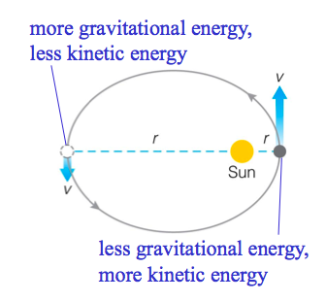
How do gravity and energy together allow us to understand orbits?
Total orbital energy (gravitational + kinetic) stays constant if there is no external force.
Orbits cannot change spontaneously.
Total orbital energy stays constant.
Notes:
The concept of orbital energy is important to understanding orbits.

Slide 49
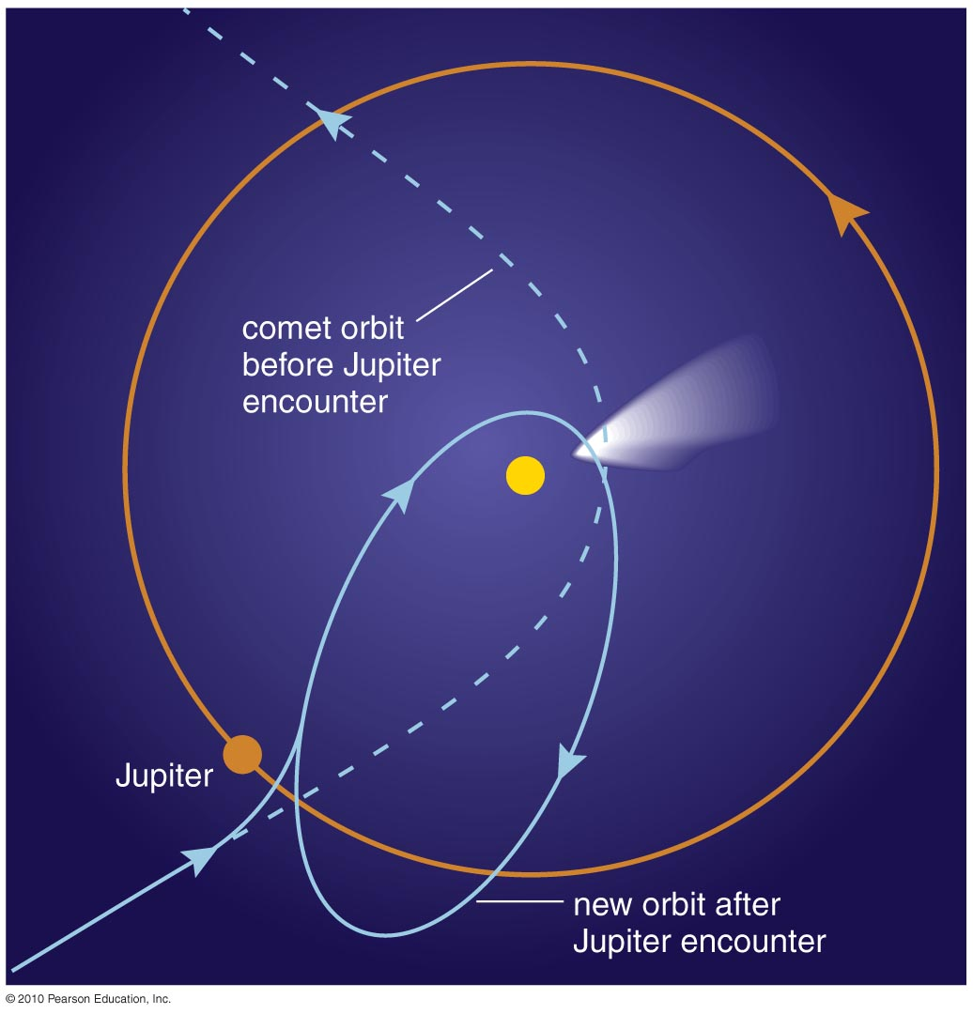
Changing an Orbit
So what can make an object gain or lose orbital energy?
Friction or atmospheric drag
A gravitational encounter
Notes:
Examples worth mentioning:
satellites in low-Earth orbit crashing to Earth due to energy loss to friction with atmosphere
captured moons like Phobos/Deimos or many moons of Jupiter: not easy to capture, and must have happened when an extended atmosphere or gas cloud allowed enough friction for the asteroid to lose significant energy.
Gravitational encounters have affected comets like Halley’s; also used by spacecraft to boost orbits…

Slide 50
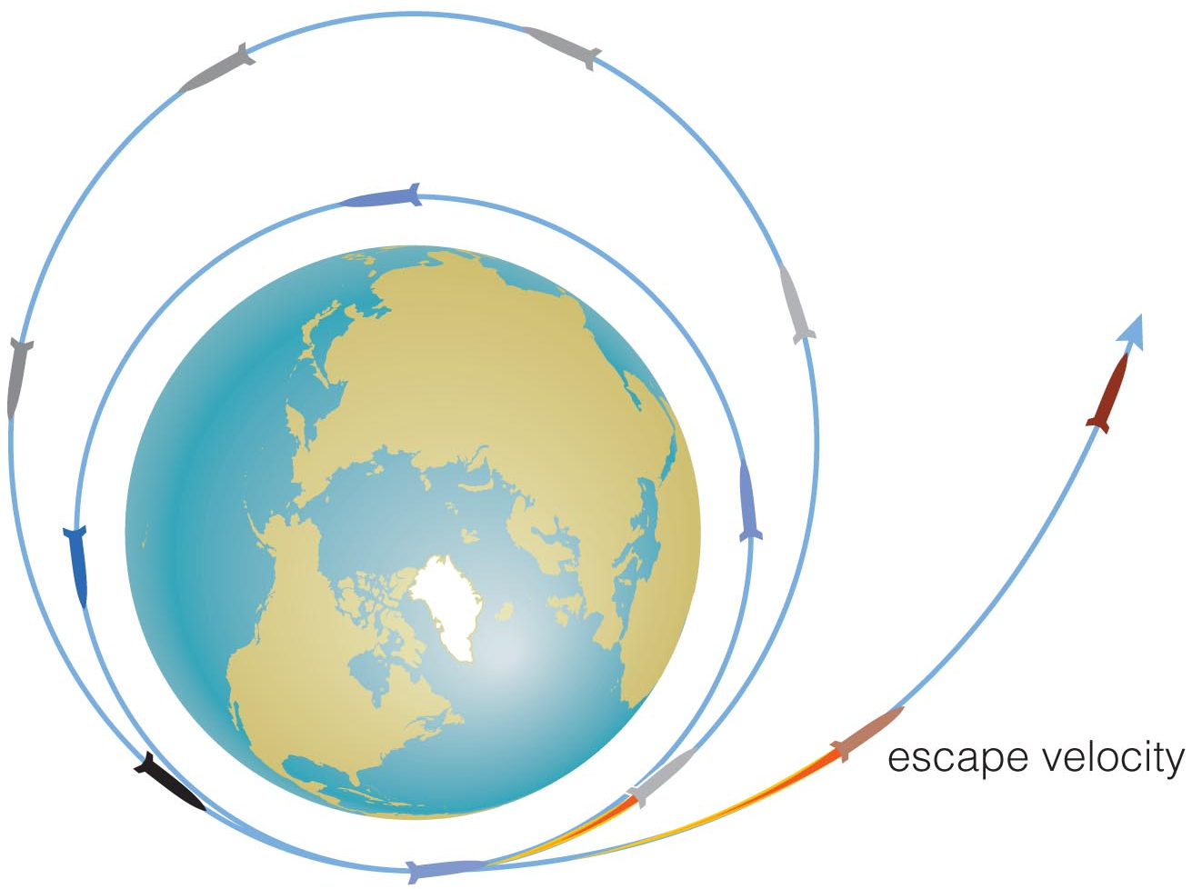
Escape Velocity
If an object gains enough orbital energy, it may escape (change from a bound to unbound orbit).
Escape velocity from Earth ≈ 11 km/s from sea level (about 40,000 km/hr)
Notes:
Can use this to discuss how adding velocity can make a spacecraft move to a higher orbit or ultimately to escape on an unbound orbit.

Slide 51
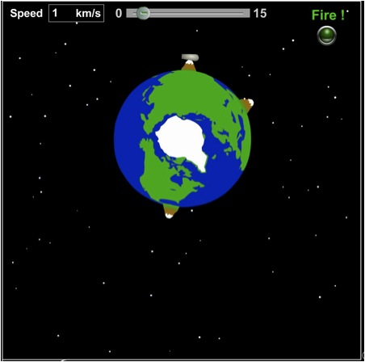
Escape and orbital velocities don’t depend on the mass of the cannonball.

Slide 52
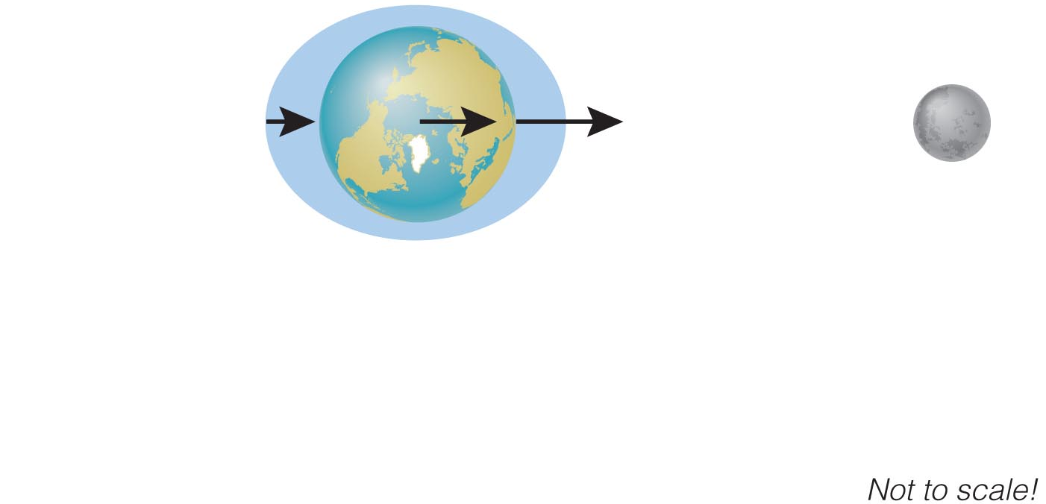
How does gravity cause tides?
Moon’s gravity pulls harder on near side of Earth than on far side.
Difference in Moon’s gravitational pull stretches Earth.
Notes:
Use this figure to explain the origin of the tidal bulges.
Gravitational pull decreases with (distance)², the Moon’s pull on Earth is strongest on the side facing the Moon, weakest on the opposite side.
The Earth gets stretched along the Earth-Moon line.
The oceans rise relative to land at these points.

Slide 53
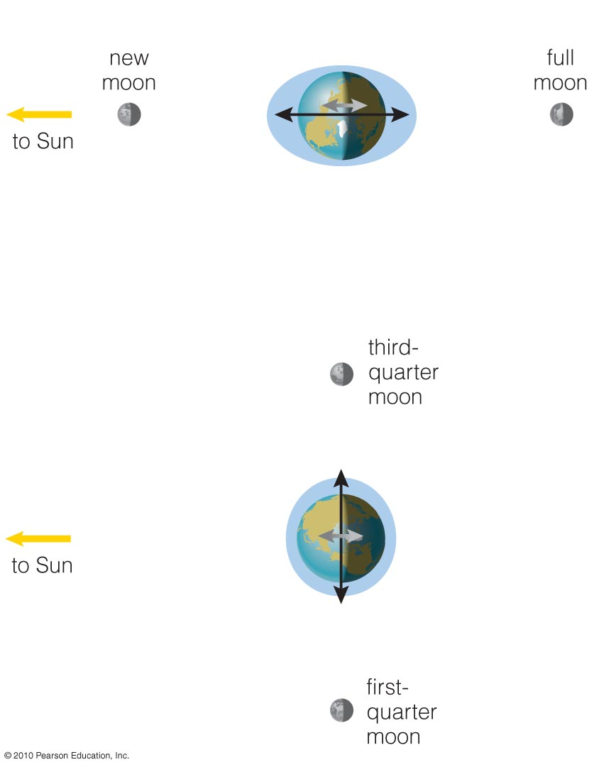
Tides and Phases
Size of tides depends on phase of Moon.

Slide 54
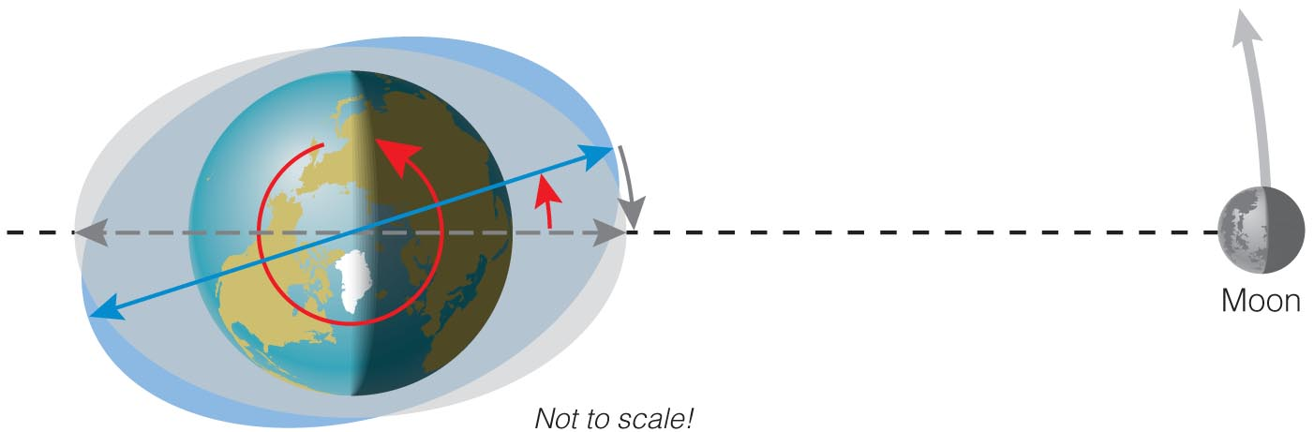
Tidal Friction
Tidal friction gradually slows Earth’s rotation (and makes the Moon get farther from Earth).
The Moon once orbited faster (or slower); tidal friction caused it to “lock” in synchronous rotation.
Notes:
Optional special topic. You might wish to perform the demonstration shown in the figure…

Slide 55
Why do all objects fall at the same rate?
The gravitational acceleration of an object like a rock does not depend on its mass because M_{rock} in the equation for acceleration cancels M_{rock} in the equation for gravitational force.
This “coincidence” was not understood until Einstein’s general theory of relativity.

Slide 56
What have we learned?
How do gravity and energy together allow us to understand orbits?
  Change in total energy is needed to change orbit
  Add enough energy (escape velocity) and object leaves.
How does gravity cause tides?
  The Moon’s gravity stretches Earth and its oceans.
Why do all objects fall at the same rate?
  Mass of object in Newton’s second law exactly cancels mass in law of gravitation.

