Slide 1
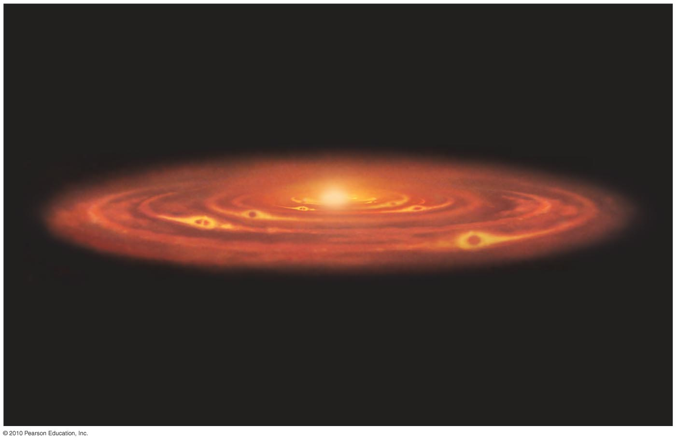
Chapter 8
Formation of the Solar System

Slide 2
8.1 The Search for Origins
Our goals for learning:
What properties of our solar system must a formation theory explain?
What theory best explains the features of our solar system?

Slide 3
What properties of our solar system must a formation theory explain?
Patterns of motion of the large bodies
  Orbit in same direction and plane
Existence of two types of planets
  Terrestrial and jovian
Existence of smaller bodies
  Asteroids and comets
Notable exceptions to usual patterns
  Rotation of Uranus, Earth’s Moon, etc.

Slide 4
What theory best explains the features of our solar system?
The nebular theory states that our solar system formed from the gravitational collapse of a giant interstellar gas cloud—the solar nebula.
  (Nebula is the Latin word for cloud.)
Kant and Laplace proposed the nebular hypothesis over two centuries ago.
A large amount of evidence now supports this idea.

Slide 5
Close Encounter Hypothesis
A rival idea proposed that the planets formed from debris torn off the Sun by a close encounter with another star.
That hypothesis could not explain observed motions and types of planets.

Slide 6
What have we learned?
What properties of our solar system must a formation theory explain?
  Motions of large bodies
  Two types of planets
  Asteroids and comets
  Notable exceptions like Earth’s Moon
What theory best explains the features of our solar system?
  The nebular theory states that solar system formed from a large interstellar gas cloud.

Slide 7
8.2 The Birth of the Solar System
Our goals for learning:
Where did the solar system come from?
What caused the orderly patterns of motion in our solar system?

Slide 8
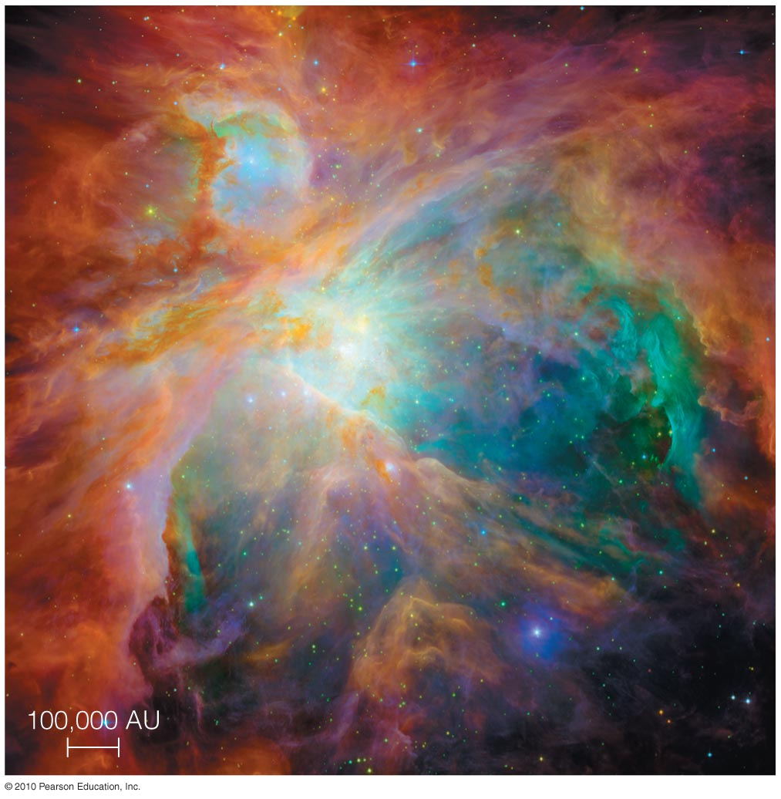
Where did the solar system come from?

Slide 9
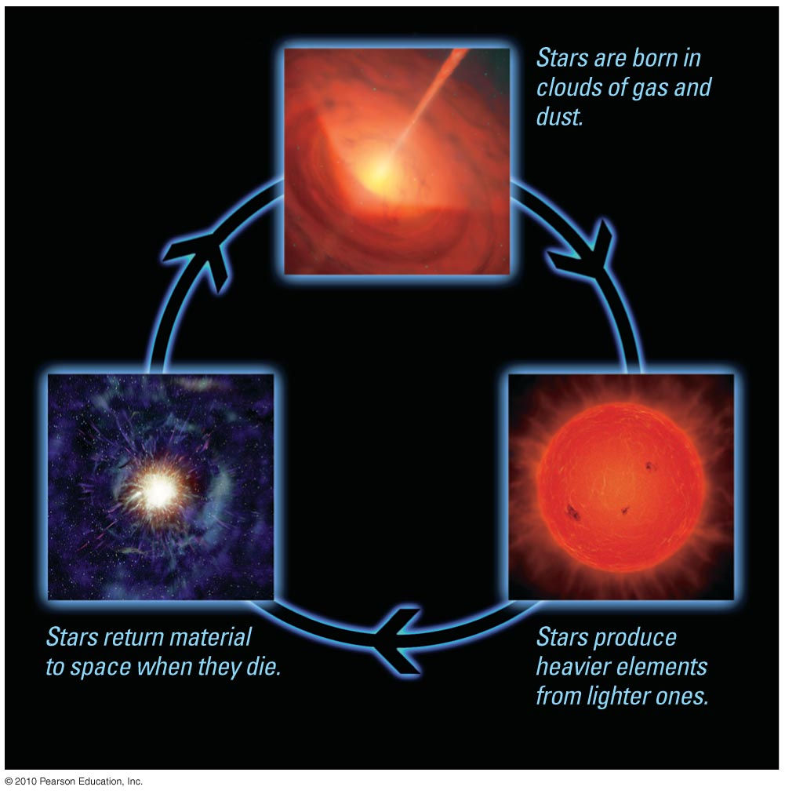
Galactic Recycling
Elements that formed planets were made in stars and then recycled through interstellar space.

Slide 10
Evidence from Other Gas Clouds
We can see stars forming in other interstellar gas clouds, lending support to the nebular theory.

Slide 11
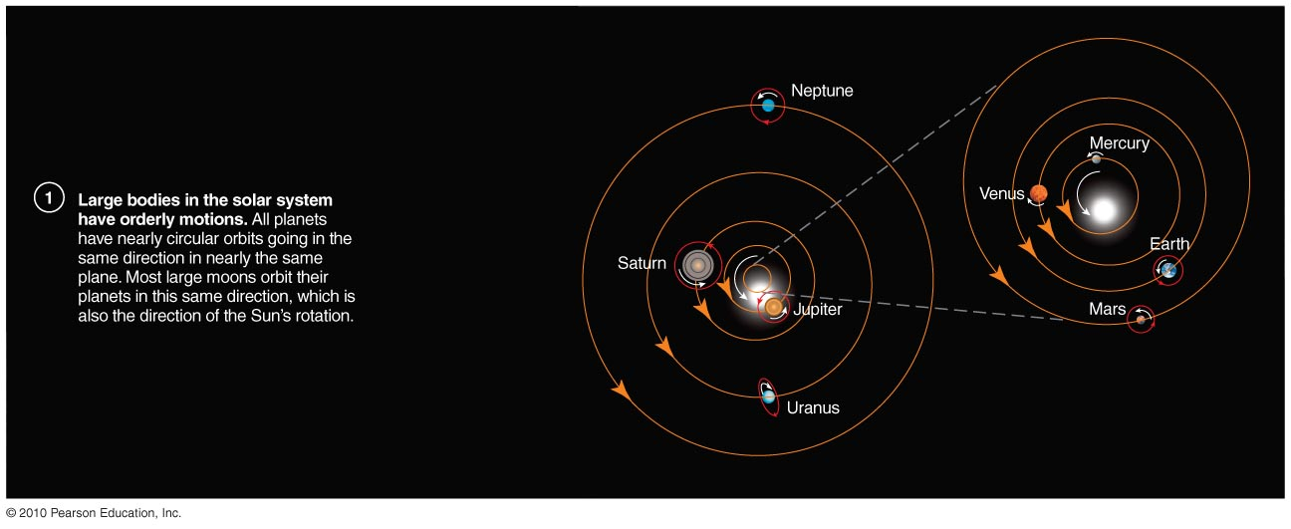
What caused the orderly patterns of motion in our solar system?

Slide 12
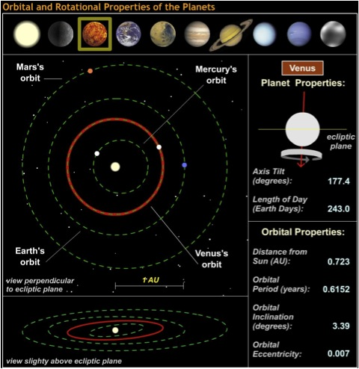

Slide 13
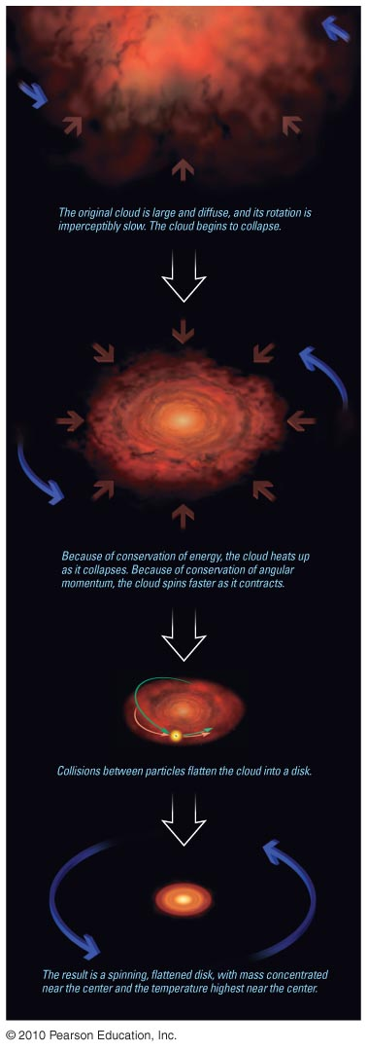
Conservation of Angular Momentum
Rotation speed of the cloud from which our solar system formed must have increased as the cloud contracted.

Slide 14
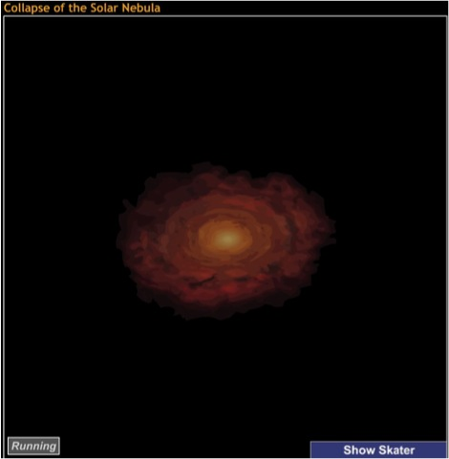
Rotation of a contracting cloud speeds up for the same reason a skater speeds up as she pulls in her arms.
Notes:
Collapse_of_solar_nebula.html

Slide 15
Flattening
Collisions between particles in the cloud caused it to flatten into a disk.

Slide 16
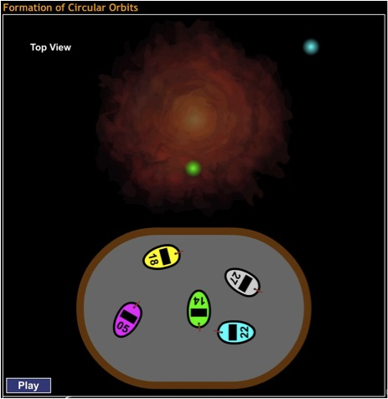
Collisions between gas particles in cloud gradually reduce random motions.

Slide 17
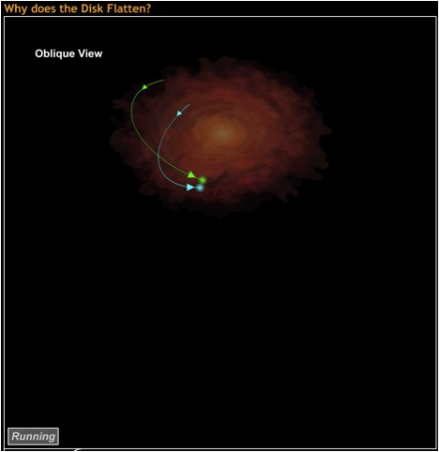
Collisions between gas particles also reduce up and down motions.

Slide 18
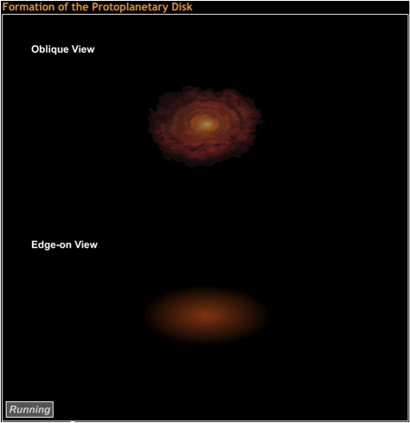
Spinning cloud flattens as it shrinks.

Slide 19
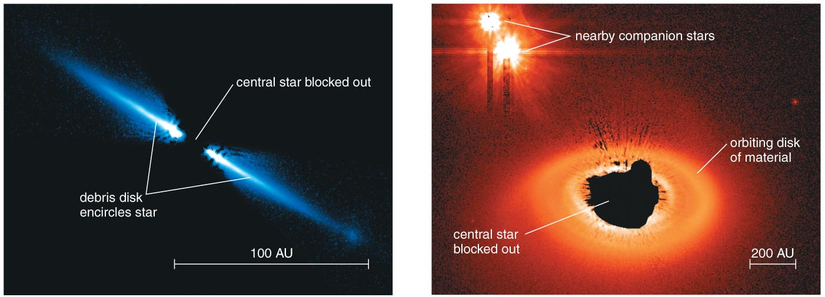
Disks around Other Stars
Observations of disks around other stars support the nebular hypothesis.

Slide 20
What have we learned?
Where did the solar system come from?
  Galactic recycling built the elements from which planets formed.
  We can observe stars forming in other gas clouds.
What caused the orderly patterns of motion in our solar system?
  Solar nebula spun faster as it contracted because of conservation of angular momentum.
  Collisions between gas particles then caused the nebula to flatten into a disk.
  We have observed such disks around newly forming stars.

Slide 21
8.3 The Formation of Planets
Our goals for learning:
Why are there two major types of planets?
How did terrestrial planets form?
How did jovian planets form?
What ended the era of planet formation?

Slide 22
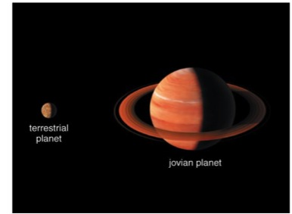
Why are there two major types of planets?

Slide 23
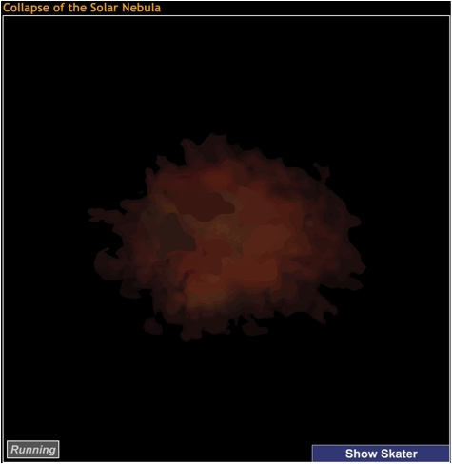
Conservation of Energy
As gravity causes cloud to contract, it heats up.

Slide 24
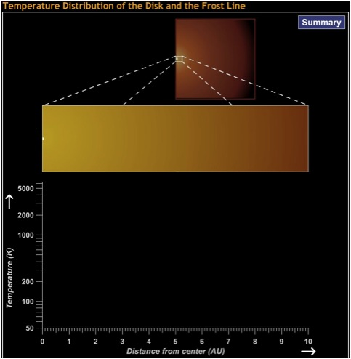
Inner parts of disk are hotter than outer parts.
Rock can be solid at much greater temperatures than ice.

Slide 25
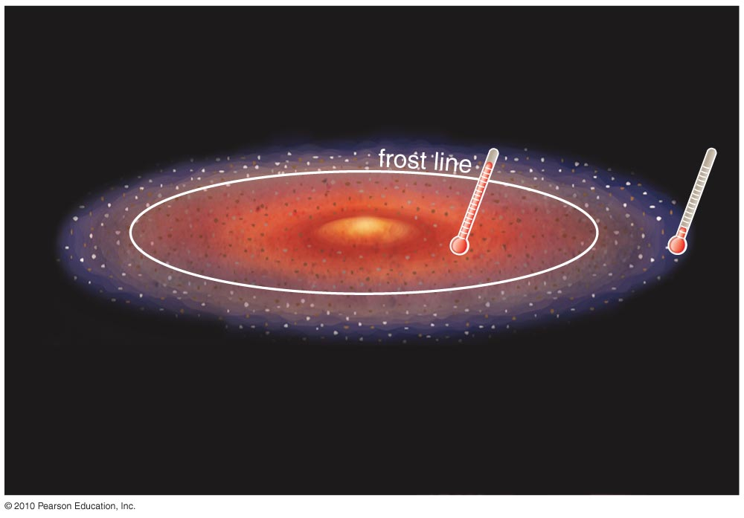
Inside the frost line: too hot for hydrogen compounds to form ices
Outside the frost line: cold enough for ices to form

Slide 26
How did the terrestrial planets form?
Small particles of rock and metal were present inside the frost line.
Planetesimals of rock and metal built up as these particles collided.
Gravity eventually assembled these planetesimals into terrestrial planets.

Slide 27
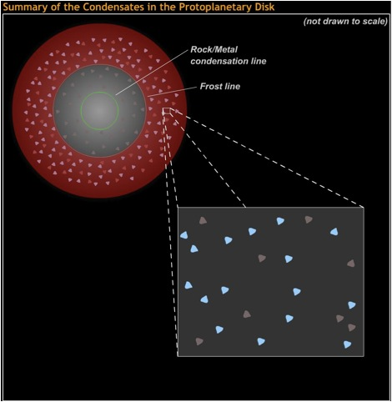
Tiny solid particles stick to form planetesimals.

Slide 28
Gravity draws planetesimals together to form planets.
This process of assembly
is called accretion.
Notes:
Same as previous

Slide 29
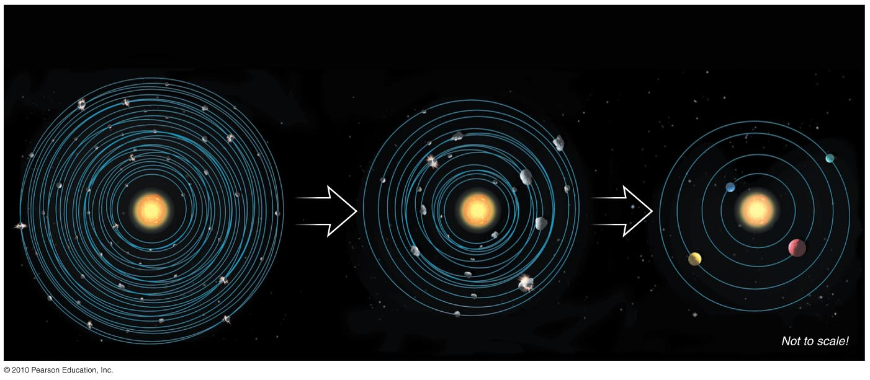
Accretion of Planetesimals
Many smaller objects collected into just a few large ones.

Slide 30
How did the jovian planets form?
Ice could also form small particles outside the frost line.
Larger planetesimals and planets were able to form.
Gravity of these larger planets was able to draw in surrounding H and He gases.

Slide 31
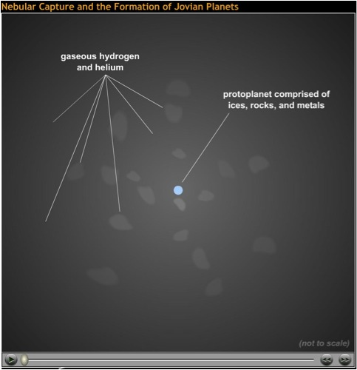
Gravity of rock and ice in jovian planets draws in H and He gases.

Slide 32
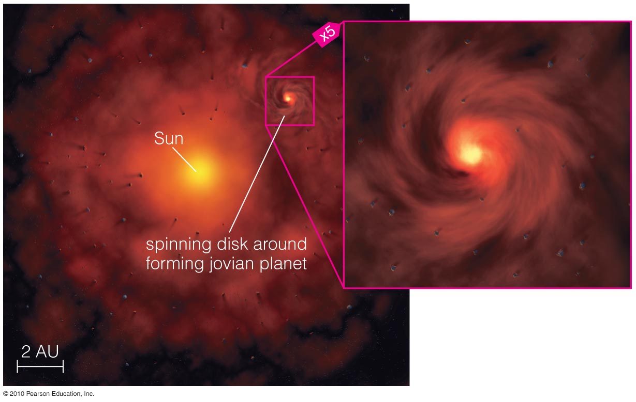
Moons of jovian planets form in miniature disks.

Slide 33
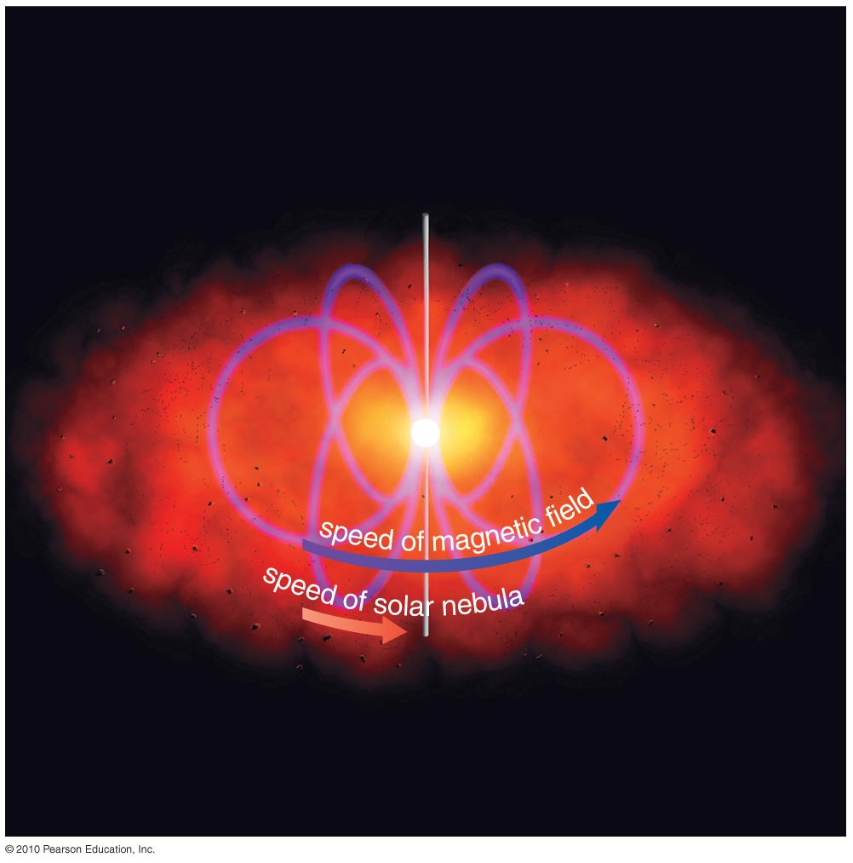
What ended the era of planet formation?

Slide 34
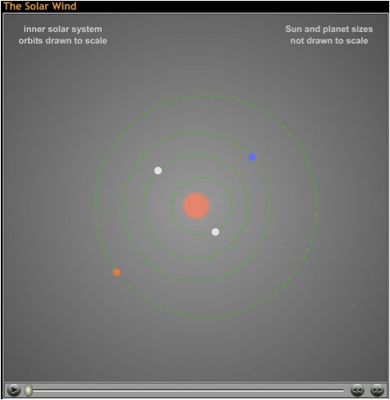
A combination of photons and the solar wind —outflowing matter from the Sun—blew away the leftover gases.

Slide 35
Solar Rotation
In nebular theory, young Sun rotated much faster than now.
Friction between solar magnetic field and solar nebular probably slowed the rotation over time.

Slide 36
What have we learned?
Why are there two major types of planets?
  Only rock and metals condensed inside the frost line.
  Rock, metals, and ices condensed outside the frost line.
How did the terrestrial planets form?
  Rock and metals collected into planetesimals.
  Planetesimals then accreted into planets.
How did the jovian planets form?
  Additional ice particles outside frost line made planets there more massive.
  Gravity of these massive planets drew in H, He gases.

Slide 37
What have we learned?
What ended the era of planet formation?
  Solar wind blew away remaining gases.
  Magnetic fields in early solar wind helped reduce Sun’s rotation rate.

Slide 38
8.4 The Aftermath of Planet Formation
Our goals for learning:
Where did asteroids and comets come from?
How do we explain “exceptions to the rules”?
How do we explain the existence of our Moon?
Was our solar system destined to be?

Slide 39
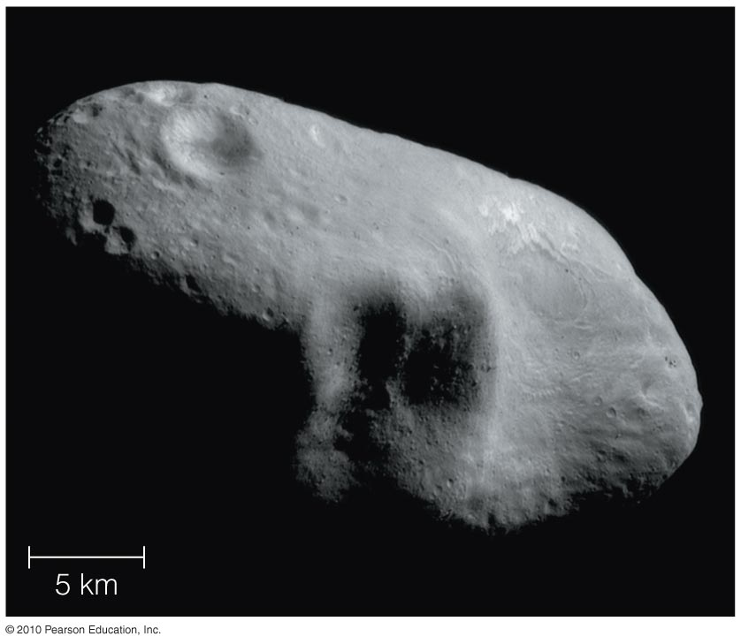
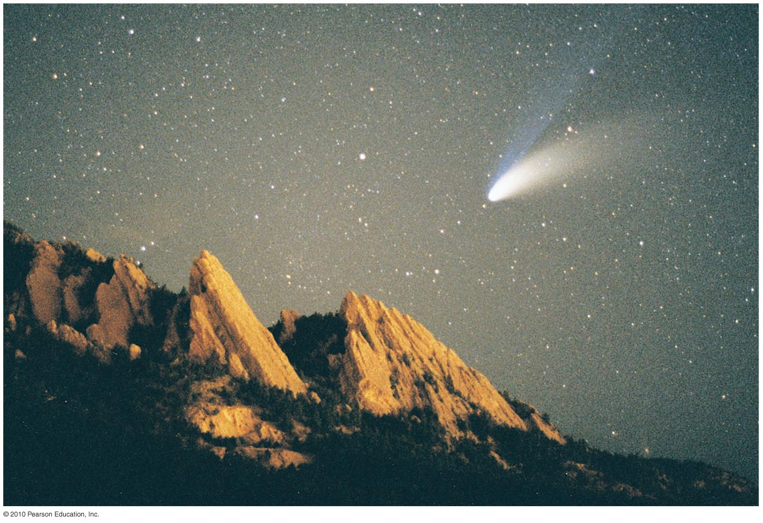
Where did asteroids and comets come from?

Slide 40
Asteroids and Comets
Leftovers from the accretion process
Rocky asteroids inside frost line
Icy comets outside frost line

Slide 41
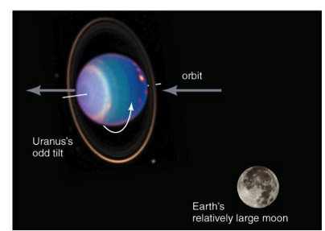
How do we explain “exceptions to the rules”?

Slide 42
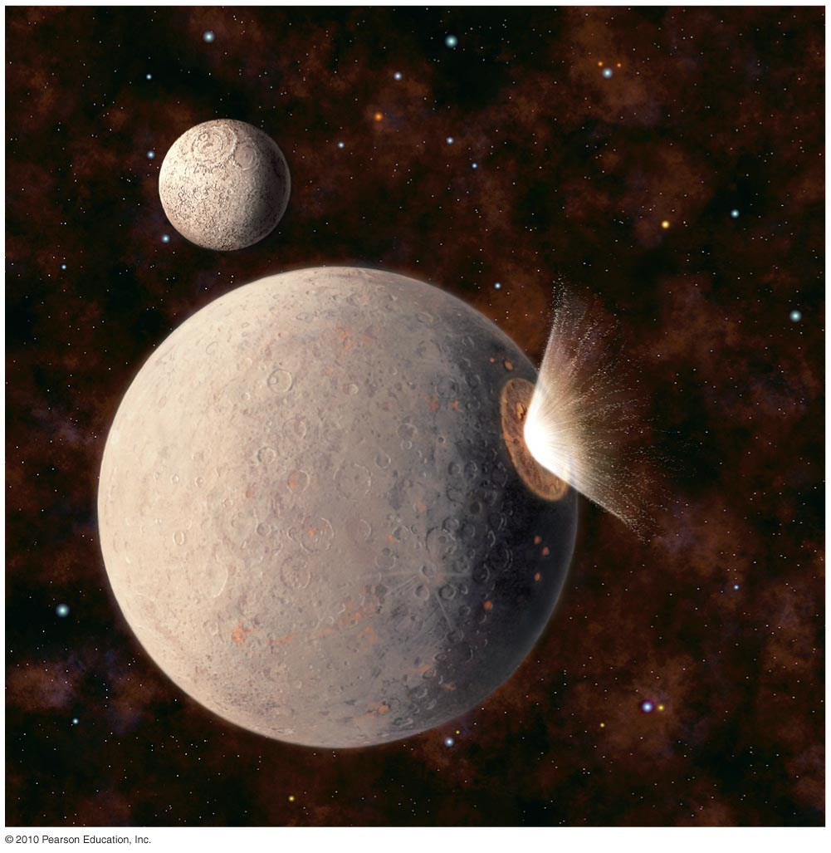
Heavy Bombardment
Leftover planetesimals bombarded other objects in the late stages of solar system formation.

Slide 43
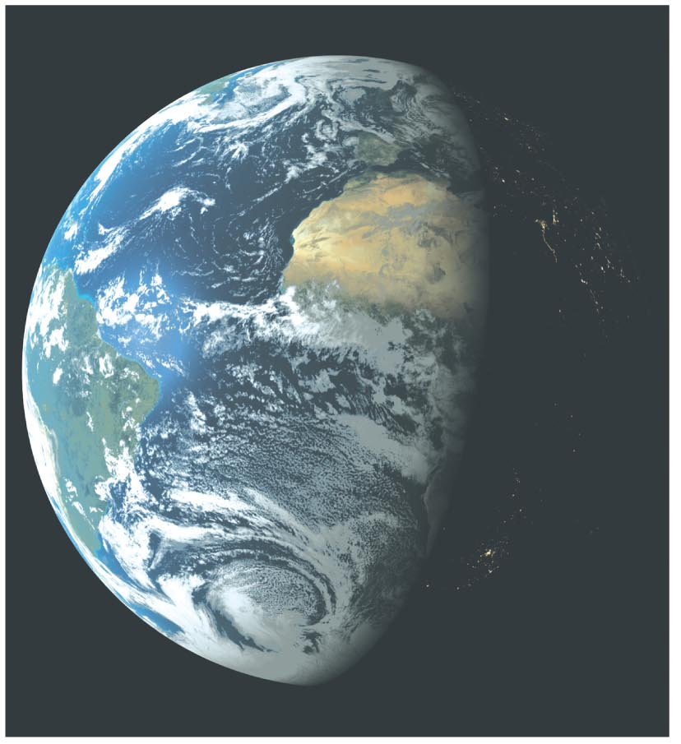
Origin of Earth’s Water
Water may have come to Earth by way of icy planetesimals.

Slide 44
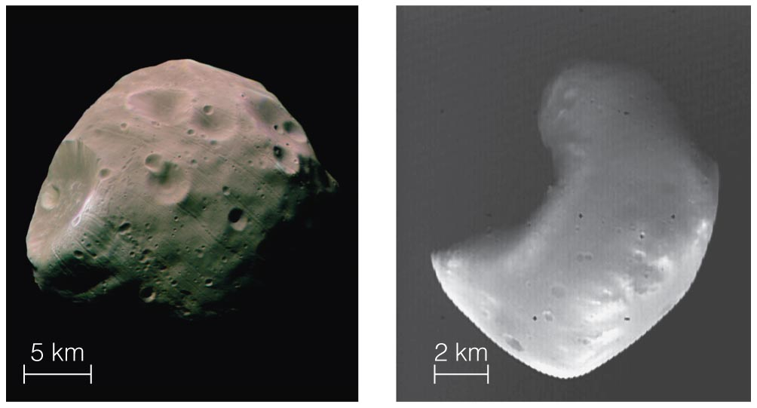
Captured Moons
Unusual moons of some planets may be captured planetesimals.

Slide 45
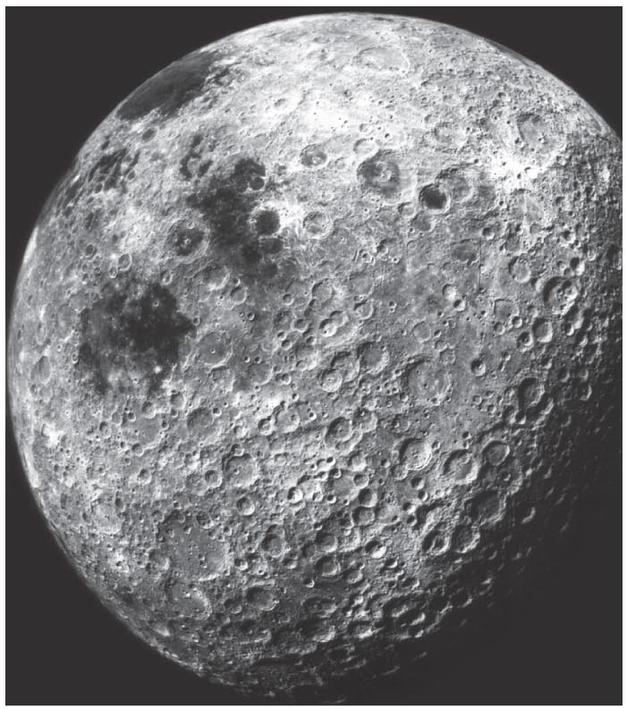
How do we explain the existence of our Moon?

Slide 46
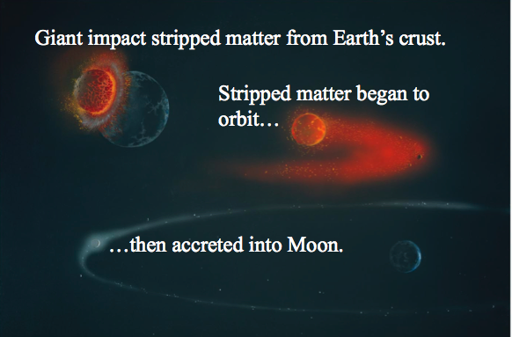
Giant Impact

Slide 47
Odd Rotation
Giant impacts might also explain the different rotation axes of some planets.

Slide 48
Thought Question
How would the solar system be different if the solar nebula had cooled, with a temperature half its actual value?
  a) Jovian planets would have formed closer to Sun.
  b) There would be no asteroids.
  c) There would be no comets.
  d) Terrestrial planets would be larger.

Slide 49
Thought Question
How would the solar system be different if the solar nebula had cooled, with a temperature half its actual value?
  a) Jovian planets would have formed closer to Sun.
  b) There would be no asteroids.
  c) There would be no comets.
  d) Terrestrial planets would be larger.

Slide 50
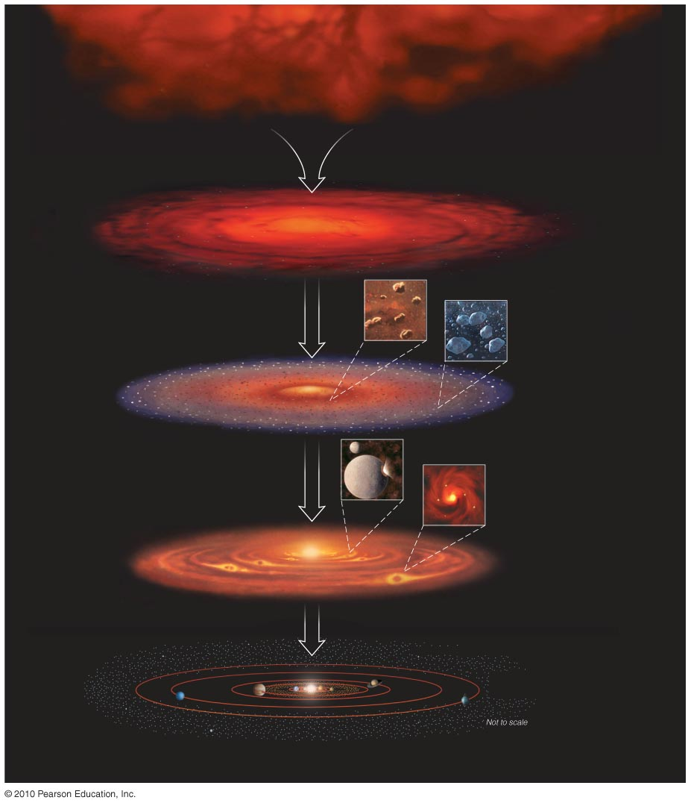
Was our solar system destined to be?
Formation of planets in the solar nebula seems inevitable.
But details of individual planets could have been different.

Slide 51
Thought Question
Which of these facts is NOT explained by the nebular theory?
There are two main types of planets: terrestrial and jovian.
Planets orbit in same direction and plane.
Existence of asteroids and comets.
Number of planets of each type (four terrestrial and four jovian).

Slide 52
Thought Question
Which of these facts is NOT explained by the nebular theory?
There are two main types of planets: terrestrial and jovian.
Planets orbit in same direction and plane.
Existence of asteroids and comets.
Number of planets of each type (four terrestrial and four jovian).

Slide 53
What have we learned?
Where did asteroids and comets come from?
  They are leftover planetesimals, according to the nebular theory.
How do we explain “exceptions to the rules”?
  Bombardment of newly formed planets by planetesimals may explain the exceptions.
How do we explain the existence of Earth’s moon?
  Material torn from Earth’s crust by a giant impact formed the Moon.
Was our solar system destined to be?
  Formation of planets seems inevitable.
  Detailed characteristics could have been different

Slide 54
8.5 The Age of the Solar System
Our goals for learning:
How does radioactivity reveal an object’s age?
When did the planets form?

Slide 55
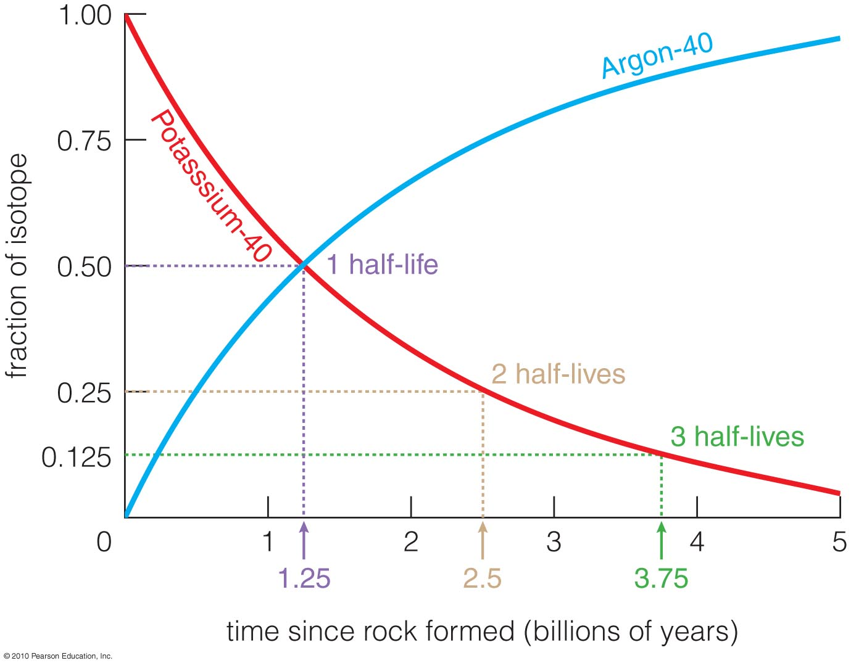
How does radioactivity reveal an object’s age?

Slide 56
Radioactive Decay
Some isotopes decay into other nuclei.
A half-life is the time for half the nuclei in a substance to decay.

Slide 57
Thought Question
Suppose you find a rock originally made of potassium-40, half of which decays into argon-40 every 1.25 billion years. You open the rock and find 15 atoms of argon-40 for every atom of potassium-40. How long ago did the rock form?
  a) 1.25 billion years ago
  b) 2.5 billion years ago
  c) 3.75 billion years ago
  d) 5 billion years ago

Slide 58
Thought Question
Suppose you find a rock originally made of potassium-40, half of which decays into argon-40 every 1.25 billion years. You open the rock and find 15 atoms of argon-40 for every atom of potassium-40. How long ago did the rock form?
  a) 1.25 billion years ago
  b) 2.5 billion years ago
  c) 3.75 billion years ago
  d) 5 billion years ago

Slide 59
When did the planets form?
Radiometric dating tells us that oldest moon rocks are 4.4 billion years old.
Oldest meteorites are 4.55 billion years old.
Planets probably formed 4.5 billion years ago.

Slide 60
What have we learned?
How does radioactivity reveal an object’s age?
  Some isotopes decay with a well-known half-life.
  Comparing the proportions of those isotopes with their decay products tells us age of object.
When did the planets form?
  Radiometric dating indicates that planets formed 4.5 billion years ago.

