Slide 1


Slide 2
Plant Assets, Natural Resources, and Intangible Assets
Chapter 9
Learning Objectives
After studying this chapter, you should be able to:
Describe how the cost principle applies to plant assets.
Explain the concept of depreciation and how to compute it.
Distinguish between revenue and capital expenditures, and explain the entries for each.
Explain how to account for the disposal of a plant asset.
Compute periodic depletion of natural resources.
Explain the basic issues related to accounting for intangible assets.
Indicate how plant assets, natural resources, and intangible assets are reported.

Slide 3
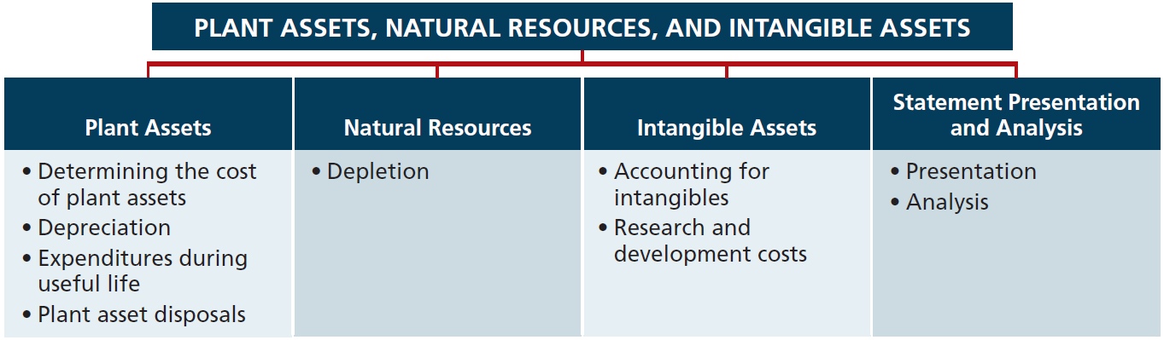
Preview of Chapter 9
Financial Accounting
Eighth Edition
Weygandt Kieso Kimmel

Slide 4
Plant Assets
Plant assets are resources that have
  physical substance (a definite size and shape),
  are used in the operations of a business,
  are not intended for sale to customers,
  are expected to provide service to the company for a number of years, except for land.
Referred to as property, plant, and equipment; plant and equipment; and fixed assets.

Slide 5
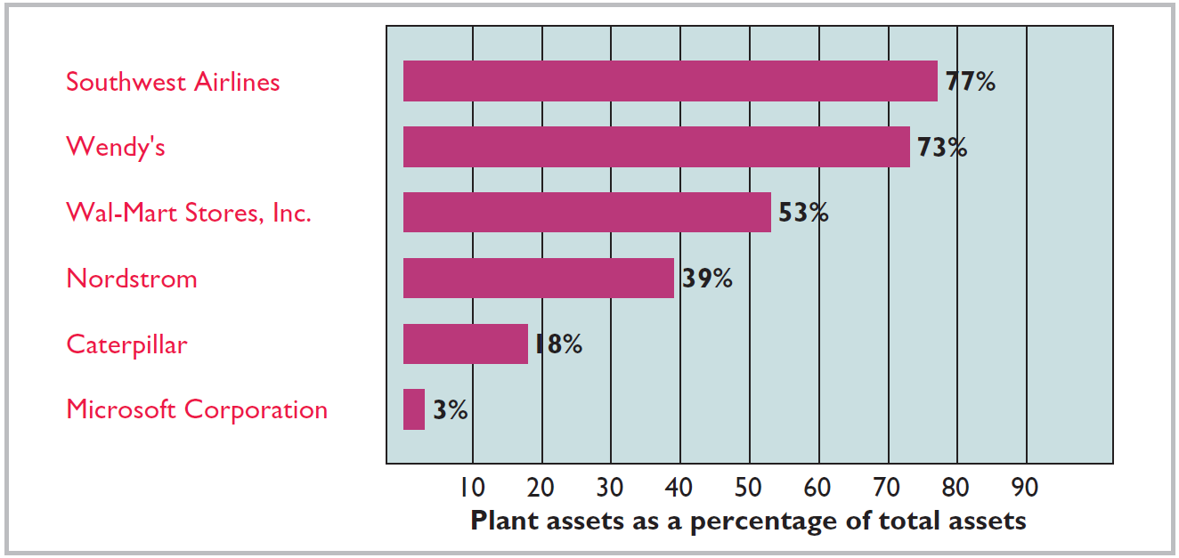
Plant Assets
Plant assets are critical to a company’s success
Illustration 9-1

Slide 6
Determining the Cost of Plant Assets
Cost Principle - requires that companies record plant assets at cost.
Cost consists of all expenditures necessary to acquire an asset and make it ready for its intended use.
LO 1 Describe how the cost principle applies to plant assets.

Slide 7
Determining the Cost of Plant Assets
Land
All necessary costs incurred in making land ready for its intended use increase (debit) the Land account.
  Costs typically include:
    cash purchase price,
    closing costs such as title and attorney’s fees,
    real estate brokers’ commissions,
    accrued property taxes and other liens on the land assumed by the purchaser, and
    clearing, leveling, demo of existing structures.
LO 1 Describe how the cost principle applies to plant assets.

Slide 8
Determining the Cost of Plant Assets
Illustration: Hayes Manufacturing Company acquires real estate at a cash cost of $100,000. The property contains an old warehouse that is razed at a net cost of $6,000 ($7,500 in costs less $1,500 proceeds from salvaged materials). Additional expenditures are the attorney’s fee, $1,000, and the real estate broker’s commission, $8,000.
Required: Determine the amount to be reported as the cost of the land.
LO 1 Describe how the cost principle applies to plant assets.

Slide 9
Determining the Cost of Plant Assets
Required: Determine amount to be reported as the cost of the land.
Land
Cash price of property ($100,000)
$100,000
Net removal cost of warehouse ($6,000)
6,000
Attorney's fees ($1,000)
1,000
Real estate broker’s commission ($8,000)
8,000
Cost of Land
$115,000
LO 1 Describe how the cost principle applies to plant assets.

Slide 10
Determining the Cost of Plant Assets
Land Improvements
Includes all expenditures necessary to make the improvements ready for their intended use.
  Examples: driveways, parking lots, fences, landscaping, and lighting.
  Limited useful lives.
  Expense (depreciate) the cost of land improvements over their useful lives.
LO 1 Describe how the cost principle applies to plant assets.

Slide 11
Determining the Cost of Plant Assets
Buildings
Includes all costs related directly to purchase or construction.
Purchase costs:
  Purchase price, closing costs (attorney’s fees, title insurance, etc.) and real estate broker’s commission.
  Remodeling and replacing or repairing the roof, floors, electrical wiring, and plumbing.
Construction costs:
  Contract price plus payments for architects’ fees, building permits, and excavation costs.
LO 1 Describe how the cost principle applies to plant assets.

Slide 12
Determining the Cost of Plant Assets
Equipment
Include all costs incurred in acquiring the equipment and preparing it for use.
Costs typically include:
  Cash purchase price.
  Sales taxes.
  Freight charges.
  Insurance during transit paid by the purchaser.
  Expenditures required in assembling, installing, and testing the unit.
LO 1 Describe how the cost principle applies to plant assets.

Slide 13
Determining the Cost of Plant Assets
Illustration: Merten Company purchases factory machinery at a cash price of $50,000. Related expenditures are for sales taxes $3,000, insurance during shipping $500, and installation and testing $1,000. Compute the cost of the machinery.
Machinery
Cash price
$50,000
Sales taxes
3,000
Insurance during shipping
500
Installation and testing
1,000
Cost of Machinery
$54,500
LO 1 Describe how the cost principle applies to plant assets.

Slide 14
Determining the Cost of Plant Assets
Illustration: Merten Company purchases factory machinery at a cash price of $50,000. Related expenditures are for sales taxes $3,000, insurance during shipping $500, and installation and testing $1,000. Prepare the journal entry to record these costs.
Equipment 54,500
Cash 54,500
LO 1 Describe how the cost principle applies to plant assets.

Slide 15
Determining the Cost of Plant Assets
Illustration: Lenard Company purchases a delivery truck at a cash price of $22,000. Related expenditures are sales taxes $1,320, painting and lettering $500, motor vehicle license $80, and a three-year accident insurance policy $1,600. Compute the cost of the delivery truck.
Truck
Cash price
$22,000
Sales taxes
1,320
Painting and lettering
500
Cost of Delivery Truck
$23,820
LO 1 Describe how the cost principle applies to plant assets.

Slide 16
Determining the Cost of Plant Assets
Illustration: Lenard Company purchases a delivery truck at a cash price of $22,000. Related expenditures are sales taxes $1,320, painting and lettering $500, motor vehicle license $80, and a three-year accident insurance policy $1,600. Prepare the journal entry to record these costs.
Equipment 23,820
License expense 80
Prepaid insurance 1,600
Cash 25,500
LO 1 Describe how the cost principle applies to plant assets.

Slide 17
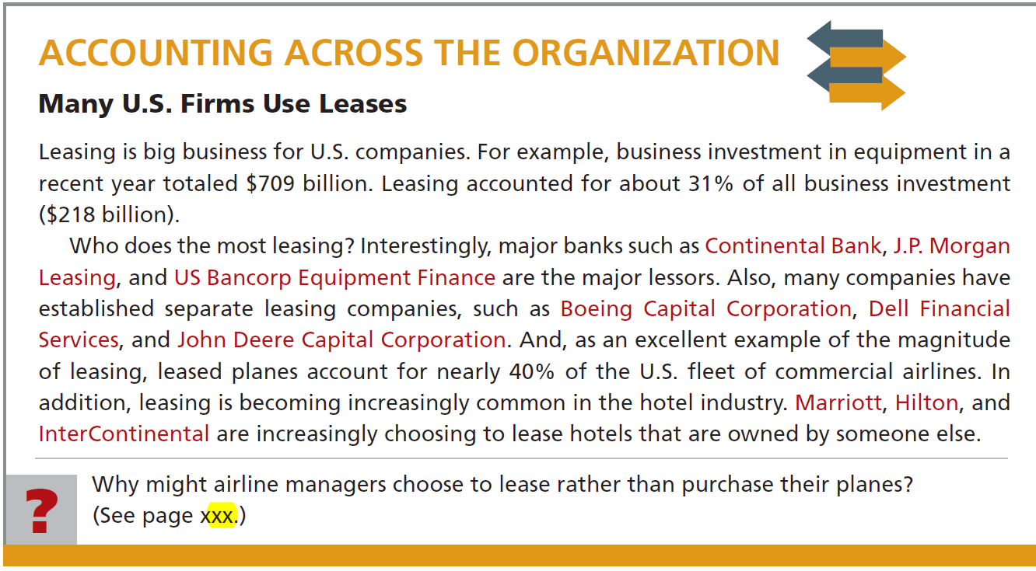
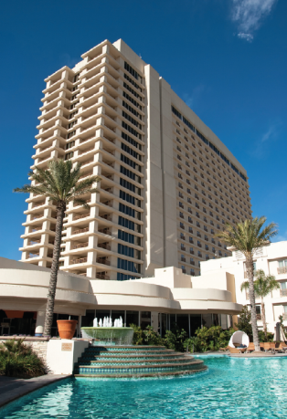

Slide 18
Depreciation
Depreciation
Process of allocating to expense the cost of a plant asset over its useful (service) life in a rational and systematic manner.
  Process of cost allocation, not asset valuation.
  Applies to land improvements, buildings, and equipment, not land.
  Depreciable, because the revenue-producing ability of asset will decline over the asset’s useful life.
LO 2 Explain the concept of depreciation and how to compute it.

Slide 19
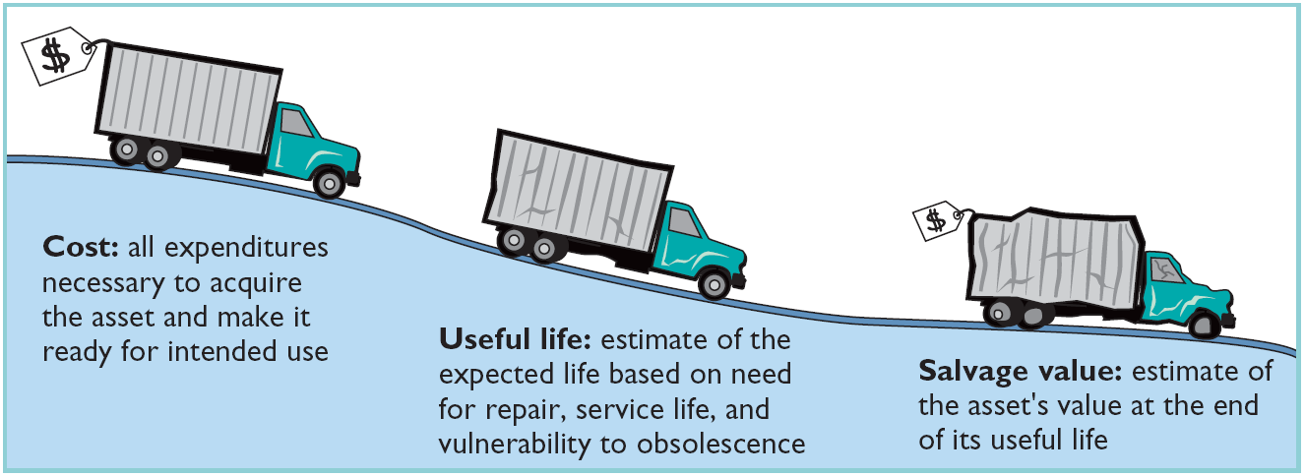
Depreciation
Factors in Computing Depreciation
Illustration 9-6
Cost
Useful Life
Salvage Value
LO 2 Explain the concept of depreciation and how to compute it.

Slide 20
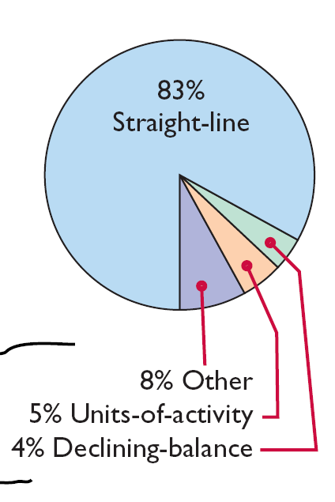
Depreciation
Depreciation Methods
Management selects the method it believes best measures an asset’s contribution to revenue over its useful life.
Examples include:
  Straight-line method.
  Declining-balance method.
  Units-of-activity method.
Illustration 9-8
Use of depreciation methods in major U.S. companies
LO 2 Explain the concept of depreciation and how to compute it.

Slide 21
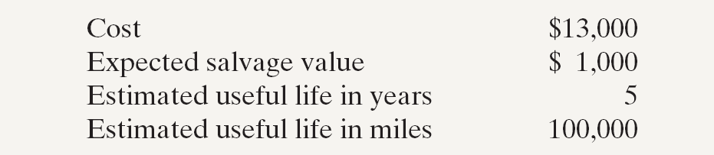
Depreciation
Illustration: Barb’s Florists purchased a small delivery truck on January 1, 2014.
Illustration 9-7
Required: Compute depreciation using the following.
(a) Straight-Line. (b) Units-of-Activity. (c) Declining Balance.
LO 2 Explain the concept of depreciation and how to compute it.

Slide 22
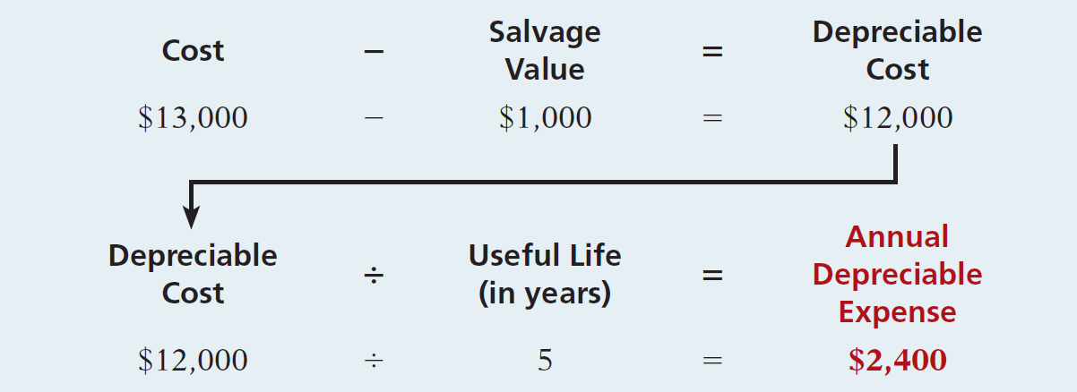
Depreciation
Straight-Line
  Expense is same amount for each year.
  Depreciable cost = Cost less salvage value.
Illustration 9-9
LO 2 Explain the concept of depreciation and how to compute it.

Slide 23
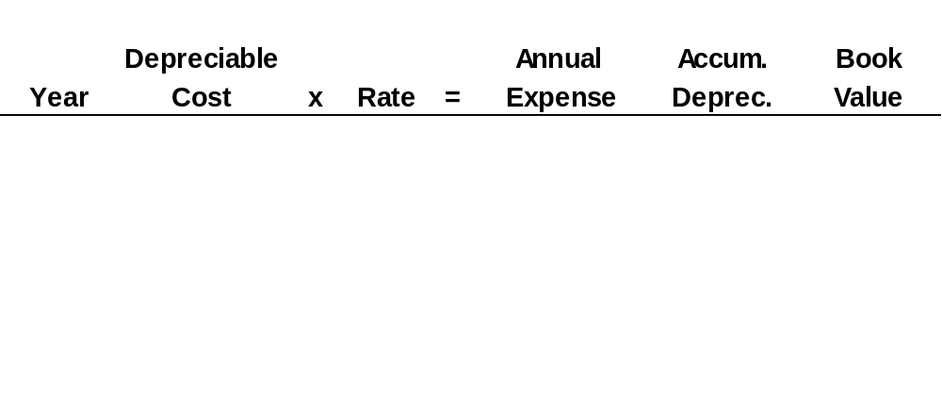
Depreciation
Illustration: (Straight-Line Method)
Illustration 9-10
2014
$ 12,000
20%
$ 2,400
$ 2,400
$ 10,600
2015
12,000
20
2,400
4,800
8,200
2016
12,000
20
2,400
7,200
5,800
2017
12,000
20
2,400
9,600
3,400
2018
12,000
20
2,400
12,000
1,000
2014 Journal Entry
Depreciation expense 2,400
Accumulated depreciation 2,400
LO 2 Explain the concept of depreciation and how to compute it.

Slide 24
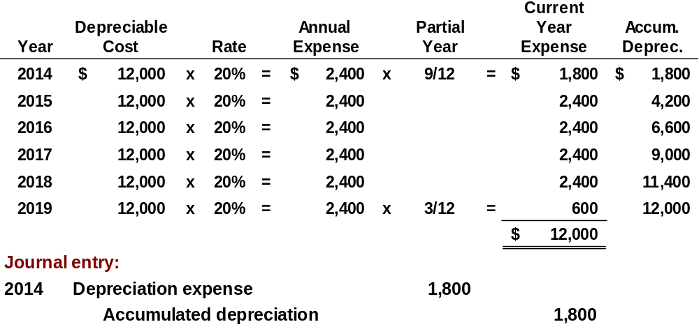
Partial Year
Depreciation
Illustration: (Straight-Line Method)
Assume the delivery truck was purchased on April 1, 2014.
LO 2

Slide 25
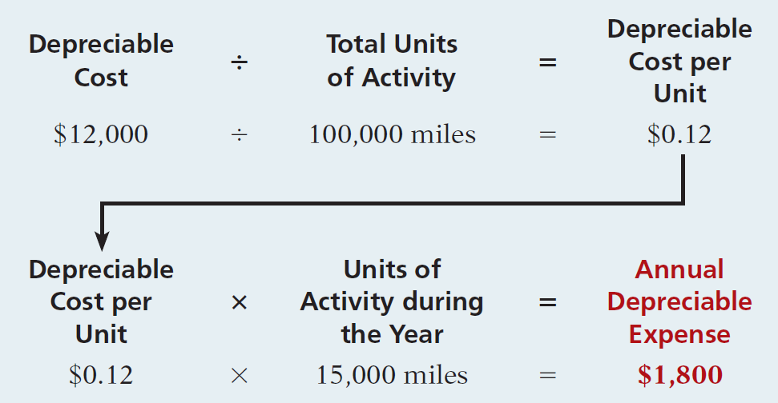
Depreciation
Units-of-Activity
Companies estimate total units of activity to calculate depreciation cost per unit.
Illustration 9-11
Expense varies based on units of activity.
Depreciable cost is cost less salvage value.
LO 2 Explain the concept of depreciation and how to compute it.

Slide 26
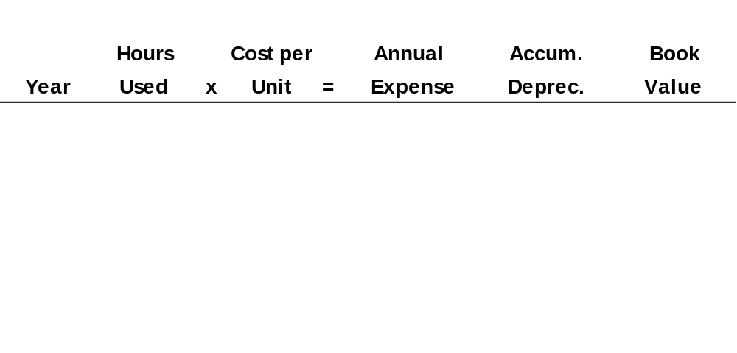
Depreciation
Illustration: (Units-of-Activity Method)
Illustration 9-12
2014
15,000
$ 0.12
$ 1,800
$ 1,800
$ 11,200
2015
30,000
0.12
3,600
5,400
7,600
2016
20,000
0.12
2,400
7,800
5,200
2017
25,000
0.12
3,000
10,800
2,200
2018
10,000
0.12
1,200
12,000
1,000
2014 Journal Entry
Depreciation expense 1,800
Accumulated depreciation 1,800
LO 2 Explain the concept of depreciation and how to compute it.

Slide 27
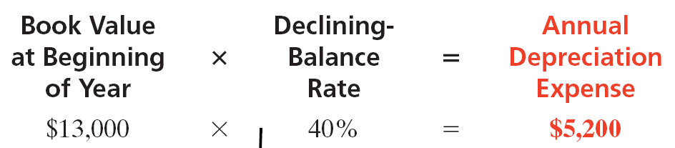
Depreciation
Declining-Balance
  Accelerated method.
  Decreasing annual depreciation expense over the asset’s useful life.
  Twice the straight-line rate with Double-Declining-Balance.
  Rate applied to book value.
Illustration 9-13
LO 2 Explain the concept of depreciation and how to compute it.

Slide 28
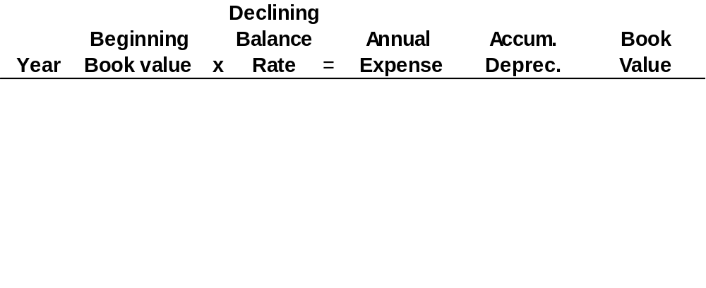
Depreciation
Illustration: (Declining-Balance Method)
Illustration 9-14
2014
13,000
40%
$ 5,200
$ 5,200
$ 7,800
2015
7,800
40
3,120
8,320
4,680
2016
4,680
40
1,872
10,192
2,808
2017
2,808
40
1,123
11,315
1,685
2018
1,685
40
685*
12,000
1,000
2014 Journal Entry
Depreciation expense 5,200
Accumulated depreciation 5,200
* Computation of $674 ($1,685 x 40%) is adjusted to $685.
LO 2

Slide 29
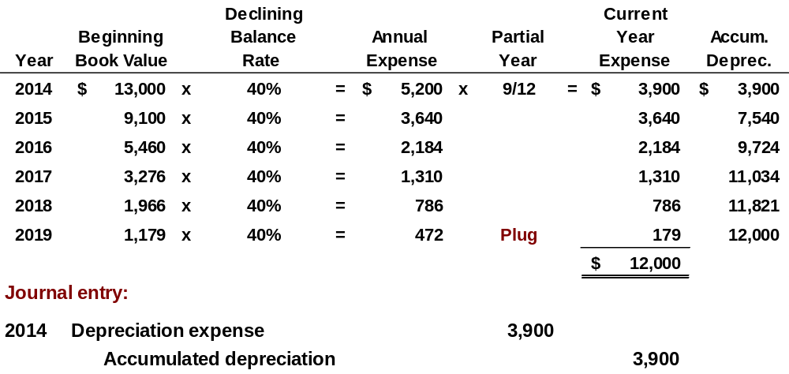
Partial Year
Depreciation
Illustration: (Declining-Balance Method)
LO 2 Explain the concept of depreciation and how to compute it.

Slide 30
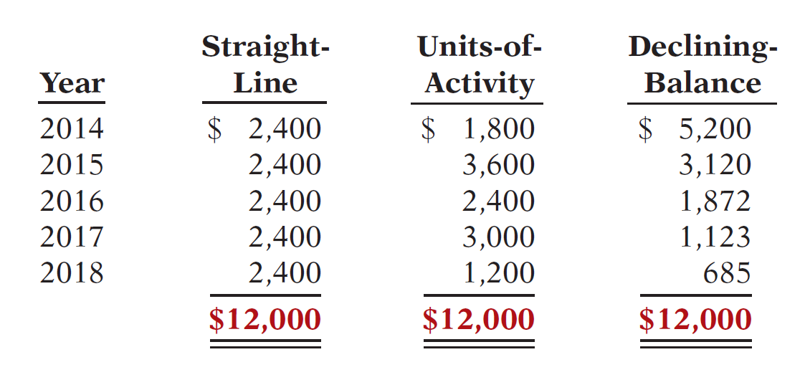
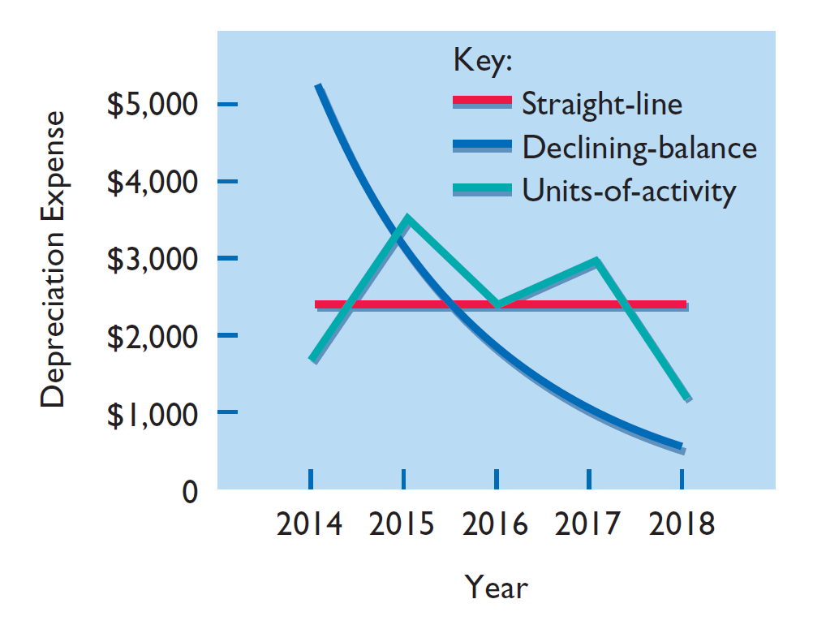
Depreciation
Illustration 9-15
Comparison of Methods
Illustration 9-16
Each method is acceptable because each recognizes the decline in service potential of the asset in a rational and systematic manner.
LO 2

Slide 31
Depreciation
Depreciation and Income Taxes
IRS does not require taxpayer to use the same depreciation method on the tax return that is used in preparing financial statements.
IRS requires the straight-line method or a special accelerated-depreciation method called the Modified Accelerated Cost Recovery System (MACRS).
MACRS is NOT acceptable under GAAP.
LO 2 Explain the concept of depreciation and how to compute it.

Slide 32
Depreciation
Revising Periodic Depreciation
Accounted for in the period of change and future periods (Change in Estimate).
Not handled retrospectively.
Not considered error.
LO 2 Explain the concept of depreciation and how to compute it.

Slide 33
Depreciation
Illustration: Arcadia HS, purchased equipment for $510,000 which was estimated to have a useful life of 10 years with a salvage value of $10,000 at the end of that time. Depreciation has been recorded for 7 years on a straight-line basis. In 2014 (year 8), it is determined that the total estimated life should be 15 years with a salvage value of $5,000 at the end of that time.
Questions:
  What is the journal entry to correct the prior years’ depreciation?
  Calculate the depreciation expense for 2014.
No Entry
Required
LO 2 Explain the concept of depreciation and how to compute it.

Slide 34
Depreciation
After 7 years
Equipment cost $510,000
Salvage value - 10,000
Depreciable base 500,000
Useful life (original) 10 years
Annual depreciation $ 50,000
First, establish NBV at date of change in estimate.
x 7 years = $350,000
Balance Sheet (Dec. 31, 2013)
Plant Assets:
Equipment
$510,000
Accumulated depreciation
350,000
Net book value (NBV)
$160,000
LO 2 Explain the concept of depreciation and how to compute it.

Slide 35
Depreciation
After 7 years
Net book value $160,000
Salvage value (new) 5,000
Depreciable base 155,000
Useful life remaining 8 years
Annual depreciation $ 19,375
Depreciation Expense calculation for 2014.
Journal entry for 2014 and future years.
Depreciation expense 19,375
Accumulated depreciation 19,375
LO 2 Explain the concept of depreciation and how to compute it.

Slide 36
Expenditures During Useful Life
Ordinary Repairs - expenditures to maintain the operating efficiency and productive life of the unit.
  Debit - Repair (or Maintenance) Expense.
  Referred to as revenue expenditures.
Additions and Improvements - costs incurred to increase the operating efficiency, productive capacity, or useful life of a plant asset.
  Debit - the plant asset affected.
  Referred to as capital expenditures.
LO 3 Distinguish between revenue and capital expenditures, and explain the entries for each.

Slide 37
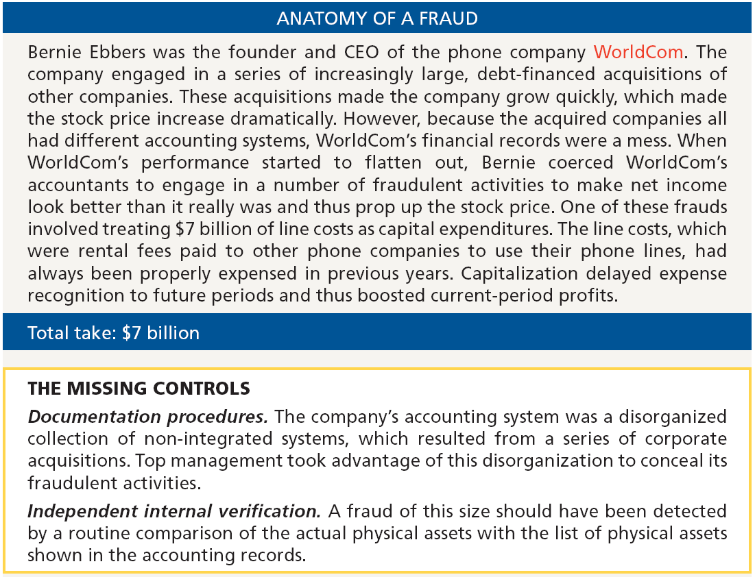
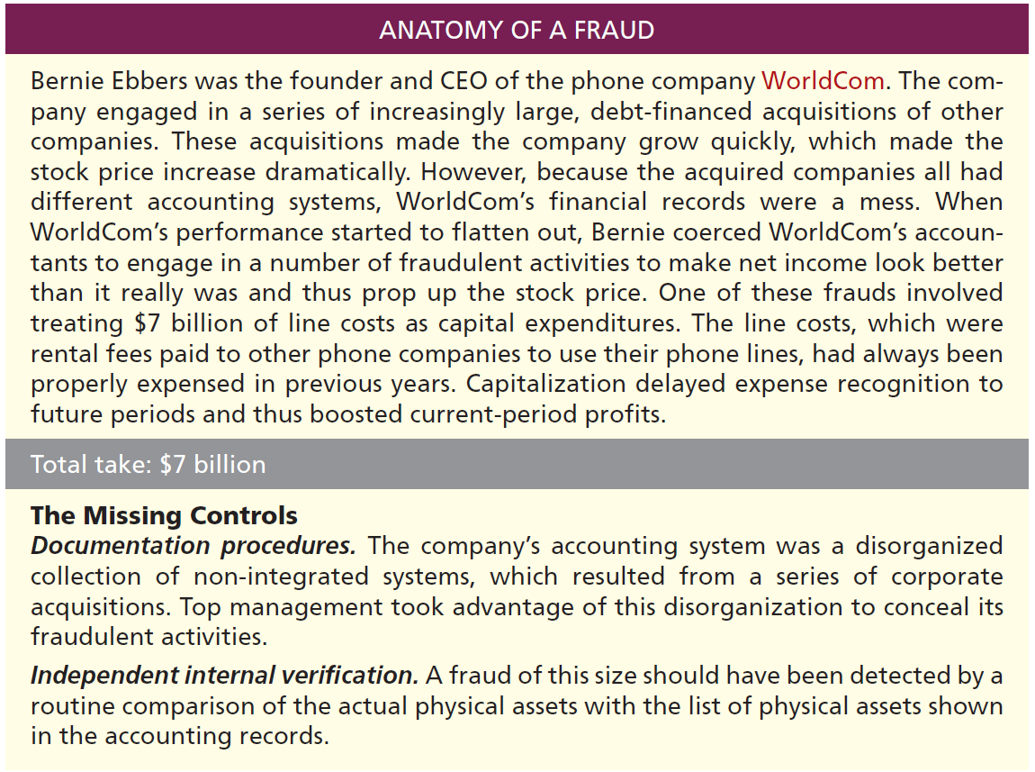

Slide 38
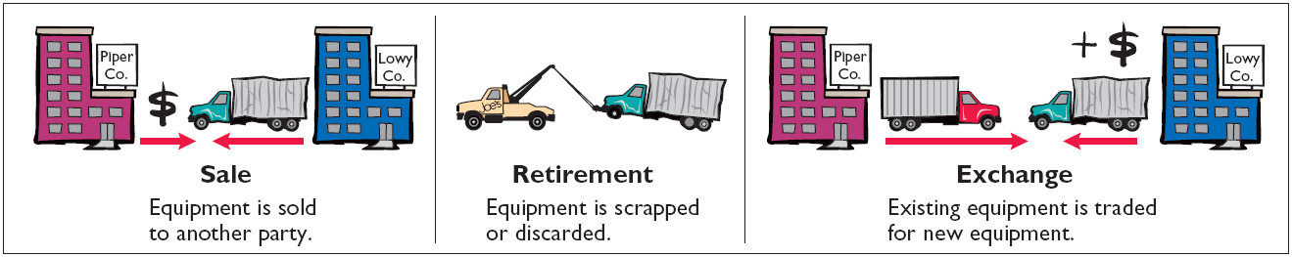
Plant Asset Disposals
Companies dispose of plant assets in three ways—Retirement, Sale, or Exchange (appendix).
Illustration 9-18
Record depreciation up to the date of disposal.
Eliminate asset by (1) debiting Accumulated Depreciation, and (2) crediting the asset account.
LO 4 Explain how to account for the disposal of a plant asset.

Slide 39
Plant Asset Disposals
Retirement of Plant Assets
  No cash is received.
  Decrease (debit) Accumulated Depreciation for the full amount of depreciation taken over the life of the asset.
  Decrease (credit) the asset account for the original cost of the asset.
  Record any difference as gain or loss on disposal.
LO 4 Explain how to account for the disposal of a plant asset.

Slide 40
Plant Asset Disposals
Illustration: Hobart Enterprises retires its computer printers, which cost $32,000. The accumulated depreciation on these printers is $32,000. Prepare the entry to record this retirement.
Accumulated depreciation 32,000
Equipment 32,000
Question: What happens if a fully depreciated plant asset is still useful to the company?
LO 4 Explain how to account for the disposal of a plant asset.

Slide 41
Plant Asset Disposals
Illustration: Sunset Company discards delivery equipment that cost $18,000 and has accumulated depreciation of $14,000. The journal entry is?
Accumulated depreciation 14,000
Loss on disposal 4,000
Equipment 18,000
Companies report a loss on disposal in the “Other expenses and losses” section of the income statement.
LO 4 Explain how to account for the disposal of a plant asset.

Slide 42
Plant Asset Disposals
Sale of Plant Assets
Compare the book value of the asset with the proceeds received from the sale.
    If proceeds exceed the book value, a gain on disposal occurs.
    If proceeds are less than the book value, a loss on disposal occurs.
LO 4 Explain how to account for the disposal of a plant asset.

Slide 43
Plant Asset Disposals
Gain on Sale
Illustration: On July 1, 2014, Wright Company sells office furniture for $16,000 cash. The office furniture originally cost $60,000. As of January 1, 2014, it had accumulated depreciation of $41,000. Depreciation for the first six months of 2014 is $8,000. Prepare the journal entry to record depreciation expense up to the date of sale.
July 1
Depreciation expense 8,000
Accumulated depreciation 8,000
LO 4 Explain how to account for the disposal of a plant asset.

Slide 44
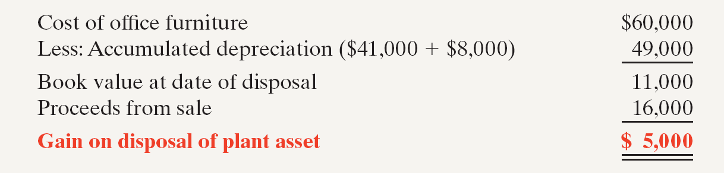
Plant Asset Disposals
Illustration 9-19
Computation of gain on disposal
Illustration: Wright records the sale as follows.
July 1
Cash 16,000
Accumulated depreciation 49,000
Equipment 60,000
Gain on disposal 5,000
LO 4 Explain how to account for the disposal of a plant asset.

Slide 45
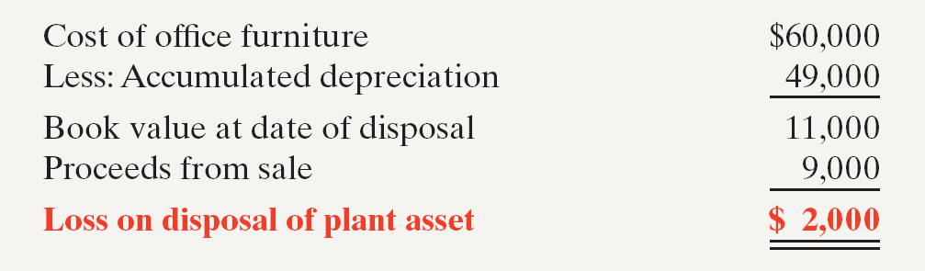
Plant Asset Disposals
Illustration: Assume that instead of selling the office furniture for $16,000, Wright sells it for $9,000.
Illustration 9-20
Computation of loss on disposal
July 1
Cash 9,000
Accumulated depreciation 49,000
Loss on disposal 2,000
Equipment 60,000
LO 4 Explain how to account for the disposal of a plant asset.

Slide 46
Natural Resources
Natural resources consist of standing timber and underground deposits of oil, gas, and minerals.
Distinguishing characteristics:
Physically extracted in operations.
Replaceable only by an act of nature.
LO 5 Compute periodic depletion of natural resources.

Slide 47
Natural Resources
Cost - price needed to acquire the resource and prepare it for its intended use.
Depletion - allocation of the cost to expense in a rational and systematic manner over the resource’s useful life.
  Depletion is to natural resources as depreciation is to plant assets.
  Companies generally use units-of-activity method.
  Depletion generally is a function of the units extracted.
LO 5 Compute periodic depletion of natural resources.

Slide 48
Natural Resources
Illustration: Lane Coal Company invests $5 million in a mine estimated to have 10 million tons of coal and no salvage value. In the first year, Lane extracts and sells 800,000 tons of coal. Lane computes the depletion expense as follows:
$5,000,000 ÷ 10,000,000 = $.50 depletion cost per ton
$.50 x 800,000 = $400,000 depletion expense
Journal entry:
Depletion expense 400,000
Accumulated depletion 400,000
LO 5 Compute periodic depletion of natural resources.

Slide 49
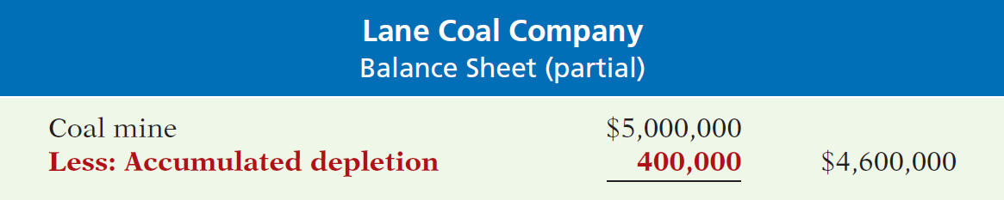
Natural Resources
Illustration 9-22
Statement presentation of accumulated depletion
Extracted resources that have not been sold are reported as inventory in the current assets section.
LO 5 Compute periodic depletion of natural resources.

Slide 50
Intangible Assets
Intangible assets are rights, privileges, and competitive advantages that result from ownership of long-lived assets that do not possess physical substance.
Limited life or indefinite life.
Common types of intangibles:
Patents
Copyrights
Goodwill
Trademarks and Trade Names
Franchises or licenses
LO 6 Explain the basic issues related to accounting for intangible assets.

Slide 51
Accounting for Intangible Assets
Limited-Life Intangibles:
  Amortize to expense.
  Credit asset account.
Indefinite-Life Intangibles:
  No foreseeable limit on time the asset is expected to provide cash flows.
  No amortization.
LO 6 Explain the basic issues related to accounting for intangible assets.

Slide 52
Accounting for Intangible Assets
Patents
Exclusive right to manufacture, sell, or otherwise control an invention for a period of 20 years from the date of the grant.
Capitalize costs of purchasing a patent and amortize over its 20-year life or its useful life, whichever is shorter.
Expense any R&D costs in developing a patent.
Legal fees incurred successfully defending a patent are capitalized to Patent account.
LO 6 Explain the basic issues related to accounting for intangible assets.

Slide 53
Accounting for Intangible Assets
Illustration: National Labs purchases a patent at a cost of $60,000 on June 30. National estimates the useful life of the patent to be eight years. Prepare the journal entry to record the amortization for the six-month period ended December 31.
Cost $60,000
Useful life / 8
Annual expense $ 7,500
6 months x 6/12
Amortization $ 3,750
Dec. 31
Amortization expense 3,750
Patent 3,750
LO 6

Slide 54
Accounting for Intangible Assets
Copyrights
Give the owner the exclusive right to reproduce and sell an artistic or published work.
Granted for the life of the creator plus 70 years.
Capitalize costs of acquiring and defending it.
Amortized to expense over useful life.
LO 6 Explain the basic issues related to accounting for intangible assets.

Slide 55
Accounting for Intangible Assets
Trademarks and Trade Names
  Word, phrase, jingle, or symbol that identifies a particular enterprise or product.
    Wheaties, Monopoly, Kleenex, Coca-Cola, Big Mac, and Jeep.
  Legal protection for indefinite number of 20 year renewal periods.
  Capitalize acquisition costs.
  No amortization.
LO 6 Explain the basic issues related to accounting for intangible assets.

Slide 56
Accounting for Intangible Assets
Franchises and Licenses
  Contractual arrangement between a franchisor and a franchisee.
    Shell, Subway, and Rent-A-Wreck are franchises.
  Franchise (or license) with a limited life should be amortized to expense over the life of the franchise.
  Franchise with an indefinite life should be carried at cost and not amortized.
LO 6 Explain the basic issues related to accounting for intangible assets.

Slide 57
Accounting for Intangible Assets
Goodwill
Includes exceptional management, desirable location, good customer relations, skilled employees, high-quality products, etc.
Only recorded when an entire business is purchased.
Goodwill is recorded as the excess of purchase price over the FMV of the identifiable net assets acquired.
Internally created goodwill should not be capitalized.
Not amortized.
LO 6 Explain the basic issues related to accounting for intangible assets.

Slide 58
Accounting for Intangible Assets
Research and Development Costs
Expenditures that may lead to
  patents,
  copyrights,
  new processes, and
  new products.
All R & D costs are expensed when incurred.
LO 6 Explain the basic issues related to accounting for intangible assets.

Slide 59
Illustration: Identify the term most directly associated with each statement.
1. The allocation of the cost of a natural resource to expense in a rational and systematic manner.
2. Rights, privileges, and competitive advantages that result from the ownership of long-lived assets that do not possess physical substance.
3. An exclusive right granted by the federal government to reproduce and sell an artistic or published work.
Depletion
Intangible Assets
Copyrights
LO 6 Explain the basic issues related to accounting for intangible assets.

Slide 60
Illustration: Identify the term most directly associated with each statement.
4. A right to sell certain products or services or to use certain trademarks or trade names within a designated geographic area.
5. Costs incurred by a company that often lead to patents or new products. These costs must be expensed as incurred.
Franchise
Research and Development Costs
LO 6 Explain the basic issues related to accounting for intangible assets.

Slide 61
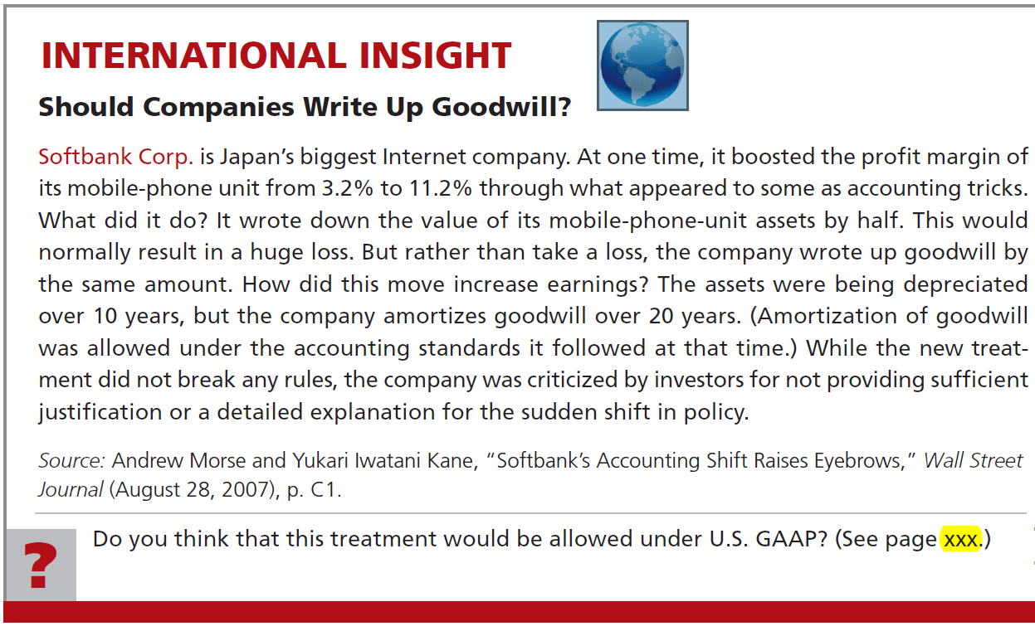


Slide 62
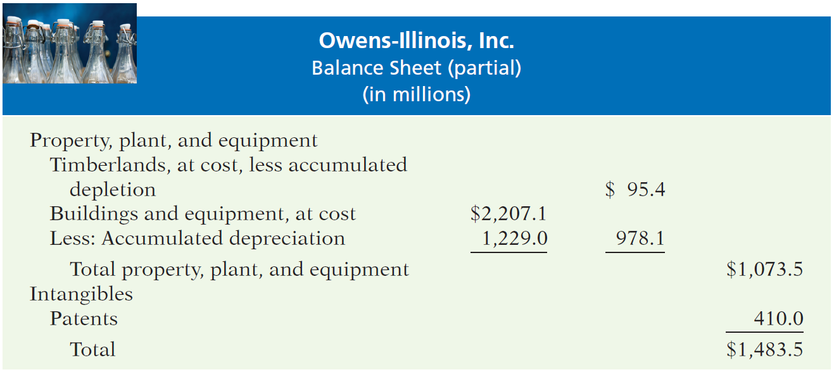
Statement Presentation and Analysis
Presentation
Illustration 9-24
LO 7 Indicate how plant assets, natural resources, and intangible assets are reported.

Slide 63
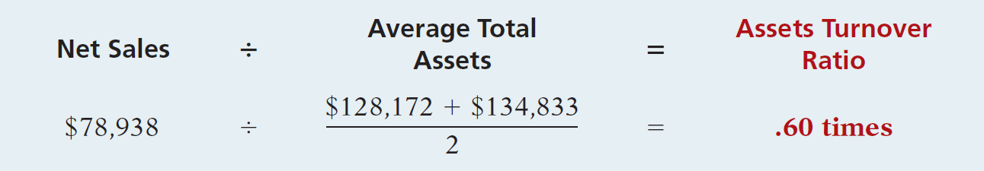
Statement Presentation and Analysis
Analysis
Illustration 9-25
Each dollar invested in assets produced $0.60 in sales. If a company is using its assets efficiently, each dollar of assets will create a high amount of sales.
LO 7 Indicate how plant assets, natural resources, and intangible assets are reported.

Slide 64
APPENDIX 9A EXCHANGE OF PLANT ASSETS
Ordinarily, companies record a gain or loss on the exchange of plant assets.
Most exchanges have commercial substance.
Commercial substance - if the future cash flows change as a result of the exchange.
LO 8 Explain how to account for the exchange of plant assets.

Slide 65
APPENDIX 9A EXCHANGE OF PLANT ASSETS
Illustration: Roland Co. exchanged used trucks (cost $64,000 less $22,000 accumulated depreciation) plus cash of $17,000 for a new semi-truck. The old trucks had a fair market value of $26,000.
Illustration 9A-1 & 9A-2
Cost of used trucks $64,000
Less: Accumulated depreciation 22,000
Book value 42,000
Fair market value of used trucks 26,000
Loss on disposal $16,000
Fair market value of used trucks $26,000
Cash paid 17,000
Cost of semi-truck $43,000
LO 8 Explain how to account for the exchange of plant assets.

Slide 66
APPENDIX 9A EXCHANGE OF PLANT ASSETS
Illustration: Roland Co. exchanged used trucks (cost $64,000 less $22,000 accumulated depreciation) plus cash of $17,000 for a new semi-truck. The old trucks had a fair market value of $26,000.
Prepare the entry to record the exchange of assets by Roland Co.
Equipment (new) 43,000
Accumulated depreciation 22,000
Loss on disposal 16,000
Equipment (old) 64,000
Cash 17,000
LO 8 Explain how to account for the exchange of plant assets.

Slide 67
APPENDIX 9A EXCHANGE OF PLANT ASSETS
Illustration: Mark Express Delivery trades its old delivery equipment (cost $40,000 less $28,000 accumulated depreciation) for new delivery equipment. The old equipment had a fair market value of $19,000. Mark also paid $3,000.
Cost of old equipment $40,000
Less: Accumulated depreciation 28,000
Book value 12,000
Fair market value of old equipment 19,000
Gain on disposal $ 7,000
Fair market value of old equipment $19,000
Cash paid 3,000
Cost of new equipment $22,000
Illustration 9A-3 & 9A-4
LO 8 Explain how to account for the exchange of plant assets.

Slide 68
APPENDIX 9A EXCHANGE OF PLANT ASSETS
Illustration: Mark Express Delivery trades its old delivery equipment (cost $40,000 less $28,000 accumulated depreciation) for new delivery equipment. The old equipment had a fair market value of $19,000. Mark also paid $3,000.
Prepare the entry to record the exchange of assets by Mark Express.
Equipment (new) 22,000
Accumulated depreciation 28,000
Equipment (used) 40,000
Gain on disposal 7,000
Cash 3,000
LO 8 Explain how to account for the exchange of plant assets.

Slide 69

Key Points
  The definition for plant assets for both IFRS and GAAP is essentially the same.
  Both international standards and GAAP follow the cost principle when accounting for property, plant, and equipment at date of acquisition.
  Under both IFRS and GAAP, interest costs incurred during construction are capitalized. Recently, IFRS converged to GAAP requirements in this area.
  IFRS, like GAAP, capitalizes all direct costs in self-constructed assets such as raw materials and labor. IFRS does not address the capitalization of fixed overhead.

Slide 70
Key Points
  IFRS also views depreciation as an allocation of cost over an asset’s useful life. IFRS permits the same depreciation methods (e.g., straight-line, accelerated, and units-of-activity) as GAAP. However, a major difference is that IFRS requires component depreciation. Component depreciation specifies that any significant parts of a depreciable asset that have different estimated useful lives should be separately depreciated. Component depreciation is allowed under GAAP but is seldom used.
  IFRS uses the term residual value, rather than salvage value.

Slide 71
Key Points
  IFRS allows companies to revalue plant assets to fair value at the reporting date. Companies that choose to use the revaluation framework must follow revaluation procedures. If revaluation is used, it must be applied to all assets in a class of assets. Assets that are experiencing rapid price changes must be revalued on an annual basis, otherwise less frequent revaluation is acceptable.
  Under both GAAP and IFRS, changes in the depreciation method used and changes in useful life are handled in current and future periods. Prior periods are not affected. GAAP recently conformed to international standards in the accounting for changes in depreciation methods.

Slide 72
Key Points
  The accounting for subsequent expenditures, such as ordinary repairs and additions, are essentially the same under IFRS and GAAP.
  The accounting for plant asset disposals is essentially the same under IFRS and GAAP.
  Initial costs to acquire natural resources are essentially the same under IFRS and GAAP.
  The definition of intangible assets is essentially the same under IFRS and GAAP.

Slide 73
Key Points
  As in GAAP, under IFRS the costs associated with research and development are segregated into the two components. Costs in the research phase are always expensed under both IFRS and GAAP. Under IFRS, however, costs in the development phase are capitalized as Development Costs once technological feasibility is achieved.
  IFRS permits revaluation of intangible assets (except for goodwill). GAAP prohibits revaluation of intangible assets.

Slide 74
Key Points
  IFRS requires an impairment test at each reporting date for plant assets and intangibles and records an impairment if the asset’s carrying amount exceeds its recoverable amount. The recoverable amount is the higher of the asset’s fair value less costs to sell or its value-in-use. Value-in-use is the future cash flows to be derived from the particular asset, discounted to present value. Under GAAP, impairment loss is measured as the excess of the carrying amount over the asset’s fair value.

Slide 75
Key Points
  IFRS allows reversal of impairment losses when there has been a change in economic conditions or in the expected use of the asset. Under GAAP, impairment losses cannot be reversed for assets to be held and used; the impairment loss results in a new cost basis for the asset. IFRS and GAAP are similar in the accounting for impairments of assets held for disposal.
  The accounting for exchanges of nonmonetary assets has recently converged between IFRS and GAAP. GAAP now requires that gains on exchanges of nonmonetary assets be recognized if the exchange has commercial substance. This is the same framework used in IFRS.

Slide 76
Looking to the Future
With respect to revaluations, as part of the conceptual framework project, the Boards will examine the measurement bases used in accounting. It is too early to say whether a converged conceptual framework will recommend fair value measurement (and revaluation accounting) for plant assets and intangibles.
The IASB and FASB have identified a project that would consider expanded recognition of internally generated intangible assets. IFRS permits more recognition of intangibles compared to GAAP. Thus, it will be challenging to develop converged standards for intangible assets, given the long-standing prohibition on capitalizing internally generated intangible assets and research and development costs in GAAP.

Slide 77
IFRS Self-Test Questions
Which of the following statements is correct?
  Both IFRS and GAAP permit revaluation of property, plant, and equipment and intangible assets (except for goodwill).
  IFRS permits revaluation of property, plant, and equipment and intangible assets (except for goodwill).
  Both IFRS and GAAP permit revaluation of property, plant, and equipment but not intangible assets.
  GAAP permits revaluation of property, plant, and equipment but not intangible assets.

Slide 78
IFRS Self-Test Questions
Research and development costs are:
  expensed under GAAP.
  expensed under IFRS.
  expensed under both GAAP and IFRS.
  None of the above.

Slide 79
IFRS Self-Test Questions
Under IFRS, value-in-use is defined as:
  net realizable value.
  fair value.
  future cash flows discounted to present value.
  total future undiscounted cash flows.

Slide 80
Copyright
“Copyright © 2012 John Wiley & Sons, Inc. All rights reserved. Reproduction or translation of this work beyond that permitted in Section 117 of the 1976 United States Copyright Act without the express written permission of the copyright owner is unlawful. Request for further information should be addressed to the Permissions Department, John Wiley & Sons, Inc. The purchaser may make back-up copies for his/her own use only and not for distribution or resale. The Publisher assumes no responsibility for errors, omissions, or damages, caused by the use of these programs or from the use of the information contained herein.”

