Slide 1
Segregation
of Duties
Kelsey Bolstad ~ Todd Madsen ~ Suraiya Akther ~ Hong Zhang

Slide 2
Two Main Applications:
(also called separation of functions or divisions of work)
- system of internal control
1. Different Individuals should be responsible for related activities
2. The responsibility for record keeping for an asset should be separate from the physical custody of that asset.

Slide 3
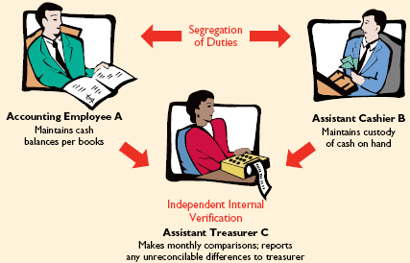

Slide 4
Segregation of
Related Activities
One employee should not be responsible for multiple tasks
Reduces fraud and inaccuracies
Example: Purchasing activities- includes ordering merchandise, order approval, receiving goods, authorizing payment, and paying for goods and services.
Example: Sales activities- making a sale, shipping or delivering, billing the customer, and receiving payment.

Slide 5
Real Life Example

Slide 6

Parmalat is Italy's eighth-largest industrial empire, the European food giant.
In 2003, Parmalat reported a net loss of
€14 billion = $20bn = £13bn !
Parmalat’s CEO transferred its profit to cover losses in other family owned businesses.
It is Europe's biggest bankruptcy!
Notes:
Parmalat is a multinational Italian dairy and food corporation. Most of its productions are sold under a variety of names in different countries. Well-known names in North America include Archway and Mother’s cookies, Olivina margarine, Black Diamond and Balderson’s cheeses, and Astro yogurt.
Having become the leading global company in the production of ultra-high temperature (UHT) milk, the company collapsed in 2003 with a €14 billion ($20bn; £13bn) hole in its accounts in what remains Europe's biggest bankruptcy.
The question is where did the billions go? Well the CEO Calisto Tanzi confessed to misappropriating close to a billion dollars and diverting the funds to cover losses in other family owned businesses.

Slide 7
In the late 90’s- Parmalat made the mistake of not segregating duties by having top management do most of the accounting work
which led to a lack of independent monitoring. The Audit and Remuneration Committee was inadequately separate to challenge and review the ongoing operations of executives and management.
Notes:
How did the CEO operate it? The key is lack of segregation of duties. The managers, who were making the accounting decisions, were also posting the journals to the general ledger. Same people were reviewing and signing off on the reconciliations and reporting. There was restricted information available to the CFO as he did not have access to the records.
There was a lack of independent monitoring at Parmalat. The boards were not truly independent and not truly vigilant. The Audit and Remuneration Committee was not separate to challenge and review the ongoing operations of executives and management.

Slide 8
Segregation of
Record-Keeping
from Physical Custody
Accountant should not have physical custody nor access to the asset
The custodian of the asset should not have access to accounting records
This is especially important so the custodian does not steal the assets because another employee is keeping record of those assets. (These assets are very vulnerable to fraud)

Slide 9
Real Life Example

