Slide 1

A+ Guide to Managing & Maintaining Your PC, 8th Edition
Chapter 3
Introducing Windows Operating Systems

Slide 2
Objectives
Learn how to use Windows to interface with users, files and folders, applications, and hardware
Learn about some Windows tools that you can use to examine and support the system

Slide 3
Using Windows
Operating system (OS) software
Controls a computer
Four main functions of all OSs
Provide a user interface
Manage files
Manage hardware
Manage applications
Windows 7 is an upgrade to Windows Vista
Every PC support technician needs to be a power user of Windows 7 and be familiar with Vista and XP

Slide 4
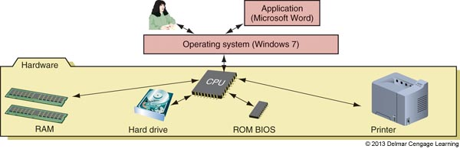
Figure 3-1 Users and applications depend on the OS to relate to all applications and hardware components

Slide 5
The Windows Desktop
Desktop is the initial screen that is displayed
Windows Desktop provides a graphical user interface (GUI)
Windows 7 and Vista desktop provides a 3-D user interface called the Aero user interface
Aero interface is not available for the Windows 7 Starter and Home Basic editions
Windows 7 requires 1 GB of RAM and a video card that supports DirectX 9 graphics standard and has at least 128 MB of graphics memory

Slide 6
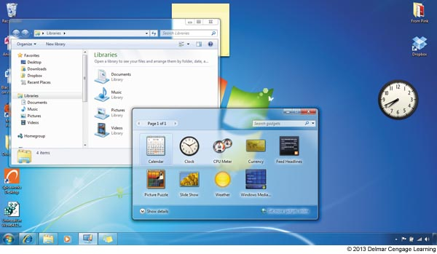
Figure 3-2 The Windows 7 desktop using the Aero interface has a glassy transparent look

Slide 7
The Windows Desktop
Start menu
Username shown at the top right
Applications used often are listed in the white left column (can change from time to time)
User libraries, files and OS utilities are listed in the dark right column

Slide 8
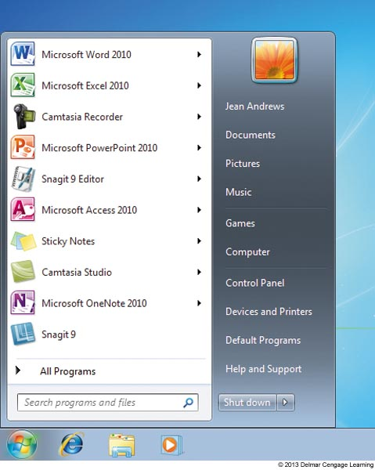
Figure 3-3 The Windows 7 Start menu

Slide 9
The Windows Desktop
How to launch an application
Use the Start menu
Click the Start button and select All Programs
Use the Search box
Click the Start button and enter the name of the program in the Search box provided
Use Windows Explorer or the Computer window
To use the Computer window in Windows 7 or Vista, click Start, Computer
Use a shortcut icon
Right-click the program file in the Computer or Explorer windows and select Create shortcut

Slide 10
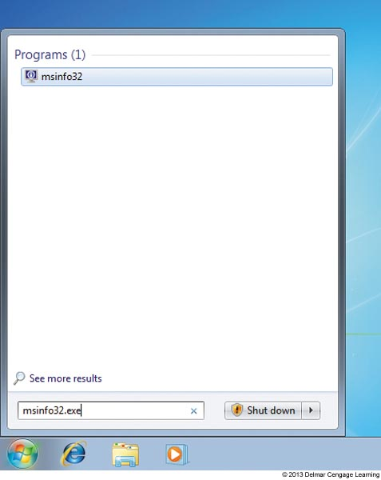
Figure 3-4 Use the Windows 7 Search box to launch a program

Slide 11
The Windows Desktop
Windows 7 Aero Snap and Aero Shake can help:
Aero Snap automatically maximizes a window when you drag it to the top of the desktop
To restore to its original size, drag the window downward
Drag a window to right or left so that it snaps to fill half the screen
Aero Shake minimizes all other windows except the one you shake
To shake, grab the title bar and shake it

Slide 12
The Windows Desktop
The Taskbar and Notification Area (System Tray)
Bottom of Windows desktop
Information about open programs, quick access to others
Quick launch icons
Notification area (system tray or systray)
Right side of taskbar and displays open services
Service: program that runs in the background
Supports or serves Windows or an application
Right-click the taskbar, use the shortcut menu
Click Properties

Slide 13
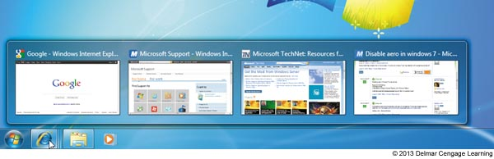
Figure 3-6 Mouse over the Internet Explorer icon in the taskbar to see each open tab in IE

Slide 14
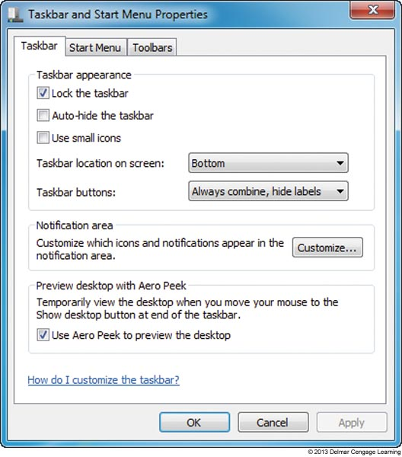
Figure 3-8 Use the Taskbar and Start Menu Properties box to control what appears in the Start menu and taskbar

Slide 15
The Windows Desktop
Personalize the Windows desktop
Right-click anywhere on the desktop
Choose Personalize from the shortcut menu
Most common problem with display is a problem with screen resolution
Screen resolution is number of dots or pixels on the monitor screen expressed as two numbers
Example: 1680x1050
Right-click anywhere on desktop and choose Screen Resolution
Can also be accessed from the Personalization window

Slide 16
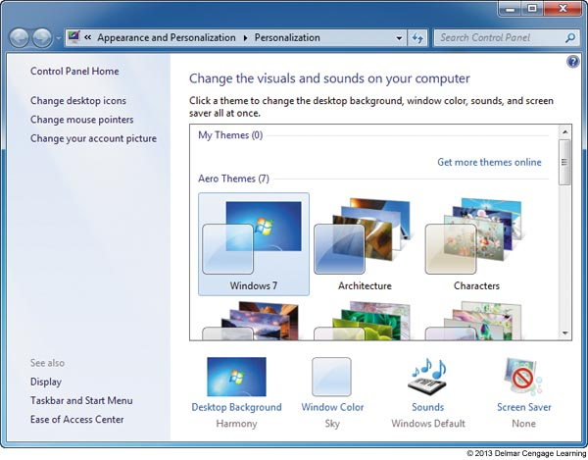
Figure 3-9 Use the Personalization window to change
the appearance of Windows

Slide 17
Windows Explorer And The Computer Window
Two most useful tools to explore files and folders are Windows Explorer and the Computer window
To Open the Computer Window
In Windows 7 or Vista, click Start, and select Computer
To Open Windows Explorer
Click the yellow Windows Explorer icon in the taskbar
Right-click Start and select Open Windows Explorer from the menu

Slide 18
Files and Directories
Every OS manages a hard drive, optical drive, USB drive, or other type of drive by using directories (also called folders), subdirectories, and files
Drive is organized with a single root directory
At top of the top-down hierarchical structure of subdirectories
Exception: hard drive
Divided into partitions
Each volume has its own root directory and hierarchical structure of subdirectories

Slide 19
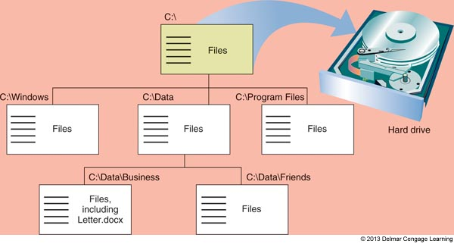
Figure 3-10 Storage devices such as a USB drive, CD, or hard drive, are organized into directories and subdirectories that contain files

Slide 20
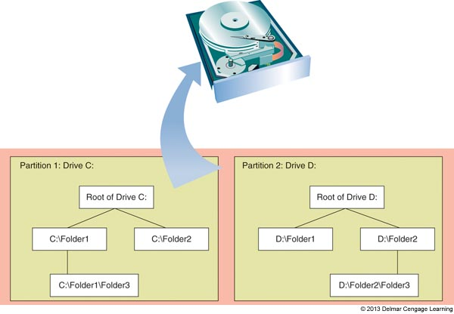
Files and Directories
Root directory can hold files or other directories
These directories are called subdirectories, child directories, or folders
Any directory can have files and other subdirectories in it
Figure 3-11 A hard drive can be divided into one or more partitions that can each
Contain a volume such as drive C: or drive D:

Slide 21
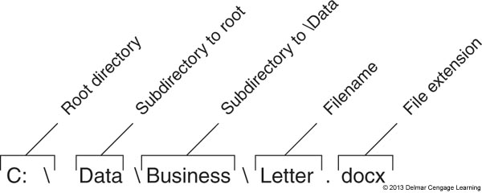
Files and Directories
Path: location of a file referenced by a drive and directories
Figure 3-12 The complete path to a file includes the volume letter, directories, filename, and file extension; the colon, backslashes, and period are required to separate items in the path

Slide 22
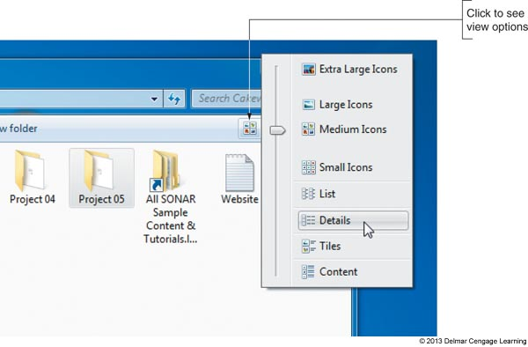
Navigate the Folder Structure
Tips to navigate when working with Windows Explorer or Computer window
Double-click items in the left pane (called navigation pane) to drill down to subfolders inside folders
To control how files appear in the right pane, click the View icon and select your view
Figure 3-13 Click the View icon to change how files and folders display

Slide 23
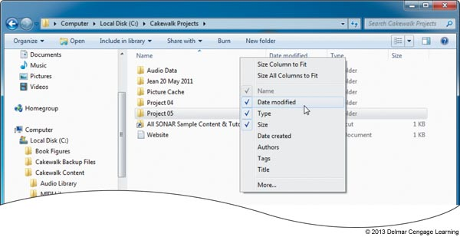
Navigate the Folder Structure
Tips to navigate when working with Windows Explorer or Computer window (cont.)
To control column headings that appear in the Details view, right-click a column heading and select the headings that you want to appear
Figure 3-14 Right-click a column heading to select columns
to display in the Details view

Slide 24
Navigate the Folder Structure
Tips to navigate when working with Windows Explorer or Computer window (cont.)
Use the Search box in the upper-right corner of the window
Use the forward and back arrows in upper-left corner to move forward and backward to previous views
Click a right arrow in the path displayed in the address bar at the top of the Explorer widows to see a drop-down list of subfolder

Slide 25
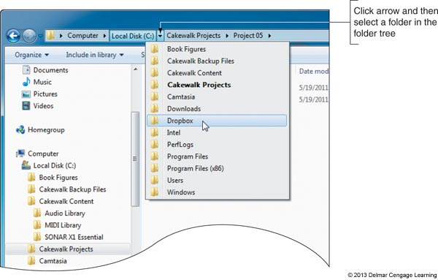
Figure 3-15 Click a right arrow in the address bar to move up the folder
tree and down to a new folder

Slide 26
Windows 7 Libraries
Windows 7 library: a collection of one or more folders
These folders can be stored on different local drives or on the network
Four default libraries are created when Windows is installed: Documents, Music, Pictures, and Videos
First three libraries can be access from the Start Menu by default
You can use the Computer window or Windows Explorer to access all libraries

Slide 27
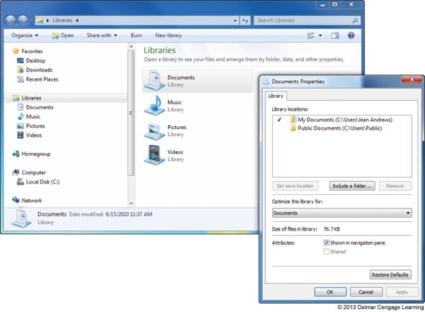
Figure 3-16 Windows 7 includes four default libraries

Slide 28
Change Windows Explorer Settings and Folder Options
You can view and change options assigned to folders
Controls how users view files in a folder, what users can do with the files
File extension
Used to identify file types
Windows does not show file extensions if it knows which application is associated with a file extension
Windows hides system files until you force it to show them

Slide 29
Create a File
Methods to create a file
Use a particular application
Use Windows Explorer or the Computer window
Right-click in the unused white area in the right pane of the window and point to New
Click the application you want to use in order to create a file
You can rename the filename (keep file extension the same)

Slide 30
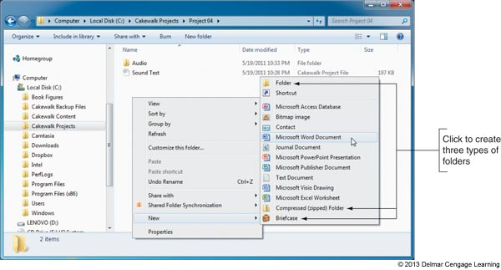
Figure 3-18 Create a new file or folder using Windows Explorer

Slide 31
Create a Folder
Create a folder:
Select parent folder
Right-click in the white area of the right pane
Select New from the shortcut menu
Select one of three choices for folder types
Make a selection
Folder is created and highlighted so that it may be renamed
Can create folders within folders within folders
The maximum length of a path and filename cannot exceed 260 characters

Slide 32
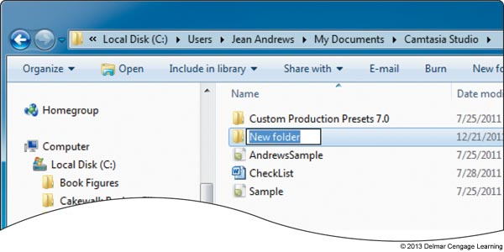
Figure 3-19 Edit the new folder’s name

Slide 33
Copy, Move, Rename, or Delete Files or Folders
Copy
Right-click file, select Copy from the shortcut menu
Click in folder white area where the copied item goes
Select Paste from the shortcut menu
Alternative way to copy or move
Drag and drop item to its new location (move)
To copy, hold down the Ctrl key while you drag and drop
Rename a file or folder
Right-click it and select Rename

Slide 34
Copy, Move, Rename, or Delete Files or Folders
Delete a file or folder
Select the item and press the Delete key
Can also, right-click on the item and select Delete from the shortcut menu
To select multiple items to delete, copy, or move at the same time, hold down the Shift or Ctrl key as you click
Shift key selects adjacent items in a list
Ctrl key selects nonadjacent items in a list

Slide 35
Change File or Folder Attributes
Use Explorer or the Computer window to view and change properties assigned to a file or folder
Properties are called file attributes or folder attributes
Attributes allow you to:
Hide a file
Make it a read-only file
Flag a file to be backed up

Slide 36
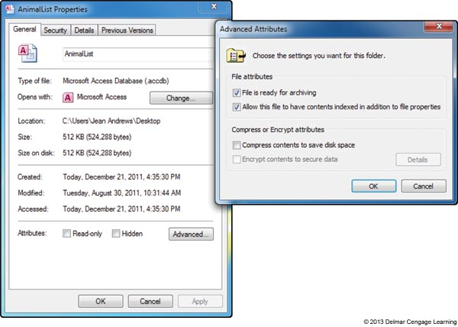
Change File or Folder Attributes
Change file attributes
Right-click a file or folder and select Properties
Figure 3-20 Use a file’s Properties box to view file properties and edit file attributes

Slide 37
Quick and Easy Windows Support Tools
Windows Tools:
System window
System Information window
Control Panel
Action Center
User Account Control dialog box
Windows Help and Support

Slide 38
System Window
System window: can give you a quick look at what hardware and software is installed
To open the System window:
Click Start
Right-click Computer
Select Properties
Useful information found there:
Edition of Windows
Service pack installed
Windows Experience index

Slide 39
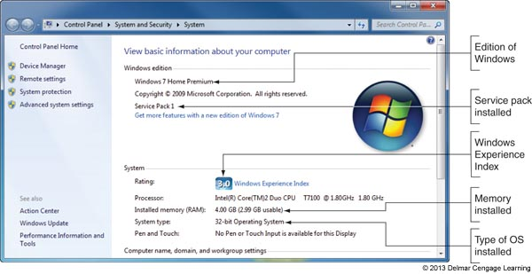
System Window
Useful information found there (continued):
Memory installed
Type of OS installed
Figure 3-21 A 32-bit version of Windows 7 Home Premium is installed

Slide 40
System Information Window
Used to view detailed information about the system
Important features
Processor or BIOS version installed
RAM is installed
OS installation directory
Hard drive size
Names of currently running drivers
Device drivers: small programs stored on hard drive that tell the computer how to communicate with a specific hardware device

Slide 41
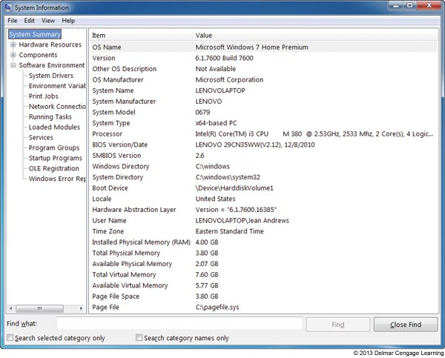
System Information Window
To run System Information
Click Start, and enter Msinfo32.exe in the Search box and press Enter
Figure 3-22 Use the System Information utility to
examine details about a system

Slide 42
The Control Panel
Contains applets used to manage the system
Accessing Control Panel in Windows
Click Start and the click Control Panel
Utilities can also be accessed by one of these methods:
Click Start and type the program name in the Search box
Find another path to the utility
Open the System window in the System and Security group of Control Panel, click Start, right-click Computer and select Properties

Slide 43
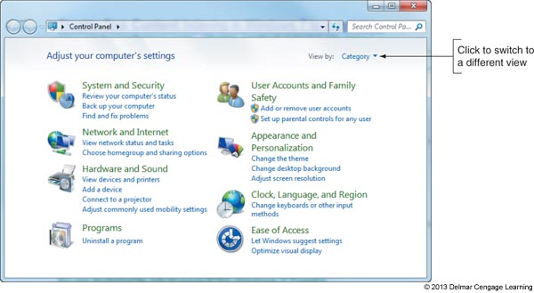
Figure 3-23 The Control Panel is organized by category, although you can easily switch to a list of selections

Slide 44
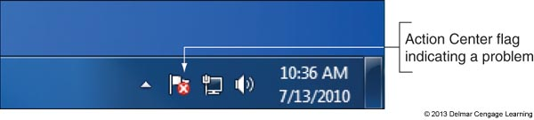
Action Center
Action Center: tool to use when you want to make a quick jab at solving a computer problem
Lists errors and issues that need attention
Action center flag appears in the notification area of the taskbar
Figure 3-24 A red X on the Action Center flag in the taskbar
indicates a critical issue needs resolving

Slide 45
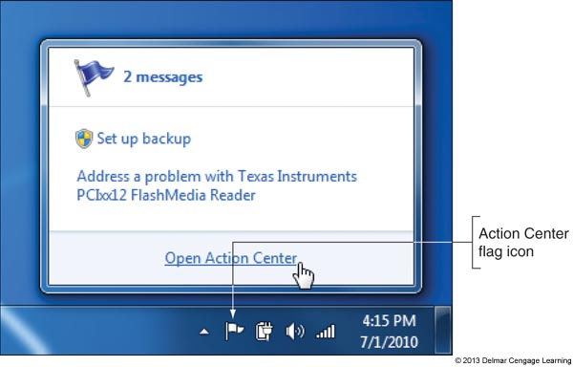
Figure 3-25 Click the Action Center flag to see a list of current
issues and to open the Action Center

Slide 46
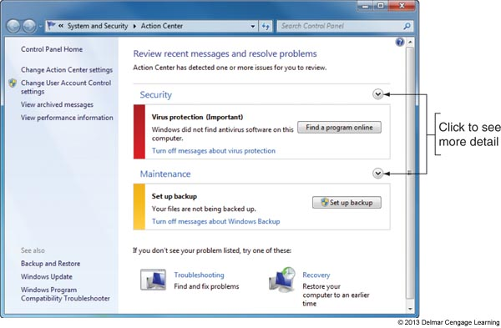
Figure 3-26 The Action Center shows a critical problem that needs
a resolution

Slide 47
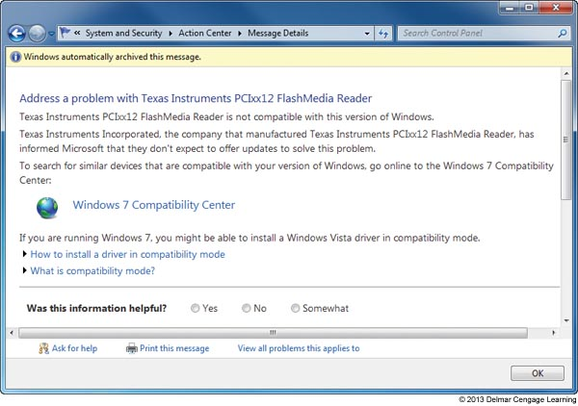
Figure 3-27 A problem reported in the Action Center
with a possible solution

Slide 48
User Account Control Box
User Account Control (UAC) dialog box appears each time a user attempts to perform an action that can be done only with administrative privileges
Used to:
Prevent malicious background tasks from gaining administrative privileges when the administrator is logged on
Administrator can log in using a less powerful user account for normal desktop activities, but still be able to perform administrative tasks while logged in as a regular user

Slide 49
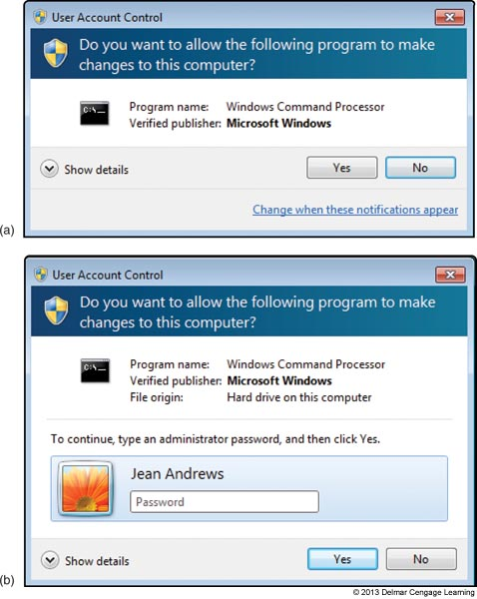
Figure 3-28 (a) and (b) (a) the User Account Control box of an administrator does not require an administrative password; (b) The UAC box of a standard User requires an administrative password

Slide 50

Network and Sharing Center
Use the Network and Sharing Center to help resolve a failed network connection
Use Control Panel or the taskbar to access the center
Figure 3-30 Wired and wireless networking icons in the taskbar

Slide 51
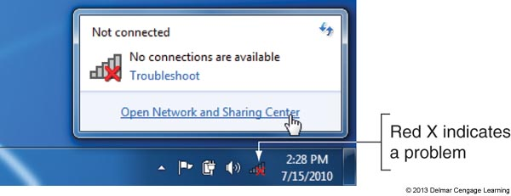
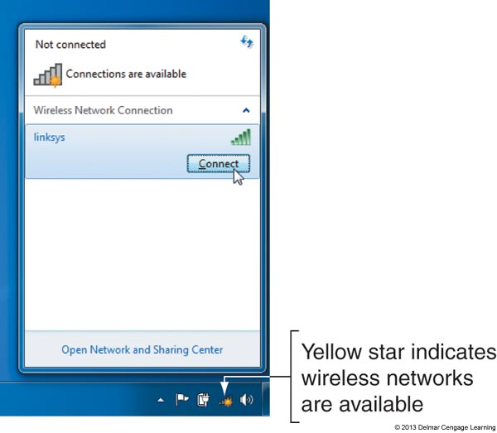
Figure 3-31 The network icon in the taskbar indicates a problem or a
possible new connection to a wireless network

Slide 52
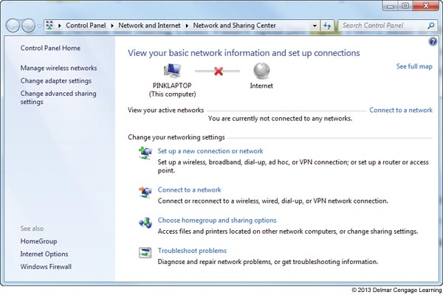
Figure 3-32 The Network and Sharing Center reports a problem
connecting to the network

Slide 53
Windows Help and Support and the Web
Start the Utility:
Click Start and click Help and Support
Tips for using the web and Help and Support:
Microsoft’s web site has tons of useful information
support.microsoft.com or windows.microsoft.com
Use a search engine such as Google, enter the error message, software application, symptom, or Windows utility in the search box
To limit a Google search to the Microsoft website, use the site:microsoft.com text in the search string

Slide 54
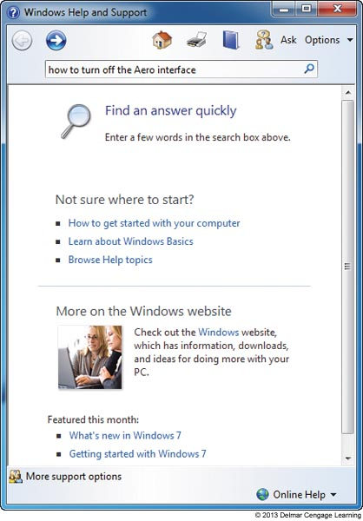
Figure 3-34 Use the Help and Support tool to teach yourself about Windows

Slide 55
Summary
OS manages system resources for users and applications
Windows 7 and Vista desktop offers the Aero user interface
Four ways to launch an application: use the Start menu, search box, Windows Explorer, or a shortcut
The right side of the taskbar is called the notification area (also known as system tray)
Windows Explorer and Computer are used to manage files, folders, and libraries

Slide 56
Summary
The file extension indicates how the file contents are organized and formatted and what program uses the file
The System window gives a quick overview of the system
The System Information window gives detailed information about the computer
Control Panel give access to a group of utility programs used to manage the system
Windows 7 Action Center is used to solve problems with security and computer maintenance issues

Slide 57
Summary
The User Account Control (UAC) box is used to protect the system against malware or accidental changes to a system done by inexperienced users
Use the Network and Sharing Center to manage, secure, and troubleshoot the network connections
Use the web and the Windows Help and Support utility to teach yourself about Windows and how to support it

