Slide 1

A+ Guide to Managing & Maintaining Your PC, 8th Edition
Chapter 5
Supporting Processors and Upgrading Memory

Slide 2
Objectives
Learn about the characteristics and purposes of Intel and AMD processors used for personal computers
Learn how to install and upgrade a processor
Learn about the different kinds of physical memory and how they work
Learn how to upgrade memory

Slide 3
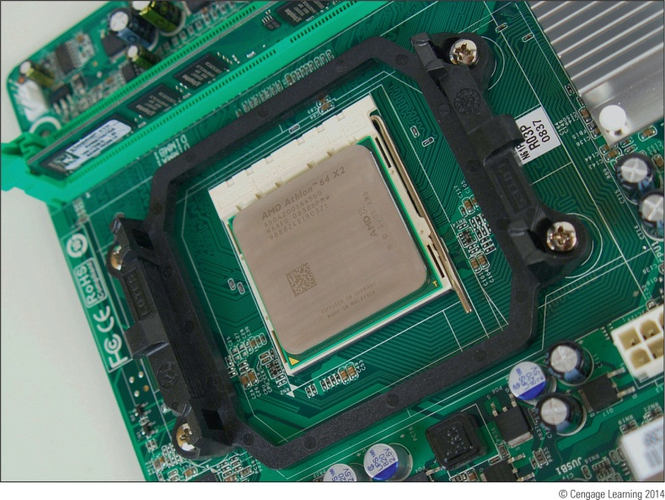
Types and Characteristics of Processors
Processor
Installed on motherboard
Determines system computing power
Two major processor manufacturers
Intel and AMD
Figure 5-1 An AMD Athlon 64 X2 installed in socket AM2+ with cooler not yet installed

Slide 4
Types and Characteristics of Processors
Features affecting processor performance and compatibility with motherboards
Clock speed the processor supports
Processor speed
Socket and chipset the processor can use
Processor architecture
Multiprocessing abilities
Dual processors
Multi-core processing
Multithreading

Slide 5
Types and Characteristics of Processors
Features affecting processor performance and compatibility with motherboards (cont’d)
Memory cache
Memory features on the motherboard that the processor can support
Support for virtualization
Integrated graphics

Slide 6
How a Processor Works
Basic components
Input/output (I/O) unit
Manages data and instructions entering and leaving the processor
Control unit
Manages all activities inside the processor
One or more arithmetic logic units (ALUs)
Performs all logical comparisons, calculations

Slide 7
How a Processor Works
Basic components (cont’d)
Registers
Small holding areas on processor chip
Holds counters, data, instructions, and addresses ALU is currently processing
Internal memory caches (L1, L2, L3)
Holds data and instructions to be processed by ALU
Buses
Connect components within the processor housing

Slide 8
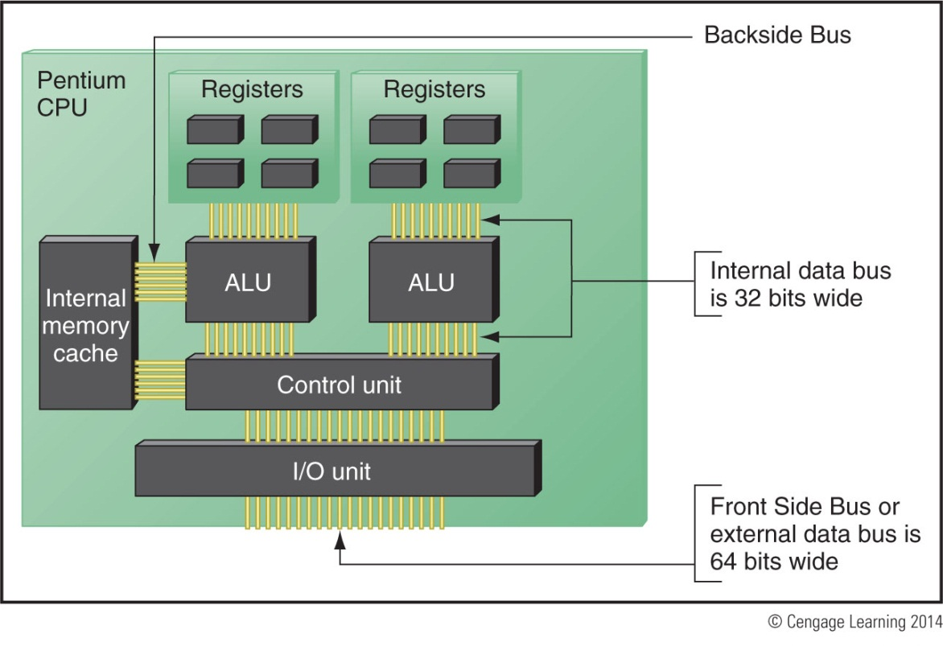
Figure 5-3 Since the Pentium processor was first released in 1993, the standard
has been for a processor to have two arithmetic logic units so that it can process
two instructions at once

Slide 9
How a Processor Works
Processor frequency (speed)
Speed at which processor operates internally
Multiplier
Factor multiplied against system bus frequency
Determines processor frequency
System bus frequency × multiplier = processor frequency
Processor sold today contain ALUs and registers that can process 32 bits or 64 bits at a time

Slide 10
How a Processor Works
Three categories of processors:
32-bit processors – known as x86 processors
Can handle 32-bit instructions from OS
Hybrid processors – known as x86-64 processors
Can handle a 32-bit OS or a 64-bit OS
AMD produced the first one (called AMD64)
64-bit processors – known as x64 processors
Require a 64-bit OS and can handle 32-bit applications only by simulating 32-bit processing

Slide 11
How a Processor Works
Memory cache (L1, L2, or L3)
Each core in a processor has its own L1 and L2 caches
All cores might share an L3 cache within the processor package
Improves performance
Memory controller
Included in processor package
Significant increase in system performance

Slide 12
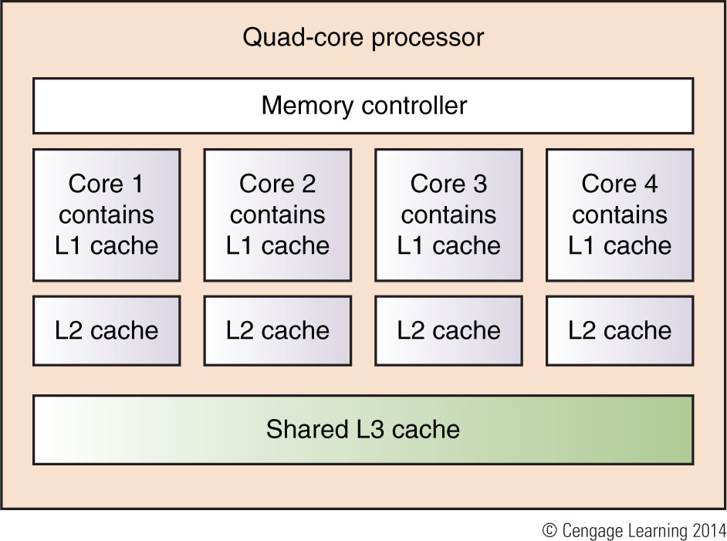
Figure 5-4 Quad-core processing with L1, L2, and L3 cache and the memory controller within the processor housing

Slide 13
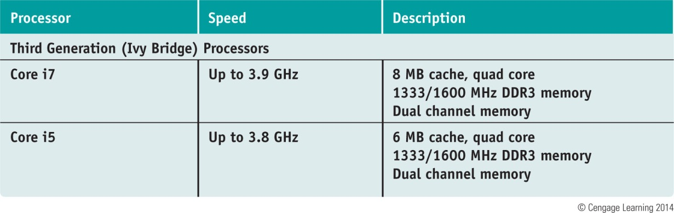
Table 4-1 Current Intel processors

Slide 14
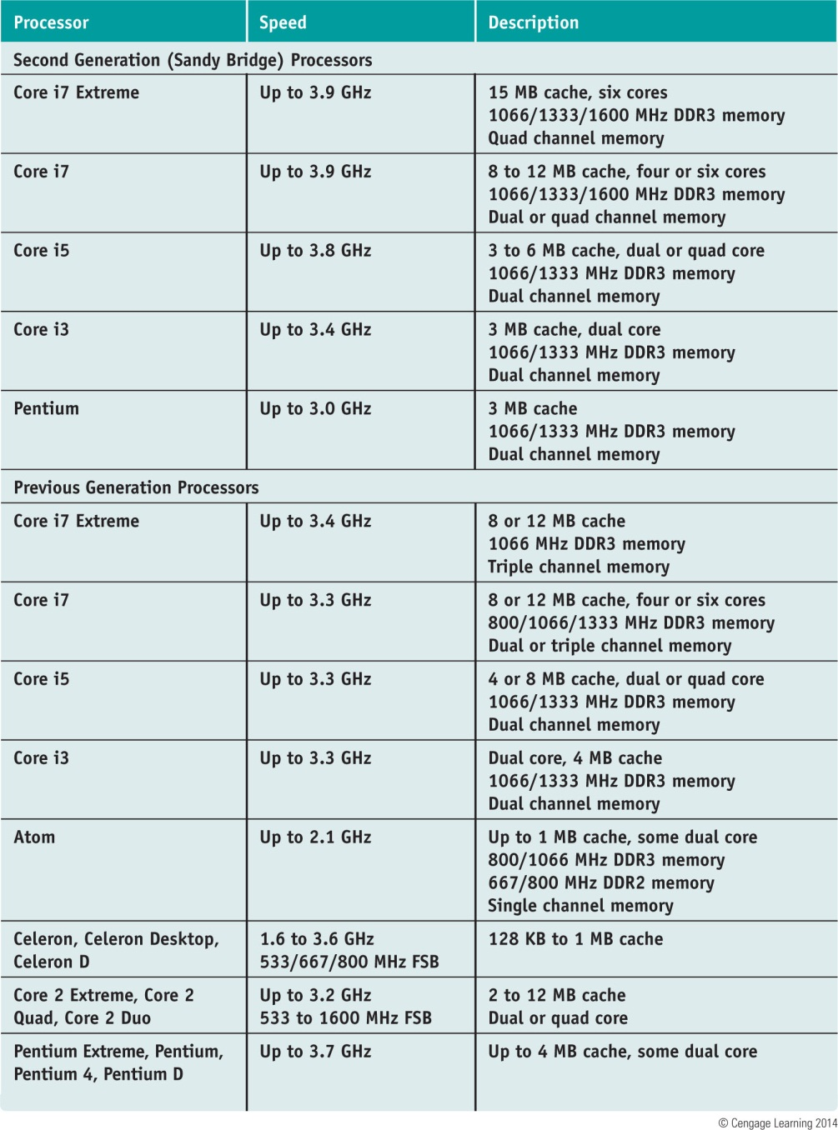
Table 4-1 Current Intel processors (continued)

Slide 15
Intel Processors
Processor identification
Processor number
Example: two Core i7 processors are identified as:
i7-940 and i7-920
Centrino technology improves laptop performance
Processor, chipset, wireless network adapter are interconnected as a unit

Slide 16
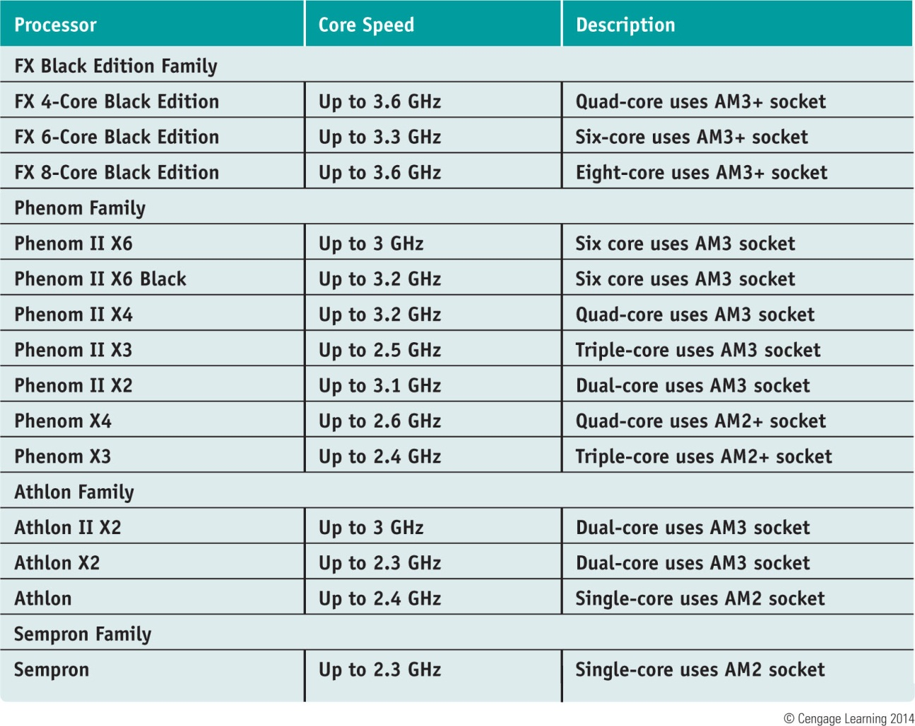
AMD Processors
Table 4-2 Current AMD processors

Slide 17
Selecting and Installing a Processor
PC repair technician tasks
Assemble a PC from parts
Exchange a faulty processor
Add a processor
Upgrade an existing processor
Must know how to:
Match processor to system
Install processor on motherboard

Slide 18
Select a Processor to Match System Needs
First requirement
Select processor motherboard is designed to support
Select best processor meeting general system requirements and user needs
May have to sacrifice performance for cost

Slide 19
Install a Processor
Installing an Intel processor in socket LGA1155
1. Read motherboard user guide and follow directions
2. Use a ground bracelet or antistatic gloves
3. Open the socket by pushing down on socket lever and gently push away from socket
4. Socket load plate opens
5. Remove socket protective cover
6. Remove protective cover from processor
7. Hold processor with index finger and thumb and align processor in socket using the gold triangle and right-angle mark

Slide 20
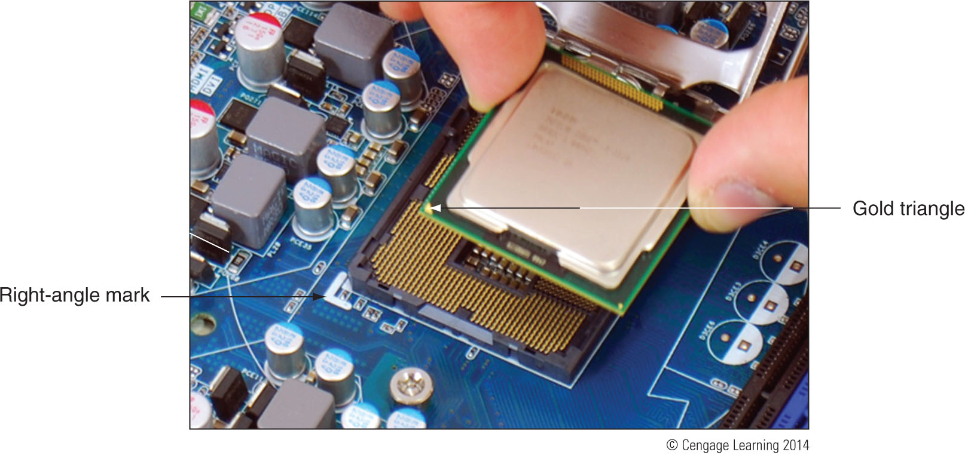
Figure 5-13 Align the processor in the socket using the gold
triangle and the right-angle mark

Slide 21
Install a Processor
Installing an Intel processor in socket LGA1155 (cont’d):
8. Ensure the processor is aligned correctly in socket
9. Return lever to its locked position

Slide 22
Install a Processor
General step to install a cooler
1. Understand how cooler posts work
2. Apply thermal compound if necessary (may be preapplied)
3. Verify locking pins are turned counter-clockwise as far as they will go
4. Push down on each locking pin until it pops into the hole
5. Connect power cord from cooler fan to motherboard
Check BIOS setup to verify the system recognized processor after system up and running

Slide 23
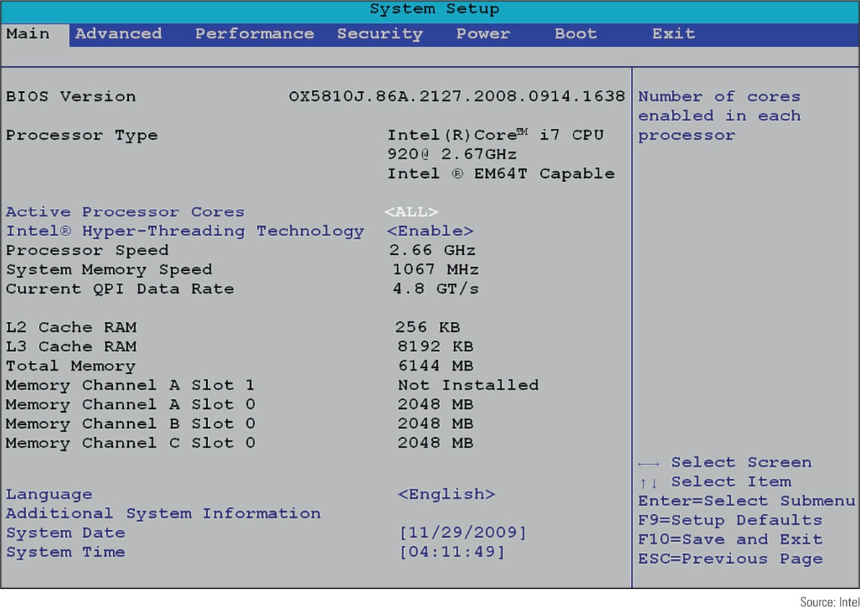
Figure 5-21 Verify the CPU is recognized correctly by BIOS setup

Slide 24
Install a Processor
Installing an Intel processor in socket LGA1366
Similar to installation of processor in Socket LGA 1155 (some steps may not be repeated)
1. Open the socket and remove protective cover
2. Line up processor with two posts on the socket (see Figure 5-25 on next slide)
3. Lower the socket load plate and return lever to locked position
Verify system works

Slide 25
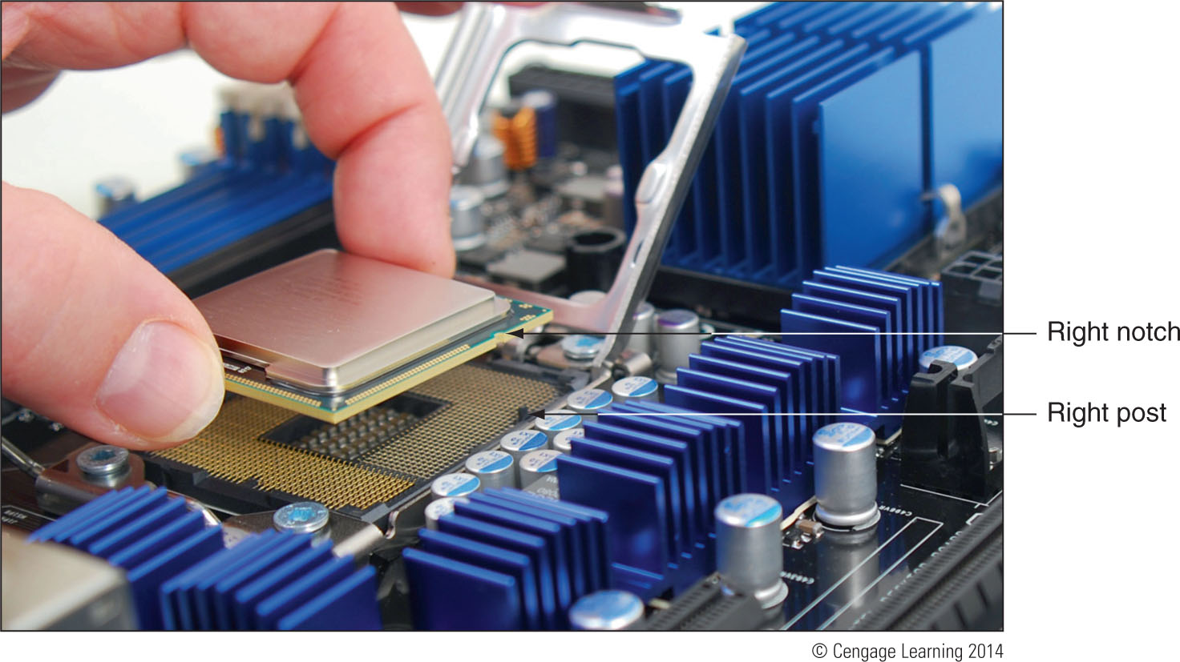
Figure 5-25 Orient the processor over the socket so that the notches on each
side of the processor match the posts on each side of the socket

Slide 26
Install a Processor
Installing an Intel processor in socket LGA775
1. Push down lever and gently push it away from socket, lift socket load plate and remove socket protective cover
2. Orient processor so notches on two edges of processor line up with two notches on the socket, place processor in socket
3. Close the socket cover, push down lever and return it to its locked position
Verify system works

Slide 27
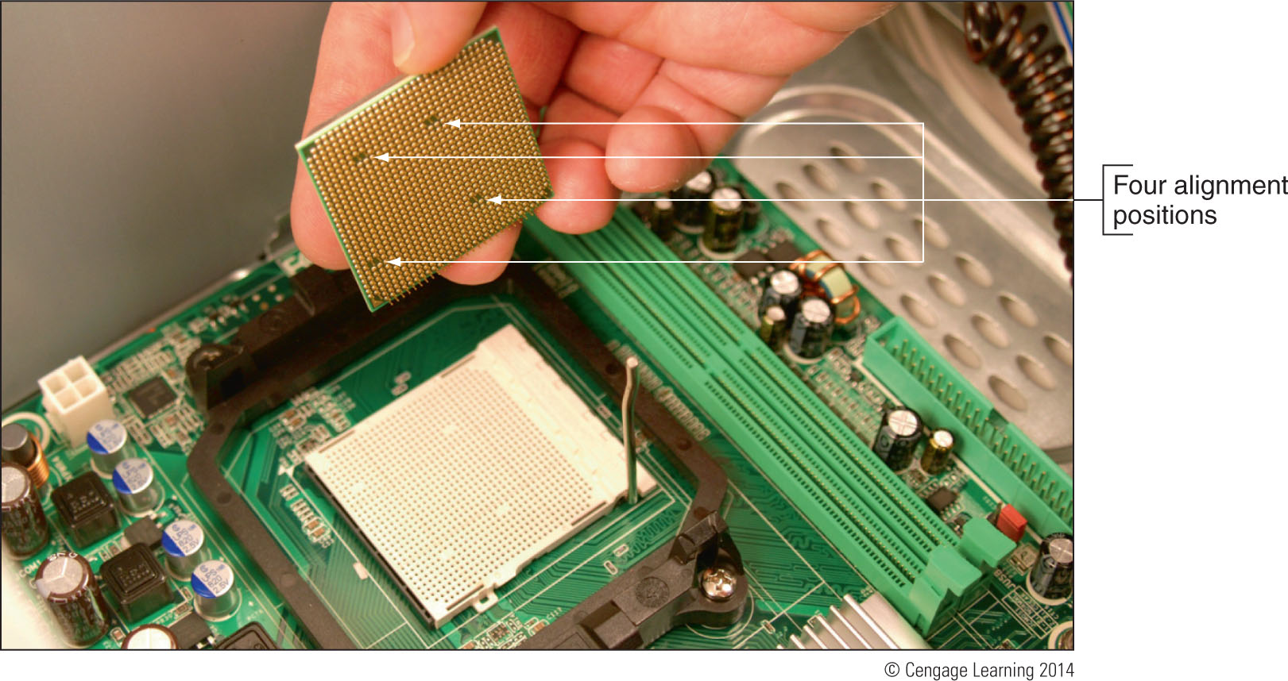
Figure 5-29 Place the processor in the socket,
orienting the notches on two sides

Slide 28
Install a Processor
Installing an AMD processor in socket AM2+
Summary of installation steps
1. Open the socket lever and remove protective cover
2. Place processor in the socket
3. Verify processor pins sitting slightly into the holes
4. Press the lever down and gently into position
5. Apply thermal compound and install cooler
6. Clip into place the clipping mechanism on one side of the cooler
7. Connect fan power cord to power connection
Verify system works

Slide 29
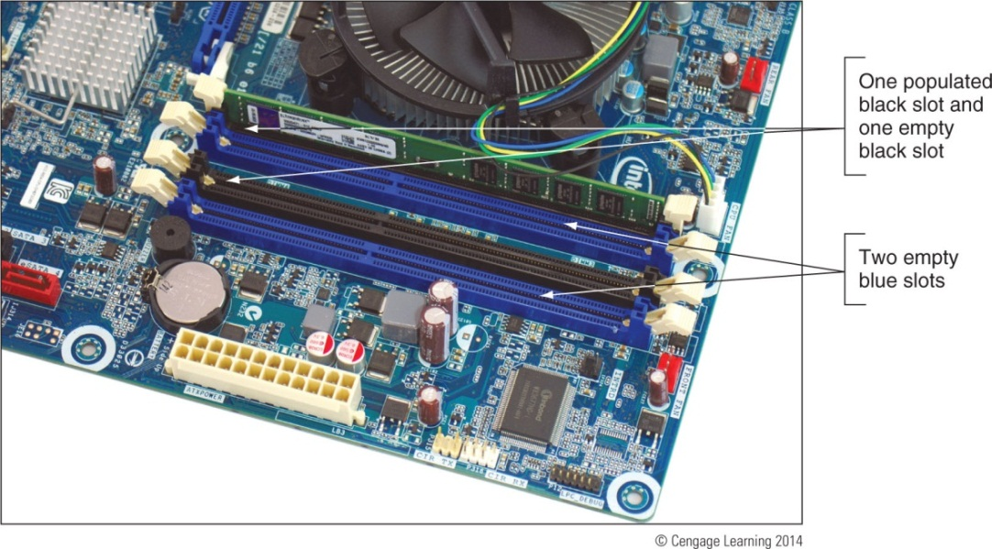
Memory Technologies
Random access memory (RAM)
Holds data and instructions used by CPU
Static RAM (SRAM) and dynamic RAM (DRAM)
Both volatile memory
Figure 5-34 RAM on motherboards today is stored in DIMMs

Slide 30
Memory Technologies
Variations of DRAM
DIMM – dual inline memory module
small outline DIMM (SO-DIMM) – used on laptops
microDIMMs – used on subnotebook computers
RIMM and SIMM (outdated)
Differences among DIMM, RIMM, SIMM modules
Data path width each module accommodates
How data moves from system bus to module

Slide 31
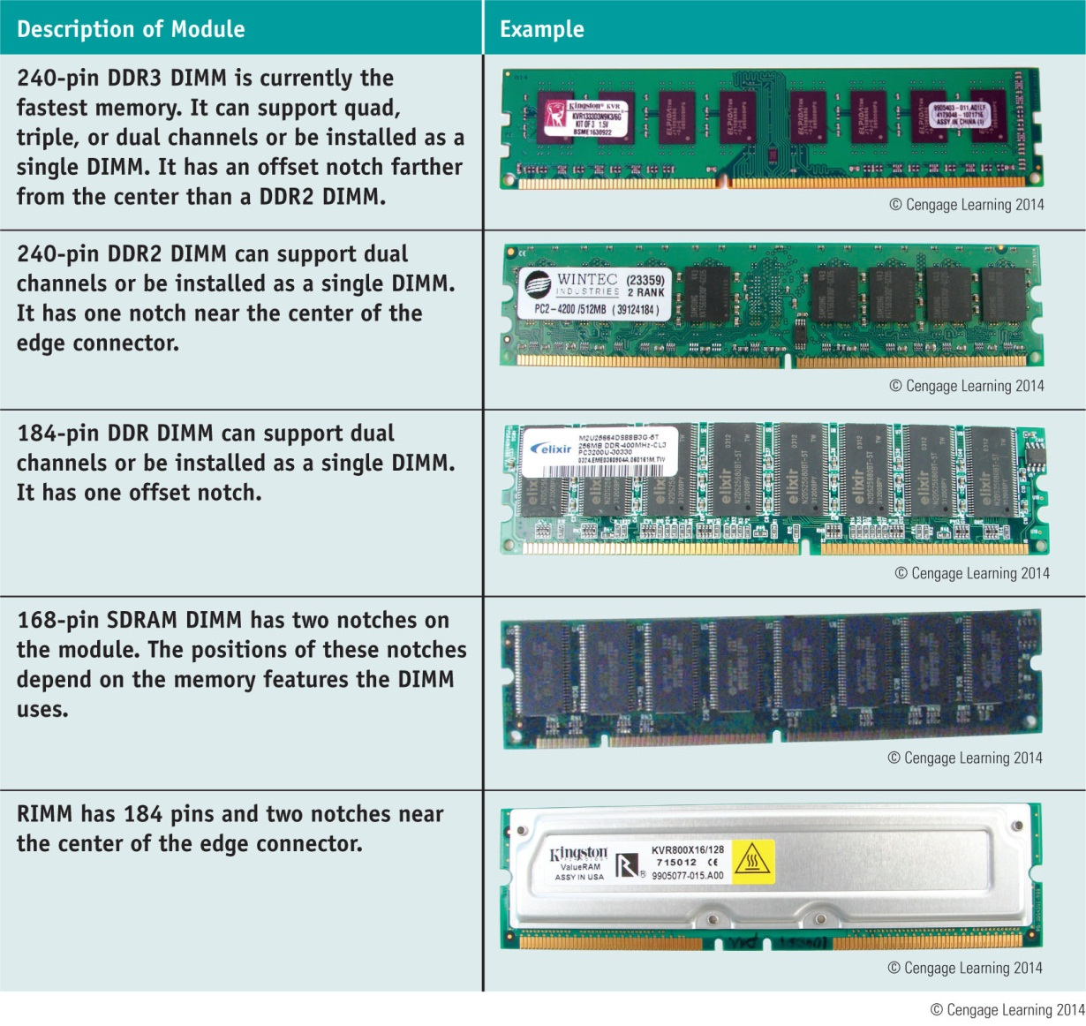
Table 4-3 Types of memory modules

Slide 32
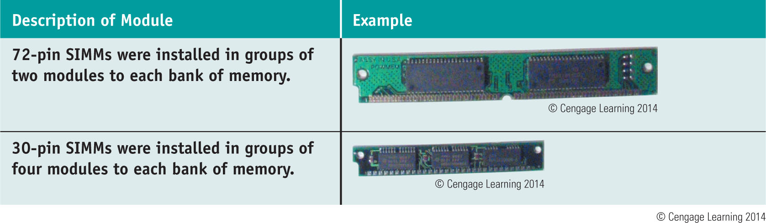
Table 4-3 Types of memory modules (continued)

Slide 33
DIMM Technologies
DIMM (dual inline memory module)
64-bit data path
Independent pins on opposite sides of module
Older DIMMs
Asynchronous with system bus
Synchronous DRAM (SDRAM)
Runs synchronously with system bus
Two notches
Uses 168 pins

Slide 34
DIMM Technologies
Double Data Rate SDRAM
Also called DDR SDRAM, SDRAM II, DDR
Two times faster than SDRAM
DDR2 SDRAM
Faster than DDR and uses less power
DDR3 SDRAM
Faster than DDR2 and uses less power
DDR2 and DDR3
Use 240 pins
Not compatible: use different notches

Slide 35
DIMM Technologies
Factors that affect capacity, features, and performance of DIMMS:
Number of channels they use
How much RAM is on one DIMM
Speed
Error-checking abilities
Buffering

Slide 36
DIMM Technologies
Early single channel DIMMs
Memory controller is accessed one DIMM at a time
Dual channels
Memory controller communicates with two DIMMs at the same time
Doubles memory access speed
Triple channels
Accesses three DIMMs at once
DDR, DDR2, DDR3 DIMMs use dual channels
DDR3 DIMMs also use triple channels

Slide 37
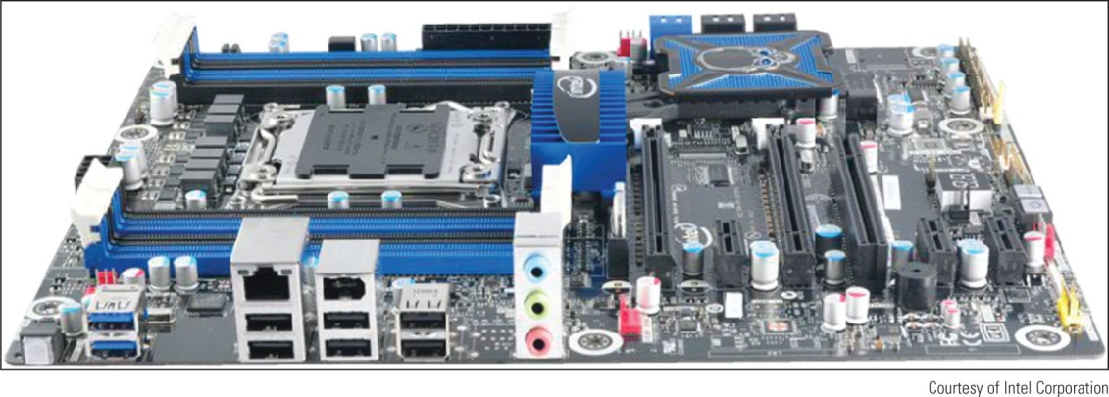
DIMM Technologies
Quad channeling
Introduced with Intel Sandy Bridge chipsets and processors
Using eight memory slots:
Processor can access four slots at a time using two different channels
Figure 5-39 The Intel Desktop
Board DX79T0 has eight memory
Slots and supports two quad channels

Slide 38
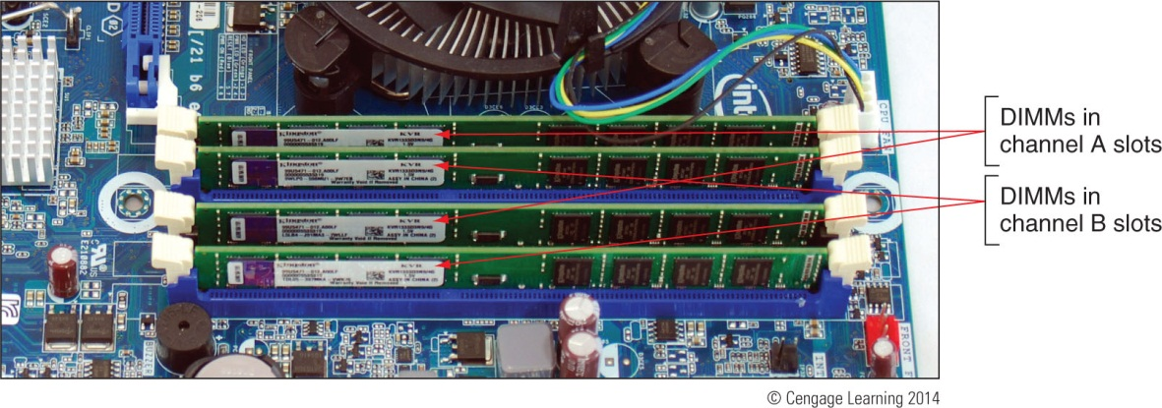
DIMM Technologies
Setting up dual channeling
Pair of DIMMs in a channel must be equally matched
Size, speed, features
Use same manufacturer (recommendation)
Figure 5-37 Matching pairs of DIMMs installed in four DIMM slots
that support dual channeling

Slide 39
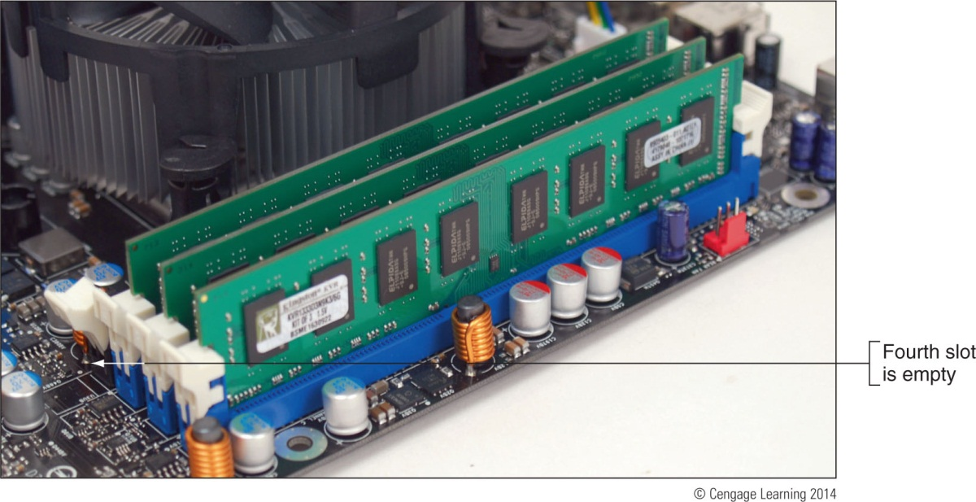
DIMM Technologies
Setting up triple-channeling
Three DIMM slots populated with three matching DDR3 DIMMs
Figure 5-38 Three identical DDR3 DIMMs installed in a triple-channel configuration

Slide 40
DIMM Technologies
DIMM Speed
Measured in MHz and PC rating
PC rating
Total bandwidth between module and CPU
DDR2 PC rating
Usually labeled PC2
DDR3 PC rating
Usually labeled PC3

Slide 41
DIMM Technologies
Single-sided DIMM
Memory chips installed on one side of module
Double-sided DIMM
Memory chips installed on both sides of module
Memory bank
Memory processor addresses at one time
64 bits wide
Dual ranked
DIMMs providing two or more banks
Reduces overall memory price at the expense of performance

Slide 42
DIMM Technologies
Error-correcting code (ECC)
Detects and corrects error in a single bit
Application: ECC makes 64-bit DIMM a 72-bit module
Parity
Error-checking based on an extra (ninth) bit
Odd parity
Parity bit set to make odd number of ones
Even parity
Parity bit set to make even number of ones
Parity error
Number of bits conflicts with parity used

Slide 43
DIMM Technologies
Buffered and registered DIMMs
Hold data and amplify signal before data written
Registered DIMM
Uses registers
Unbuffered DIMM
No buffers or register support
Fully buffered DIMM (FB-DIMM)
Uses an advanced buffering technique
Allows servers to support a large number of DIMMs
Notches on module indicate supported technologies

Slide 44
DIMM Technologies
CAS latency and RAS latency
Column access strobe (CAS) latency
Row access strobe (RAS) latency
Both refer to number of clock cycles it takes to write or read a column or row of data off a memory module
CAS latency used more than RAS latency
Lower values are better than higher
Memory module ads
Provide CAS latency value within series of timing numbers
Example: 5-5-5-15

Slide 45
RIMM Technologies
Direct Rambus DRAM
Also known as RDRAM, Direct RDRAM, Rambus
RIMM memory module
Expensive and slower than current DIMMs
RIMMs using 16-bit data bus: two notches, 184 pins
RIMMs using 32-bit data bus: single notch, 232 pins
C-RIMM (Continuity RIMM)
Placeholder module
Ensures continuity throughout all slots
No memory chip

Slide 46
Memory Technologies and Memory Performance
Memory performance factors to consider
Total RAM installed
Memory technology used
Speed of memory in MHz, PC rating, or ns
ECC or non-ECC
CL or RL rating
Single, dual, triple or quad channeling
Connectors inside memory slots are tin or gold
Edge connectors on memory modules follow suit
Match connectors to prevent corrosive chemical reactions between metals

Slide 47
How to Upgrade Memory
Basic technique
Add more RAM modules
Problems solved
Slow performance
Applications refusing to load
An unstable system
Windows “Insufficient memory” error message

Slide 48
How to Upgrade Memory
Questions to ask
How much RAM do I need and how much is currently installed?
How many and what kind of memory modules are currently installed on my motherboard?
How many and what kind of modules can I fit on my motherboard?
How do I select and purchase the right modules for my upgrade?
How do I physically install the new modules?

Slide 49
How Much Memory Do I Need and How Much Is Currently Installed?
Best answer: “All you can get”
Windows 7 requires at least 2 GB RAM
RAM limit for a 32-bit OS
4 GB installed RAM

Slide 50
How Many and What Kind of Memory Modules Are Currently Installed?
Open the case and look at memory slots
How many slots?
How many filled?
Review module imprint
Examine module for physical size and notch position
Read motherboard documentation
See if board supports dual, triple, or quad channels
Last resort
Take motherboard and old memory modules to a good computer parts store for confirmation

Slide 51
How Many and What Kind of Modules Can Fit on My Motherboard?
Read motherboard documentation
Indicates how much memory motherboard can physically hold
DIMM modules
DIMMs can be installed as single modules
Motherboard supporting dual channeling
Install matching DIMMs in each channel for best performance
DDR3 board supporting triple channeling
For best performance install three matching DIMMs in triple-channel slots

Slide 52
How Many and What Kind of Modules Can Fit on My Motherboard?
Motherboard using DDR3 triple-channel DIMMs
Use three matching DIMMs in the three blue slots
If fourth slot populated, board reverts to single channeling
Dual channeling:
Install two matching DIMMs in two blue slots farthest from processor
Leave other two slots empty
For one installed DIMM:
Place it in the blue slot farthest position from processor

Slide 53
How Many and What Kind of Modules Can Fit on My Motherboard?
Motherboard using DDR3 triple-channel DIMMs (cont’d.)
Follow motherboard documentation
Serial Presence Detect (SPD)
Declares module’s size, speed, voltage, and data path width to system BIOS at startup
Today’s memory always supports SPD

Slide 54
How Many and What Kind of Modules Can Fit on My Motherboard?
Motherboard using DDR DIMMs with dual channeling
Allows three different DDR DIMM speeds in one to four sockets, supports dual channeling
Two blue memory slots and two black slots
For dual channeling
Matching DIMMs must be installed in the two blue sockets
If two DIMMs installed in the two black sockets
They must match each other

Slide 55
How Many and What Kind of Modules Can Fit on My Motherboard?
Pentium motherboard using DDR DIMMs
Example: Motherboard using 168-pin single-sided DIMM modules
Documentation says to use unbuffered, 3.3-V, ECC, PC100 DIMM SDRAM modules
PC100: modules should be rated to work with a motherboard running at 100 MHz
Can choose to use or not use ECC modules
BIOS setup should show feature disabled
Three DIMM slots on the board (sockets) hold one bank of memory

Slide 56
How Many and What Kind of Modules Can Fit on My Motherboard?
RIMM modules
No longer made
Replace one or more C-RIMMs with RIMMs
Match new RIMMs existing RIMMs
Follow motherboard documentation
Look at existing modules and motherboard documentation

Slide 57
How Do I Select and Purchase the Right Memory Modules?
Compromises if exact match not available
Mixing unbuffered memory with buffered
Registered memory will not work
Match memory module manufacturer if possible
Try using memory from two different manufacturers
If mixing memory speeds:
All modules perform at slowest speed

Slide 58
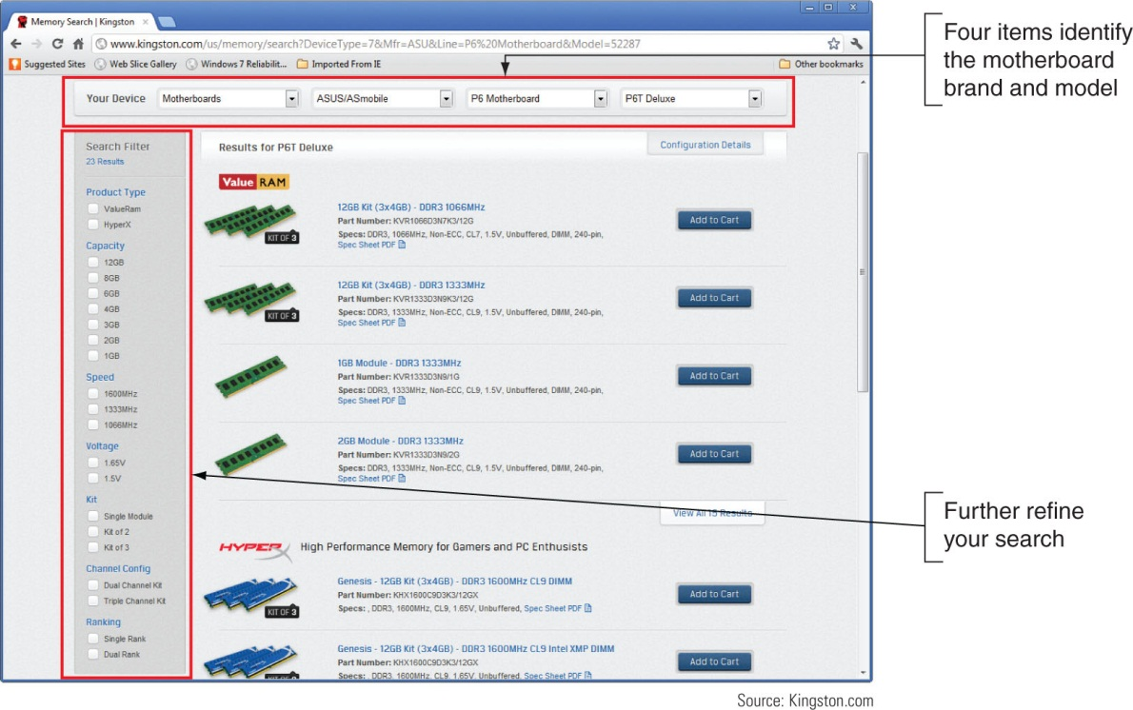
How Do I Select and Purchase the Right Memory Modules?
Using a web site to research your purchase
Look for search utility matching modules to board
Figure 5-56 The Kingston web site DIMM recommendations
for a particular motherboard

Slide 59
How Do I Install the New Modules?
Precautions:
Always use a ground bracelet
Turn off power, unplug power cord, press power button, remove case cover
Handle memory modules with care
Do not touch metal contacts on memory module or expansion cards
Do not stack cards or modules
Look for notches on one side or in the middle for correct orientation

Slide 60
How Do I Install the New Modules?
Installing DIMMS
Pull out supporting arms on the sides of the slot
Use notches on DIMM edge connector as a guide
Insert DIMM straight down into the slot
Ensure supporting arms lock into position
New installations are generally uncomplicated
Usually involve placing memory on motherboard
Older computers may need change to CMOS setup
If new memory not recognized try reseating device

Slide 61
How Do I Install the New Modules?
Installing RIMMS
Install RIMMs beginning with bank 0, followed by bank 1
If C-RIMM is already in the slot remove C-RIMM
Insert module straight down in the socket
When fully inserted supporting clips should pop back into place

Slide 62
Summary
Processor: most important motherboard component
Two major manufacturers are Intel and AMD
Processors are rated by speed of the system bus, the socket and chipset, processor architecture, multi-core rating, internal memory cache, amount and type of RAM and computing technologies
Memory cache inside the processor housing can be L1, L2, and L3 cache
Core of processor has two arithmetic logic units (ALUs) and each core can process two threads at once

Slide 63
Summary
Current families of Intel processors include Core, Atom, Celeron, and Pentium
Current AMD processor families include FX, Phenom, Athlon, and Sempron
Select a processor that the motherboard supports
When installing, always follow directions in motherboard user guide
DRAM is stored on four kinds of modules: DIMM, SO-DIMM, RIMM, and SIMM modules
DIMMs can be single-sided or double-sided

Slide 64
Summary
DIMMs can work together in dual, triple, or quad channels
DIMM and RIMM speeds are measured in MHz or PC rating
The memory controller can check memory for errors and possibly correct those errors using ECC
Buffers and registers are used to hold data and amplify a data signal
RIMMs require that every RIMM slot be populated
When upgrading memory, use the type, size, and speed the motherboard supports

