Slide 1

A+ Guide to Managing & Maintaining Your PC, 8th Edition
Chapter 6
Supporting Hard Drives

Slide 2
Objectives
Learn about the technologies used inside a hard drive and how a computer communicates with a hard drive
Learn how to select and install a hard drive
Learn about tape drives and floppy drives

Slide 3
Hard Drive Technologies and Interface Standards
Hard disk drive (HDD) or hard drive sizes
2.5" size for laptop computers
3.5" size for desktops
1.8" size for low-end laptops, other equipment

Slide 4
Technologies Used Inside a Hard Drive
Solid state drive (SSD) or solid state device (SSD)
No moving parts
Built using nonvolatile flash memory stored on EEPROM (Electronically Erasable Programmable Read Only Memory) chips
Memory in an SSD is called NAND flash memory
Lifespan is based on the number of write operations to the drive
Expensive technology, but faster, more reliable, last longer, and use less power than magnetic drives

Slide 5
Technologies Used Inside a Hard Drive
Magnetic hard drive
One, two, or more platters, or disks
Stacked together, spinning in unison inside a sealed metal housing
Firmware controls data reading, writing and motherboard communication
Read/write heads are controlled by an actuator
Data is organized in concentric circles, called tracks
Tracks are divided into segments called sectors
Most current drives use 4096-byte sectors
Hybrid hard drives use both technologies
Operating system must support it

Slide 6
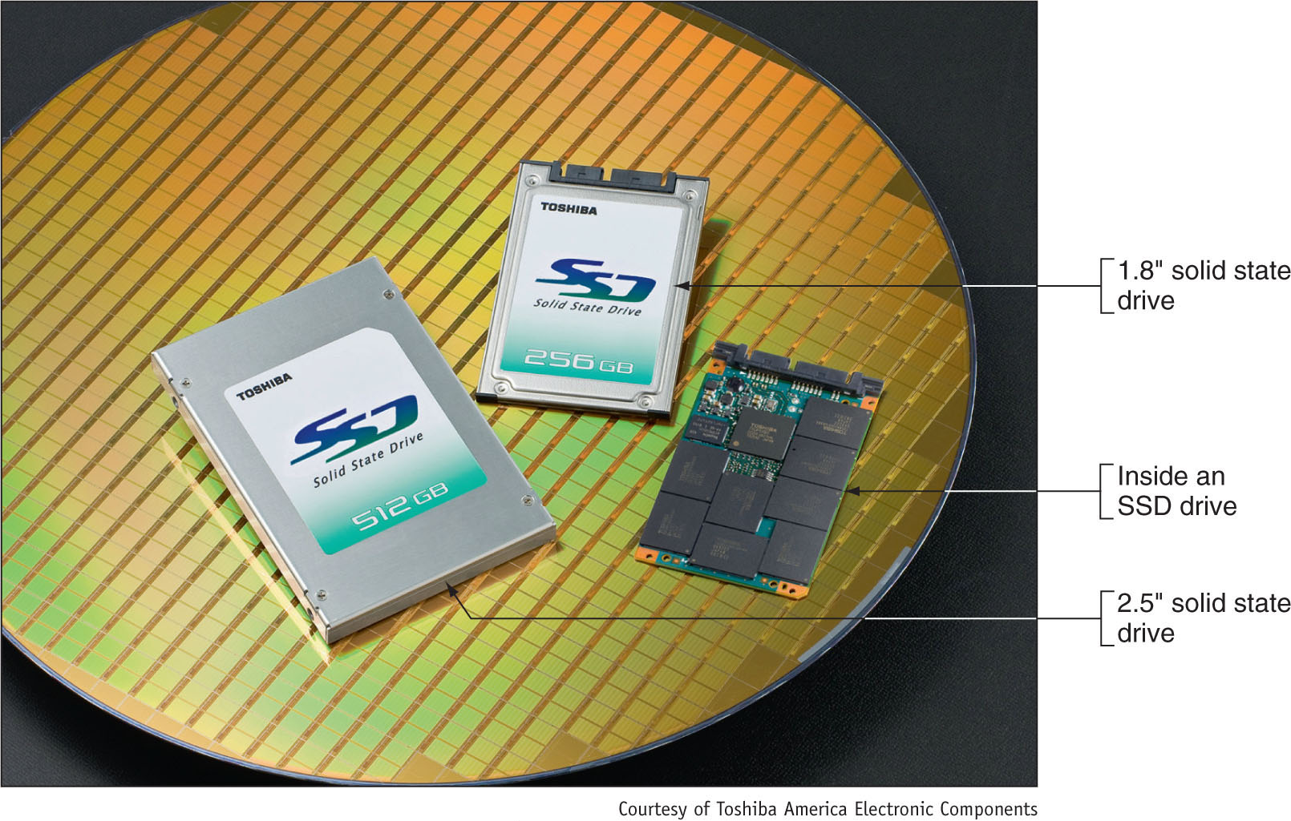
Figure 6-2 Solid-state drives by Toshiba

Slide 7
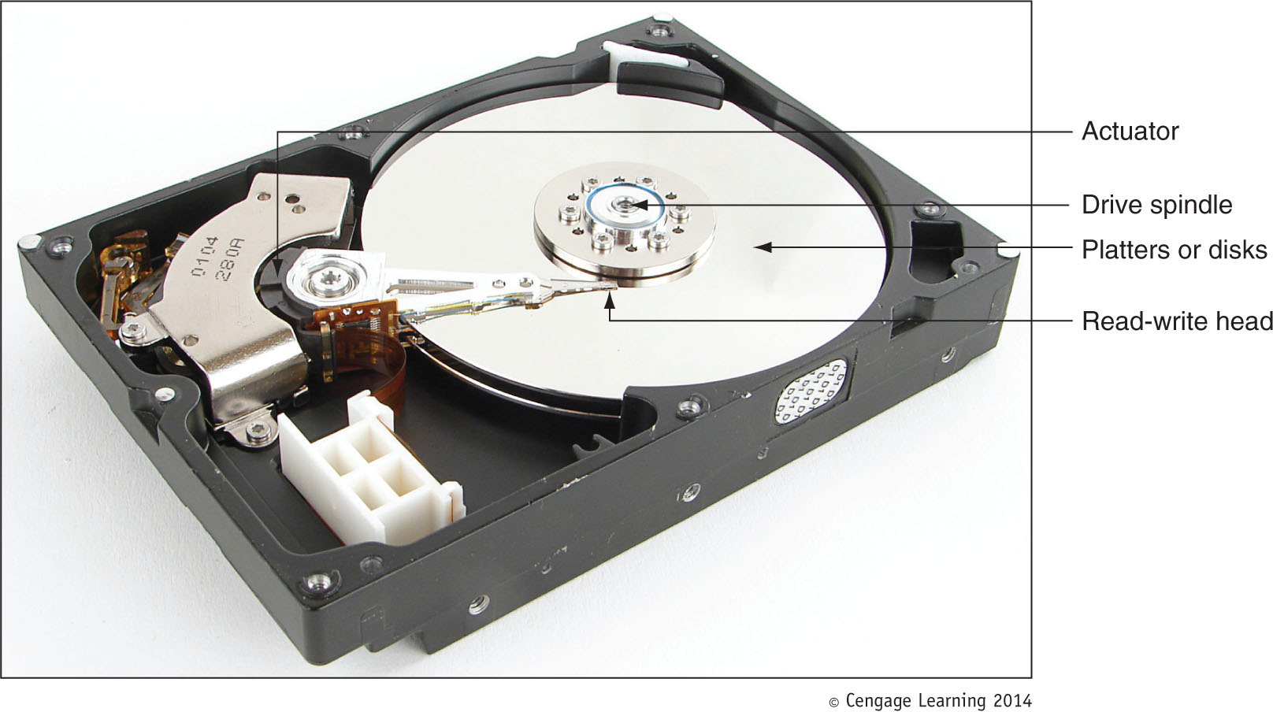
Figure 6-3 Inside a magnetic hard drive

Slide 8
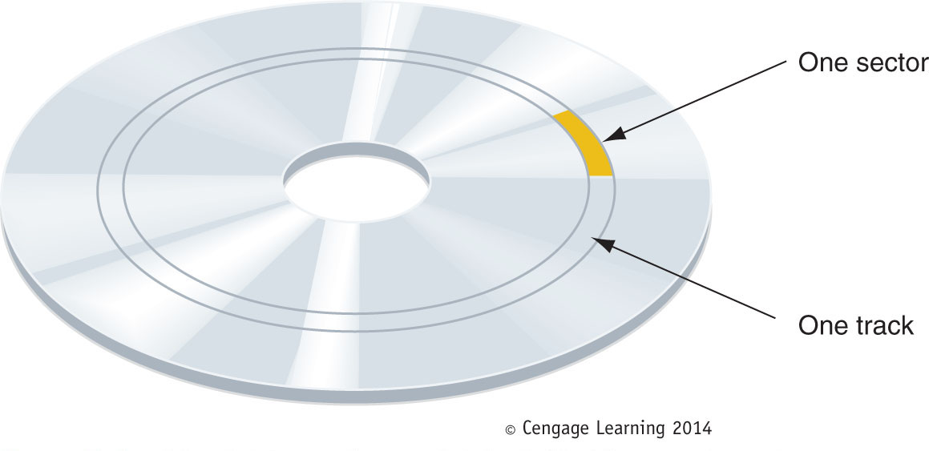
Figure 6-4 A hard drive or floppy disk is divided into tracks and
sectors; several sectors make one cluster

Slide 9
Technologies Used Inside a Hard Drive
Low-level formatting – sector markings are written to the hard drive at the factory
Not the same as high-level formatting performed for Operating System installation
Firmware, BIOS and OS use logical block addressing (LBA) to address all hard drive sectors
Size of each sector + total number of sectors determine drive capacity
S.M.A.R.T – Self-Monitoring Analysis ad Reporting Technology
Used to predict when a drive is likely to fail

Slide 10
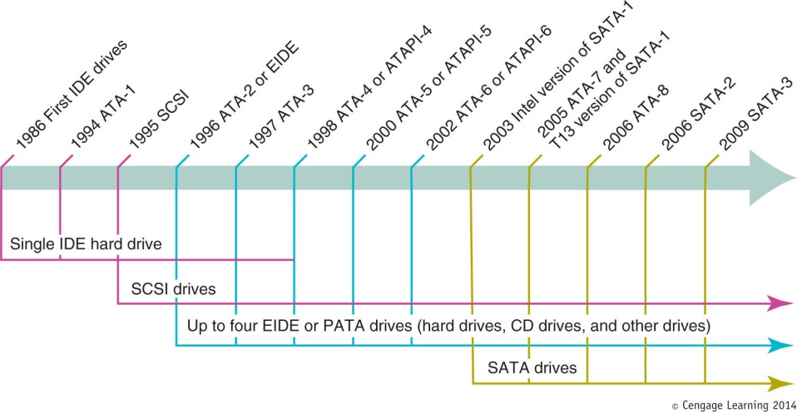
Interface Standards Used By a Hard Drive
Current internal hard drives methods
Parallel ATA (PATA) and Serial ATA (SATA)
External hard drive methods
External SATA (eSATA), SCSI, FireWire, USB, Fibre Channel
Figure 6-5 Timeline of interface standards used by internal drives

Slide 11
Interface Standards Used by a Hard Drive
Interface standards define data speeds and transfer methods with a computer system
Also define types of cables and connectors
Standards
Developed by Technical Committee T13
Published by American National Standards Institute (ANSI)

Slide 12
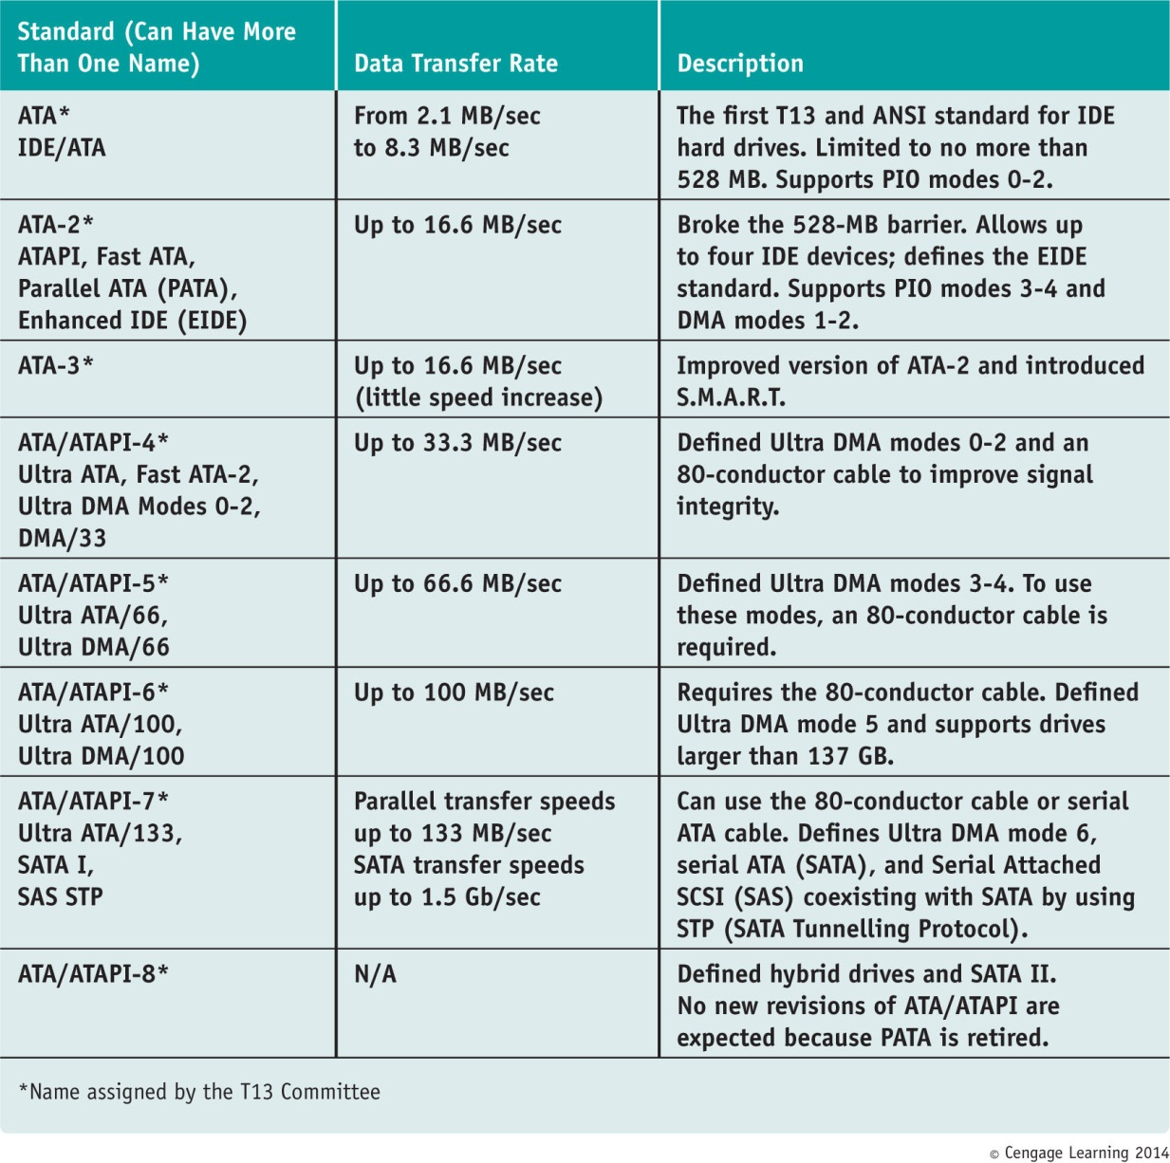
Table 5-1 Summary of ATA interface standards for storage devices

Slide 13
Parallel ATA or EIDE Drive Standards
Parallel ATA or EIDE drive standards or Integrated Drive Electronics (IDE)
Allows one or two IDE connectors on a motherboard
Each use 40-pin data cable
Advanced Technology Attachment Packet Interface
Required by optical drives (e.g., CD or DVD)
Types of PATA ribbon cables
Older cable
40 pins and 40 wires
80-conductor IDE cable
40 pins and 80 wires
Maximum recommended length of either is 18”

Slide 14
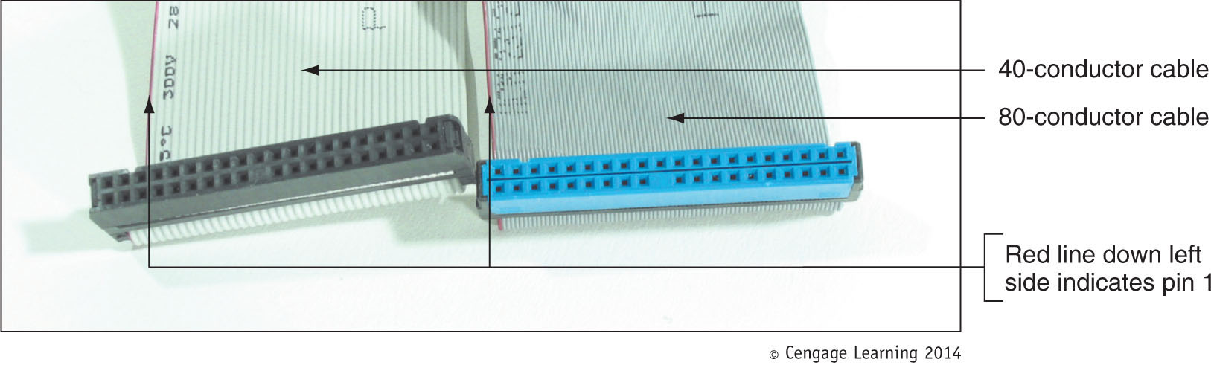
Figure 6-9 In comparing the 80-conductor cable to the 40-conductor cable, note they are
about the same width, but the 80-conductor cable has many more and finer wires

Slide 15
Parallel ATA or EIDE Drive Standards
Transferring data between hard drive and memory
Direct memory access (DMA) transfer mode
Transfers data directly from drive to memory without involving the CPU
Seven DMA modes
Programmed Input/Output (PIO) transfer mode
Involves the CPU, slower than DMA mode
Five PIO modes used by hard drives
Ultra DMA
Data transferred twice for each clock beat, at the beginning and again at the end

Slide 16
Parallel ATA or EIDE Drive Standards
Startup BIOS
Autodetects drive and selects fastest mode that drive and BIOS support
Independent Device Timing
Motherboard chipset feature
Supported by most chipsets today
Allows two hard drives to share same parallel ATA cable but use different standards
Allows two drives to run at different speeds as long as motherboard supports them

Slide 17
Serial ATA Standards
Serial ATA standards
Developed by a consortium of manufacturers
Serial ATA International Organization (SATA-IO)
Uses serial data path rather than traditional parallel data path
Advantages
Faster than PATA interfaces and used by all drive types
Multiple connectors are easy to configure
Supports hot-swapping (hot-plugging)
Connect and disconnect drive while system is running
Internal cable length: up 1 meter
Cable does not hinder airflow (narrower than PATA)

Slide 18
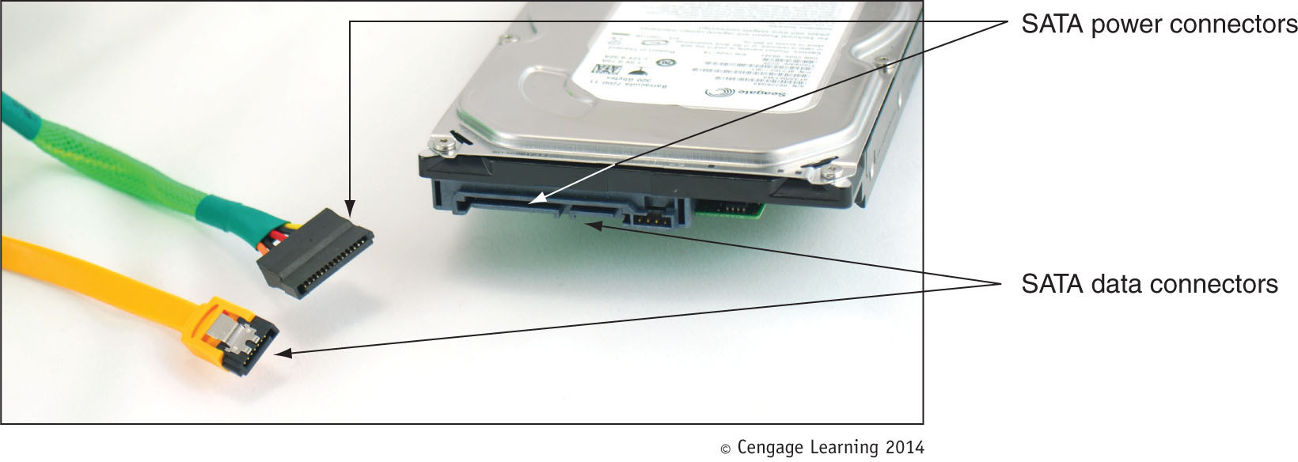
Figure 6-12 A SATA data cable and SATA power cable

Slide 19
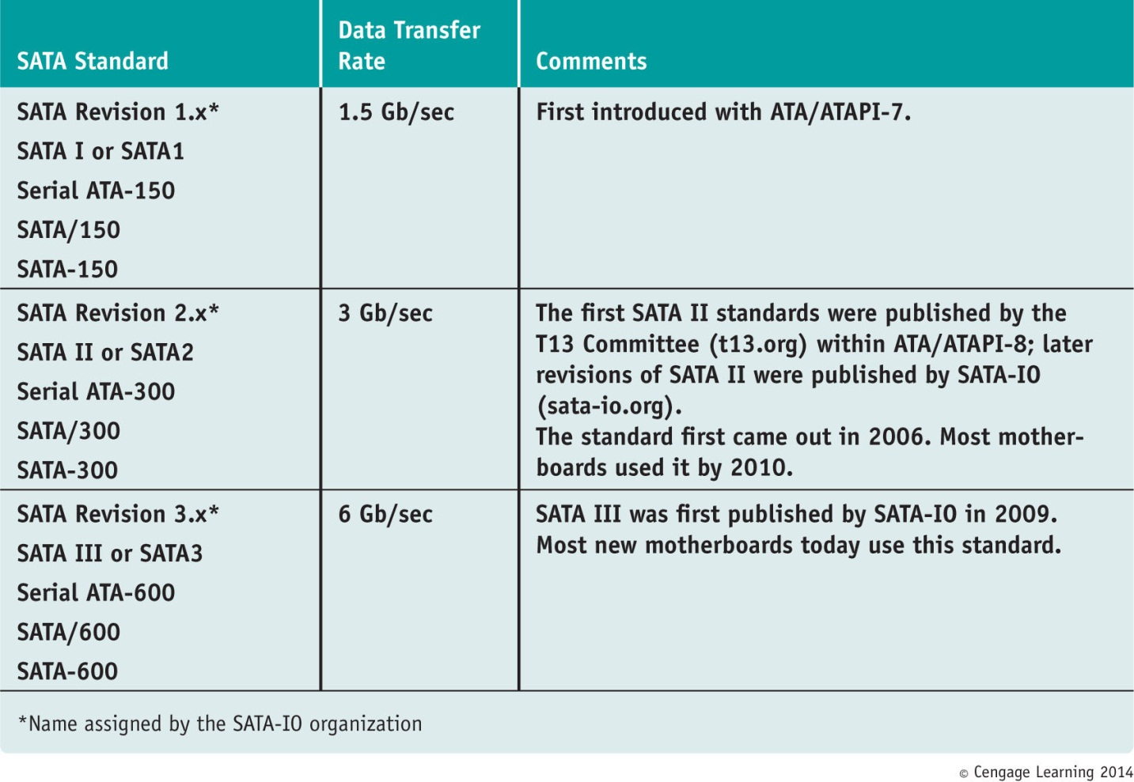
Table 5-2 SATA Standards

Slide 20
Serial ATA Standards
Serial ATA standards (cont’d.)
Motherboard or expansion card can provide external SATA (eSATA) ports for external drives
External SATA (eSATA)
eSATA drives use special external shielded serial ATA cable up to 2 meters long
Purchasing considerations
SATA standards for the drive and motherboard need to match for optimum speed
If no match, system runs at the slower speed

Slide 21
SCSI Technology
Small Computer System Interface standards
Used primarily in servers
Support either 7 or 15 devices (standard dependent)
Provides better performance than ATA standards
SCSI subsystem
SCSI controller types: embedded or host adapter
Host adapter supports internal and external devices
Daisy chain: combination of host adapter and devices
Each device on bus assigned SCSI ID (0 - 15)
A physical device can embed multiple logical devices
Assigned a Logical Unit Number (LUN)

Slide 22
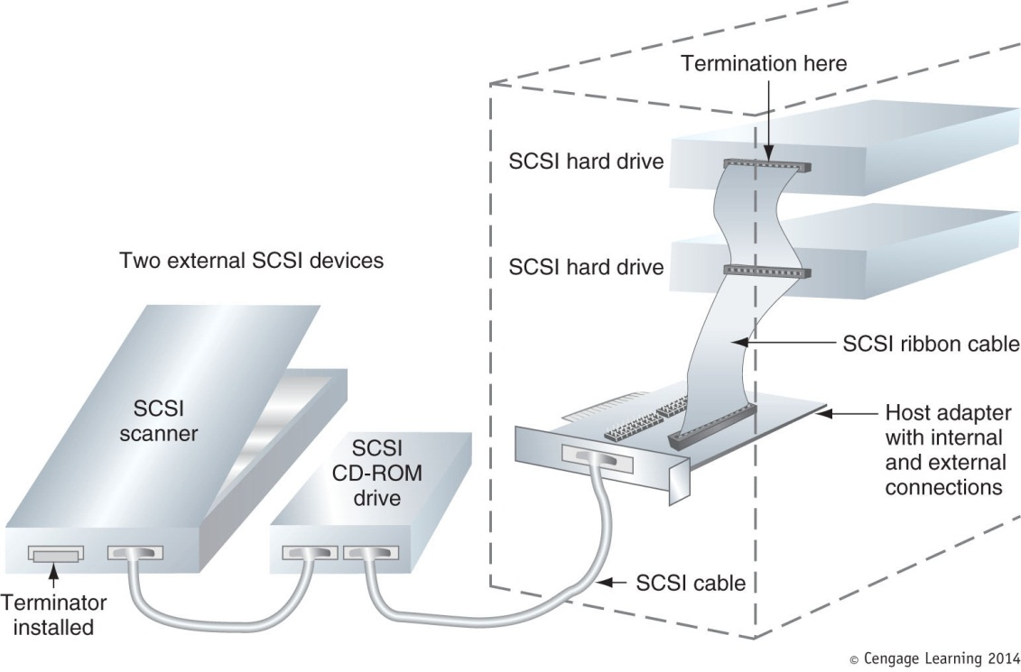
Figure 6-15 Using a SCSI bus, a SCSI host adapter card can support internal and external SCSI devices

Slide 23
SCSI Technology
Terminating resistor
Plugged into last device at end of the chain
Reduces electrical noise or interference on the cable
Categories of SCSI Standards
8-bit (narrow SCSI)
Uses 50-pin SCSI connector (A cable) or 25-pin SCSI connector that looks like a parallel port (DB-25)
16-bit (wide SCSI)
Uses 68-pin SCSI connector (P cable)

Slide 24
SCSI Technology
Various SCSI versions
SCSI-1, SCSI-2, and SCSI-3
Also known as regular SCSI, Fast SCSI, Ultra SCSI
Serial attached SCSI (SAS)
Allows for more than 15 devices on single chain
Uses smaller, longer, round cables
Uses smaller hard drive form factors, larger capacities
Compatible with serial ATA

Slide 25
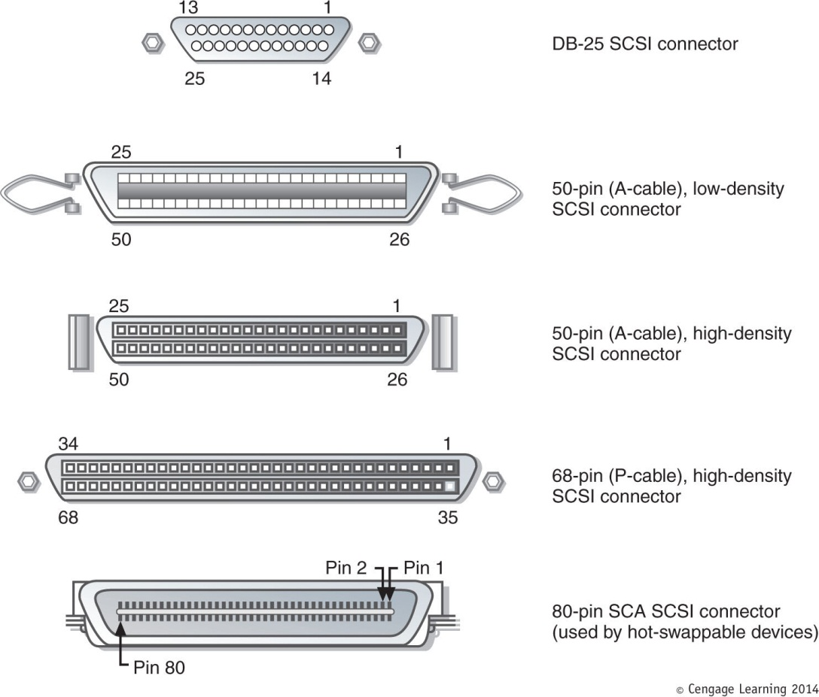
Figure 6-18 The most popular SCSI connectors are 50-pin, A-cable connectors
For narrow SCSI and 68-pin, P-cable connectors for wide SCSI

Slide 26
How to Select and Install Hard Drives
Topics covered
Selecting a hard drive
Installation details for SATA drive, IDE drive
How to install hard drive in a bay too wide for drive
How to set up a RAID system

Slide 27
Selecting a Hard Drive
Hard drive must match OS and motherboard
Need to know what standards the motherboard or controller card providing the drive interface can use
Consult documentation for the board or card
BIOS uses autodetection to prepare the device
Drive capacity and configuration selected
Best possible ATA standard becomes part of configuration

Slide 28
Selecting a Hard Drive
Considerations:
Drive capacity
Today’s desktop hard drives range from 60 GB – 2 TB
Spindle speed
Most common is 7200 RPM
The higher the RPMs, the faster the drive
Interface standard
Use standards the motherboard supports
Cache or buffer size
Ranges from 2 MB to 64 MB

Slide 29
Steps to Install a Serial ATA Drive
Some SATA drives have two power connectors
Choose only one to use
Never install two power cords at the same time
If you have a SATA drive and a PATA connector (or vice versa)
Purchase an adapter to make the drive fit the motherboard connection
Can also purchase a SATA and/or PATA controller card

Slide 30
Steps to Install a Serial ATA Drive
Step 1: Know your starting point
How is your system configured?
Is everything working properly?
Write down what you know about the system
Step 2: Read the documentation and prepare your work area
Read all installation instructions first
Visualize all the steps
Protect against ESD and avoid working on carpet

Slide 31
Steps to Install a Serial ATA Drive
Step 2: Read the documentation and prepare your work area (cont’d)
Handle the drive carefully
Do not touch any exposed circuitry
Drain static electricity from the package and from your body by touching metal for at least 2 seconds
Do not place the drive on the computer case or on a metal table

Slide 32
Steps to Install a Serial ATA Drive
Step 3: Install the drive
Turn off the computer and unplug it
Decide which bay will hold the drive
Slide drive in the bay and secure it (use two screws on both sides)
Use correct motherboard serial ATA connector
Connect a 15-pin SATA or 5-pin Molex power connector from the power supply to the drive
Check all connections and power up the system
Verify drive recognized correctly via BIOS setup

Slide 33
Steps to Install a Serial ATA Drive
Now ready to prepare the hard drive for first use
Boot from Windows setup CD or DVD
Follow directions on the screen to install Windows on the new drive
If installing a second hard drive with Windows installed on first drive use Windows Disk Management utility to partition and format the second drive

Slide 34
Steps to Install a Serial ATA Drive
Installing a drive in a removable bay
Unplug the cage fan from its power source
Turn handle on each locking device counterclockwise to remove it
Slide the bay to the front and out of the case
Insert hard drive in the bay
Use two screws on each side to anchor the drive in the bay
Slide the bay back into the case
Reinstall the locking pins

Slide 35
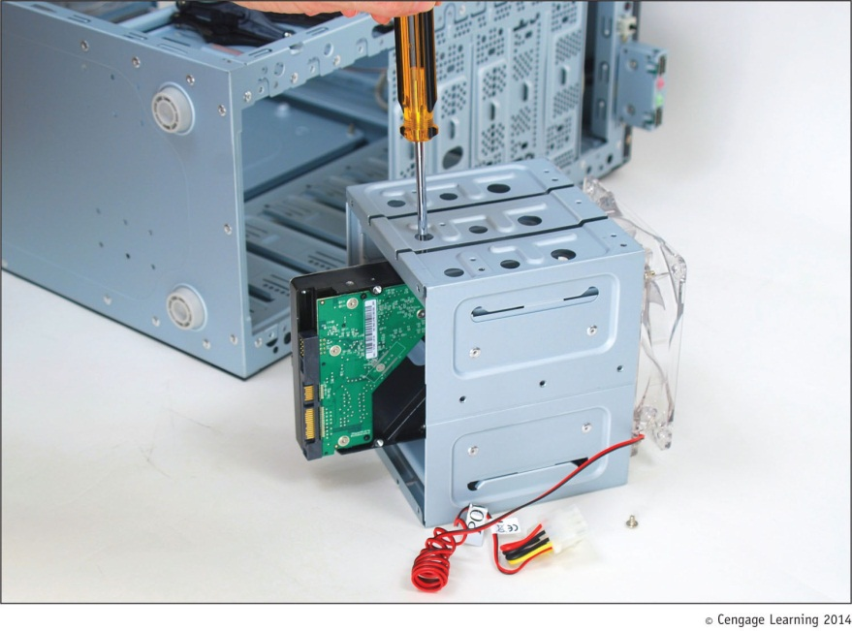
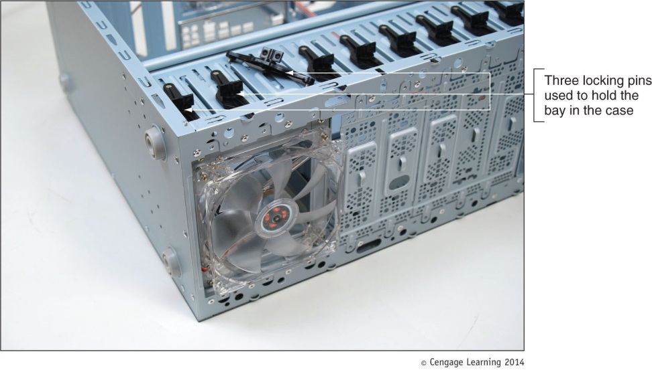
Figure 6-30 The removable bay has a fan in front and is anchored to the case with locking pins
Figure 6-31 Install the hard drive in the bay using two screws on each side of the drive

Slide 36
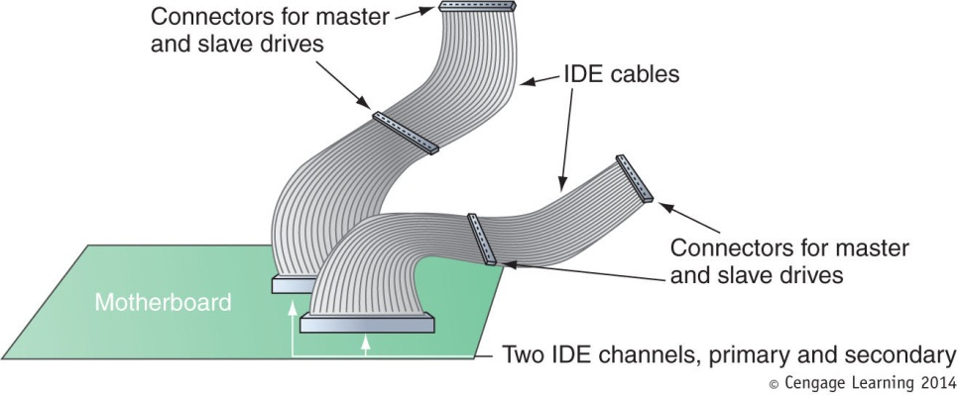
Steps to Configure and Install a Parallel ATA Drive
Configurations for four EIDE devices in a system:
Primary IDE channel, master device
Primary IDE channel, slave device
Secondary IDE channel, master device
Secondary IDE channel, slave device
Figure 6-35 A motherboard supporting PATA has two IDE channels; each can support a master and slave drive using a single EIDE cable

Slide 37
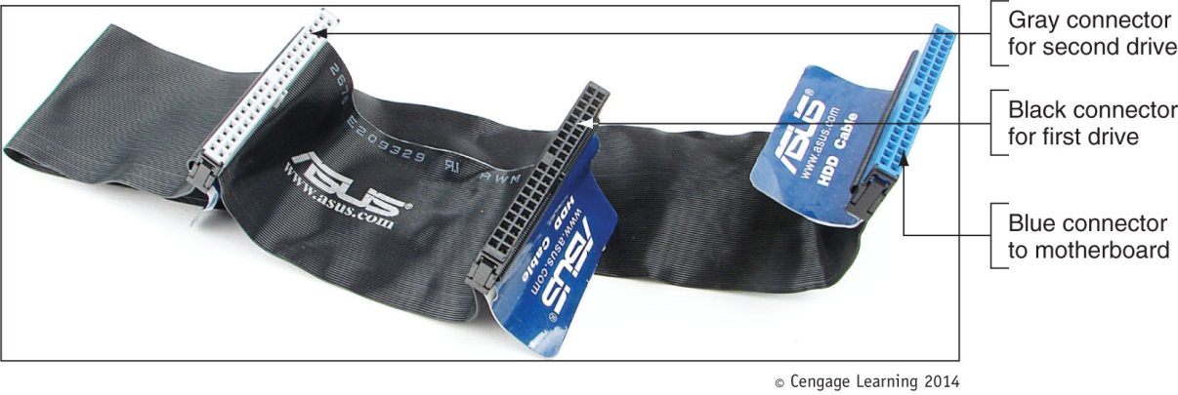
Steps to Configure and Install a Parallel ATA Drive
Master or slave designations are made by:
Setting jumpers or DIP switches
Use special cable-select data cable
Color-coded connectors
Blue end connects to motherboard; black end connects to drive
Figure 6-36 80-conductor cable connectors are color-coded

Slide 38
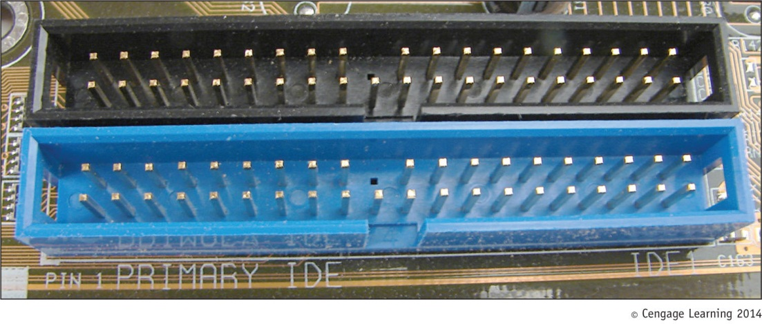
Steps to Configure and Install a Parallel ATA Drive
Motherboard color-coding
Primary channel connector: blue
Secondary channel connector: black
Ensures ATA/66/100/133 hard drive installed on the primary IDE channel
Figure 6-37 The primary IDE channel connector is often color-coded as blue

Slide 39
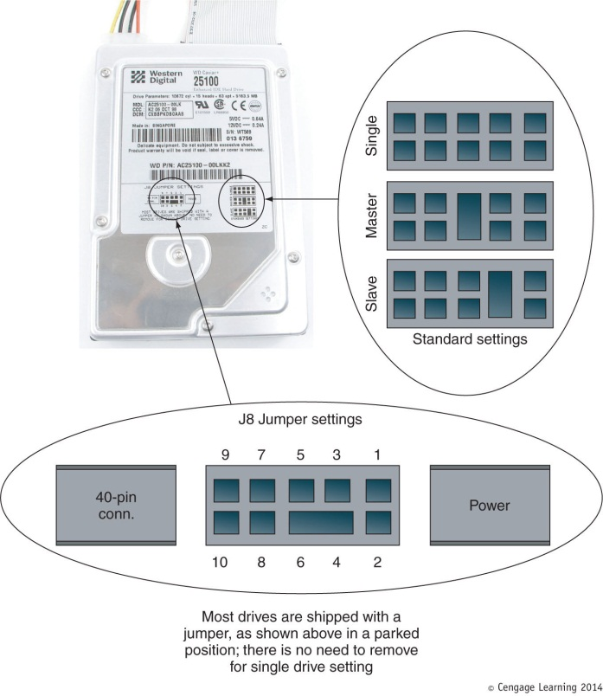
Steps to Configure and Install a Parallel ATA Drive
Step 1: Open case, decide how to configure drives
Step 2: Set the jumpers on the drive
Figure 6-38 A PATA drive most likely will have diagrams of jumper settings for master and slave options printed on the drive housing

Slide 40
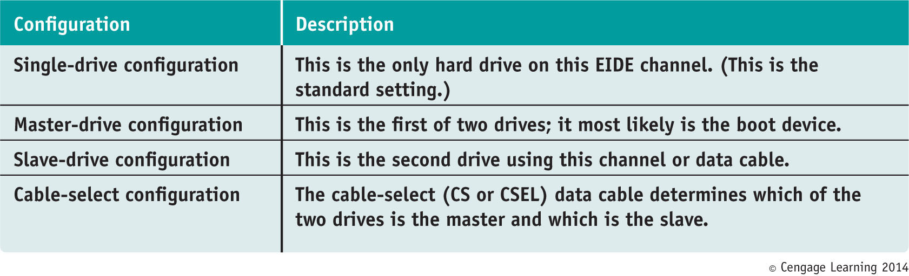
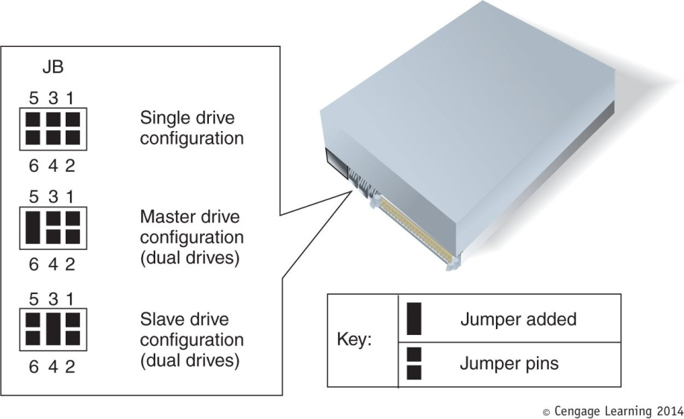
Table 5-4 Jumper settings on a parallel ATA hard drive
Figure 6-39 Jumper settings on a hard drive and their meanings

Slide 41
Steps to Configure and Install a Parallel ATA Drive
Step 3: Mount the drive in the bay
Decide whether to connect data cable before or after inserting bay inside the computer case
Then install drive in bay and connect the cable in whichever order works best
Connect data cable to IDE connector on motherboard
Install a power connection to each drive
Before replacing case cover verify installation

Slide 42
Setting Up Hardware RAID
RAID (Redundant Array of Inexpensive Disks)
Also: Redundant Array of Independent Disks
A technology that configures two or more hard drives to work together as an array of drives
Why use RAID?
To improve fault tolerance by writing two copies of it, each to a different hard drive
To improve performance by writing data to two or more hard drives to that a single drive is not excessively used

Slide 43
Types of RAID
Spanning – sometimes called JBOD (just a bunch of disks)
Uses two hard drives to hold a single Windows volume
When one drive is full, data is written to second drive
RAID 0 – uses two or more physical disks
Writes to physical disks evenly across all disks so that no one disk receives all activity
Windows calls RAID 0 a striped volume

Slide 44
Types of RAID
RAID 1: Mirroring
Duplicates data on one drive to another drive and is used for fault tolerance (mirrored volume)
RAID 5: uses three or more drives
Stripes data across drives and uses parity checking
Data is not duplicated
RAID 10: RAID 1+0 (pronounced RAID one zero)
Combination of RAID 1 and RAID 0
Takes at least 4 disks

Slide 45
How to Implement Hardware RAID
Hardware implementation
Hardware RAID controller or RAID controller card
Motherboard does the work, Windows unaware of hardware RAID implementation
Software implementation uses operating system
Best RAID performance
All hard drives in an array should be identical in brand, size, speed, other features
If Windows installed on a RAID hard drive RAID must be implemented before Windows installed

Slide 46
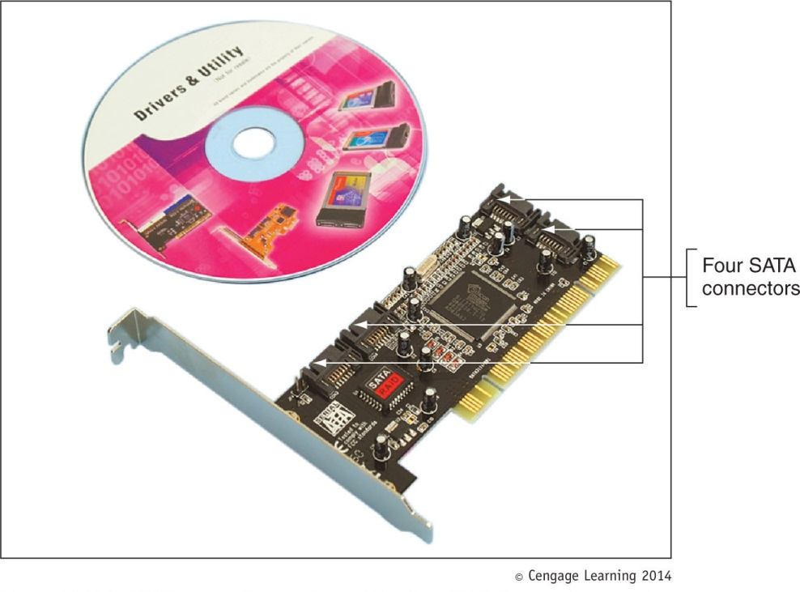
Figure 6-45 RAID controller card provides four SATA internal connectors

Slide 47
How to Implement Hardware Raid
General directions to install RAID 5 array using three matching SATA drives
Install drives in the computer case and connect each to motherboard
Boot system and enter BIOS setup
Verify drives recognized, select option to configure SATA, and select RAID
Reboot the system
Press Ctrl and I to enter the RAID configuration utility
Select option 1 to “Create RAID Volume”
Select RAID 5 (Parity), stripe size value, volume size
Create volume

Slide 48
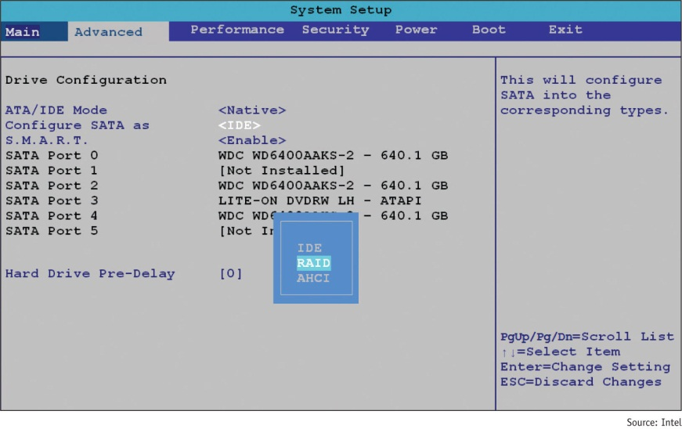
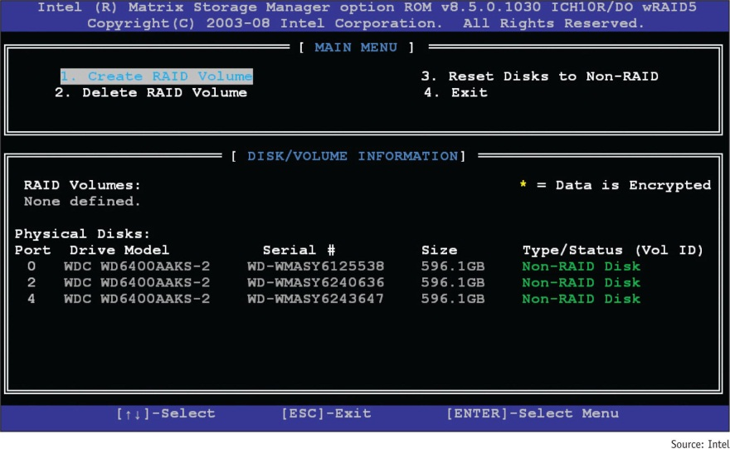
Figure 6-47 Configure SATA ports on the motherboard to enable RAID
Figure 6-48 BIOS utility to configure a RAID array

Slide 49
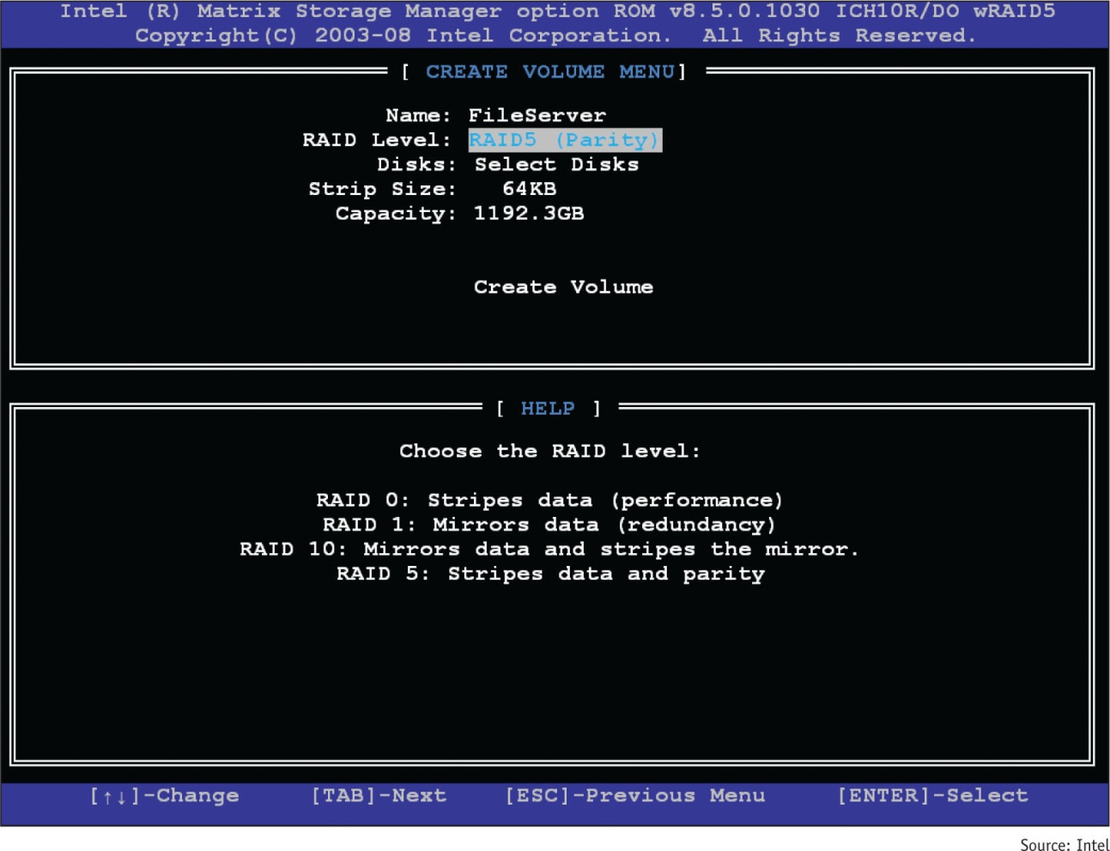
Figure 6-49 Make your choices for the RAID array

Slide 50
About Tape Drives and Floppy Drives
Tape drives can use a SATA, PATA, or SCSI interface
As a technician, you may be called on to support old floppy drives
Both tape drives and floppy drives are covered in this section

Slide 51
Installing Tape Drives and Selecting Tape Media
Tapes drives – an inexpensive way of backing up a hard drive
WORM (write once read many) – assures data written will not be deleted or overwritten
Disadvantage: data is stored by sequential access
To read data from anywhere on the tape, you must start at the beginning of the tape and read until you find the data you want
Slow and inconvenient

Slide 52
Installing Tape Drives and Selecting Tape Media
Two kinds of tapes:
Full-sized data cartridges
Minicartridges
More popular because their drives can fit into a standard 3-inch drive bay of a PC case
When selecting a tape drive, consider:
How many and what type of cartridges the drive can use
How it interfaces with the computer
External drives can connect to a computer using a USB, FireWire, SCSI, SAS, or eSATA port

Slide 53
Installing a Floppy Drive
Floppy disk drive (FDD)
3 ½” floppy disk format
Holds only 1.44 MB of data
Floppy drive subsystem
Floppy drive, ribbon cable, power cable, connections
Today’s floppy drive cables have a connector at each end to accommodate a single drive
Older cables have an extra connector or two in the middle of the cable for a second floppy drive

Slide 54
Installing a Floppy Drive
Install the drive in a bay as you would a hard drive
Connect floppy drive data cable and power cord to motherboard
If you connect the cable the wrong way, the drive light will stay lit and will not work
Be sure the end of the cable with the twist connects to the drive and the other end to the motherboard
Replace cover, turn on computer, and enter BIOS setup to verify installation

Slide 55
Summary
A hard disk drive (HDD) comes in 3.5” for desktop and 2.5” for laptops
A hard drive can be magnetic, solid-state, or hybrid
Most hard drives use the ATA interface standards
Two ATA categories are parallel ATA and serial ATA
S.M.A.R.T is a self-monitoring technology whereby the BIOS monitors the health of a hard drive
SCSI interface standards include narrow and wide SCSI and can use a variety of cables and connectors

Slide 56
Summary
When selecting a hard drive, consider storage capacity, technology, spindle speed, interface standard, and buffer size
SATA drives require no configuration and are installed using a power cord and a data cable
PATA drives require you to set a jumper to determine if the drive will be the single drive, master, or slave on a single cable
RAID technology uses an array of hard drives to provide fault tolerance and/or improvement in performance

Slide 57
Summary
Hardware RAID is implemented using the motherboard BIOS or a RAID controller card
Software RAID is implemented in Windows
Tape drives are an inexpensive way to back up an entire hard drive or portions of it
Today’s floppy disks are 3.5” high-density disks that hold 1.44 MB of data
After a floppy disk drive is installed, you must configure the drive in BIOS setup

