Slide 1

A+ Guide to Managing & Maintaining Your PC, 8th Edition
Chapter 7
Installing Windows

Slide 2
Objectives
How to plan a Windows installation
How to install Windows 7
What to do after the installation
Learn about special concerns when installing Windows in a large enterprise

Slide 3
How to Plan a Windows Installation
Situations requiring a Windows installation
New hard drive
Existing Windows version corrupted
Operating System upgrade

Slide 4
Choose the Edition, License, and Version of Windows 7
Editions of Windows 7
Windows 7 Starter: intended to be used on notebooks or in developing nations
Only comes in the 32-bit version
Windows 7 Home Basic: has limited features and is available only in underdeveloped countries
Windows 7 Home Premium: similar to Home Basic but includes additional features
Windows 7 Professional: intended for business users
Can purchase multiple site licenses

Slide 5
Choose the Edition, License, and Version of Windows 7
Editions of Windows 7 (continued)
Windows 7 Enterprise: similar to Windows 7 Professional but includes additional features
Does not include Windows DVD Maker
Multiple site licenses are available
Windows 7 Ultimate: includes every Windows 7 feature
Multiple site licenses are not available

Slide 6
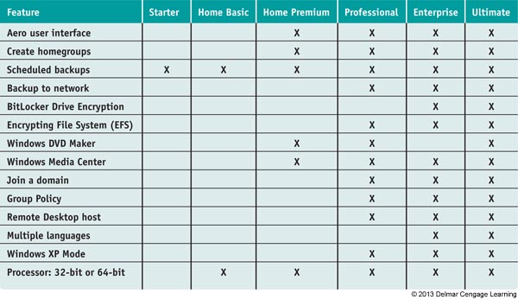
Table 2-1 Windows 7 editions and their features

Slide 7
Choose the Edition, License, and Version of Windows 7
Purchase options
Retail
Costs less if you purchase a license to upgrade from Vista or XP
Must purchase a Windows 7 full license for any computer that has an OS other than Vista or XP
Original Equipment Manufacturer (OEM)
Costs less but can only be installed on a new PC for resale

Slide 8
Choose the Edition, License, and Version of Windows 7
32-bit or 64-bit Versions
64-bit installation usually performs better than 32-bit
Can also support 64-bit applications, which run faster
64-bit installations of Windows require 64-bit device drivers

Slide 9
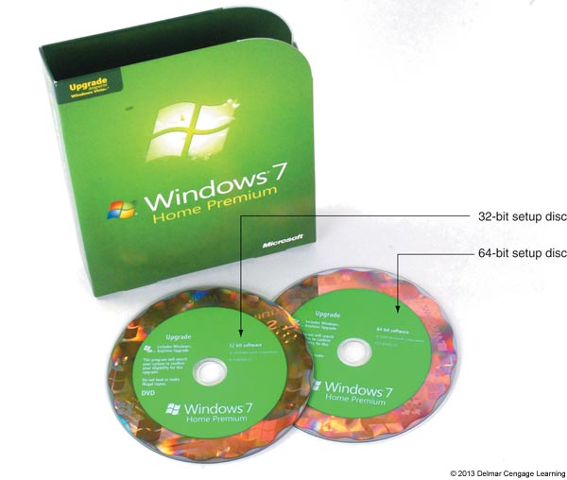
Figure 7-1 A Windows 7 DVD contains either a 32-bit version
or a 64-bit version of Windows

Slide 10
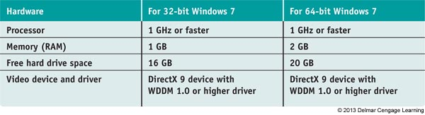
Verify Your System Qualifies for Windows 7
Download, install, and run the Windows 7 Upgrade Advisor to find out if a system can be upgraded
Table 2-3 Minimum and recommended hardware requirements for Windows 7

Slide 11
Verify Your System Qualifies for Windows 7
To understand if a system qualifies for Windows 7, it helps to understand how Windows relates to hardware by using device drivers and system BIOS
When system is turned on:
The motherboard BIOS manages essential devices such as keyboard, monitor, and hard drive
Motherboard BIOS is contained on a chip on the motherboard

Slide 12
Verify Your System Qualifies for Windows 7
Motherboard BIOS provides three functions:
System BIOS contains instructions for running hardware devices before an OS is started
Startup BIOS starts the computer and finds a boot device that contains an OS
Then turns the startup process over to the OS
Setup BIOS is used to change motherboard settings
Can use it to enable or disable a device on the motherboard, change data and time, or select the order of boot devices for startup BIOS to search

Slide 13
Verify Your System Qualifies for Windows 7
Device drivers: small programs stored on the hard drive that tell the computer how to communicate with a specific hardware device
32-bit OS requires 32-bit drivers and 64-bit OS requires 64-bit drivers
Device drivers can be downloaded from the manufacturer’s website or found on installation DVDs
When installing, be sure to have Windows 7 device drivers for all critical devices
Windows XP Mode: environment installed in Windows 7 that supports older applications

Slide 14
Installations with Special Considerations
When the computer does not have a DVD drive
Download Windows 7 from Microsoft’s website
Assumes the computer already has a working OS
Use an external DVD drive
If PC does not have an OS installed, you must change boot order in BIOS setup
Copy the installation files to a USB flash drive
Use a DVD drive on another computer
Share the DVD drive and install from there
Assumes the computer already has a working OS

Slide 15
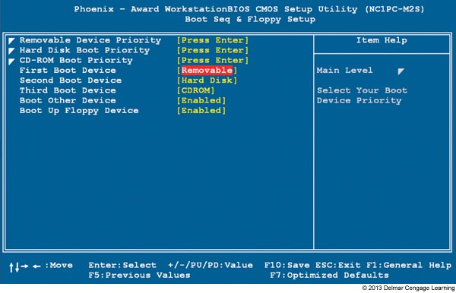
Figure 7-6 Set the boot order in BIOS setup

Slide 16
Installations with Special Considerations
Factory recovery partition
Some brand-name computers have hidden recovery partition
Contains a utility to create a recovery CD
Recovery CD must be created before drive failure
To access hidden partition, press a key during startup

Slide 17
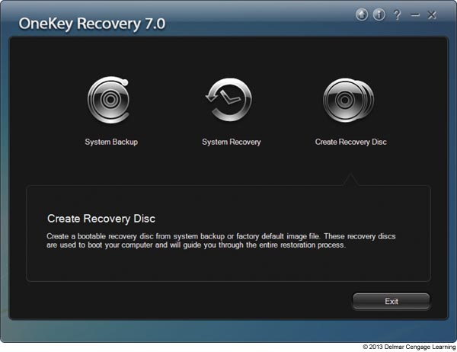
Figure 7-7 Use the recovery utility on this laptop to create DVDs that can
be used to recover the system in the event the hard drive fails

Slide 18
Installations with Special Considerations
Installation in a virtual computer
Virtual computer or virtual machine
Software simulating hardware of a physical computer
Allows installation and running of multiple operating systems at the same time on a PC
Reason to use a virtual machine
Train users, run legacy software, and support multiple operating systems
Can capture screen shots of boot process in a virtual machine

Slide 19
Installations with Special Considerations
Popular virtual machine programs for Windows:
Virtual PC by Microsoft, VirtualBox by Oracle, and VMware by VMware INC.
Windows XP Mode
Windows XP installation runs under Virtual PC
Can be installed on a Windows 7 Professional, Enterprise, or Ultimate computer

Slide 20
Choose the Type of Installation: In-Place Upgrade, Clean Install, or Dual Boot
If hard drive is new, a clean install must be installed
If an OS is already installed, you have three options
Clean install: overwrites the existing OS and applications
Advantage: get a fresh start
In-place upgrade: a Windows installation launched from the Windows desktop and keeps user settings and installed applications from the old OS
Requires qualifying OSs called upgrade paths
Dual boot: Can install Windows in a second partition
Need at least two partitions or a second hard drive

Slide 21
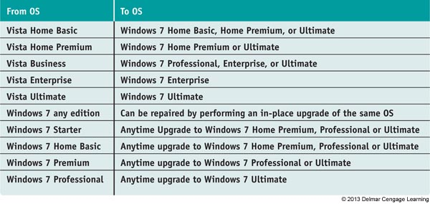
Table 2-4 In-place upgrade paths to Windows 7

Slide 22
Choose the Type of Installation: In-Place Upgrade, Clean Install, or Dual Boot
Other tips to keep in mind:
A 64-bit version of Windows can only be upgraded to a 64-bit OS
A 32-bit OS can only be upgraded to a 32-bit OS
If you want to install a 64-bit version of Windows over a 32-bit OS, a clean install must be performed
Can only upgrade Windows Vista to Windows 7 after Vista Service Pack 1 or later has been installed

Slide 23
Understand the Choices You’ll Make During the Installation
Size of the Windows Partition
Each partition formatted with a file system and assigned a drive letter
Called a volume
decide whether to use all the available space on the drive
Reasons to use multiple volumes
Dual-boot system
Organize data on one drive and OS on the other
Windows can have up to four partitions

Slide 24
Understand the Choices You’ll Make During the Installation
Administrator Account
Every Windows computer has two local administrator accounts:
During installation – an account name and password can be entered to create a local user account that is assigned administrator privileges
A built-in administrator account is created by default (named Administrator)

Slide 25
Understand the Choices You’ll Make During the Installation
Network Configuration
Homegroup – each computer shares files, folders, libraries, and printers with other computers in the homegroup
Provides less security than a workgroup
new to Windows 7 (cannot be used with earlier versions)
Workgroup – each computer maintains a list of users and their rights on that particular PC
The computer allows a user access to local resources based on this file

Slide 26
Understand the Choices You’ll Make During the Installation
Network Configuration
Domain – a logical group of networked computers that share a centralized directory database of user account information and security for the entire group of computers
A type of client/server network
Active Directory: the directory database used by Windows Servers
During installation, you will need to know the domain name and computer name to use so that you can join the domain

Slide 27
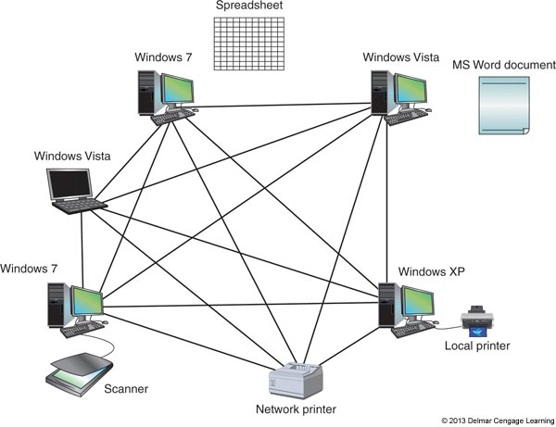
Figure 7-12 A Windows workgroup is a type of peer-to-peer network where no single computer controls the network and each computer controls its own resources.

Slide 28
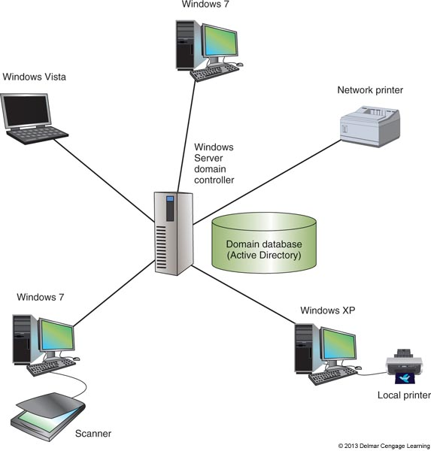
Figure 7-13 A Windows domain is a type of client/server network where security on each PC or other device is controlled by a centralized database on a domain controller

Slide 29
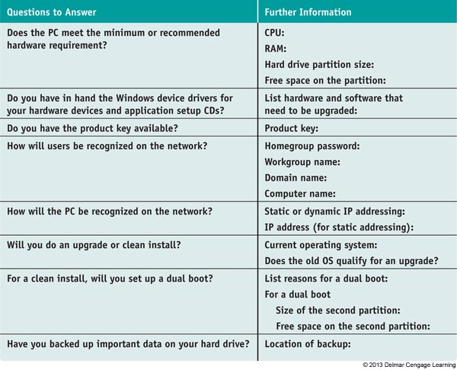
Table 2-5 Checklist to complete before installing Windows

Slide 30
Final Checklist Before Beginning the Installation
Verify all application software DVDs and device drivers are available
Back up all important data
If not reformatting the drive, run antivirus software to ensure the drive is free from malware
Use BIOS setup to verify the boot sequence needed for installation
Also disable any virus protection setting that might prevent the boot area of the drive from being altered
For laptops, use AC adapter so you don’t run out of battery

Slide 31
Installing Windows 7
Topics covered
Learn how to install Windows 7 as an:
In-place upgrade
Clean install
Dual boot
Make sure you document what you did during the installation
Documentation might be helpful for future maintenance and troubleshooting

Slide 32
Steps to Performing a Windows 7 In-Place Upgrade
Steps to upgrade from Vista to Windows 7
1. Close applications
2. Launch Windows 7 Setup
Click Install or Run setup.exe
3. Check compatibility if you have not already done so
4. Allow setup program to download updates
5. Accept license agreement
6. Select Upgrade for type of installation
7. Setup will check for compatibility issues and will verify the upgrade path is valid

Slide 33
Steps to Performing a Windows 7 In-Place Upgrade
Steps to upgrade from Vista to Windows 7 (cont.)
8. PC might reboot several times, will then ask for the product key to be entered
9. You will be asked how to handle updates
It is suggested to Use recommended settings
10. Verify the time and date settings are correct
11. Select the network location
12. Different options may appear at this step, depending on what you did in Step 11
13. Windows Update downloads and installs updates and the system restarts

Slide 34
Steps to Perform a Clean Install or Dual Boot
If no OS is installed on PC:
boot from Windows 7 DVD and choose Custom installation
If an OS is already installed on PC:
Begin the installation from the Windows Desktop or by booting from Windows 7 DVD
If installing a 64-bit OS when a 32-bit OS is already installed:
Must begin the installation by booting from the DVD

Slide 35
Steps to Perform a Clean Install or Dual Boot
1. When booting directly from Windows 7 DVD
Select language and click Next
2. Click Install Now
3. Accept license agreement
4. Choose Custom (advanced) for type of installation
5. List of partitions displayed
For a clean install, make selection and click Next
If performing a dual boot and need to create a partition, click Drive options (advanced)
Setup steps you through creating a new partition

Slide 36
Steps to Perform a Clean Install or Dual Boot
6. Windows will ask for a username and computer name.
Click Next to get to the screen where you will enter a password
7. Installation will now continue in the same way as an upgrade

Slide 37
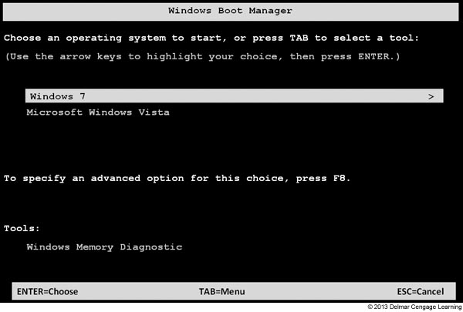
Steps to Perform a Clean Install or Dual Boot
Boot with a dual boot
Boot loader menu automatically appears
Provides a selection for an operating system
Figure 7-28 Boot loader menu in a dual-boot environment

Slide 38
Use the Windows 7 Upgrade DVD on a New Hard Drive
Sometimes you might need to use the upgrade DVD to install Windows 7 when replacing a hard drive
Setup expects that an old OS is installed if you use the upgrade DVD
Solutions:
Reinstall Vista or Windows XP and install Windows 7 as an upgrade
Install Windows 7 twice
Use Windows 7 upgrade DVD to perform a clean install
Do not enter product key
Install Windows 7 again but this time as an upgrade

Slide 39
What to Do After A Windows Installation
Verify network access
Activate Windows
Install Windows updates and service packs
Verify automatic updates are set as you want them
Install hardware
Install applications, including antivirus software
Set up user accounts and transfer (or restore) user data
Turn Windows features on or off

Slide 40
Verify That You Have Network Access
To join the computer to a domain:
Right-click Computer and select Properties to bring up the System window
Scroll down to Computer name, domain and workgroup settings – Click Change settings
Click Network ID and follow directions on-screen
If not connecting to a network:
Use the Network and Sharing Center to try to resolve the problem

Slide 41
Activate Windows 7
Microsoft requires product activation
Ensures a valid Windows license has been purchased
You have 30 days after installation to activate
To activate Windows 7:
Click the Start button and enter activate in the Search box
Windows Activation window opens
Click Activate Windows online now

Slide 42
Install Windows Updates and Service Packs
To download and apply updates:
Click Start, All Programs, and Windows Update
Windows Update window will appear and will display a message if updates are available
Click important updates to get a list of updates available
Select the ones you want to install
May not always list the ones needed the first time
May take 2-3 passes to get the PC entirely up to date

Slide 43
Configure Automatic Updates
During installation, you chose how you want to handle Windows updates
To verify or change this setting:
Click Change settings in the left pane of the Windows Update window
Recommended setting is to allow Windows to automatically download and install updates daily

Slide 44
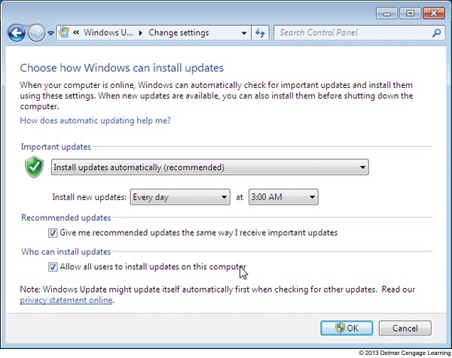
Figure 7-34 Manage how and when Windows is updated

Slide 45
Install Hardware
Devices that were not automatically installed during the installation must be installed
As you install each device, reboot and verify operation before moving on to next device
You may need to:
Install drivers for the motherboard
Install drivers that cam with any video cards
Install the printer
For other hardware devices, read and follow manufacturer directions

Slide 46
Install Hardware
Device Manager: the primary Windows tool for managing hardware
You can disable or enable a device, update its drivers, uninstall a device, and undo a driver update
Problems with Legacy Devices
If the driver does not load correctly or gives errors, try searching the Internet for a Windows 7 driver
If you don’t find one, run Vista driver installation program in compatibility mode

Slide 47
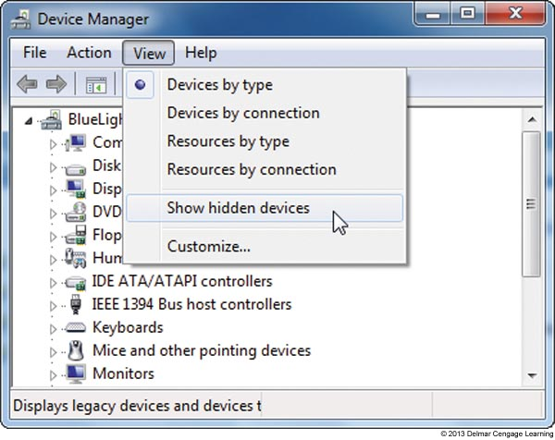
Figure 7-41 By default, Windows does not display legacy drivers in Device
Manager; you show these hidden devices by using the View menu

Slide 48
Install Applications
Follow installation instructions for each application that needs to be installed
Be sure to install antivirus software
After an application is installed, check to see if any updates are available for the application
If you need to uninstall an application, open Control Panel and click Uninstall a program

Slide 49
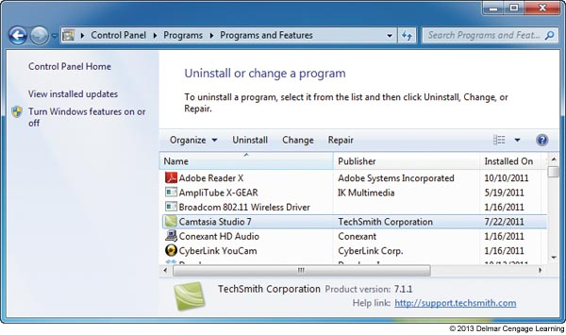
Figure 7-46 Select a program from the list to view your
options to manage the software

Slide 50
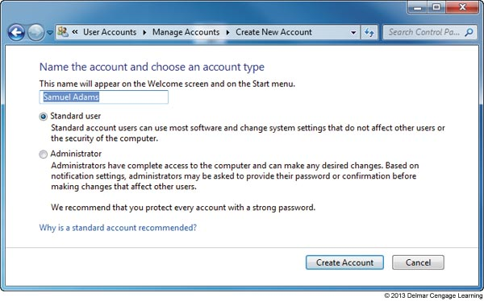
Set Up User Accounts and Transfer User Data
Use Control Panel to add or remove user accounts
Figure 7-47 Decide the privilege level for the new account

Slide 51
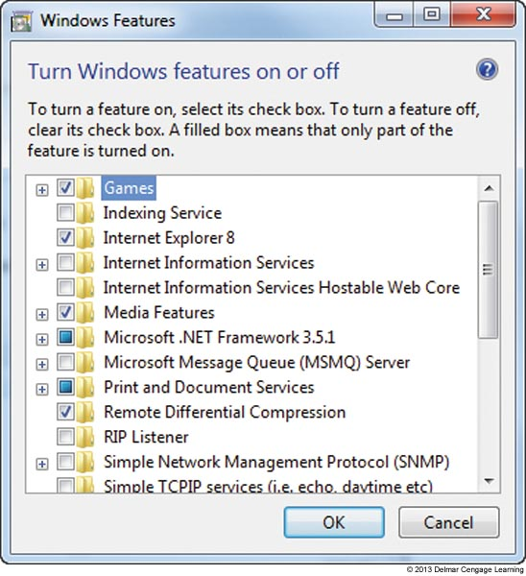
Turn Windows 7 Features On or Off
Save on system resources by turning off Windows features you will not use
Figure 7-48 Turn Windows features
on or off

Slide 52
Deployment Strategies for Windows 7
Deployment strategy: a procedure to install Windows, device drivers, and applications on a computer
Can include the process to transfer user settings, application settings, and user data files from an old installation to the new installation
A deployment strategy is essential when supporting large corporations with hundreds of computers
Microsoft suggest four deployment strategies based on the number of computers to be deployed

Slide 53
Deployment Strategies for Windows 7
High-Touch with Retail Media (recommended for fewer than 100 computers)
All work is done by a technician sitting at the computer
Copy setup files on setup DVD to a file server and share the folder
Server used in this way is called a distribution server
Use Windows 7/Vista Easy Transfer to transfer user settings and user data
User State Migration Tool (USMT) – command-line tool that can be used in a domain environment

Slide 54
Deployment Strategies for Windows 7
High-Touch with Standard Image (recommended for 100-200 computers)
Drive-imaging software is used to clone the entire hard drive to another bootable media (process is called drive imaging or disk cloning)
Can use tools in Windows Automated Installation Kit (AIK) or third-party software
Installing a standard image on another computer is called image deployment
Takes longer for initial setup but les time to install on each computer

Slide 55
Deployment Strategies for Windows 7
Lite-Touch High Volume Deployment (recommended for 200-500 computers)
Uses a deployment server on the network to serve up the installation after a technician starts the process
Files in installation include Windows, device drivers and applications (called the distribution share)
Technicians boot the computer to Windows PE
Windows Preinstallation Environment is a minimum OS
Can be installed on a USB drive
Responses to prompts are stored in an answer file so a technician is not required to sit through installation

Slide 56
Deployment Strategies for Windows 7
Lite-Touch High Volume Deployment (continued)
USMT is then used to transfer user settings, application settings, and user data
Microsoft Assessment and Planning (MAP) Toolkit
Can be used to query hundreds of computers in a single scan
Automatically examines hardware and applications on each computer to verify compatibility with Windows 7

Slide 57
Deployment Strategies for Windows 7
Zero-Touch, High-Volume Deployment (recommended for more than 500 computers)
Most difficult to set up and requires complex tools
Uses a push automation
A server automatically pushes the installation to a computer when a user is not likely to be sitting at it
Automated with no user intervention required
Can turn on a computer that is turned off and even works on when no OS is installed

Slide 58
Using the USMT Software
General steps to use USMT:
Download and install AIK software on a technician’s computer
Copy the USMT program files from technician’s computer to source computer
Run the scanstate command on source to copy user files and settings to a file server
Install Windows 7, device drivers, and applications on the destination computer
Run the loadstate command to apply user files and settings from the file server to the destination computer

Slide 59
Summary
Planning requires many decisions
Purchase options, versions, 32-bit or 64-bit, hardware requirements, installation method, and network issues (user accounts, workgroup vs. domain)
Windows 7 installation choices
Upgrade, clean install, or dual boot
Also need to know how to install Windows on a new hard drive using an upgrade license
Vista installation works the same as a Windows 7 installation

Slide 60
Summary
After installation
Verify network access, activate Windows, install any Windows updates or service packs, verify automatic updates is configured correctly, install hardware and applications, create user accounts, and turn Windows features on or off
When working in a Large Enterprise
Four deployment strategies are recommended
High-touch with retail media, high-touch with a standard image, lite-touch with high volume, and zero-touch with high volume

