Slide 1

A+ Guide to Hardware: Managing, Maintaining, and Troubleshooting, Sixth Edition
Chapter 9
Satisfying Customer Needs

Slide 2
Objectives
Learn about some job roles and responsibilities of those who sell, fix, or support personal computers
Learn what customers want and expect beyond your technical abilities
Learn how to interact with customers when selling, servicing, and supporting personal computers
Learn how to customize a computer system to meet customer needs

Slide 3
Job Roles and Responsibilities
PC support technician
Works on site, works closely with users and is responsible for ongoing PC maintenance
Prepare for a problem by performing routine preventative maintenance, keeping good records, and making backups of data
PC service technician
Goes to a customer site in response to a service call
Usually not responsible for ongoing maintenance but do interact with users
Also known as computer repair technician or field service technician

Slide 4
Job Roles and Responsibilities
Technical retail associate
Work in a consulting role to advise customers about the best technology to meet their needs, how to apply the technology, and maybe how to configure it
Bench technician
Works in a lab environment, might not interact with users, and is not permanently responsible for them
Help-desk technician
Provides telephone or online support
Remote location puts them at a disadvantage

Slide 5
Certification and Professional Organizations
Certification and advanced degrees:
Proves competence and achievement
Improves job opportunities
Creates a higher level of customer confidence
Qualifies for promotions and other training or degrees
Computing Technology Industry Associate (CompTIA) – most significant certifying organization
A+ Certification – first choice for certification as a PC technician
Microsoft and Cisco offer vendor specific certifications to support their products

Slide 6
Record-Keeping and Information Tools
Resources, records, and information tools:
The specific application, OS, or hardware you support must be available to you to test, observe, and study
Use to re-create a customer’s problem when possible
Digital or printed copy of the same documentation the user sees
Any technical documentation available from manufacturer (beyond user manuals)
Online help targeted to field technicians and help-desk technicians

Slide 7
Record-Keeping and Information Tools
Resources, records, and information tools (cont’d):
Expert system – software that is designed and written to help solve problems
Poses questions about a problem to be answered by technician or customer
Responses trigger more questions until solution is suggested
Help desk tracking software – allows you to create, edit, and close calls for help (tickets)

Slide 8
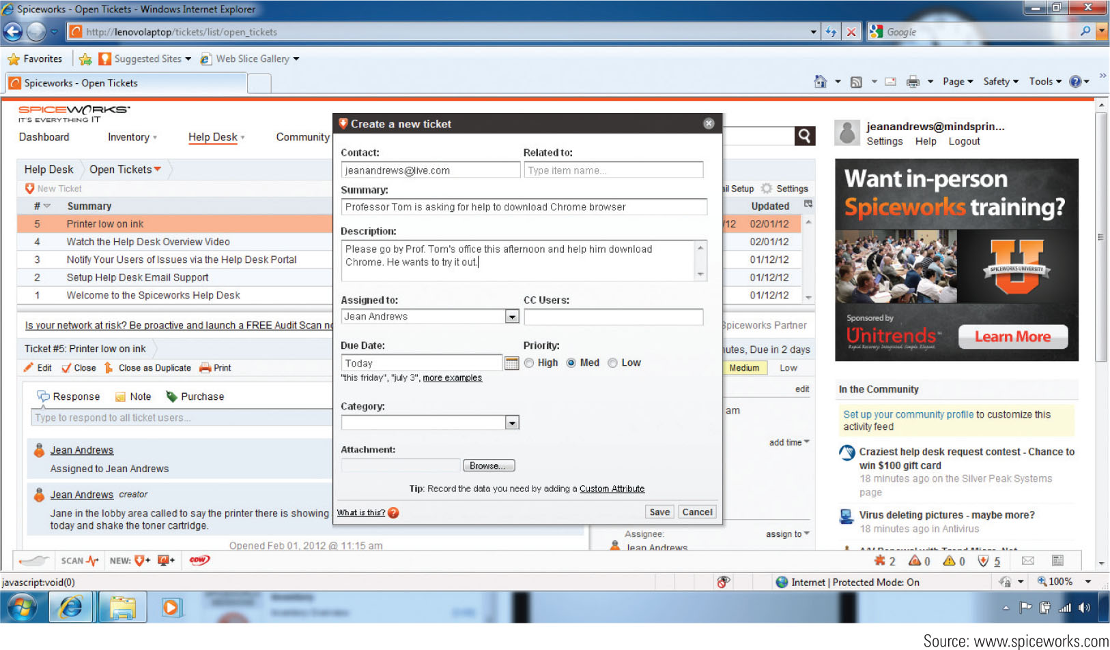
Figure 9-4 Spiceworks Help Desk Software allows you to create,
edit, and close tickets used by technicians

Slide 9
What Customers Want: Beyond the Technical Know-How
Traits of a competent and helpful technician:
Trait 1: A positive and helpful attitude
Trait 2: Listening without interrupting your customer
Trait 3: Proper and polite language
Trait 4: Sensitivity to cultural differences
Trait 5: Taking ownership of the problem
Trait 6: Dependability and reliability

Slide 10
What Customers Want: Beyond the Technical Know-How
Traits of a competent and helpful technician (cont’d):
Trait 7: Credibility
Trait 8: Integrity and honesty
Trait 9: Know the law with respect to your work
Observe the laws concerning use of software
Trait 10: Looking and behaving professionally

Slide 11
Stay Safe and Keep Others Safe
Electrical equipment damaged physically, exposed to water, moisture, or electrical shorts
Unplug immediately
Other dangers
Chemical burns
Cables that can cause people to trip
Heavy equipment that can hurt a technician’s back
Sharp edges in and around case

Slide 12
Planning for Good Service
To provide good service there must be a plan that covers the entire service situation
From the first contact with the customer to closing the call

Slide 13
Initial Contact With a Customer
Customers expect both technical and interpersonal skills
Technicians should:
Know the problem to be addressed
The urgency of the situation
What computer, software, and hardware need servicing
Arrive with a complete set of equipment needed
Greet customer in a friendly manner and shake hands
Listen and ask questions

Slide 14
Initial Contact With a Customer
Beginning a phone call professionally
Identify yourself and your organization
Ask for and write down name and number of caller
Follow company polices to obtain further information
Be familiar with your company’s customer service policies
Open up the conversation for the caller to describe the problem

Slide 15
Interview the Customer
Questions that can help identify the problem:
What error messages, unusual displays, or failures did you see? Describe the problem.
When did the problem start?
What was the situation when the problem occurred?
What programs or software were you using?
Did you move your computer system recently?
Has there been a recent thunderstorm or electrical problem?

Slide 16
Interview the Customer
Questions that can help identify the problem (cont’d):
Have you made any hardware, software, or configuration changes?
Has someone else used your computer recently?
Is there some valuable data on your system that is not backed up that I should know about before I start working on the problem?
Can you show me how to reproduce the problem?

Slide 17
Interview the Customer
After you have interviewed the user:
If you don’t understand what customer is telling you, ask open-ended questions to try to narrow down the specifics of the problem
Re-create the circumstances that existed when the problem occurred in as much detail as possible
Make no assumptions
Use diplomacy and good manners

Slide 18
Set and Meet Customer Expectations
Important to create an expectation of certainty with customers
Establish a timeline with your customer for completion of a project
Keep customer informed of progress
Give the customer an opportunity to make decisions about repairs
Repair or replace?
Help them decide which is to their advantage

Slide 19
Working With a Customer On Site
Avoid distractions
Don’t accept personal calls on your cell phone
Answer calls from work, but keep call to a minimum
If you must excuse yourself, explain to the customer and return as soon as possible
Be as unobtrusive as possible as you work
Keep tools and papers out of customer’s way
Protect customer’s confidential materials
Ask customer if they would like to put confidential materials away

Slide 20
Working With a Customer On Site
When working at a user’s desk, follow these guidelines:
Don’t take over the mouse or keyboard without permission
Ask permission to use the printer or other equipment
Don’t use the phone without permission
Don’t pile your tools on top of user’s papers
Accept personal inconvenience to accommodate the user’s urgent business needs
If user is present, ask before making a software or hardware change

Slide 21
Working With a Customer On the Phone
Requires more interaction with customers
Must be able to visualize what the customer sees
Patience is required if dealing with novice user
If call is disconnected, call back immediately
Don’t eat or drink while on the phone
If caller must be put on hold, tell them how long it will be before you get back to them
Speak clearly and slowly
Keep small talk upbeat and positive

Slide 22
Dealing With Difficult Customers
When trying to solve a problem over the phone and the customer is not knowledgeable:
Be specific with your instructions
Don’t ask the customer to do something that might destroy settings or files without having them back up first
Ask customer what is displayed on the screen to help track keystrokes
Follow along at your own PC
Give the customer plenty of opportunity to ask questions

Slide 23
Dealing With Difficult Customers
When trying to solve a problem over the phone and the customer is not knowledgeable (cont’d):
Compliment the customer whenever you can
If customer cannot help you solve the problem without a lot of coaching, tactfully request that the caller have someone with more experience call you

Slide 24
Dealing With Difficult Customers
When the customer is overly confident:
Compliment the customer’s knowledge, experience, or insight
Slow the conversation down
Don’t back off from using problem solving skills
Be careful not to accuse the customer of making a mistake
Even though the customer might be using technical jargon, do not use jargon back to the customer

Slide 25
Dealing With Difficult Customers
When the customer complains:
Be an active listener, and let customers know they are not being ignored
Give the customer a little time to vent, and apologize when you can
Start conversation over from beginning
Don’t be defensive
Know how your employer wants you to handle a situation where you were verbally abused

Slide 26
Dealing With Difficult Customers
When the customer complains:
If the customer is complaining about a product or service that is not from you company, don’t say “That’s not our problem”
If the complaint is against you or your product, identify the underlying problem if you can
Sometimes simply making progress or reducing the problem to a manageable state reduces the customer’s anxiety
Point out ways you think communication could be improved

Slide 27
The Customer Decides When the Work Is Done
When you think a problem is solved, allow customer to decide when the service is finished
Complete these tasks before closing the call:
Reboot PC to make sure you have not caused a problem with the boot
Allow the customer enough time to be fully satisfied that all is working
Ask user to verify any restored data
Review service call with the customer
Explain preventative maintenance to the customer

Slide 28
Sometimes You Must Escalate a Problem
Every technician does not know how to solve every problem with a PC
Sometimes, a problem needs to be assigned to someone higher in the support chain
If that happens, follow through to make sure the customer and new support person have made contact

Slide 29
The Job Isn’t Finished Until the Paperwork Is Done
Include in documentation sufficient details broken down by:
Cost of individual parts
Hours worked
Cost per hour
Make detailed notes so that you can use them later when solving similar problems
Record initial symptoms of the problem, the source of the problem, how you discovered the source, and how the problem was solved

Slide 30
Working With Co-Workers
Put business matters above personal matters
Do not be personally offended when someone lets you down or does not please you
Keep negative opinions to yourself
Practice good organization skills
Know your limitations and be willing to admit when you can’t do something
Learn how to handle conflict at work
Never give bad news or point out a fault by email
Speak face to face or by telephone

Slide 31
Dealing With Prohibited Content and Activity
Many organizations have a code of conduct that applies to employees and/or customers
Part of a technician’s job might include keeping track of software licensing to ensure that a company is not using pirated software
Must ensure that unauthorized copies of original software are not being produced (software piracy)
When you start a new job, find out how to deal with prohibited content or activity

Slide 32
Dealing With Prohibited Content and Activity
Things you need to know:
Go through the proper channels when you suspect an infringement of the law
What data or device should you preserve as evidence for what you believe has happened?
What documentation are you expected to submit and to whom is it submitted?
Proper documentation surrounding the evidence of a crime is crucial to a criminal investigation

Slide 33
Customizing Computer Systems
Important principles to keep in mind when customizing a system for a customer:
Meet application requirements – consider any special hardware the applications might require
Such as digital tablet for graphics applications
Balance functionality and budget
Put the most money on hardware components that are most needed for primary purpose
Consider hardware compatibility
Start with motherboard and processor

Slide 34
Graphics or CAD/CAM Workstation
Graphics-intensive applications perform complex calculations and require high-end workstations with high-end video cards
Requirements for high-end workstations:
Use a motherboard that provides quad channels for memory and plenty of memory slots (for lots of RAM)
Use a powerful multicore processor with a large CPU cache
Use fast hard drives with plenty of capacity
Use a high-end video card

Slide 35
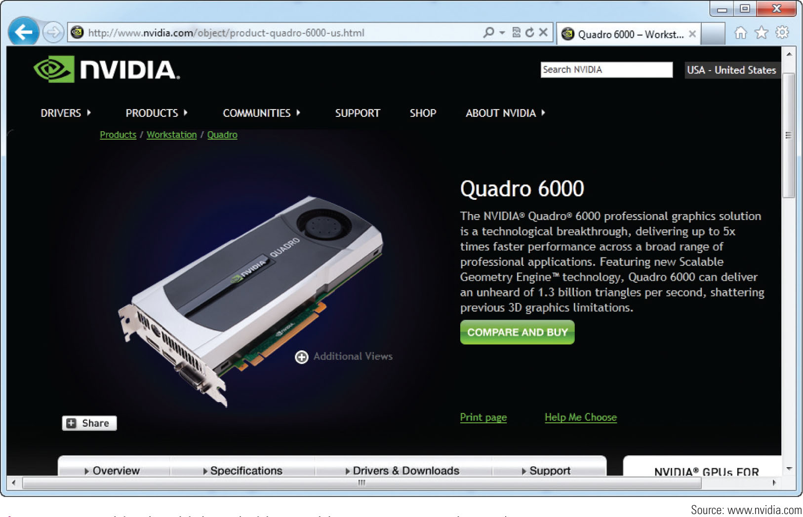
Figure 9-18 This ultra-high-end video card by NVIDIA costs almost $4,000

Slide 36
Audio and Video Editing Workstation
Audio and Video editing workstations require a mid-range to high-end workstation:
Use a motherboard that supports dual, triple, or quad channel memory running at least 1600 MHz RAM speed
Use a Core i7 or higher processor
Install at least 16 GB RAM; more is better
Select a good video card that has a GeForce GTX graphics processor or better
Use a double-sided, dual layer DVD burner
Install one or more fast and large hard drives

Slide 37
Virtualization Workstation
Virtualization: one physical machine hosts multiple activities that are normally done on multiple machines
Requirements for a virtual machine computer:
Processor should be a multicore processor
Need extra amounts of RAM when a computer is running several VMs
Each VM must have an OS installed
Make sure you have adequate hard drive space for each VM

Slide 38
Gaming PC
Gaming PCs require powerful processors and high-end video and sound cards
Some gamers overclock their CPUs or use dual video cards
Must also ensure cooling methods are adequate
Today, gamers can purchase PCs built specifically for gaming enthusiasts

Slide 39
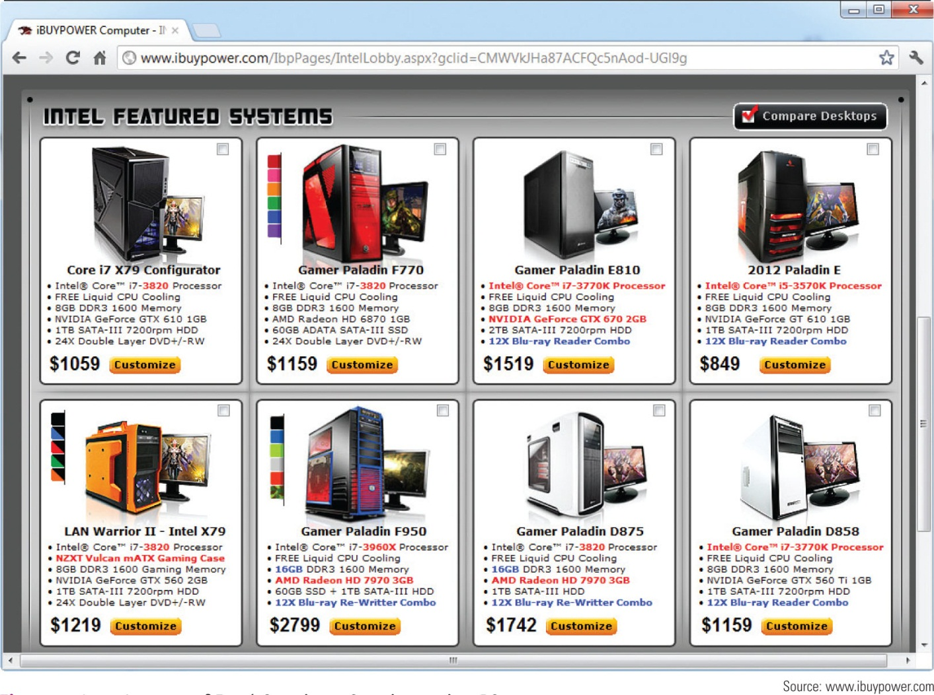
Figure 9-21 A group of Intel Core i5 or Core i7 gaming PCs

Slide 40
Home Theater PC
A custom-built HTPC needs to include:
Applications software
HDMI port to connect video output to television
Cable TV input
Satellite TV input
Internet access
Remote control
Low background noise
Surround sound
Case form factor – small enough to fit on a shelf of an entertainment center

Slide 41
Home Server PC
Home server PC is useful to share files among several computers on a small home network
Features and hardware to consider:
A processor with moderate power
Storage speed and capacity need to be maximized
Network transfers need to be fast, especially for streaming videos and movies
Printer sharing
Onboard video works well
Windows 7 can be used, but Windows Home Server 2011 is a better option

Slide 42
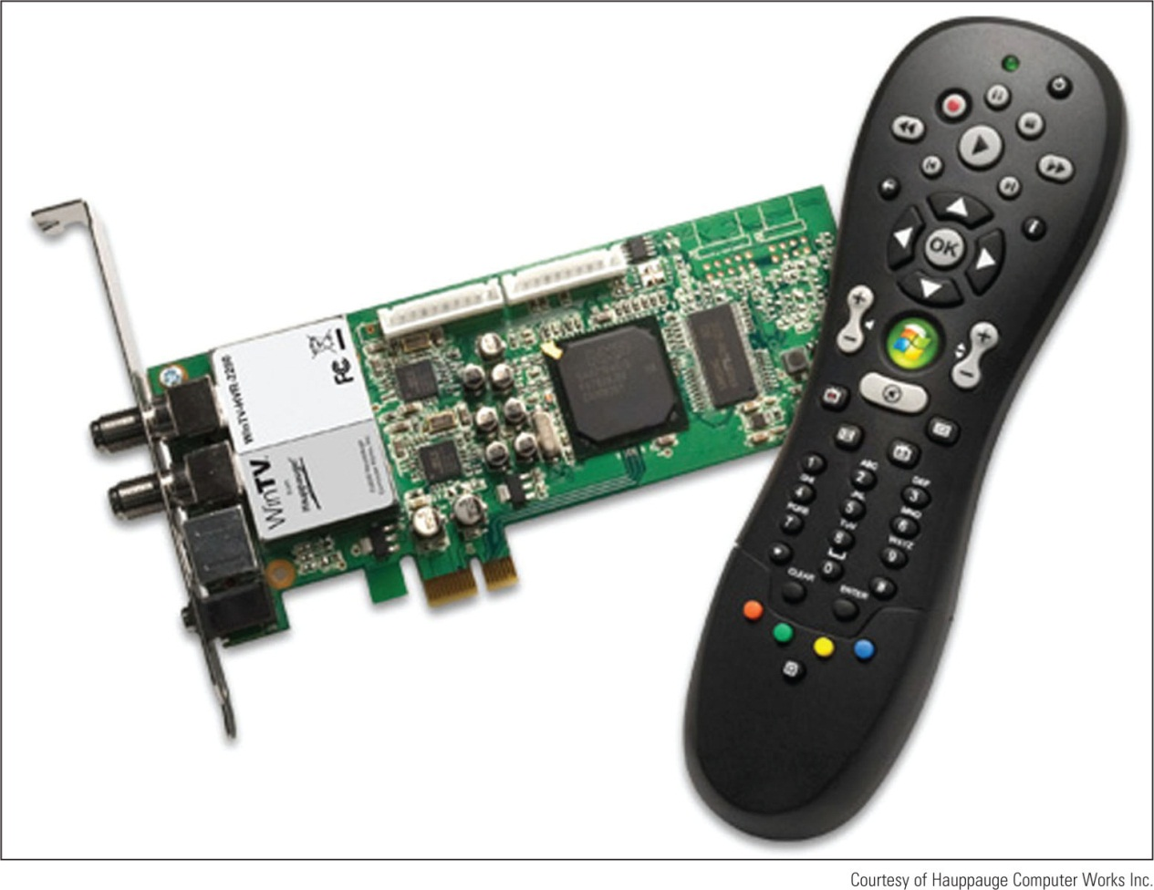
Figure 9-22 Dual TV tuner card with IR remote lets you watch and record
two TV programs at the same time

Slide 43
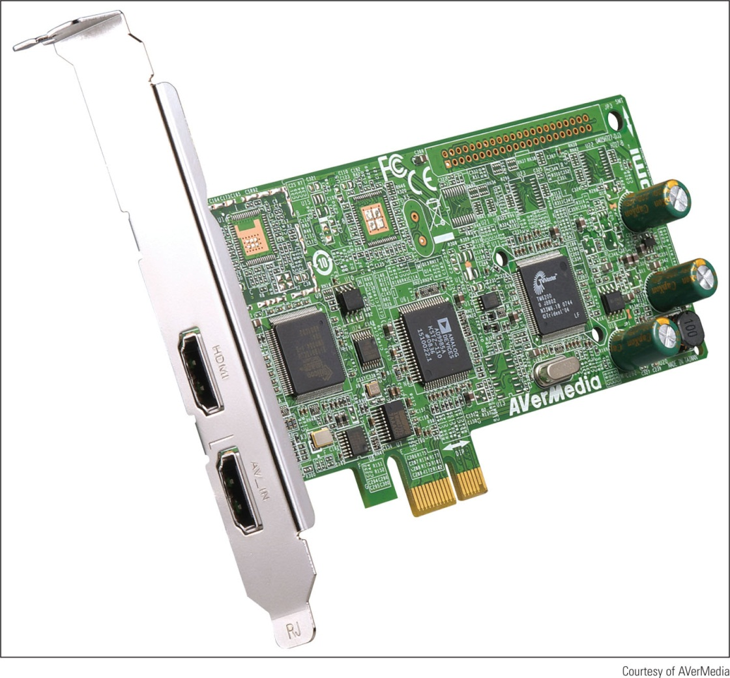
Figure 9-23 The AVerMedia AVerTV HD DVR (CO27) video capture card
has two HDMI input ports and uses a PCIe x1 expansion slot

Slide 44
Thick Client and Thin Client
Virtualization server: provides a virtual desktop for users on multiple client machines
Thick client (also called fat client): regular desktop computer or laptop that is used as a client by a virtualization server
Thin client: a computer that has an OS but has little computer power and might only need to support a browser used to communicate with the server
Server does most of the processing
To reduce costs, configure it to meet only the minimum requirements for Windows

Slide 45
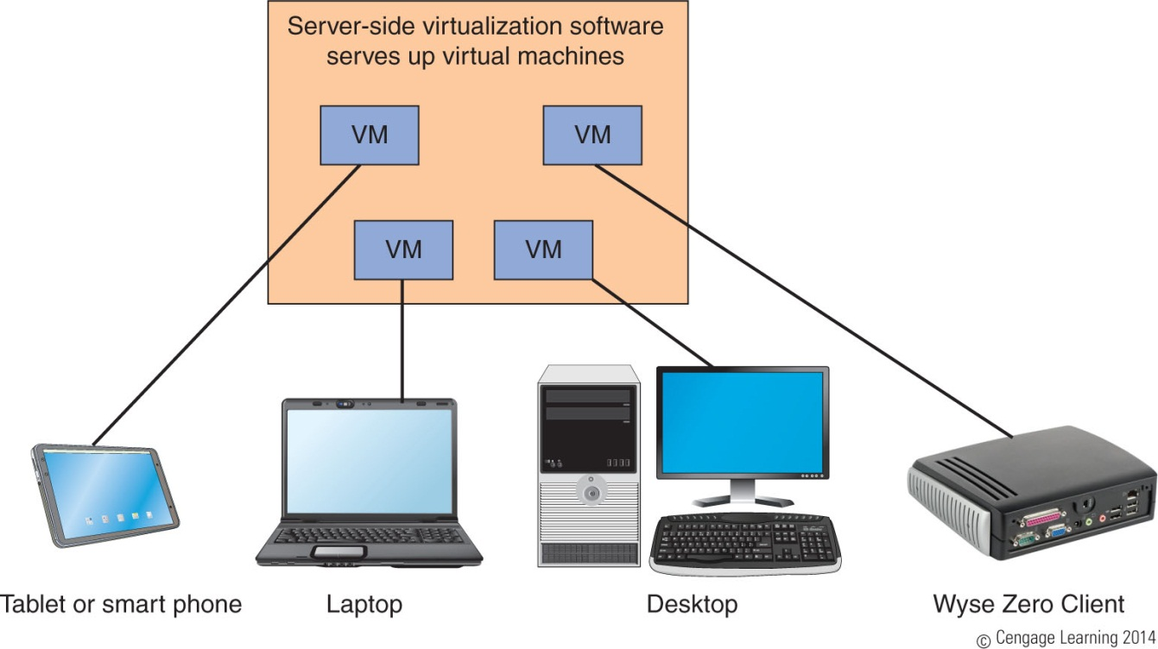
Figure 9-26 A virtualization server provides a desktop to each
client computer or appliance

Slide 46
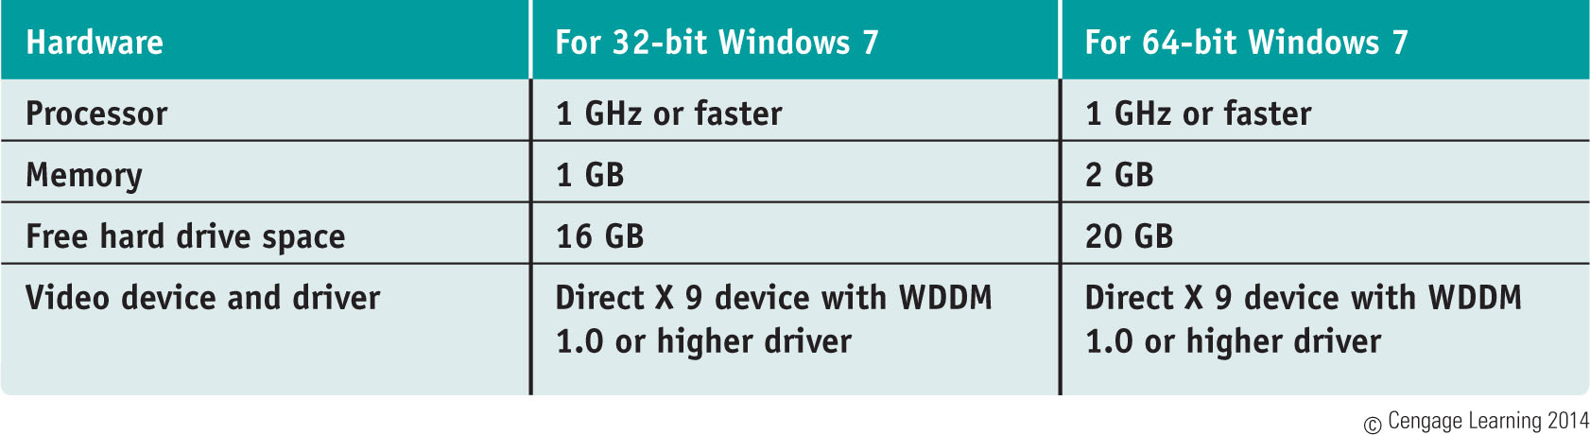
Table 7-1 Minimum and recommended hardware requirements for Windows 7

Slide 47
Summary
Five key job roles of a PC technician include PC support technician, PC service technician, technical retail associate, bench technician, and help-desk technician
A+ Certification by CompTIA – most recognized certification for PC repair technician
Customers want more than just technical know-how
Customers expect their first contact to be professional and friendly
Set and meet customer expectations with good communication

Slide 48
Summary
Deal confidently and gracefully with customers who are difficult
Be aware of documented code of conduct for your organization
A chain-of-custody document provides a paper trail of how evidence in a criminal case is handled
As a technician you might be called upon to customize a system for a customer including a graphics or CAD/CAM workstation, audio and video editing workstation, virtualization workstation, gaming PC, Home Theater PC, home server PC, thick or think client

