Slide 1

A+ Guide to Managing & Maintaining Your PC, 8th Edition
Chapter 10
Maintaining Windows

Slide 2
Objectives
Learn how to set up and perform scheduled preventive maintenance tasks to keep Windows healthy
Learn how to prepare for disaster by keeping good backups of user data and Windows system files
Learn how to use commands to manage files and folders and how to use Disk Management to manage hard drives
Learn how to configure Windows to use a language other than English

Slide 3
Scheduled Preventive Maintenance
Preventive maintenance
Alleviates slow computer performance
Tasks
Verifying critical Windows settings
Clean up the hard drive
Checking drive for errors
Free up hard drive space

Slide 4
Verify Critical Windows Settings
Three Windows settings are critical for keeping a system protected
Explain importance to users so they do not change the settings
Verify updates and service packs are installed
Windows Updates should be configured to automatically allow updating
Antivirus software should be set to scan regularly and up to date
Check that the Windows 7 network location is set correctly

Slide 5
Clean Up the Hard Drive
Delete unneeded files occasionally
Windows requires about 15% hard drive free space
Defragmenting drives, burning CDs and DVDs, and other tasks
Ways to improve drive performance and free up space:
Defragmenting the drive
Checking for errors
Compressing folders
Moving files and folders to other drives

Slide 6
Directory Structures
User Profile Namespace – when a user logs onto Windows 7/Vista a user profile is created
A collection of user data and settings
Consists of two general items
A user folder – created under the C:\Users folder and contains a group of subfolders collectively called the user profile namespace
Ntuser.dat – file stored in the C:\Users\username folder

Slide 7
Directory Structures
Program Files
C:\Program Files – where Windows stores program files unless you select a different location
In 64-bit versions of Windows:
64-bit program files are stored in C:\Program Files and 32-bit program files are stored in C:\Program Files (x86) folder

Slide 8
Directory Structures
Folders for Windows Data
Registry location: C:\Windows\system32\config
Backup of the registry: C:\Windows\system32\config\RegBack
Fonts: C:\Windows\Fonts
Temporary files: C:\Windows\Temp
Offline files: stored in the client-side caching (CSC) folder which is C:\Windows\CSC
Allows users to work with files in the folder when the computer is not connected to a corporate network

Slide 9
Use the Disk Cleanup Utility
Use the Windows Disk Cleanup utility to delete temporary files
To use:
Open Windows Explorer, right-click the volume that Windows is installed on, and select Properties
On the General tab, click Disk Cleanup
To see temporary system files that can also be deleted, click Clean up system files
If even more space is needed click the More Options to see what else could be deleted

Slide 10
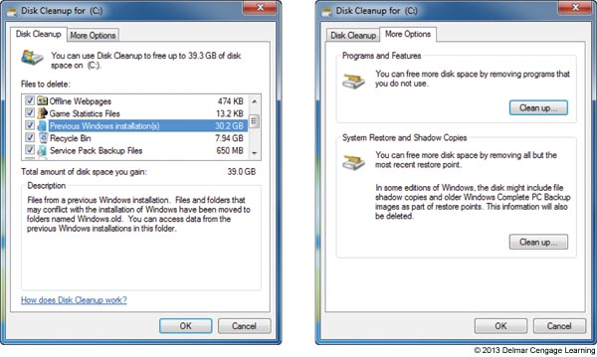
Figure 10-2 Clean up system files no longer needed in order to free up disk space

Slide 11
Defrag the Hard Drive
Defragment: to rearrange fragments or parts of files so each file is stored in contiguous clusters
Two types of hard drives:
Magnetic hard disk drives (HDDs) – contain spinning platters
Windows 7/Vista automatically defrags once a week
Solid-state drives (SSDs) – contain flash memory
Has no moving parts so defrag does not improve read/write time
Defragmenting this type of drive is not recommended

Slide 12
Defrag the Hard Drive
Cluster (also called file allocation unit): group of whole sectors in a file system
Number of sectors in a cluster is fixed
A file is stored in whole clusters
Unused space at end of last cluster is called slack and is wasted free space
As files are written and deleted from a drive, clusters are used, released, and used again
Moving arm of drive may have to move all over a drive to collect all fragments of a file
Slows down performance
Solution is to defragment the drive

Slide 13
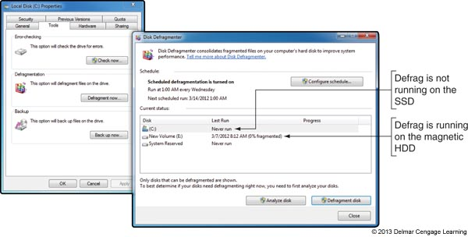
Figure 10-4 Windows is set to automatically defragment
a magnetic hard drive once a week

Slide 14
Check the Hard Drive for Errors
Error checking utility: searches for bad sectors on a volume and recovers the data from them if possible
To use error checking utility:
Right-click the drive in Windows Explorer and select Properties from the shortcut menu
Click the Tools tab and click Check now
In the Check Disk dialog box, check Automatically fix file system errors and Scan for and attempt recovery of bad sectors
Click Start

Slide 15
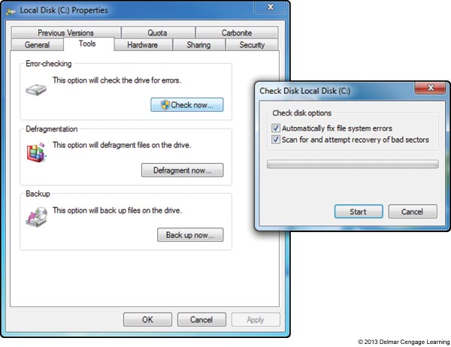
Figure 10-6 Windows repairs hard drive errors under the drive’s
Properties box using Windows Explorer

Slide 16
Free Up Space On the Drive
Uninstall software you no longer use
Move data off the drive
Consider moving videos, photos, and other data to an external hard drive or burning them to DVDs
Move programs off the drive
Uninstall a program and reinstall it on a second hard drive
Use drive or folder compression
It is not recommended to compress the volume on which Windows is stored

Slide 17
Move the Virtual Memory Paging File
Virtual memory: a file used to enhance the amount of RAM in a system
To save space you can move virtual memory paging file
Pagefile.sys
Hidden file stored in C drive root directory
Move to another partition on the same or different drive
New drive speed should be equal to or greater than existing drive and should have plenty of free space (at least three times the amount of installed RAM)

Slide 18
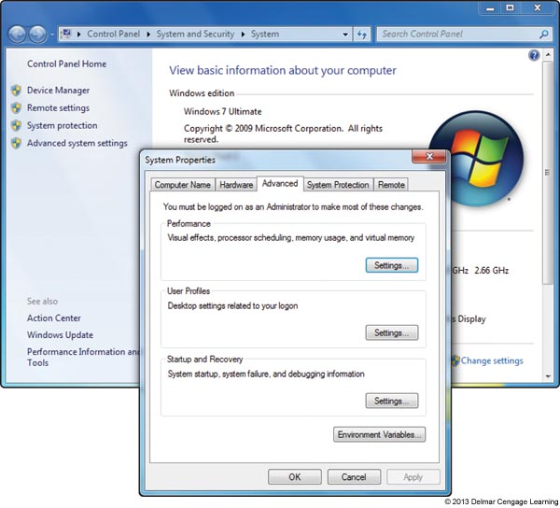
Figure 10-7 Manage virtual memory using the System Properties box

Slide 19
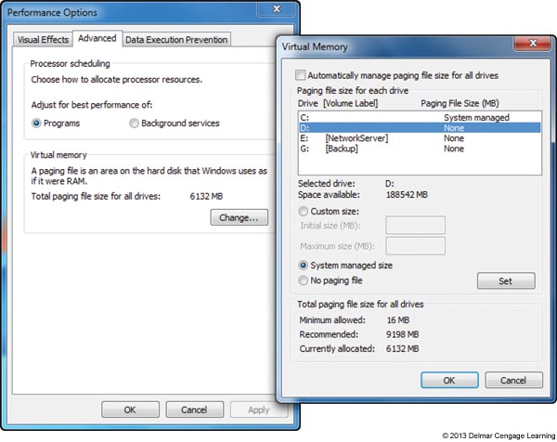
Figure 10-8 Move Pagefile.sys to a different drive

Slide 20
Backup Procedures
Backup
Extra copy of a data or software file
Use if original file becomes damaged or destroyed
Ways to lose data
System failure, virus, file corruption, or some other problem
Never trust important data to only one media

Slide 21
Planning For Disaster Recovery
Decisions to make for a backup and recovery plan
Decide on backup media
Decide on the backup software
Consider purchasing third-party backup software
Easier to use
Offers more features than Microsoft utility
Decide how simple or complex your backup strategy should be
Large organizations might require backups be documented daily, scheduled at certain times of the day or night, and recovery plans tested regularly

Slide 22
Planning For Disaster Recovery
After backup plan is in place, test the recovery plan
Test the recovery process
Erase a file and use the recovery procedures to verify that you can restore the file from backup
Keep backups in a safe place and routinely test them
Should be kept under lock and key
In case of fire, keep backups off-site
Routinely verify backups are good by performing a test recovery of a backed-up file or folder

Slide 23
Create and Use Backups in Windows 7
Back up the Windows Volume
Called the system image
Points to keep in mind :
A system image includes the entire drive on which Windows is installed
A system image must be created on an internal or external hard drive
Don’t depend just on the system image as your backup
You can create a system image any time after Windows is installed

Slide 24
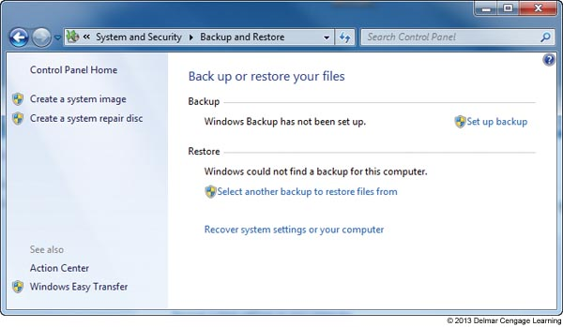
Figure 10-10 Use the Backup and Restore window to create a system image

Slide 25
Create and Use Backups in Windows 7
Back up user data
1. Open the Backup and Restore window
2. Select the media to hold the backup
3. In the next box, select Let me choose so you can select the folder to backup, then click Next
4. In the next box, select the libraries and folders you want to back up, click Next to continue
5. Verify the correct folders and libraries are selected
You can also change the frequency in this step
6. Review your backup settings and click Save settings and run backup

Slide 26
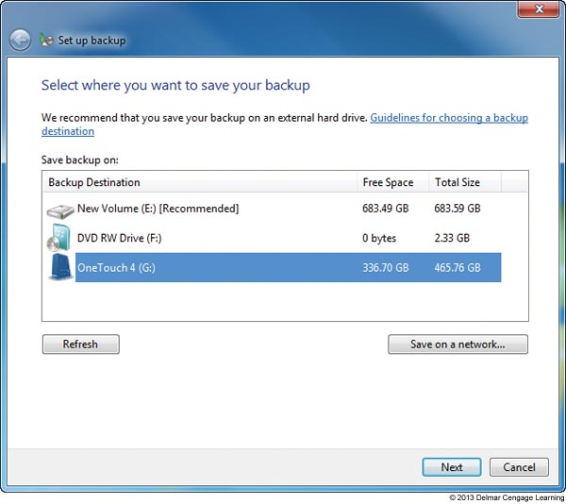
Figure 10-11 Select the destination media to hold the backup

Slide 27
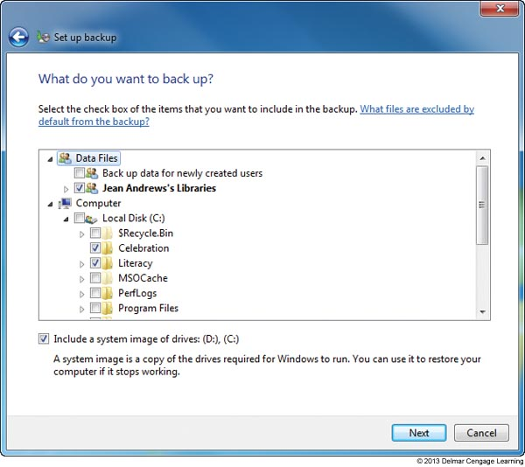
Figure 10-13 Select the folders or libraries to include in the backup

Slide 28
Create and Use Backups in Windows 7
Recover a Corrupted or Lost File or Folder
1. Make the backup media available to computer
2. Open Backup and Restore and click Restore my files
3. Use one of three buttons to locate the file or folder
Follow directions on-screen to restore
To restore a previous version of a file or folder:
1. Copy the corrupted file or folder to a new location
2. Right click the file or folder and select Restore previous version
3. Select the version you want and click Restore

Slide 29
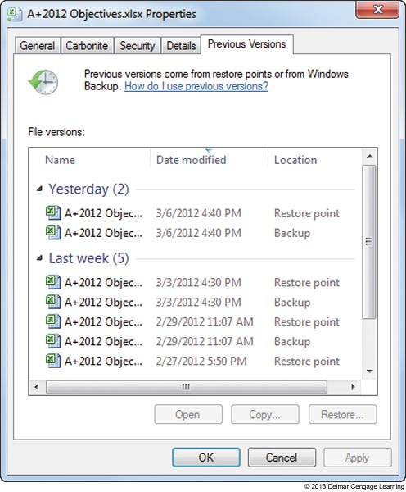
Figure 10-17 Restore a file or folder from a previous version

Slide 30
Create and Use Backups in Windows 7
Windows System Protection – automatically backs up system files and stores them at regular intervals
Restore point
Condition at time a snapshot taken
Includes Windows system files
Restore points are taken at least every 24 hours
Can use up to 15 percent of disk space
If disk space gets too low, restore points are no longer made
Can manually create restore point at any time using the System Protection tab of System Properties

Slide 31
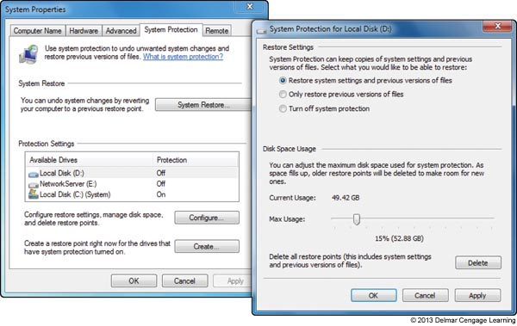
Figure 10-18 Make sure System Protection is turned on which Windows
is installed

Slide 32
Create and Use Backups in Windows 7
Apply a restore point
System Restore restores the system to its condition at the time a restore point is made
User data not altered
Can affect installed software, hardware, user settings, and OS configuration settings
Changes made to settings are lost after restore point is created
Always use most recent restore point capable of fixing the problem

Slide 33
Create and Use Backups in Windows 7
Points to remember about system restore
Great tool for fixing a device, restoring Windows settings, and solving application problems
Limitations
Recovers from errors only if registry somewhat intact
Process cannot remove virus or worm infection
Process might create a new problem
Process might make many changes to a system
Process requires restore points
Restore points kept in a hidden folder on the hard drive
Viruses and malware sometimes hide in restore points
Can launch System Restore using startup recovery tools

Slide 34
Managing Files, Folders, and Storage Devices
This section of the chapter covers:
Managing files and folders using commands in a command prompt window
Managing hard drive partitions and volumes using the Disk Management utility

Slide 35
How Partitions and File Systems Work
All data is stored on a hard drive in sectors (records)
Each sector on drive is the same size (usually 512 bytes)
Low-level formatting: A process (usually performed at the factory) that electronically creates the hard drive tracks and sectors and tests for bad spots
Size of the sector and total number of sectors determine capacity
Today’s drive capacities are measured in GB (gigabytes) or TB (terabytes)

Slide 36
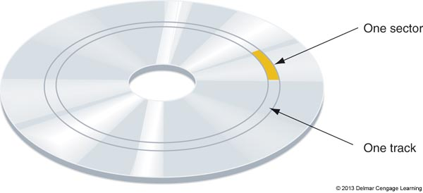
Figure 10-20 A magnetic hard drive is divided into concentric circles called
tracks, and tracks are divided into sectors

Slide 37
How Partitions and File Systems Work
Hard drives are further divided into one or more partitions (can have up to four in Windows)
Maps of the partitions are kept in a partition table in the first sector of the drive called the Master Boot Record (MBR)
Can have up to three primary partitions (also called volumes)
A fourth partition (called extended partition) can hold one or more volumes called logical drives

Slide 38
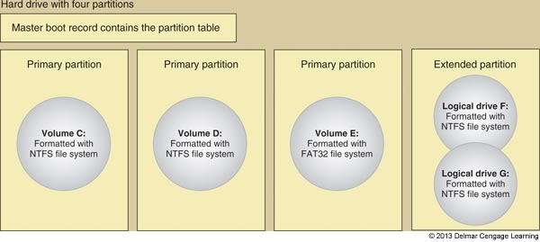
Figure 10-21 A hard drive with four partitions; the fourth partition is an
extended partition

Slide 39
How Partitions and File Systems Work
Before a drive can be used it must be:
Assigned a drive letter (C: or D:)
Formatted using a file system
File system is overall structure an OS uses to name, store, and organize files on a drive
Windows 7 supports three types of file systems: NTFS, FAT32, and exFAT
Windows assigns two functions to partitions:
System partition (usually drive C:) – active partition that contains the OS program to start up Windows
Boot partition – partition where Windows OS is stored

Slide 40
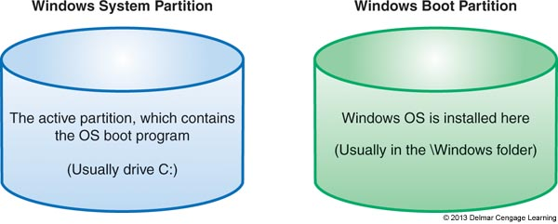
Figure 10-22 Two types of Windows hard drive partitions

Slide 41
How Partitions and File Systems Work
File systems supported by Windows for volumes that don’t hold the Windows installation:
NTFS – uses smaller allocation unit or cluster sizes than FAT32 (more efficient)
exFAT – use for large external storage devices to be used with other operating systems
FAT32 – use for small hard drives or USB flash drives
FAT16 – only recommended on volumes less than 4 GB
CDFS(Compact Disc File System) and UDF – CDFS is an older file system used by optical discs and is being replaced by UDF (Universal Disc Format)

Slide 42
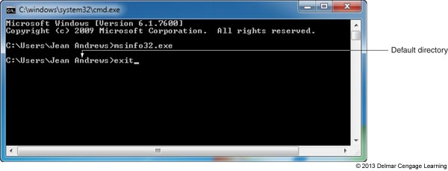
Commands To Manage Files and Folders
Command prompt window
Open by entering cmd.exe in the search box
Provides a Command Line Interface (CLI)
Enter command lines to perform a variety of tasks
Figure 10-24 Use the exit command to close the command prompt window

Slide 43
Commands to Manage Files and Folders
Windows 7 and Vista have two levels of command prompt windows
Standard window – default directory is the currently logged on user’s folder
Commands requiring administrative privileges will not work
Elevated window – requires the user to logon as an administrator
The word “administrator” will appear in the title bar
Default directory will be C:\Windows\system32

Slide 44
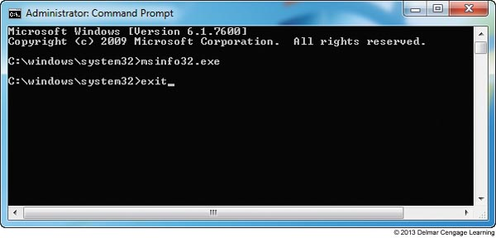
Figure 10-25 An elevated command prompt window has administrative
privileges

Slide 45
Commands to Manage Files and Folders
Tips for working in a command prompt window:
Type cls and press Enter to clear the window
Press the up arrow to retrieve the last command
Press the right arrow to retrieve the last command line one character at a time
Press Ctrl+Break or Ctrl+Pause to terminate a command before it is finished
Type exit and press Enter to close the window

Slide 46
Commands To Manage Files and Folders
File naming conventions
Filename and file extension characters
Letters a through z and numbers 0 through 9
Characters: _ ^ $~ ! # % & – { } ( ) @ ' `
Filename with spaces:
Enclose filename in double quotation marks
Wildcard characters in command lines
Question mark (?): wildcard for one character
Asterisk (*): wildcard for one or more characters

Slide 47
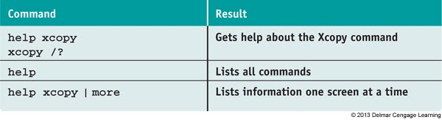
Commands To Manage Files and Folders
Help or <command name> /?
Table 3-1 Sample help commands

Slide 48
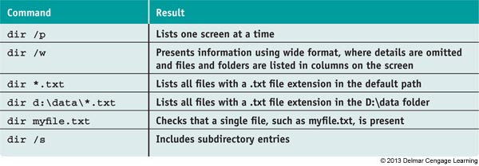
Commands to Manage Files and Folders
Dir [<filename>] [/p] [/s] [/w]
List files and directories
Table 3-2 Sample dir commands

Slide 49
Commands To Manage Files and Folders
MD [drive:]path
Creates a subdirectory under a directory
CD [drive:]path or CD..
Changes current default directory
Use .. after CD to move from child directory to its parent directory
RD [drive:]path
Removes a subdirectory
Directory must contain no files
Directory must contain no subdirectories
Directory must not be current directory

Slide 50
Commands To Manage Files and Folders
Del or Erase <filename>
Erases files or groups of files
Ren <filename1> <filename2>
Renames a file
Copy <source> [<destination>] [/V] [/Y]
Useful switches or parameters
/V: size of each new file compared to the size of original file
/Y: confirmation message does not appear asking to confirm before overwriting a file

Slide 51
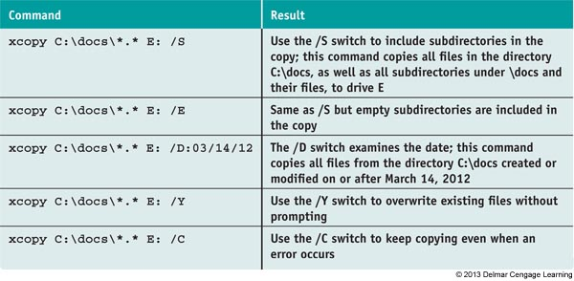
Commands To Manage Files and Folders
Recover <filename>
Attempts to recover a file when parts corrupted
Xcopy <source> [<destination>] [/S] [/C] [/Y] [/D:date]

Slide 52
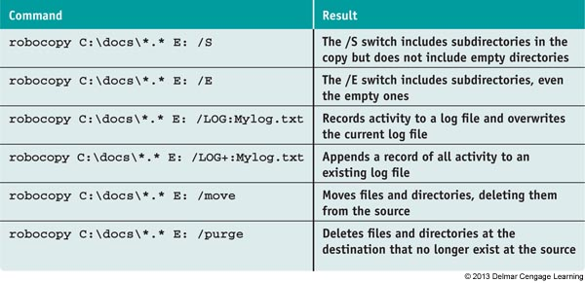
Commands To Manage Files and Folders
Robocopy <source> [<destination>] [/S] [/E] [/LOG:filename] [/LOG+:filename] [/move] [/purge]
Robust File Copy command
Table 3-4 Robocopy commands and results

Slide 53
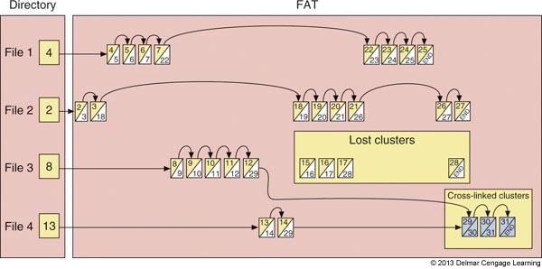
Commands To Manage Files and Folders
chkdsk [drive:] [/f] [/r]
Fixes file system errors
Recovers data from bad sectors
Figure 10-27 Lost and cross-linked clusters

Slide 54
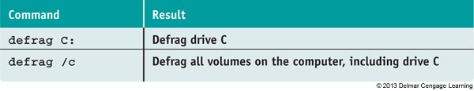
Commands To Manage Files and Folders
Defrag [drive:] [/C]
Examines a drive for fragmented files
Rewrites fragmented files in contiguous clusters
Table 3-5 Defrag commands and results

Slide 55
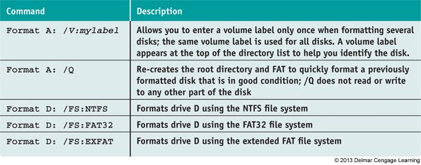
Commands To Manage Files and Folders
Format <drive:> [/v:label] [/q] [fs:<filesystem>]
Format command
Table 3-6 Format commands and results

Slide 56
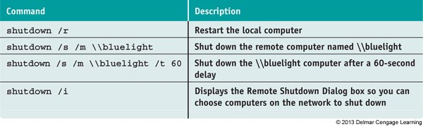
Commands To Manage Files and Folders
Shutdown [/m \\computername] [/i] [/r] [/s] [/f] [/t xx]
Shut down the local computer or a remote computer
Figure 10-7 Shutdown commands and results

Slide 57
Use Disk Management To Manage Hard Drives
Disk Management is the primary tool for managing hard drives
Manage partitions, prepare a new drive for first use, mount a drive, use Windows dynamic disks, or troubleshoot problems with the hard drive
Manage Partitions
Use Disk Management to resize, create, and delete partitions

Slide 58
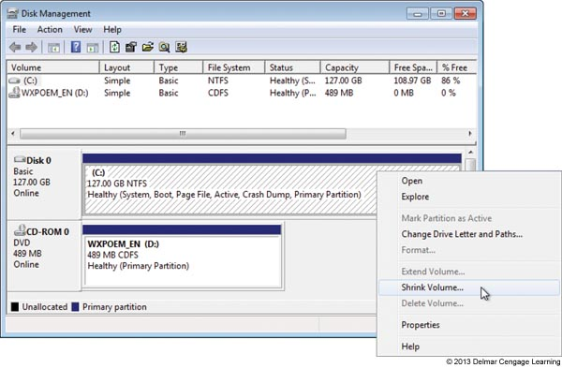
Figure 10-29 Shrink a volume to make room for a new partition

Slide 59
Use Disk Management To Manage Hard Drives
Prepare a drive for first use
Step 1: Initialize the Disk
Choose the MBR system or Globally Unique Identifier Partition Table (GUID or GPT) system
MBR system can have up to four partitions
GPT system can support up to 128 partitions and is recommended for drives larger than 2 TB
Step 2: Create a Volume and Format It with a File System

Slide 60
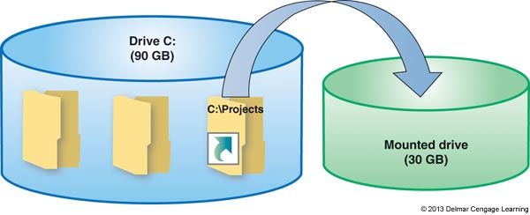
Use Disk Management To Manage Hard Drives
How to Mount a Drive
Mounted drive is a volume accessible by a folder on another volume
Folder has more available space
Mount point: C:\Projects folder
Figure 10-33 The C:\Projects folder is the mount point for the mounted drive

Slide 61
Use Disk Management To Manage Hard Drives
Windows Dynamic Disks
Several dynamic disks can work together to collectively present a single dynamic volume
Data to configure each hard drive is stored in a disk management database (resides in last 1 MB of space on each hard drive)
Better reliability, spanning, stripping (RAID 0) to improve performance, mirror two hard drives for fault tolerance (RAID 1) for XP

Slide 62
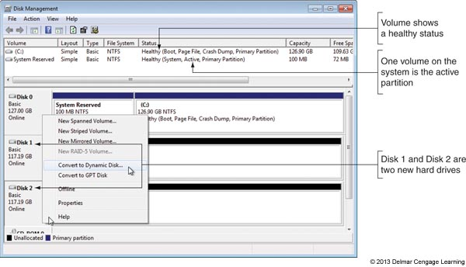
Use Disk Management To Manage Hard Drives
Windows dynamic disks (cont’d.)
Disk Management converts two or more basic disks to dynamic disks
Figure 10-37 Convert a basic disk to a dynamic disk

Slide 63
Use Disk Management To Manage Hard Drives
Drive and volume statuses:
Healthy
Failed
Online
Active
Unallocated
Formatting
Basic
Dynamic
Offline, foreign drive, and healthy (at risk)

Slide 64
Regional and Language Settings
Configure computer to use a different language
For Windows 7/Vista Ultimate and Enterprise editions, use Windows Update to download and install the language pack
For all editions of Windows 7/Vista/XP, download and install a limited Language Interface Pack (LIP) using Windows Update
Getting LIP for other Windows editions
Go to Microsoft Web site

Slide 65
Summary
Regular preventive maintenance
Improves performance and troubleshooting
Verify Windows settings, defragment hard drives, check drive for errors, reduce startup process to essentials, and free up hard drive space
Windows offers may preventative maintenance tools
Plan for disaster recovery in the event a hard drive fails by performing routine backups of data and system files
Windows 7 Backup and Restore can be used to schedule routine backups of user data files

Slide 66
Summary
Commands useful to manage files, folders and storage media include Help, Dir, Del, Copy, Recover, Xcopy, Robocopy, MD, CD, RD, Chkdsk, Defrag, and Format
Use Disk Management to manage hard drives and partitions
A language pack can be downloaded and installed in Windows 7/Vista Ultimate and Enterprise editions
A limited LIP can be downloaded and installed in any edition of Windows 7/Vista

