Slide 1

A+ Guide to Managing & Maintaining Your PC, 8th Edition
Chapter 11
Optimizing Windows

Slide 2
Objectives
Learn about Windows utilities and tools you can use to solve problems with Windows
Learn how to optimize Windows to improve performance
Learn how to manually remove software

Slide 3
Windows Utilities and Tools to Support the OS
Some subjects covered in this chapter include:
The Windows Shell and Kernel
Task Manager
System Configuration Utility (MSconfig)
Services console
Computer Management
Microsoft Management Console (MMC)
Event Viewer
Reliability and Performance Monitor
Registry Editor

Slide 4
What is the Shell and the Kernel?
Shell: portion of an OS that relates to the user and to applications
Provides tools such as Windows Explorer and the Windows desktop
Made up of subsystems that operate in user mode
Kernel: responsible for interacting with hardware
Known as the “core” of the OS
Has two main components:
HAL (hardware abstraction layer) – layer closest to hardware
Executive services interface – operate between the user mode subsystems and the HAL

Slide 5
How Windows Manages Applications
Process: a program that is running under the authority of the shell, together with the system resources assigned to it
When a process makes a request for resources to the Win32 subsystem the request is known as a thread
A thread is a single task, such as printing a file that the process requests from the kernel
Sometimes a process is called an instance

Slide 6
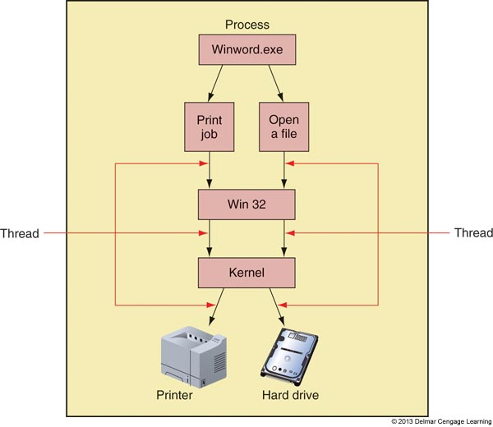
Figure 11-2 A process with more than one thread is called multithreading

Slide 7
Task Manager
Taskmgr.exe displays applications and processes
Also displays information about memory performance, network activity, and user activity
Several ways to access Task Manager:
Press Ctrl+Alt+Delete
Right click a blank area in the taskbar and select Start Task Manager from shortcut menu
Press Ctrl+Shift+Esc
Click Start, enter taskmgr.exe in the search box

Slide 8
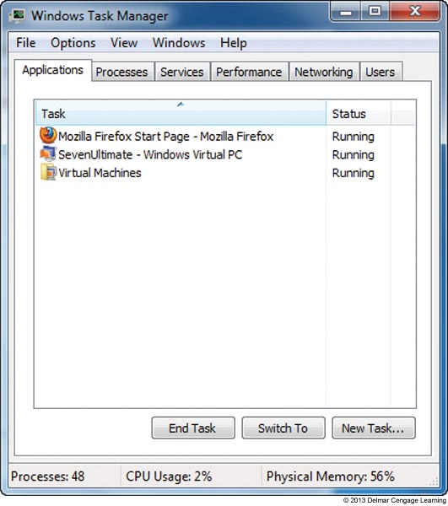
Task Manager
Applications Tab
States: running or not responding
End task button at bottom of the window
Figure 11-5 The Applications tab in Task Manager shows
the status of active
applications

Slide 9
Task Manager
Processes Tab
Lists system services and other processes, CPU time, and memory use
Identifies applications slowing down a system
Showing all processes running under current user
System, Local Service, and Network Service accounts
Cannot display dialog box on-screen or interact with user
Stopping a process
Click End Process
Be careful not to end critical Windows processes

Slide 10
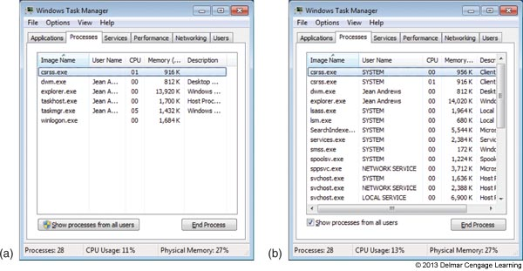
Figure 11-6 Processes running under (a) the current user and (b) all users, for a new Windows 7 installation

Slide 11
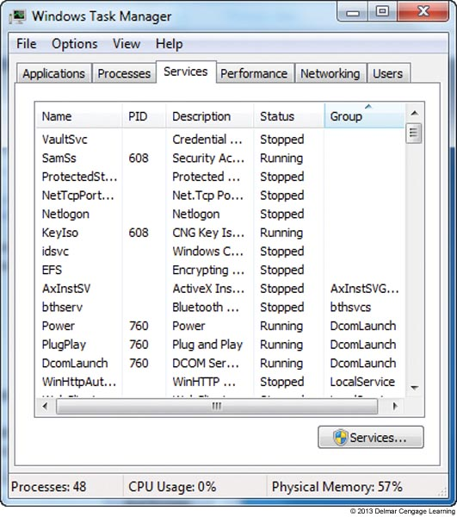
Task Manager
Services Tab
Lists currently installed services with status
Figure 11-9 The Services tab of Windows 7 Task Manager gives the current status of all installed services

Slide 12
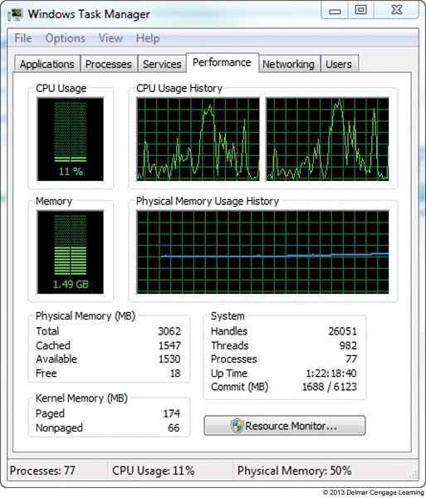
Task Manager
Performance Tab
Provides graphs to show how system resources are used
Figure 11-10 The Performance tab window shows details about how system resources are being used

Slide 13
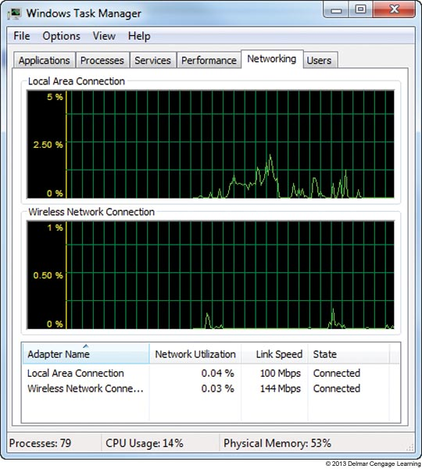
Task Manager
Networking Tab
Displays how heavily network being used by a computer
Figure 11-11 Use the Networking tab of Task Manager to monitor network activity

Slide 14
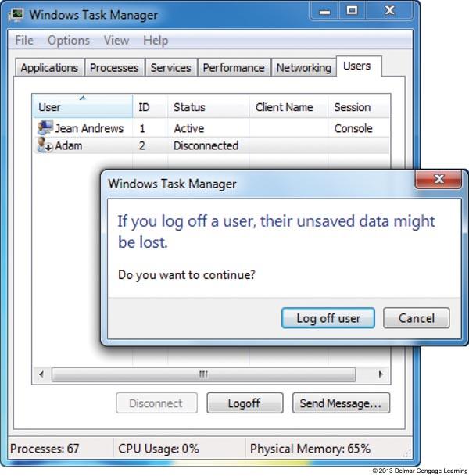
Task Manager
Users Tab
Shows all users currently logged on
Log off user to improve performance
Figure 11-12 Use Task Manager to log off a user

Slide 15
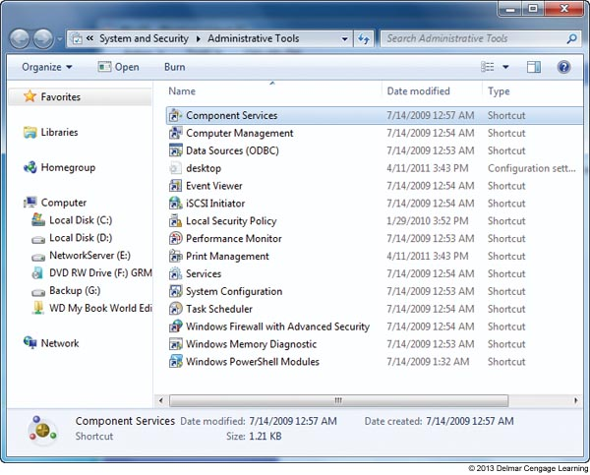
Administrative Tools
Windows Administrative tools can be found in Control Panel
Figure 11-13 Administrative
tools available
in Windows 7
Ultimate

Slide 16
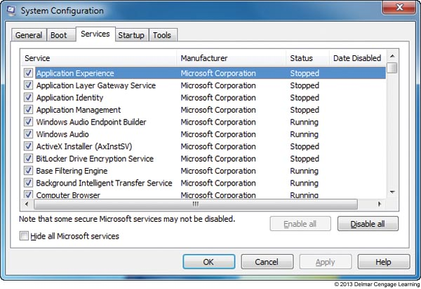
System Configuration (MSconfig)
Msconfig.exe
Use to view processes launched at startup and to temporarily disable a process from loading
Figure 11-15 Use MSconfig to view and control services launched at startup

Slide 17
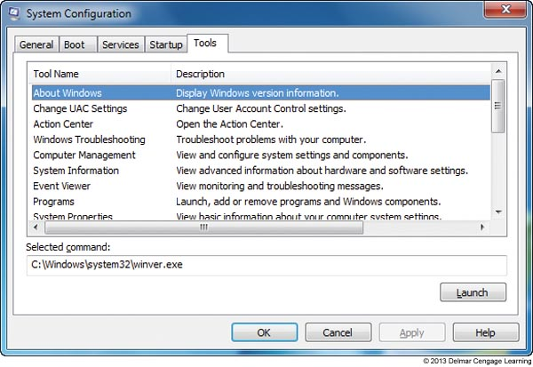
Figure 11-18 The Tools tab makes it easy to find troubleshooting tools

Slide 18
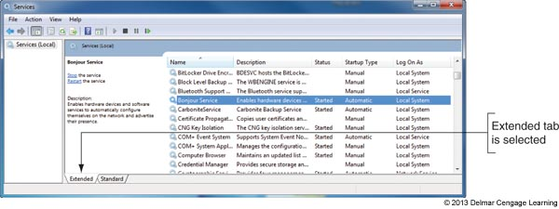
Services Console
Services console is used to control the Windows and third-party services installed
To launch: type Services.msc in the search box
Figure 11-19 The Services console is used to manage Windows services

Slide 19
Services Console
Selecting Properties
Provides more information about a service
Allows stopping or starting a service
Service startup types
Automatic (Delayed Start): starts shortly after startup, after the user logs on
Automatic: starts when Windows loads
Manual: starts as needed
Disabled: cannot be started

Slide 20
Computer Management
Consolidates several Windows administrative tools
Use to manage local PC and other network computers
Administrator authority required
Viewing may allow lesser privileges
Accessing Computer Management in Windows
Enter compmgmt.msc in Search box
Click Start, right-click Computer, and select Manage
Control Panel
Click Administrative Tools group

Slide 21
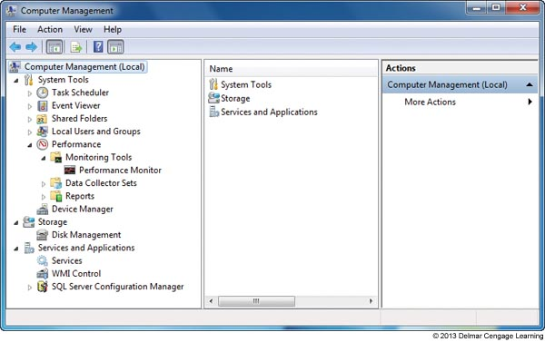
Figure 11-21 Windows Computer Management combines several
administrative tools into a single easy-to-access window

Slide 22
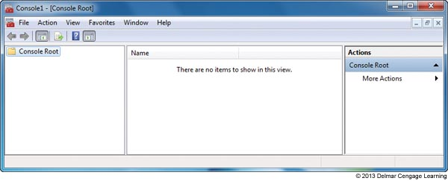
Microsoft Management Console (MMC)
Windows utility to build customized console windows
Console is a single window containing one or more administrative tools
Snap-ins are individual tools in a console
Must be logged in with administrator privileges
Figure 11-22 An empty console

Slide 23
Event Viewer
Eventvwr.msc
Tool for troubleshooting problems with Windows, applications, and hardware
Also a Computer Management console snap-in
Three main types of events that are logged:
Error
Warning
Information

Slide 24
Event Viewer
Views of logs that are most useful:
Administrator Events log: shows only Warning and Error events intended for administrator
Application log: shows events recorded by an application
Security log: includes successful and unsuccessful logins to a user account
Setup log: events when applications are installed
System log: events triggered by Windows components
Forwarded Events log: receives events recorded on other computers

Slide 25
Event Viewer
Save time reviewing logs by using filters
To view most significant events when troubleshooting check Critical and Error under Event level
To save a filtered file:
Right-click the log and select Save Filtered Log File As
To control the size of a log file, you can clear it
Right-click the log and select Clear Log
To control the maximum size of the log file:
Right-click the log and select Properties

Slide 26
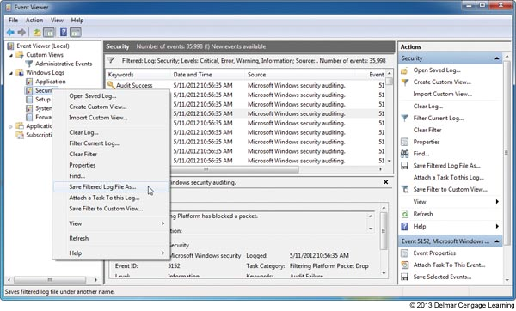
Figure 11-28 Save a filtered log file so that you can view it later

Slide 27
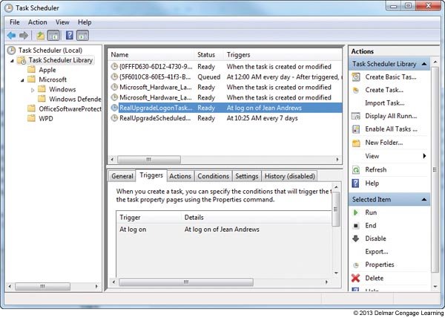
Task Scheduler
Windows Task Scheduler – can be set to launch a task or program at a future time
Figure 11-30
View and manage
tasks from the
Task Scheduler
Window

Slide 28
The Registry Editor
Difficult problems might require editing or removal of a registry key
Registry organization
Registry
Database designed with a treelike structure (i.e., hierarchical database)
Contains configuration information for Windows, users, software applications, and installed hardware devices
Registry built in memory at startup
Windows uses current hardware configuration and information taken from files

Slide 29
The Registry Editor
Five files used to build registry are called hives:
SAM (Security Accounts Manager), Security, Software, System, and Default hives
Registry organized into five treelike structures (called keys)
Each key can have subkeys
Subkeys can have more subkeys and can be assigned one or more values
Data is organized in registry keys differently than the way it is organized in the hive files

Slide 30
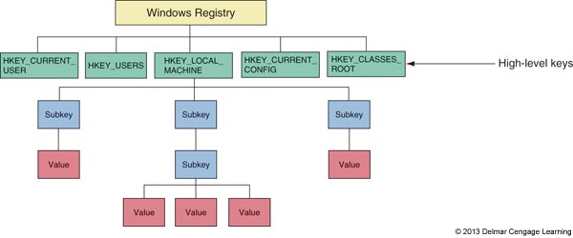
Figure 11-31 The Windows registry is logically organized
in five keys with subkeys

Slide 31
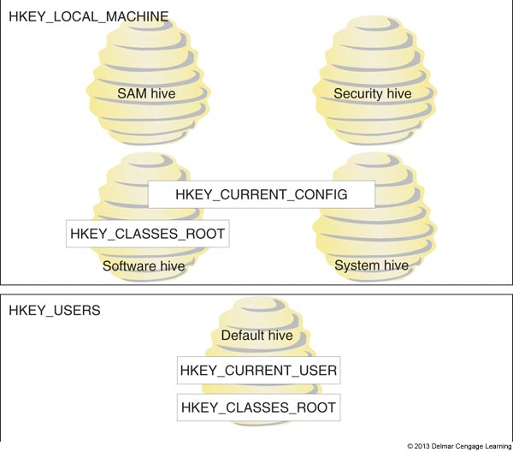
Figure 11-32 The relationship between registry keys and hives

Slide 32
The Registry Editor
Five keys:
HKEY_LOCAL_MACHINE (HKLM)
Contains hardware, software, and security data
HKEY_CURRENT_CONFIG (HKCC)
Used to identify each hardware device
HKEY_CLASSES_ROOT (HKCR)
Used to determine which application opens
HKEY_USERS (HKU)
Contains data about all users
HKEY_CURRENT_USER (HKCU)
Contains data about the current user

Slide 33
The Registry Editor
Before editing the registry
Back up registry
Use System Protection to create a restore point
Back up a single registry key just before editing the key
Make an extra copy of the C:\Windows\System32\config folder
For Windows XP, back up the system state
Back up and restore individual keys
Edit the registry with Registry Editor (regedit.exe)

Slide 34
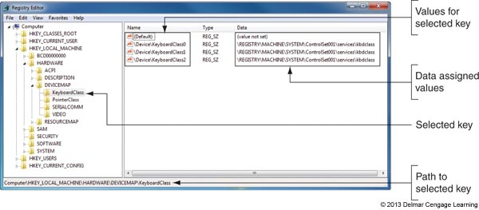
Figure 11-33 The Registry Editor showing the five main keys, subkeys,
values, and data

Slide 35
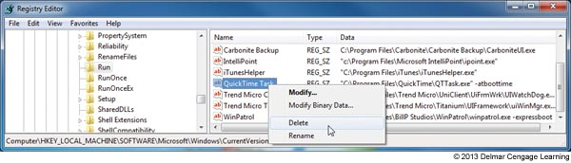
Figure 11-35 Right-click a value to modify, delete, or rename it

Slide 36
Windows 7 Tools to Monitor Performance and Optimize Resources
Windows 7 Performance Information and Tools window
Resource Monitor
Reliability Monitor
Performance Monitor

Slide 37
Performance Information and Tools Window
Give information to evaluate performance of a system
Also adjusts Windows for best performance
To open:
Click Start, right-click Computer, and select Properties. In the System window, click Performance Information and Tools
In the Action Center, click View performance information

Slide 38
Performance Information and Tools Window
The Windows Experience Index evaluates key system components to give a high-level view of the computer’s performance
Five key components are rated on a scale of 1.0 to 7.9
The index is the lowest value of all five ratings (considered to be the bottleneck component for overall performance)

Slide 39
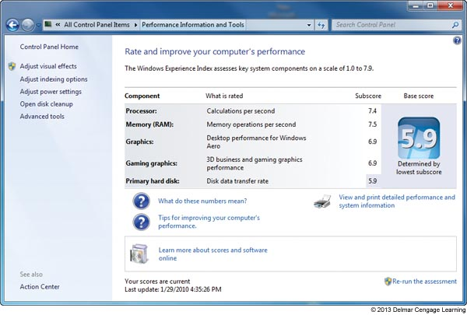
Figure 11-37 The Windows Experience Index give a rating of key
system components in this Windows 7 computer

Slide 40
Windows 7 Resource Monitor
Resource Monitor (resmon.exe) – monitors performance of the processor, memory, hard drive, and network
To access:
In Task Manager, click Resource Monitor on the Performance tab
In the Performance Information and Tools window, click Advanced Tools and click Open Resource Monitor
In Computer Management window

Slide 41
Windows 7 Resource Monitor
The Memory tab in Resource Monitor shows five ways memory is used:
Hardware Reserved memory: used by BIOS and certain drivers (Windows does not have access)
In Use memory: used by other drivers, the OS and applications
Modified memory: available as soon as its contents are written to disk
Standby memory: holding data and code ready to use
Free memory: will be used as the system needs it

Slide 42
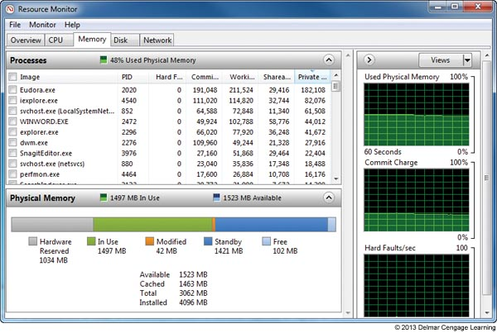
Figure 11-40 The Resource Monitor shows how memory is currently used

Slide 43
Windows 7 Resource Monitor
Easiest way to determine if memory upgrade is needed:
Watch the memory bar as a user works
If Free memory consistently disappears from the graph, a memory upgrade would be helpful
Network tab: useful if you suspect a program is hogging network resources
Look for process in the Processes with Network Activity group

Slide 44
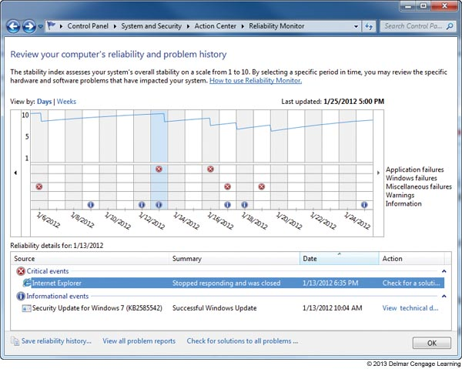
Windows 7 Reliability Monitor
Reliability Monitor - Gives information about problems and errors that happen over time
Figure 11-42 Use the Reliability
Monitor to search for when a
Problem began and what else
Happened about that time

Slide 45
Windows 7 Performance Monitor
Perfmon.msc or Perfmon.exe (another MMC snap-in)
Can track activity by hardware and software to measure performance
Starting the monitor
Click Start, enter perfmon.msc in search box
In Performance Information and Tools window, click Advanced Tools, and click Open Performance Monitor
In Computer Management window, click Performance Monitor

Slide 46
Windows 7 Performance Monitor
Contains hundreds of counters used to examine many aspects of the system
To conserve system resources, only use the counter you really need
Also offers several data collector sets
Data collector set: counters that you can use to collect data about the system and save in a report or a log file
Can create custom data collector sets

Slide 47
Improving Windows Performance
Assuming Windows is starting with no errors
Use 10 step-by-step procedures
Search for problems affecting performance
Clean up Windows startup process
Trouble starting windows
Address those errors first before addressing performance
See Chapters 6

Slide 48
Improving Windows Performance
Step 1: Perform routine maintenance
Verify critical Windows settings
Clean up, defrag, and check the hard drive
Uninstall software you no longer need
Back up data before applying any fixes
Step 2: Clean windows startup
Verify startup programs kept to a minimum
Use Safe Mode to set a benchmark for the time it takes to start Windows when only minimum of programs are launched

Slide 49
Improving Windows Performance
Step 2: Clean windows startup (cont’d.)
Observe performance in Safe Mode
Time a normal startup and a Safe Mode boot
Significant difference: reduce Windows startup to essentials
No improvement indicates problem with hardware or Windows settings (proceed to Step 3)
Investigate and eliminate startup programs
Check for unwanted scheduled tasks
Monitor the startup process

Slide 50
Improving Windows Performance
Step 3: Check if the hardware can support the OS
Use the Windows 7/Vista Windows Experience Index to see if a hardware component might be a bottleneck
Considering upgrading the component if you find it is creating a bottleneck
May also have to consider an upgrade to the OS to solve performance issues

Slide 51
Improving Windows Performance
Step 4: Check for performance warnings
Use Performance Information and Tools window to view performance issues
Clicking an issue
Displays dialog box describing the issue
Gives suggestions to resolve it
Investigate each issue one at a time
Tools to assist in troubleshooting are listed in Advanced Tools window
Windows XP does not offer Advanced Tools – Use Event Viewer and view System log instead

Slide 52
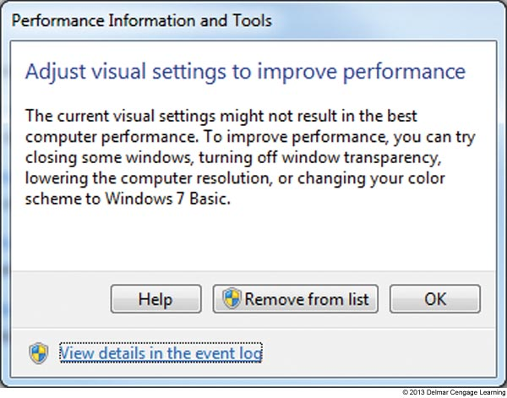
Figure 11-51 Windows reports that current visual settings are
affecting performance

Slide 53
Improving Windows Performance
Step 5: Check for a history of problems
Determine if a problem with hardware or software installation is affecting performance
Determine when time problem started
Use Windows 7 or Vista Reliability Monitor
Find out what changes were made around the time the problem started
See if other problems occurred

Slide 54
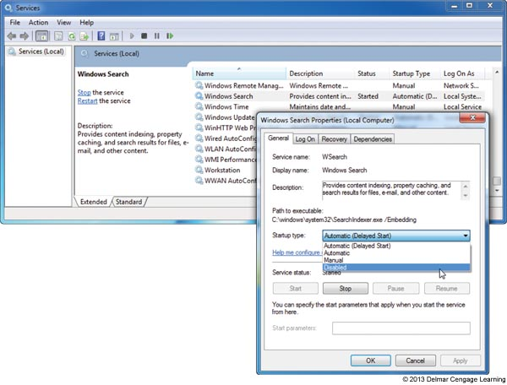
Improving Windows Performance
Step 6: Disable the indexer for Windows search
May cause performance problems
Figure 11-53
Disable the Windows
Search service

Slide 55
Improving Windows Performance
Step 7: Plug up any memory leaks
Caused when an application does not properly release memory allocated to it that it no longer needs
Use Task Manager Processes tab
Click View and Select Columns
Verify Memory Private Working Set, Handles, and Threads columns are checked
Watch values over time for increases
Solving memory leak
Obtain update or patch from program manufacturer’s Web site

Slide 56
Improving Windows Performance
Step 8: Consider using ReadyBoost
Flash drive or secure digital (SD) memory card used to boost hard drive performance
Acts as a buffer to speed up access time
Best for hard drive running at less than 7200 RPM
Windows automatically tests device qualifications
256 MB to 4 GB, 256 MB free space, 2 MB/sec of throughput
Step 9: Disable the Aero interface
Uses memory and computing power
May require memory or video card upgrade

Slide 57
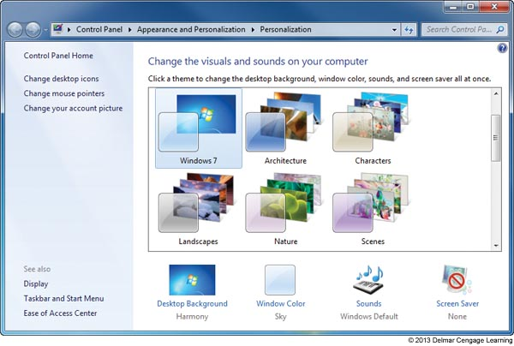
Figure 11-58 Disable the Windows 7 Aero interface to conserve
system resources

Slide 58
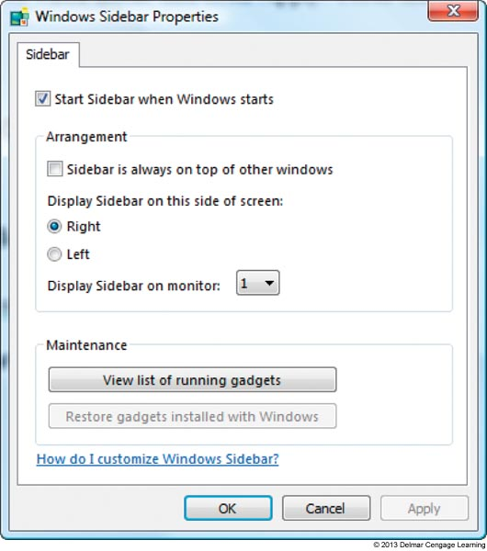
Improving Windows Performance
Step 10: Disable the Vista Sidebar
Might see slight performance improvement
Figure 11-60 Disable the Vista sidebar
to improve performance

Slide 59
Manually Removing Software
Manually uninstall
Programs refusing to uninstall or giving errors when uninstalling
Use as a last resort
Try program’s uninstall routine
Delete the program folders and files
Delete the registry entries used by the software
Remove entries in the Start menu and delete shortcuts
Remove any entries that launch processes at startup

Slide 60
Manually Removing Software
Step 1: First try the uninstall routine
Can be access from the Windows 7/Vista Programs and Features window, the XP Add Remove Programs window, or an uninstall utility in the All Programs menu
Step 2: Delete Program files
Look for the program folder in one of these folders:
C:/Program Files
C:/Program Files (x86)

Slide 61
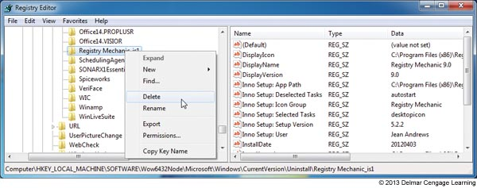
Manually Removing Software
Step 3: Delete Registry entries
Editing the registry can be dangerous – back up first!
Follow steps outlined on pages 204-205
Figure 11-65 Delete the registry key that lists the software as installed software

Slide 62
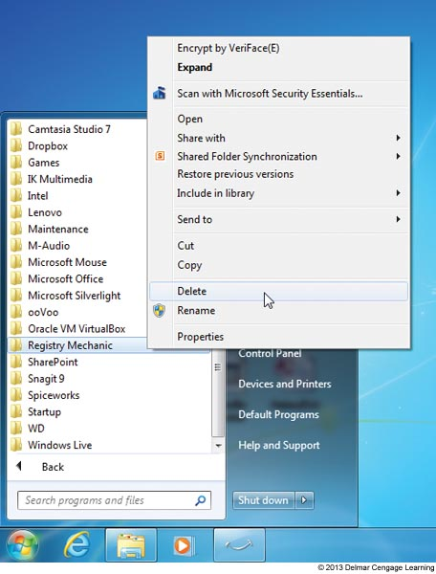
Manually Removing Software
Step 4: Remove the program from the All Programs menu and the Desktop
Figure 11-66 Delete the program
From the All Programs menu

Slide 63
Manually Removing Software
Step 5: Remove Startup processes
Restart the PC and watch for any startup errors about a missing program file
Use MSconfig to find out how the program is set to start
This entry point is called an orphaned entry
You’ll need to delete this startup entry by editing the registry, deleting a shortcut in a startup folder, or disabling a service using the Services console

Slide 64
Manually Removing Software
Registry keys that affect startup and logon events:
If a system is giving repeated startup errors you may want to search through registry keys where startup processes can be located
See Appendix G for a list of registry keys and startup folders

Slide 65
Summary
Windows OS is made up of two main components: the shell and the kernel
Tools to optimize Windows
Task Manager
Administrative Tools group of Control Panel
System Configuration Utility (MSconfig)
Services console
Computer Management console
Microsoft Management Console (MMC)
Event Viewer

Slide 66
Summary
Tools to optimize Windows (continued):
Registry Editor (regedit.exe)
Performance Information and Tools window
Windows 7 Resource Monitor
Windows 7 Reliability monitor
Windows 7 Performance Monitor
Vista Reliability and Performance Monitor (an earlier version of the three Windows 7 tools above)
XP Performance Monitor (System Monitor) – is an earlier version of the Windows 7 Performance Monitor

Slide 67
Summary
To troubleshoot a sluggish Windows system
Follow the 10 step performance troubleshooting process discussed in this chapter
If software does not uninstall correctly you can manually uninstall the software
To manually delete software:
Delete the program files, entries in the All Programs menu, registry keys, and items in startup folders

