Slide 1

A+ Guide to Managing & Maintaining Your PC, 8th Edition
Chapter 12
Troubleshooting Windows and Applications

Slide 2
Objectives
Learn about Windows tools to help you when troubleshooting Windows and application problems
Learn about general strategies and steps you can take to troubleshoot and solve any computer problem
Learn how to troubleshoot blue screen stop errors and improper shutdowns
Learn how to troubleshoot problems with applications

Slide 3
Overview of Windows Troubleshooting Tools
Refer to Table 5-1 on pages 212-216 for a quick reference of the many troubleshooting tools offered in Windows

Slide 4
Strategies To Troubleshoot Any Computer Problem
Should first approach the problem as an investigator
Be careful not to compound the problem through actions before discovering as much as you can about the problem
Ask questions until you understand the source of the problem
A systematic method used by most expert troubleshooters is introduced in this chapter
Refer to the diagram on the next slide and on page 217 of the text

Slide 5
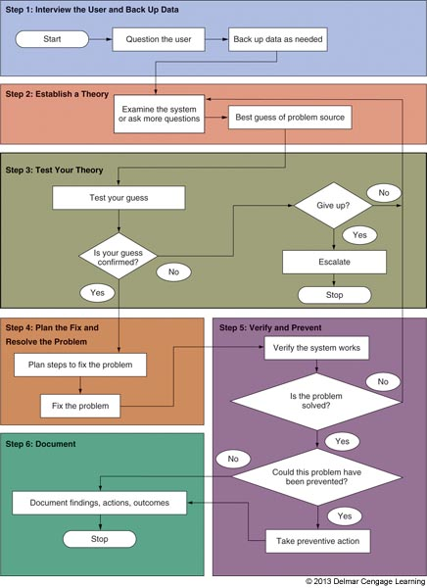
Figure 12-1 General approach to problem solving

Slide 6
Strategies To Troubleshoot Any Computer Problem
There are 13 rules introduced throughout the chapter that might be useful when troubleshooting
Here is Troubleshooting Rule #1: Approach the Problem Systematically
Start at the beginning and walk through it carefully
If you find more than one problem on the same computer, work on only one problem at a time
Trying to solve more than one at a time can get very confusing

Slide 7
Step 1: Interview the User and Back Up Data
Some possible questions to ask:
Please describe the problem. What error messages, unusual displays, or failures did you see?
When did the problem start?
What was the situation when the problem occurred?
What programs or software were you using?
What changes have recently been made to the system?
Has there been a recent thunderstorm or electrical problem?

Slide 8
Step 1: Interview the User and Back Up Data
Some possible questions to ask (cont’d):
Have you made any hardware, software, or configuration changes?
Has someone else used your computer recently?
Is there some valuable data on your system that is not backed up that I should know about before I start working on the problem?
Can you show me how to reproduce the problem?

Slide 9
Step 1: Interview the User and Back Up Data
Troubleshooting Rule #2: Establish Your Priorities
Decide what your first priority is
When practical, ask user for help deciding priorities
Troubleshooting Rule #3: Beware of User Error
If you suspect this, ask user to show you the problem and watch what the user is doing
Troubleshooting Rule #4: Keep Your Cool and Don’t Rush
A wrong move can be costly – carefully plan your moves and research the problem

Slide 10
Step 1: Interview the User and Back Up Data
Back up any important data that is not currently backed up before you begin working
If computer won’t boot to Windows desktop, use Windows Explorer to copy files to a flash drive
If Windows Explorer can’t be used
Remove the hard drive and connect to a USB port on another computer
Copy the data to the other computer

Slide 11
Step 2: Examine The System and Make Your Best Guess
Troubleshooting Rule #5: Make No Assumptions
Hardest rule to follow
Do your own investigating after the user tells you about the problem
Troubleshooting Rule #6: Try the Simple Things First
Most problem are easy to fix
Check simple things first
Example: if USB drive is not working, verify the drive works on another computer before verifying drivers

Slide 12
Step 2: Examine The System and Make Your Best Guess
Follow this process to form best theory and test:
Reproduce the problem and observe for yourself what the user described
Decide if the problem is hardware or software related
Make your best guess as to the source of the problem
Example: if video does not work, a best guess is the monitor cables are loose or the monitor is turned off
Troubleshooting Rule #7: Become a Researcher
Search the web, ask questions, read documentation, make phone calls

Slide 13
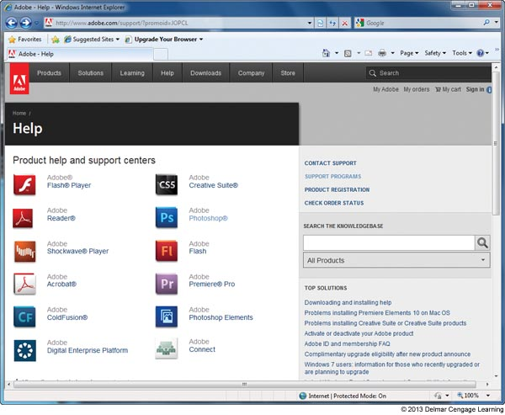
Figure 12-2 Search the manufacturer web sites for help with a
hardware or software product

Slide 14
Step 3: Test Your Theory
Example of a test:
Video does not work and you suspect loose cables
Check the connection and discover that it is loose
Connect it securely and problem is solved
Example that includes testing an incorrect guess:
CD drive won’t read a CD, suspect a scratched CD
CD looks fine, no scratch
Next guess, CD drive is not recognized by Windows
Check Device Manager and it reports errors
Next guess, drivers are corrupted

Slide 15
Step 3: Test Your Theory
Troubleshooting Rule #8: Divide and Conquer
Isolate the problem – Remove one hardware or software component after another until the problem is isolated
Try the following:
In Windows, stop all nonessential services running in the background
Boot from a bootable CD or DVD to eliminate OS on the hard drive
Start Windows in Safe Mode to eliminate unnecessary startup programs

Slide 16
Step 3: Test Your Theory
Troubleshooting Rule #9: Write Things Down
Take notes, draw diagrams, make lists
Troubleshooting Rule #10: Don’t Assume the Worst
When working with a hard drive that is not working, don’t assume that data is lost
Troubleshooting Rule #11: Reboot and Start Over
Take a break, walk away from the problem
Come back and begin again

Slide 17
Step 4: Plan Your Solution and Then Fix the Problem
Troubleshooting Rule #12: Use the Least Invasive Solution First
Fix the problem so that they system returns to normal working condition with the least amount of effort
Troubleshooting Rule #13: Know Your Starting Point
Find out what works and doesn’t work before you take anything apart

Slide 18
Step 4: Plan Your Solution and Then Fix the Problem
Plan your solution and fix the problem:
Consider different solutions and select the least invasive one
Before applying your solution, determine what works and what doesn’t work
Fix the problem

Slide 19
Step 5: Verify the Fix and Take Preventative Action
After problem is fixed:
Reboot the system and verify all is well
Have the user check everything and verify also
Ask yourself this question: Could this problem have been prevented?
If so, instruct the user on what to do, set Widows to automatically install updates, etc…

Slide 20
Step 6: Document What Happened
Reasons to document:
Help when troubleshooting the next situation
Train others
Develop effective preventative maintenance plans
Satisfy any audits or employer queries about your work
Many companies use Help Desk Software to record this information

Slide 21
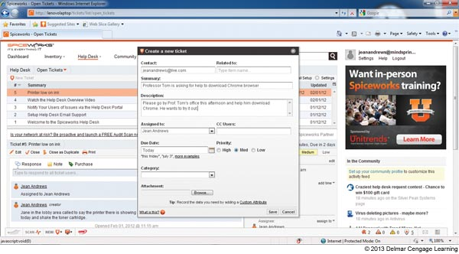
Figure 12-5 Help Desk Software allows you to create, edit,
and close tickets used by technicians

Slide 22
Troubleshooting Blue Screen Errors and Improper Shutdowns
Blue screen error: happens when processes running in kernel mode encounter a problem and Windows must stop
Also known as a stop error or blue screen of death (BSOD)
A stop error at the top and the specific number of the error at the bottom will help with troubleshooting

Slide 23
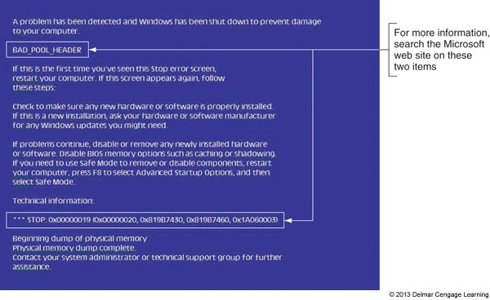
Figure 12-6 A blue screen of death (BSOD) is definitively not a good sign

Slide 24
Troubleshooting Blue Screen Errors and Improper Shutdowns
How to deal with blue screen errors after startup:
Search the Microsoft web site
If a device driver or service that caused the problem is listed, use Windows Explorer to locate the program file
You can try to reinstall the device or program
After a restart, a Windows error message box might appear with useful information
Check Event Viewer
Check Archived Messages in the Action Center
In Vista, check Problem Reports and Solutions window

Slide 25
Troubleshooting Blue Screen Errors and Improper Shutdowns
How to deal with blue screen errors after startup (cont’d):
Use Windows Updates to apply patches
Undo any recent changes
If unsure which changes to undo, consider using System Restore
Use Memory Diagnostics tool to check memory
Use Chkdsk /r to check the hard drive for errors

Slide 26
Troubleshooting Blue Screen Errors and Improper Shutdowns
Common blue screen errors:
BAD_POOL_HEADER – could occur for a variety of reasons such as a corrupted Windows update, bad memory, or a corrupted application
NTFS_FILE_SYSTEM – hard drive might be corrupted
KERNEL_DATA_INPAGE_ERROR – could not read the paging file
UNEXPECTED_KERNEL_MODE_TRAP – most likely caused by bad memory
DIVIDE_BY_ZERO_ERROR – most likely caused by an application

Slide 27
Windows 32-Bit and 64-Bit Patches
Must get a 32-bit patch for a 32-bit installation of Windows, a device driver, or an application
For a 64-bit installation of Windows:
Must get a 64-bit device driver
An application could be a 32-bit or 64-bit application
Guidelines when reading error messages:
The term x86 refers to 32-bit CPUs and operating systems
All CPUs in PCs today are hybrid processors
The term x86-64 refers to these processors and also may refer to a 64-bit OS

Slide 28
Windows 32-Bit and 64-Bit Patches
Guidelines when reading error messages (cont’d):
The term IA64 refers to 64-bit Intel processors
The term x64 refers to 64-bit operating systems

Slide 29
Memory Diagnostics
Identifies problem with memory
Eliminates memory as problem source
Use one of these methods to start the utility
Command Prompt window command: mdsched.exe
If Windows desktop will not load, press Spacebar during the boot
Select Windows Memory Diagnostic from the Windows Boot Manager screen
If you cannot boot from the hard drive, boot from the Windows setup DVD
Click Repair your computer then click Windows Memory Diagnostic

Slide 30
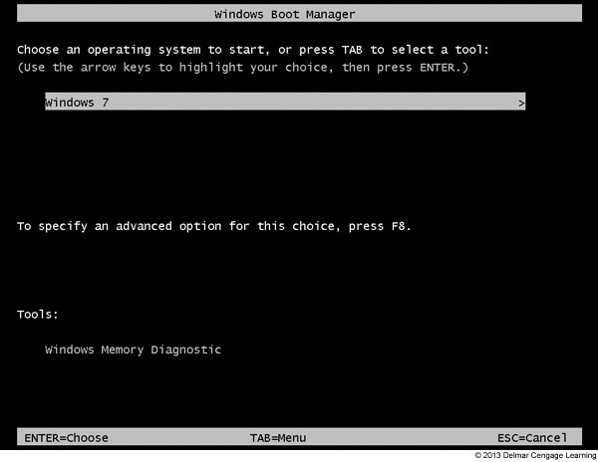
Figure 12-9 Force the Windows Boot Manager menu to display by
pressing the Spacebar during the boot

Slide 31
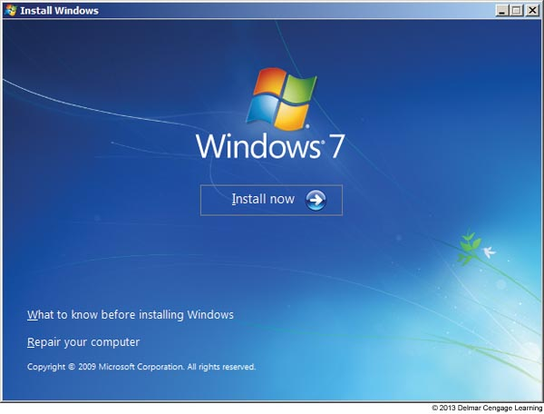
Figure 12-10 Opening menu when you boot from the Windows 7 setup DVD

Slide 32
System File Checker
System file checker (SFC)
SFC protects system files and keeps cache current
Can refresh a damaged file
Run SFC in elevated command prompt window: sfc /scannow
If corrupted system files are found, might need the Windows setup DVD to restore files
If SFC won’t run using the above command, try the command sfc /scanonce
Will scan files immediately after the next reboot

Slide 33
Dealing with Improper Shutdowns
Hardware that can cause these errors:
Memory, motherboard, CPU, video card, or the system overheating
When these error occur:
Check Event Viewer – look for hardware failure
Apply any Windows patches
Use Memory Diagnostics and Chkdsk /r
If overheating is suspected, go into BIOS setup and check the temperature of the CPU
Should not exceed 38 degrees C

Slide 34
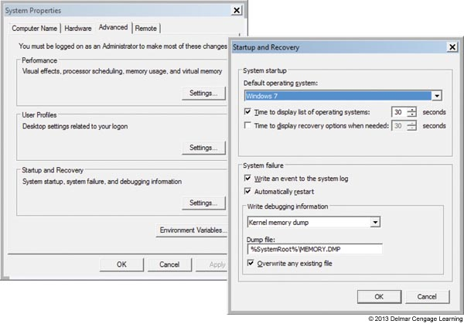
Dealing With Endless Shutdowns and Restarts
If caught in an endless cycle of restarts:
Boot into Safe Mode where you can change the Windows setting to control automatic restarts
Figure 12-15 Use the Startup
and Recovery box to change
the way Windows responds
to a stop error

Slide 35
Troubleshooting Applications
Problems with an application might be caused by:
The application
Hardware
The operating system
Data
Other applications in conflict with the application
User

Slide 36
General Steps For Solving Application Errors
Step 1: Interview the User and Back Up Data
Ask the user to reproduce the problem while you watch
Try a reboot
Step 2: Error Messages, The Web, and Logs Might Help
Check Windows 7 Action Center
Check Vista Problem Reports and Solutions window
For XP error dialog boxes, click Send Error Report and follow links to find out more information

Slide 37
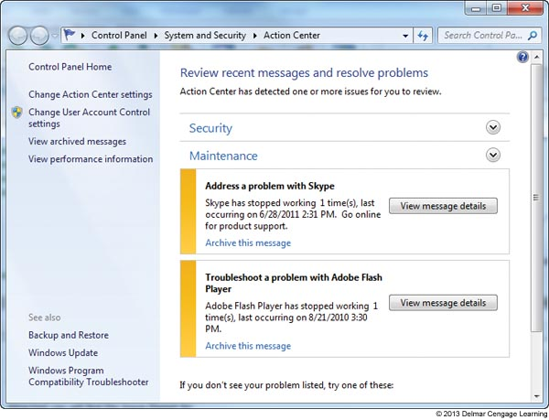
Figure 12-16 Windows 7 reports problems with two applications

Slide 38
General Steps For Solving Application Errors
Step 2: Error Messages, The Web, and Logs Might Help (cont’d):
Search the web for help
Use Event Viewer and Reliability Monitor to look for clues
Step 3: Consider the Data or the Application is Corrupted
Application settings might be wrong
Uninstall and reinstall the application

Slide 39
General Steps For Solving Application Errors
Step 4: Consider Outside Interference
Suspect a virus
System resources might be low
Another application might be interfering
A service may have failed to start
Bad memory
Corrupted hard drive
A background program might be conflicting with the application

Slide 40
General Steps For Solving Application Errors
Step 5: Consider Windows Might Be the Problem
A problem with an application might be solved by updating or restoring Windows system files
Download Windows updates
Use System File Checker to verify and replace system files
Use System Restore

Slide 41
Responding To Specific Error Messages
When An Application Hangs:
Use Task Manager to end it
If Task Manager can’t end it, use the Tasklist and Taskkill commands
Tasklist command returns the process identify (PID)
Taskkill command uses the process ID to kill the process
Example:
use taskkill | more to list running processes
Note the PID of the process you want to end (ex. 2212)
Enter taskkill /f /pid:2212 to forcefully kill the process

Slide 42
Responding To Specific Error Messages
When a File Fails to Open
The application is not installed or the file extension is wrong
A program associated with a file extension is called a default program
Use the Default Programs window to change the program associated with a file extension
Data Sources Open Database Connectivity (ODBC) tool: can be used to allow data files to be connected to applications they normally would not use

Slide 43
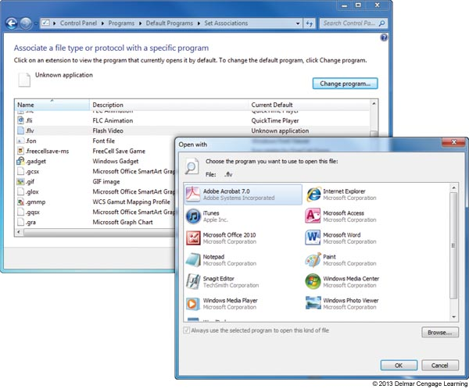
Figure 12-21 Select the default program to associate with a file extension

Slide 44
Responding To Specific Error Messages
When a Service Fails to Start
Can be caused by a corrupted or missing service program
Check the Service console to make sure the service is set to start automatically
Use the service’s Properties box to find the path and filename to the executable program
Next, use Windows Explorer to make sure the program file is not missing

Slide 45
Responding To Specific Error Messages
When A DLL Is Missing or a Component Is Not Registered
Most applications have many small programs called components that serve the main program
These small component services often have a .DLL extension (Dynamic Link Library)
When an error message appear about a missing DLL
Reinstall the application
Recover it from backup or from the application installation files

Slide 46
Responding To Specific Error Messages
When A DLL Is Missing or a Component Is Not Registered (cont’d)
The relationship between the main program and the component might be broken
Use a Microsoft Management Console snap-in called Component Services (COM+) to register components
On older versions of Windows use the Regsvr32.exe program to register the component

Slide 47
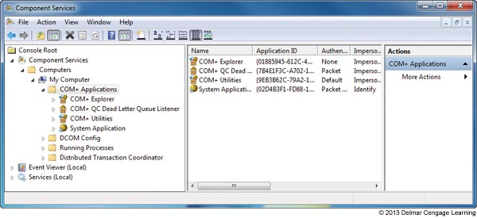
Figure 12-26 Use the Component Services window to register
components used by an application

Slide 48
Responding To Specific Error Messages
When the Application Has Never Worked
Update Windows and search the web
Run the installation program or application as an administrator
Consider whether an older application is having compatibility problems with Windows
Verify that the application is digitally signed

Slide 49
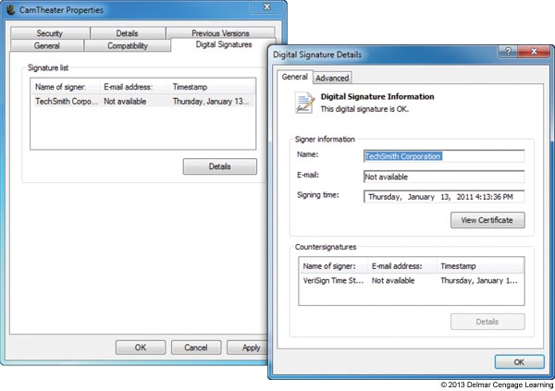
Figure 12-30 This program is digitally signed

Slide 50
Summary
There are many Windows tools that can be used to help find a solution to a problem with a system
Many technicians use a six step troubleshooting process to help them solve PC related problems
To solve blue screen stop errors, use the web, Event Viewer, Windows updates, System Restore, Memory Diagnostics, and Chkdsk to examine the system and solve the problem
Microsoft calls 32-bit OSs x86-based OSs and x64 applies to 64-bit OSs

Slide 51
Summary
Use the System File Checker (SFC) tool to verify and restore system files
Windows error messages and logs can help examine a system looking for the source of an application problem
Applying Windows patches and repairing system files can sometimes solve an application problem

