Slide 1

A+ Guide to Managing & Maintaining Your PC, 8th Edition
Chapter 13
Troubleshooting Hardware Problems

Slide 2
Objectives
Learn how to approach and solve a computer problem related to hardware, especially when the problem occurs during the boot
Learn how to troubleshoot problems with the electrical system
Learn how to troubleshoot problems that occur during POST before video is active
Learn how to troubleshoot error messages that occur during the POST

Slide 3
Objectives
Learn how to troubleshoot problems with the motherboard, processor, and RAM
Learn how to troubleshoot hard drive problems
Learn how to troubleshoot problems with the monitor and video
Learn about protecting a computer and the environment

Slide 4
How to Approach A Hardware Problem
First step: Interview the customer
Include these questions:
Can you describe the problem, when did it first start, and when does it occur?
Was the computer recently moved?
Was any new hardware or software recently installed?
Was any software recently reconfigured or upgraded?
Did someone else use your computer recently?

Slide 5
How to Approach A Hardware Problem
Include these questions (cont’d):
Does the computer have a history of similar problems?
Is there important data on the drive that is not backed up?
Can you show me how to reproduce the problem?
After gathering information:
Prioritize what to do and begin diagnosing and addressing the problem

Slide 6
How to Approach A Hardware Problem
Troubleshooting resources:
User manuals
Internet
Chat, telephone, or email technical support
Manufacturer’s diagnostic software
Technical associates in your organization
Technicians need a game plan on how to solve PC problems
The flowchart on the following slide is a great example

Slide 7
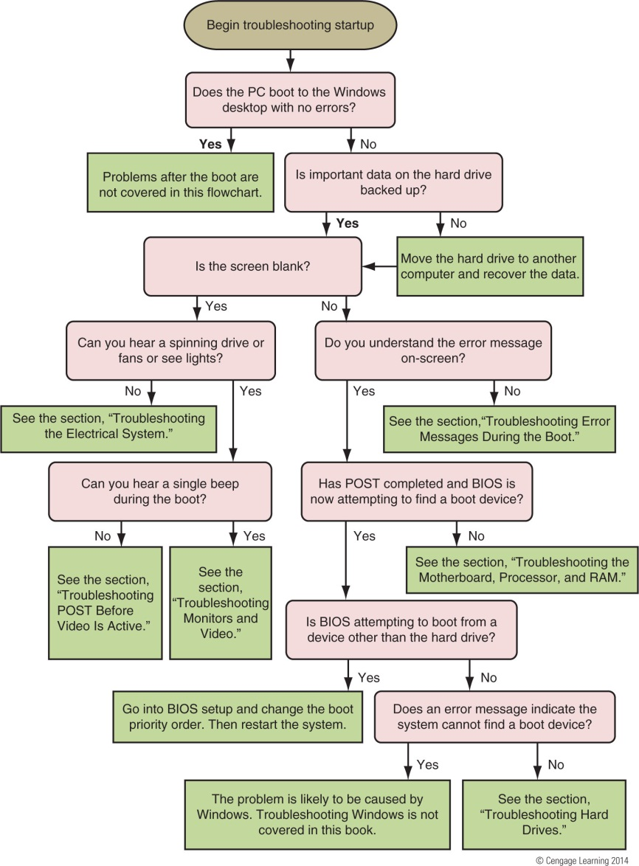
Figure 13-2 Use this flowchart when first facing a computer problem

Slide 8
How to Approach A Hardware Problem
On a computer that is not booting properly:
If the hard drive has important data on it, consider moving the hard drive to a working computer as a second drive
No need to install the drive in a bay, just connect it with a data cable and power cable
Use Windows Explorer to copy files from non-booting drive to the hard drive of the working computer
Return drive to the original system and continue trying to solve the original problem

Slide 9
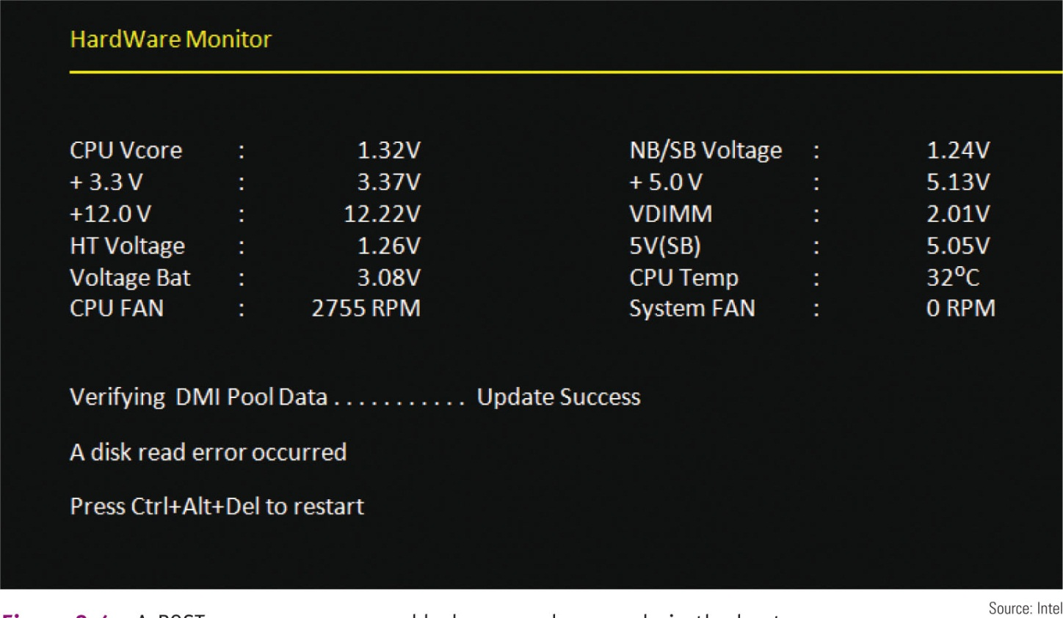
Figure 13-4 A POST error message on a black screen shown early in the boot

Slide 10
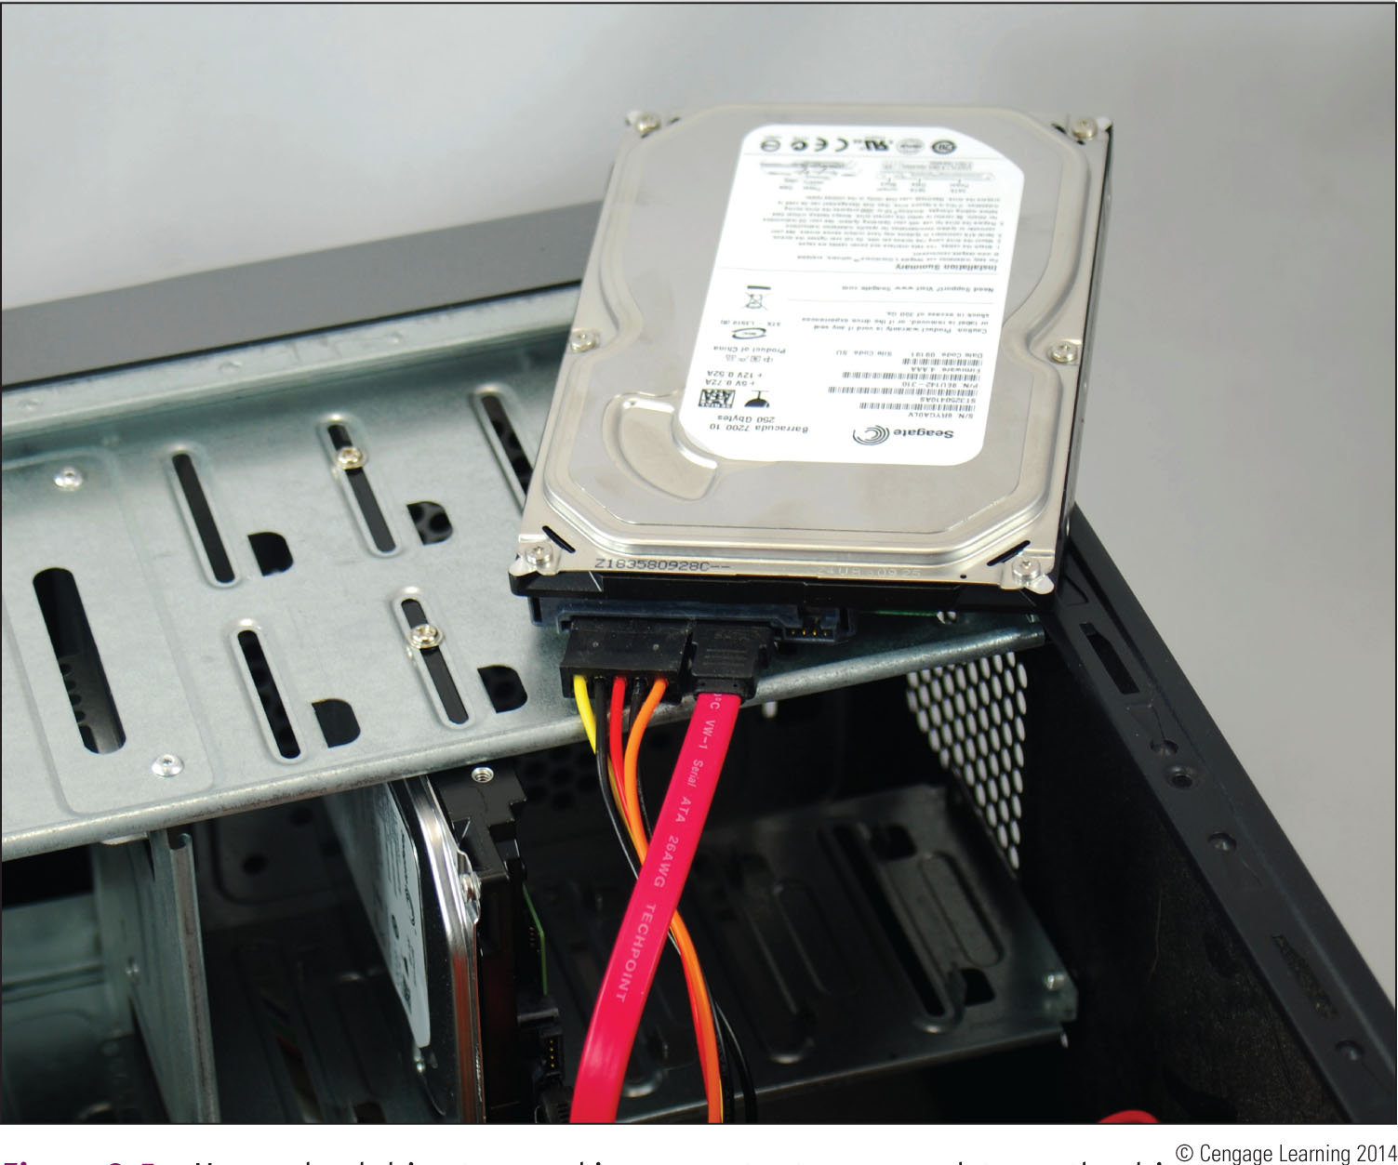
Figure 13-5 Move a hard drive to a working computer to recover data on the drive

Slide 11
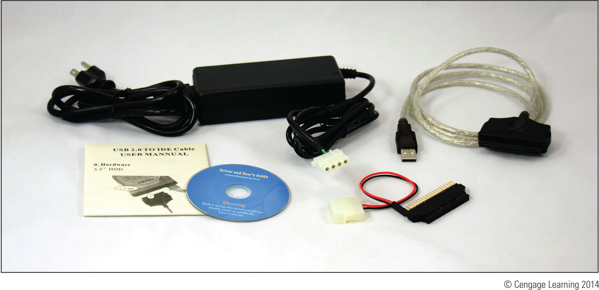
Figure 13-6 Use an IDE-to-USB converter for diagnostic testing and to
recover data from a failing PATA hard drive

Slide 12
Troubleshooting the Electrical System
Electrical problems can:
Occur before or after the boot
Be consistent or intermittent
Possible symptoms of electrical problem:
PC appears to be “dead”
PC sometimes locks up during booting
Error codes or beeps occur during booting
Smell burnt parts or odors
PC powers down at unexpected times
PC appears dead except you hear a whine coming from the power supply

Slide 13
Troubleshooting the Electrical System
Try these simple things first:
If you small any burnt part, don’t turn system on
Find burnt up part and replace
If power supply is whining, don’t turn system on
Open case and look for short or consider upgrading
Test power supply with a power supply tester
Check power cord connection and power bar it may be plugged into
Is power outlet controlled by wall switch? If so, turn it on
Are any cable connections loose?

Slide 14
Troubleshooting the Electrical System
Try these simple things first (cont’d):
Is the circuit breaker blown? Is the house circuit overloaded?
Are all switches on the system turned on?
Is it possible the system has overheated? If so, wait awhile and try again
Older computers might be affected by electromagnetic interference (EMI)
Check for sources of EMI such as fluorescent lighting or an electric fan or copier sitting near PC

Slide 15
Problems That Come and Go
Generally, intermittent problems are more difficult to solve
Symptoms of what may be an intermittent problem:
Computer stops or hangs for no reason
Memory errors appear intermittently
Data is written incorrectly to the hard drive
Keyboard stops working at odd times
Motherboard fails or is damaged
Power supply overheats and becomes hot to touch
Power supply fan whines and becomes noisy

Slide 16
Power Problems With the Motherboard
Short might occur if a motherboard component makes improper contact with the chassis
Can seriously damage the motherboard
Check for missing/loose standoffs or loose screws
Shorts in motherboard circuits might also cause problems
Look for damage on the bottom of the motherboard
Look for burned-out capacitors that are spotted brown or corroded

Slide 17
Problems With Overheating
Symptoms of overheating:
System hangs or freezes at odd times or after the boot starts
Windows BSOD (blue screen of death) error occurs during the boot
You cannot hear a fan running or the fan makes a whining sound
You cannot feel air being pulled into or out of the case
You can purchase a temperature sensor that will sound an alarm when the inside of the case is too hot

Slide 18
Problems With Overheating
Things to do to solve overheating:
If system hangs, go into BIOS setup and find the CPU screen that reports temperature (should not exceed 38 degrees C)
Use compressed air, a blower, or antistatic vacuum to remove dust from the power supply and vents
Check airflow inside the case to see if fans are running (may need to replace a fan)
Install extra fans if case will hold them
Can the side of the case hold a chassis air guide that guides air to the processor? If so, install one

Slide 19
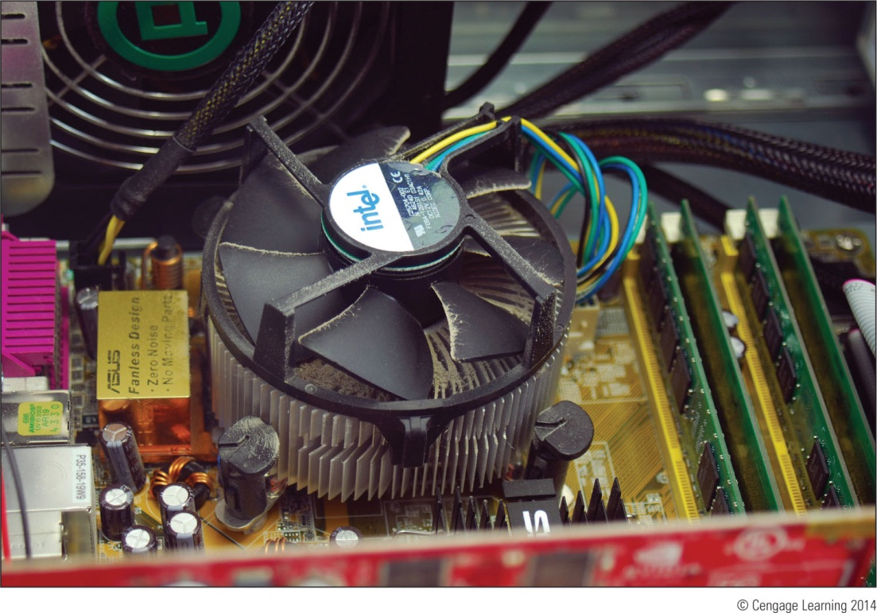
Figure 13-9 Dust in the cooler fan can cause the fan to fail and the
processor to overheat

Slide 20
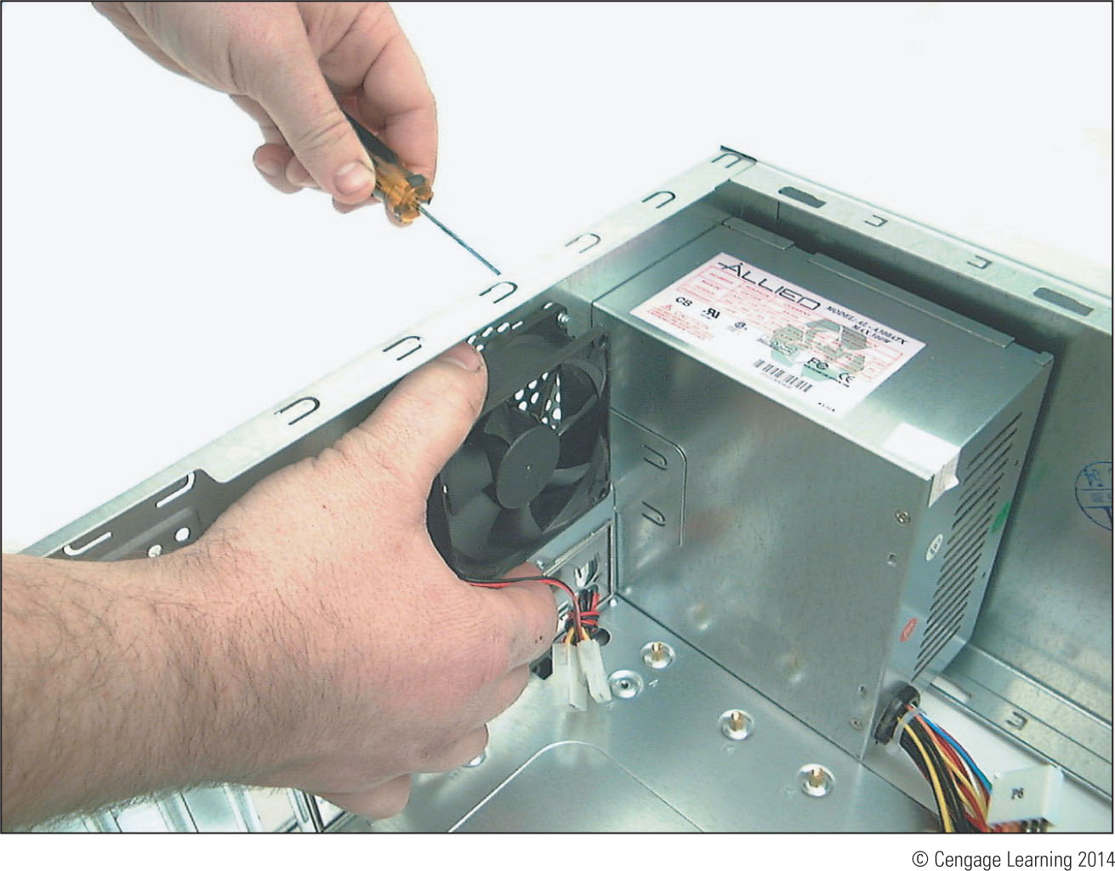
Figure 13-10 Install one exhaust fan on the rear of the case
to help pull air through the case

Slide 21
Problems With Overheating
Things to do to solve overheating (cont’d):
To improve airflow, replace missing faceplates and expansion slot covers
Ensure cables are not in the way of airflow
Place case so that there are a few inches of space on both sides and the top of the case
Verify the cooler is connected properly to the processor
After closing the case, leave system off for at least 30 minutes

Slide 22
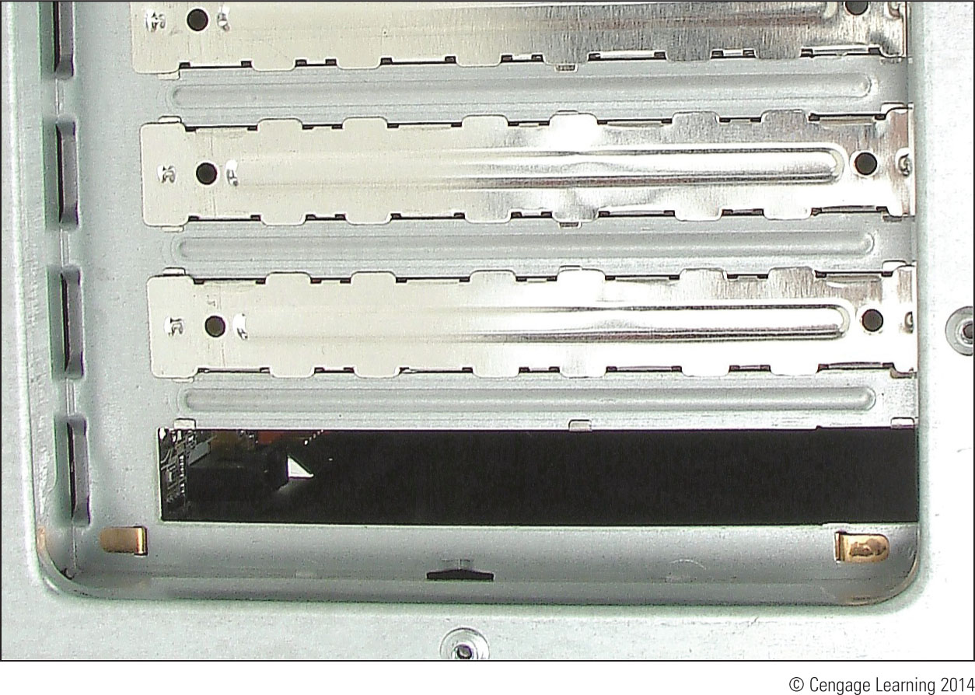
Figure 13-11 For optimum airflow, don’t leave empty expansion
slots and bays uncovered

Slide 23
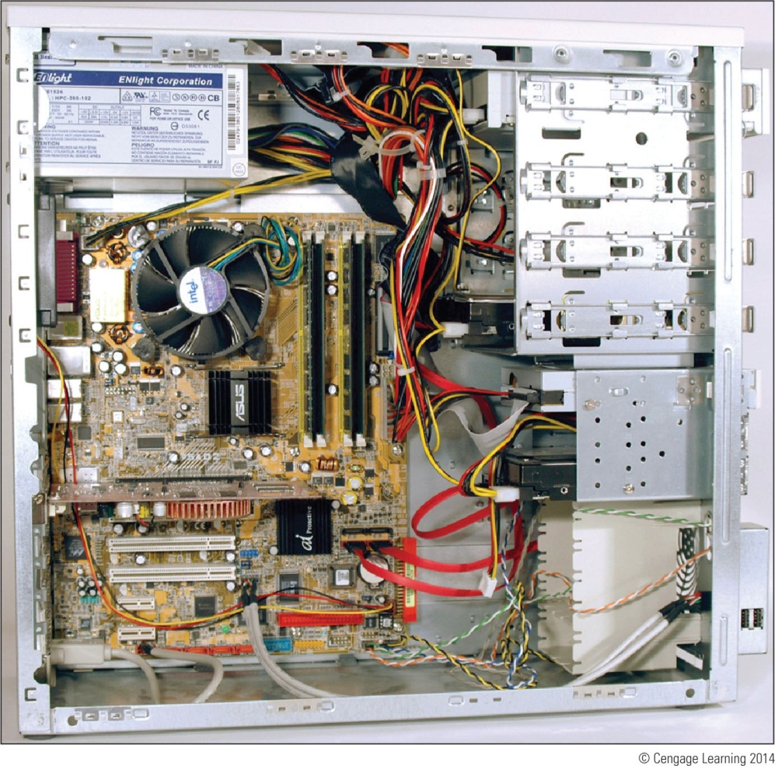
Figure 13-12 Use cable ties to hold cables out of the way of fans and airflow

Slide 24
Problems With Overheating
Things to do to solve overheating (cont’d):
Check BIOS setup to see if the processor is being overclocked (can cause system to overheat)
Have too many peripherals been installed inside the case? Try to leave an empty slot between each card
Flash BIOS to update firmware on motherboard
Replace thermal compound if it has hardened

Slide 25
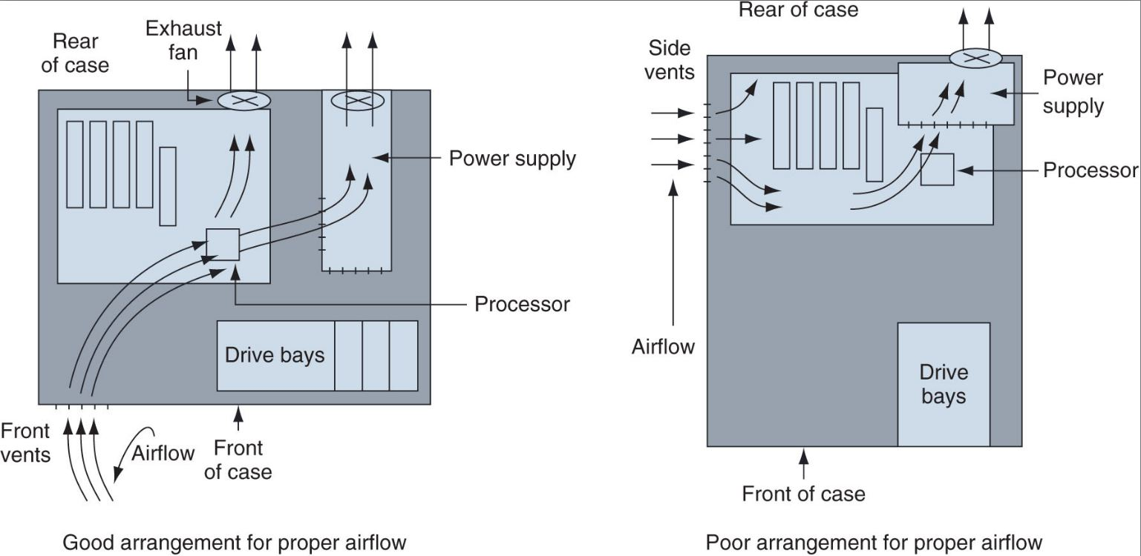
Figure 13-14 Vents and fans need to be arranged for best airflow

Slide 26
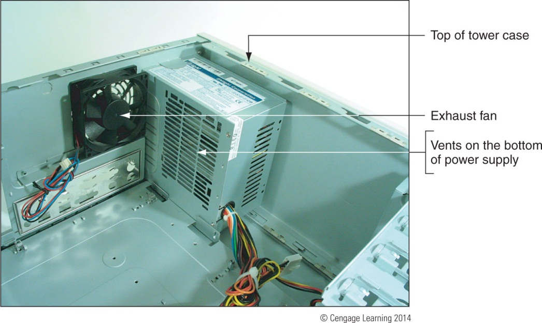
Problems With Overheating
Use a power supply that has vents on the bottom and front for better ventilation
Figure 13-15 This power supply has vents on the bottom to
provide better airflow inside the case

Slide 27
Troubleshooting POST Before Video Is Active
If power is getting to system, but screen is blank:
Turn off and then back on
Listen carefully to any beep codes or BIOS speech messages
One beep or no beep indicates all is well
If you hear more than one beep
Look up beep code in the motherboard or BIOS documentation

Slide 28
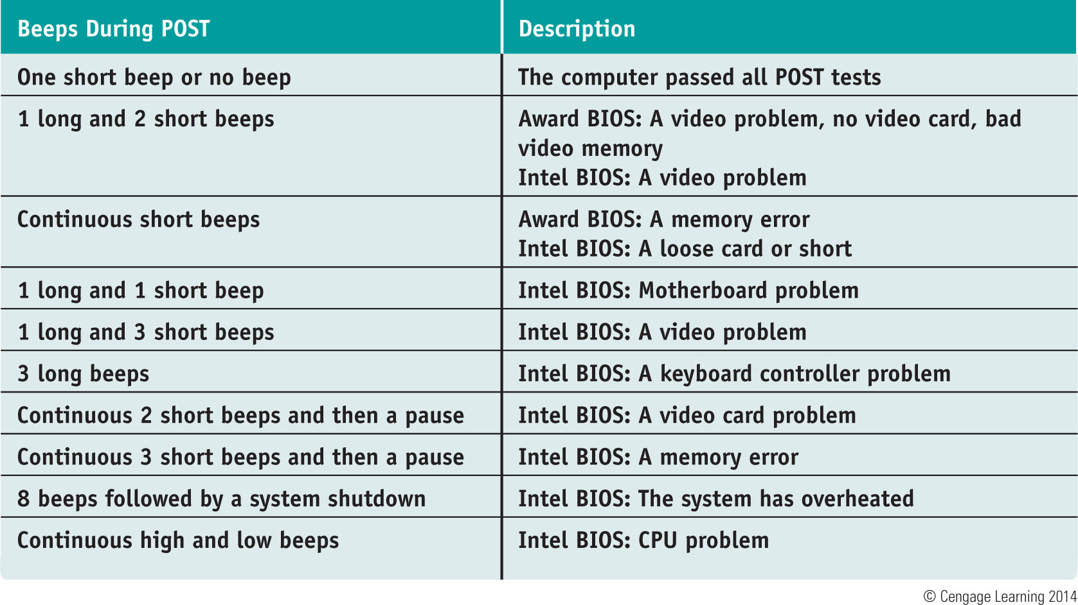
Table 8-2 Common beep codes and their meanings for Intel and Award BIOS

Slide 29
Troubleshooting Error Messages During the Boot
If video and electrical systems are working
Most boot problems show up as an error message on the screen
Error messages that occur before Windows starts to load usually apply to hardware components
See table on following slide
If Windows boot manager program has problems loading Windows
Different set of error messages will be displayed

Slide 30
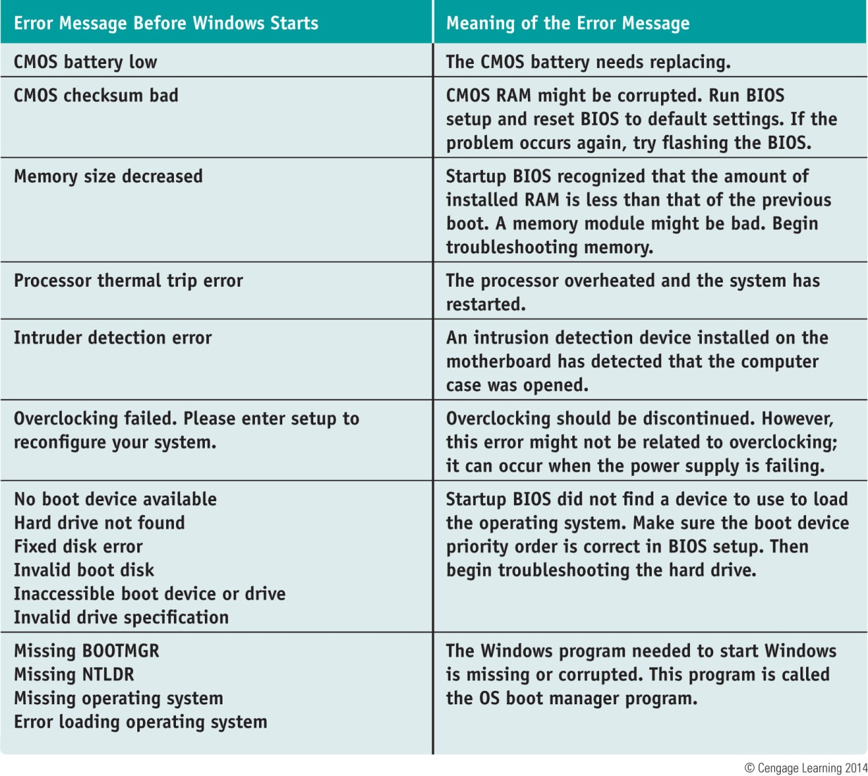
Table 8-3 Error messages that occur before Windows starts

Slide 31
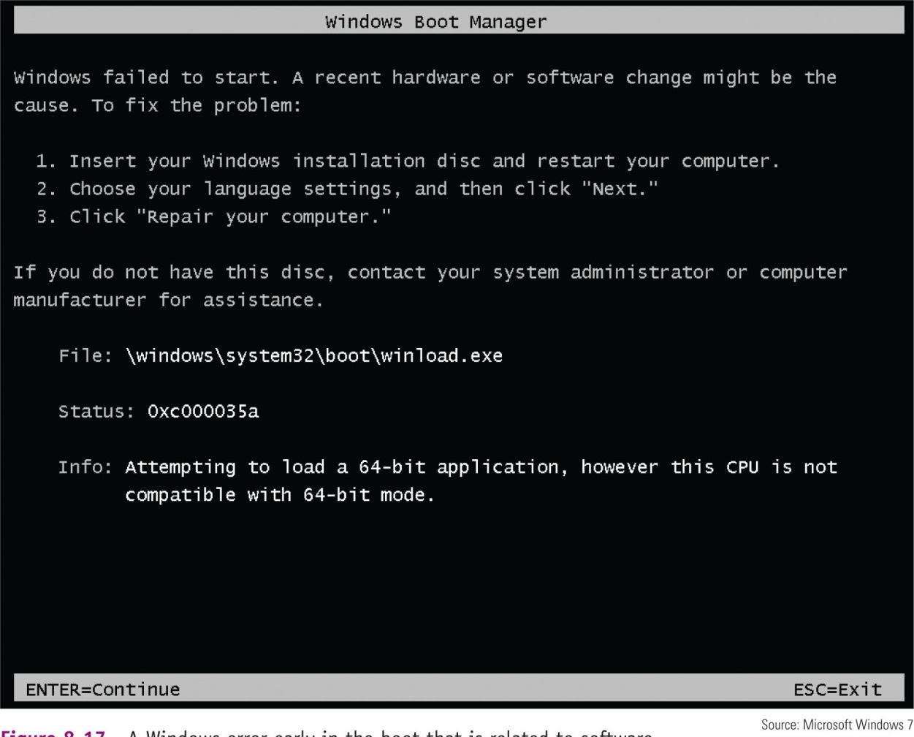
Figure 13-17 A Windows error early in the boot that is related to software

Slide 32
Troubleshooting the Motherboard, Processor, and RAM
Symptoms that a motherboard, processor, or memory is failing:
System begins to boot put then powers down
Error message is displayed during the boot
System becomes unstable, hangs, or freezes at odd times
Intermittent Windows or hard drive errors occur
Components on the motherboard or devices connected to it don’t work
Check simple things first

Slide 33
Troubleshooting the Motherboard, Processor, and RAM
Follow these steps to find source of problem:
1. The problem might be a virus
Run antivirus software to check for viruses
2. A memory module might be failing
Use Memory Diagnostics tool to test memory
3. Check for potential hardware problems using Device Manager
4. Download and install any Windows updates or patches
5. If problem began after a change or new install, uninstall device or application

Slide 34
Troubleshooting the Motherboard, Processor, and RAM
Follow these steps to find source of problem (cont’d):
6. Use System window to find out how much RAM is installed (consider upgrading if not enough)
7. Check BIOS setup to ensure proper settings
8. Disable any quick booting features in BIOS
Then look for errors reported during the boot
9. Flash BIOS to update firmware on the board
10. Check CD that came with motherboard
May have diagnostic tests
11. Update all drivers of motherboard components that are not working

Slide 35
Troubleshooting the Motherboard, Processor, and RAM
Follow these steps to find source of problem (cont’d):
12. If an onboard port is not working:
Verify the problem is not with the device using the port
Go into BIOS setup and verify the port is enabled
Check Device Manager and verify Windows recognizes port with no errors
Update motherboard drivers for this port from manufacturer’s web site
Use a loop-back plug to test the port
Disable the port in BIOS setup and install an expansion card

Slide 36
Troubleshooting the Motherboard, Processor, and RAM
Follow these steps to find source of problem (cont’d):
13. Suspect the problem is a failing hard drive
14. Suspect the problem is caused by overheating
15. Search the support section of the web sites
16. Verify the installed processor is supported by the motherboard

Slide 37
Problems With Installations
If new processor, DIMM, or other component has been installed and system does not boot:
1. Check simple things first
Check all power and data connections
2. Open case and check installation of the new component
3. Reboot the system
If problem still occurs, make sure new component is compatible with system

Slide 38
Problems With Installations
If new processor, DIMM, or other component has been installed and system does not boot (cont’d):
4. Try taking out new component and checking for physical defects (bent pins on processor)
5. Is case getting too hot?
6. Clean edge connectors on memory or expansion cards (blow out any dust from inside case)
7. When upgrading processor
Reinstall old processor, flash BIOS and try the new processor again

Slide 39
Troubleshooting Hard Drives
Problems caused by hard drive during the boot can be caused by:
Hard drive subsystem
File system on the drive
Files required by Windows when it begins to load
Hardware problems usually show up at POST
Could be due to :
The drive, data cable, electrical system, motherboard, SCSI host adapter

Slide 40
Troubleshooting Hard Drives
Things to do and check before opening case:
Check to see if BIOS displays a numeric error code or other message during POST
Check BIOS setup for errors in the hard drive configuration
Try booting from another bootable media
For a RAID array, use the firmware utility to check the status of each disk in the array and check for errors

Slide 41
Troubleshooting Hard Drives
If the problem is still not solved, open case and check these things:
Remove and reattach all drive cables
If using a RAID, SATA, PATA, or SCSI controller card, remove and reseat it or place in a different slot
Check jumper settings on IDE drives
Inspect drive for damage
Determine if hard drive is spinning by listening to it
Check the cable for frayed edges
Check installation manual

Slide 42
Troubleshooting Hard Drives
If the problem is still not solved, open case and check these things (cont’d):
Use Windows tools for checking a hard drive
Check the drive manufacturer’s web site for diagnostic software
Move the device to a working computer and install it as a second drive
Exchange the three field replaceable units
Reconnect or swap the data cable
Reseat or exchange the controller card
Exchange the hard drive for a known good drive

Slide 43
Troubleshooting Hard Drives
If the problem is still not solved, open case and check these things (cont’d):
If your drives whines loudly, try replacing it
A bad power supply or a bad motherboard also might cause a disk boot failure

Slide 44
Troubleshooting Monitors and Video
For monitor and video problems:
Try easy things first such as:
Check cable connections
Check contrast/brightness adjustments

Slide 45
Monitor Indicator Light Is NOT On; No Image On-Screen
Ask these questions and try:
Is the monitor power cable plugged in?
Is the monitor turned on?
Is the monitor cable plugged into the video port at the back of the PC?
Try a different monitor and a different monitor cable

Slide 46
Monitor Indicator Light IS On; No Image On-Screen
Try the following:
Ensure video cable is securely connected
If monitor displays POST but goes blank when Windows starts to load:
Problem is with Windows, not monitor
Ensure monitor is set to correct voltage (110 vs. 220)
Might be problem with video card
Verify video cable connection inside case
Check the contrast adjustment
Check brightness or backlight adjustment

Slide 47
Monitor Indicator Light IS On; No Image On-Screen
Try the following:
Switch out monitor-to-computer cable
Test a monitor you know is good on the computer you suspect is bad
Open computer case and reseat video card
Trade a good video for suspected bad video card
Test the RAM on the motherboard
Try using a backup PCI video card if using a PCI-Express or AGP video card
Trade the motherboard for one you know is good

Slide 48
Monitor Indicator Light IS On; No Image On-Screen
Try the following (cont’d):
For notebook computers, is the LCD switch turned on?
For notebook computers, try connecting a second monitor to the notebook and use the function key to toggle between the LCD panel and second monitor

Slide 49
Poor Display
Solve these problems by using controls on the monitor and Windows settings - Do the following:
LCD monitor controls – usually located on front of monitor
Windows display settings – use to adjust font size, screen resolution, brightness, color, and Clear Type text
Update video drivers

Slide 50
Problems With CRT Monitors
If monitor flickers, has wavy lines or a distorted image, try the following:
Monitor flicker can be caused by poor cable connections
Odd-colored blotches or screen flicker can be result of EMI
Use degauss button to eliminate accumulated or stray magnetic fields
Change refresh rate to the highest value supported
Consider purchasing a newer monitor

Slide 51
Display Settings Make the Screen Unreadable
Return to standard VGA settings called VGA mode
Do the following:
Reboot the system and press F8 to get to Advanced Boot Options menu
Select Safe Mode to boot up with minimal configuration of Windows
After you have changed display settings, restart Windows

Slide 52
Protecting A Computer and The Environment
Avoid future problems by protecting your computer against environmental factors such as:
Humidity
Dust
Out-of-control electricity
Technicians must learn how to properly dispose of used computer equipment

Slide 53
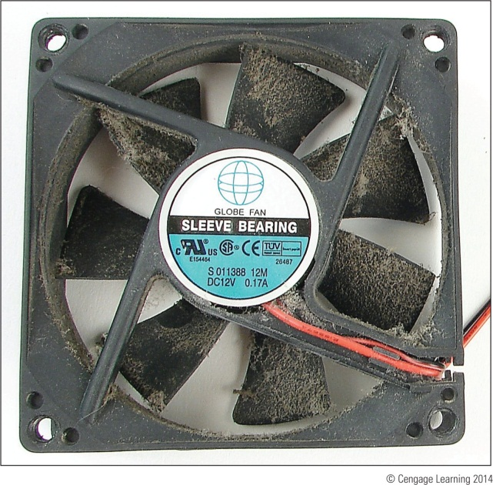
Physically Protect Your Equipment
Do’s and Don’ts to protect a computer:
Do not move or jar computer when on
Protect a computer against dust and other airborne particles
Allow for good ventilation inside and outside the system
Figure 13-39 This dust-jammed case fan caused a system to overheat

Slide 54
Physically Protect Your Equipment
Do’s and Don’ts to protect a computer (cont’d):
High temperatures and humidity can be dangerous
Use BIOS setup to disable ability to write to the hard dive boot sector
Protect your CDs, DVDs, BDs, and other storage media
Don’t leave a computer turned off for weeks or months at a time
Do not unpack and turn on a cold computer
Protect electrical equipment from power surges
Use uninterruptible power supply (UPS) to protect against power surges, brownouts, or sags

Slide 55
Document Preventative Maintenance
Keep a record book for each new computer
Record any changes in setup data and any problems or maintenance
Keep a record of all changes to BIOS setup data and jumpers on the motherboard
Label documentation and keep in a safe place

Slide 56
How to Dispose Of Used Equipment
First check to see if any equipment can be donated or at least recycled
If computer is to be given away
Uninstall any applications software
Delete private data (use a zero-fill utility)
If trashing a computer
Use a degausser to erase everything on a magnetic hard drive or drill holes through the drive
Comply with local government regulation when disposing of any type of equipment

Slide 57
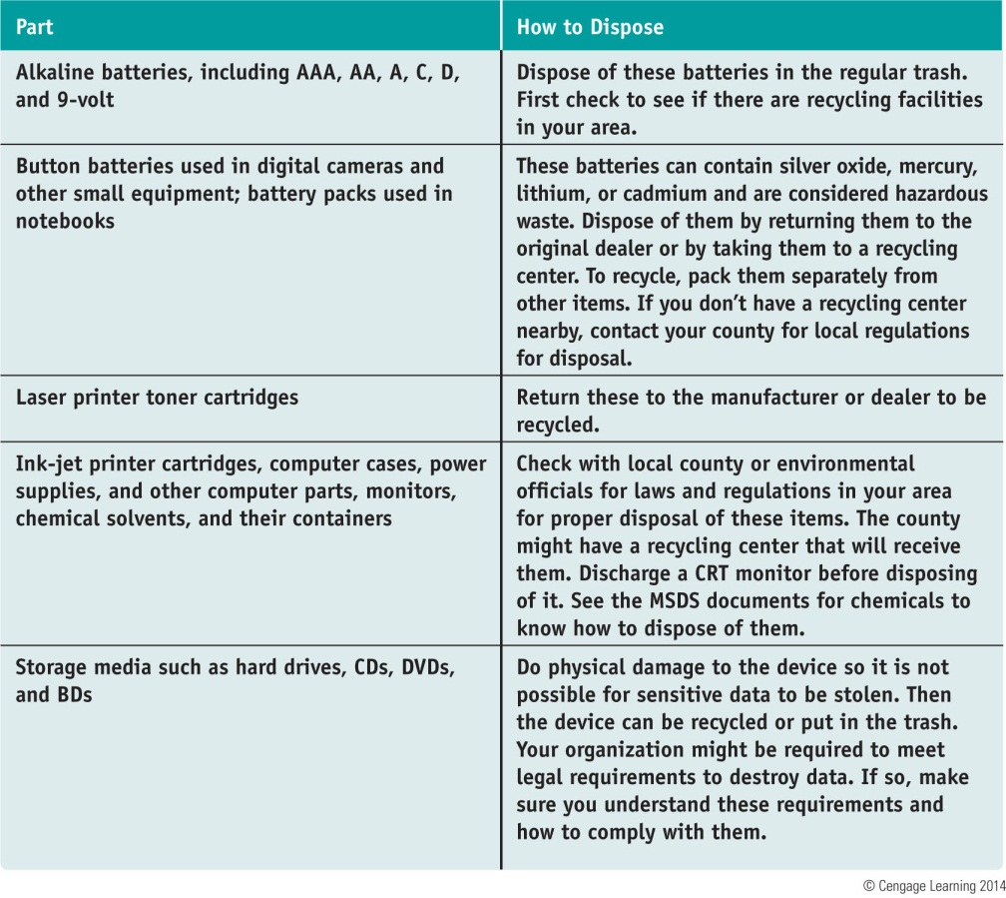
How to Dispose Of Used Equipment
Table 8-4 Computer parts and how to dispose of them

Slide 58
Summary
Always begin troubleshooting my interviewing the user
Decide if problem occurs before or after a successful boot and if it is caused by hardware or software
Listen for spinning fans or drives and look for indicator lights to ensure a system is getting power
Removing dust from a system, providing for proper ventilation, and installing extra fans can help keep a system from overheating

Slide 59
Summary
BIOS gives beep codes when a POST error occurs during the boot before it tests video
Error messages on a black screen during the boot are usually put there by startup BIOS during the POST
The motherboard, processor, RAM, processor cooler assembly, and CMOS battery are field replaceable units
Problems caused by the hard drive during a boot can be caused by the hard drive subsystem, file system, or by files required by Windows to load

Slide 60
Summary
Video problems can be caused by the monitor, video cable, video card, onboard video, video drivers, or Windows display settings
A CRT monitor might have a degauss button to eliminate stray EMI
Protect a computer against dust and other airborne particles using protective enclosures and air filters, and ridding the inside of a computer from dust
Dispose of used equipment and consumables according to local government environmental guidelines

