Slide 1

A+ Guide to Managing & Maintaining Your PC, 8th Edition
Chapter 14
Troubleshooting Windows Startup Problems

Slide 2
Objectives
Learn about the boot process from the time you press the power button until the Windows desktop loads
Learn about Windows tools that can help when solving Windows startup problems
Learn how to troubleshoot Windows startup problems

Slide 3
Understanding The Boot Process
Choosing between a hard boot and a soft boot
Hard boot (cold boot): turning on the power with the on/off switch
Takes more time than a soft boot
Initializes the processor and clears memory
Soft boot (warm boot): using the OS to reboot
To save time use the soft boot to restart
If a soft boot doesn’t work, use a hard boot

Slide 4
Startup BIOS Controls The Beginning Of The Boot
Startup BIOS: responsible for getting a system up and running
A successful boot depends on the hardware, the BIOS, and the OS performing without errors
Startup BIOS is responsible for:
Reads motherboard settings and runs the POST
Setup BIOS might be run (if key is pressed to request)
Startup BIOS searches for a bootable device

Slide 5
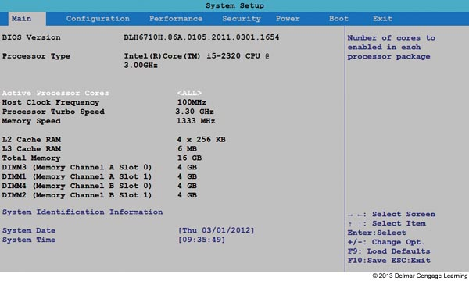
Figure 14-2 Use BIOS setup screens to change the
hardware configuration for a system

Slide 6
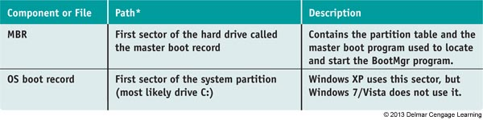
Steps To Start Windows 7/Vista
The following table lists the components and files necessary to start Windows 7/Vista
Table 6-1 Software components and files needed to start Windows 7/Vista

Slide 7
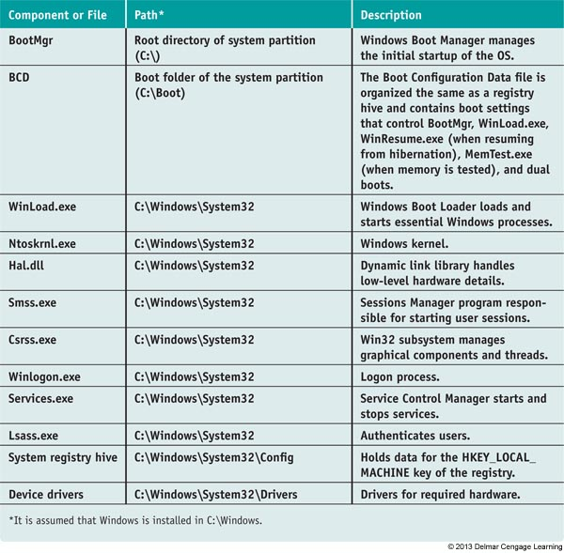
Table 6-1 Software components and files needed to start Windows 7/Vista (continued)

Slide 8
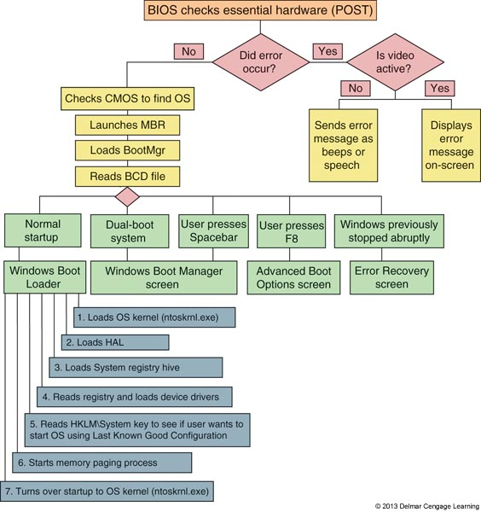
Figure 14-3 Steps to booting the computer and loading Windows 7/Vista

Slide 9
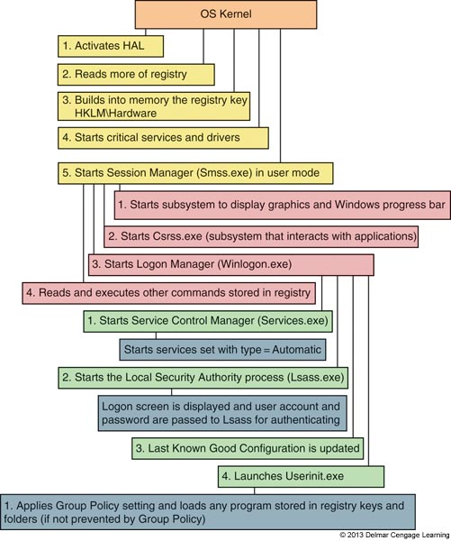
Figure 14-4 Steps to complete loading Windows 7/Vista

Slide 10
Windows 7/Vista Tools for Solving Startup Problems
Windows tools to solve startup problems
Advanced Boot Options menu
Windows Recovery Environment (Windows RE)
Command prompt window in Windows RE

Slide 11
Advanced Boot Options Menu
Press F8 as Windows loads
Repair Your Computer
Only available in Windows 7
Launches Windows Recovery Environment
Safe Mode boots a minimum configuration OS
Uses default system services
No network access
Uses a plain video driver
“Safe Mode” appears in four corners of the screen
Screen resolution: 800 x 600
Desktop wallpaper (background): black

Slide 12
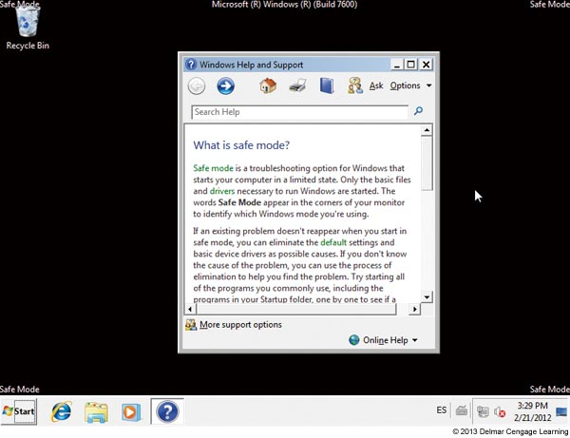
Figure 14-11 Safe Mode loads a minimum Windows configuration

Slide 13
Advanced Boot Options Menu
Recovering the system using Safe Mode
Use System restore
Scan system for virus and run Memory Diagnostics and Chkdsk
Use Device Manager to uninstall, disable a device with problems, or roll back a driver
Use System Configuration (Msconfig) to disable unneeded services or startup processes
Use Programs and Features window to uninstall software
Use Event Viewer to find information about previously failed startups

Slide 14
Advanced Boot Options Menu
Tips about loading Safe Mode
Form Advanced Boot Options menu
First, try Safe Mode with Networking
Next, try Safe Mode
Then, try Safe Mode with Command prompt
Safe Mode won’t load if core Windows components are corrupted
When loading Windows in Safe Mode
All files used for the load are recorded in Ntbtlog.txt file
File might identify service, device driver, or application loaded at startup causing a problem

Slide 15
Advanced Boot Options Menu
Safe mode with networking
Use when solving a problem with booting and network access is needed
Also use when the Windows installation files are available on the network
Safe mode with command prompt
Use the sfc /scannow command to verify system files
Use the chkdsk /r command to check for file system errors
If problem not solved, launch System Restore

Slide 16
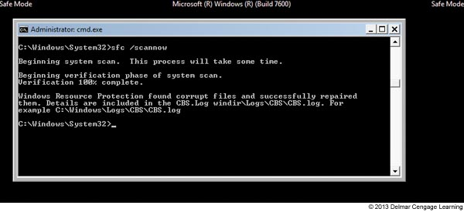
Figure 14-12 SFC finds and repairs corrupted system files

Slide 17
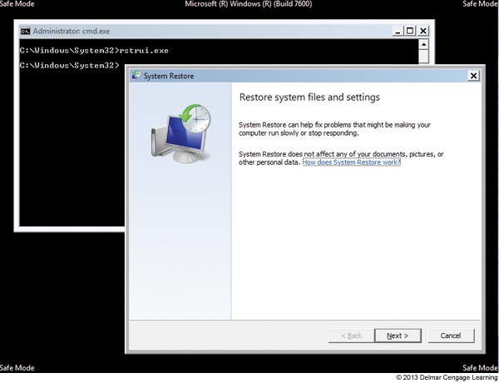
Figure 14-13 Use System Restore after booting to
Safe Mode with Command Prompt

Slide 18
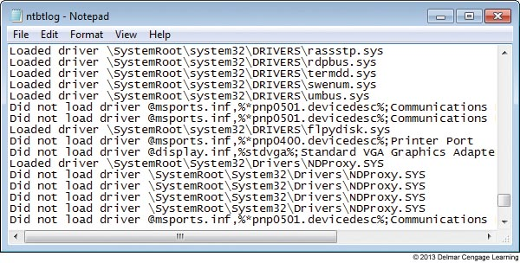
Advanced Boot Options Menu
Enable boot logging
Windows loads normally with regular desktop
All files used during load process are recorded
C:\Windows\Ntbtlog.txt
Figure 14-14 Sample Ntbtlog.txt file

Slide 19
Advanced Boot Options Menu
Enable low-resolution video (640x480)
Used when video setting does not allow screen to display clearly to fix a bad setting
Windows XP, option is called “Enable VGA Mode”
Last known good configuration
Saved in registry after each successful logon
Can undo a bad installation and solve the problem
Try the Last Known Good early in troubleshooting, before it’s overwritten
When logging onto the system in Safe Mode, the Last Known Good not saved

Slide 20
Advanced Boot Options Menu
Directory services restore mode (Windows Domain controllers only)
Used as one step in the process of recovering from a corrupted Active Directory
Debugging mode
Can move system boot logs from failing computer to another computer for evaluation
Disable automatic restart on system failure
Stop rebooting upon encountering a system failure

Slide 21
The Windows Recovery Environment (Windows RE)
Operating system launched from the Advanced Boot Options menu
Provides graphical and command-line interfaces
To launch Windows RE
Boot from Windows 7 or Vista setup DVD, and select language preference
In Windows 7, it is installed on the hard drive and available from the Advanced Boot Options menu
A Windows 7 system repair disc can be created and can be used to launch Windows RE

Slide 22
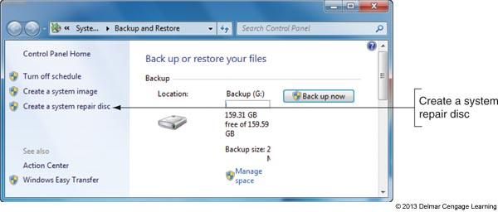
Figure 14-15 Use Backup and Restore to create a system repair disc to use instead of Windows setup DVD

Slide 23
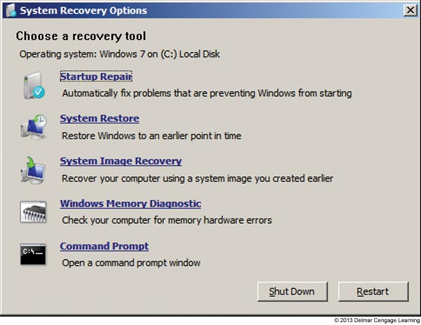
The Windows Recovery Environment (Windows RE)
After Windows RE is launched the System Recovery Options box offers several recovery tool options
Figure 14-18 Recovery
Tools in Windows RE
for Windows 7

Slide 24
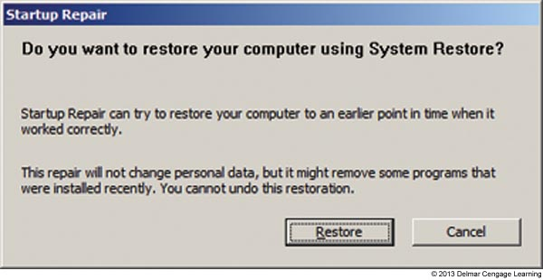
The Windows Recovery Environment (Windows RE)
Use the least intrusive tools first
Use these Windows RE tools in the order listed:
1. Startup Repair – least intrusive
Does not change data or installed applications
Figure 14-20 Startup
Repair suggests you
use System Restore

Slide 25
The Windows Recovery Environment (Windows RE)
Use these Windows RE tools in the order listed:
2. Windows Memory Diagnostic
Use if memory is suspected to be a problem
3. System Restore
Can sometimes fix a problem with a corrupted device driver, corrupted Windows settings, or corrupted programs
4. Command Prompt
Use this option to run chkdsk or restore a corrupted registry from the Command Prompt window
5. System Image Recovery – last resort
Will erase everything and restore previous image

Slide 26
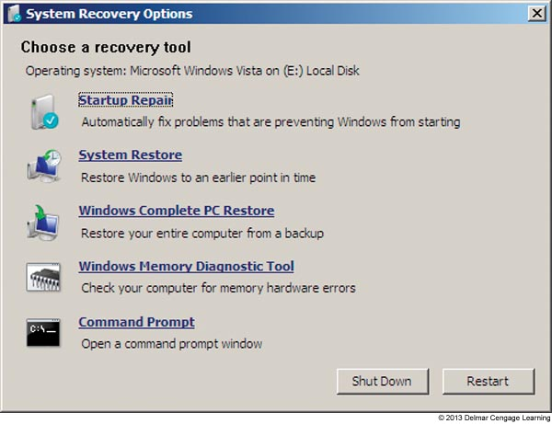
The Windows Recovery Environment (Windows RE)
In Vista, the Complete PC Restore option is available instead of the Windows 7 option of System Image Recovery
Figure 14-23 Recovery
Tools in Windows RE for
Windows Vista

Slide 27
The Command Prompt Window in Windows RE
Use when graphical tools available in Windows RE fail to solve the problem
Offers full read and write access to all files on the drives
Repair a hard drive or other drive
Use chkdsk and format commands to repair a drive
Use diskpart to manage hard drives, partitions, and volumes
Refer to table on the next slide which lists important diskpart commands

Slide 28
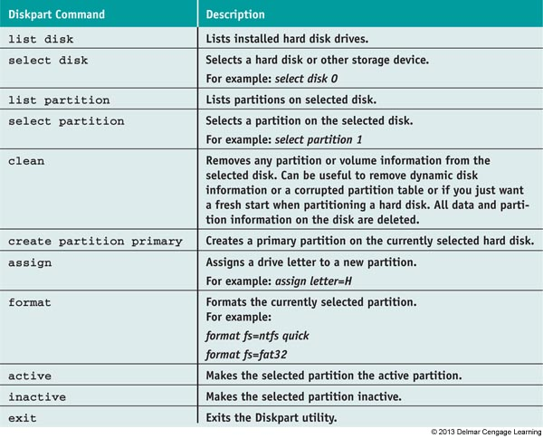
Table 6-2 Important diskpart commands used at the DISKPART> prompt

Slide 29
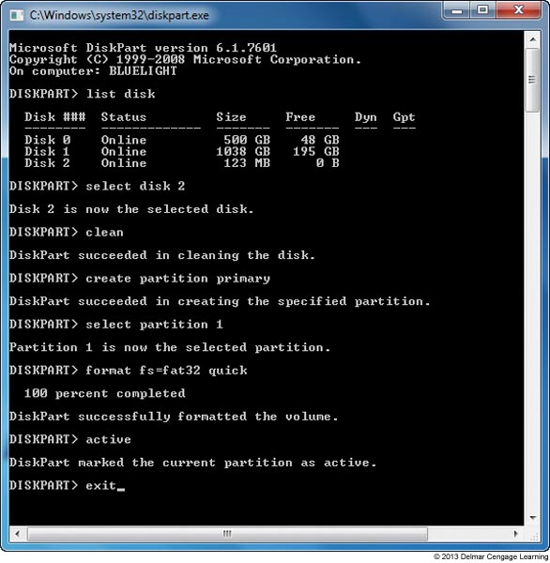
Figure 14-24 Use commands in diskpart to partition and format a USB flash drive

Slide 30
The Command Prompt Window in Windows RE
Enable networking
Networking is not normally available
Use the wpeinit command to enable networking
Repair the file system and key boot files
Use the bootrec command to repair the BCD and boot sectors
Use the bcdedit command to manually edit the BCD
Use the bootsect command to repair a dual boot system

Slide 31
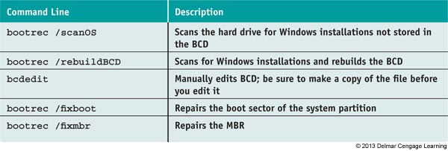
Table 6-3 Commands used in the command prompt window of Windows
RE to repair system files and the file system

Slide 32
The Command Prompt Window in Windows RE
Manage data files and system files
Use cd, copy, rename, and delete commands
Restore registry files using those saved in the RegBack folder
After each fix, reboot the system to see if problem was solved
Use commands in Table 6-4 (see next slide) to restore registry files

Slide 33
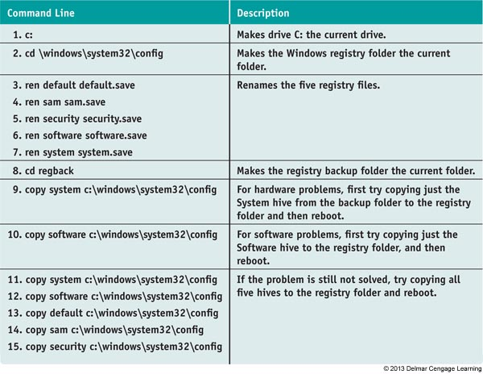
Table 6-4 Steps to restore the registry files

Slide 34
Troubleshooting Windows 7/Vista Startup
To determine where in the boot process the failure occurred, focus on three startup stages of the boot
Stage 1: Before the progress bar
Stage 2: After the progress bar and before logon
Stage 3: After logon

Slide 35
Problems At Stage 1: Before The Flag Or Progress Bar Appears
Problems might be caused by hardware or startup files
Is the screen blank? If nothing is on the screen:
Monitor LED light lit
Reboot, check monitor power, and that it is on
Monitor LED light is not lit
Verify system power, monitor is plugged in and on
If hard drive is not spinning suspect no power is getting to system
Verify system not in standby mode or hibernation
Trade monitor for a good one

Slide 36
Problems At Stage 1: Before The Flag Or Progress Bar Appears
Does the computer appear to have power?
Can’t hear spinning drive or see lights on case front
Suspect electrical system
Check power connections and switches
May have bad power supply
Loose connections inside case

Slide 37
Problems At Stage 1: Before The Flag Or Progress Bar Appears
Does an error message appear before Windows starts?
BIOS displays error message on-screen if problem is detected
Uses beeps or speech if video not working
On-screen messages for nonessential hardware
Try to bypass error by pressing a key and moving forward in the boot
On-screen messages for essential hardware
Focus attention on the error message, beep code, and voice message describing problem

Slide 38
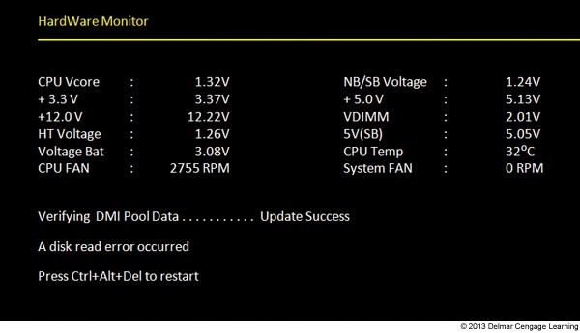
Figure 14-25 This error message at POST indicates a hardware problem

Slide 39
Problems At Stage 1: Before The Flag Or Progress Bar Appears
Can startup BIOS access the hard drive?
Possible messages
Hard drive not found
Fixed disk error
Disk boot failure, insert system disk and press enter
No boot device available
Check for physical problem
Drive, data cable, power, motherboard
Verify BIOS detected drive correctly
Turn on autodetection and reboot
Power down system, unplug it, and physically inspect

Slide 40
Problems At Stage 1: Before The Flag Or Progress Bar Appears
Can startup BIOS access the hard drive? (cont’d.)
BIOS found hard drive, but could not read drive
A disk read error occurred
Drive not recognized
Invalid boot disk
Inaccessible boot device
Invalid drive specification
Invalid partition table
Operating system not found
Could not find bootmgr or bootmgr missing
Boot from Windows setup DVD (see next slide)

Slide 41
Problems At Stage 1: Before The Flag Or Progress Bar Appears
Use BIOS setup to set the boot sequence
Access BIOS setup utility
Find screen to change boot sequence
Make sure DVD drive is listed before hard drive
Force system to boot from Windows Vista setup DVD
Save settings and exit BIOS setup

Slide 42
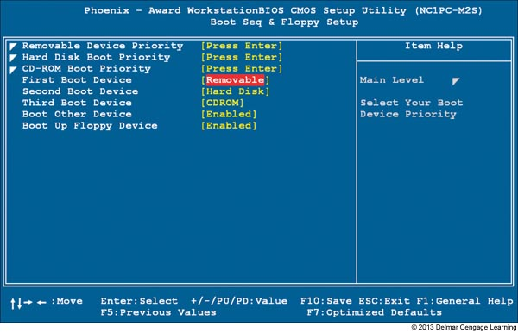
Figure 14-26 Set the boot order in BIOS setup

Slide 43
Problems At Stage 1: Before The Flag Or Progress Bar Appears
Can you boot from the Windows setup DVD?
If not then study error messages, and solve immediate hardware problem
Hard drive and optical drive might have failed
Try a bootable USB flash drive
Successful boot from flash drive indicates problem with both the hard drive and DVD drive
If able to boot from Windows DVD
Windows logon screen appears
Problem isolated to the hard drive

Slide 44
Problems At Stage 1: Before The Flag Or Progress Bar Appears
Can Windows RE find the Windows installation?
Launch Windows RE
Windows RE attempts to locate Windows installation on the hard drive
If Windows RE cannot locate the installation, but BIOS setup recognizes the drive
Drive partitions and file systems might be corrupted
If Windows RE does locate the installation
Problem likely limited to corrupted or missing system files or drivers
Attempt fixes: restart system after each step

Slide 45
Problems At Stage 1: Before The Flag Or Progress Bar Appears
Can Windows RE find the Windows installation? (cont’d.)
Run Startup Repair
Sometimes fixes drastic problems with system files, boot records
Run System Restore
Process won’t help if file system corrupted
Restart system and launch Advanced Boot Options menu
No boot menu: problem may be corrupted boot sector
Boot menu appears: probable BCD file or other startup file problem

Slide 46
Problems At Stage 1: Before The Flag Or Progress Bar Appears
Can Windows RE find the Windows installation? (cont’d.)
Restart system, launch Advanced Boot Options menu (cont’d.)
If boot menu appears: enable boot logging and reboot
Check boot log (\Windows\ntbtlog.txt) for the last entry
Might indicate which system file missing or corrupt
If boot menu does not appear:
Return to Windows RE, launch command prompt window, and attempt to repair boot sector

Slide 47
Problems At Stage 1: Before The Flag Or Progress Bar Appears
Can Windows RE find the Windows installation? (cont’d.)
If boot menu does appear:
Return to Windows RE, launch command prompt window, and attempt to repair the BCD file
Try to repair corrupted file system
Use command prompt window and chkdsk c: /r command
When startup files missing or corrupt
Windows may display an error message

Slide 48
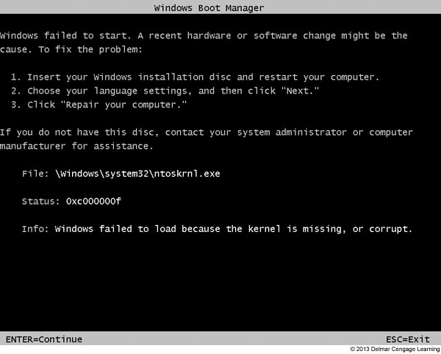
Figure 14-28 Windows might display a screen similar to this one when a
critical startup file is missing or corrupt

Slide 49
Problems At Stage 1: Before The Flag Or Progress Bar Appears
Can Windows RE find the Windows installation? (cont’d.)
Use command prompt window to access drive C
Get to C prompt: use DIR command to list folders and files
Good list: check log file for clues
Not a good list: most likely Vista installation destroyed beyond repair
Make every effort to copy data to another media

Slide 50
Problems At Stage 1: Before The Flag Or Progress Bar Appears
Options to recover from a corrupted Windows installation
Option 1: Complete PC backup available
Restore system to last backup
Option 2: Complete PC backup not available and data backups available on hard drive
Install Windows, format hard drive during installation, install all applications again, restore data
Option 3: Complete PC backup and data backup not available
Try to copy data to removable device and reinstall Windows

Slide 51
Problems At Stage 1: Before The Flag Or Progress Bar Appears
Steps to reinstall Windows
Follow these steps when OS refuses to boot and important data on the drive:
Boot from Windows setup DVD
Follow directions on-screen to install the OS
If you suspect hard drive might be failing, reformat the hard drive and reinstall Windows
If you suspect a healthy hard drive
Run Chkdsk to fix errors
Install all applications and device drivers
Create all user accounts and customize Vista settings
Delete the \Windows.Old folder

Slide 52
Problems At Stage 2: After The Flag Or Progress Bar Appears/Before Logon
Microsoft progress bar appears during the boot
Windows kernel loaded successfully
Critical drivers and services configured to be started by the kernel running
Session Manager (Smss.exe) running in user mode started the Win32 subsystem
If logon screen not displayed:
Probable corrupted driver or service started after kernel finished its part of the boot
Fix by isolating and disabling Windows component, service, or application causing trouble

Slide 53
Problems At Stage 2: After The Flag Or Progress Bar Appears/Before Logon
Follow these steps:
1. Launch Advanced Boot Options and try to boot into Safe Mode
Immediately run antivirus software
Run Chkdsk c: /r
Examine all logs in Event Viewer
Use MSconfig to stop applications just installed, then uninstall and reinstall
Use System Information (msinfo32.exe)
Use Device Manager to check for hardware errors
Use the System File Checker (SFC) tool
Rename the \Windows\Ntbtlog.txt file

Slide 54
Problems At Stage 2: After The Flag Or Progress Bar Appears/Before Logon
Follow these steps: (cont’d)
2. If cannot boot into Safe Mode, select Last Known Good Configuration on the Advanced Boot Options menu
3. Launch Windows RE and run Startup Repair from the System Recovery Options menu
4. In Windows RE, run System Restore
Select the latest restore point
If that doesn’t fix the problem, try an earlier one
5. Boot to Advanced Boot Options menu and select Enable Boot Logging

Slide 55
Problems At Stage 2: After The Flag Or Progress Bar Appears/Before Logon
Follow these steps: (cont’d)
6. Compare the Ntbtlog.txt file to one that was created in Safe Mode to find what caused error
7. If you can boot into Safe Mode, use Device Manager to disable the device or use Services console to disable the service
8. If you cannot boot into Safe Mode, open command prompt window in Windows RE
Back up registry, find key that loads services and drivers

Slide 56
Problems At Stage 2: After The Flag Or Progress Bar Appears/Before Logon
Follow these steps: (cont’d)
9. Disable service or driver by changing Start value to 0x4
Reboot, replace program file, and restart service or driver

Slide 57
Problems At Stage 3: After Windows Logon
Problems caused by applications or services configured to launch at startup
Shortcuts in startup folders, Scheduled Tasks, or software installation processes affecting registry entries
Error message at startup
Disable program using MSconfig

Slide 58
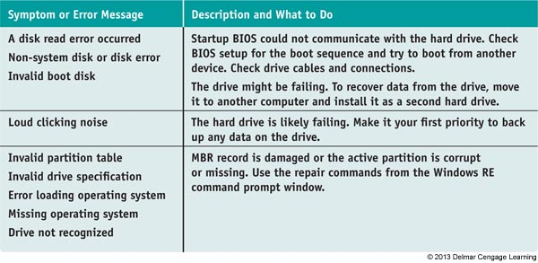
Figure 14-5 Error messages during Windows startup
and what to do about them (continues)

Slide 59
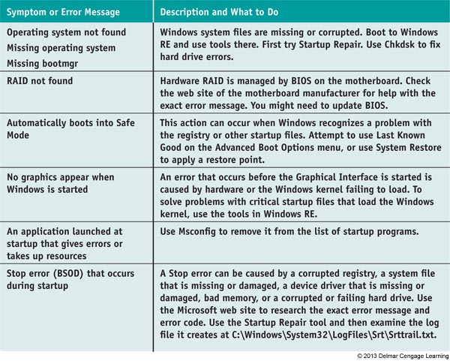
Figure 14-5 Error messages during Windows startup
and what to do about them (continued)

Slide 60
How to Recover Lost Data
Use Windows tools, third party software, or commercial data recovery services
Recovering a deleted or corrupted data file
Look in the Recycle Bin
Restore it from backup using the Backup and Restore window or use Previous Versions tab on file’s Properties box
Use the Recover command
Use application manufacturer’s web site
Use third party software

Slide 61
How to Recover Lost Data
Recover data from a computer that will not boot
Remove hard drive and install as a second nonbooting hard drive in another system
Use IDE to USB or a SATA to USB converter kit
Temporarily connect hard drive to a USB port on a working computer
Browse drive and copy data using Windows Explorer
Use a data recovery service
Search for “data recovery” on the Internet
Read up on reviews, understand warranty and guarantees, and get a recommendation

Slide 62
Summary
When a system is turned on, startup BIOS takes control to examine hardware components and find an OS to load
Windows 7/Vista startup is managed by Windows Boot Manager(BootMgr) and Windows Boot Loader (WinLoad.exe)
Advanced Boot Options menu offers many options that are useful when troubleshooting startup problems

Slide 63
Summary
Windows Recovery Environment (Windows RE) includes tools such as System Repair, Memory Diagnostics, System Restore, a command prompt window, and System Image Recovery
Windows tools and techniques used to troubleshoot a failed boot include Last Known Good Configuration, Startup Repair, System Restore, Safe Mode, Command Prompt, in-place upgrade of Windows, reimaging the hard drive, and reinstalling Windows

Slide 64
Summary
In a failed Windows boot, it is important to determine at what point in the boot the failure occurred
If a hard drive will not boot, data recovery might be possible by installing the drive in another system as a second, nonbooting hard drive

