Slide 1

A+ Guide to Managing & Maintaining Your PC, 8th Edition
Chapter 15
Connecting to and Setting up a Network

Slide 2
Objectives
Learn about the TCP/IP protocols and standards Windows uses for networking
Learn how to connect a computer to a network
Learn how to configure and secure a multifunction router on a local network

Slide 3
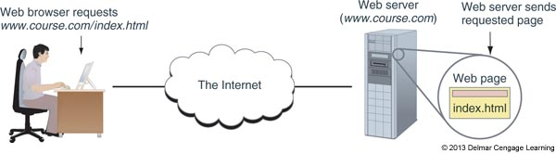
Understanding TCP/IP and Windows Networking
Client/server applications
Two computers and two applications involved
Communication occurs three levels
Hardware, operating system, application
Dependent on one computer addressing the other
Figure 15-1 A web browser (client software) requests a web page from a web server (server software); the web server returns the requested data to the client

Slide 4
Layers of Network Communication
When two devices communicate, they must use the same protocols (language)
Almost all networks today use a group or suite of protocols known as TCP/IP (Transmission Control Protocol/Internet Protocol)
Data is broken up into segments and each segment is put into a packet
A packet contains the data and information that identifies the type of data, where it came from, and where it is going

Slide 5
Layers of Network Communication
Level 1: Hardware level
Root level of communication
Wireless or network cables
Phone lines or TV cable lines
Includes the network adapter and MAC address
MAC (media access control) address is a unique 48-bit hexadecimal number hard-coded on the card by the manufacturer
Also known as hardware address, physical address, adapter address, or Ethernet address
Communication protocols used

Slide 6
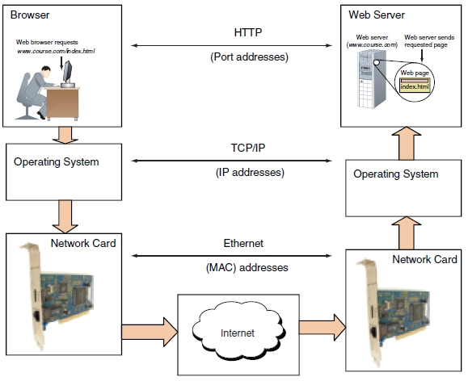
Figure 15-2 Network communication happens in layers
Courtesy: Course Technology/Cengage Learning

Slide 7
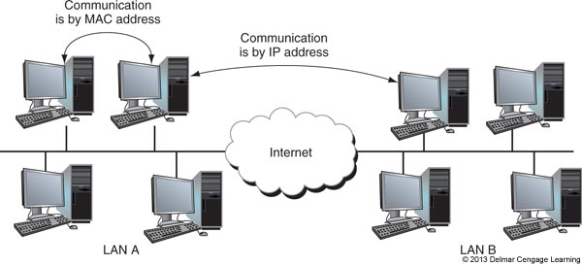
Layers of Network Communication
Level 2: Operating system level
Manages communication between itself and another computer using TCP/IP
Uses IP addressing
Figure 15-4 Computers on the same LAN use MAC addresses to communicate, but computers on different LANs use IP addresses to communicate over the Internet

Slide 8
Layer of Network Communication
Layer 2: Operating system level: (cont’d)
IP address
32-bit or 128-bit number that is assigned to a network connection
Used to find computers on networks and subnetworks, including the Internet

Slide 9
Layers of Network Communication
Level 3: Application level
Client communicates with other server applications
Port number
Uniquely identifies computer application
Socket
IP address followed by a colon and port number
E-mail example: 36.60.30.5:25
Web server example: 136.60.30.5:80

Slide 10
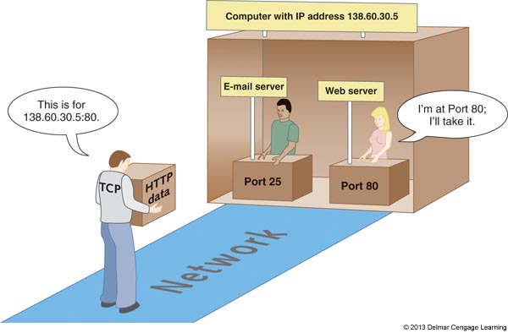
Figure 15-5 Each server running on a computer is
addressed by a unique port number

Slide 11
How IP Addresses Get Assigned
A MAC address is embedded on a network adapter at a factory
IP addresses are assigned manually or by software
Static IP address: manually and permanently assigned to a computer or device
Dynamic IP address: assigned by a server each time the device connects to the network
A DHCP (dynamic host configuration protocol) server assigns addresses to a DHCP client that is requesting an address

Slide 12
How IP Addresses Get Assigned
An IP address has 32 or 128 bits
Internet Protocol version 4 (IPv4) – uses a 32-bit address to identify a network connection
Currently a shortage of IPv4 IP addresses
Internet Protocol version 6 (IPv6) was created partly due to the shortage of IPv4 addresses
Uses a 128-bit IP address
Internet Assigned Numbers Authority (IANA) is responsible for keeping track of assigned IP addresses

Slide 13
How IPv4 IP Addresses Are Used
IP address: 32 bits long, made up of 4 groups, each 8 bits long
Four decimal numbers separated by periods
72.56.105.12
Largest possible 8-bit number
11111111 (255 decimal)
Largest possible decimal IP address
255.255.255.255
11111111.11111111.11111111.11111111 binary
Octet: each of the four decimal numbers
0 to 255, 4.3 billion potential IP addresses

Slide 14
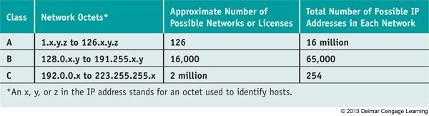
How IPv4 IP Addresses Are Used
IP address identifies network and host
Classes are based on the number of possible IP addresses in each network within each class
Table 7-1 Classes of IP addresses

Slide 15
How IPv4 IP Addresses Are Used
Class A addresses:
First octet identifies the network and last three can be used to identify the host
Class B addresses:
First two octets identify the network and last two can be used to identify the host
Class C addresses:
First three octets identify the network and the last octet can be used to identify the host

Slide 16
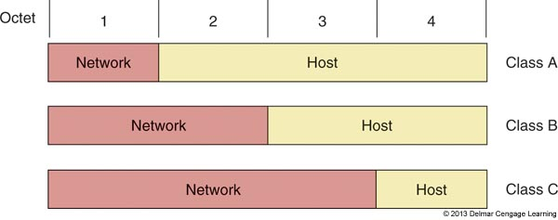
How IPv4 IP Addresses Are Used
Class D addresses: octets 224 through 239
Multicasting
Class E addresses: octets 240 through 254
Research
Figure 15-7 The network portion and host portion for each class of IP addresses

Slide 17
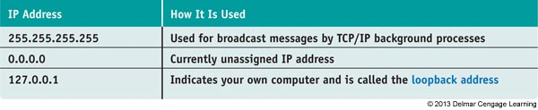
How IPv4 IP Addresses Are Used
A few IP addresses are reserved for special use by TCP/IP and should not be assigned to a device
Table 7-2 Reserved IP addresses

Slide 18
How IPv4 IP Addresses Are Used
Subnets using IPv4
Large networks can and should be divided into smaller networks called subnetworks or subnets
To divide a network into subnets, you designate part of the host portion of the IP address as a subnet
Example: Class A network of 69.0.0.0
On network 69 you could have 16 million hosts
You can divide this network into 256 subnets by using the second octet for the subnet address
Possible network numbers would range from 69.0.x.y – 69.255.x.y

Slide 19
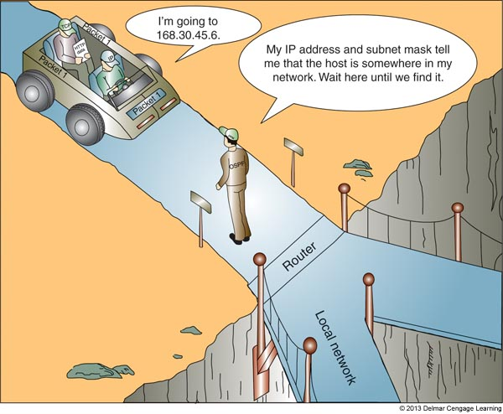
How IPv4 IP Addresses Are Used
The subnet mask identifies which part of an IP address is the network id and which is the host id
Subnet masks help a device know if an IP address is part of it’s network or belongs to another
Figure 15-8 A host can
Always determine if an IP
Address is on its
network

Slide 20
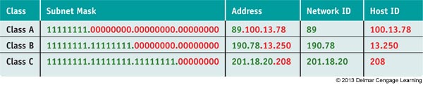
How IPv4 IP Addresses Are Used
Subnet masks
Group of ones followed by a group of zeros
Classful subnet masks: all ones, all zeros in an octet
Classless subnet mask: mix of zeros and ones
Table 7-3 Default subnet masks for classes of IP addresses

Slide 21
How IPv4 IP Addresses Are Used
A network is divided into a subnet when the subnet mask takes some of the host portion for the network ID
Example: Dividing 69.0.0.0 into 256 subnets
The subnet mask would be 255.255.0.0 instead of 255.0.0.0
Therefore, an address of 69.12.34.56 with a subnet mask of 255.255.0.0 yields:
Network id = 69.12.0.0
Host id = 34.56

Slide 22
How IPv4 IP Addresses Are Used
Public IP addresses: available to the Internet
Private IP addresses: used on private network
Use router with NAT (Network Address Translation) redirection for Internet access
NAT: a TCP/IP protocol that substitutes the public IP address of the router for the private IP address of a computer that needs to communicate on the Internet
IEEE recommend the following be used:
10.0.0.0 through 10.255.255.255
172.16.0.0 through 172.31.255.255
192.168.0.0 through 192.168.255.255

Slide 23
How IPv6 IP Addresses Are Used
IPv6 address has 128 bits written as 8 blocks of hexadecimal numbers separated by colons
Example: 2001:0000:0B80:0000:0000:00D3:9C5A:00CC
Each block is 16 bits
Leading 0s in a 4-character hex block can be eliminated. For example, the IP address above:
2001:0000:B80:0000:0000:D3:9C5A:CC
If blocks contain all zeros, they can be written as double colons. From IP address above:
2001:0000:B80::D3:9C5A:CC
Only one set of double colons is used

Slide 24
How IPv6 IP Addresses Are Used
Terms used in the IPv6 standards:
Link (local link): a local area network (LAN) or wide area network (WAN) bound by routers
Interface: node’s attachment to a link
Can be logical or physical
Logical attachment is used for tunneling (used by IPv6 to transport IPv6 packets over an IPv4 network)
Interface ID: last 64 bits or 4 blocks of an IP address
Neighbors: two or more nodes on the same link

Slide 25
How IPv6 IP Addresses Are Used
Three tunneling protocols for IPv6 packets to travel over an IPv4 network:
ISATAP (Intra-Site Automatic Tunnel Addressing Protocol)
Teredo – addresses intended to be used by this protocol always begin with the same 32-bit prefix (called fixed bits) which is 2001
6TO4 – older protocol being replaced by Teredo or ISATAP

Slide 26
How IPv6 IP Addresses Are Used
Three types of IPv6 addresses:
Unicast address: packets are delivered to a single node on a network
Multicast address: packets are delivered to all nodes on a network
Anycast address: used by routers; identifies multiple destinations and packets are delivered to the closest destination

Slide 27
How IPv6 IP Addresses Are Used
There are three types of unicast addresses:
Global unicast (global address): can be routed on the Internet
Most begin with the prefix 2000::/3
The /3 indicates the first three bits are fixed and always 001
Link-local unicast (link-local or local address): can be used for communicating with nodes in same link
Most begin with FE80::/64
Begins FE80 followed by enough zeros to make 64 bits
Unique local address (ULA): identifies a specific site within a large organization
Prefixes are FC00::/7 and FD00::/8

Slide 28
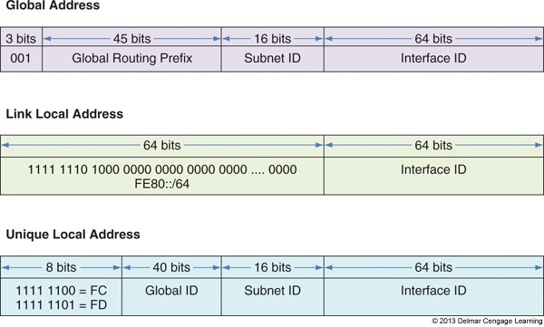
Figure 15-10 Three types of IPv6 unicast addresses

Slide 29
View IP Address Settings
Use the ipconfig command in a command prompt window to show the IPv4 and IPv6 addresses assigned to all network connections
IPv6 addresses are followed by a % sign and a number
The number is called the zone ID or scope ID and is used to identify the interface in a list of interfaces of a computer
Refer to Figure 15-11 on the next slide

Slide 30
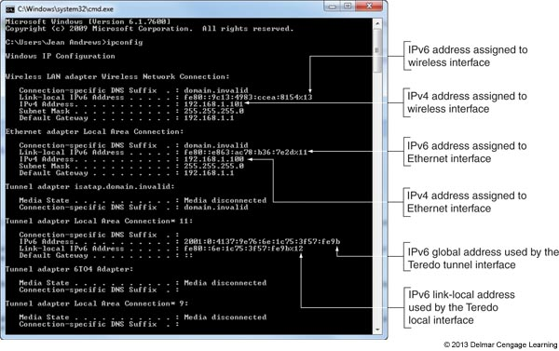
Figure 15-11 The ipconfig command showing IPv4 and IPv6
addresses assigned to this computer

Slide 31
Character-based Names Identify Computers and Networks
Character-based names: substitute for IP addresses
Host name (computer name): name of a computer
Workgroup name: identifies a workgroup
Domain name: identifies a network
Fully qualified domain name (FQDN): identifies computer and network to which it belongs
Uses name resolution
DNS server finds IP address when FDQN known
Windows uses a host file

Slide 32
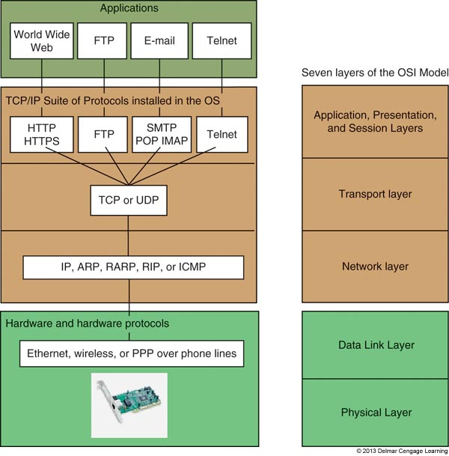
TCP/IP Protocol Layers
Figure 15-14 How software, protocols, and technology on a TCP/IP network relate to each other

Slide 33
TCP/IP Protocols Used By The OS
TCP (Transmission Control Protocol)
Connection-oriented protocol
Checks whether data is received and resends if it is not
When a TCP packet reaches destination, an acknowledgement (ack) is sent back to the source
If source does not receive ack, it resends the data
Used by Web browsers and e-mail
UDP (User Datagram Protocol)
Connectionless protocol (best-effort)
Used for broadcasting and streaming video

Slide 34
TCP/IP Protocols Used By Applications
HTTP (Hypertext Transfer Protocol)
HTTPS (HTTP secure) protocol
Encrypts and decrypts data before sent and processed
SMTP (Simple Mail Transfer Protocol)
Used to send e-mail message
SMTP AUTH (SMTP Authentication)
POP and IMAP
Delivery of email message
Telnet
Remotely control a computer

Slide 35
TCP/IP Protocols Used By Applications
LDAP (Lightweight Directory Access Protocol)
Used by clients when an application needs to query a database
SMB (Server Message Block)
Used by Windows to share files and printers
FTP (File Transfer Protocol)
Transfer files between two computers
Can use browsers, Windows Explorer, or third party software to transfer files using FTP

Slide 36
TCP/IP Protocols Used By Applications
SSH (Secure Shell)
Used to pass login information to a remote computer and control that computer over a network
SFTP (Secure FTP)
Uses encryption to transfer files
SNMP (Simple Network Management Protocol)
Used to monitor network traffic
RDP (Remote Desktop Protocol)
Used by the Windows Remote Desktop and Remote Assistance utilities to connect to and control a remote computer

Slide 37
Connecting A Computer To A Network
Connecting a computer to a network
Quick and easy in most situations
Topics covered
Connecting to a network using Ethernet, wireless, and dial-up connections

Slide 38
Connect To a Wired Network
Steps
1. Install network adapter
2. Connect network cable to Ethernet RJ-45 port and network port (wall jack, router, switch)
Verify lights
3. Windows assumes dynamic IP addressing
Automatically configures the network connection
4. Verify Internet connectivity

Slide 39
Connect To a Wired Network
Troubleshooting
Verify Device Manager recognizes adapter without errors
If error occurs, try updating NIC drivers
If adapter has no errors, open Network and Sharing Center
A red X indicates a problem
Click X to start Windows Network Diagnostics
After Windows has resolved the problem
Should see a clear path from the computer to the Internet

Slide 40
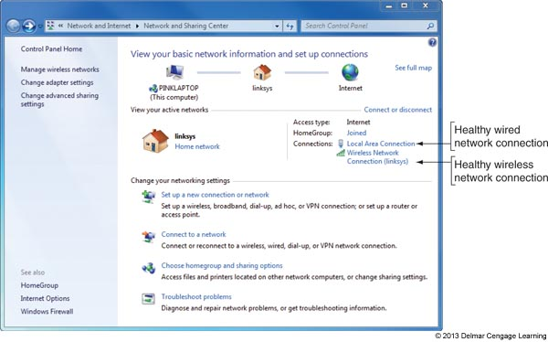
Figure 15-21 The Network and Sharing Center reports
two healthy network connections

Slide 41
Connect To a Wired Network
Follow these steps to verify and change TCP/IP settings:
Click Change adapter settings in the Network and Sharing Center
In Network Connections window, right-click local area connection and select Properties from Shortcut menu
Select TCP/IPv4 and click Properties
Default setting is dynamic IP addressing
To change to static select Use the following IP address
Enter IP address, subnet mask, and default gateway

Slide 42
Connect To a Wired Network
Follow these steps to verify and change TCP/IP settings: (cont’d)
If you have the IP addresses of DNS servers, check Use the following DNS server addresses and enter up to two IP addresses
If using a laptop that moves from one network to another and one network uses static:
Click Alternate Configuration and select User configured to enter static IP address information
If General tab is configured for dynamic, computer will first try to use that but will apply static if dynamic is not available

Slide 43
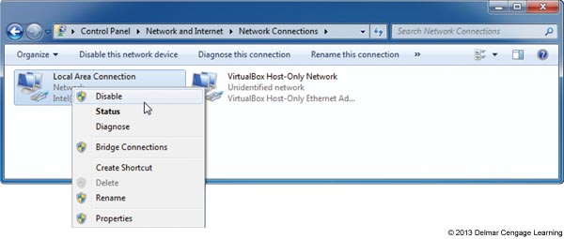
Connect To a Wired Network
Follow these steps to verify and change TCP/IP settings: (cont’d)
Close all boxes and windows and try to access network resources
If still don’t connect, try to disable and enable the network connection
Figure 15-24 To reset
A network connection,
Disable and enable the
connection

Slide 44
Connect To a Wireless Network
Wireless networks types
unsecured public hotspots or secured private hotspots
Steps to connect to a wireless network using Windows 7:
Install wireless adapter
Embedded wireless: turn on wireless device
A yellow star in the network icon on taskbar indicates hotspots are available
Enter the security key or password and click OK

Slide 45
Connect To a Wireless Network
Steps to connect to a wireless network using Windows 7: (cont’d)
If network is unsecured, verify that Windows has configured the network as a Public network
Test the connection
For some hotspots, a home page appears and you must enter a code or agree to the terms of use

Slide 46
Connect To a Wireless Network
Wireless networks are created using access points
Methods used by access points to secure wireless networks:
A security key is required
SSID is not broadcasted
SSID (Service Set Identifier) = name
Only computers with registered MAC addresses are allowed to connect
To find out the MAC address of a computer use the ipconfig /all command

Slide 47
Connect To a Wireless WAN (Cellular) Network
Needed to connect to a wireless wide area network (WWAN):
Hardware and software
Subscriber Identification Module (SIM) card: flash memory card that contains all information you need to connect to a cellular network:
Password and other authentication information
Encryption standards
Services that your subscription includes

Slide 48
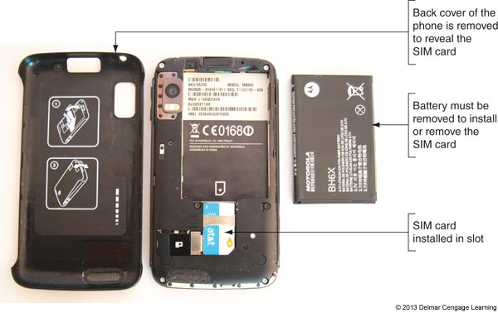
Figure 15-35 A SIM card contains proof that your device can
use a cellular network

Slide 49
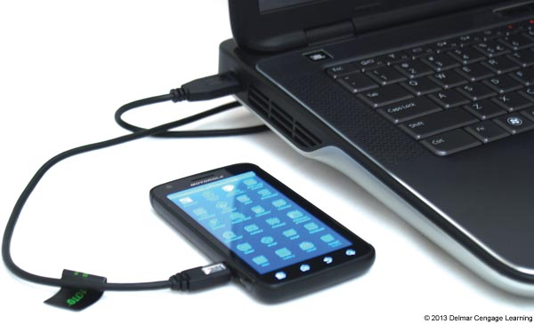
Connect To a Wireless WAN (Cellular) Network
Options for hardware and software:
Use an embedded mobile broadband modem
Tether your cell phone to your computer
Use a USB broadband modem
Figure 15-36 Tether your cell
phone to your laptop using
a USB cable

Slide 50
Connect To a Wireless WAN (Cellular) Network
How to connect to a cellular network:
Using an embedded broadband modem: insert the SIM card provided by your mobile operator
Also need to use software either provided by your OS or your mobile operator
Using your cell phone: install software provided by mobile operator and tether your phone to your computer
Using a USB broadband modem: Ensure SIM card is inserted in the device then insert the modem into a USB port
Windows finds the device and software installed on the device automatically runs

Slide 51
Create A Dial-Up Connection
Bare-bones installation steps
Install internal or external dial-up modem
Plug phone line into PC modem port and wall jack
Open Network and Sharing Center window, click Set up a connection or network, select Set up a dial-up connection, click Next
Enter ISP information, click Connect

Slide 52
Create A Dial-Up Connection
To use the connection
Go to Network and Sharing Center
Click Connect to a network
Select dial-up connection, click Connect, click Dial
You will hear modem dial up the ISP and make the connection

Slide 53
Create A Dial-Up Connection
Troubleshooting tips:
Verify phone line and modem are working
Check Dial-up Connection Properties box for errors
Dial the number manually from a phone
Try another phone number
Listen for number being dialed
Remove and reinstall dial-up connection

Slide 54
Create A VPN Connection
Virtual private network (VPN): used by remote employees to connect to a corporate network by way of the Internet
Data is encrypted using a technique called a tunnel or tunneling
The VPN is often managed by client/server software
Windows can be used to create a VPN connection instead of third-party software
VPN connection is a virtual connection
Setting up a tunnel over an existing connection

Slide 55
Create A VPN Connection
General steps to connect to VPN using Windows 7:
1. In Network and Sharing Center, click Set up a new connection or network, click Connect to a workplace, click Next
In the Connect to a Workplace box, click Use my Internet connection (VPN), enter IP address or domain name of the network, name the VPN connection and click Next
3. Enter username and password and click Connect

Slide 56
Setting Up A Multifunction Router For A SOHO Network
In order to setup a SOHO (small office or home office) network you need to know:
How to configure a multipurpose router
Stands between the network and the Internet
How to set up and secure a wireless access point
Most SOHO routers are also a wireless access point

Slide 57
Functions Of A SOHO Router
Function 1: As a router, stands between the ISP network and the local network, routes traffic between
Function 2: As a switch, manages several network ports that can be connected to wired computers or other network devices
Function 3: As a DHCP server, all computer receive their IP address from this server
Function 4: As a wireless access point, a wireless computer can connect to the Internet

Slide 58
Functions Of A SOHO Network
Function 5: As a firewall, blocks unwanted traffic from the Internet and provides Network Address Translation (NAT) so that computers can use private or local link IP addresses
Can also restrict Internet access for computers
Function 6: As an FTP server, can connect an external hard drive and FTP firmware on router can be used to share files with network users

Slide 59
Install and Configure the Router on the Network
Always follow direction of the manufacturer but the following are general steps:
1. On one of the computers on the network, launch the router setup program on the CD that came with it
The setup program will instruct you to make physical connections necessary
2. You will be given opportunity to change the SSID and password (recommended that you do)
May be asked whether to allow automatic updating
3. Test the connection by using the browser to access the Internet

Slide 60
Install and Configure the Router on the Network
Use a browser and firmware on the router to configure the router:
1. Open browser and enter IP address of router
Enter admin as the username and use the password entered during setup
2. Use menus on the main setup page of the router firmware to change router’s configuration
Every router is different so poke around until you find the setting you need to configure
When finished, click Save Settings and close browser

Slide 61
Install and Configure the Router on the Network
Configuration changes to possibly make to router’s configuration:
Change Router password
Change SSID and configure the DHCP server
View assignments make by ISP
Assign static IP addresses
Configure the firewall to disable all ports
Improve QoS for an application

Slide 62
Install and Configure the Router on the Network
Port Filtering: used to open or close certain ports
Applications are assigned these ports so you are filtering or controlling what applications can or cannot get through a firewall
Port Forwarding: when firewall receives a request for communication from the Internet to a specific computer and port, the request will be allowed and forwarded to that computer
Port Triggering: opens a port when a PC on the network initiates communication through another port
A demilitarized zone (DMZ): a computer or network that is not protected by a firewall

Slide 63
Install and Configure the Router on the Network
Tips when using port forwarding or port triggering:
Must lease a static IP address from your ISP
For port forwarding to work, the computer on your network must have a static IP address
If the computer using port triggering stops sending data, the router might close the triggered port before communication is complete
Using port forwarding, your computer and network are more vulnerable
You are allowing external users directly into your private network

Slide 64
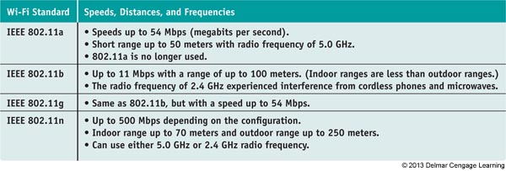
Set Up A Wireless Network
Wi-Fi (Wireless Fidelity) standards have evolved over the years
Technical name is IEEE 802.11 standards
Table 7-6 Older and current Wi-Fi standards

Slide 65
Set Up A Wireless Network
802.11n: latest Wi-Fi standard
Uses multiple input/multiple output (MIMO), which means a device can use two or more antennas to improve performance
Most wireless devices today are 802.11 b/g/n compatible
Place your router or wireless access point in the center of where you want your hotspot
Higher position works better than a lower position
Also place in a physically secure place

Slide 66
Set Up A Wireless Network
802.11n network configuration options to consider:
The radio frequency (RF) the network will use
Choices are 5 GHz and 2.4 GHz
The older wireless devices that will use the network
If network consists of older 802.11b/g devices, network must support 2.4 GHz frequency
RF interference
The channel the network will use
The channel width for the network
(40 or 20 MHz)
Radio power level the device will use

Slide 67
Set Up A Wireless Network
Securing a wireless network:
Method 1: Requiring a security key and using data encryption
Three main protocols for encryption
WEP (Wired Equivalent Privacy) – no longer considered secure because key used for encryption is static
WPA (Wi-Fi Protected Access) – also called TKIP and is stronger than WEP because encryptions keys are constantly changing
WPA2 (also called 802.11i standard) – latest and best encryption standard

Slide 68
Set Up A Wireless Network
Securing a wireless network: (cont’d)
Method 2: Disable SSID broadcasting
Not considered a strong security method because software can be used to discover an SSID that is not broadcasted
Method 3: Filter MAC addresses
Considered a weak security measure and does not use encryption
Wi-Fi Protected Setup (WPS): generates the SSID and key using a random string of hard-to-guess letters and numbers

Slide 69
Summary
Network communication happens at three levels
Hardware, operating system, and application
At the hardware level, a network adapter has a MAC address that uniquely identifies it on a network
Using TCP/IP, the OS identifies a network connection by an IP address
At the application level, a port address identifies an application
An IPv4 address has 32 bits and an IPv6 address has 128 bits

Slide 70
Summary
TCP/IP application protocols include: FTP, HTTP, and Telnet
TCP/IP protocols at the operating system level include TCP and UDP
A PC support technician must know how to configure TCP/IP settings and make a wired or wireless connection to an existing network
The best method to secure a wireless network is to use encryption

Slide 71
Summary
A multifunction router for a SOHO network might serve several functions including a router, a switch, a DHCP server, a wireless access point, a firewall using NAT, and an FTP server
Change the router’s SSID and password as soon as you install it
To secure a wireless access point, enable MAC address filtering, disable SSID broadcasting, and enable encryption (WPA2, WPA, or WEP)

