Slide 1

A+ Guide to Managing & Maintaining Your PC, 8th Edition
Chapter 16
Networking Types, Devices, and Cabling

Slide 2
Objectives
Learn about network types and topologies
Learn about the hardware used to build local networks
Learn how to set up and troubleshoot the wiring in a small network

Slide 3
Network Types and Topologies
Networks can be categorized by technology used and size of the network
Personal Area Network (PAN): consists of personal devices such as a cell phone and notebook
Local Area Network (LAN): covers a small local area such as a home, office, or other building
Wireless LAN: covers a limited geographic area and is popular in places where cables are difficult to install
Metropolitan Area Network (MAN): covers a large campus or city
Wide Area Network (WAN): covers a large geographic area and is made up of small networks

Slide 4
Network Types and Topologies
Network topology: arrangement of connections between computers (also called physical topology)
Mesh network: each node on the network is responsible for sending and receiving transmissions to any other node without a central point of communication
Ring network: nodes form a ring (seldom used today)
Bus network: all nodes are connected in a sequential line (an older topology)
Star network: uses a centralized device to manage traffic on the network

Slide 5
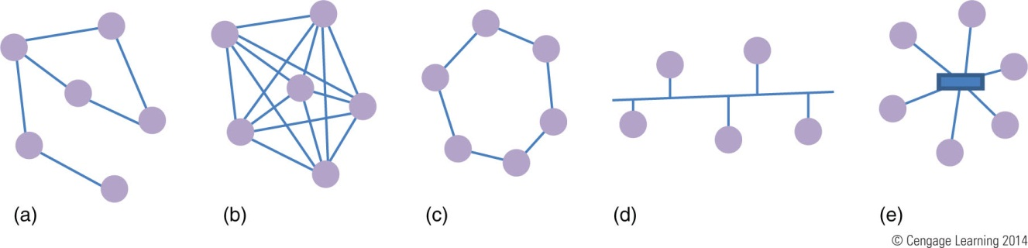
Figure 16-1 Network topologies: (a) mesh, (b) fully connected mesh,
(c) ring, (d) bus, and (e) star

Slide 6
Network Technologies Used for Internet Connections
Internet Service Provider (ISP): used to connect to the Internet
Most common type of connections are DSL and cable Internet (cable modem)
Bandwidth: measure of the maximum data transmission rate
Data throughput: actual network transmission speed
Latency: delays in network transmissions
Measured by the round-trip time it takes for a data packet to travel from source to destination and back

Slide 7
Network Technologies Used for Internet Connections
Cable Internet (cable modem)
Uses existing cable lines
Always connected (always up)
TV signals and PC data signals share same coax cable
Cable modem converts PC’s digital signals to analog

Slide 8
Network Technologies Used for Internet Connections
DSL (Digital Subscriber Line)
Group of broadband technologies
Wide range of speeds
Uses ordinary copper phone lines and unused voice frequencies
Always connected
Some DSL services offer connect on demand
Can use the same phone line for voice and DSL at the same time

Slide 9
Network Technologies Used for Internet Connections
Cable Internet vs. DSL
Both can sometimes be purchased on a sliding scale
Cable modem shares TV cable infrastructure with neighbors
Service may become degraded
DSL uses dedicated phone line
Must filter phone line static
Similar setup for both
Installation completed by provider or user
Both use PC network port or USB port to connect cable modem or DSL modem

Slide 10
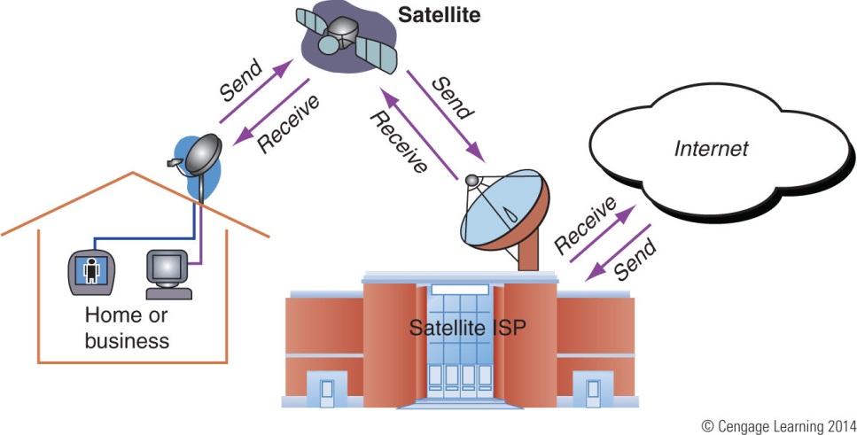
Network Technologies Used for Internet Connections
Satellite provides high-speed Internet connections in remote areas
Available everywhere (even airplanes)
Disadvantages: requires line-of-site connectivity and latency occurs when uploading
Figure 16-9 Communication by satellite can include television and Internet access

Slide 11
Network Technologies Used for Internet Connections
Fiber optic - dedicated point-to-point (PTP)
No line sharing
Broadband fiber-optic cable
Television, Internet data, voice communication
Verizon technology: Fiber Optic Service (FiOS)
Upstream and downstream speeds and prices vary

Slide 12
Network Technologies Used for Internet Connections
WiMAX or 802.16 wireless
Supports up to 75 Mbps with a range of up to several miles
WiMAX version 2.0 can support up to 1 Gbps for fixed users and up to 100 Mbps for mobile users
WiMAX cellular towers are generally placed 1.5 miles apart
Sometimes used as a last-mile solution for DSL and cable Internet technologies
Some laptops have a built-in WiMAX modem to connect to 4G networks that use WiMAX

Slide 13
Network Technologies Used for Internet Connections
Cellular WAN covers a wide area
Made up of cells created by base stations
Cell phone network competing technologies
GSM (Global System for Mobile Communications)
Requires devices have a SIM card that contains a microchip to hold subscription data
CDMA (Code Division Multiple Access)
Do not require a SIM card in a cellular device
4G (Fourth Generation) technology: fastest speed for cellular data
2G and 3G technology is still used

Slide 14
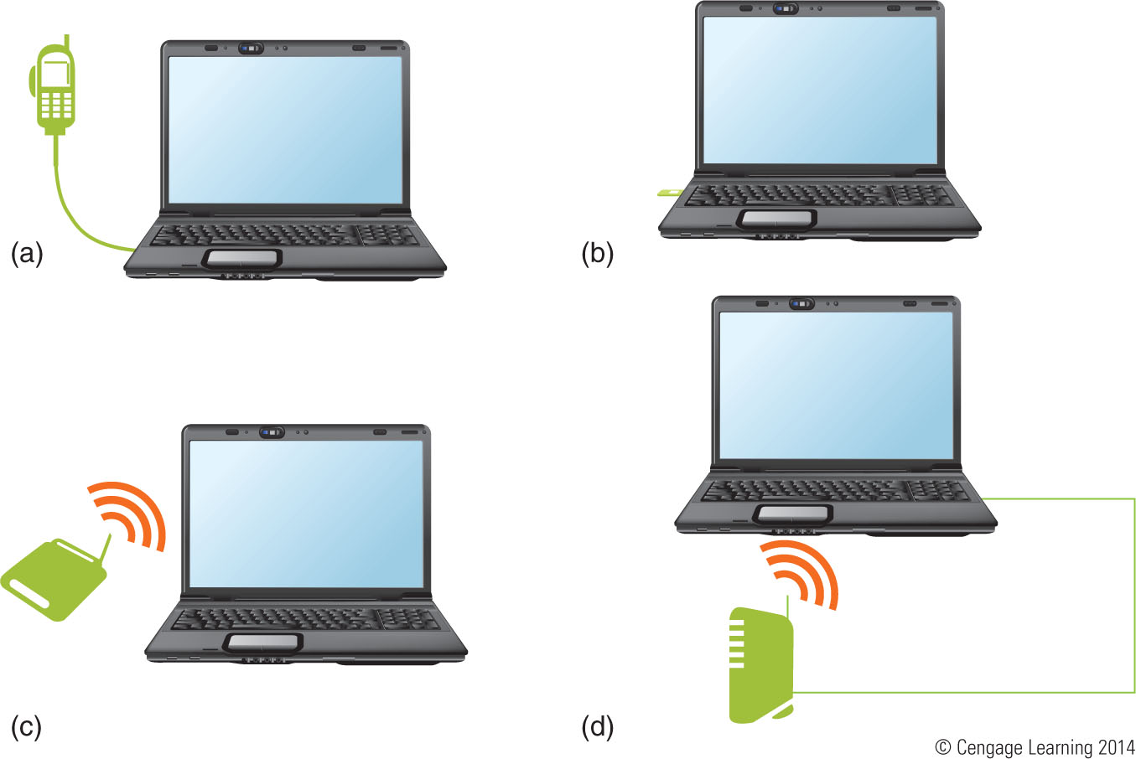
Figure 16-13 Four external devices a computer or network can use
to make a cellular Internet connection

Slide 15
Hardware Used By Local Networks
In this section you will learn about:
Desktop and laptop devices
Hubs
Switches
Bridges
Other network devices
Cables and connectors these devices use

Slide 16
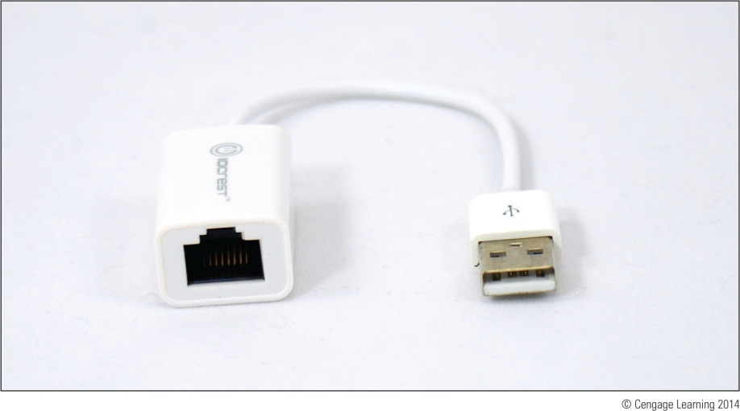
Wired and Wireless Network Adapters
Network adapter: direct connection to a network
Might be a network port on motherboard or a network interface card (NIC)
Might also be an external device connected via USB port
Provides RJ-45 port (looks like a large phone jack)
Figure 16-15 USB device
provides an Ethernet port

Slide 17
Wired and Wireless Network Adapters
Features to be aware of when selecting an adapter:
The slot a NIC uses
May need to uninstall or disable existing network port
Ethernet speeds
10 Mbps, 100 Mbps, 1 Gbps, and 10 Gbps
MAC address – every network adapter has one
48-bit unique ID number hard-coded by manufacturer
Status indicator lights
Used to indicate connectivity and activity
Wake-on-LAN – wakes up the computer when it receives certain communication on the network

Slide 18
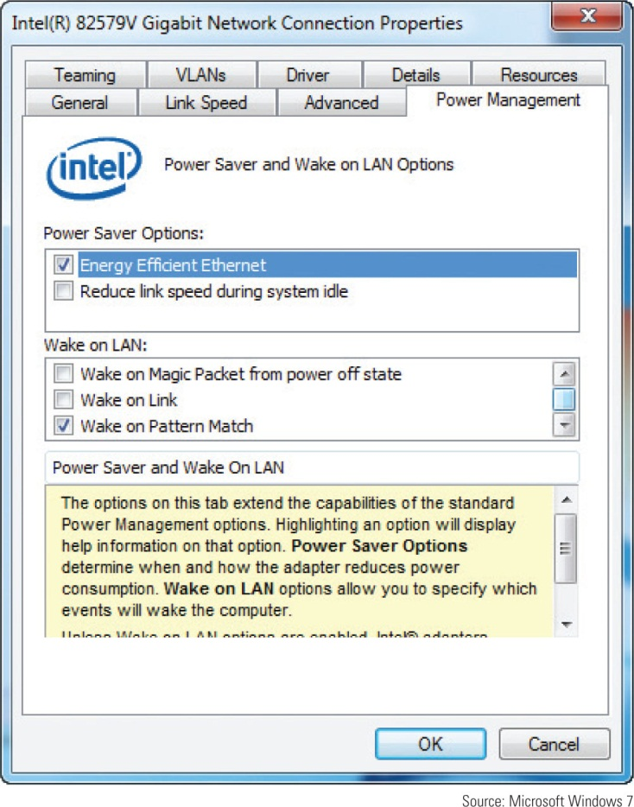
Figure 16-20 Enable variations of Wake on LAN based on what
type of software is allowed to wake up the computer

Slide 19
Wired and Wireless Network Adapters
Features to be aware of when selecting an adapter (cont’d):
Quality of Service (QoS)
Ability to control which applications have priority on the network
Must be configured on the router and the network adapter of each computer
Power over Ethernet (PoE)
Allows power to be transmitted over Ethernet cable
Might be available on high-end wired adapters
Used where electrical outlets may not be available

Slide 20
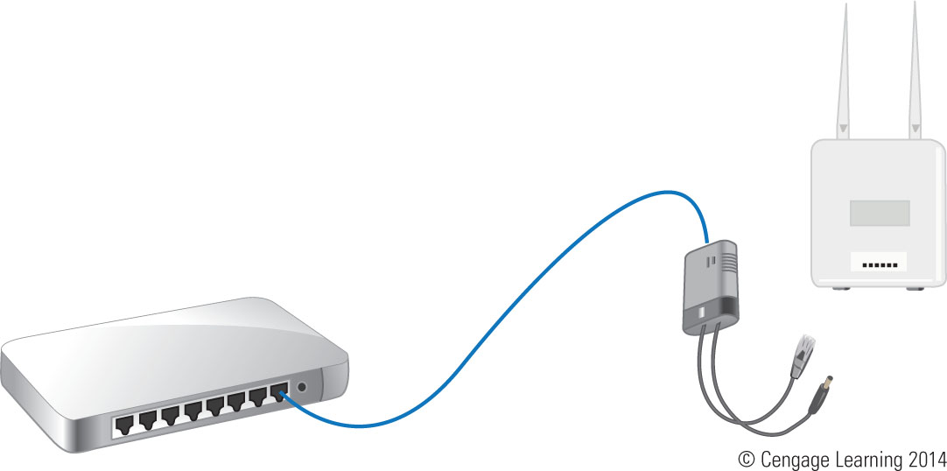
Figure 16-22 Use a PoE splitter if the receiving device is not PoE compatible

Slide 21
Dial-Up Modems
POTS (Plain Old Telephone Service) or Dial-up
Least expensive, slowest Internet connection
Uses: travel, broadband down, saving money
Desktop computers modem cards provide two phone jacks (RJ-11 jacks)
Twisted-pair cabling is used
Pairs of wires are twisted together to reduce crosstalk
Last modem standard: V.92

Slide 22
Hubs and Switches
Most wired networks use a star bus topology: nodes connected to a centralized hub or switch
Hub: pass-through device (outdated technology)
No regard for data or frame’s destination
Switch: keeps a table of all devices connected to it
When a frame is received, switch searches its MAC address table for the destination MAC address and sends frame only to the device with that address
If destination MAC address is not in table, switch sends frame out all ports (except receiving port)

Slide 23
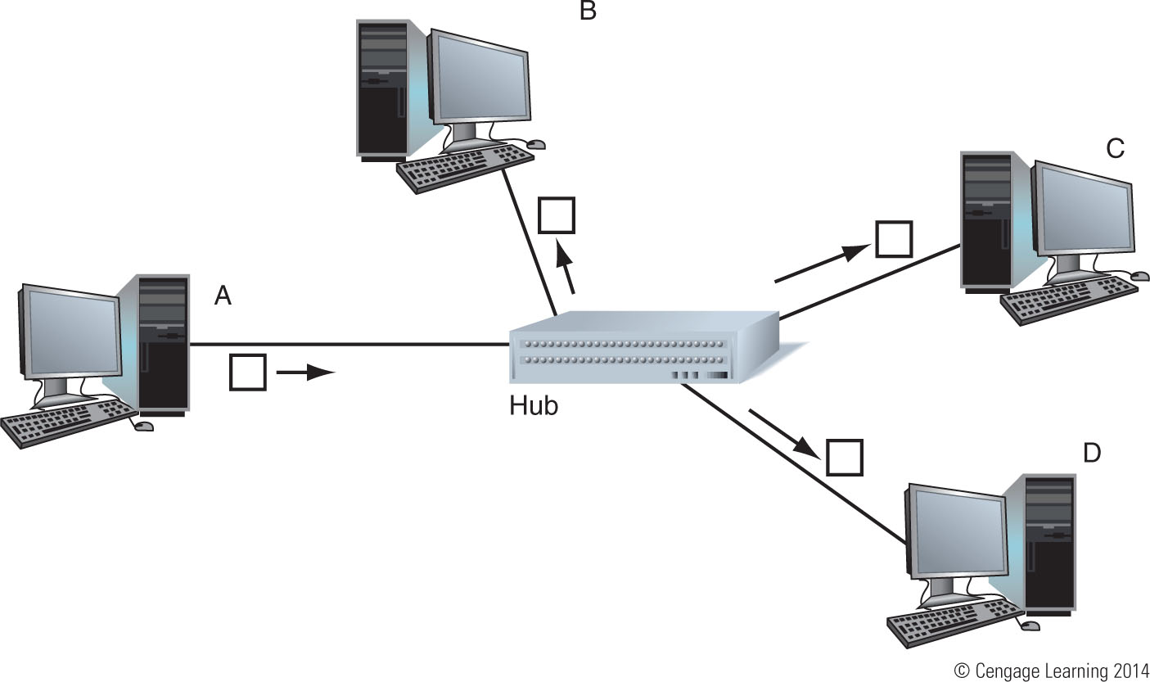
Figure 16-24 Any data received by a hub is replicated and passed
on to all other devices connected to it

Slide 24
Wireless Access Points and Bridges
Allows wireless device connection to LAN
Devices communicate through access point
May double as a router
Can also be a bridge
A bridge is a device that stands between two segments of a network and manages network traffic between them
Keeps a table of MAC addresses just like a switch

Slide 25
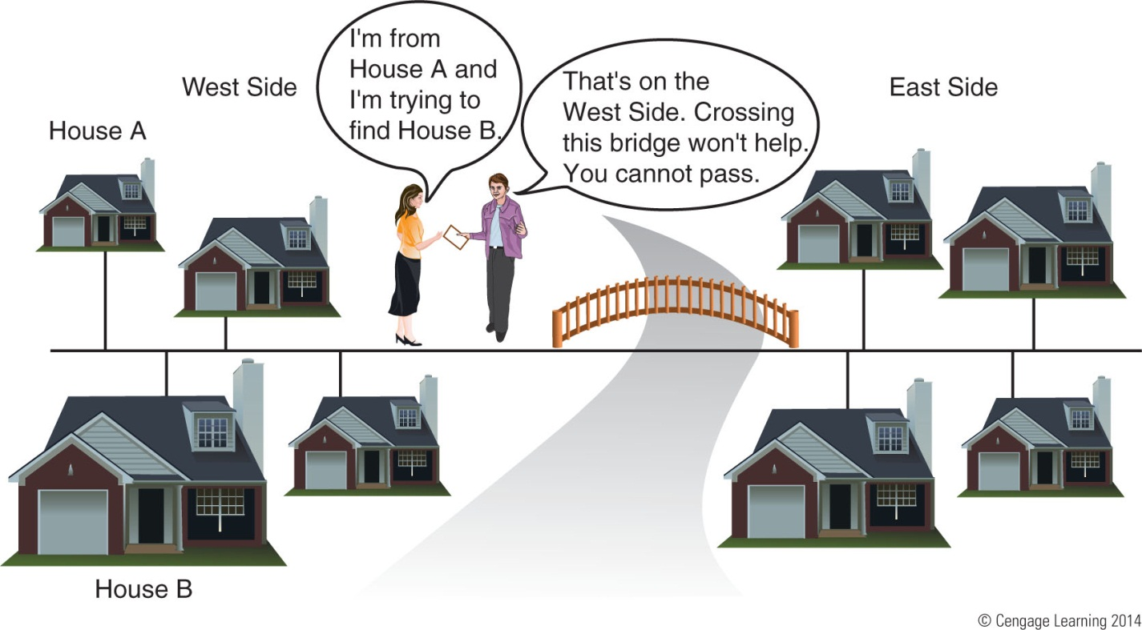
Figure 16-28 A bridge is an intelligent device making decisions
concerning network traffic

Slide 26
Other Network Devices
Network Attached Storage (NAS) device: contains bays for holding hard drives and also includes an Ethernet port to connect to a network
Most support RAID
VoIP phone: Voice over Internet Protocol
A TCP/IP protocol that manages voice communication over the Internet
VoIP phone connects directly to a network
Internet appliance: type of thin client designed to make it easy for a user to connect to the Internet
Sold years ago but are no longer popular

Slide 27
Ethernet Cables and Connectors
Types of Ethernet cabling:
Twisted-pair – most popular cabling for local networks
Unshielded (UTP) and shielded twisted pair (STP)
UTP cable is least expensive and most common
Rated by category: CAT3 through CAT6a
Consists of four pairs of twisted wires (8 wires total)
Coaxial cable: single copper wire with braided shield
No longer used for networking
Fiber-optic: glass strands inside protective tubing
Transmit signals as pulses of light
Two types: single-mode and multimode

Slide 28
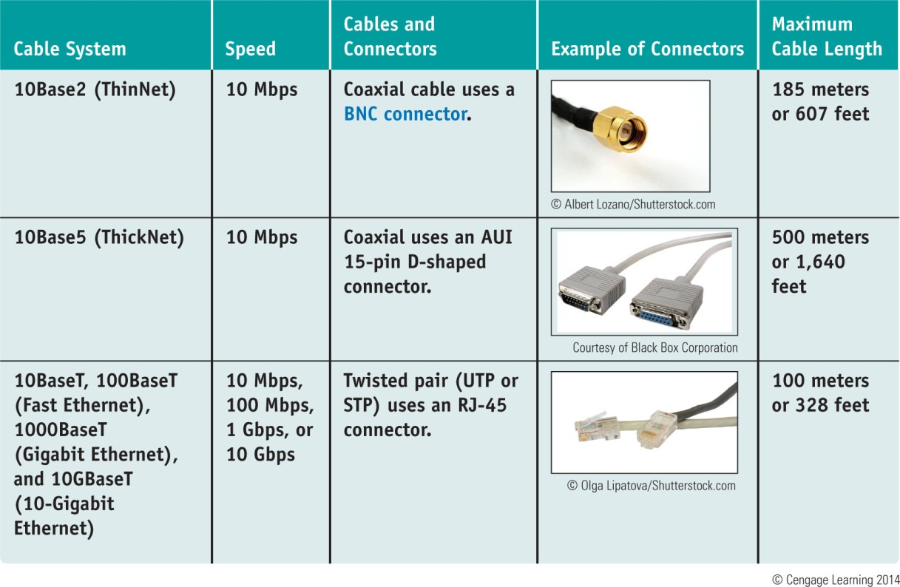
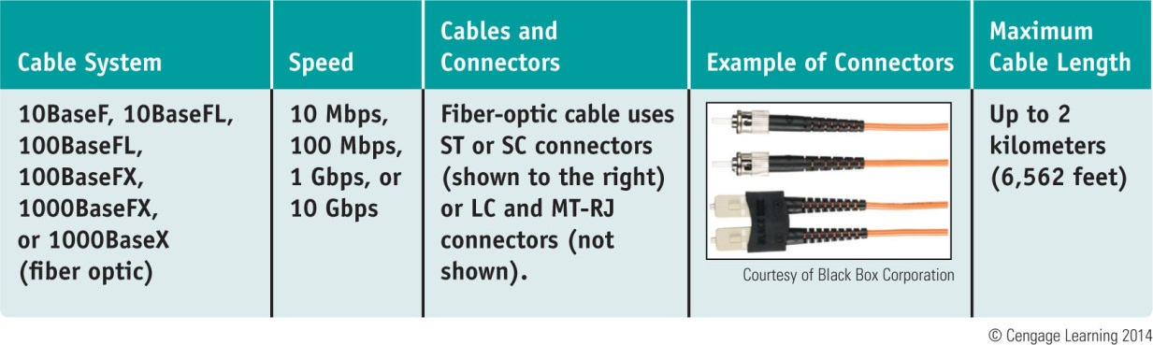
Table 10-2 Variations of Ethernet and Ethernet cabling

Slide 29
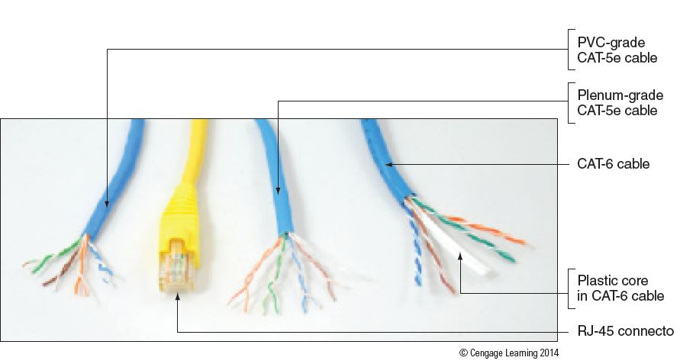
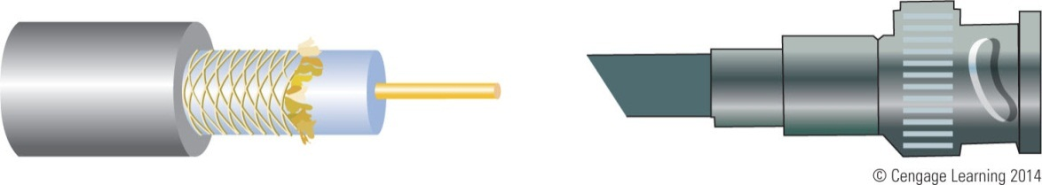
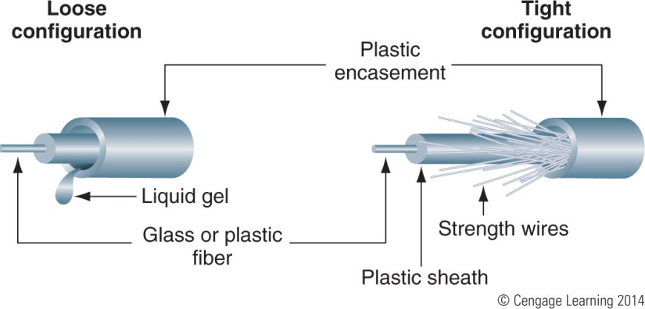
Figure 16-30 The most common networking cable for a local network is UTP cable using an RJ-45 connector
Figure 16-31 Coaxial cable and a BNC connector are used with ThinNet Ethernet
Figure 16-33 Fiber-optic cables contain a glass core for transmitting light

Slide 30
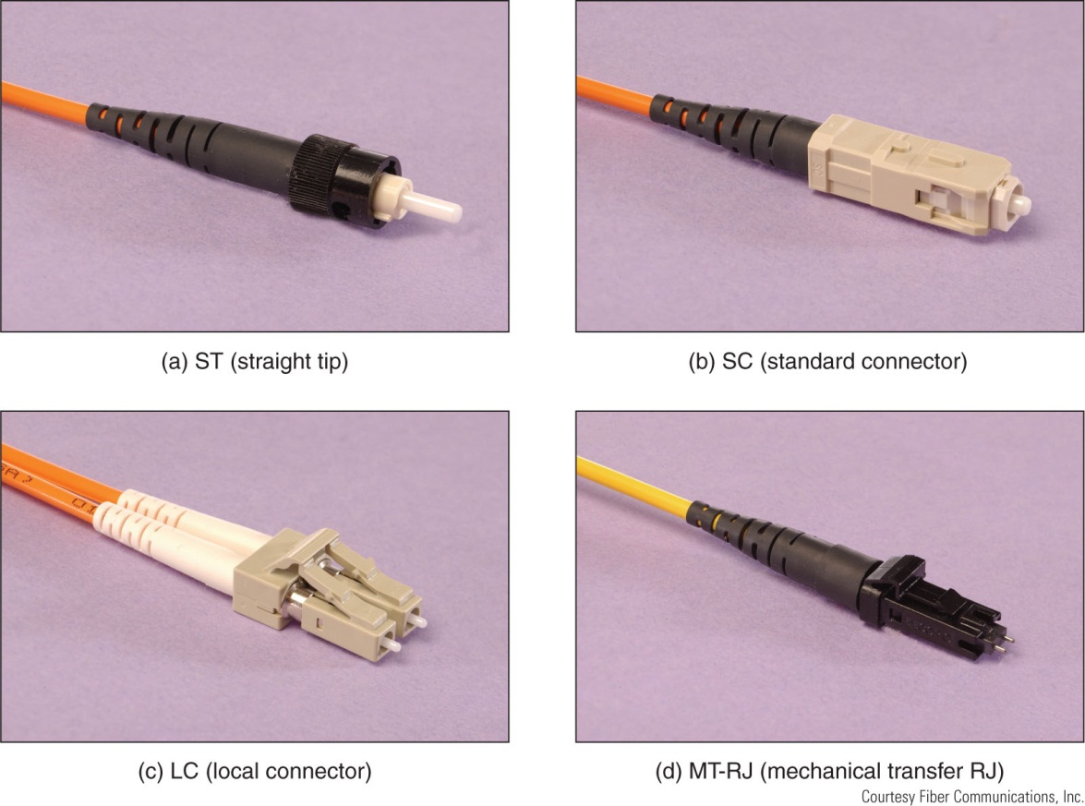
Figure 16-34 Four types of fiber-optic connectors: (a) ST, (b) SC,
(c) LC, and (d) MT-RJ

Slide 31
Ethernet Cables and Connectors
Ethernet types (categorized by speed):
10-Mbps Ethernet – invented by Xerox in 1970s
100-Mbps Ethernet (also known as Fast Ethernet or 100BaseT)
Uses STP or UTP cabling rated CAT-5 or higher
100BaseFX uses fiber-optic cable
1000-Mbps Ethernet (also known as Gigabit Ethernet)
Becoming most popular choice for LAN technology
Uses same cabling and connectors as Fast Ethernet
10-Gigabit Ethernet
Uses fiber-optic cable

Slide 32
Setting Up and Troubleshooting Network Wiring
To set up a small network, you will need:
Computers, switches, network cables, a router, and a device that provides Internet access (cable modem)
Regarding cabling, be sure:
Cables are out of the way and not a trip hazard
Cables don’t exceed the recommended length (100 meters for twisted pair)
Use cables rated at CAT-5e or higher
Uses switches rated at the same speed as your router and network adapters

Slide 33
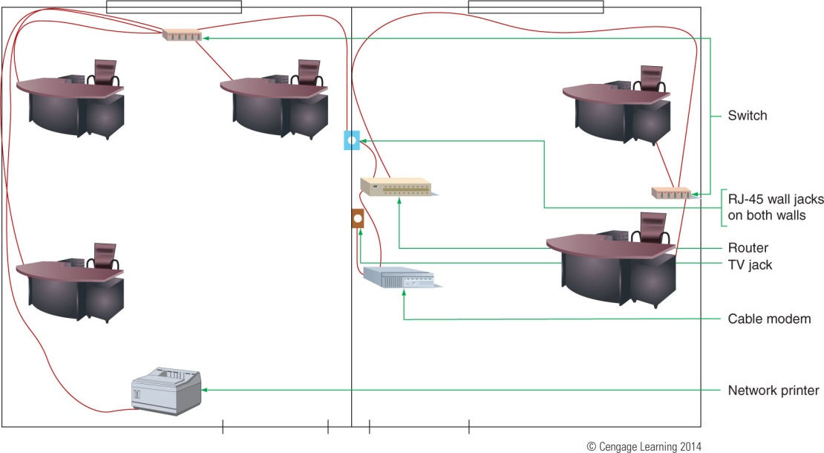
Setting Up and Troubleshooting Network Wiring
Place wireless access point/router near the center of the area where you want your wireless hotspot
Router needs to have access to cable or DSL modem
Figure 16-35 Plan the physical configuration of a small network

Slide 34
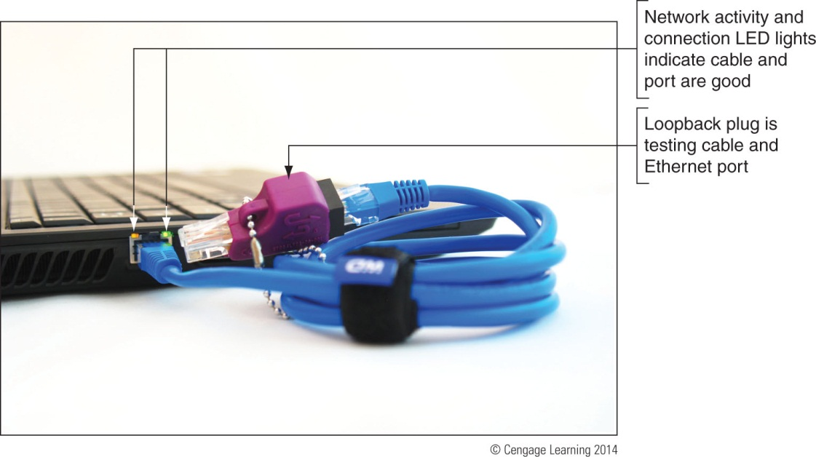
Tools Used By Network Technicians
Loopback plug: used to test a network cable or port
Also used to find out which port on a switch matches up with a wall jack
Figure 16-36 A loopback plug verifies the cable and network port are good

Slide 35
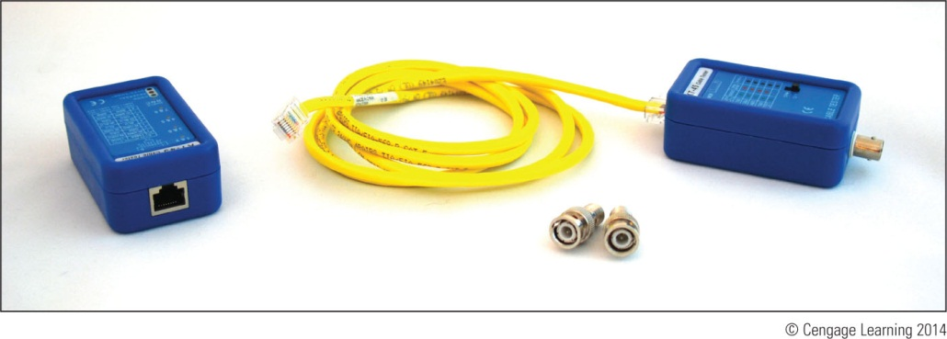
Tools Used By Network Technicians
Cable tester: used to test a cable
Can also find out what type of cable it is if it is not labeled and to locate the ends of a network cable in a building
Has two components: remote and the base
Figure 16-37 Use a cable tester pair to determine the type
of cable and/or if the cable is good

Slide 36
Tools Used By Network Technicians
Network multimeter: can test cables, ports, and network adapters
Can detect Ethernet speed, duplex status, default router on a network, length of a cable, voltage levels of PoE, and other network statistics
Many can document test results and upload results to a PC

Slide 37
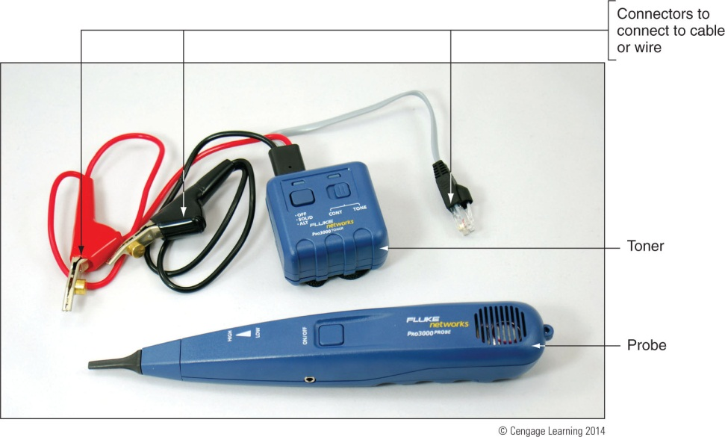
Tools Used By Network Technicians
Toner probe: two-part kit used to find cables in walls
Toner connects to one end of cable and puts out a continuous tone while a probe is used to search the walls for the tone
Figure 16-40 A toner probe kit by Fluke Corporation

Slide 38
Tools Used By Network Technicians
Wire stripper: used to build your own network cable
Cuts away the plastic jacket or coating around wires
Crimper: used to attach a terminator or connector to the end of a cable
Can serve double-duty as a wire cutter and stripper

Slide 39
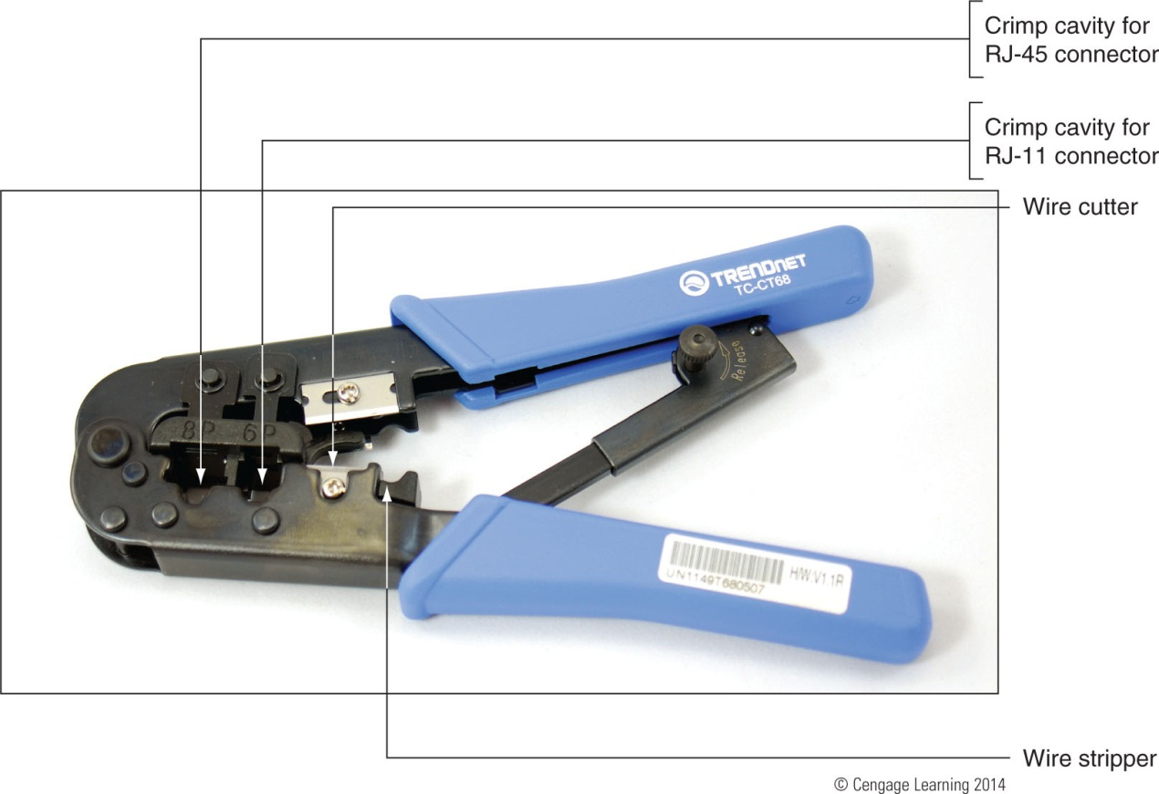
Figure 16-41 This crimper can crimp RJ-45 and RJ-11 connections

Slide 40
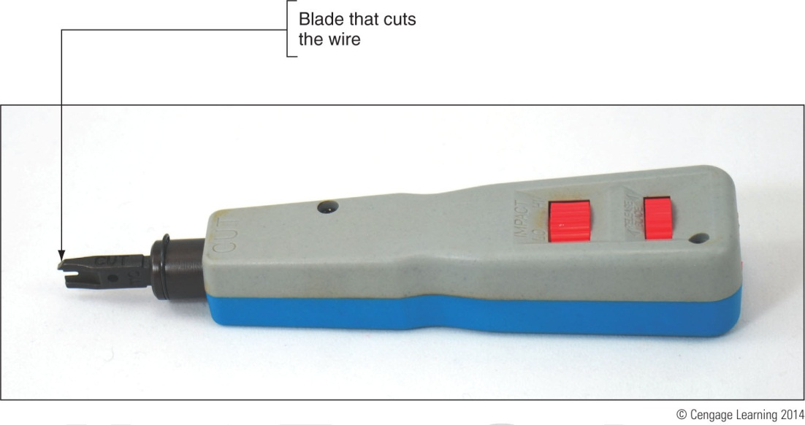
Tools Used By Network Technicians
Punchdown tool: also called an impact tool
Used to punch individual wires into slots in a keystone RJ-45 jack that is used in an RJ-45 wall jack
Figure 16-42 A punchdown tool forces a wire into a slot and cuts off the wire

Slide 41
Tools Used By Network Technicians
Patch panel: provides multiple network ports for cables that converge in one location
Each port is numbered on the front of the panel
Keystone jacks are color-coded for the wires to be inserted on the back of the panel
Punchdown tool is used to terminate

Slide 42
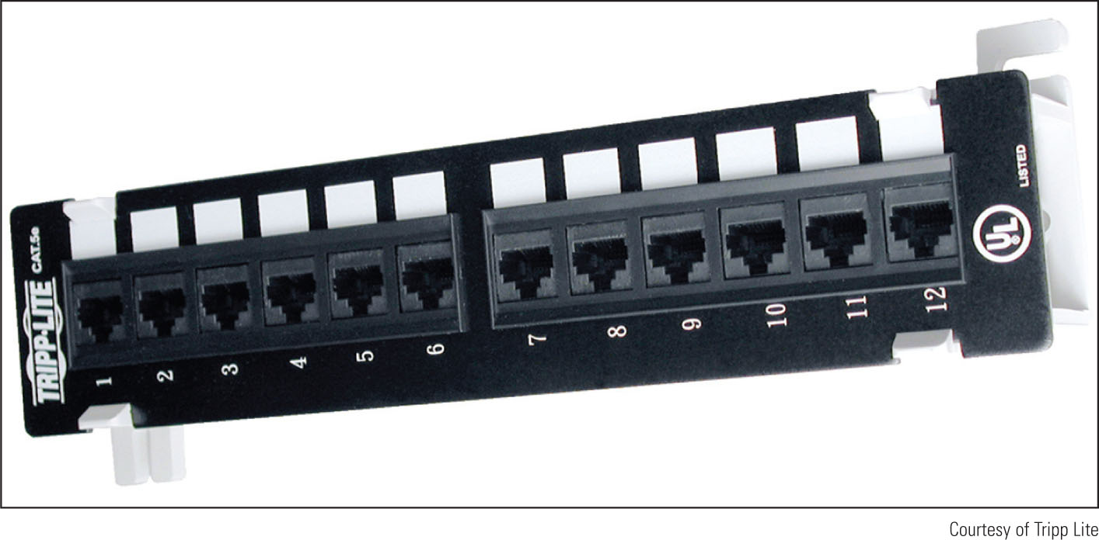
Figure 16-43 A patch panel provides Ethernet ports for cables
converging in an electrical closet

Slide 43
How Twisted-Pair Cables and Connectors Are Wired
Straight-through cable: used to connect a computer to a switch or other network device
Also called a patch cable
Crossover cable: used to connect two like devices such as a hub to a hub or a PC to a PC
Transmit and receive lines are reversed
RJ-45 connector has eight pins
10BaseT and 100BaseT Ethernet use only four pins
Gigabit Ethernet uses all eight pins

Slide 44
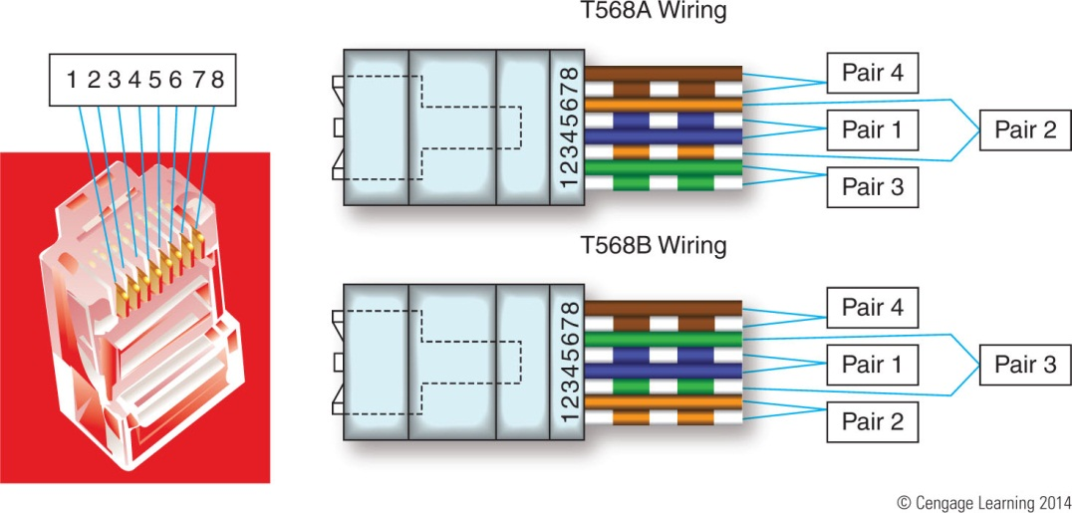
How Twisted-Pair Cables and Connectors Are Wired
Twisted pair cabling is color-coded in four pairs
Solid wire and a striped wire are in a pair
Two standards for wiring: T568A and T568B
Figure 16-44 Pinouts for an RJ-45 connector

Slide 45
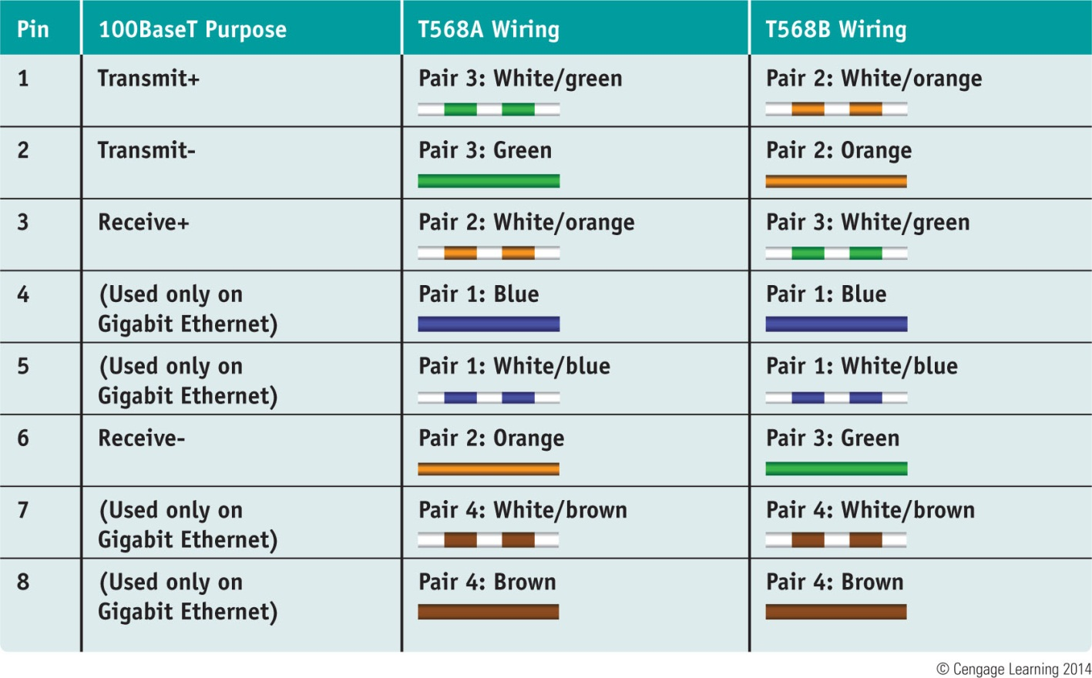
Table 10-3 The T568A and T568B Ethernet standards for wiring RJ-45 connectors

Slide 46
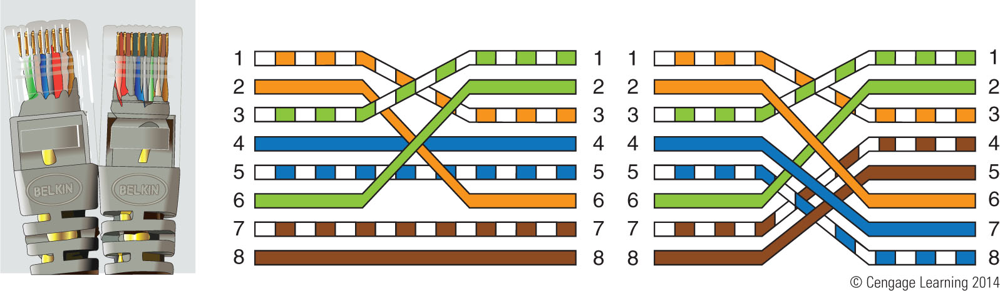
How Twisted-Pair Cables and Connectors Are Wired
When working with existing wiring be sure to find out if wiring is using T568A or T568B
If not sure, use T568B because it is most common
Figure 16-45 Two crossed pairs in a crossover cable is compatible with 10BaseT or 100BaseT
Ethernet; four crossed pairs in a crossover cable is compatible with Gigabit Ethernet

Slide 47
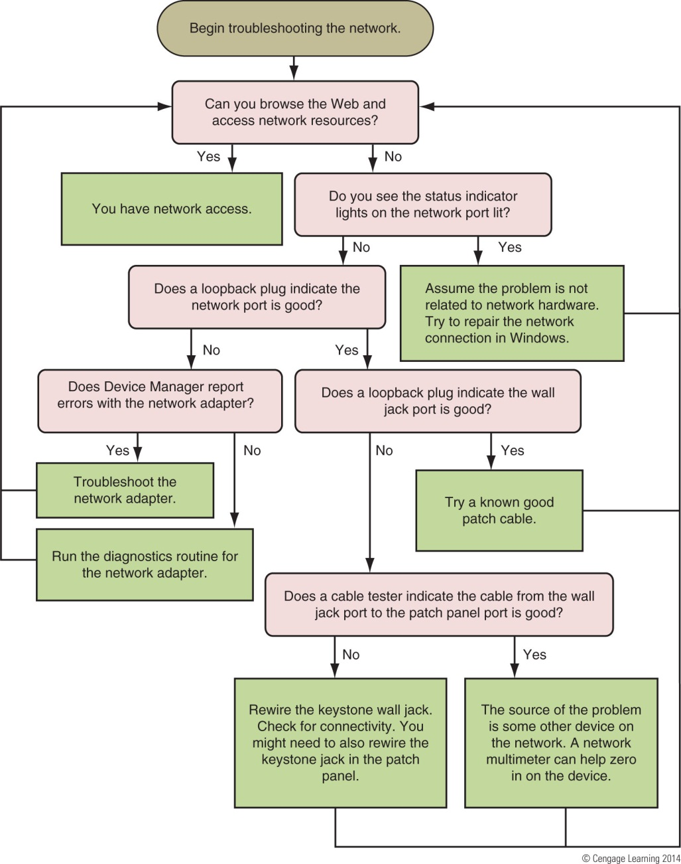
Figure 16-57 Flowchart to troubleshoot networking problems related to hardware

Slide 48
Summary
Networks are categorized in size as a PAN, LAN, Wireless LAN, MAN, or WAN
Topologies include: mesh, ring, bus, star, and hybrid network topology
Ethernet uses the star or hybrid (star bus) topology
Network performance is measured in bandwidth and latency
Two most popular ways to connect to the Internet are cable Internet and DSL
Technology used by cell phones for data is called 3G or 4G

Slide 49
Summary
Networking hardware includes: network adapters, dial-up modems, hubs, switches, routers, wireless APs, bridges, cables, and connectors
Most popular Ethernet cable is twisted pair using RJ-45 connectors
Switches and older hubs are used as a centralized connection point for devices
Other network devices include a NAS, a VoIP phone, and older/outdated Internet appliances
Twisted pair cabling is rated by category: CAT-3, CAT-5, CAT-5e, CAT-6, and CAT-6a

Slide 50
Summary
Networking tools include: loopback plug, cable tester, multimeter, tone probe, wire stripper, crimper, and punchdown tool
RJ-45 connector has eight pins
Two standards used to wire network cables are T568A and T568B
Two types of network cables are straight through and crossover cables
When troubleshooting, tools that can help are status indicator lights, loopback plugs, cable testers and network multimeter

