Slide 1

A+ Guide to Managing & Maintaining Your PC, 8th Edition
Chapter 17
Windows Resources on a Network

Slide 2
Objectives
Learn how to support some client/server applications
Learn how to share and secure files and folders on the network
Learn how to troubleshoot network connections

Slide 3
Supporting Client/Server Applications
Client/Server applications expected to support:
Internet Explorer
Remote Desktop
Other remote applications
Also need to know how to configure network settings to improve performance for client/server applications using:
Wake on LAN
Quality of Service techniques
Group Policy

Slide 4
Internet Explorer
Most popular client/server applications are a browser and web server
Internet Explorer (IE) version 9: latest version at this writing
Easy to upgrade to latest IE version by using Windows Update
Tips when using IE window:
To show the menu bar, press the Alt key
To get help using IE, press F1 to open Windows Help and Support

Slide 5
Internet Explorer
Use the Internet Options box to manage IE settings
Click Tools icon and click Internet Options
Internet Options box has several tabs with different configuration options and settings
General Tab
Change the home page or add a second home page
Protect your identity and surfing records
Check Delete browsing history on exit if you want your history cleared each time you close IE
Manage IE cache

Slide 6
Internet Explorer
Security Tab
Set security level (medium-high is the default level)
Prompts before downloading content
Does not download ActiveX controls that are not signed by Microsoft (virus can sometimes hide in an ActiveX control)
To customize security settings, click Custom level

Slide 7
Internet Explorer
Privacy Tab and Content Tab
Use Privacy Tab to block cookies that might invade your privacy or steal identity
Content tab contains settings for parental controls, allowed content based on ratings, certificates used by web sites, and how AutoComplete and Feeds are handled

Slide 8
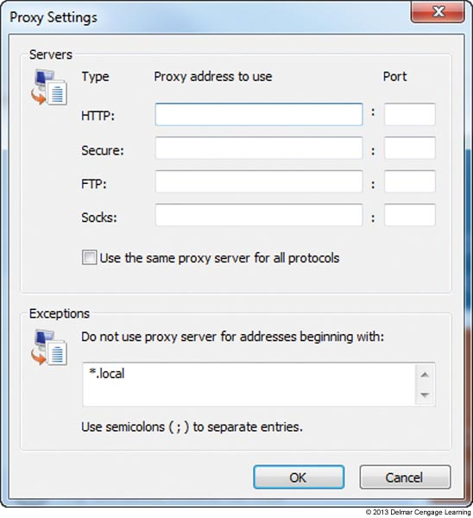
Internet Explorer
Connections Tab and Proxy Settings
Allows you to configure proxy server settings and create a VPN connection
Proxy server: intercepts requests that a browser makes of a server and serves up request from a cache it maintains
Figure 17-9 Enter the IP address
of all proxy servers on your
corporate network

Slide 9
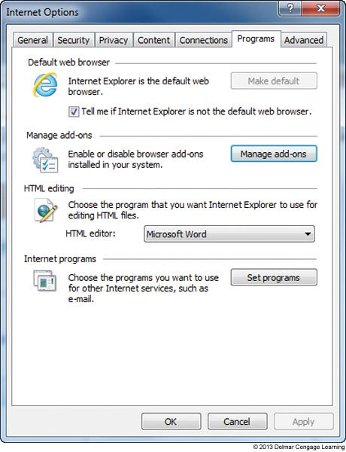
Internet Explorer
Programs Tab
Used to manage add-ons
Add-ons: small apps that help IE display multimedia content, manage email, translate text, or other actions
Figure 17-10 Use the Programs Tab to manage add-ons and default applications
used for Internet services

Slide 10
Internet Explorer
Advanced Tab
Contains several miscellaneous settings used to control Internet Explorer
One setting is useful when IE is giving problems
If you suspect problems are caused by wrong settings, click Reset to return IE to all default settings

Slide 11
Remote Desktop
Remote Desktop gives a user access to a Windows desktop from anywhere on the Internet
To use Remote Desktop, the computer you want to remotely access (the server) must be running business or professional editions of Windows 7/Vista/XP
Computer accessing can be running any version of Windows
Computers set to serve up Remote Desktop are not as secure
You can use software that does not require opening ports for a more secure solution

Slide 12
Remote Applications
Remote application: installed and executed on a server and is presented to a user working at a client computer
Windows Server includes software to manage remote apps
Remote Desktop Services (Windows Server 2008 and later)
Terminal Services (Windows Server prior to 2008)
Both use RDP protocol to present the remote app and the data to its client

Slide 13
Remote Applications
Windows 7 RemoteApp and Desktop Connection is used to install the small client program using one of two methods:
System administrator provides an application proxy file
System administrator provides a URL to the server application

Slide 14
Network Settings To Support Applications
Wake on LAN
Causes host computer to turn on when a specific type of network activity happens
Even if computer is off, network adapter retains power and listens for network activity
Computer wakes up when adapter receives a specific type of network activity
Two types of activity that can trigger Wake on LAN:
Wake pattern
Magic packet

Slide 15
Network Settings To Support Applications
Wake on LAN (cont’d)
System administrator might use utilities to remotely wake a computer to perform routine maintenance
Don’t use Wake on LAN on a laptop
Can drain the battery
Must be supported by your motherboard and network adapter
Must be enabled in both Windows and BIOS setup
Follow steps on pages 379-380 to enable

Slide 16
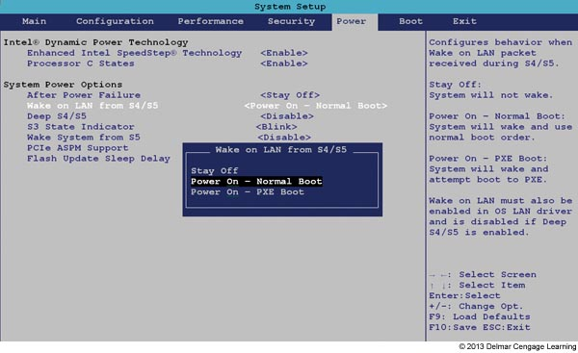
Figure 17-22 Use the Power screen in BIOS setup to enable Wake on LAN

Slide 17
Network Settings to Support Applications
Quality of Service (QoS)
Can improve network performance for an application by raising its priority for allotted network bandwidth
For Windows to enable QoS the network adapter must support QoS
To configure Windows to provide QoS:
Enable QoS for the network connection and adapter
Set the QoS priority level for applications
Some applications (Microsoft Office 365) have QoS priority levels sets automatically
Follow steps on page 380 to enable QoS in Windows

Slide 18
Use Group Policy to Improve QoS Applications
Group Policy (gpedit.msc)
Used to control what users can do and how the system can be used
Only available in Windows professional and business editions
Works by:
Making entries in registry
Applying scripts to Windows startup, shutdown, and logon processes
Affecting security settings

Slide 19
Use Group Policy to Improve QoS Applications
Group Policy (cont’d)
Can be applied to computer or user
Computer policies are applied just before logon screen
User policies are applied after login
To use Group Policy to set the QoS level for an application follow steps on pages 382-383
To get the most out of QoS, configure each router and computer on the network to use QoS

Slide 20
Controlling Access to Folders and Files
Managing shared resources is accomplished by:
Assigning rights to user accounts
Assigning permissions to folders and files

Slide 21
Classify User Accounts and User Groups
Principle of least privilege: An approach where computer users are assigned the minimum rights required to do their job
Rights or privileges are established when you first create a user account (based on account type)
Rights can later be changed by changing the user groups to which the account belongs
User accounts are created from the Control Panel or by using the Computer Management console

Slide 22
Classify User Accounts and User Groups
Type of User Account
Administrator account: has complete access to the system and can make changes that affect the security of the system and other users
Standard user account: can use software and hardware and make some system changes but cannot make changes that affect the security of the system or other users

Slide 23
Classify User Accounts and User Groups
Built-in User Groups
Administrators and Users groups
Guests group
Has limited rights and is given a temporary profile that is deleted when user logs off
Backup Operators group
Can back up and restore files on the system regardless of its access permission to files
Power Users group
Windows XP group that can read from and write to parts of the system, install apps, and perform limited administrator tasks

Slide 24
Classify User Accounts and User Groups
Windows might automatically assign one of these built-in user groups to an account:
Authenticated Users group: includes all user accounts except the Guest account
Everyone group: includes the Authenticated Users group as well as the Guest account
Anonymous users: users who have not been authenticated on a remote computer

Slide 25
Classify User Accounts and User Groups
Customized User Groups
Use Management Console in business and professional editions of Windows to create custom user groups
Easier to assign permissions to user groups rather than to individual accounts
User groups work well when several users need the same permissions
Create a user group and then assign permission to the user group

Slide 26
Methods to Assign Permissions To Folders and Files
Three general strategies for managing shared folder and files in Windows
Windows 7 homegroup sharing: use when all users on a network require the same access to all resources
Workgroup sharing: offers better security than a homegroup
Domain controlling: if computer belongs to a domain, all security is managed by the network administrator for the entire network

Slide 27
Methods to Assign Permissions To Folders and Files
Tips on which folder to use to hold shared data:
Private data for individual users
C:\Users or the XP C:\Documents and Settings folder for that user
Data for all users to share
C:\Users\Public folder
For best security, create a folder not in either of the above folders and assign permissions to that folder and its subfolders
Allow all users access or only certain users or user groups

Slide 28
Methods to Assign Permissions To Folders and Files
Using workgroup sharing, Windows offers two methods to share a folder
Share permissions: grant permissions only to network users and not to local users
Apply to a folder and its contents, not to individual files
NTFS permissions: apply to local users and network users
Apply to both folders and individual files
Work on NTFS volumes only

Slide 29
Methods to Assign Permissions To Folders and Files
Tips when implementing permissions:
If both share and NTFS permission are used, the most restrictive permission applies
If NTFS permissions are conflicting the more liberal permission applies
Permission propagation: when permissions are passed from parent to child
Inherited permissions: permissions attained from a parent object
When you move or copy an object to a folder, the object takes on permissions of that folder

Slide 30
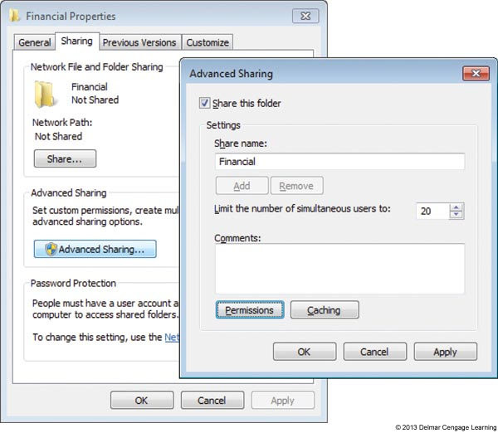
How to Share Folders and Files
How to Use Share Permission
For NTFS volume, use NTFS permission whenever possible
Figure 17-41 Use the
sharing tab of a folder
properties box to set up
share permissions

Slide 31
Support and Troubleshoot Shared Folders and Files
Few tips about managing shared folders and files:
Use advanced permissions settings if you need further control of a user or group
Click Advanced on the Security tab of a folder’s Properties box
Manage permissions using parent folder
Subfolders inherit permissions of the parent folder
Check the effective permissions
To know for sure which permissions are in effect, see Effective Permissions tab of Advanced Security Settings box

Slide 32
Support and Troubleshoot Shared Folders and Files
Few tips about managing shared folders and files: (cont’d)
Take ownership of a folder
Owner of a folder always has full permissions
Use only one workgroup
Performance improves when they are all in the same workgroup
Require passwords for all user accounts
Use a mapped network drive

Slide 33
How to Map a Network Drive
A network drive map makes one computer (client) appear to have a new hard drive
Assign a drive letter to a path to a shared folder or drive on another computer
Network File System (NFS) makes it possible for files on the network to be accessed as easily as if they are stored on the local computer

Slide 34
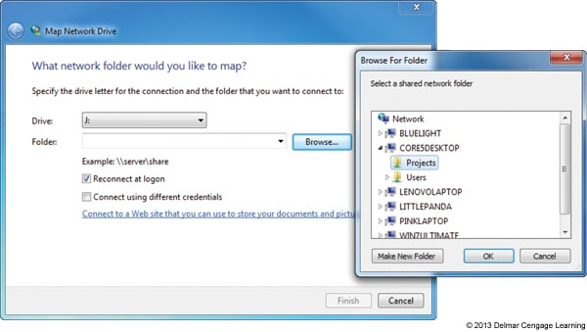
Figure 17-47 Mapping a network drive to a host computer

Slide 35
Hidden Network Resources and Administrative Shares
To protect confidential data from users on the network:
Disable File and Printer Sharing
Hide a shared folder
If you want to share a folder, but don’t want others to see it add a $ to the end of the folder name
Those that want to access the hidden folder must enter the complete path to the folder (including $) in search box

Slide 36
Hidden Network Resources and Administrative Shares
Local shares: folders and files on a computer that are shared with others using local user accounts
Administrative shares: folders that are shared by default that administrator accounts at the domain level can access
Two types of administrative shares:
The %systemroot% folder
Any volume or drive
Don’t share the /Windows folder or an entire drive
Don’t want system files and folders exposed

Slide 37
Troubleshooting Network Connections
Both hardware and software tools can help when troubleshooting network connections
Hardware tools:
Cable tester
Loopback plug
Wireless locator
Windows TCP/IP utilities

Slide 38
Cable Tester, Loopback Plug, and Wireless Locator
Cable tester – can be used to:
Test whether a cable is good or not
Find out what type of cable it is
Trace a network cable through a building
Loopback plug – can be used to test a network cable or port
Cable testers work on cables that are not live
Loopback plugs work with live cables and ports
When buying a loopback plug pay attention to Ethernet speeds supported
Some only support 100 Mbps

Slide 39
Cable Tester, Loopback Plug, and Wireless Locator
Wireless locator – helps find a Wi-Fi hotspot and measures the strength of an RF signal
Helpful when mapping out where to position a wireless access point
When buying a wireless locator, look for one that tells if the hotspot is encrypted and supports all current Wi-Fi standards

Slide 40
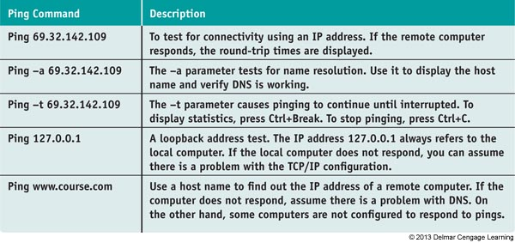
TCP/IP Utilities Used For Troubleshooting
Ping [-A] [-T] [TARGETNAME]
Tests connectivity by sending an echo request to a remote computer
Table 8-2 Examples of the ping command

Slide 41
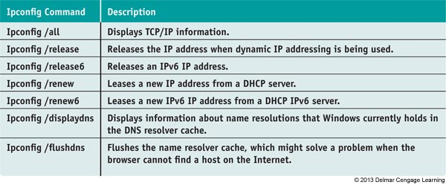
TCP/IP Utilities Used For Troubleshooting
IPCONFIG [/ALL] [/RELEASE] [/RENEW] [/DISPLAYDNS] [/FLUSHDNS]
Can display TCP/IP configuration
Table 8-3 Examples of ipconfig command

Slide 42
TCP/IP Utilities Used For Troubleshooting
NSLOOKUP [COMPUTERNAME]
Lets you read information from the Internet name space by requesting information about domain name resolutions from the DNS server’s zone data
A reverse lookup is when you use the Nslookup command to find the host name when you know the IP address

Slide 43
TCP/IP Utilities Used For Troubleshooting
TRACERT TARGETNAME
Sends a series of requests to the destination computer and displays each hop to the destination
A hop happens when a packet moves from one router to another
A packet is assigned a Time To Live (TTL), which is the number of hop counts it can make before a router drops the packet and sends an ICMP message back to the host that sent packet

Slide 44
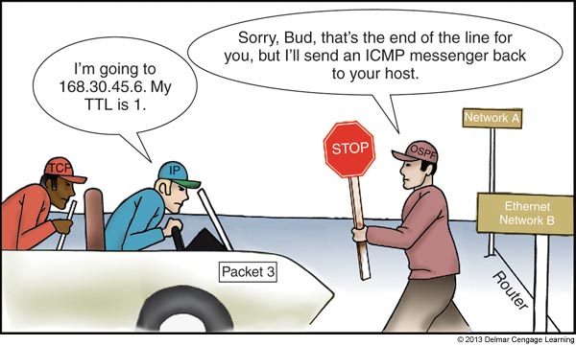
Figure 17-58 A router eliminates a packet that has exceeded its TTL

Slide 45
TCP/IP Utilities Used For Troubleshooting
The NET Commands
NET command is several commands in one
Most require an elevated command prompt window
Net use command
Connects or disconnects a computer from a shared resource
Net user command
Manages user accounts

Slide 46
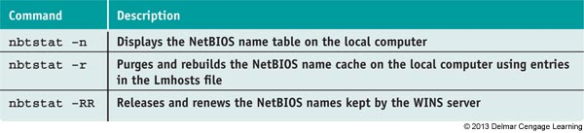
TCP/IP Utilities Used For Troubleshooting
NBTSTAT [-N] [-R] [-RR]
Used to display statistics about the NetBT (NetBIOS over TCP/IP) protocol
NetBIOS is an older network protocol suite used before TCP/IP
Table 8-4 Nbtstat commands

Slide 47
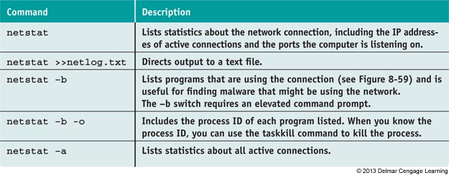
TCP/IP Utilities Used For Troubleshooting
NETSTAT [-a] [-b] [-o]
Gives statistics about TCP/IP and network activity
Table 8-5 Netstat commands

Slide 48
Strategies For Troubleshooting Network Connections
Check for local connectivity
Use Windows Explorer to try to access shared folders on the network
Determine whether other computers on network are having trouble with their connections
If some resources can be accessed, but not all:
Might be caused by cables or a switch on the network
Test for Internet access by opening a browser
Use ipconfig command to check IP addressing
Computer assigns itself an address starting with 169.254 if it was unable to lease an IP address

Slide 49
Problems With No Connectivity or Intermittent Connectivity
Begin by checking hardware and then move on to checking Windows network settings
Check status indicator lights on the NIC or Ethernet port
Steady light indicates connectivity and blinking light indicates activity
Check the network cable connection at both ends
For wireless networking, make sure wireless switch on a laptop is turned on
May need to move laptop to a new position in the hotspot

Slide 50
Problems With No Connectivity or Intermittent Connectivity
After checking hardware, try one of the following Windows methods:
In an elevated command prompt, use ipconfig /release followed by ipconfig /renew
In Windows 7 Network and Sharing Center, click a yellow triangle or red X to launch Windows diagnostics
In Vista, open Network and Sharing Center, click Diagnose and repair
In XP Network Connections window, right-click network icon and select Repair

Slide 51
Problems With No Connectivity or Intermittent Connectivity
If problem is still not resolved, check NIC drivers:
Check for adapter in Device Manager
If errors are reported with adapter in Device Manager, try updating drivers
If errors still occur, check the manufacturer web site for diagnostic software
Try running antivirus software and updating Windows

Slide 52
Problems with Internet Connectivity
If you have local connectivity, but not Internet access:
Try recycling the connection to the ISP
Unplug power source to the cable modem or other device used to connect to ISP to restart
Use Network and Sharing Center, on any computer, to repair the connection
For a cable modem, make sure your TV works
To eliminate router, connect one computer directly to the broadband modem
If you can access the Internet, you have proven router is the problem

Slide 53
Problems with Internet Connectivity
No Internet connectivity: (cont’d)
To eliminate DNS as the problem
Substitute a domain name for an IP address in a ping command (If ping works, DNS works)
Ping your DNS server
If having problems reaching a particular website, try using the tracert command
Example: tracert www.course.com
If one computer cannot access Internet but other can, make sure MAC address filtering is disabled

Slide 54
Problems with Internet Connectivity
No Internet connectivity: (cont’d)
Verify router firewall or Windows firewall settings
Contact your ISP

Slide 55
Use TCP/IP Utilities to Solve Connectivity Problems
Follow these steps to verify the local computer is communicating over the network:
1. Try to release the current IP address and lease a new address
2. Ping another computer on the network
Ping a computer on the Internet using its host address
3. Enter ipconfig /all at a command prompt to verify IP information
4. Ping the loopback address (127.0.0.1)
5. Use the netstat –b command to find out if the program to access the network is actually running

Slide 56
Use TCP/IP Utilities to Solve Connectivity Problems
Follow these steps to verify the local computer is communicating over the network: (cont’d)
6. Verify firewall settings are correct
7. Use the following command to verify that no computers have the same computer name:
Net view \\computername
8. Verify NTFS permissions and share settings on any computer that can be pinged but no found through Windows Explorer
9. Use the following command to view list of shared folders on a remote computer:
Net view \\computername

Slide 57
Use TCP/IP Utilities to Solve Connectivity Problems
Follow these steps to verify the local computer is communicating over the network: (cont’d)
10. If the net view command using a computer name does not work, try the command using an IP address
Net view 192.168.1.102
11. If you’re having problems getting a network drive map to work, try making the connection with the net use command
Net use z: \\computername\folder
To disconnect a mapped network drive:
net use z: /delete

Slide 58
Use TCP/IP Utilities to Solve Connectivity Problems
For slow network connections, try:
1. If a computer uses both a wireless and wired connection you can control the priority order of the connections
Use the Networking tab of Task Manager to see the priority order and find out which connection is faster
2. To change the priority order, open Network and Sharing Center and click Change adapter settings
Press Alt to display menu bar, click Advanced and Advanced Settings
Select the connection you want to move up in the priority order and click green up arrow

Slide 59
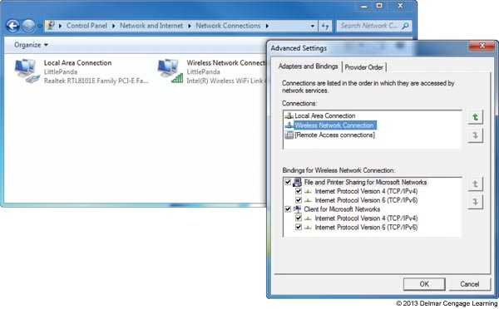
Figure 17-65 Change the priority order of the network connections

Slide 60
Chapter Summary
The Internet Options dialog box is used to manage many Internet Explorer settings
Remote Desktop gives you access to your Windows desktop from anywhere on the Internet
Configure the Windows network adapter properties and BIOS setup to use Wake on LAN
A policy can be set using Group Policy to improve QoS for an application
Controlling access to folders and files on a network is done by assigning rights to user accounts and assigning permissions to files and folders

Slide 61
Chapter Summary
Apply the principle of least privilege when assigning rights to users
Three ways to share files and folder on a network are to use homegroup sharing, workgroup sharing, and domain controllers
A mapped network drive makes it easier for users to access drives and folders on the network
Cable testers, loopback plugs, and wireless locators are used to troubleshoot hardware connection problems

Slide 62
Chapter Summary
Useful Windows TCP/IP utilities are ping, ipconfig, nslookup, tracert, net use, net user, nbtstat, and netstat
When troubleshooting network problems, check hardware, device drivers, Windows, and client/server applications, in that order

