Slide 1
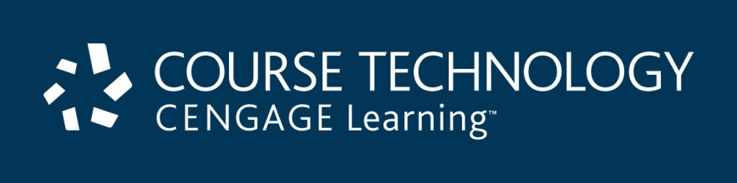
A+ Guide to Managing & Maintaining Your PC, 8th Edition
Chapter 18
Security Strategies

Slide 2
Objectives
Learn how to secure a Windows workstation
Learn how to authenticate to a computer or network using a token and about other security techniques to protect a computer or SOHO network and its resources
Learn how to recognize, remove, and protect against malicious software

Slide 3
Securing a Windows Workstation
Two goals in securing network resources:
To protect resources
To not interfere with the functions of the system
Sometimes these two goals are in conflict with each other

Slide 4
Use Windows to Authenticate Users
Controlling access to computer resources is done by:
Authentication
Proves that an individual is who he says he is
Authorization
Determines what an individual can do in the system after authentication
Assign a password to each account created
Best to give user the ability to change the password

Slide 5
Use Windows to Authenticate Users
Controlling how a user logs on
Normally, a user clicks name and enters password from Welcome screen
Malware can sometimes intercept and trick users into providing user accounts and passwords
More secure method requires user to press Ctrl+Alt+Del to get to logon

Slide 6
Use Windows to Authenticate Users
Updating Windows 7/Vista to use Ctrl+Alt+Del logon
Enter netplwiz in search box, press Enter
User Accounts box appears
Click Advanced tab, check Require users to press Ctrl+Alt+Delete, click Apply and close box

Slide 7
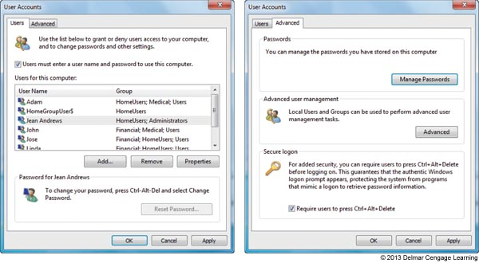
Figure 18-3 Change the way users log onto Windows

Slide 8
Use Windows to Authenticate Users
Power settings used to lock a workstation
Quickest way to lock a workstation is to press the Windows key + L
Another method is to press Ctrl+Alt+Delete
User clicks Lock this computer
To unlock, user must enter password
Disable the Guest account
Disabled by default and should remain disabled
Set up an account for visitors, create a standard account and name it Visitor

Slide 9
Use Windows to Authenticate Users
Reset a user password
If user forgets password or password becomes compromised the password can be reset
For business and professional editions of Windows:
Reset password using the Computer Management console
For all editions of Windows:
use the netplwiz command or Control Panel to reset password

Slide 10
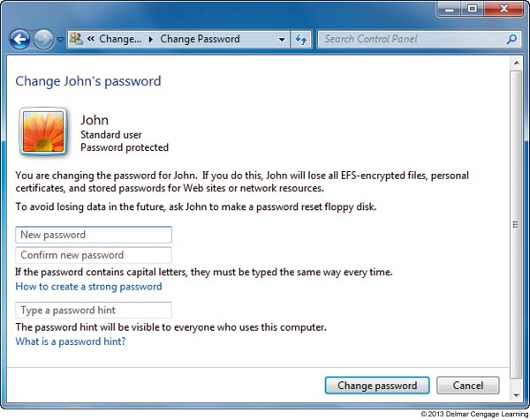
Figure 18-10 Reset a user’s password

Slide 11
Use Windows to Authenticate Users
Create strong passwords
Not easy to guess by humans and computer programs
Criteria
Use eight or more characters
Combine uppercase and lowercase letters, numbers, symbols
Use at least one symbol: second through sixth positions
Do not use consecutive letters or numbers, adjacent keyboard keys, your logon name, words in any language
Do not use same password for more than one system

Slide 12
File and Folder Encryption
In Windows, files and folders can be encrypted using Windows Encrypted File System (EFS)
Works only with the NTFS file system and business/professional editions of Windows
If a folder is marked for encryption, every created in or copied to the folder will be encrypted
An encrypted file remains encrypted if moved to an unencrypted folder

Slide 13
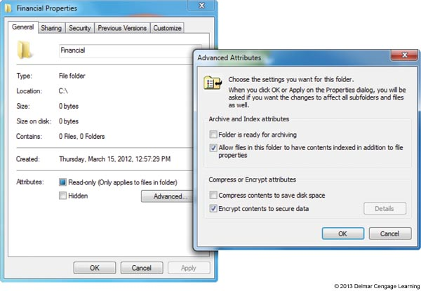
Figure 18-11 Encrypt a folder and all its contents

Slide 14
Windows Firewall Settings
A router can serve as a hardware firewall
In addition, a large corporation might use a software firewall (called corporate firewall) installed on a computer between Internet and the network
A personal firewall (also called host firewall) is software on a computer to protect that computer
Windows Firewall is a personal firewall that protects a computer
Automatically configured when you set your network location in the Network and Sharing Center
Can also customize the settings

Slide 15
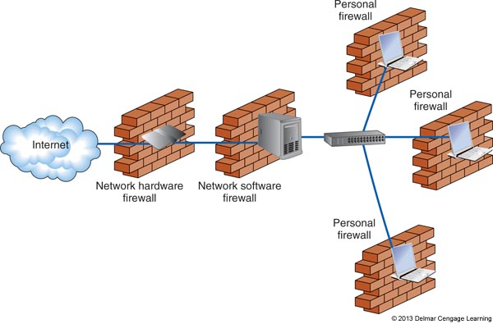
Figure 18-12 Three types of firewalls used to protect a network and
individual computers on the network

Slide 16
Local Security Policies Using Group Policy
Group Policy: controls what users can do with a system and how the system is used
Available with business and professional editions of Windows
Can set security policies to help secure a workstation
Example: require all users to have passwords and to rename default user accounts
Follow steps on pages 437-438 to set a few important security policies

Slide 17
Use BitLocker Encryption
Encrypts entire Windows volume and any other volume on the drive
Works in partnership with file and folder encryption
Three ways to use BitLocker Encryption
Computer authentication
Computer has a chip on motherboard called TPM (Trusted Platform Module) that holds BitLocker key
If hard drive is stolen, BitLocker would not allow access without BitLocker key
User authentication – startup key stored on USB drive
Computer and user authentication – PIN or password required at every startup

Slide 18
Use BitLocker Encryption
Provides great security at a price
Risk the chance of TPM failure
Risk losing all copies of the BitLocker (startup) key
Use BitLocker only if the risks of BitLocker giving problems outweigh the risk of stolen data

Slide 19
Use BIOS Features to Protect the System
BIOS security features
Power-on passwords
Supervisor password – required to change BIOS setup
User password – required to use the system or view BIOS setup
Drive lock password – required to access the hard drive
Stored on the hard drive so it will still control access to drive in the event the drive is removed

Slide 20
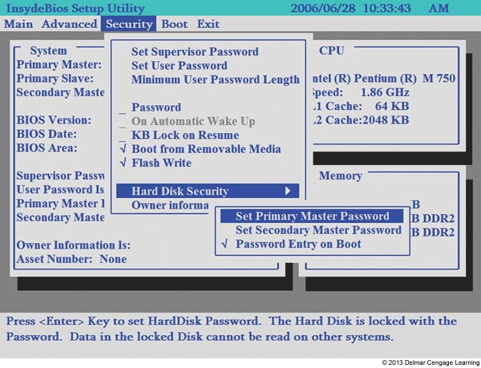
Figure 18-19 Submenu shows how to set a hard drive password that
will be written on the drive

Slide 21
Additional Methods to Protect Resources
In this part of chapter, you will learn:
To securely authenticate users on a large network
Physically protect computer resources
Destroy data before you toss out a storage device
Educate users to not compromise security measure in place

Slide 22
Authenticate Users For Large Networks
Smart Cards
Small device containing authentication information
Keyed into a logon window by a user
Read by a smart card reader
Transmitted wirelessly
Variations of smart cards
Key fob
Wireless token
Memory stripe card
Cell phone with token

Slide 23
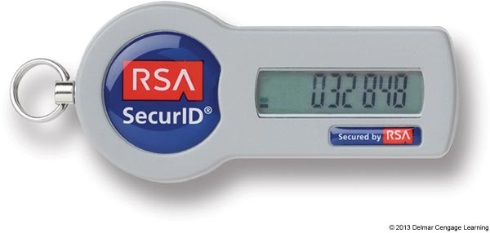
Figure 18-20 A smart card such as this SecurID key fob is used to authenticate a user gaining access to a secured network

Slide 24
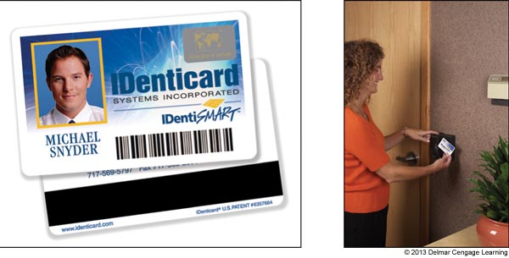
Figure 18-21 A smart card with a magnetic strip can be used
inside or outside a computer network

Slide 25
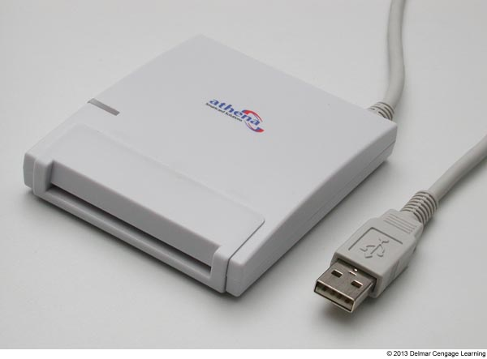
Figure 18-22 This smart card reader by Athena Smartcard Solutions
(www.athena-scs.com) uses a USB connection

Slide 26
Authenticate Users For Large Networks
Biometric data
Validates the person’s physical body
Biometric device - input device that inputs biological data about a person which can identify a person’s:
Fingerprints, handprints, face, voice, retinal, iris, and handwritten signatures
Retinal scanning scans blood vessels on the back of the eye
Considered the most reliable of all biometric data scanning
Used for highest level of security by government and military

Slide 27
Physical Security Methods and Devices
Suggestions:
Keep really private data under lock and key
Lock down the computer case
Use lock and chain
To physically tie computer to a desk or other permanent fixture
Privacy filters
Fits over the screen to prevent it from being read from a wide angle
Use a theft-prevention plate
Embed it into the case or engrave your ID information into it

Slide 28
Data Destruction
Ways to destroy printed documents and sanitize storage devices:
Use a paper shredder
Overwrite data on the drive
Physically destroy the storage media
For magnetic devices, use a degausser
Exposes a storage device to a strong magnetic field to completely erase data
For solid-state devices, use a Secure Erase utility
Use a secure data-destruction service

Slide 29
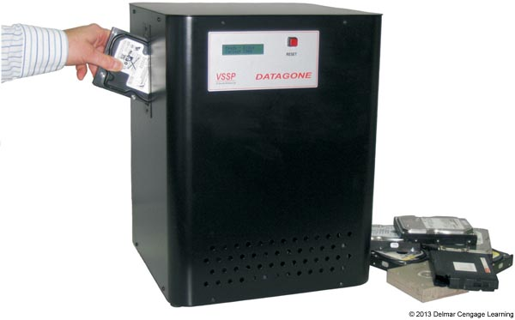
Figure 18-26 Use a degausser to sanitize a magnetic hard drive or tape

Slide 30
Educate Users
Important security measures for users
Never give out passwords to anyone
Do not store passwords on a computer
Do not use same password on more than one system
Be aware of shoulder surfing
Other people peek at your monitor screen
Lock down your workstation each time you step away
Be on the alert for tailgating
When someone who is unauthorized follows the employee through a secured entrance
Also when someone continues to use a Windows session

Slide 31
Educate Users
Social engineering techniques
Don’t forward an email hoax
Site to help you debunk a virus or email hoax:
www.snopes.com
www.viruslist.com
www.vmyths.com
Phishing: a type of identity theft where the sender of an email scams you into responding with personal data
An email message might contain a link that leads to a malicious script

Slide 32
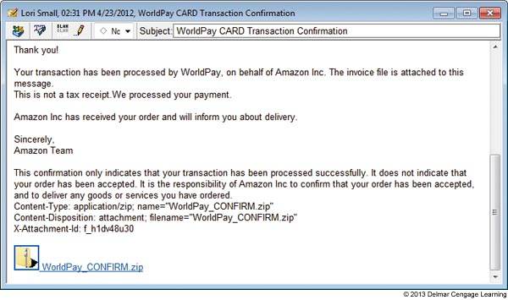
Figure 18-27 This phishing technique using an email message with an
attached file is an example of social engineering

Slide 33
Educate Users
Commonsense rules to protect a laptop:
Always know where your laptop is
Never check in your laptop as baggage
Never leave in overhead bins, keep at feet
Never leave a laptop in an unlocked car or hotel room
Use a laptop cable lock to secure to table if you must leave it in a hotel room
When at work, lock your laptop in a secure place

Slide 34
Dealing With Malicious Software
Malicious software (malware, computer infestation)
Any unwanted program that means harm
Transmitted to a computer without user’s knowledge
Grayware
Any annoying and unwanted program
Might or might not mean harm

Slide 35
What Are We Up Against?
Virus program
Replicates by attaching itself to other programs
Boot sector virus
Virus that hides in the MBR program in the boot sector or in an OS boot loader program
Adware
Produces unwanted pop-up ads
Spyware software
Spies on user and collects personal information

Slide 36
What Are We Up Against?
Keylogger
Tracks all keystrokes
Worm program
Copies itself throughout a network or the Internet without a host program
Overloads the network
Trojan
Does not need a host program to work
Substitutes itself for a legitimate program
Often downloaded from a web site or a user is tricked into opening an email attachment

Slide 37
What Are We Up Against?
Rootkit
Virus that loads itself before the OS boot is complete
Can hide folders that contain software it has installed
Can hijack internal Windows components so it masks information Windows provides to user mode utilities

Slide 38
Step-By-Step Attack Plan
Step 1: Identify Malware Symptoms
Pop-up ads plague you when surfing the web
Browser hijacking: might be redirected to a web site you didn’t ask for
System works much slower than it used to
Number and length of disk accesses seem excessive for simple tasks
Problems making a network connection
Antivirus software displays one or more messages
Windows updates fail to install correctly
System cannot recognize CD or DVD drive

Slide 39
Step-By-Step Attack Plan
Step 1: Identify Malware Symptoms (cont’d)
In Windows Explorer, filenames now have weird characters or file sizes seem excessively large
OS begins to boot, but hangs before getting to desktop
Receive email messages telling you that you have sent someone spam or an infected message
Cannot access AV software sites and cannot update your AV software
Message appears that a downloaded document contains macros, or an application asks whether it should run macros in a document

Slide 40
Step-By-Step Attack Plan
Step 2: Quarantine an Infected System
Prevent spreading of malware
Immediately disconnect from network or turn off the wireless adapter
Download antivirus software
Disconnect other computers while infected computer connected
Connect infected computer directly to the ISP
Boot into Safe Mode with Networking
Before cleaning up infected system back up data to another media

Slide 41
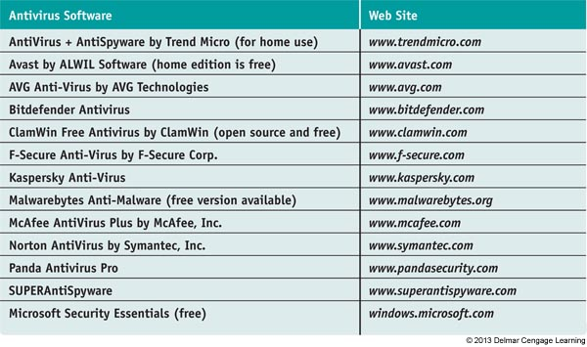
Step-By-Step Attack Plan
Step 3: Run AV Software
Before selecting AV software, read reviews and check out reliable web sites that rate AV software
Table 9-1 Antivirus software and web sites

Slide 42
Step-By-Step Attack Plan
Step 3: Run AV Software (cont’d)
Run AV software already installed
Update software and perform a full scan
Run AV software from a networked computer
Install and run AV software on the infected computer
Purchase AV software on CD or use another computer to download
Install and run AV software in Safe Mode
Run AV software from a bootable rescue disk or flash drive

Slide 43
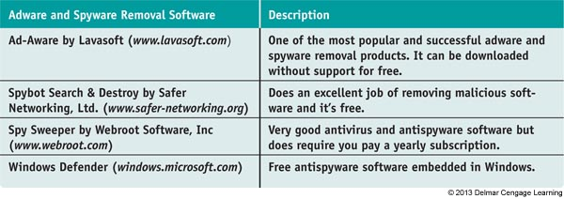
Step-By-Step Attack Plan
Step 4: Run Adware or Spyware Removal Software
Specifically dedicated to removing adware or spyware
Better than antivirus software
Windows Defender: antispyware included in Windows 7/Vista
Table 9-2 Anti-adware and antispyware software

Slide 44
Step-By-Step Attack Plan
Step 5: Purge Restore Points
Some malware hides its program files in restore points stored in System Volume Information folder maintained by System Protection
If System Protection is on, AV software can’t clean
Turn off System Protection and run AV software
Turn System Protection back on after AV software has scanned the system

Slide 45
Step-By-Step Attack Plan
Step 6: Clean Up What’s Left Over
Antivirus or antiadware software
May not delete files
Check Antivirus or antiadware software Web site for instructions to manually clean things up
Respond to any startup errors
Use MSconfig.exe
Program launched from registry
Back up and delete registry key
Program launched from startup folder
Move or delete shortcut or program in the folder

Slide 46
Step-By-Step Attack Plan
Step 6: Clean Up What’s Left Over (cont’d)
Research malware types and program files
Several Web sites offer virus encyclopedias
Check things out carefully
Some information is put on web to purposefully deceive
Learn which sites you can rely on
Delete files
Try to delete program file using Windows Explorer
Empty the Recycle Bin
May have to remove hidden or system file attributes
Delete all Internet Explorer temporary files

Slide 47
Step-By-Step Attack Plan
Step 6: Clean Up What’s Left Over (cont’d)
Clean the registry
Use a registry cleaning utility
Use Autoruns at Microsoft TechNet
Helps in searching for orphaned registry entries
Clean up Internet Explorer
Remove unwanted toolbars and home pages
Use Programs and Features window or Add or Remove Programs window
Disable suspicious add-ons
Delete unwanted ActiveX add-ons

Slide 48
Step-By-Step Attack Plan
Step 7: Dig Deeper to Find Malware Processes
Use Task Manager to search for malware processes
Most processes are registered as running
Virus may disguise itself as a legitimate Windows core process
Svchost.exe process running under a user name
Located somewhere other than C:\Windows\system32
Use Process Explorer at Microsoft TechNet
Identifies how processes relate to each other
Useful tool for software developers
Used to smoke out processes, DLLs, and registry keys eluding Task Manager

Slide 49
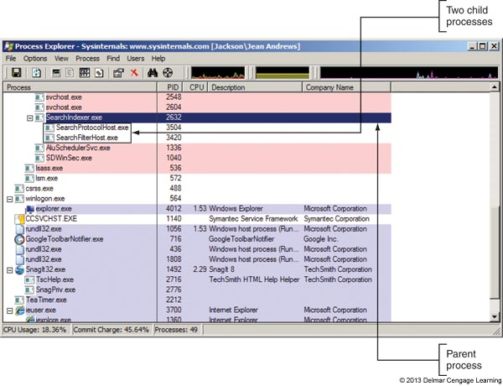
Figure 18-35 Process Explorer color codes child-parent relationships among
processes and gives information about processes

Slide 50
Step-By-Step Attack Plan
Step 6: Remove Rootkits
Rootkit: program using unusually complex methods to hide itself on a system
Designed to keep a program working at root level without detection
Can prevent display of running rootkit process
May display a different name for the process
Filename may not be displayed in Windows Explorer
Registry editor may not display rootkit registry keys or display wrong information

Slide 51
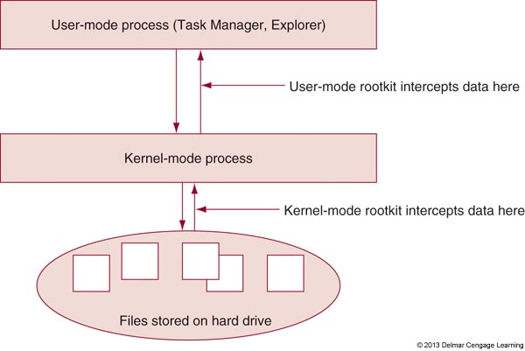
Figure 18-36 A rootkit can run in user mode or kernel mode

Slide 52
Step-By-Step Attack Plan
Step 8: Remove Rootkits (cont’d.)
Rootkit not detected if Windows tools infected
Anti-rootkit software
Looks for running processes that don’t match up with the underlying program filename
Compares files, registry entries, processes provided by the OS to the lists it generates from the raw data
Best-known anti-rootkit product is Blacklight by F-Secure (www.f-secure.com)

Slide 53
Step-By-Step Attack Plan
Step 9: Repair Boot Blocks
Hard drive boot sectors infected or damaged
Repair MBR or OS boot record
Launch the Recovery Environment, and access command prompt
Use the command bootrec /fixmbr repairs MBR
Use the command bootrec /fixboot repairs OS boot record
BIOS code corrupted
If see an error at POST “Award BootBlock BIOS ROM checksum error”
See motherboard manufacturer web site for information

Slide 54
Step-By-Step Attack Plan
Step 10: Enable System Protection and Educate the User
If System Protection is still turned off, turn it back on and create a restore point
Go over with the user some tips presented earlier in this chapter to keep the system free from malware

Slide 55
Step-By-Step Attack Plan
Step 11: Protect Against Malicious Software
Always use a software firewall
Windows Firewall is turned on by default
Use anti-malware software
To avoid conflicts and not slow down performance, it is best to run only one anti-malware program on a computer
Keep Windows updates current
Keep good backups
Keep the User Account Control box enabled

Slide 56
Step-By-Step Attack Plan
Step 11: Protect Against Malicious Software (cont’d)
Limit the use of administrator accounts
Set Internet Explorer for optimum security
Use a hard drive image
Can reinstall the image if a system gets infected
No data is kept on a personal computer
Set policy that says all data must be stored on network drives
Use network-monitoring software
Constantly monitoring the network for unusual activity

Slide 57
Summary
The netplwiz command can be used to require user to press Ctrl+Alt+Del to logon to Windows
Windows power settings can be used to lock down a workstation after inactivity and require a password to unlock the workstation
Encrypted File System (EFS) is used with NTFS volume in Windows business and professional versions
Windows Firewall, Group Policy, BitLocker Encryption, and BIOS security features can all be used to help secure a computer and its data

Slide 58
Summary
Large networks might use smart cards and biometric data to authenticate a user
Physical security can include a locked door, lock and chain, or privacy filter
Data can be destroyed using a paper shredder, low-level format, drill, degausser, or Secure Erase utility
Educate users against social engineering and how to best protect a laptop when traveling

Slide 59
Summary
Malware includes a virus, adware, spyware, keylogger, worm, Trojan, and rootkit
Malware symptoms include pop-up ads, slow performance, error messages, file errors, spam, and strange processes running
When you suspect a computer is infected, immediately quarantine it
To protect a computer against malware, use a software firewall, keep AV software up to date and running, and maintain Windows updates

