Slide 1

A+ Guide to Managing & Maintaining Your PC, 8th Edition
Chapter 19
Supporting Notebooks

Slide 2
Objectives
Learn about special considerations when supporting notebooks that are different from supporting desktop computers
Learn how to configure, optimize and troubleshoot slots, ports, and peripheral devices used with notebooks
Learn how to replace and upgrade internal components in a notebook and all-in-one computer
Learn how to troubleshoot hardware problems with notebooks

Slide 3
Special Considerations When Supporting Notebooks
Notebook (laptop): portable computer
Varieties: tablet PCs and netbooks
Tablet PC has more features than a notebook
Netbook is smaller and has less features than notebook
Comparing notebooks to desktop computers
Use the same technology as desktops
Smaller, portable, and uses less power
Replacement parts cost more than desktops
Notebooks offer a variety of ports and slots

Slide 4
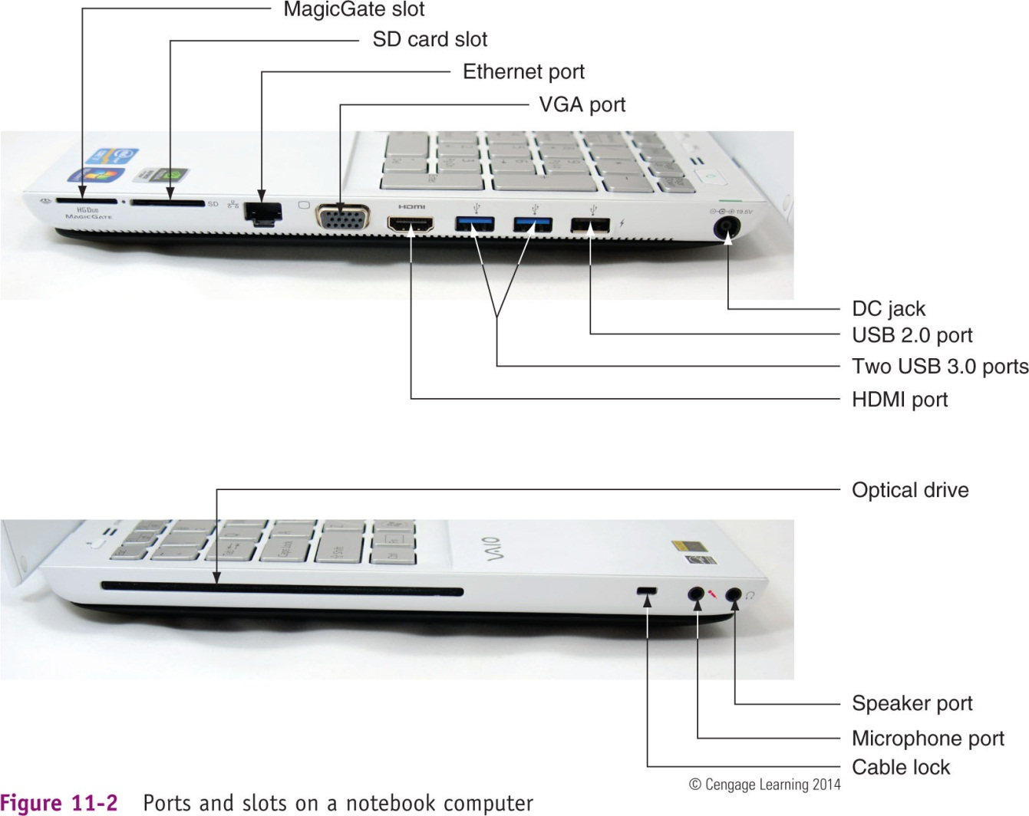
Figure 19-2 Ports and slots on a notebook computer

Slide 5
Warranty Concerns
Always check to see if notebook is under warranty before servicing
Contacting technical support: information needed
Notebook model and serial number
Purchaser name, phone number, address
Service options
On-site
Ship to authorized service center
Phone assistance or online chat

Slide 6
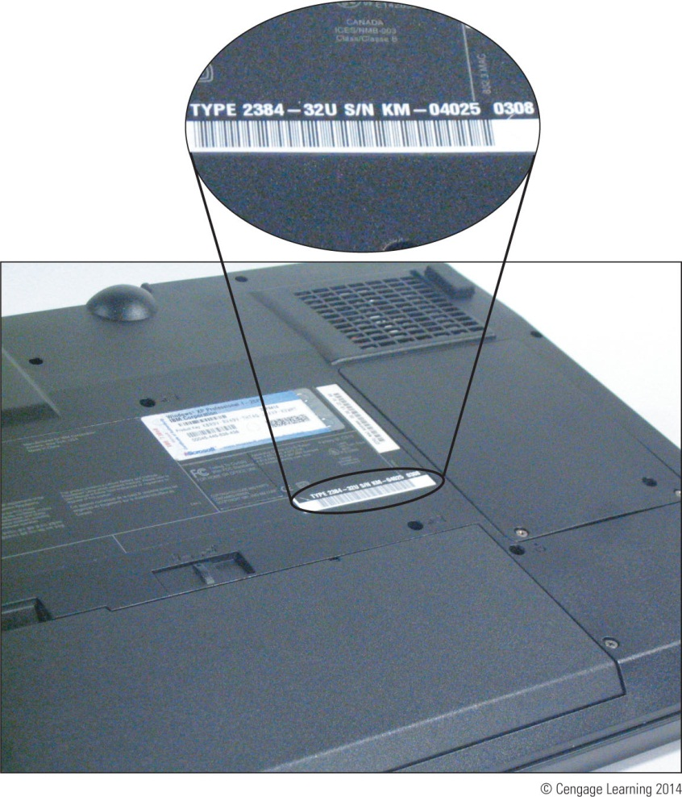
Figure 19-4 The model and serial number stamped on the bottom of a notebook are used to identify the notebook to service desk personnel.

Slide 7
Service Manuals and Other Sources of Information
Service manuals save time
Enables safe notebook disassembly
Locating documentation – Service manual
Manufacturer’s physical manual
Manufacturer’s Web site
Support or FAQ pages
Third party websites
User manual
Provides basic maintenance tasks

Slide 8
Diagnostic Tools Provided By Manufacturers
To determine problem components use diagnostic software provided by manufacturer
Sources:
Manufacturer’s Web site
CDs bundled with the notebook
Hard drive or floppy disk
Example: PC-Doctor
Included with Lenovo, Fujitsu, and HP notebooks
Can be purchased separately

Slide 9
The OEM Operating System Build
Operating system preinstalled at the factory
Original equipment manufacturer (OEM)
OS Build
Customized installation of the OS
Proprietary drivers
Customized diagnostic software
Use caution when upgrading to new OS

Slide 10
The OEM Operating System Build
Recovery partition and recovery CDs
Hard drive recovery partition can contain OS
May be hidden
Files protected from access
See user manual for access
Can also use Disk Management utility in Windows
Recovery CDs came bundled with older notebooks
Provided by manufacturer
Drivers and application setup programs
Today’s laptops provide a way to create recovery media before there is a problem

Slide 11
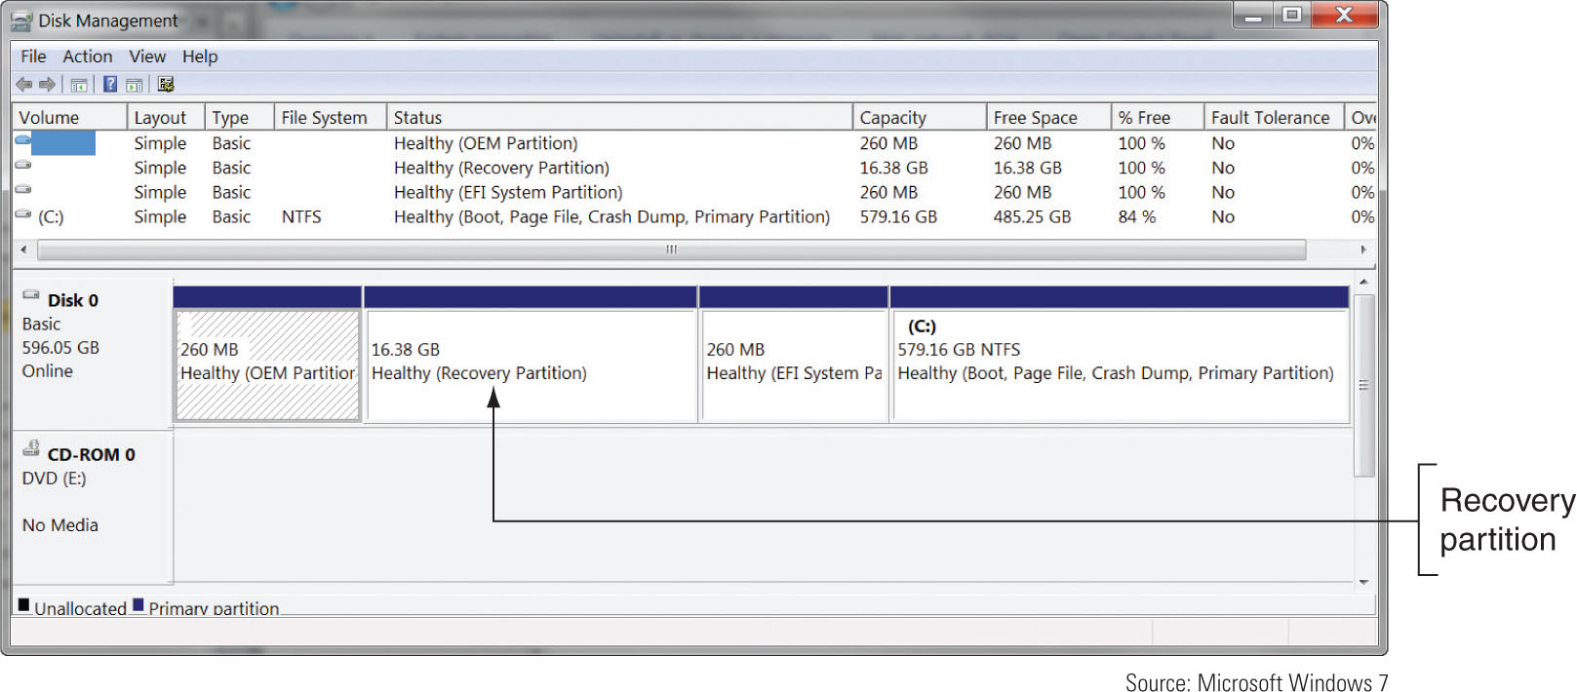
Figure 19-8 This notebook hard drive has a recovery partition that can be used to recover the system.

Slide 12
The OEM Operating System Build
Operating system upgrades
Perform only if necessary
Tips:
Upgrade using OS build from manufacturer
Ensure supporting device drivers included
Follow OEM’s specific instructions
Off-the-shelf OS advice:
Verify system component compatibility
Ensure device drivers available
Flash BIOS before upgrade, if necessary

Slide 13
Maintaining Notebooks and Notebook Components
General guidelines:
Do not touch LCD panel with sharp objects
Do not pick up or hold by the lid
Use OEM recommended battery packs
Do not tightly pack in a suitcase – use carrying case
Do not move while hard drive is being accessed
Do not put close to appliances generating strong magnetic field
Do not connect to the Internet using a public network without setting the network location to Public

Slide 14
Maintaining Notebooks and Notebook Components
General guidelines: (cont’d.)
Use passwords with each Windows user account
Keep notebook at room temperature
Keep OS current
Keep away from smoke, water, dust
Do not power up and down unnecessarily
Do not run it while it is in the case, resting on pillow or covered by a blanket
Protect notebook against ESD
Remove CD/DVD before traveling
Take precautions if notebook gets wet

Slide 15
Maintaining Notebooks and Notebook Components
Cleaning tips:
Clean LCD panel with a soft dry cloth
Use compressed air
To clean keyboard, track ball, and touch pad
To blow out air vents
Remove keyboard if keys are sticking and then blow air under keys
Use contact cleaner
Battery connections

Slide 16
Special Keys, Buttons, and Input Devices on a Notebook
Button or switches might be above the keyboard
Most of the same settings that these buttons control may also be changed using Windows tools
Some settings might be:
Volume
Screen brightness
Dual displays
Bluetooth or Wi-Fi

Slide 17
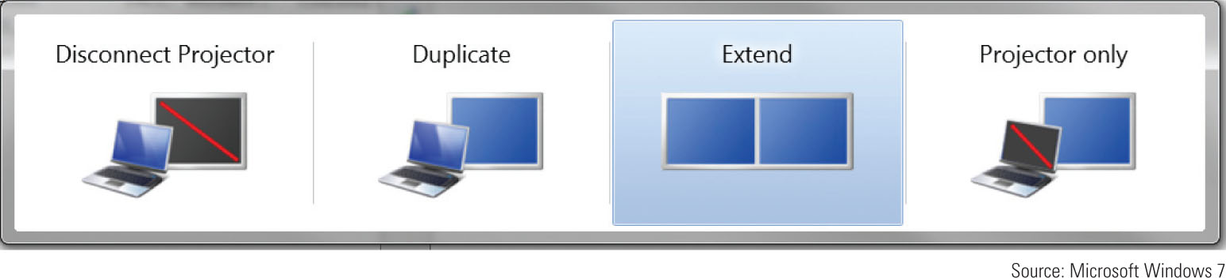
Figure 19-12 Control dual monitors on a laptop

Slide 18
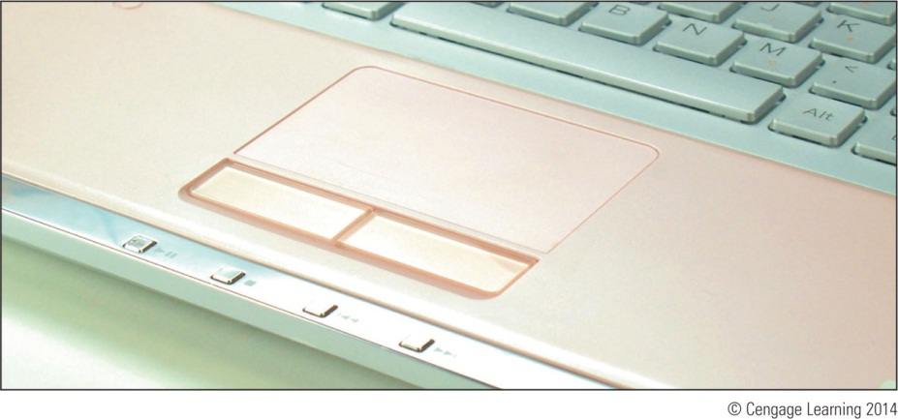
Special Keys, Buttons, and Input Devices on a Notebook
Common laptop pointing devices
Touch pad, TrackPoint or point stick
Some prefer USB wired or wireless mouse
Figure 19-13 The touch pad is the most common pointing device on a notebook

Slide 19
Special Keys, Buttons, and Input Devices on a Notebook
Adjust touch pad or TrackPoint
Mouse Properties box:
Adjust pointer speed, mouse trails, pointer size, how the touch pad buttons work, other settings for pointing devices
Tablet PCs
Stylus controlled from the Pen and Input Devices box
Accessed from Windows Control Panel

Slide 20
PCMCIA and ExpressCard Slots
Most peripheral devices today use a USB port to connect to a notebook
Older notebooks offered slots to connect peripherals
Personal Computer Memory Card International Association (PCMCIA)
Include variations of PC Card, CardBus, ExpressCard
PC Card slot technologies
16-bit ISA bus
Three standards pertaining to size and thickness
Type 1, Type II, Type III

Slide 21
PCMCIA and ExpressCard Slots
CardBus
Increases bus width to 32 bits
Backward compatible with earlier standards
ExpressCard matches PCI Express and USB 2.0
Two sizes: ExpressCard/34 and ExpressCard/54
Not backward compatible
Hot-pluggable, hot-swappable, and supports autoconfiguration

Slide 22
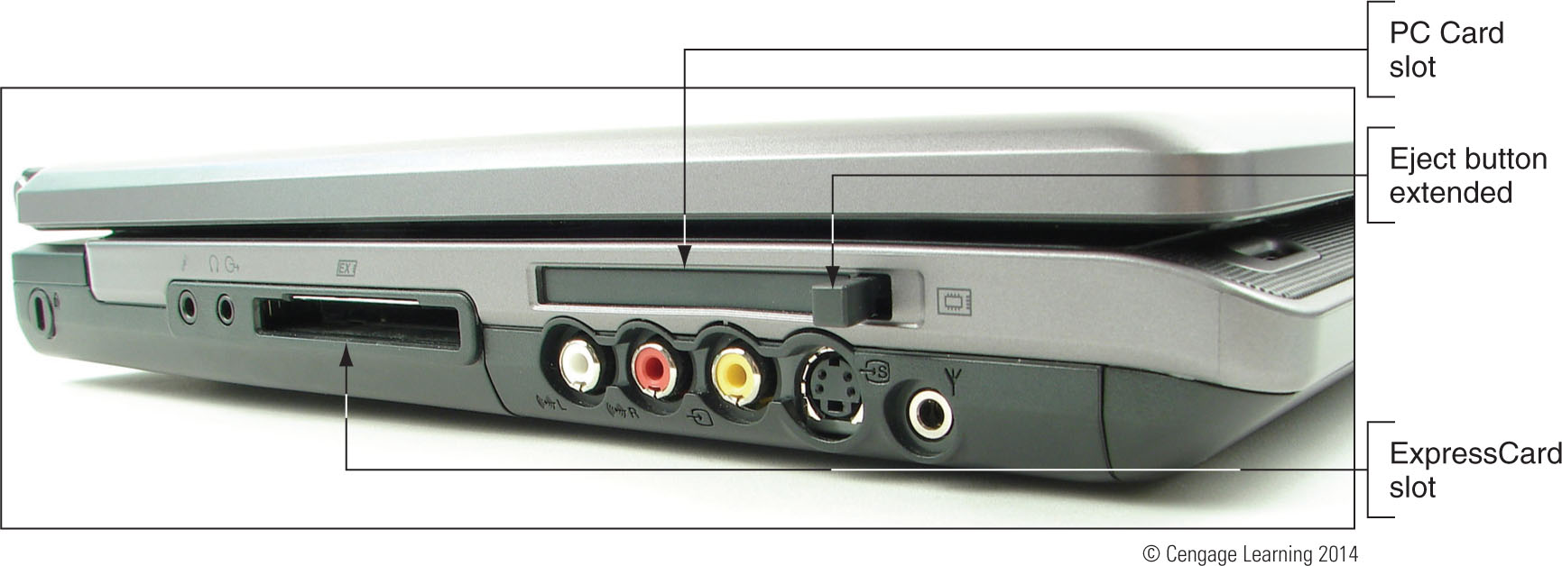
Figure 19-18 This notebook has one CardBus slot and one ExpressCard slot

Slide 23
PCMCIA and ExpressCard Slots
Windows services for PC Card or ExpressCard
Socket service and card service
Removing card from PC card or ExpressCard slot
Use the Safely Remove Hardware icon in the notification area
Proceed to eject the card

Slide 24
Updating Port or Slot Drivers
If problems arise with a port or slot:
Use Device Manager to see if errors are reported
Backups of drivers may be stored on hard drive
Download the latest drivers from manufacturer’s web site
If problem is not solved by updating drivers:
Use Device Manager to uninstall the port or slot drivers
Then use support tools to reinstall the drivers

Slide 25
Power and Electrical Devices
Notebook power sources
AC adapter or a battery pack
Auto-switching AC adapter feature
Device automatically switches from 110 V to 220 V AC power
Today’s batteries use:
Lithium Ion Technology
Some notebooks use two batteries
Second battery is known as a sheet battery

Slide 26
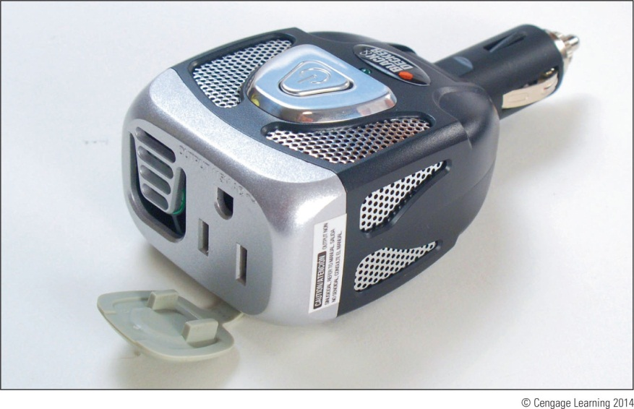
Power and Electrical Devices
Notebook power needs
A DC adapter for travel
Inverter changes DC to AC
Figure 19-26 An inverter changes DC to AC and provides an outlet for your laptop’s AC adapter

Slide 27
Power Management
Use power management settings to conserve power
Power-saving states
Sleep mode: also called suspend mode
Saves power when computer is not in use
Hibernation: work is saved to hard drive and powers system down
Older computers allows power settings to be configured in Windows and in BIOS setup
Newer BIOS does not control power settings that might conflict with Windows settings

Slide 28
Power Management
Using the Advanced Configuration and Power Interface (ACPI) standards, BIOS might refer to 5 S states:
S1: hard drive and monitor are turned off, everything else runs normally
S2: processor is also turned off
S3: everything is shut down except RAM and enough of the system to respond to a wake-up (sleep mode)
S4: hibernation
S5: power off state after a normal shutdown

Slide 29
Port Replicators and Docking Stations
Port replicator
Easy connection to full-sized monitor, keyboard, AC power adapter, and other devices
Docking station
Same functions as port replicator
Additional slots for adding secondary storage devices and expansion cards

Slide 30
Replacing and Upgrading Internal Parts
Topics:
Alternatives to consider before taking on complex repair projects
How to upgrade memory
How to exchange a drive
How to perform other complex repair projects
Exchanging an LCD panel or motherboard

Slide 31
Three Approaches to Dealing with a Broken Internal Device
Factors to consider before starting repair project:
Warranty
Time the repair will take
Alternatives to fixing (upgrading)
Return notebook to manufacturer or service center
Substitute external component for internal device
Replace the internal device

Slide 32
Three Approaches to Dealing with a Broken Internal Device
Before replacing or upgrading a component:
Back up important data if possible
Ground yourself against ESD
Remove ExpressCards, CDs, DVDs, flash memory cards, or USB devices and then shut down notebook
Disconnect AC adapter
Undock (if necessary) and remove the battery

Slide 33
Upgrading Memory
Memory used in notebooks
SO-DIMMs (small outline DIMMs)
DDR3 or DDR2
SO-RIMMs (small outline RIMMs) – used by older notebooks
Can only use the type of memory the notebook is designed to support

Slide 34
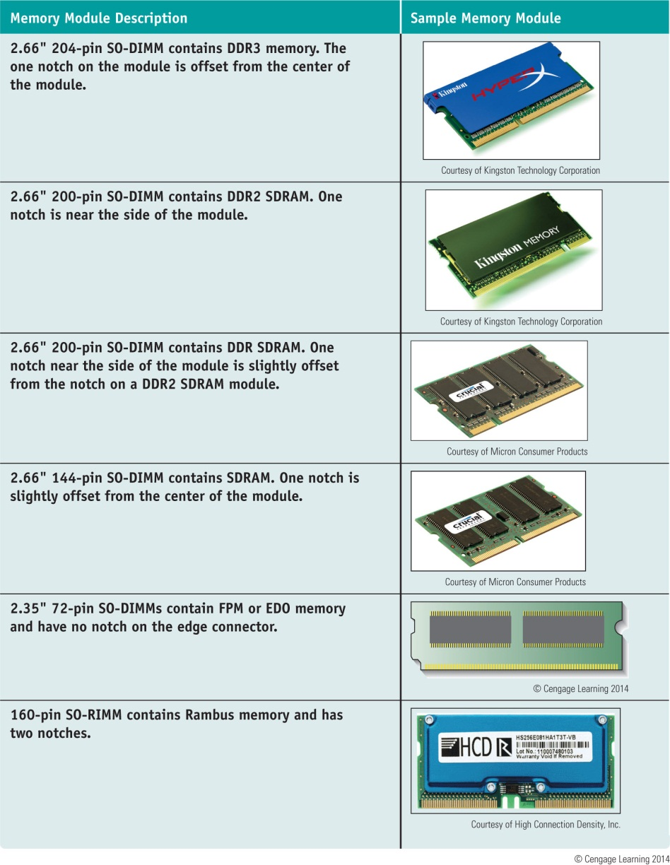
Table 11-2 Memory modules used in notebook computers

Slide 35
Upgrading Memory
How to upgrade notebook memory:
Upgrade process is similar to desktops
Considerations:
Make sure warranty not being voided
Search for best buy on a suitable and authorized part
General steps:
Decide how much memory to upgrade
Purchase memory
Install it
Follow steps outlined in the chapter

Slide 36
Replacing a Hard Drive
General guidelines:
See manufacturer’s documentation for drive sizes and connector types
Be aware of voiding manufacturer’s warranty
Shopping:
Notebook drive: 2.5 inches wide
May use SSD (solid state device) technology
Hard drives connector: SATA or PATA (IDE)
44-pin IDE drive may use adapter to interface between proprietary connector and motherboard

Slide 37
Replacing a Hard Drive
Issues to consider before replacing hard drive:
Old drive crashed
Recovery media and notebook drivers CD required
Upgrade: must transfer data from old drive to new one
Older notebook computers required disassembly
Newer notebooks: easy to replace
If BIOS setup uses autodetect:
System boots up and BIOS recognizes new drive
Searches for an operating system
If a new drive: boot from Windows recovery CD

Slide 38
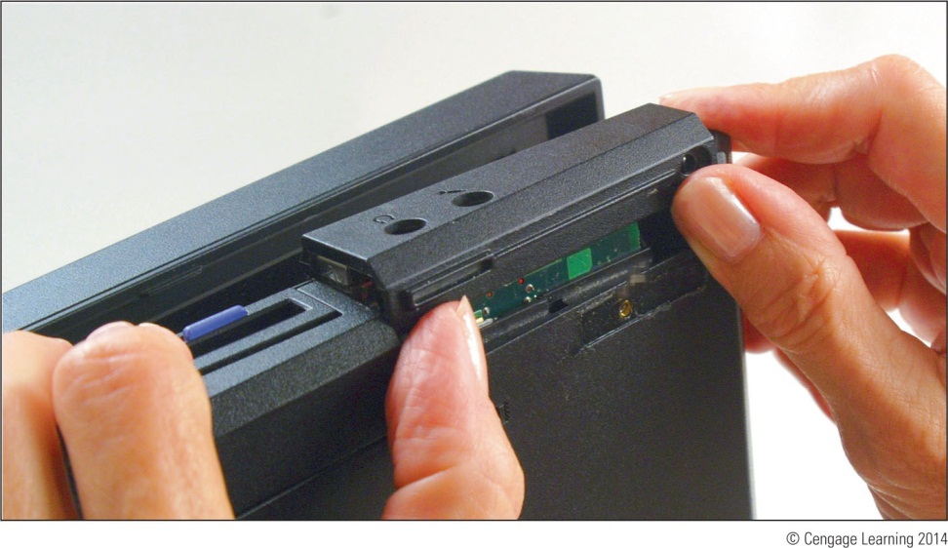
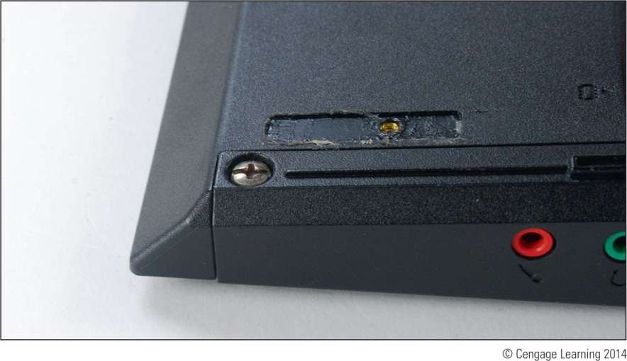
Figure 19-40 This one screw holds the hard drive in position
Figure 19-41 Push the drive out of its bay

Slide 39
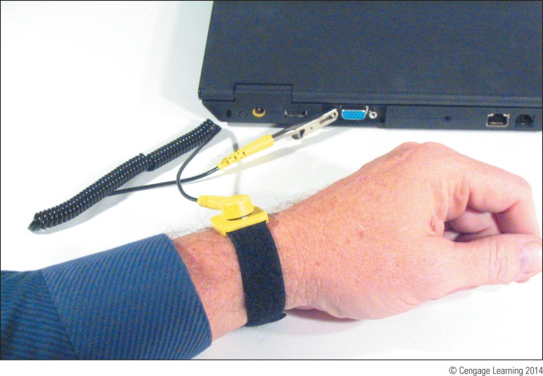
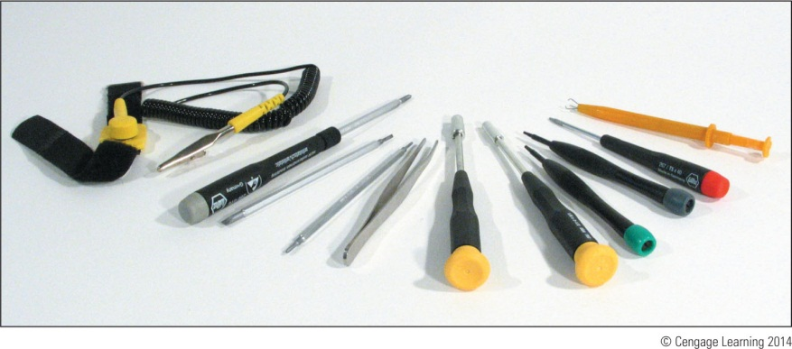
Disassembling and Reassembling a Notebook Computer
Requires special tools and extra patience
Figure 19-43 To protect the system against ESD, attach the alligator clip of a ground strap to an I/O port on the back of the notebook.
Figure 19-44 Tools for disassembling a notebook computer.

Slide 40
Disassembling and Reassembling a Notebook Computer
Many small screws require smaller tools
Work methodically:
Keep screws and components organized
Place screws in a pillbox (label each compartment)
Place screws on soft padded work surface
Use white labeling tape
Place screws on notebook paper
Write where screw belongs
Tape screw beside manufacturer documentation
Keep notes to help with reassembly

Slide 41
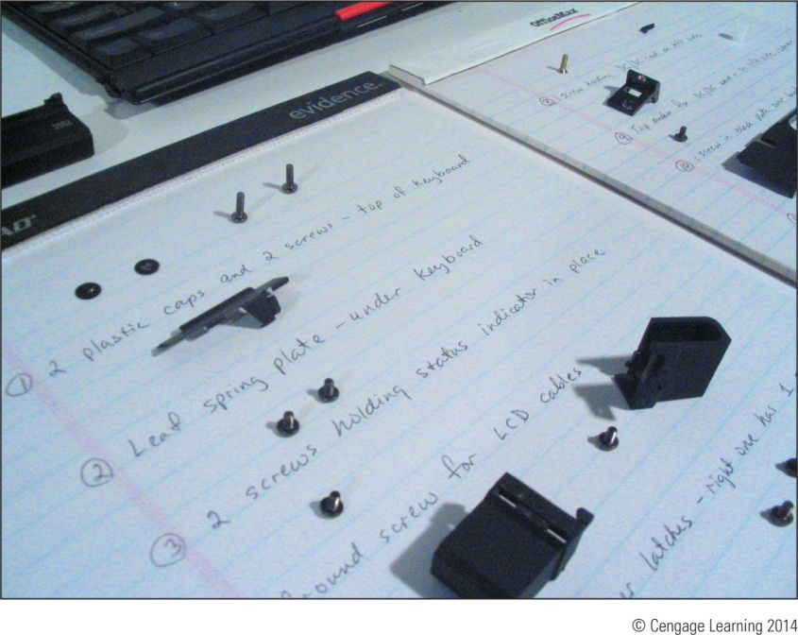
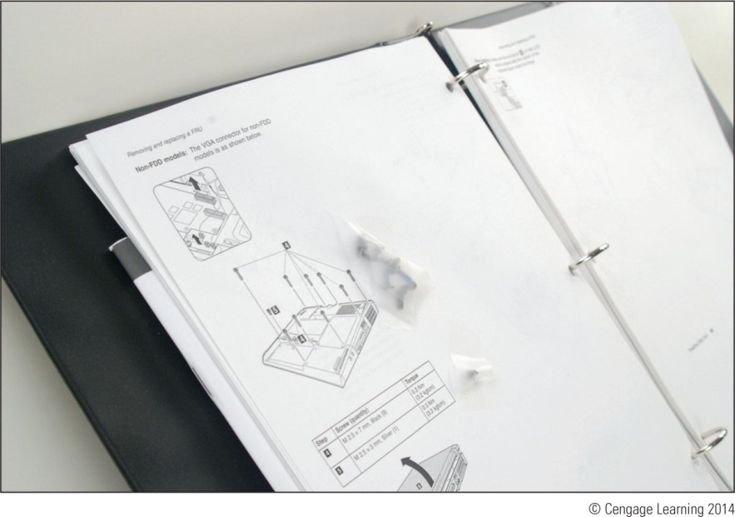
Figure 19-46 Using a notepad can help you organize screws so you know which screw goes where when reassembling
Figure 19-47 Tape screws beside the step in the manufacturer documentation that told you to remove the screw.

Slide 42
Disassembling and Reassembling a Notebook Computer
Disassembly tips:
Find the hardware service manual
Consider the warranty might still apply
Opening the case might void the warranty
Take the time necessary, do not force anything
Protect against ESD
Understand ZIF connectors
Pry up plastic covers with dental pick or screwdriver
Plastic screws may be used only once
Disassemble components in order

Slide 43
Disassembling and Reassembling a Notebook Computer
Reassembly tips:
Reassemble notebook in reverse order
Tighten, but do not over tighten, all screws
Before installing the battery or AC adapter verify there are no loose parts inside the notebook

Slide 44
Disassembling and Reassembling a Notebook Computer
Replacing the keyboard and touchpad:
Power down and unplug notebook
Remove screws on notebook bottom
Open Lid
Push keyboard toward lid while pulling it up to release it from the case
Bring keyboard out of the case and forward
Expose keyboard ribbon cable
Use screwdriver to lift cable connector up and out
Replace keyboard following steps in reverse order
If touchpad is part of keyboard bezel, remove keyboard before removing the keyboard bezel

Slide 45
Disassembling and Reassembling a Notebook Computer
Replacing optical drives:
Remove keyboard
Remove screw holding DVD drive to notebook
Slide drive out of the bay and new drive into the bay
Ensure connection with drive connector
Replace the screw
Replacing expansion cards:
Newer notebook use Mini PCI Express slots (Mini PCIe)
Uses 52 pins on the edge connector
Older notebooks use a Mini PCI slot

Slide 46
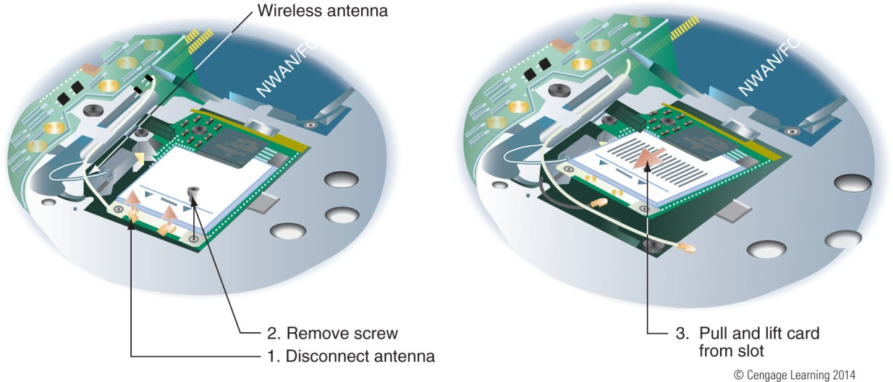
Disassembling and Reassembling a Notebook Computer
Steps to remove a Mini PCIe wireless network card:
Disconnect antenna from Wi-Fi card
Remove the one screw at the top of the card
Pull card forward and out of the slot
Figure 19-61 How to remove a Mini PCI Express card

Slide 47
Disassembling and Reassembling a Notebook Computer
Replacing the processor:
Use CPU supported by manufacturer and notebook model
For many laptops, remove the cover on the bottom to expose the processor fan and heat sink assembly
Some laptops may require you to remove the keyboard and keyboard bezel to reach the fan assembly and processor

Slide 48
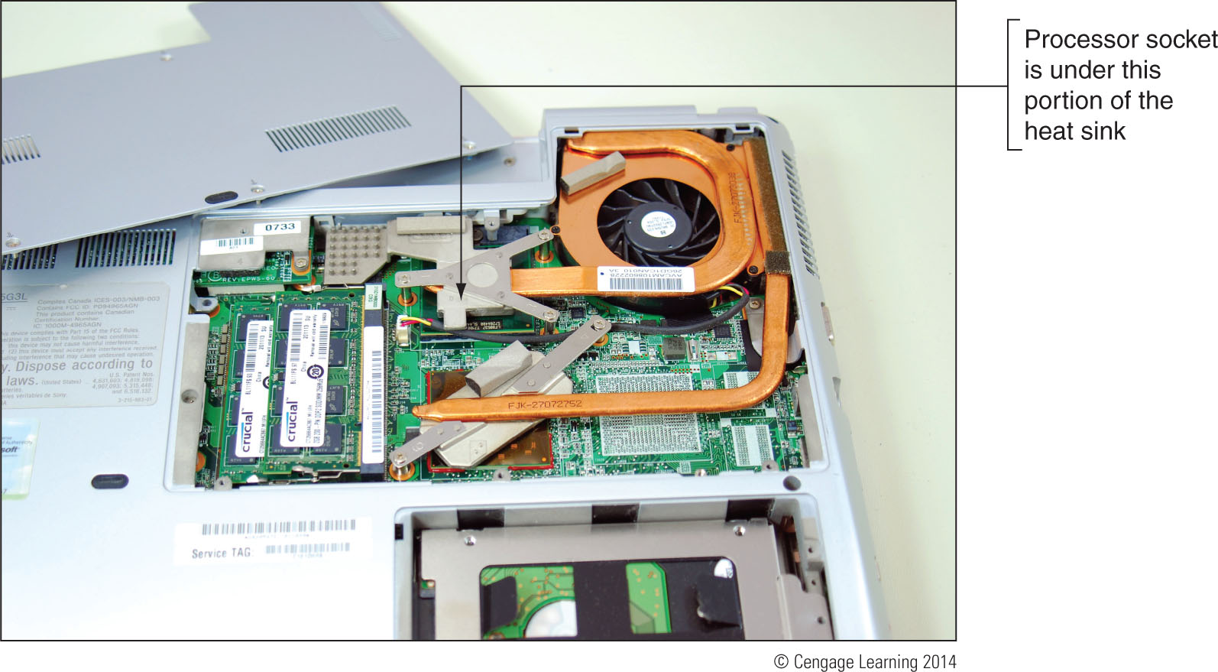
Figure 19-63 Remove the cover from the bottom of the laptop to expose
the heat sink and fan assembly and to reach the processor

Slide 49
Disassembling and Reassembling a Notebook Computer
Replacing the motherboard:
Need to fully disassemble the entire notebook
Consider alternatives before proceeding
General procedure for replacing the motherboard:
Remove the keyboard, optical drive, and mini PCIe card
Remove the notebook lid and keyboard bezel assembly
Lift up the assembly and disconnect two cables connecting it to the motherboard
Remove CPU and DVD drive
Remove screw that hold motherboard in place

Slide 50
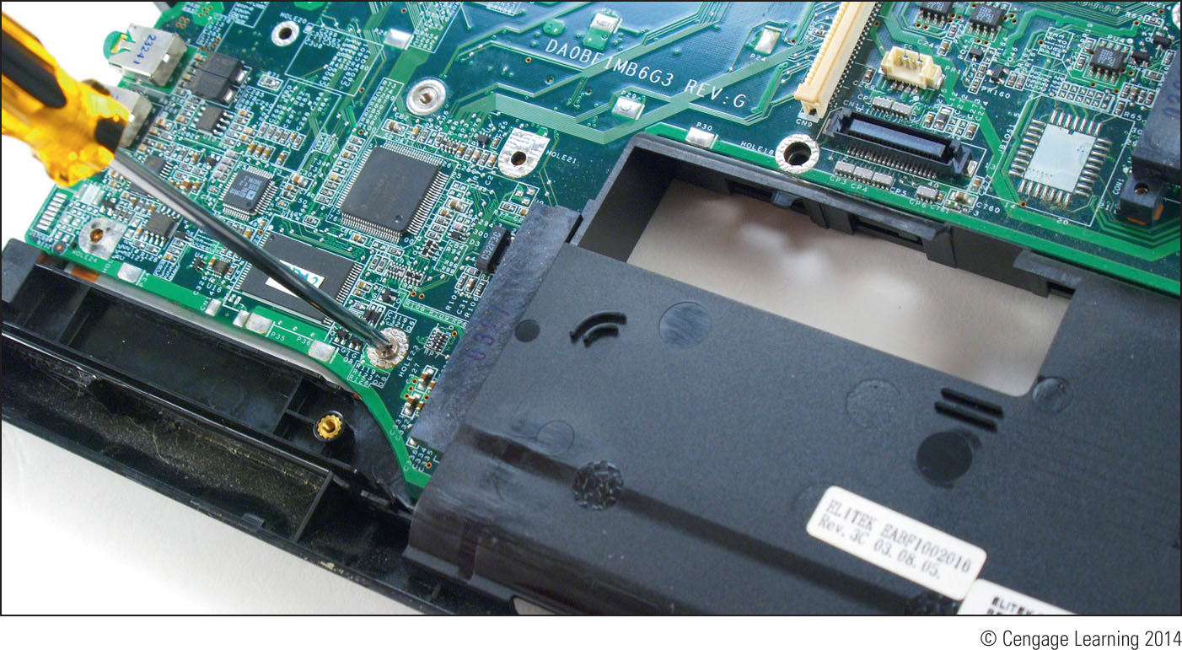
Figure 19-71 Remove the single screw attaching the motherboard to the case

Slide 51
Disassembling and Reassembling a Notebook Computer
Replacing the LCD panel:
If LCD panel is dim or black:
Connect external monitor to video port
Toggle between LCD panel, external monitor, and both the panel and monitor
If external monitor works: LCD panel assembly likely broken
If LCD display entirely black: replace LCD assembly
If LCD display dim: video inverter problem
High-end notebooks contain video card
May need to replace it too

Slide 52
Disassembling and Reassembling a Notebook Computer
General directions to replace an LCD panel:
Remove AC adapter and battery pack
Remove the keyboard
Remove screws holding hinge in place
Remove hinge cover
Remove screws holding LCD panel to the notebook
Remove LCD panel from the notebook
Remove screws holding the top cover and LCD panel
Disconnect old inverter and install the new one
Reattach LCD panel assembly to the notebook

Slide 53
Working Inside An All-In-One Computer
All-in-one computer: uses a mix of components sized for a desktop and a notebook
For some components, you’ll need to buy replacements from the manufacturer because they are most likely proprietary
See the service manual for specific directions about replacing parts

Slide 54
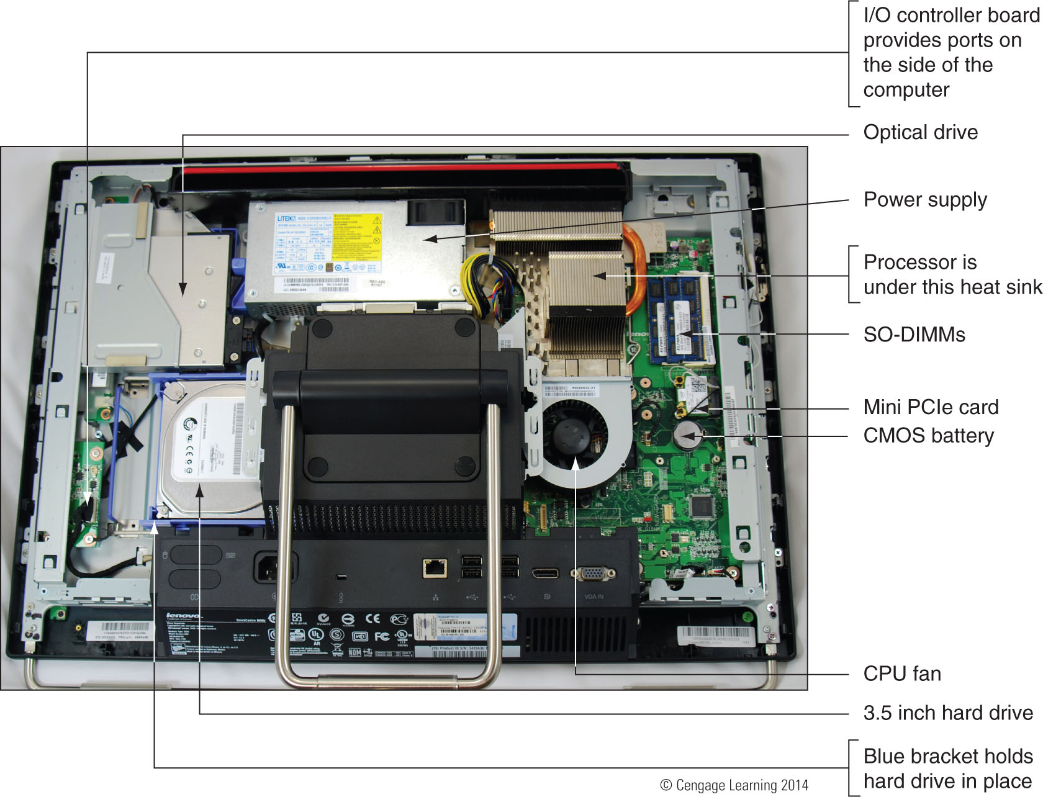
Figure 19-80 Components inside an all-in-one computer

Slide 55
Troubleshooting Notebooks
Use diagnostics software to troubleshoot problems with notebook ports, slots or other devices
Download from manufacturer’s web site if you don’t have it available on the hard drive
Next few slides cover some common problems with notebooks and how to solve them

Slide 56
Problems Logging Onto Windows
Check to make sure NumLock is off
Notebooks use this key to toggle between keys interpreted as letters and numbers
Most notebooks have a NumLock indicator light near the keyboard

Slide 57
No Wireless Connectivity
Notebook might have a switch to turn internal wireless adapter on and off
Might also use a key combination for that purpose
Ensure switch is set to on
For intermittent connectivity, ensure laptop is within range of wireless access point
Follow directions for your notebook to turn Bluetooth on

Slide 58
Power or Battery Problems
If power is not getting to the system or battery indicator light is lit:
Verify the AC adapter is plugged into an outlet
Check if AC adapter’s plug is secure outlet
Check connections on both sides of AC adapter transformer
Check connection at notebook
If battery is not charging when AC adapter is plugged in, problem might be with battery or motherboard

Slide 59
No Display
If LCD panel shows a black screen but power light is on:
Look for an LCD cutoff switch or button on laptop
Try to use the video port on the notebook to connect to an external monitor
If external monitor does work, problem is with the LCD panel assembly
Will need to replace inverter or LCD panel

Slide 60
Flickering, Dim, or Otherwise Poor Video
Tips to solve problems with bad video:
Verify Windows display settings
Adjust the brightness
Update the video drivers
A flickering screen can be caused by bad video drivers, a low refresh rate, a bad inverter, or loose connections inside the laptop

Slide 61
Summary
Notebook computers are designed for travel
The notebook manufacturer documentation are useful when disassembling, troubleshooting, and repairing a notebook
A notebook uses a customized installation of the Windows OS, customized by the manufacturer
A notebook hard drive is likely to contain a recovery partition or notebook may come with recovery CDs
PC Cards, CardBus, and ExpressCard slots are a popular way to add peripheral devices to notebooks

Slide 62
Summary
Updating drivers for a port of slot can sometimes solve problems
A notebook can be powered by a battery pack or AC adapter connected to a power source
Windows 7/Vista uses sleep mode and hibernation to conserve power
When an internal component needs replacing, consider disabling the component and using an external peripheral device in its place
Current notebooks use SO-DIMMs for memory

Slide 63
Summary
When upgrading components on a notebook, use components that are the same brand as notebook
Use diagnostics software from the notebook manufacturer to troubleshoot
Use a multimeter to check the voltage output of an AC adapter
Use an external monitor to verify that a video problem is with the LCD panel rather than internal video card or motherboard

