Slide 1
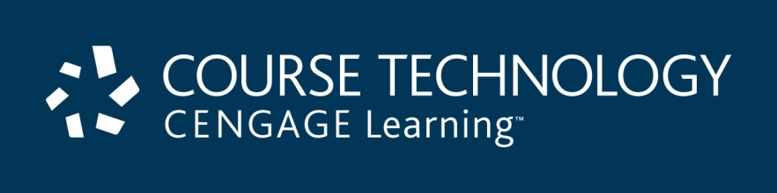
A+ Guide to Managing & Maintaining Your PC, 8th Edition
Chapter 20
Mobile Devices and Client-side Virtualization

Slide 2
Objectives
Learn about operating systems used with mobile devices
Compare hardware components used with mobile devices and laptops
Configure, secure, synchronize, and troubleshoot mobile devices that use the iOS
Configure, secure, and synchronize mobile devices that use the Android OS
Learn about the basics of server-side and client-side virtualization

Slide 3
Operating Systems Used on Mobile Devices
Mobile OSs are factory installed
Android OS by Google
Based on Linux
Used on variety of smart phones and tablets
Used on 60% of smart phones sold today
iOS by Apple
Based on Mac OS X
Used on iPhone, iPad, iPod Touch
Used on 30% of smart phones sold today
10% of market shared by: Blackberry OS, Windows Phone, and Symbian OS

Slide 4
Android OS by the Open Handset Alliance and Google
Based on Linux: Linux and Android are open source
Releases of Android based on dessert names
Froyo
Gingerbread
Honeycomb
Ice Cream Sandwich
(Newest release is Jellybean)

Slide 5
Android OS by the Open Handset Alliance and Google
Android supports windows, panes, 3d graphics
Connects to Wi-Fi, Bluetooth, cellular networks
Android apps are sold or freely distributed from any source or vendor
Google Play is the official source for apps
Most apps are written using Java using the Android software developer kit (SDK)

Slide 6
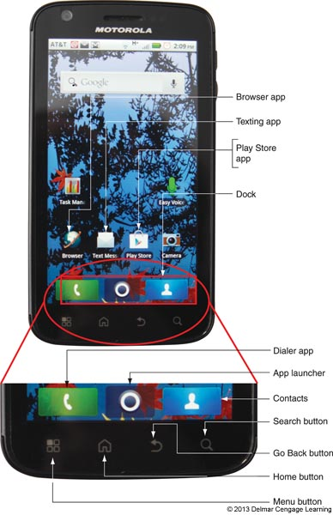
Figure 20-1 The Atrix smart phone by Motorola comes with Android Froyo installed

Slide 7
iOS by Apple
iOS is proprietary software from Apple
Only used by Apple devices
Apple is sole developer and can maintain strict standards on its products
iOS apps are only available through the iTunes App Store
iPads and iPods must be activated by connecting them to a computer that has iTunes installed
A process called jailbreaking allows users to download software from other sources

Slide 8
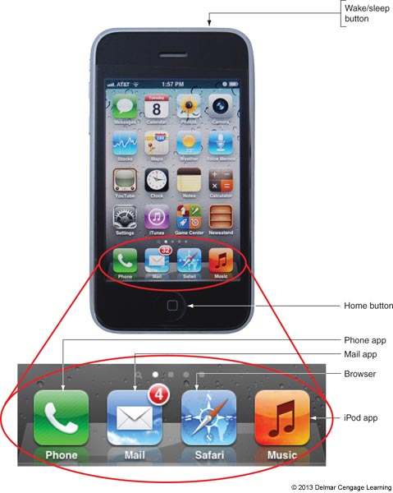
Figure 20-5 An iPhone by Apple has iOS version 5.1 installed

Slide 9
Comparing Open Source and Closed Source Operating Systems
Developers for iOS (closed source) only have access to APIs which are calls to the OS
Apps must be tested and approved before being sold in the App store
Better assurance of high quality apps
Centralized app purchasing
Android apps (open source) can be obtained from many sources
No assurance of quality
Market is not always convenient for developers
Many variations of Android exist, creating incompatibilities

Slide 10
Comparing Mobile Device Hardware to Laptops
A smart phone is a cell phone with added capabilities
Ability to send/receive Short Message Service (SMS) text or Multimedia Messaging Service (MMS) voice, photo, video message
Web browsing
Email client
Game play
Take photos and video
Use a variety of apps
Uses a cellular network and usually has Wi-Fi and Bluetooth connections

Slide 11
Comparing Mobile Device Hardware to Laptops
Handheld tablet is larger than a smart phone with similar functions
Most connect to Wi-Fi and Bluetooth and some have cellular network connectivity
Some can make phone calls and use MMS
Many tablets can be connected to peripherals such as keyboards

Slide 12
Touch Interface
Mobile devices rely on touch screens
Touch screens that rely on a two-finger pinch are called multitouch
Touch screens use two primary technologies:
Capacitive – uses electrodes that sense conductive properties of the skin; not pressure sensitive; more responsive
Resistive – use two sheets of glass that respond to pressure

Slide 13
Storage Devices
Most smart phones use a SIM card that contains cellular carrier information
Internal storage used by iOS and Android to hold apps and data is flash memory
Android devices often have an external slot for an SD card and/or USB ports for extra storage (Apple devices don’t have these slots)

Slide 14
Other Hardware Components
Gyroscope or accelerometer
Motion and position sensing device
Helps to adjust screen orientation
Used by games to sense device movement
GPS
System of 24 or more satellites
Devices use 4 or more satellites to triangulate location of the device on earth
Note: There are no field serviceable parts (or field-replaceable units (FRU) in mobile devices

Slide 15
Configuring, Syncing, and Securing iOS Devices
Most of the settings required to support an iOS device are in the Settings app
Configure the iOS and apps
Configure network connections
Turn airplane mode on/off
Make cellular data connection (requires a cellular data plan): see p. 486 for the specific steps
Wi-Fi connection: see p. 486 for the specific steps
Bluetooth connection: see p. 486 for the specific steps

Slide 16
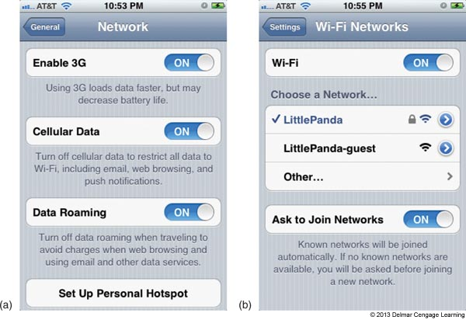
Figure 20-17 (a) Enable access to a cellular data network,
(b) Turn on Wi-Fi and show a Wi-Fi network

Slide 17
Configuring Email
Email can be managed in a one of two ways
Using a browser
Using an email client
Smart phones use a built-in mail app
To configure the Mail app on iOS you need the following:
Your email address and password
Names of your incoming and outgoing email servers
Type of protocol your incoming server uses (POP or IMAP)
Security protocols used

Slide 18
Syncing, Updating, Backing up, and Restoring from Backup
On Apple devices, you can backup iOS settings, email, documents, and other data using iTunes or iCloud
iTunes backs up to your computer in your user profile directory on Windows 7/Vista
iCloud backs up to storage on Apple web sites at www.icloud.com
To restore data from backup, connect the device to iTunes and select Restore from Backup
iTunes can also be used to install iOS updates and patches

Slide 19
Syncing, Updating, Backing up, and Restoring from Backup
iCloud can be used instead of iTunes
You can set up a free iCloud account to hold your apps, music and so forth
The first 5 GB of storage is free
Requires iOS 5 or higher

Slide 20
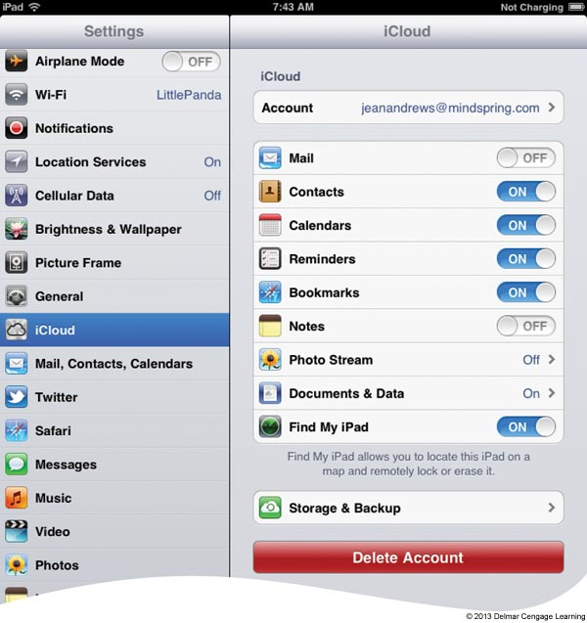
Figure 20-31 Decide what type of content to sync to iCloud

Slide 21
Securing an iOS Mobile Device
Data kept on a smart phone that could be at risk if lost, stolen, or damaged
App data such as email, calendar, voicemail, contacts, etc.
Videos and photos you have taken
Network connection settings
To protect this data use:
Passcode locks
Locator applications
Remote wipes

Slide 22
Passcode Locks and Failed Logins
You can set a 4-digit passcode for iOS
You cannot access the contents of the device without the passcode (although an emergency call can still be made)
You can configure iOS to erase your data after 10 failed passcode attempts
If this occurs, you restore your data from a backup

Slide 23
Locator Applications and Remote Wipes
If your device is lost or stolen you can configure it send its location to you
Use the iCloud setting Find My iPhone or Find My iPad
From iCloud.com/find the device’s location is shown on a map as a green dot
You can tell your device to play a sound or display a message
You can also remotely set a passcode lock using Remote Lock
As a last resort, use Remote Wipe to delete the contents of the phone to protect your privacy

Slide 24
Troubleshooting iOS Devices
Common problems include:
Touch screen not working properly
Settings cannot be changed
Buttons don’t work
One or more apps don’t work

Slide 25
Troubleshooting iOS Devices
Various problems can be solved by trying the following:
Restart the phone
Reset the phone
Update the iOS
Reset all settings
Erase all data and settings
Restore the phone
Recover the device
Try support.apple.com for more troubleshooting tips

Slide 26
Configuring, Syncing, and Securing Android Devices
Because Android is open source, different manufacturer’s devices may require different steps to configure the device and OS
You should use the user guide for each device you are supporting
Most settings you will need are in the Settings app

Slide 27
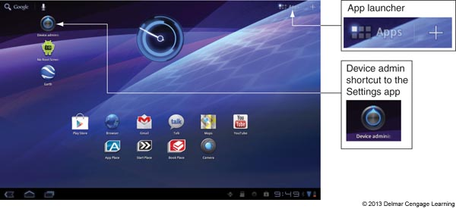
Figure 20-41 Use the Apps icon in the upper-right corner of a tablet to view
and manage installed apps

Slide 28
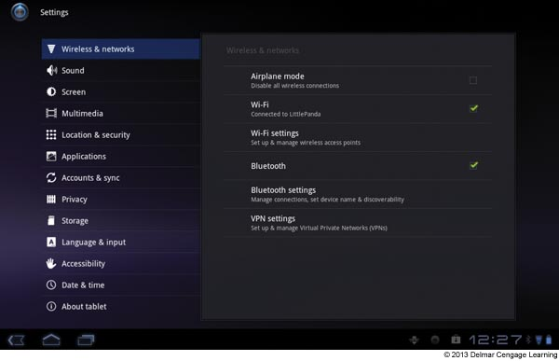
Figure 20-42 In the Wireless & networks group of the Settings menu, change Airplane mode, Wi-Fi, Bluetooth, and VPN settings

Slide 29
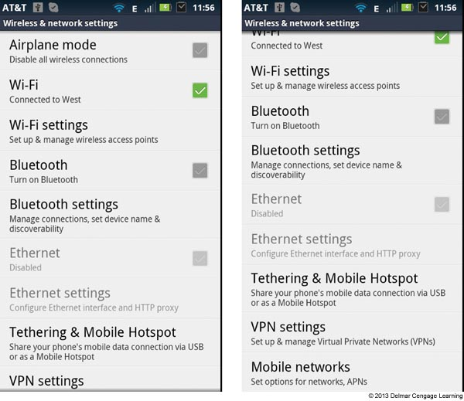
Figure 20-45 Top and bottom of the Wireless & network settings screen on an Android phone

Slide 30
Configuring Email
Since Google owns Gmail, it’s easy to configure a Gmail account on Android
Once configured, you can sync books, calendars, contacts, Gmail, and Google Photos
Other types of accounts can be automatically configured by Android

Slide 31
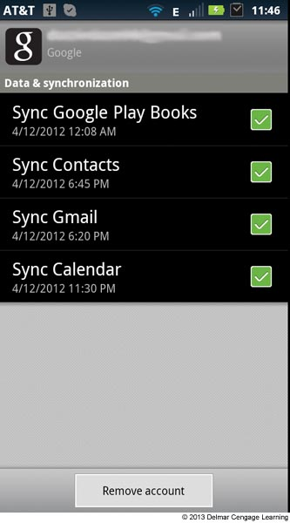
Figure 20-46 Sync content tied to your Gmail account

Slide 32
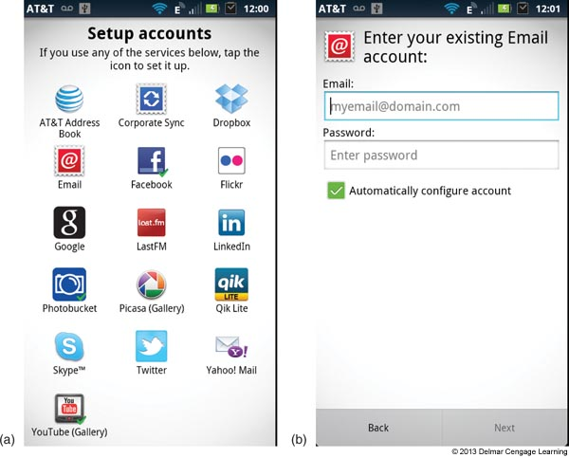
Figure 20-47 Android can automatically configure several types of accounts

Slide 33
Syncing, Backing up, and Restoring from Backup
Android offers a number of options for these tasks
Sync using online accounts: Gmail, Facebook, Twitter, Dropbox, LinkedIn etc. have sync functions
Use third-party syncing apps: for personal files such as pictures, music, and videos there are several sync apps
Motorola’s Phone Portal
SugarSync
Sync apps with your app source
Google Play allows apps to be updated automatically or manually

Slide 34
Back up to a USB Device or Smart Card
Most Android device manufacturers have an app to back up data to a smart card (such as an SD card) or a USB device if they are present
Restoring your Android device can be difficult since no single app backs up everything
You need to retrieve the contents from each backup location such as online accounts, SD cards, etc.

Slide 35
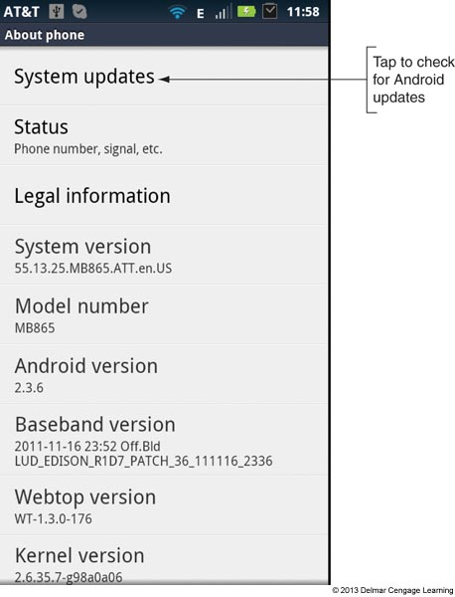
Updating the Android OS
Android updates are automatically pushed to the device by the manufacturer
You can also manually check for updates

Slide 36
Securing an Android Mobile Device
Android OS includes some security features but also relies on third-party applications
Security features include:
Passcode protection
You can use a Password, PIN, or set a Pattern (most secure)
Set failed login restrictions – Android automatically locks down after five failed attempts
Remote wipes and locator applications – provided by third-party vendors
Antivirus protection – provided by third-party vendors

Slide 37
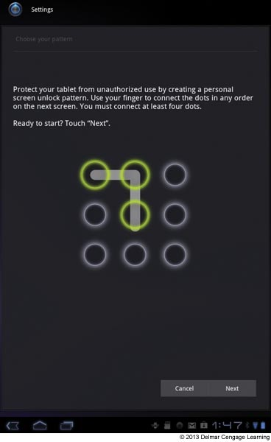
Figure 20-55 Create a pattern that must be entered in order to unlock the device

Slide 38
Troubleshooting Android Devices
Some steps to try to resolve Android problems
Force a reboot with a button combination (check manufacturer’s Web site for the combination) or by battery removal
Uninstall and reinstall a misbehaving app
Install updates if available
Use the device Recovery mode which brings the system to the original factory state
Root your device to gain administrative access; gives you complete access to the file system, and all commands and features

Slide 39
Virtualization Basics
Virtualization: when one physical machine hosts multiple activities that are normally done on multiple physical machines
Two types of virtualization
Server-side virtualization
Client-side virtualization

Slide 40
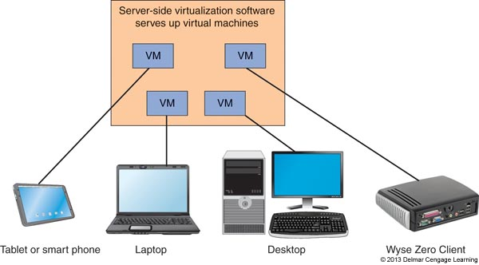
Server-Side Virtualization
Provides a virtual desktop for users on multiple client machines
Most processing is done on the server
Provides a virtual desktop infrastructure (VDI)

Slide 41
Server-Side Virtualization
Advantages
Maximizes a company’s investment in hardware
Centralizes support for hardware, software, and users
Disadvantages
Requires high-end servers and more network bandwidth
User experience may be diminished

Slide 42
Clients Used with Server-Side Virtualization
Fat clients – regular desktop computer or laptop
Thin clients – computer has a regular OS but comparatively little computer power
Zero clients – dumb terminal or ultra-thin client does not have an OS and just provides a user interface (keyboard, mouse, monitor) and network connection with enough software to load the virtualization program

Slide 43
Server-Side Virtualization Using Cloud Computing
Server-side virtualization is delegated to a third-party service and resources are accessed via the Internet
Different types of cloud computing:
Infrastructure as a Service (IaaS) – provides servers and storage for the client to use as needed
Platform as a Service (PaaS) – provides servers and OS but customer installs applications
Software as a Service (SaaS) – provides hardware, OS, and applications

Slide 44
Client-Side Virtualization
Personal computer provides virtual environments for applications using three possible methods:
Presentation virtualization – remote application on a server is controlled by a local computer (Remote Desktop Services is an example)
Application virtualization – a virtual environment allows an application to run independent of the host operating system
Client-side desktop virtualization – software installed on a PC manages virtual machines, each VM has its own OS installed (Virtual PC, VMWare Player, and VirtualBox are examples)

Slide 45
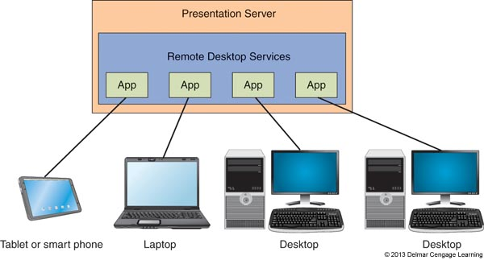
Figure 20-57 Microsoft Remote Desktop Services presents applications to
the user at a local computer

Slide 46
Virtual Machines and Hypervisors
Software used to create and manage virtual machines on a server or local computer is called a virtual machine manager (VMM) or hypervisor
Two types of hypervisor
Type 1 – installs on a computer before an OS (called bare-metal hypervisor); partitions hardware computing power into multiple VMs
Type 2 – installs in host OS as an application; not as powerful as Type 1 because it is dependent on the host OS

Slide 47
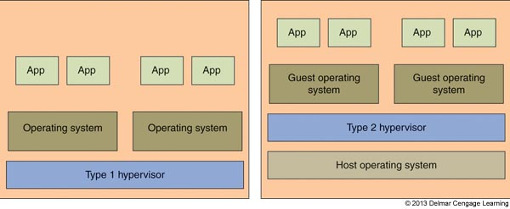
Figure 20-58 Type 1 and Type 2 hypervisors

Slide 48
Hardware Requirements
Motherboard BIOS – should support hardware assisted virtualization (HAV): Intel-VT or AMD-V; must be enabled in the BIOS
Hard drive space – enough for the minimum requirements of each VM; virtual disks can be dynamic or fixed
Processor and memory – Processor must support HAV; use a dual-core or better; enough memory for the host and each VM that will run simultaneously

Slide 49
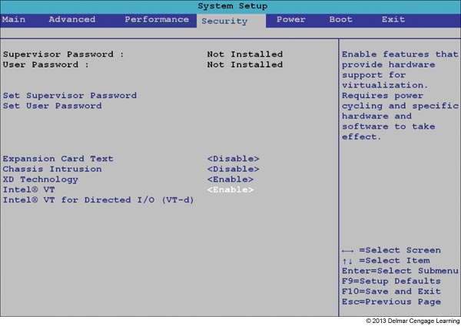
Figure 20-59 BIOS setup screen to enable hardware virtualization

Slide 50
Hardware Requirements
A hypervisor emulates hardware and presents this virtual hardware to each VM
Includes a virtual processor, memory, motherboard, hard drive, optical drive, keyboard, mouse, monitor, network adapter etc.
Hypervisor allows you to configure which virtual hardware is installed

Slide 51
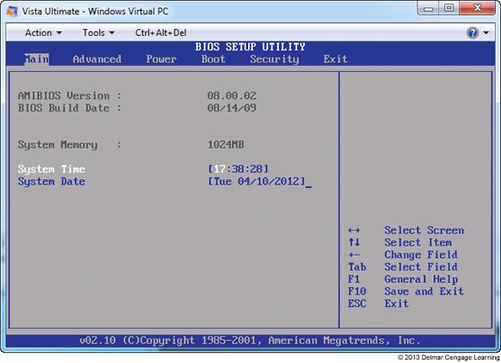
Figure 20-60 An emulated motherboard provides setup BIOS screens in the VM

Slide 52
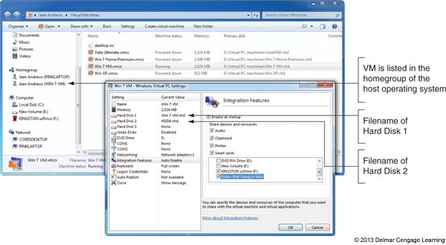
Figure 20-61 Emulated (virtual) hardware is installed in a VM under
Windows Virtual PC

Slide 53
Secure a Virtual Machine
Virtual machines are susceptible to hackers and malware the same as a physical machine
If the VM has access to the Internet, it should have the firewall installed and malware protection installed
VMs should be isolated for best security
Secure permissions to files that hold the VM

Slide 54
Summary
Operating Systems Used on Mobile Devices
Operating systems used on mobile devices include Android by Google, iOS by Apple, Blackberry by RIM, Windows Phone by Microsoft, and Symbian by the Symbian.
Android is an open-source OS, and anyone can develop and sell Android apps or variations in the Android OS. Google is the major distributor of Android and Android apps from its Google Play web site.
The iOS by Apple is used only on Apple devices, including the iPhone, iPad, and iPod touch. Apps for the iOS are distributed solely by Apple from its online iTunes App Store.

Slide 55
Summary
Comparing Mobile Device Hardware to Tablets and Laptops
Smart phones and handheld tablets use multitouch screens and SSD storage, and they contain no field-serviceable parts. Because some tablets can make phone calls and send text messages, there is little distinction between a tablet and a smart phone.
An accelerometer in a mobile device is used to sense the position of the device and can be used to change the screen orientation.
A device can know its location because of its GPS receiver. Geotracking can be done as the device reports its position.

Slide 56
Summary
Configuring, Syncing, and Securing iOS Devices
Using the iOS, the Settings app is used to manage network connections, configure email, manage content on the device, and configure many iOS settings.
Content on an Apple device can be synced and backed up using iTunes to a personal computer or using iCloud to sync to online storage at icloud.com.
An iOS device can be secured using a passcode. In addition, you can use iCloud to perform a remote wipe to protect sensitive data.
To troubleshoot an iOS device, you can restart, reset, update, erase, restore, and recover the iOS on the device.

Slide 57
Summary
Configuring, Syncing, and Securing Android Devices
The Settings app on an Android device can be used to manage network connections, email, online accounts, updates to Android, and security.
Syncing and backing up content on an Android device is done with online accounts, using third-party apps for syncing, syncing all your apps to an app store, and backing up content to external storage connected to the device.

Slide 58
Summary
Virtualization Basics
Server-side virtualization happens on the server, and client-side virtualization happens on the client machine.
Three ways to implement client-side virtualization include presentation virtualization, application virtualization, and client-side desktop virtualization.
Client-side desktop virtualization is done by creating multiple virtual machines on a physical machine using a hypervisor.
A Type 1 hypervisor installs before any OS is installed and is called a bare-metal hypervisor. A Type 2 hypervisor is an application that installs in an OS. A Type 1 hypervisor is faster and more secure than a Type 2 hypervisor.

