Slide 1

A+ Guide to Managing & Maintaining Your PC, 8th Edition
Chapter 21
Supporting Printers

Slide 2
Objectives
Learn about printer types and features
Learn how to install printers and share a printers and how to manage printer features, add-on devices, and the printer queue
Learn about routine maintenance tasks necessary to support printers
Learn how to troubleshoot printer problems

Slide 3
Printer Types and Features
Configure, repair, maintain printers
Requires knowledge of printer types and features
Understanding how a printer works
Helps in fixing printer problems

Slide 4
Printer Languages
Communication methods between OS and printer
Printer uses PostScript commands to build the page
Printer uses PCL commands to build the page
PCL: Printer Control Language
Windows GDI builds page, then sends it to the printer
GDI: Graphics Device Interface
Windows 7/Vista uses XML Paper Specification (XPS) to build the page, then sends it to the printer
XPS (XML Paper Specification)
Raw data printed with little-to-no formatting

Slide 5
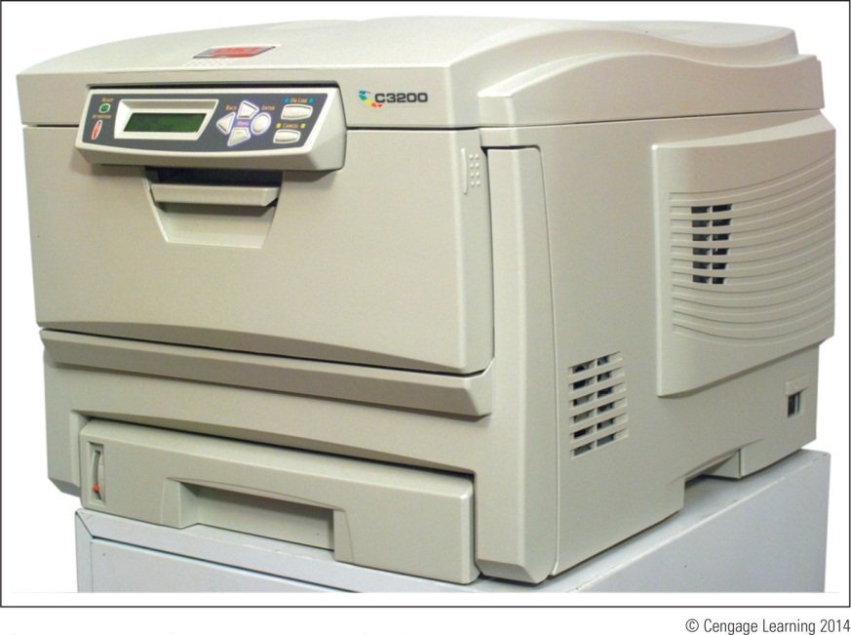
Types of Printers
Major categories:
Laser, inkjet (ink dispersion), thermal printers, and impact printers
Figure 21-1 Okidata C3200n color laser printer

Slide 6
Laser Printers
Laser printer: electrophotographic printer
Uses mechanical, electrical, and optical technologies
How laser printers work:
Toner placed on electrically charged rotating drum
Toner deposited on paper moving at drum speed

Slide 7
Laser Printers
Seven steps in laser printing:
Processing image: bitmap of final page stored in memory
Conditioning: drum surface charged to -600 V
Writing: laser beam writes -100 V image to drum surface
Developing: toner applied to -100 V areas of the drum
Transferring: toner drawn off drum and onto paper
Fusing: heat and pressure fuse toner to paper
Cleaning: drum cleaned of residual toner and charge
Color laser printing
Writing process repeated four times

Slide 8
Laser Printers
Parts used in the charging, exposing, developing, and cleaning steps undergo the most wear
Toner cartridge needs replacing most often
Followed by image drum, fuser cartridge, and transfer assembly
Other printer parts that might need replacing:
Pickup roller – pushes forward a sheet of paper
Separation pad – keeps more than one sheet of paper from moving forward
Printer that is able to print on both sides of paper is called a duplex printer (double-sided printer)

Slide 9
Inkjet Printers
Overview of inkjet printer technology
Uses a type of ink-dispersion printing
Doesn’t provide high-quality resolution of laser printers
Print head moves across paper
One line of text created with each pass
Ink applied to paper using matrix of small dots
Plates with magnetic charge direct path to the page
Different types of inkjets form droplets of ink in different ways
Most popular is the bubble-jet

Slide 10
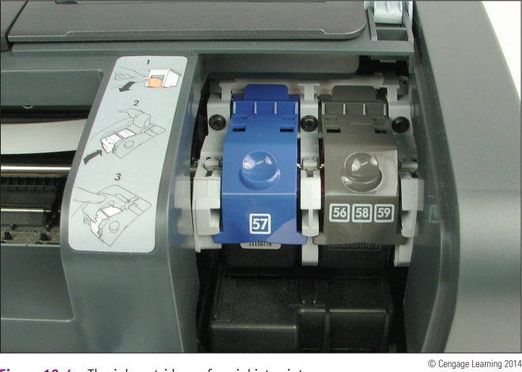
Inkjet Printers
Comparing inkjet to laser printers:
Usually slower
Images smudge on inexpensive paper
Use only paper designed for inkjet printers
Inkjet printer buying advice:
Printer using two or four separate cartridges
Figure 21-4 The ink cartridges of an inkjet printer

Slide 11
Impact Printers
Overview of impact printer technology
Best known impact printer: dot matrix printer
A print head moves across width of the paper
Pins are used to print matrix of dots on the page
Pins shoot against a cloth ribbon
Ribbon impacts paper and deposits ink
Dot matrix printer technology advantages:
Continuous tractor feed allows event and data logging
Can use carbon paper: print multiple copies
Extremely durable

Slide 12
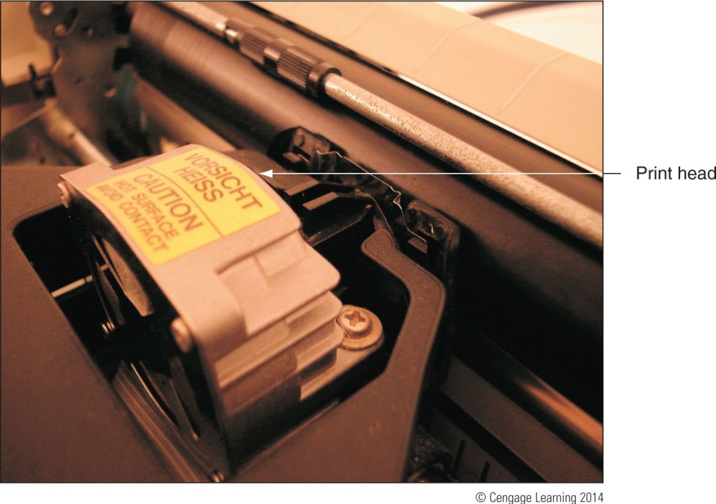
Impact Printers
Guidelines for maintaining print heads:
Keep the printer in a cool, well-ventilated area
Do not print over 50 to 75 pages without a cool down
Figure 21-6 Keep the print head of a dot matrix printer as cool as possible so that it will last longer

Slide 13
Thermal Printers
Use heat to create an image
Two types of thermal printers:
Direct thermal printer
Burns dots onto special coated paper (thermal paper)
Often used as receipt printers
Thermal transfer printer
Uses a ribbon that contains wax-based ink
Heating element melts ribbon onto thermal paper
Used to print receipts, bar code labels, clothing labels, or container labels
Reliable and easy to maintain

Slide 14
Using Windows to Install, Share, and Manage Printers
Printers can connect to a single computer or a network
Local printer attached to a PC using a port or wireless connection
Network printer has an Ethernet port to connect directly or uses Wi-Fi to connect to an access point
OS compatible print drivers required
Use 32-bit drivers for a 32-bit OS and 64-bit drivers for a 64-bit OS
Windows 7 has many drivers built in or drivers can be downloaded from manufacturer’s website

Slide 15
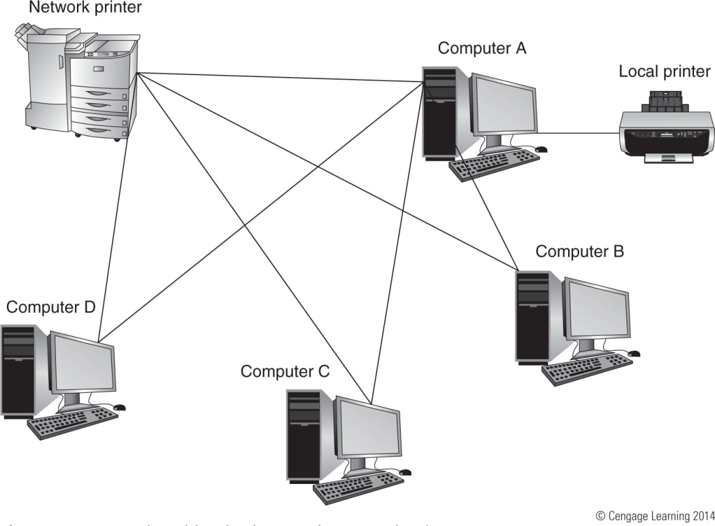
Figure 21-10 A shared local printer and a network printer

Slide 16
Installing A Local or Network Printer
Ways to install a local USB printer
Plug in USB printer: Windows 7/Vista installs printer automatically
Launch the installation program
Installing a non-USB local printer or network printer using Windows 7/Vista
Verify printer on and available
In Windows 7 Control Panel click Devices and Printers
For Windows Vista, click Printers from Control Panel

Slide 17
Installing A Local or Network Printer
Installing a non-USB local printer or network printer using Windows 7/Vista (cont’d)
Click Add a printer and select the type of printer
Windows searches for available printers
Select printer from the list and click Next
Tell Windows where to find the printer drivers
Follow the wizard to install the printer
Send a test page to ensure proper setup
A test page can be sent anytime through the Printer Properties dialog box

Slide 18
Install a Local Printer Using Windows XP
Installation begins differently depending on port
FireWire, USB, PC Card, ExpressCard, wireless
Software installation or printer connection order vary
Review printer documentation
Generals steps
Run setup program as an administrator
Connect the printer to the port when instructed
Close New Hardware Found Wizard
Make selection for default printer
Test the printer

Slide 19
How to Install a Local Printer Using Windows XP
Printer installation using a parallel port
Serial and parallel ports: not hot-pluggable
Generals steps
Plug printer into the port, turn on the printer
If installing drivers from manufacturer’s program:
Launch printer setup program, followed directions
If using the Windows installation process:
Open Printers and Faxes window, click Add a printer
Follow Add Printer Wizard directions
Print a test page

Slide 20
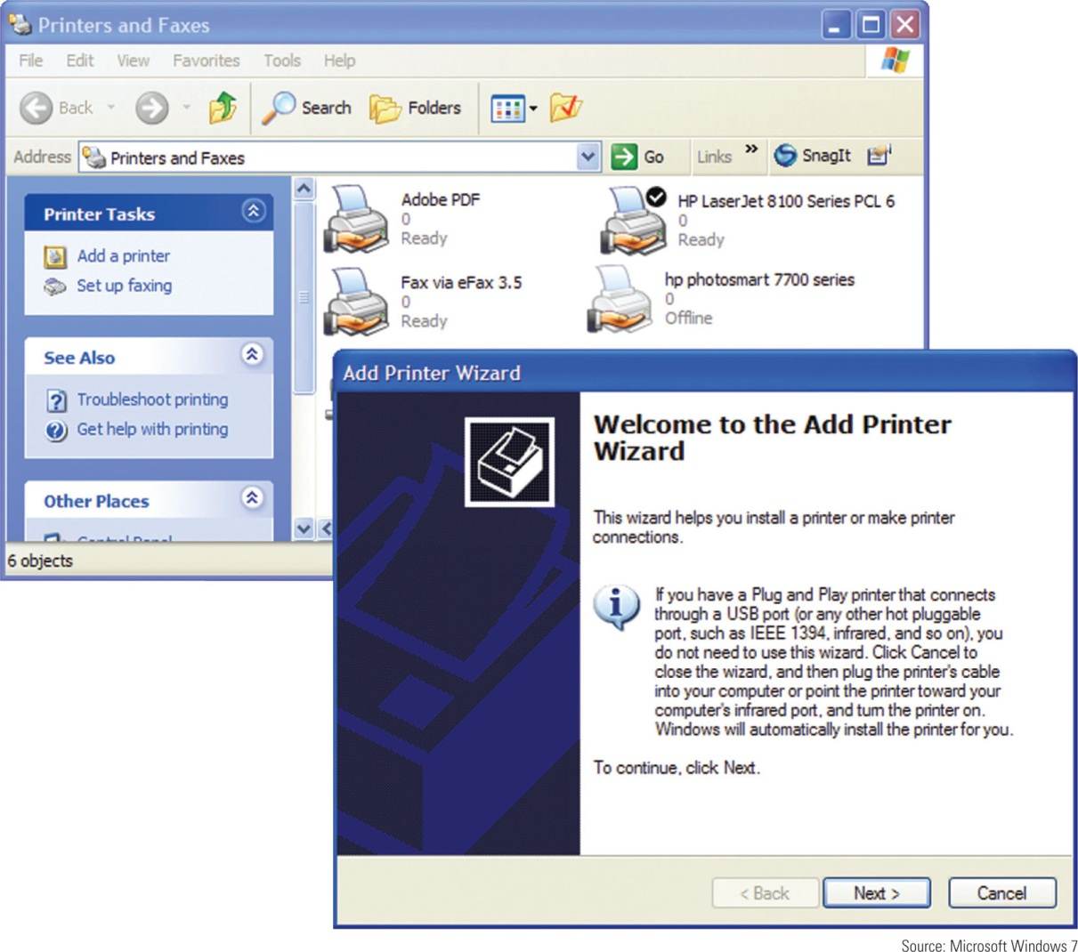
Figure 21-19 Use the Add Printer Wizard to install a printer

Slide 21
Steps To Install a Network Printer Using Windows XP
Follow manufacturer directions
General steps
Open XP Printers and Faxes window
Start the wizard to add a new printer
Select option to install a local printer
Do not ask Windows to automatically detect printer
Choose Create a new port
Select Standard TCP/IP Port, Click Next twice
Identify the printer on the network
Click Have Disk

Slide 22
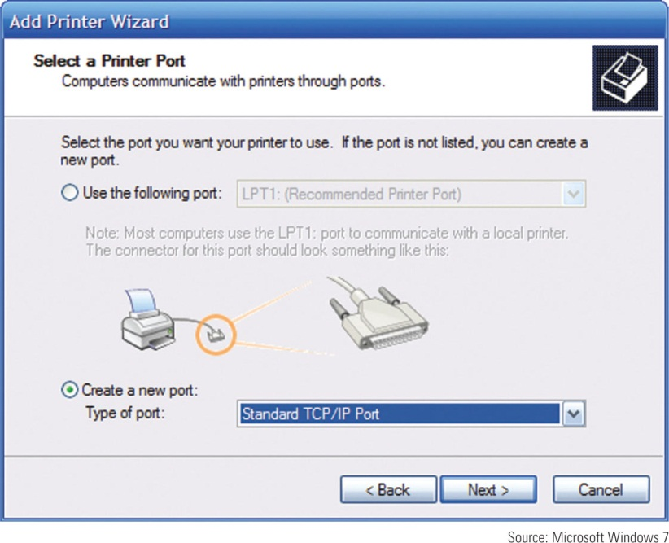
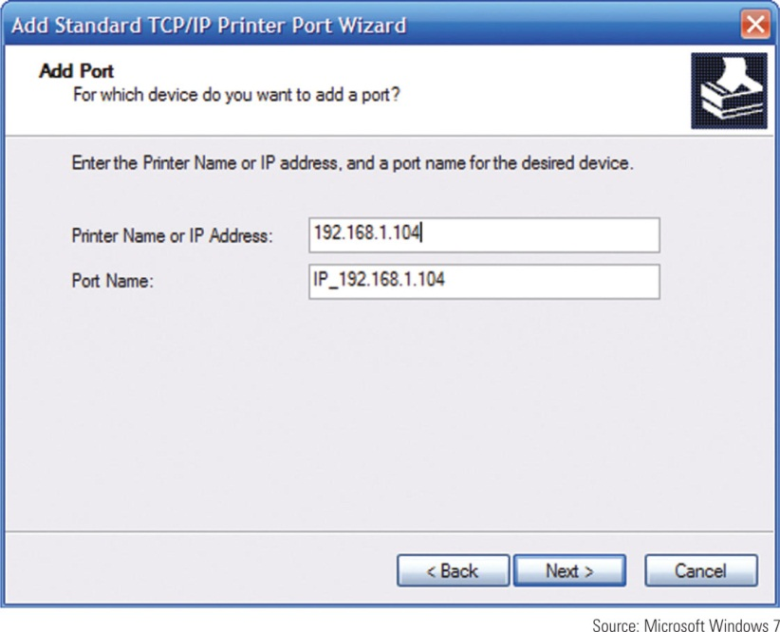
Figure 21-22 Configure a local printer to use a standard TCP/IP port.
Figure 21-23 Enter the printer name or IP address to identify the printer
on the network.

Slide 23
Sharing an Installed Printer
Windows 7: make sure Turn on file and printer sharing is selected
Vista: Printer sharing must be turned on
XP: File and Printer Sharing must be installed
General steps for Windows 7/Vista/XP
Open Properties dialog box, select Sharing
Select Share this printer, enter name for the printer
Make drivers available in Additional Drivers window
32-bit operating systems: select x86
64-bit operating systems: select x64

Slide 24
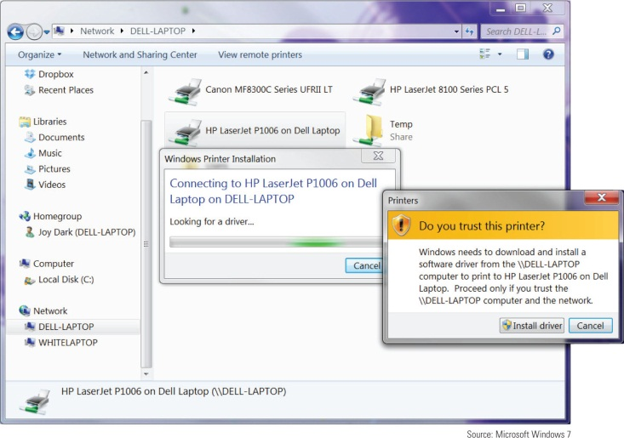
Installing a Shared Printer
Two ways to install a shared printer on a remote computer
Use Windows 7 Devices and Printers window, Vista Printer window or XP Printers and Faxes window
Use Windows Explorer, the Network, or My Network Places window
Figure 21-26 Install a shared printer using Windows Explorer

Slide 25
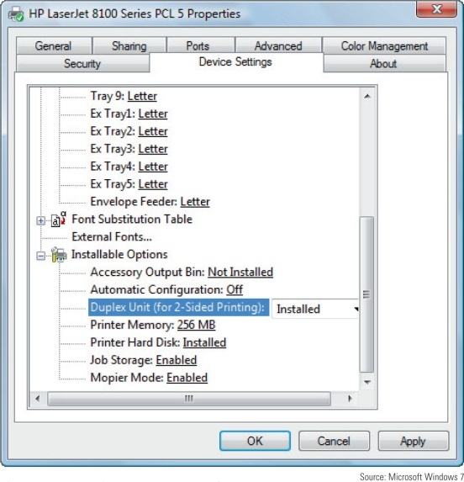
Managing Printer Features and Add-on Devices
Use the printer Properties box to:
Manage printer features and hardware devices
Click the Device Settings tab
Manage duplex printing and paper sizes
Useful option: print a test page
Figure 21-27 The Device Settings for an HP printer

Slide 26
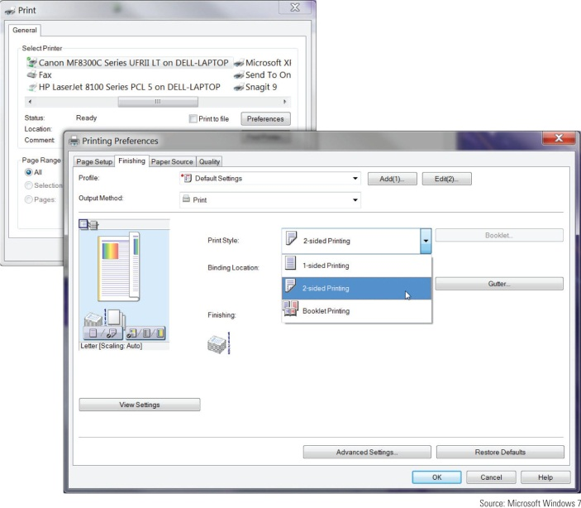
Managing Printer Features and Add-On Devices
After you have installed a new printer add-on:
Equipment or feature is listed as an option in the Printing Preferences box
Examples: input trays and feeders, staplers, sorters, stackers, binders, output trays to sort output by user
Figure 21-29 Printing on both sides
of the paper

Slide 27
Managing the Printer Queue
Spooling: process of queuing print requests from application
Print spooler: print queue
To manage print queue: double-click the printer icon in Windows 7 Devices and Printers window
If the printer reports a problem with printing, will be displayed as the status for the first job in the queue
To cancel a print job, right-click the job and select Cancel from shortcut menu
To cancel all print job, click Printer and select Cancel All Documents

Slide 28
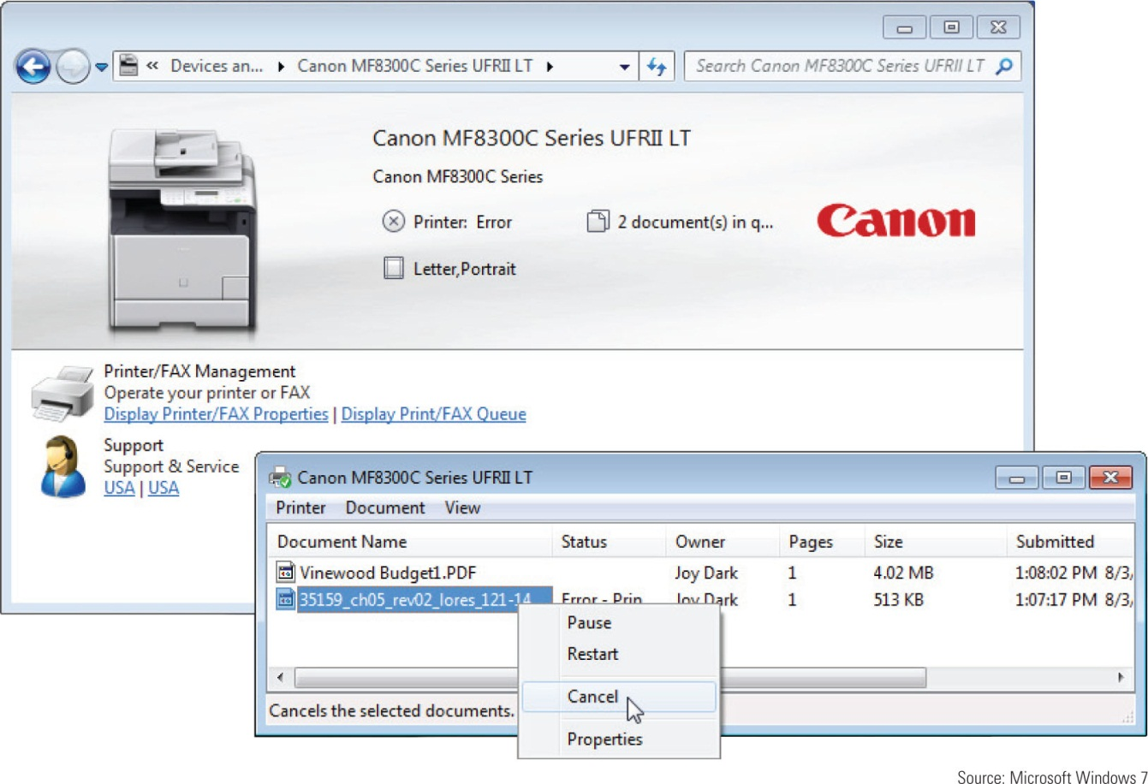
Figure 21-30 Manage the printer queue

Slide 29
Printer Maintenance and Upgrades
Extending printer working life
Follow manufacturer’s directions for device use
Perform necessary routine maintenance

Slide 30
Online Support for Printers
On printer manufacturer’s web site look for:
Online documentation
Knowledge base of common problems
Explanation of what to do about them
Updated device drivers
Replacement parts
Printer maintenance kits
Additional software
Firmware updates

Slide 31
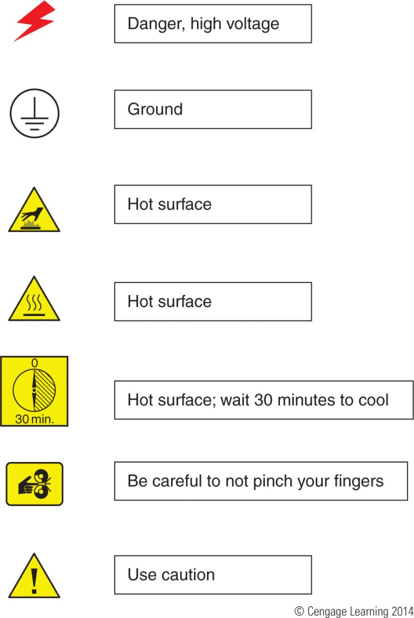
Figure 21-31 Symbols imprinted on a device that indicate danger

Slide 32
Online Support for Printers
Protection when working inside a printer
Turn printer off, unplug it, wait about 30 minutes
Never look at laser beam
Use an antistatic ground bracelet
Have help nearby
General directions to replace a cartridge:
Turn on printer and open front cover
Printer releases the cartridges so you can then open the latch on top of the cartridge to remove it
Install new cartridge

Slide 33
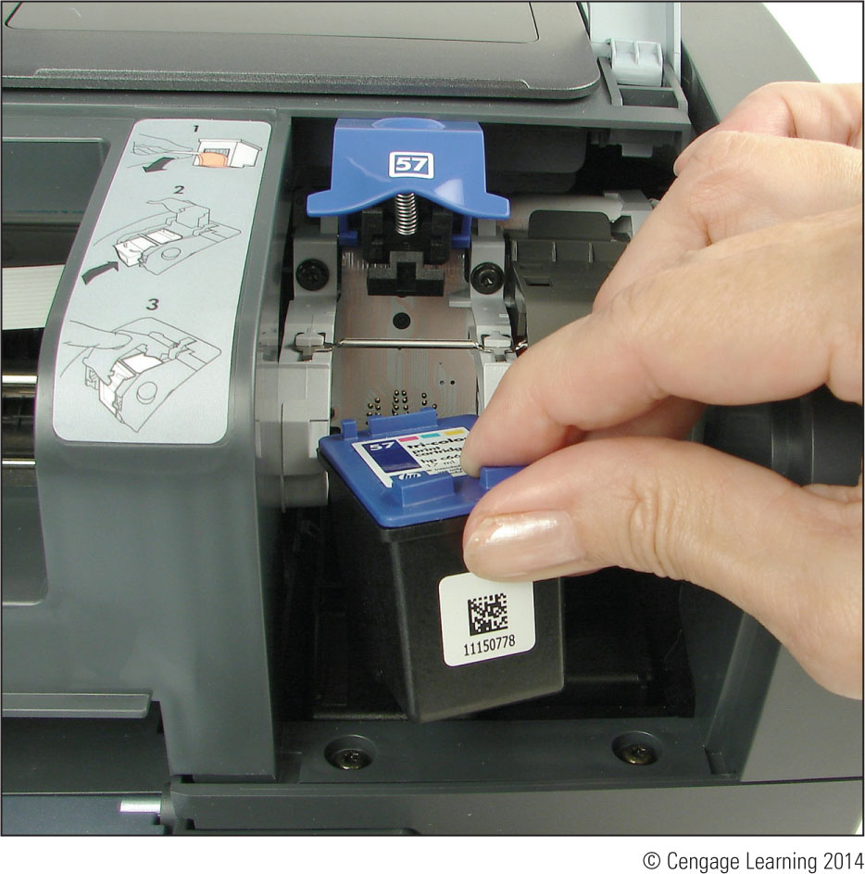
Figure 21-32 Installing an ink cartridge in an inkjet printer

Slide 34
Cleaning a Printer
As part of routine printer maintenance:
Clean outside of the printer with a damp cloth
Do not use ammonia-based cleaners
Clean the inside of the printer with a dry cloth
Do not blow out toner with compressed air
Two safe tools:
Toner-certified vacuum cleaner
Extension magnet brush
Software may be used to clean inkjet nozzles and calibrate/align cartridges
Cartridge nozzles may have to be manually cleaned

Slide 35
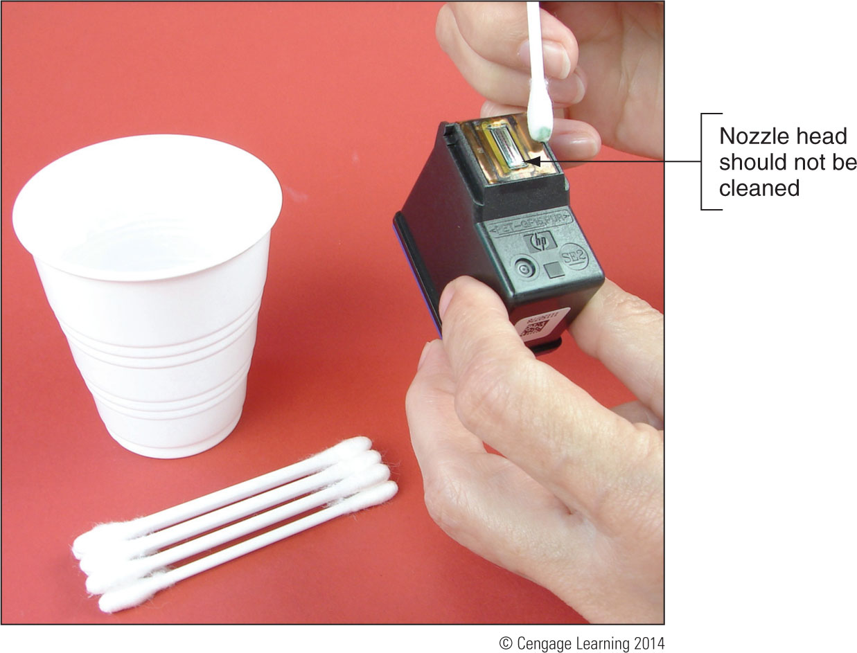
Figure 21-33 Clean the area around the nozzle plate with a damp cotton swab

Slide 36
Printer Maintenance Kits
Printer maintenance kit
Specific printer components
Step-by-step instructions for performing maintenance
Special tools or equipment: utilities and printer buttons
Examples of replacing printer consumables (follow steps outlined on pages 613-617)
Replacing a toner cartridge
Replacing an image drum
Replacing a fuser

Slide 37
Upgrade the Printer Memory or Hard Drive
Internal hard drives hold print jobs and fonts
Extra memory can speed up memory performance, reduce print errors, prevent Out of Memory errors
General installation:
Use a screwdriver to remove printer cover plate
Remove thumb screws on the back of the printer, pull out the formatter board
Memory modules and hard installed on this board
Hard drive embedded on proprietary board that fits in the bay
Enable and configure using printer Properties window

Slide 38
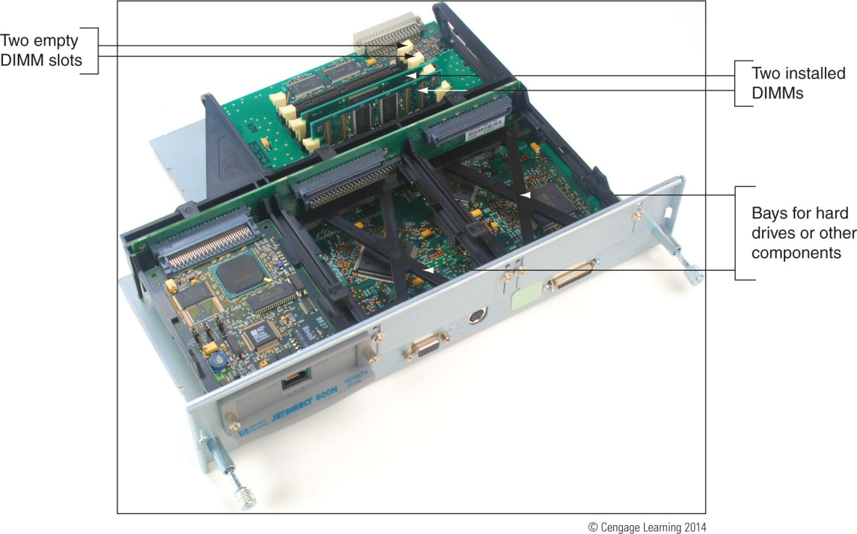
Figure 21-46 Memory is installed on the formatter board

Slide 39
Print Servers and The Print Management Tool
Print server: hardware or software that manages print jobs sent to one or more printers on a network
Can be:
A dedicated hardware device
Software installed on a computer on the network
Programs embedded in firmware on a printer
Embedded firmware print server
Manage print jobs, view printer status, see job history, and check counters
Utilities are access through a browser

Slide 40
Print Servers and The Print Management Tool
Windows Print Management
Available in Windows 7/Vista professional and business editions
Use it to monitor and manage printer queues for all printers on a network
In Print Management, each computer on the network that shares a printer is considered a print server

Slide 41
Troubleshooting Printers
Section topics:
General printer troubleshooting
Troubleshooting specific problems
General tasks performed during troubleshooting
Interview the user
Find out what works and does not work
Make an initial determination of the problem
When the problem is solved, check with the client
Document problem symptoms and solutions

Slide 42
Printer Does Not Print
Use flowchart on next slide to isolate problem
Isolate problem to one of the following areas:
The printer itself
Connectivity between the PC and its local printer
Connectivity between the PC and a network printer
OS and printer drivers
Application attempting to use the printer

Slide 43
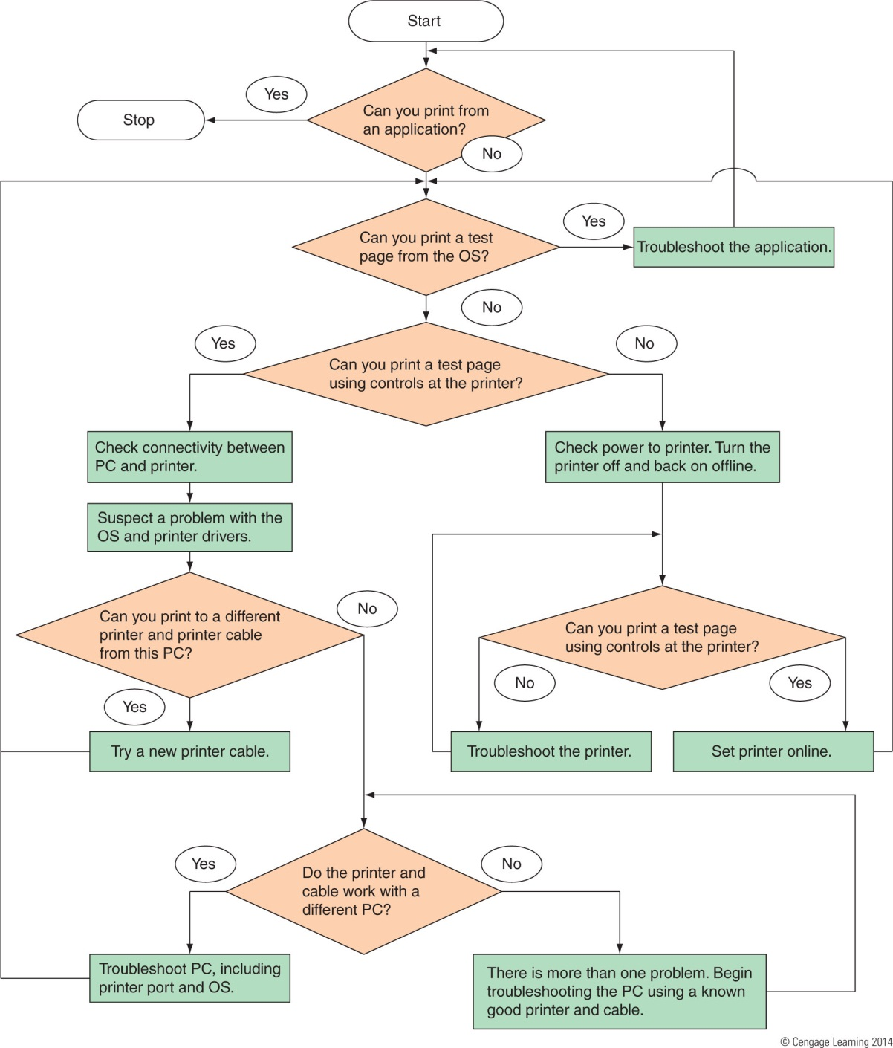
Figure 21-52 How to isolate a printer problem.

Slide 44
Printer Does Not Print
Problems with the printer itself
Verify that the printer is on
Print a self-test page
Review test page for clues
Test page not printing
Troubleshoot the printer until it prints correctly: check paper issues, cover issues, cartridges installed, power source issues, reset the printer, check documentation
Test page will not print at all
Take printer to a certified repair shop

Slide 45
Printer Does Not Print
Problems with a local printer cable or port
Verify cable firmly connected at both ends
For a USB port, try a different port
Try a different cable, use a shorter cable
Use same printer and cable with different PC
Use Device Manager to verify the port is enabled
Use BIOS setup to check how the port is configured
Use a port tester to test the port

Slide 46
Printer Does Not Print
Problems with connectivity for a network printer or shared printer
If self-test page prints but Windows test page does not print then connectivity might be the issue
Verify printer is online, power cycle printer, reboot PC
Verify correct default printer selected
Check IP address information
Delete and reinstall printer
Verify configuration, ping the printer, run diagnostics
Research error codes, flash firmware

Slide 47
Printer Does Not Print
Problems with connectivity for a shared printer
Print a test page from local computer
Verify correct default printer selected and online
At remote computer, verify access to the computer to which printer attached
Delete printer and reinstall
Print to another shared printer
Verify hard drive space

Slide 48
Printer Does Not Print
Problems printing from Windows
Delete all print jobs in the printer’s queue
Verify correct printer selected and online
Verify cable connections
Stop and restart Windows Print Spooler service
Delete printer and reinstall
Check for updated driver
Try to print to a file
Verify that enough hard drive space is available
Print from Safe Mode

Slide 49
Printer Does Not Print
Problems printing from applications
Verify correct printer
Printing a different file within same application
Cancel print jobs in the queue and reboot computer
Create data in a new file and try to print it
Print from another application
If you can print from other applications, consider reinstalling the problem application
Close any applications that are not being used
Add more memory to printer

Slide 50
Poor Print Quality
Can be caused by printer drivers, application, Windows, or the printer
Poor print quality for laser printers:
Unplug printer and allow to cool for 30 minutes
Rock or replace toner cartridge
EconoMode (uses less toner) might be on; turn off
Paper quality might not be high enough
Printer might need cleaning
Ensure printer does not require routine maintenance
Laser drum might need replacing

Slide 51
Poor Print Quality
Poor print quality for laser printers (cont’d):
Distorted images can be caused by foreign material
If page has a gray background, image drum is worn out and needs replacing
Ghosted images are usually caused by a problem with the image drum
Poor print quality for inkjet printers:
Is the correct paper quality being used?
Is the ink supply low? Remove and reinstall cartridge
Follow printer’s documentation to clean each nozzle

Slide 52
Poor Print Quality
Poor print quality for inkjet printers (cont’d):
Clean sponge near carriage rest
If printing transparencies, change the fill pattern in your application
Poor print quality for impact printers:
Ribbon might need replacing
Adjust the print head spacing
Check the print head for dirt

Slide 53
Poor Print Quality
Garbled characters on paper:
Cancel all print jobs in the queue and try printing a different document from the same application
Print using a different application
Is USB cable securely connected at both ends?
Power down printer by pressing a Reset button
Update printer drivers
Printer might needs servicing

Slide 54
Poor Print Quality
Low memory errors
Possible indications of low memory
Only part of page print
Printer may have a flashing light
Printer may display message on display panel such as:
“20 Mem Overflow”, “Out of memory”, or “Low Memory”
Install more memory or print only simple pages with few graphics
Print a self-test page to verify how much memory is installed

Slide 55
Poor Print Quality
Wrong print colors:
Some paper is designed to print on only one side
Try flipping the paper over
Adjust the quality of print
For an inkjet printer, try cleaning the ink cartridges and calibrating the printer
For a laser printer, try calibrating the printer

Slide 56
Summary
Languages that Windows can use with printing are PostScript, PCL, GDI, and XPS
Two most popular printers are laser and inkjet
Seven steps of laser printing include: processing, charging, exposing, developing, transferring, fusing, and cleaning
Inkjet printers print by shooting ionized ink at a sheet of paper
Dot matrix printers are a type of impact printer
Direct thermal printers use heat to burn dots into special paper

Slide 57
Summary
A printer is installed as a local printer connected directly to PC or a network printer
Under Windows7/Vista/XP, you can install a printer by launching a setup program on the CD that came with the printer
You can share an installed printer on a network
Network printers are usually identified by an IP address
An inkjet or laser printer can be calibrated to align color on the page

Slide 58
Summary
Check the page count of the printer to know when service is due
Memory and a hard drive can be added to improve performance
Use a print server to manage printers on a network
The Print Management tool in Windows can be used
Poor print quality can be caused by printer drivers, the application, Windows, or the printer
A printer needs memory to render a print job
If low on memory, add more memory

