Slide 1
Introduction to the .NET Platform
Raj Krishnan

Slide 2
Agenda
What is the .NET Platform / Framework?
How does compilation work in .NET?
What are assemblies vs. namespaces?
What is the Global Assembly Cache?

Slide 3

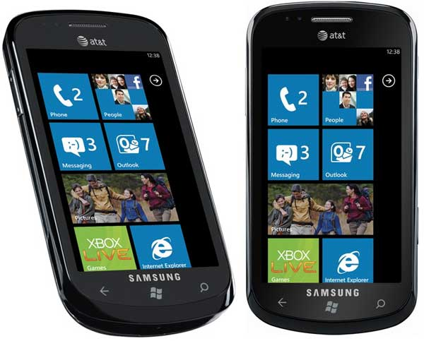

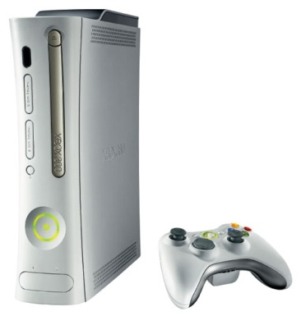
What is the .NET Platform?
Microsoft’s first reboot for developers since the Win32 API (1993)
Foundation for Store Apps, WinRT, 2012 and beyond
Enables the creation of broad types of solutions
Client apps (console, WPF, Windows Store Apps, Universal Apps)
Web applications & services
Many others: Windows services, Xbox games, cloud-based, Office plug-ins, …
Notes:
Updated, removed forms, added Windows Store

Slide 4
The .NET Platform
It’s not (only) technical stuff, it’s a much broader Microsoft initiative
Foundations:
.NET Framework and languages
Tools (Visual Studio)
Servers (SQL Server, BizTalk, etc.)
Services (alerts, authentication, etc.)

Slide 5
Four .NET design goals
Simplify development
More abstraction, less plumbing
Windows API
HWND hwndMain = CreateWindowEx(
0, "MainWClass", "Main Window",
WS_OVERLAPPEDWINDOW | WS_HSCROLL | WS_VSCROLL,
CW_USEDEFAULT, CW_USEDEFAULT,
CW_USEDEFAULT, CW_USEDEFAULT,
(HWND)NULL, (HMENU)NULL, hInstance, NULL);
ShowWindow(hwndMain, SW_SHOWDEFAULT);
UpdateWindow(hwndMain);
.NET
Form form = new Form();
form.Text = "Main Window";
form.Show();
Notes:
That implies in less (perf/memory) control as well, the same way as assembly language provides more control than C++.

Slide 6
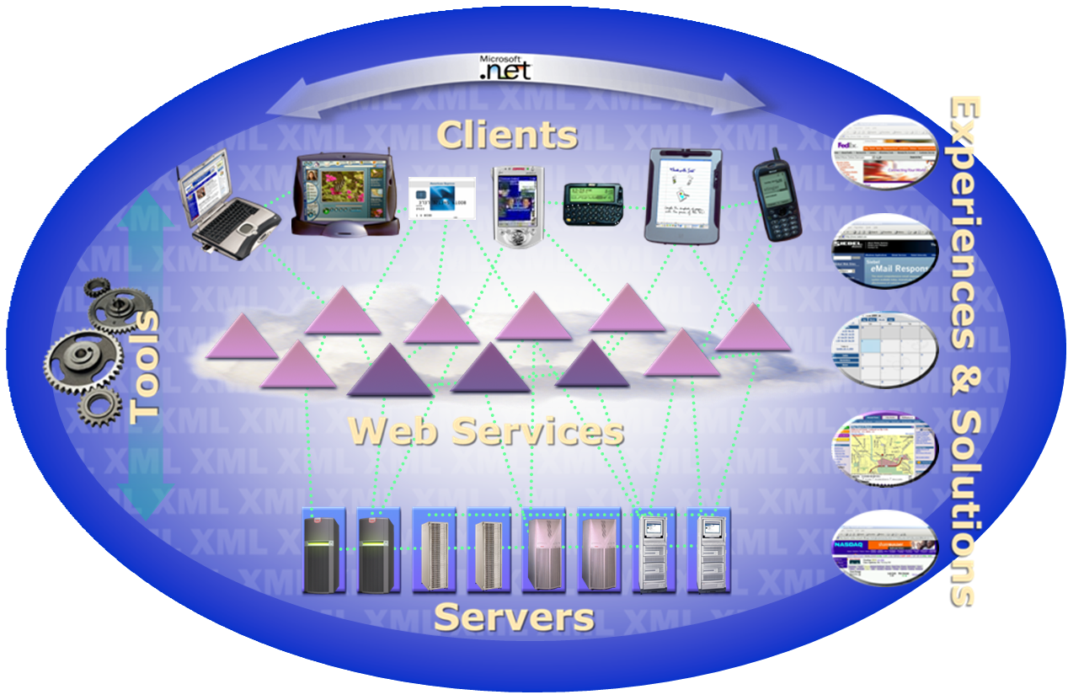
Four .NET design goals
Unify programming models
Across all languages and application types

Slide 7
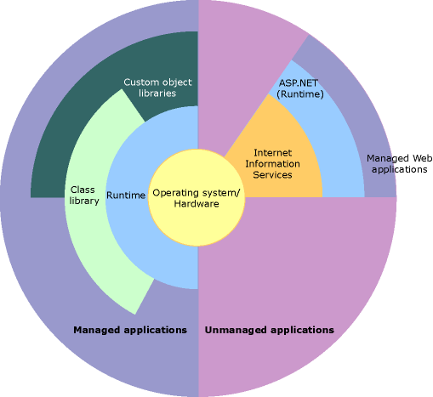
.NET Framework

Slide 8
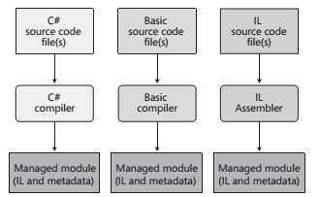
Unify Languages
Notes:
Create source code files written in any programming language that supports the CLR
Use the corresponding compiler to check the syntax and analyze the source code.
Regardless of which compiler you use, the result is a managed module.
A managed module is a standard 32-bit Windows portable executable (PE32) file or a standard 64-bit Windows portable executable (PE32+) file that requires the
CLR to execute.
At run time, the CLR compiles the IL into native CPU instructions.
Native code compilers produce code targeted to a specific CPU architecture, such as x86, x64,
Managed Module – PE, CLR Header, Metadata, IL code

Slide 9
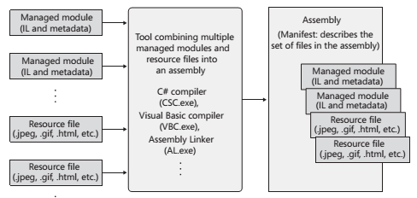
Assembly
Notes:
C# compiler emits a managed module that contains a manifest.
The manifest indicates that the assembly consists of just the one file. So, for projects that have just one managed module and no resource (or data) files, the assembly will be the managed module,
An assembly allows you to decouple the logical and physical notions of a reusable, securable, versionable component.
How you partition your code and resources into different files is completely up to you.
An assembly’s modules also include information about referenced assemblies (including their version numbers).
Deploying assemblies is much easier than deploying unmanaged components
Metadata - binary information which describes the characteristics of a resource .
Description of the Assembly , Data Types and members with their declarations and implementations, references to other types and members , Security permissions etc.
Everything needed to interact with another module.
The compiler embeds the metadata in the target output file, a dll, an .exe or a .netmodule in the case of multi-module assembly.
Metadata describes the contents in an assembly.
Manifest describes the assembly itself, providing the logical attributes shared by all the modules and all components in the assembly

Slide 10
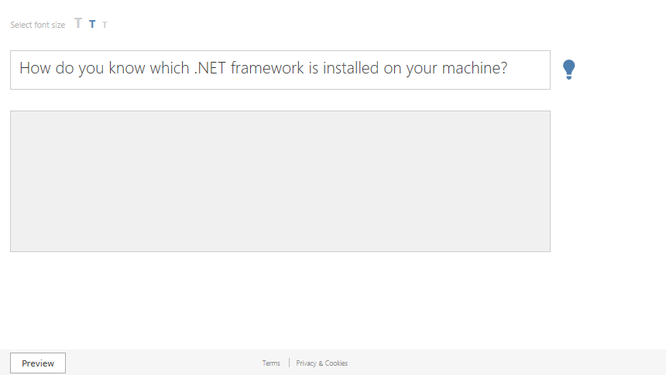
Notes:
%SystemRoot%\Microsoft.NET\Framework

Slide 11
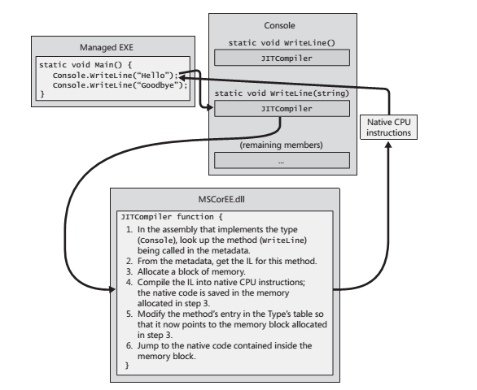
Executing the code
Notes:
Job of CLR –
Managed assemblies contain both metadata and Intermediate Language. IL is a CPU-independent machine language
Any high-level language may not expose all facilities offered by the CLR except the IL assembly language
IL is converted to native CPU instructions by CLR’s JIT ( just-in-time) compiler.
When Main makes its first call to WriteLine, the JITCompiler function is called. The JIT­ Compilerfunction is responsible for compiling a method’s IL code into native CPU instructions.
Because the IL is being compiled “just in time,” this component of the CLR is frequently referred to as a JITteror a JIT compiler

Slide 12
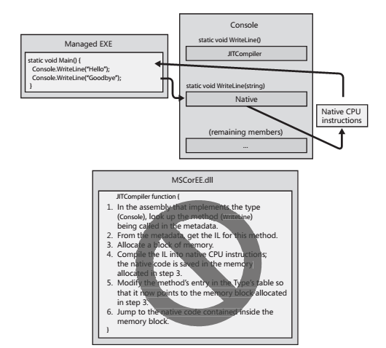
Executing the code
Notes:
Job of CLR –
Managed assemblies contain both metadata and Intermediate Language. IL is a CPU-independent machine language
Any high-level language may not expose all facilities offered by the CLR except the IL assembly language
IL is converted to native CPU instructions by CLR’s JIT ( just-in-time) compiler.
When Main makes its first call to WriteLine, the JITCompiler function is called. The JIT­ Compilerfunction is responsible for compiling a method’s IL code into native CPU instructions.
Because the IL is being compiled “just in time,” this component of the CLR is frequently referred to as a JITteror a JIT compiler

Slide 13

Four .NET design goals
Utilize web standards and best practices
Rich XML, Json standard protocols
Easier to deploy, run, & maintain
For components, versioning, availability
No DLL hell!

Slide 14
.NET Framework
What is it?
Provides the compile-time and runtime foundation for creating and running .NET applications

Slide 15
.NET Framework
VB.NET
C++.NET
C#
J#
…
Common Language Specification
ASP.NET
Windows Forms
ADO.NET and XML
Base Class Library
Common Language Runtime (CLR)
MSMQ
COM+
IIS
WMI
OS
Notes:
Framework Class Library (FCL). The FCL is a set of DLL assemblies that contain several thousand type definitions in which each type exposes some functionality.
To access any of the framework’s features, you need to know which namespace contains the types that expose the facilities you’re after.
Visual Studio allows you to create a Portable Class Library project. This project type lets you create a single class library assembly that works with various application
types, including the .NET Framework proper, Silverlight, Windows Phone, Windows Store
apps, and Xbox 360

Slide 16
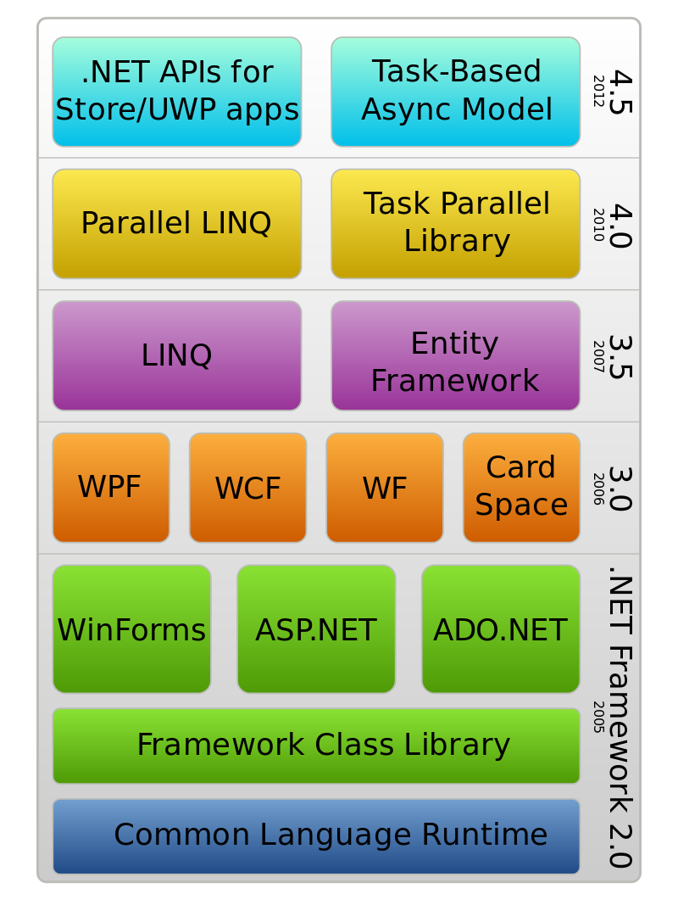
.Net framework stack

Slide 17
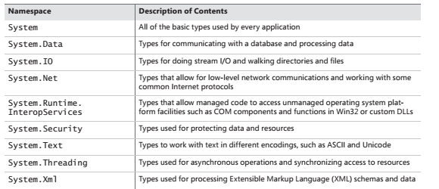
Namespace and FCL
Notes:
If an assembly is to be accessed by multiple applications, the assembly must be placed into a well known directory, and the CLR must know to look in this directory automatically when a reference to
the assembly is detected. This well-known location is called the global assembly cache (GAC).

Slide 18
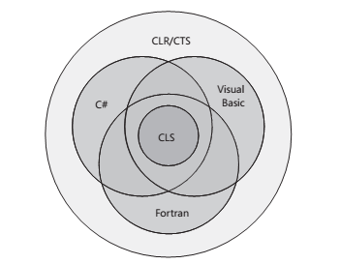
CLR, CTS and CS

Slide 19
Demo Console application and Ildasm

Slide 20
.NET Framework
VB.NET
C++.NET
C#
J#
…
Common Language Specification
ASP.NET
Windows Forms
ADO.NET and XML
Windows platforms originally, others (such as Mono) later
Base Class Library
Common Language Runtime (CLR)
MSMQ
COM+
IIS
WMI
OS

Slide 21
.NET Framework
VB.NET
C++.NET
C#
J#
…
Common Language Specification
ASP.NET
Windows Forms
Access to OS services
ADO.NET and XML
Base Class Library
Common Language Runtime (CLR)
MSMQ
COM+
IIS
WMI
OS

Slide 22
.NET Framework
VB.NET
C++.NET
C#
J#
…
Base Class Library Support
Thread Support
COM Marshaler
Common Language Specification
Type Checker
Exception Manager
ASP.NET
Windows Forms
Managed execution environment
Security Engine
Debug Engine
IL to Native
Compilers
Code
Manager
Garbage
Collector
ADO.NET and XML
Class Loader
Base Class Library
Common Language Runtime (CLR)
MSMQ
COM+
IIS
WMI
OS
Notes:
CLR Design Goals:
Dramatically simplify application development
Provide a robust and secure execution environment
Support multiple programming languages
Simplify deployment and management
Manages running code
Verifies type safety
Provides garbage collection, error handling
Code access security for semi-trusted code
Provides common type system
Value types (integer, float, user defined, etc)
Objects, Interfaces
Provides access to system resources
Native API, COM interop, etc.

Slide 23
.NET Framework
VB.NET
C++.NET
C#
J#
…
Common Language Specification
ASP.NET
Windows Forms
…
…
ADO.NET and XML
Base Class Library
Common Language Runtime (CLR)
Built-in .NET APIs; each block has a specific purpose
MSMQ
COM+
IIS
WMI
OS
Notes:
Class Library Design Goals
Make it simple to use
Factored and extensible
Web standards and practices as the foundation
Unify application models
Make It Simple To Use
Organization
Organized in hierarchical namespaces
Unified type system
Everything is an object
Boxing converts value types to objects
No need for special variant type
Component Oriented
Properties, methods & events are 1st class
Design-time functionality

Slide 24
.NET Framework
System.Web
System.WinForms
VB.NET
C++.NET
C#
J#
…
Services
UI
Design
ComponentModel
Description
HtmlControls
Discovery
Common Language Specification
WebControls
Protocols
System.Drawing
Caching
ASP.NET
Windows Forms
Security
Drawing2D
Printing
Configuration
SessionState
Imaging
Text
ADO.NET and XML
System.Data
System.Xml
ADO
SQL
XSLT
Serialization
Base Class Library
Design
SQLTypes
XPath
Common Language Runtime (CLR)
System
Collections
MSMQ
IO
Security
Runtime
COM+
IIS
WMI
Configuration
Net
ServiceProcess
InteropServices
Remoting
Diagnostics
OS
Reflection
Text
Globalization
Resources
Threading
Serialization
Notes:
Class Library Design Goals
Make it simple to use
Factored and extensible
Web standards and practices as the foundation
Unify application models
Make It Simple To Use
Organization
Organized in hierarchical namespaces
Unified type system
Everything is an object
Boxing converts value types to objects
No need for special variant type
Component Oriented
Properties, methods & events are 1st class
Design-time functionality

Slide 25
.NET Framework
VB.NET
C++.NET
C#
J#
…
Common Language Specification
ASP.NET
Windows Forms
Multi-language support
ADO.NET and XML
Base Class Library
Common Language Runtime (CLR)
MSMQ
COM+
IIS
WMI
OS

Slide 26
.NET Framework
VB.NET
C++.NET
C#
J#
…
Common Language Specification
APL Ada Asml Beta C# C++ Cobol Delphi ECMAScript Eiffel F# (CAML) | Pascal Perl Pizza P# (Prolog) RPG Ruby Scheme S# (Smalltalk) Visual Basic Zonnon Forth | Fortran Haskell Lua ILASM lcc J# Mercury Mixal ML (SML) Mondrian Oberon
ASP.NET
Windows Forms
ADO.NET and XML
Base Class Library
Common Language Runtime (CLR)
MSMQ
COM+
IIS
WMI
OS

Slide 27
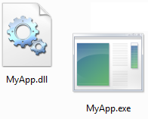


Multi-language, multi-platform
.NET assemblies
VB .NET Application
vbc.exe
.NET intermediate code
x86, etc.
C# Application
JIT compiler
csc.exe
Source code is compiled to intermediate language code (IL = CIL = MSIL)
JIT-compiler compiles IL code to machine code
Notes:
Compiling to specific architectures (x86, amd64, ia64):
http://blogs.msdn.com/b/junfeng/archive/2004/08/11/212555.aspx
http://msdn.microsoft.com/en-us/library/system.reflection.processorarchitecture.aspx
Run LinQPad example = C# Program
void Main()
{
var foo=3;
var bar =5;
Console.WriteLine(foo + bar);
}
C# Statement
var =3;
Console.WriteLine(var)

Slide 28


















Multi-platform
Increased Functionality
Xbox 360
Pocket PC Phone
Tablet PC
Smart Personal Objects
Smartphone
Notebook PC
Servers
.NET Compact Framework
.NET Framework

Slide 29

Think about it…
Advantages / disadvantages of 2-step compilation and intermediate language?
Advantages
Multi-language support
Disadvantages
Performance (at least in the first run)
Intellectual property of the code (can be disassembled / reverse engineered)
Portability
Only one CLR per platform
Dependency on the .NET Framework

Slide 30
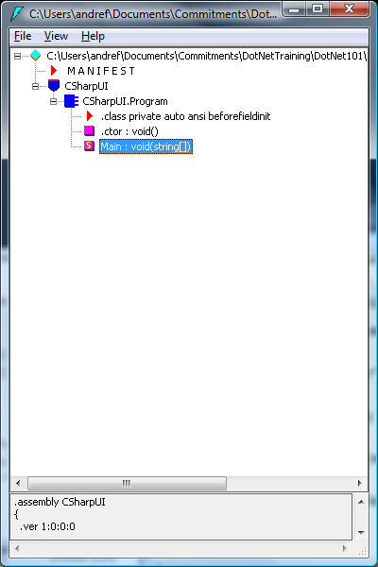
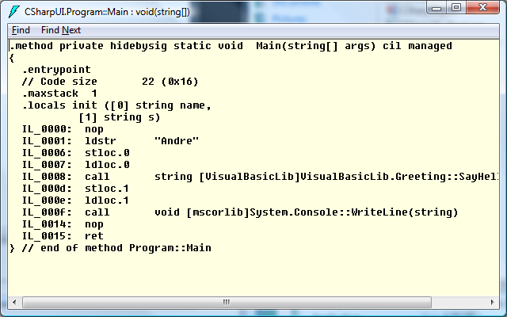
Viewing intermediate language code
Use the IL Disassembler Tool (ildasm)
Notes:
Update: Changed slide title

Slide 31
Practice
Hello, multi-language world!
Let’s make a C# application interact with a Visual Basic application
Let’s identify compiled assemblies (.exe, .dll)
Let’s explore the intermediate code with the ildasm tool.
.

Slide 32
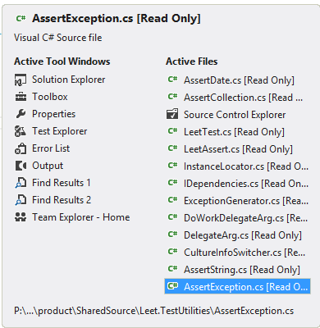
Shortcut tip
CTRL (SHIFT) TAB
Cycle through open files/windows
Close only the current file (tab)? CTRL F4

Slide 33
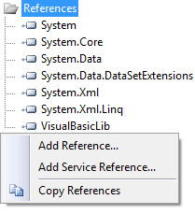
Project References
Allows you to (re)use in your project…
.NET APIs
3rd party APIs
COM components
Other projects’ code
Even .exe assemblies can be referenced
Assemblies and references are a great hook to introduce…

Slide 34
Namespaces
.NET 101 Session #1

Slide 35
What is a namespace?
While .NET assemblies tell how code is physically organized…
Namespaces are logical groupings of code inside an assembly
How do we use them?
Assemblies are added as project references
Namespaces are imported in source code
……………………………………
……………………………………
……………………………………
……………………………………
……………………………………
……………………………………
……………………………………
namespaces
assembly (.dll or .exe)
Notes:
If an assembly is to be accessed by multiple applications, the assembly must be placed into a wellknown directory, and the CLR must know to look in this directory automatically when a reference to
the assembly is detected. This well-known location is called the global assembly cache (GAC).

Slide 36
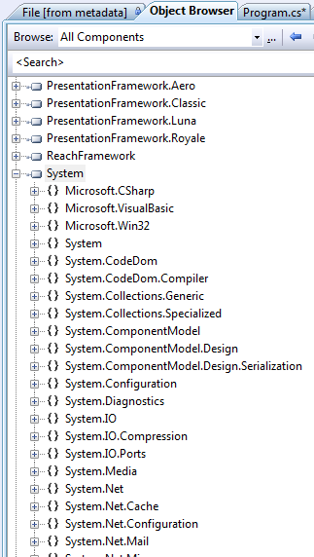
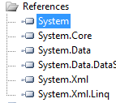
Practice
What’s the relation between assemblies and namespaces?
One assembly contains one or more namespaces
Let’s investigate the System.dll assembly in the Object Browser
Just double click System in any project’s References tree
assemblies
namespaces

Slide 37
Practice
On the other hand, the implementation of a namespace can be split into multiple assemblies
Check namespace System.IO, for example, in
System.dll assembly
mscorlib.dll assembly
System.Core.dll assembly

Slide 38

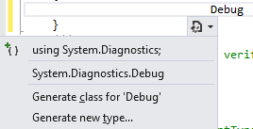
Consuming namespaces
using <namespace>
The lazy/smart way:
Type the name of the target type you want to consume (such as class)
Press CTRL . (dot) to open the smart tag
Press ENTER to have the namespace automagically imported to your file

Slide 39


Final notes on namespaces
Namespaces can also be nested
Or qualified
namespace BugTracker {
namespace GUI {
public class FrmAddBug () { ... }
}
}
namespace BugTracker.GUI { ... }
using BugTracker.GUI;
using BugTracker;
using GUI;

Slide 40
Important note on deployment
In .NET, the Windows Registry is legacy
DLL Hell!
XCOPY deployment is encouraged
However, some assemblies may need to be shared
.NET System assemblies
Your own assembly

Slide 41
The Global Assembly Cache (GAC)
GAC
Central repository for .NET assemblies
Provides a shared assembly location
Supports assembly versioning (side by side execution)
Physically located at %windir%\assembly
Can be manipulated through gacutil tool

Slide 42
.NET Evolution
v1.0, 2002
v1.1, 2003
First .NET version to ship in an OS (Windows Server 2003)
Introduced .NET Compact Framework
V2.0, 2005
Major improvements in the CLR
Supported by VS 2002
Supported by VS 2003
Supported by VS 2005

Slide 43
.NET Evolution
V3.0, 2006
Still uses v2.0 CLR
Major APIs were added (WPF, WCF, WF…)
Shipped with Windows Vista / Server 2008
V3.5, 2008
Major language improvements, especially LINQ
Shipped with Windows 7 / Server 2008 R2
V4.0, 2010
Parallel extensions, new language features
Introduces DLR and a new CLR
Supported by VS 2005
Supported by VS 2008
Still uses v2.0 CLR
Supported by VS 2010

Slide 44
.NET Evolution
V4.5, 2012
Replaces v4.0 CLR
Async/await, Store Apps, Zip, HTML5
Shipped with Windows 8 / Server 2012
V4.5.2, 2013
PCL, diagnostics
Shipped with latest Windows 8 / Server 2012
Supported by VS 2010, VS2012
Supported by VS 2010, VS 2012
V4.5.1
V4.6, 2015
VS 2013, VS 2015
Notes:
New Slide

Slide 45
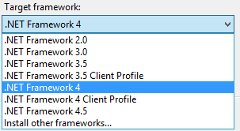
.NET Compatibility
More than one version of the framework can be installed on your machine
Visual Studio wizards can upgrade projects from previous versions
Since VS 2008, multiple .NET versions are supported
Notes:
Update: screen snippet

Slide 46
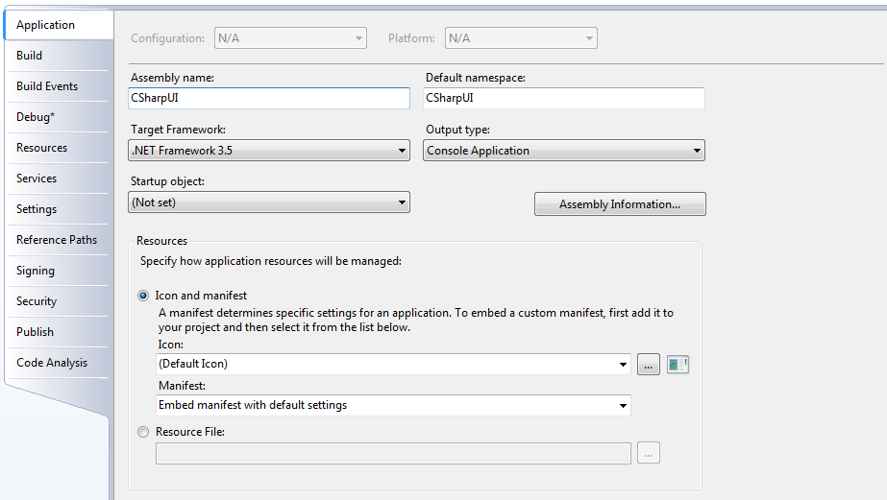

Talking about Project Properties…
Used to manage many aspects of a project
Productivity tips:
To launch, double-click the Properties node in Solution Explorer
When closing, no need to save (it gets auto-saved)

Slide 47
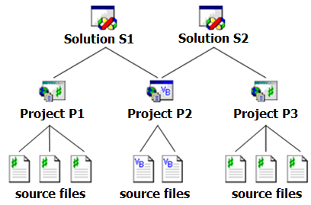
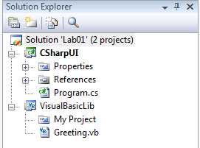
Projects and solutions
The most essential VS units
Defines a development structure
Solution Explorer: the name says it all
notice the dock/undock icon

Slide 48
Solution items X project items
Solution items
Projects
Solution folders
Common items for all projects
Project items
Related source files
Ex: C# code, resource files, XML files, etc.
References
Project properties

Slide 49
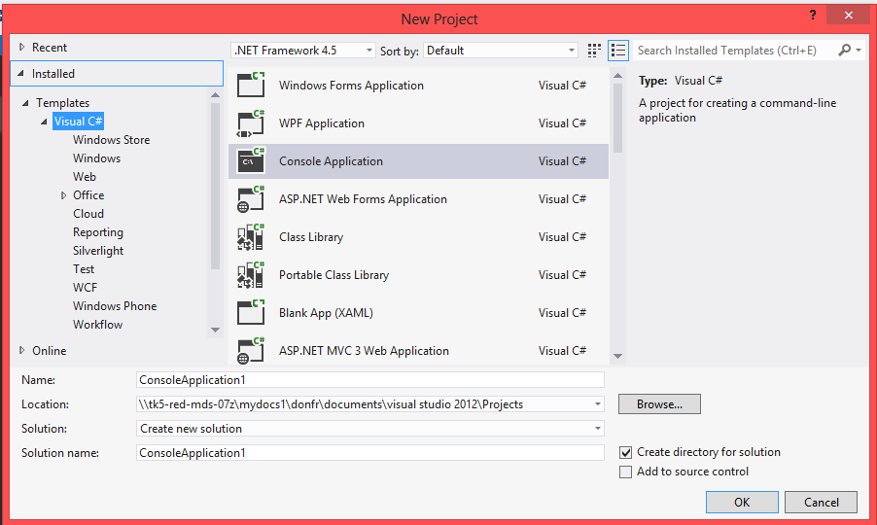
What is a project template (type)?
It provides starting files, an initial project structure and configuration
Notes:
Updated: added VS2012

Slide 50
Popular VS projects
Console Application (.exe)
WPF Application (.exe)
Class Library (.dll)
“Web Projects” (.dlls + content pages)
ASP .NET Web Site
ASP .NET Web Service
WCF Service
Windows Store
Notes:
Updated: Removed Forms, added store and WPF

Slide 51
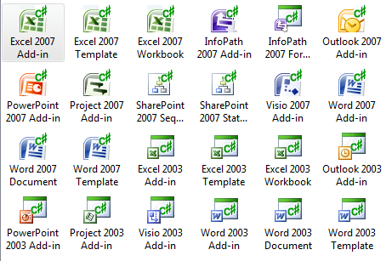
Many other project types
Smart Device
Office
Database
Workflow
Reporting
Test
Extensibility
Setup (installer)
Your own!
Notes:
Marked HIdden

Slide 52
Extensions and Packages
http://visualstudiogallery.com
Power Tools
Productivity Power Tools
NuGet Packages
Samples
Notes:
Added R#

