Slide 1
Introduction to Data Warehousing
CPS 196.03
Notes 6

Slide 2
Warehousing
Growing industry: $30+ billion industry
Range from desktop to huge:
  Walmart: 900-CPU, 2,700 disk, 23TB
  Teradata system (numbers from earlier part of this decade)
Lots of buzzwords, hype
  slice & dice, rollup, MOLAP, pivot, ...

Slide 3
Outline
What is a data warehouse?
Why a warehouse?
Models & operations
Implementing a warehouse

Slide 4
What is a Warehouse?
Collection of diverse data
  subject oriented
  aimed at executive, decision maker
  often a copy of operational data
  with value-added data (e.g., summaries, history)
  integrated
  time-varying
  non-volatile
more

Slide 5
What is a Warehouse?
Collection of tools
  gathering data
  cleansing, integrating, ...
  querying, reporting, analysis
  data mining
  monitoring, administering warehouse

Slide 6
Warehouse Architecture
Client
Client
Query & Analysis
Metadata
Warehouse
Integration
Source
Source
Source

Slide 7
Motivating Examples
Forecasting
Comparing performance of units
Monitoring, detecting fraud
Visualization

Slide 8

Why a Warehouse?
Two Approaches:
  Query-Driven (Lazy)
  Warehouse (Eager)
?
Source
Source

Slide 9
Query-Driven Approach
Client
Client
Mediator
Wrapper
Wrapper
Wrapper
Source
Source
Source
Notes:
7

Slide 10
Advantages of Warehousing
High query performance
Queries not visible outside warehouse
Local processing at sources unaffected
Can operate when sources unavailable
Can query data not stored in a DBMS
Extra information at warehouse
  Modify, summarize (store aggregates)
  Add historical information

Slide 11
Advantages of Query-Driven
No need to copy data
  less storage
  no need to purchase data
More up-to-date data
Query needs can be unknown
Only query interface needed at sources
May be less draining on sources

Slide 12
OLTP vs. OLAP
OLTP: On Line Transaction Processing
  Describes processing at operational sites
OLAP: On Line Analytical Processing
  Describes processing at warehouse

Slide 13
OLTP vs. OLAP
OLTP
OLAP
Mostly updates
Many small transactions
Mb-Gb of data
Raw data
Clerical users
Up-to-date data
Consistency, recoverability critical
Mostly reads
Queries long, complex
Tb-Pb of data
Summarized, consolidated data
Decision-makers, analysts as users

Slide 14
Data Marts
Smaller warehouses
Spans part of organization
  e.g., marketing (customers, products, sales)
Do not require enterprise-wide consensus
  but long term integration problems?

Slide 15
Warehouse Models & Operators
Data Models
  relations
  stars & snowflakes
  cubes
Operators
  slice & dice
  roll-up, drill down
  pivoting
  other

Slide 16
Warehouse Models
Modeling data warehouses: dimensions, measures
  Star schema: A fact table in the middle connected to a set of dimension tables
  Snowflake schema: A refinement of star schema where some dimensional hierarchy is normalized into a set of smaller dimension tables, forming a shape similar to snowflake
  Fact constellations: Multiple fact tables share dimension tables, viewed as a collection of stars, therefore called galaxy schema or fact constellation

Slide 17
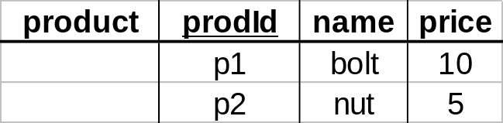
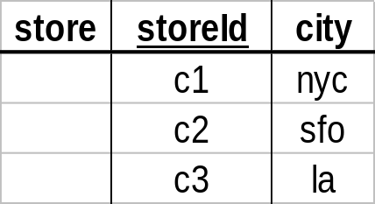
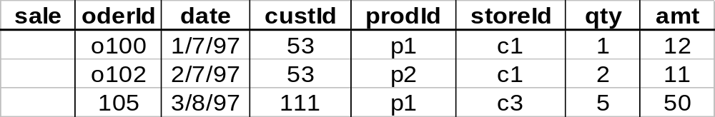
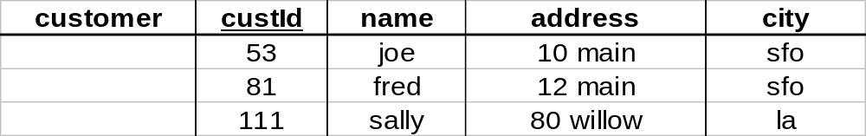
Star
Measures

Slide 18
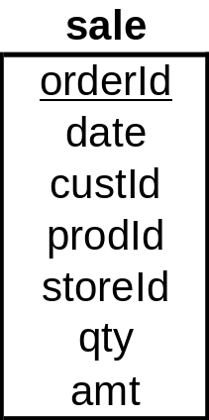
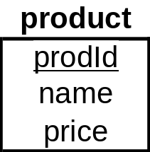
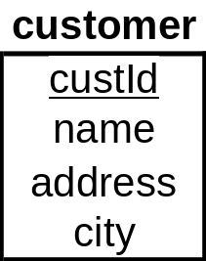
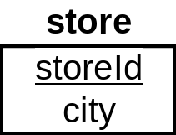
Star Schema

Slide 19
Another Example of Star Schema
time
time_key
day
day_of_the_week
month
quarter
year
item
item_key
item_name
brand
type
supplier_type
Sales Fact Table
time_key
item_key
branch_key
branch
location
location_key
branch_key
branch_name
branch_type
location_key
street
city
state_or_province
country
units_sold
dollars_sold
avg_sales
Measures

Slide 20
Terms
Fact table
Dimension tables
Measures

Slide 21
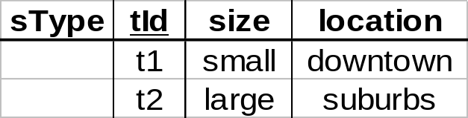
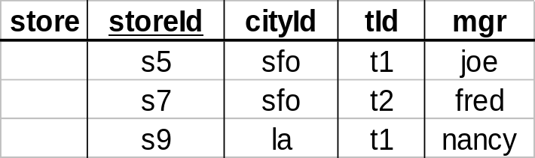
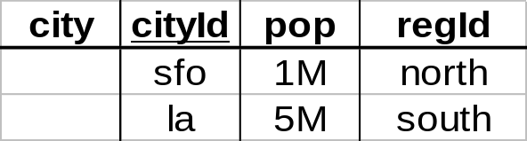
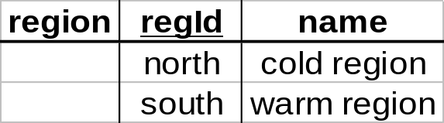
Dimension Hierarchies
sType
store
city
region
➔ snowflake schema
➔ constellations

Slide 22
Example of Snowflake Schema
time
item
time_key
day
day_of_the_week
month
quarter
year
item_key
item_name
brand
type
supplier_key
supplier
Sales Fact Table
supplier_key
supplier_type
time_key
item_key
branch_key
branch
location
location_key
location_key
street
city_key
branch_key
branch_name
branch_type
units_sold
dollars_sold
city
city_key
city
state_or_province
country
avg_sales
Measures

Slide 23
Example of Fact Constellation
time
time_key
day
day_of_the_week
month
quarter
year
item
Shipping Fact Table
item_key
item_name
brand
type
supplier_type
Sales Fact Table
time_key
time_key
item_key
shipper_key
item_key
branch_key
from_location
branch
location_key
location
to_location
branch_key
branch_name
branch_type
units_sold
location_key
street
city
province_or_state
country
dollars_cost
dollars_sold
units_shipped
avg_sales
shipper
Measures
shipper_key
shipper_name
location_key
shipper_type

Slide 24
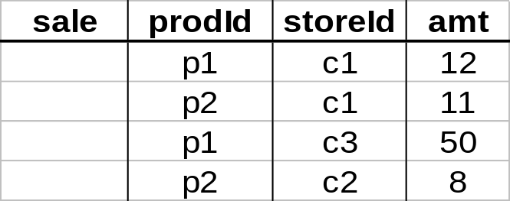
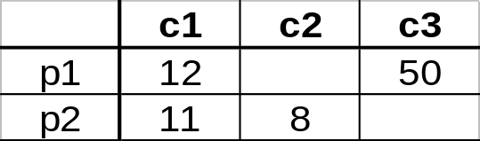
Cube
Fact table view:
Multi-dimensional cube:
dimensions = 2
Recall counters in Apriori

Slide 25
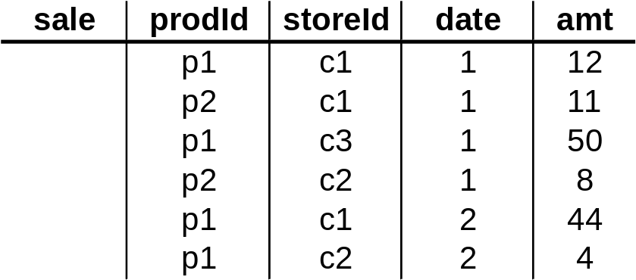
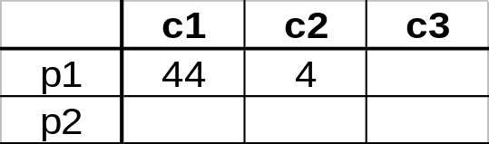
3-D Cube
Fact table view:
Multi-dimensional cube:
day 2
day 1
dimensions = 3

Slide 26
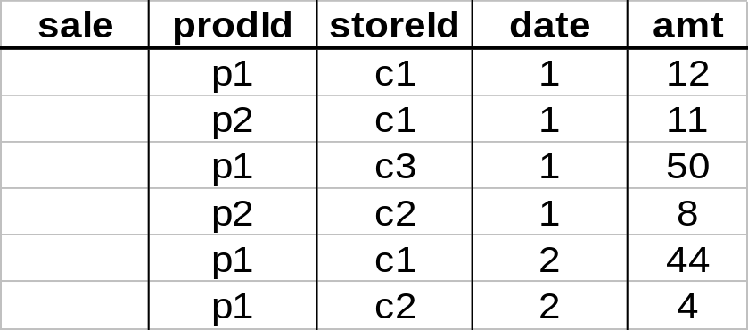
Aggregates
Add up amounts for day 1
In SQL: SELECT sum(amt) FROM SALE
WHERE date = 1
81

Slide 27
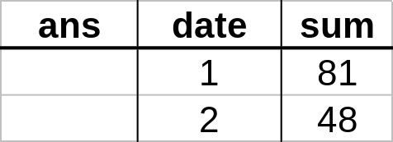
Aggregates
Add up amounts by day
In SQL: SELECT date, sum(amt) FROM SALE
GROUP BY date

Slide 28
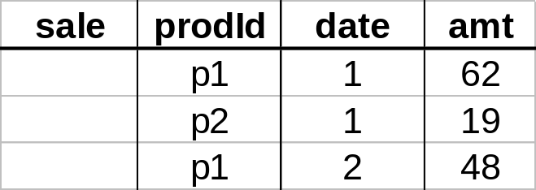
Another Example
Add up amounts by day, product
In SQL: SELECT date, sum(amt) FROM SALE
GROUP BY date, prodId
rollup
drill-down

Slide 29
Aggregates
Operators: sum, count, max, min, median, ave
“Having” clause
Using dimension hierarchy
  average by region (within store)
  maximum by month (within date)

Slide 30
Types of Measures in Data Cubes
Distributive: if the result derived by applying the function to n aggregate values is the same as that derived by applying the function on all the data without partitioning
    E.g., count(), sum(), min(), max()
Algebraic: if it can be computed by an algebraic function with M arguments (where M is a bounded integer), each of which is obtained by applying a distributive aggregate function
    E.g., avg(), min_N(), standard_deviation()
Holistic: if there is no constant bound on the storage size needed to describe a subaggregate.
    E.g., median(), mode(), rank()

Slide 31
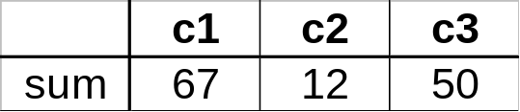
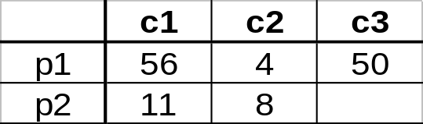
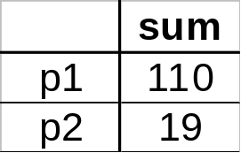
Cube Aggregation
Example: computing sums
day 2
. . .
day 1
129
rollup
drill-down

Slide 32
Cube Operators
day 2
. . .
day 1
sale(c1,*,*)
129
sale(c2,p2,*)
sale(*,*,*)

Slide 33
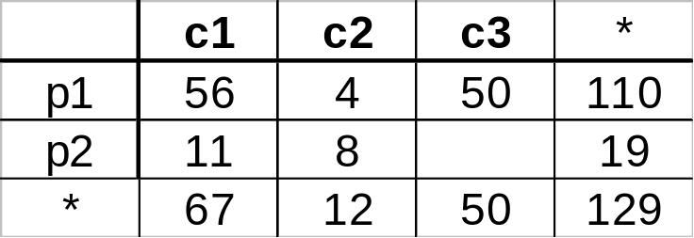
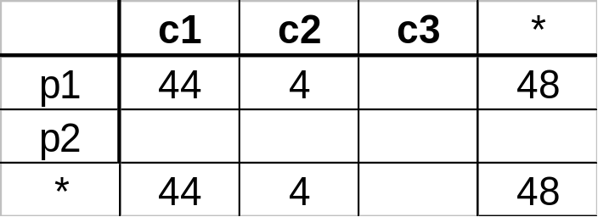
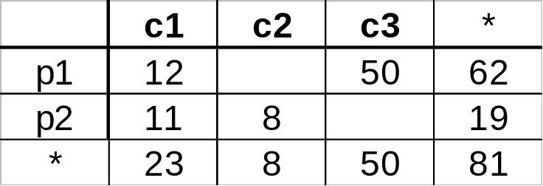
Extended Cube
*
day 2
sale(*,p2,*)
day 1

Slide 34

Cube Aggregates Lattice
129
all
city
product
date
city, product
city, date
product, date
city, product, date
day 2
day 1

Slide 35
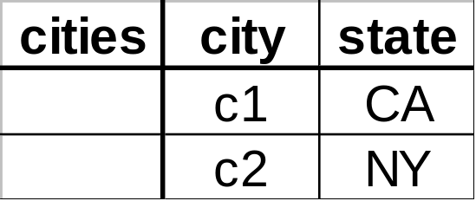
Dimension Hierarchies
all
state
city

Slide 36
Dimension Hierarchies
all
city
product
date
city, product
city, date
product, date
state
city, product, date
state, date
state, product
state, product, date
not all arcs shown...

Slide 37
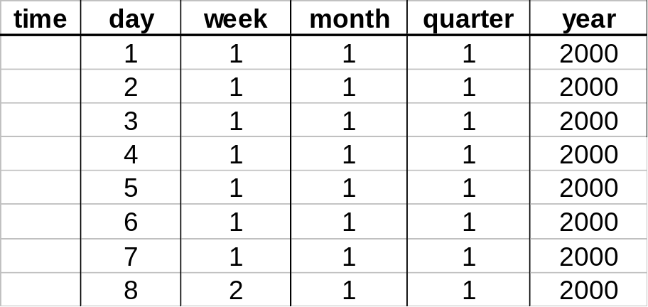
Interesting Hierarchy
all
years
weeks
quarters
months
conceptual
dimension table
days

Slide 38
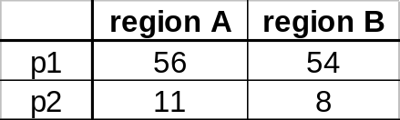
Aggregation Using Hierarchies
day 2
customer
day 1
region
country
(customer c1 in Region A;
customers c2, c3 in Region B)

Slide 39
Multidimensional Data
Sales volume as a function of product, month, and region
Dimensions: Product, Location, Time
Hierarchical summarization paths
Region
Industry Region Year
Category Country Quarter
Product City Month Week
Office Day
Product
Month

Slide 40

Typical OLAP Operations
Date
Total annual sales
of TV in U.S.A.
1Qtr
2Qtr
3Qtr
4Qtr
sum
Product
TV
PC
U.S.A
VCR
sum
Canada
Country
Mexico
sum
All, All, All

Slide 41
Typical OLAP Operations
Roll up (drill-up): summarize data
  by climbing up hierarchy or by dimension reduction
Drill down (roll down): reverse of roll-up
  from higher level summary to lower level summary or detailed data, or introducing new dimensions
Slice and dice: project and select
Pivot (rotate):
  reorient the cube, visualization, 3D to series of 2D planes
Other operations
  drill across: involving (across) more than one fact table
  drill through: through the bottom level of the cube to its back-end relational tables (using SQL)

Slide 42

Fig. 3.10 Typical OLAP Operations

Slide 43
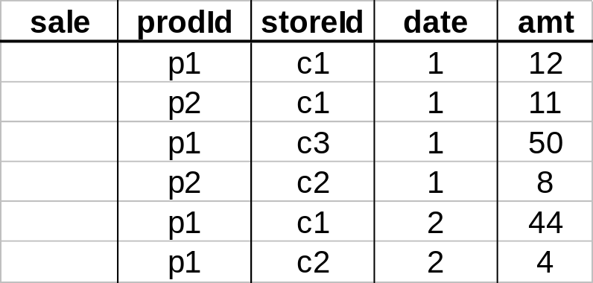
Pivoting
Fact table view:
Multi-dimensional cube:
day 2
day 1
Pivot turns unique values from
one column into unique columns
in the output

