Slide 1


ITM 440/540
03 - Physical Layer
Representing Bit Patterns using Signals
Carol Davids@2015

Slide 2
Readings in text
Forouzan: Part 2 Introduction
Forouzan: Chapter 3
Illustrations from text are included in these slides
Carol Davids@2015

Slide 3
Outline: data – signal - channel
Data is the information we want to send
Signals are physical, observable events we use to encode data.
Channel or Link is the logical and physical path used to send the signal.
Carol Davids@2015

Slide 4
Outline: Analog and Digital
Define Analog and Digital
The data to be transmitted can be either
  analog or digital data
The signals used to represent the data can be either
  analog or digital signals
Carol Davids@2015

Slide 5
Outline: Periodic analog signals
Terminology of sine waves
  Frequency
  Period
  Amplitude
  Phase
Terminology of periodic signals moving in a medium
  Propagation speed
  Wavelength (propagation speed x period)
Carol Davids@2015

Slide 6
Outline: Time Domain vs. Frequency Domain
We can represent a signal in either the time domain or the frequency domain
In the time domain, the x-axis represents time and the y-axis represents amplitude
In the frequency domain, the x-axis represents frequency and the y-axis represents amplitude.
Carol Davids@2015

Slide 7
Outline: Periodic analog signals
Sine waves are the building blocks of all analog signals
A composite analog signal is the weighted sum of sine waves
Carol Davids@2015

Slide 8
Outline: Composite Signals
Terminology of composite analog signals
  Periodic
  Aperiodic
  Bandwidth
Carol Davids@2015

Slide 9
Outline: Digital Signals
Terminology of digital signals
  Level
  Bit Rate
  Propagation speed
  Bit Length
Carol Davids@2015

Slide 10
Outline: Bandwidth
The digital signal we put onto the transmission medium behaves like a composite analog signal
The signals have a characteristic bandwidth
The channels in which signals travel also have a characteristic bandwidth
The channels are classified as :
  Baseband
  Broadband
Carol Davids@2015

Slide 11
Outline: Baseband vs. Broadband
Baseband transmission
  Keeps the signal in digital format.
  The signal contains all the frequencies from 0 to infinity.
  The channel must pass all these frequencies.
Broadband transmission
  Uses a baseband signal to modulate an analog carrier frequency.
  The resulting signal occupies a part of the frequency spectrum centered around the analog carrier frequency.
  The channel must pass this set of frequencies
Carol Davids@2015

Slide 12
Outline: Transmission Impairments
Transmission impairments
  Attenuation
  Distortion
  Noise
Units of measure (metrics) used to describe transmission impairments
  Attenuation - dB
  Noise - SNR
Carol Davids@2015

Slide 13
Outline: Data Rate Limits
Data Rate Limits:
How many bits per second can be signaled in a channel?
The answer may depend on these factors:
  The analog bandwidth of the channel
  The number of signal levels in the digital representation of the data
  The amount of noise in the channel
Carol Davids@2015

Slide 14
Outline: Data Rate Limits
Data Rate Limits: Information Theory:
Information Theory is the branch of telecommunications that tries to identify the maximum data rate that can be sent in a given channel
Two important findings of information theory are
  Nyquist - noiseless channel - bit rate limit
  Shannon - noisy channel - bit rate
Carol Davids@2015

Slide 15
Outline: Nyquist and Shannon
Nyquist
  Maximum bit rate in a noiseless channel is proportional to the analog bandwidth of the channel and to the log base 2 of the number of levels in the signal.
  The constant of proportionality is 2.
Shannon
  Maximum bit rate in a noisy channel is proportional to the analog bandwidth and the log base 2 of the sum of 1 plus the SNR of the channel.
Carol Davids@2015

Slide 16
Outline: Units of measure
Characteristic Units, abbreviation
Analog Bandwidth Hertz, Hz
Digital Bandwidth bits per second, b/s
Throughput bits per second, b/s
Delay (latency) seconds, s
  Propagation time seconds, s
  Transmission time seconds, s
  Queuing time seconds, s
  Processing time seconds, s
Bandwidth-Delay product bits*
*a measure of volume – digital bandwidth x delay
Carol Davids@2015

Slide 17
Outline: Bandwidth-Delay Product
Bandwidth-Delay product
  a characteristic of a channel or link
  a measure of the volume of bits that the channel can hold
  the product of digital bandwidth (bits/sec) and delay (sec)
Carol Davids@2015

Slide 18
Physical Layer
Physical layer is a logical layer
It translates the logical ones and zeros that represent the data to be sent into physical signals that are put onto the medium of the network
Carol Davids@2015

Slide 19
Data vs. Signals that represent data
Distinguish between data and signals
Data is the information that needs to be transmitted
Signals are the observable changes we impose on the medium in order to represent data
Carol Davids@2015

Slide 20
analog vs. digital
Analog information takes on a continuous range of values.
Digital information takes on a discrete set of values.
Carol Davids@2015

Slide 21
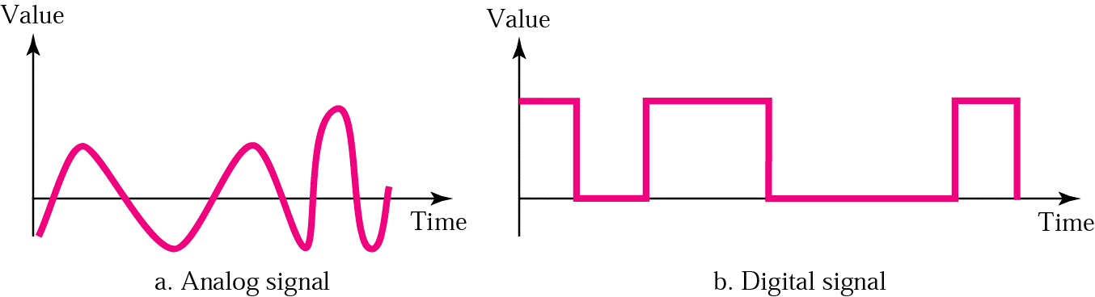
Analog signals and digital signals
Analog signal can take on a continuous set of values.
A digital signal can take on only a discrete set of values.
Carol Davids@2015

Slide 22
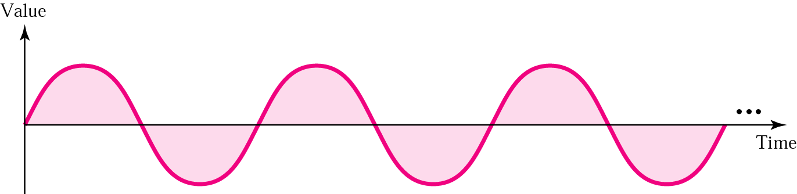
Analog Signals
The sine wave is the basic building block of all analog data
Any wave form can be represented by the sum of sine waves having different amplitudes, frequencies and phases
See the appendix to these slides and Section 3.2 of the text for more detail.
Carol Davids@2015

Slide 23
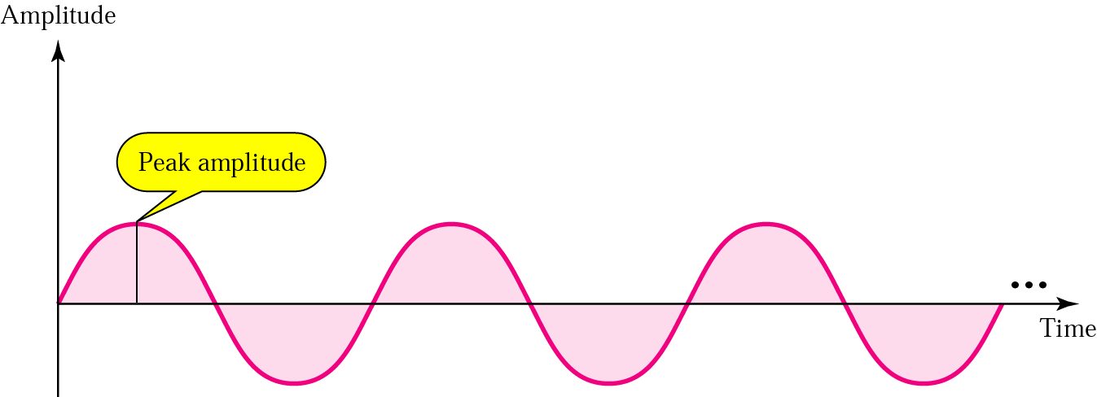
Amplitude
A sine wave takes on a continuous set of values between -A and +A.
Carol Davids@2015

Slide 24
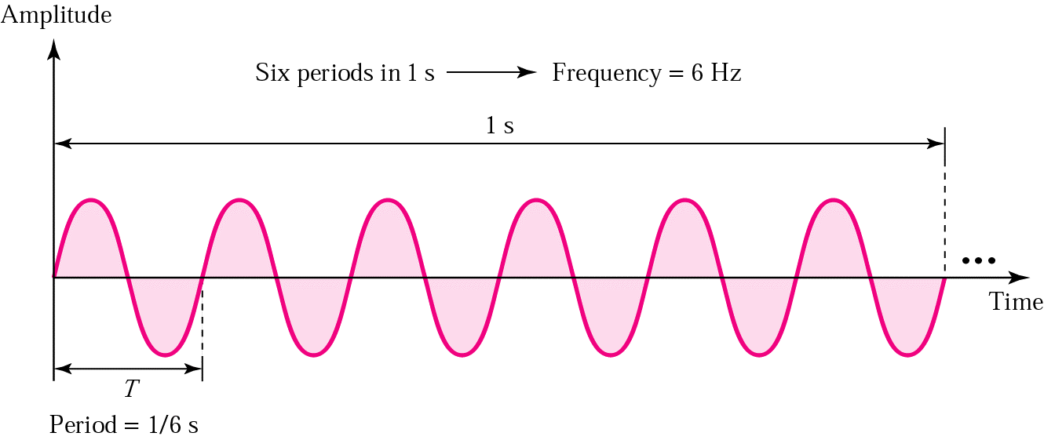
Frequency
The number of cycles per second.
A cycle is a single traversal of the recurring pattern.
Carol Davids@2015

Slide 25
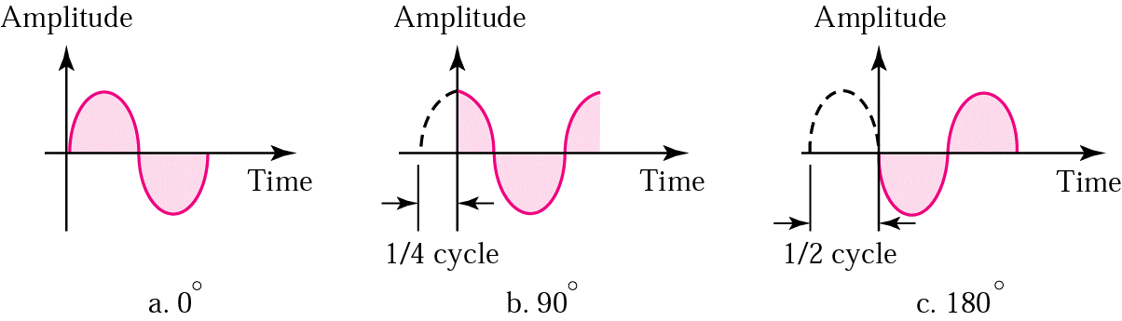
Phase
Defines the position of the wave pattern with respect to time 0.
Carol Davids@2015

Slide 26
Frequency vs. Period
Period is measured in seconds.
Frequency is measured in cycles per second or radians per second.
The name of the unit that measures cycles per second is Hertz, abbreviated Hz
Carol Davids@2015

Slide 27
Units of Period
Milliseconds 10⁻³ s
Microseconds 10⁻⁶ s
Nanoseconds 10⁻⁹ s
Picoseconds 10⁻¹² s
  From Table 3.1 page 61
  Memorize this terminology
Carol Davids@2015

Slide 28
Units of Frequency
Kilohertz 10³ Hz
Megahertz 10⁶ Hz
Gigahertz 10⁹ Hz
Terahertz 10¹² Hz
  Information in Table 3.1 page 61
  Memorize this terminology
Carol Davids@2015

Slide 29
Example
What is the frequency of a sine wave whose period is 100 ms?
Frequency = 1/period
Period = 100 ms = 100 x 10⁻³ s = 10² x 10⁻³ s = 10⁻¹ s
Frequency = 1/period = 1/10⁻¹ Hz = 10 Hz
Do you want this expressed in KHz?
  Substitute 1 Hz = 10⁻³ KHz into the above
  Frequency = 10 x 10⁻³ KHz = 10⁻² KHz
Carol Davids@2015

Slide 30
Generalizing Frequency
Frequency can be taken to mean the rate of change of a value with respect to time.
High frequency --> many changes in a given period of time
Low frequency --> few changes in the same period of time
Carol Davids@2015

Slide 31
Generalizing Frequency
Frequency of 0 -->constant signal level
Frequency of infinity -->signal level changes instantaneously (the change takes no time at all)
Carol Davids@2015

Slide 32
Phase
Phase corresponds to the position of the point on the circle when you started it rolling.
It represents the shift of the sine wave along the time axis.
Carol Davids@2015

Slide 33
Time Domain vs. Frequency Domain
The representations we have looked at so far are Time Domain representations of a sine wave
Time Domain representation shows how the amplitude of the wave changes with time
Using a time domain representation we can derive both the frequency and the phase of the wave
Carol Davids@2015

Slide 34
Time Domain vs. Frequency Domain
There is another way to represent a sine wave
A frequency domain representation
The frequency domain representation shows peak amplitude at each frequency
Carol Davids@2015

Slide 35
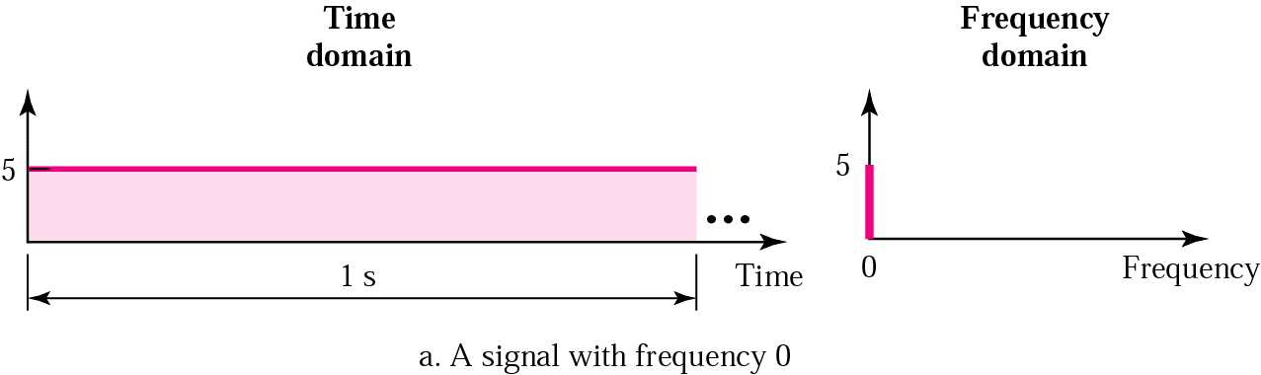
Example
This is a special case, with frequency 0.
A = 5
Carol Davids@2015

Slide 36
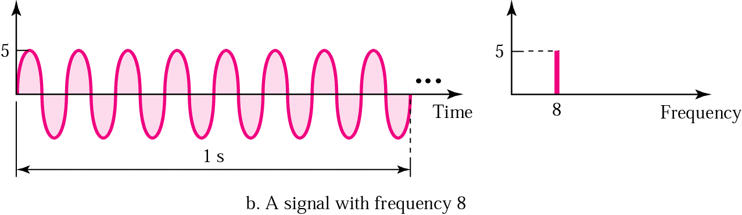
Example
f = 8
A = 5
Carol Davids@2015

Slide 37
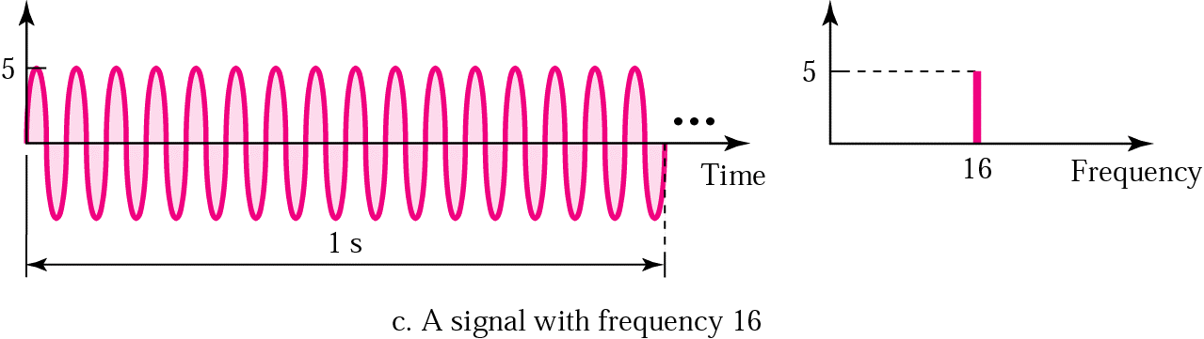
Example
f = 16
A = 5
Carol Davids@2015

Slide 38
Digital signals
We now look at ways to represent data using a digital signal.
A digital signal can take on only discrete values - such as +5 volts and -5 volts, but not the voltages in between.
It is discontinuous.
Carol Davids@2015

Slide 39
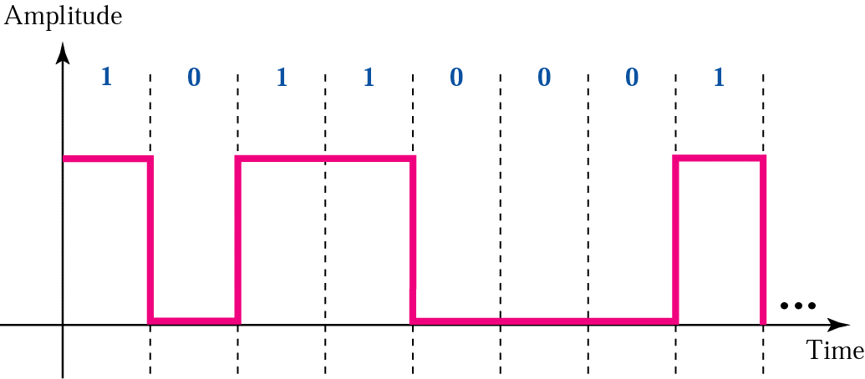
Digital signals
In illustration 3.16a below a positive voltage represents the bit ‘1’ and a zero voltage represents the bit ‘0’
The signal is discontinuous, since at the time T1, the signal appears to have two values +V and 0 simultaneously.
+V
0
T1
Carol Davids@2015

Slide 40
Digital signals
We can use a string of pulses to represent a digital signal.
In illustration 3.16 below a positive voltage represents the bit ‘1’ and a zero voltage represents the bit ‘0’
+V
0
T1
Carol Davids@2015

Slide 41

Digital signals
In illustration 3.16 b. below Level 4 represents the bit pattern 11, Level 3 represents the bit pattern 10, Level 1 represents the bit pattern 00.
Carol Davids@2015

Slide 42
Digital signals
Thus, in illustration 3.16 b. 2 bits are associated with each data level (data level == signal)
Carol Davids@2015

Slide 43
Digital signals
How many distinct data levels or signal levels do we need in this example?
4
Carol Davids@2015

Slide 44
Digital signals and Bit Length
To describe a digital signal we use a metric called ‘Bit Length.’
Bit Length is the distance that one bit occupies on the transmission medium.
It represents the speed of the signal on the transmission medium (distance/time) times the time period over which the signal is imposed on the medium (time)
(distance/time) x (time) == distance
Carol Davids@2015

Slide 45
Digital Signal is a composite analog signal
The very high frequencies contribute to the sharp edges.
The more harmonics you include, the more closely the wave can resemble an ideal square wave.
But the frequency spectrum of the medium over which you send the signal must include those high frequencies.
Carol Davids@2015

Slide 46
Digital Signals through different media
The higher the bandwidth of the medium, the more accurately the digital signal can be transported by that medium.
Carol Davids@2015

Slide 47
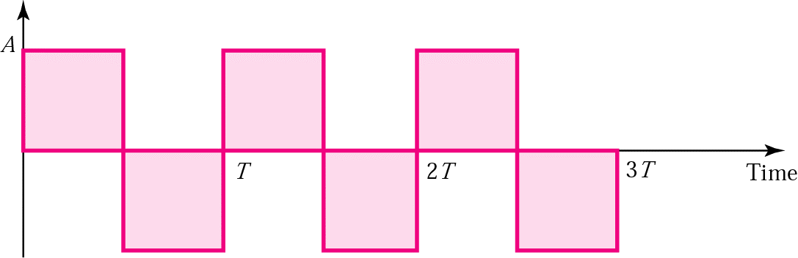
Example of a square wave
Below is an illustration (from ed. 3) of a square wave.
This is a periodic signal and is not useful for carrying information. It is used as illustration.
The period is time T.
Carol Davids@2015

Slide 48
Square wave example
This signal can be described by the following formula:
S(t) = 4A/π sin 2π(f)t + 4A/3π sin 2π(3f)t +
4A/5π sin 2π(5f)t + 4A/7π sin 2π(7f)t + ……….
Carol Davids@2015

Slide 49
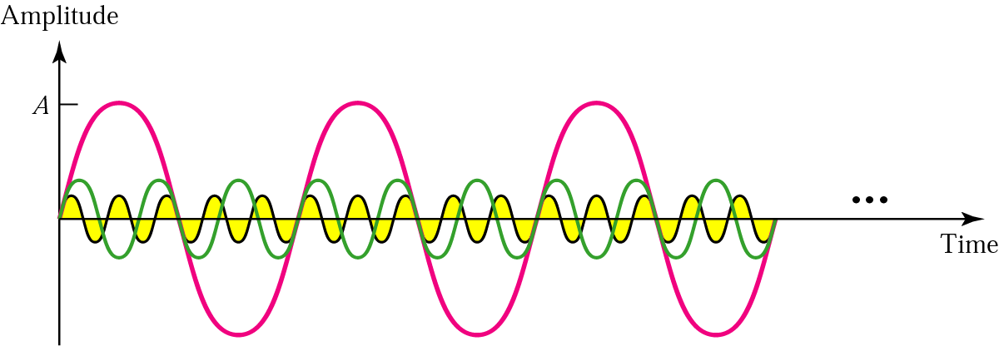
Square wave example
First three harmonics
Illustration from ed. 3
f
3f
5f
Carol Davids@2015

Slide 50
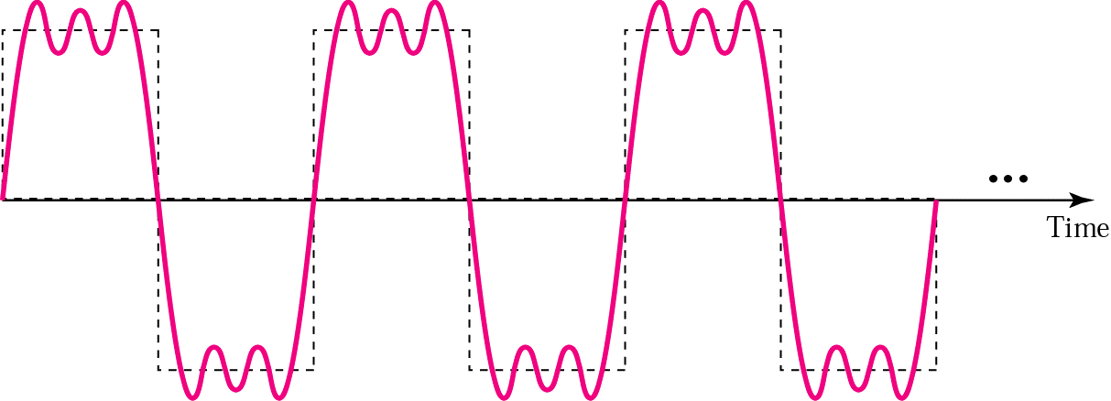
Square wave example
Sum of first three harmonics would look something like the illustration below.
Carol Davids@2015

Slide 51
Periodic vs. non-periodic
Interesting signals are non-periodic – that is – not predictable
Periodic signals can be represented in the frequency domain by a discrete set of frequencies
Non-periodic signals can be represented in the frequency domain by a continuous set of frequencies.
Carol Davids@2015

Slide 52

Periodic vs. non-periodic
Figure 3.12, ed. 4
Carol Davids@2015

Slide 53
Bandwidth of a Signal
The bandwidth of a signal refers to the difference between the highest significant* frequency and the lowest significant frequency in the signals frequency spectrum.
(*Significant - means that the frequency has a large enough amplitude to impact the results we are interested in.)
Carol Davids@2015

Slide 54
Bandwidth of a Channel
The bandwidth of a particular channel is the range of frequencies that it can pass without losing one-half of the power contained in the signal.
The bandwidth of a channel is given as the difference between two frequencies.
Carol Davids@2015

Slide 55
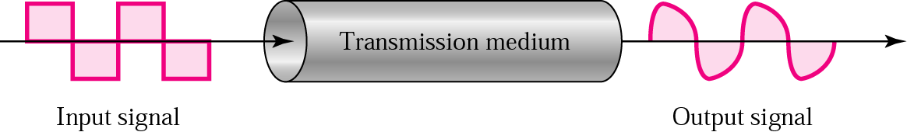
Signals on the medium
If the bandwidth of the signal includes spikes that fall outside the bandwidth of the medium, then the signal will degrade during transmission over that medium.
Carol Davids@2015

Slide 56
Example
If a periodic signal is decomposed into five sine waves with frequencies of 100, 300, 500, 700, and 900 Hz, what is the bandwidth?
Draw the spectrum, assuming all components have a maximum amplitude of 10 V.
Carol Davids@2015

Slide 57
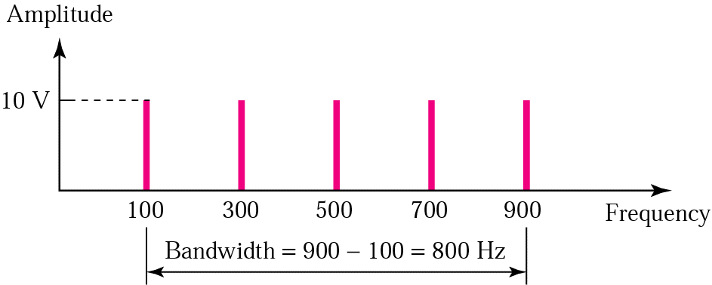
Solution
B = f_{h} - f_{l} = 900 - 100 = 800 Hz
The spectrum has only five spikes, at 100, 300, 500, 700, and 900
Carol Davids@2015

Slide 58
Example
A signal has a bandwidth of 20 Hz. The highest frequency is 60 Hz. What is the lowest frequency?
Draw the spectrum if the signal contains all integral frequencies of the same amplitude.
Carol Davids@2015

Slide 59
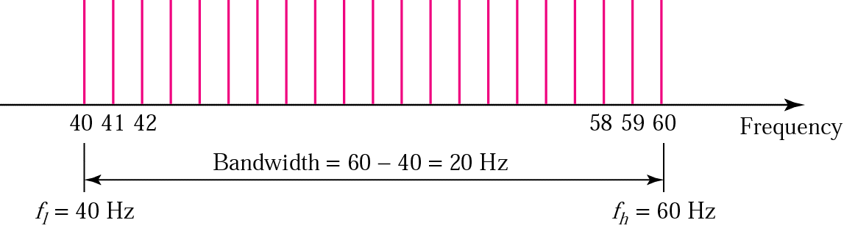
Solution
B = f_{h} - f_{l}
20 = 60 - f_{l}
f_{l} = 60 - 20 = 40 Hz
Carol Davids@2015

Slide 60
Bandwidth of medium vs. frequency spectrum of signal
If the highest frequency in the signal is 2 kHz and the lowest frequency in the signal is 1 kHz. This means that the bandwidth of the signal is 1 kHz (2-1).
Can you send that signal on the medium described on the next page?
Carol Davids@2015

Slide 61
Bandwidth of medium vs. frequency spectrum of signal
The highest frequency the medium can pass is 4 kHz and the lowest frequency the medium can pass is 3 kHz.
Thus, the bandwidth of the medium is 1 kHz (4-3).
But the medium can’t carry the signal because the two frequencies in the signal are 1 kHz and 2 kHz. They are both below the frequencies that the medium can pass.
Carol Davids@2015

Slide 62
Digital vs. Analog Bandwidth
Analog bandwidth is the range of frequencies that a medium can pass.
Digital bandwidth is the maximum bit rate that a medium can pass.
These two different measures of bandwidth use different units to represent the same property of the medium.
That property – intuitively – is ‘how fast the energy state of the medium can change.’
Carol Davids@2015

Slide 63
Baseband Transmission = Low Pass
When we use baseband transmission we send a digital signal over a channel without changing the digital signal into an analog signal
Baseband transmission requires we use a low band filter - a filter that allows frequencies as low as 0 Hz to pass.
Carol Davids@2015

Slide 64

Baseband Transmission requires a Low-Pass Channel
A low pass channel enables us to use baseband transmission methods.
These allow us to send a ‘frequency’ of 0 Hz
Carol Davids@2015

Slide 65
Baseband Transmission requires a Low-Pass Channel
Notice the low pass channel can have a wide bandwidth or a narrow bandwidth
The important thing is that it passes the 0 Hz frequency.
Carol Davids@2015

Slide 66
Low-pass vs. band-pass
Low pass has a low frequency of 0 and a high frequency of f.
Band-pass has a low frequency of f₁ and a high frequency of f₂, where f₁ is not equal to 0.
As you can see, a low pass link is a special case of a band-pass link.
Carol Davids@2015

Slide 67
Analog signals vs. digital signals
Digital signals need signals ranging in frequency from 0 to infinity.
But we don’t require infinitely high harmonics so we take f_{k}, where f_{k} is high enough to give us a pretty sharp edge on the square pulse.
Digital signals need a low pass link in order to create the flat top on the square pulse.
Carol Davids@2015

Slide 68
Analog signals vs. digital signals
Analog signals can occupy band-pass channels.
The bandwidth of an analog signal can be shifted. Thus if the signal has a low frequency of f₁ and a high frequencey of f₂, it can be shifted to a low of f₁ +50 Hz and a high of f₂ +50 Hz
Band-pass channels are more available than low-pass channels.
Carol Davids@2015

Slide 69
Analog signals vs. digital signals
Band-pass channels are more available than low-pass channels.
The bandwidth of a band-pass medium can be divided into several band-pass channels.
Each channel can then carry a different communication.
Example is analog cellular telephone network
Here 30 kHz channels are used.
Carol Davids@2015

Slide 70
Transmission Impairment
As a signal travels in a medium it gets damaged and altered in various ways.
Three basic types of impairments are:
  Attenuation
  Distortion
  Noise
Carol Davids@2015

Slide 71
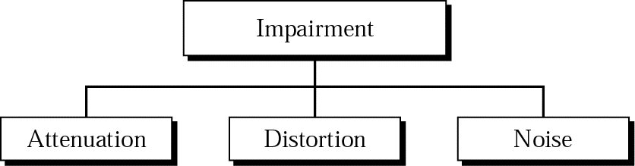
Transmission Impairment
As a signal travels in a medium it gets damaged and altered in various ways.
Carol Davids@2015

Slide 72
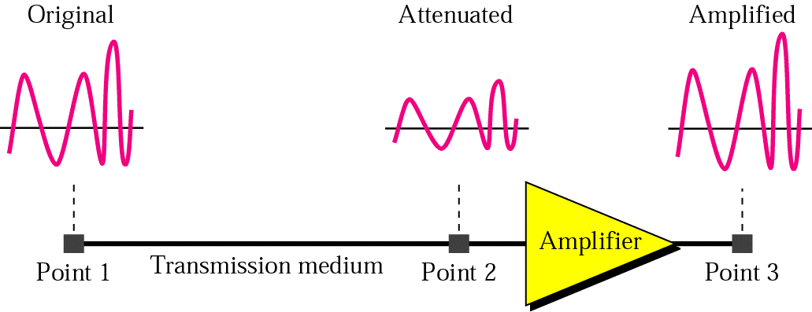
Attenuation
Attenuation refers to the loss of magnitude of the signal.
It refers to the loss of signal energy.
Carol Davids@2015

Slide 73
Attenuation
Attenuation is a relative measure
It’s unit is decibels - dB.
dB = 10log₁₀ (P2/P1) where P2 is the energy in the signal at point 2 and P1 is the energy in the signal at point 1
Carol Davids@2015

Slide 74
Example
Imagine a signal travels through a transmission medium and its power is reduced to half.
This means that P2 = 1/2 P1.
In this case, the attenuation (loss of power) can be calculated as
10 log₁₀ (P2/P1) = 10 log₁₀ (0.5P1/P1) =
10 log₁₀ (0.5) = 10(–0.3) = –3 dB
Carol Davids@2015

Slide 75
Example
Imagine a signal travels through an amplifier and its power is increased ten times.
This means that P2 = 10 P1. In this case, the amplification (gain of power) can be calculated as
10 log₁₀ (P2/P1) = 10 log₁₀ (10P1/P1)
= 10 log₁₀ (10) = 10 (1) = 10 dB
Carol Davids@2015

Slide 76
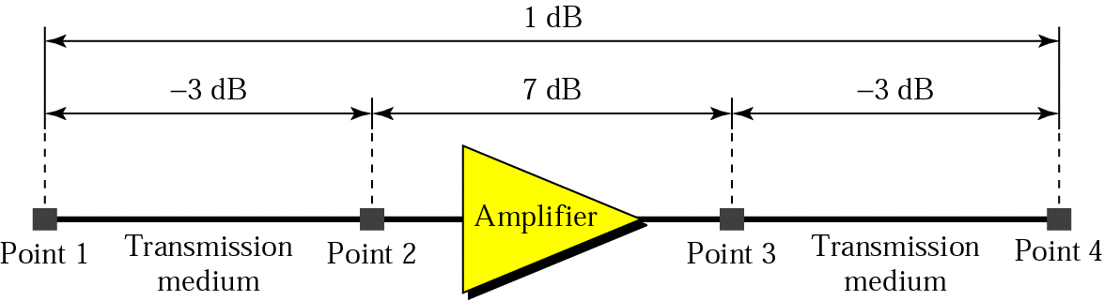
Example
dB is a useful metric since they can be added and subtracted whereas the numbers they represent would have to be multiplied and divided.
dB = –3 + 7 – 3 = +1
Carol Davids@2015

Slide 77
Distortion
Distortion refers to the fact that different frequencies within the composite signal’s frequency spectrum propagate through the medium at different speeds.
This means that different components of the waveform arrive at different times.
Adding them up at time t1 means that the signal that is recreated has a different shape than the one that was sent.
Carol Davids@2015

Slide 78

Distortion
Different components of the waveform arrive at different times, causing distortion at the receiver.
Carol Davids@2015

Slide 79
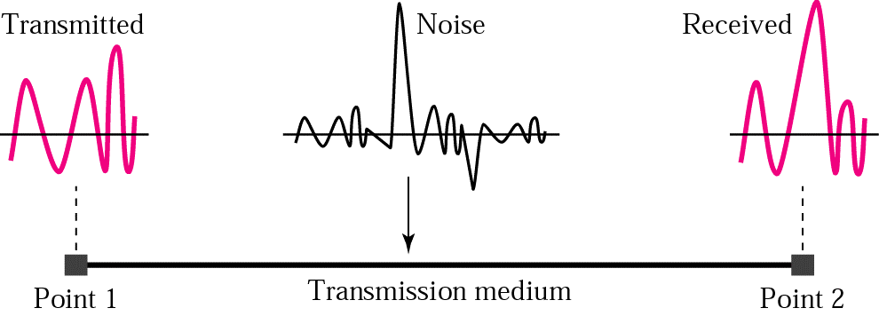
Noise
Noise refers to the presence of electromagnetic energy on the channel that was not put there by the data source.
Carol Davids@2015

Slide 80
Noise
This energy can come from several different sources:
  Thermal noise - random motion of electrons
  Induced noise - motors and appliances
  Cross talk - special case of induced noise
  Impulse noise - special case of induced noise resulting from
Carol Davids@2015

Slide 81
Noise
  Cross talk - special case of induced noise, where one wire acts as a broadcast antenna and the other as a receiver
  Impulse noise - special case of induced noise, where lighting or other electrical arcs occur over a very short period of time and dump a large spike of energy onto the channel
Carol Davids@2015

Slide 82

Noise
Cross talk and impulse noise are added to the information being carried in the cannel.
Carol Davids@2015

Slide 83
Noise Measurements
Two different metrics are used to quantify the amount of noise:
SNR = signal to noise ratio
SNR_{dB} = signal to noise ratio measured in dB
dB = 10log10 (P2/P1), where P2 is power in signal 2 and P1 is power in signal 1
Carol Davids@2015

Slide 84
Noise Measurements
In the case of noise measurements,
SNR_{dB} = 10log10 (Power in signal/Power in noise)
SNR = Power in signal/Power in noise
Carol Davids@2015

Slide 85
Limits on data rates
Information theory teaches us that there is an upper limit on the rate at which information can be sent in a channel
Nyquist (noiseless) channel upper limit - says the upper limit is dependent on the number of levels we choose to encode our data
Shannon (noisy) channel upper limit - says the upper limit is independent of the number of levels and is proportional to the log₂ of (1+SNR)
Carol Davids@2015

Slide 86
Nyquist (noiseless) Bit Rate
Nyquist (noiseless) channel upper limit - says the upper limit is dependent on the number of levels we choose to encode our data
The maximum theoretical bit rate the channel can support is two times the product of the analog bandwidth of the channel and the logarithm to the base 2 of the number of different levels you use to encode your data
Bit Rate_{maximum} = 2 x bandwidth x log₂L
Carol Davids@2015

Slide 87
Nyquist (noiseless) Bit Rate
Bit Rate_{maximum} = 2 x bandwidth x log₂L
See examples 3.34, 3.35 and 3.36 on pages 86 and 87
Carol Davids@2015

Slide 88
Shannon (noisy – sh!) Bit Rate
Shannon (noisy) channel upper limit
The upper limit on the bit rate that the link or channel can carry is independent of the number of levels
The upper limit is proportional to the log₂ of (1+SNR), where SNR is the ratio of the power in the signal to the power in the noise. (Signal to Noise Ratio)
Carol Davids@2015

Slide 89
Shannon (noisy – sh!) Bit Rate
Bit Rate_{maximum} = bandwidth x log₂(1 + SNR)
Here bandwidth is the analog bandwidth of the channel measured in Hz – and is a number you can look up.
SNR is a unit-less number – the ratio of two energy values – and is a number you can look up.
See examples 3.38, 3.39 and 3.40
Carol Davids@2015

Slide 90
Performance Metrics
Bandwidth – bits / second
Throughput – bits/second
Latency or delay
  Propagation time
  Transmission time
  Queuing time
  Processing time
Bandwidth-Delay product
Carol Davids@2015

Slide 91
Throughput
The throughput of a system is the measure of how fast data can pass through a system.
The system may consist of hubs, switches, routers, and the links that connect them.
The system may simply be a switch, hub or router.
The throughput is measured in bits/second
Carol Davids@2015

Slide 92
Throughput
Thus, the units of measure are the same as the digital bandwidth or of the bit rate.
Bits/sec
Carol Davids@2015

Slide 93
Latency
Latency measures the total time it takes a message to be sent from source to destination – starting with its first bit and ending with its last bit.
Four factors contribute to latency:
  Propagation time (single bit)
  Transmission time (message)
  Queuing time
  Processing time
Carol Davids@2015

Slide 94
Propagation speed
Propagation speed is the speed of electromagnetic energy in the medium
Distance (dist) / Propagation speed (dist/sec)
Carol Davids@2015

Slide 95
Propagation time
Propagation time is the time it takes a bit to travel from source to destination.
Propagation Time == Propagation Distance (dist) / Propagation speed (dist/sec)
Carol Davids@2015

Slide 96
Transmission time
Transmission time is the time it takes a message to travel from source to destination.
Message size (bits) / Bandwidth (bits/sec)
Carol Davids@2015

Slide 97
Queuing time and Processing time
Queuing time is the amount of time that a device such as a switch or router allows the message to sit in a queue before processing it.
Processing time is the amount of time that a device such as a switch or router takes to process the message once it is taken off the queue.
Carol Davids@2015

Slide 98
Bandwidth-Delay product
The bandwidth-delay product is a measure of the total number of bits the transmission link can hold.
Bandwidth (bits/sec) x Delay (sec)
Carol Davids@2015

Slide 99

Bandwidth-Delay Product
The bandwidth-delay product gives a measure of the number of bits that can occupy the link or channel at a given time.
Carol Davids@2015

Slide 100
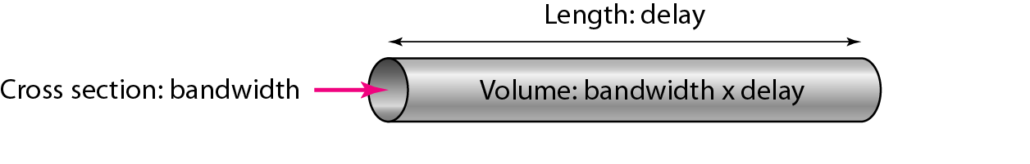
Bandwidth-Delay Product
Figure 3.33 in Example 3.48 illustrates how the bandwidth-delay product corresponds to the volume of bits that can occupy the link at any time.
Carol Davids@2015

Slide 101
Time Domain vs. Frequency Domain
The representations we have looked at so far are Time Domain representations of a sine wave
Time Domain representation shows how the amplitude of the wave changes with time
Using a time domain representation we can derive both the frequency and the phase of the wave
Carol Davids@2015

Slide 102
The End
Carol Davids@2015

