Slide 1


ITM 540
Data Networks
The Physical Layer - Digital Transmission
Carol Davids
Carol Davids © 2015

Slide 2
Reading Assignment
Forouzan: Chapter 4 - Digital Transmission:
  Section 4.1 – Digital to digital conversion
  Section 4.3 – Transmission modes
Carol Davids © 2015

Slide 3
Line Code
A line code provides a translation from groups of logical bits to groups of physical signals.
Distinguish between logical ‘bits’ and physical signals
Carol Davids © 2015

Slide 4
Bit rate vs. Signal rate
The rate at which bits appear to be sent is called the bit rate
The rate at which signals are created is called the signal rate
The signal rate is also sometimes called the baud rate.
Carol Davids © 2015

Slide 5
Data Elements vs. Signal Elements
Think of using a code book to translate strings of bits into strings of physical signals
You use the code book to translate data elements (bits) into signal elements (bauds).
Data element | Signal element
bbbb | L1
bbbb | L2
Line code book
Carol Davids © 2015

Slide 6
Data Elements vs. Signal Elements
We will speak of the number of bits per signal element or bits per baud.
The text book uses the letter ‘r’ to represent this ratio of bits/signal element.
Data element | Signal element
bbbb | L1
bbbb | L2
Line code book
Carol Davids © 2015

Slide 7
Data Elements vs. Signal Elements
Signal rate: S = signals/second
Data rate: N = bits/second
Relationship between S and N
N is proportional to S
That is, if you want to send more bits per second, you have to send more signals per second
Carol Davids © 2015

Slide 8
Data Elements vs. Signal Elements
S and N are related by the ratio r
r = bits/signal
S = N / r or r x S = N
Check the units
signals/sec = (bits/sec) / (bits/signal)
= (bits/sec) (signals/bit)
= (signals/sec)
Carol Davids © 2015

Slide 9
Example 1: One bit -> One of two distinct signal levels
The code book shown below translates the bit ‘0’ to a pulse of height 0 volts.
It translates the bit ‘1’ to a pulse with a positive polarity.
Unipolar Line Code
Bit | Signal Polarity
0 | 0
1 | +
Carol Davids © 2015

Slide 10
Example 1: One bit -> One of two distinct signal levels
Polarity refers to whether the signal has a positive voltage or a negative voltage.
The value of polarity can be ‘plus’ (+) or ‘minus (-)
Unipolar Line Code
Bit | Signal Polarity
0 | 0
1 | +
Carol Davids © 2015

Slide 11
Example 1: One bit -> One of two distinct signal levels
In this example, r = 1, or there is 1 bit per baud
Unipolar Line Code
Bit | Signal Polarity
0 | 0
1 | +
Carol Davids © 2015

Slide 12
Example 2: One bit -> One of two distinct signal levels
The code book shown below translates the bit ‘0’ to a pulse with a positive polarity and height A.
It translates the bit ‘1’ to a pulse with negative polarity and height A. Here the level is either +A or –A.
Polar : NRZ-L
Bit | Signal Polarity
0 | +A
1 | -A
Carol Davids © 2015

Slide 13
Example 2: One bit -> One of two distinct signal levels
In this example, r = 1, and there is 1 bit per baud
Polar : NRZ-L
Bit | Signal Polarity
0 | +
1 | -
Carol Davids © 2015

Slide 14
Example 3: Two bits -> One of four distinct signal levels
4QAM code book
The code book shown at right translates the bits ‘00’ to a signal element whose phase is 0.
It translates the bits ‘01’ to a signal element whose phase is 90.
And so forth.
Bit Pattern | Signal level
00 | Phase = 0°
01 | Phase = 90°
10 | Phase = 180°
11 | Phase = 270°
Carol Davids © 2015

Slide 15
Example 3: Two bits -> One of four distinct signal levels
4QAM code book
In this example, r=2 and there are 2 bits per signal level.
Bit Pattern | Signal level
00 | Phase = 0°
01 | Phase = 90°
10 | Phase = 180°
11 | Phase = 270°
Carol Davids © 2015

Slide 16
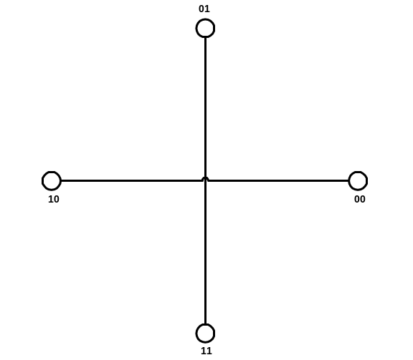
4QAM Illustration
Use 4 signal levels to represent the 4 different ways you can combine 2 bits.
4 QAM : 4 valued Quadrature
Amplitude Modulation: Both phase and amplitude of signal can be changed: In this example, the amplitude of the wave is constant; phase of the wave can have one of 4 different values; illustrated here, those values are 0°, 90°, 180°, and 270°.
Carol Davids © 2015

Slide 17
Example 4: Three bits -> One of 8 distinct signal levels
Bit Pattern | Signal level
000 | Amplitude 1, Phase = 0°
001 | Amplitude 1, Phase = 90°
010 | Amplitude 1, Phase = 180°
011 | Amplitude 1, Phase = 270°
100 | Amplitude 2, Phase = 0°
101 | Amplitude 2, Phase = 90°
110 | Amplitude 2, Phase = 180°
111 | Amplitude 2, Phase = 270°
8QAM code book
The code book at right translates the bits ‘000’ to a signal level with amplitude 1 and phase 0.
It translates the bits ‘101’ to a signal level with amplitude 2 and phase 90.
And so forth..
Carol Davids © 2015

Slide 18
Example 4: Three bits -> One of 8 distinct signal levels
Bit Pattern | Signal level
000 | Amplitude 1, Phase = 0°
001 | Amplitude 1, Phase = 90°
010 | Amplitude 1, Phase = 180°
011 | Amplitude 1, Phase = 270°
100 | Amplitude 2, Phase = 0°
101 | Amplitude 2, Phase = 90°
110 | Amplitude 2, Phase = 180°
111 | Amplitude 2, Phase = 270°
8QAM code book
In this example, r = 3 and there are 3 bits per baud
Carol Davids © 2015

Slide 19
Example 5: Two bits -> 1 of 4 distinct signal levels
Bit Pattern | Last Signal Polarity |  | Signal Value
00 | + |  | +1
00 | - |  | -1
01 | + |  | +3
01 | - |  | -3
10 | + |  | -1
10 | - |  | +1
11 | + |  | -3
11 | - |  | +3
The code book at right translates the bits ‘00’ to a signal with amplitude +1 IF the last signal polarity you put onto the medium was positive.
It translates the bits ‘00’ to a signal with amplitude -1 IF the last signal polarity you put onto the medium was negative.
2B1Q Code Book
Carol Davids © 2015

Slide 20
Example 5: Two bits -> 1 of 4 distinct signal levels
Bit Pattern | Last Signal Polarity |  | Signal Value
00 | + |  | +1
00 | - |  | -1
01 | + |  | +3
01 | - |  | -3
10 | + |  | -1
10 | - |  | +1
11 | + |  | -3
11 | - |  | +3
This line code is called 2 binary 1 quaternary
This refers to the fact that we are using 4 signal values {+1, -1, +3, -3} and each of these signal levels represents a unique pattern of 2 bits
2B1Q Code Book
Carol Davids © 2015

Slide 21
Example 5: Two bits -> 1 of 4 distinct signal levels
Bit Pattern | Last Signal Polarity |  | Signal Value
00 | + |  | +1
00 | - |  | -1
01 | + |  | +3
01 | - |  | -3
10 | + |  | -1
10 | - |  | +1
11 | + |  | -3
11 | - |  | +3
In this example, r = 2 and there are 2 bits per baud
2B1Q Code Book
Carol Davids © 2015

Slide 22
Pulse rate vs. Bit rate
A pulse or a symbol is the actual physical state that we send and detect over the medium.
It might be the voltage state on the wire or it might be the amplitude and phase of a radio frequency wave.
The pulse rate or symbol rate represents the number of pulses or symbols per second.
Carol Davids © 2015

Slide 23
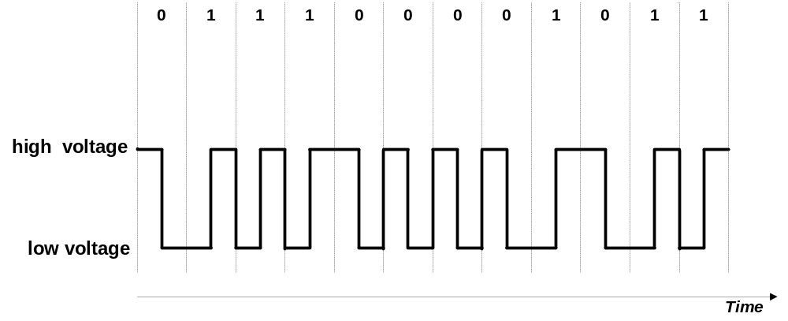
Pulse rate vs. Bit rate
If we use 2 pulses or symbols to represent one bit, then the pulse rate or symbol rate will be twice as great as the bit rate. r=1/2
Carol Davids © 2015

Slide 24
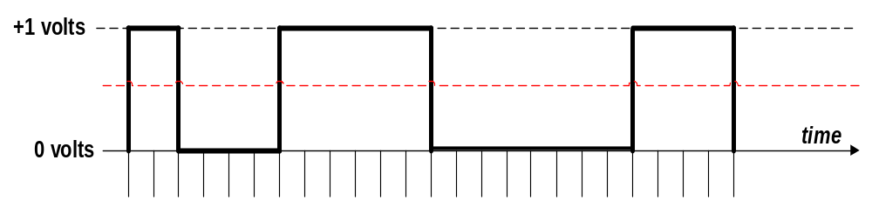
Illustration 1: Pulse rate vs. Bit rate
Here we use 1 pulse (symbol) to represent one bit.
The illustration shows 24 time intervals.
If there is one symbol every .02 milliseconds then the symbol rate is 50 Kbaud per second and also 50 Kbits per second.
Carol Davids © 2015

Slide 25
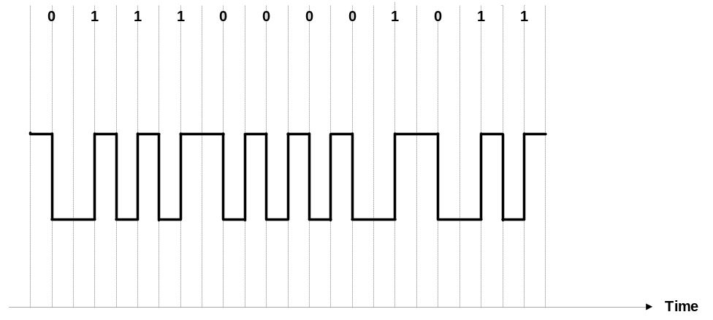
Illustration 2: Pulse rate vs. Bit rate
Here we use 2 pulses or symbols to represent one bit.
The illustration shows 24 time intervals.
Carol Davids © 2015

Slide 26

Illustration 2: Pulse rate vs. Bit rate
There is still one symbol every .02 milliseconds so the symbol rate is still 50 Kbaud per second
But the logical data rate or bit rate is one bit every .04 milliseconds, so the data rate is 25 Kbits per second.
Carol Davids © 2015

Slide 27
Characteristics of the signals we create
Analog Bandwidth
Baseline Wandering
DC Components
Self-synchronization
Built-in Error detection
Immunity to noise and interference
Complexity
Carol Davids © 2015

Slide 28
Analog bandwidth of the signal
The analog bandwidth of the signal we create will limit the types of link that can carry it.
If the signal we create contains a very high frequency component, then some links will not be able to carry it.
For example, if we are sending 2 bits per signal, and the link can only vibrate at 100 signals per second, then the upper limit on the bit rate will be proportional to 200 bits per second.
Carol Davids © 2015

Slide 29
Analog Bandwidth and Baseband Transmission
When we speak about base band transmission, B is the highest frequency in the signal that we are putting onto the link
Carol Davids © 2015

Slide 30
Bit rate, Baud rate and Data Rate
N represents the bit rate (data rate) at which our data is carried over the transmission medium
Bits/second
Carol Davids © 2015

Slide 31
Bit rate, Baud rate and Data Rate
S represents the rate at which signals are sent over the transmission medium
Baud rate = signals/second
Carol Davids © 2015

Slide 32
Bit rate, Baud rate and Data Rate
r represents the number of bits that each signal element carries
r = bits/signal
Carol Davids © 2015

Slide 33
Baseline wandering
The receiver of the signal keeps a running average of the power in the received signal
The average is called the baseline
It compares baseline power to the power in the currently incoming signal
This comparison is used to determine the value of the signal
Carol Davids © 2015

Slide 34
Baseline wandering
If the baseline is skewed by say a long string of 0 volt signals or a long string of 1 volt signals, for example, then the baseline could have too low a value or too high a value.
Then the comparison with the energy in the incoming pulse could lead to the detector reaching the wrong conclusion as to the signal that was sent.
Carol Davids © 2015

Slide 35
DC Components
A particular pattern in the data bits can also cause the signal that we put onto the medium to have a constant non-zero voltage for a long period of time.
The flat line signal thus created has a high amplitude spike at the 0 Hz location in the frequency domain.
Carol Davids © 2015

Slide 36
DC Components
That is, the signal has a large component of direct current. This can cause two types of problem.
First, some network elements, such as capacitors and some telecommunications links, cannot pass direct currents at all.
This means that the received signal cannot be decoded to represent the bits you intended to send.
Carol Davids © 2015

Slide 37
DC Components
Second, the DC component on the line will have polarity – it will be either positive or negative.
This positive or negative ‘bias’ can interfere with signals in neighboring lines and can also cause the received signal to be mis-interpreted.
Carol Davids © 2015

Slide 38
Self-Synchronization
Self-Synchronization refers to the ability of the receiver to learn when the clock ‘ticked’ at the sending side.
The goal is to have the receiver’s clock ticking in phase with the sender’s.
If the receiver can figure out when the sender’s clock ‘ticked’ from the signal itself, this is a valuable attribute.
Carol Davids © 2015

Slide 39
Synchronization
The receiver’s symbol intervals need to correspond to the sender’s symbol intervals.
If the sender’s and receiver’s clocks are running at different rates, the receiver may interpret the same physical square wave to represent a different pattern of 0’s and 1’s than the sender intended.
Carol Davids © 2015

Slide 40
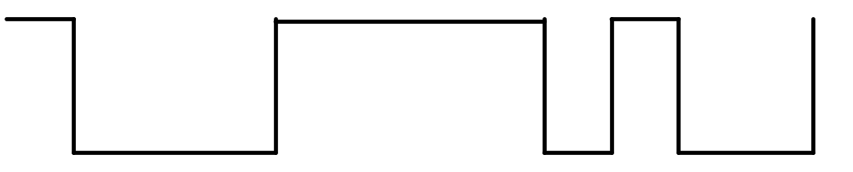
Synchronization
The image below represents the signal values that are put onto the transmission medium.
Carol Davids © 2015

Slide 41
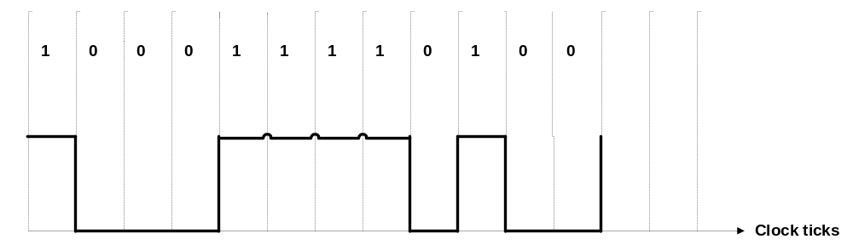
Synchronization
On the first clock tick, a logic 1 - represented by a high signal value - was sent.
On each of the next three clock ticks, a logic 0 - represented by a low signal value - was sent.
Carol Davids © 2015

Slide 42
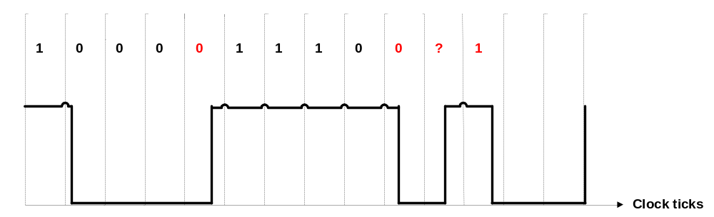
Synchronization
The same voltage pattern that was sent is received.
But if the clock in the receiving device is running at a different rate than the clock on the sending device it may interpret the voltage pattern differently.
1
Carol Davids © 2015

Slide 43

Synchronization
Illustration 4.3 from text book: The clock at the receiver is ticking faster than the one at the sender. The receiver senses the incoming signal twice during the + voltage pulse, whereas the sender only intended for it to be sensed once.
Carol Davids © 2015

Slide 44
Self Synchronization
A self-synchronizing digital signal includes timing information in the data being transmitted.
‘Knife edges’ – vertical lines in the received signal - can be used to alert the receiver to the beginning middle or end of the pulse.
The goal is to put as many of these verticals or transitions into the signal
The receiving device can synchronize its clock using the rising or the falling edge of a pulse.
Carol Davids © 2015

Slide 45
Line Coding Schemes
Line codes can be divided into the following categories:
  Unipolar
  Polar
  Bipolar
  Multilevel
  Multitransition
Carol Davids © 2015

Slide 46

Line Coding Schemes
Figure 4.4 shows the different categories of line codings.
Carol Davids © 2015

Slide 47
Polarity
Three types of polarity that can be used for line codes:
  Unipolar
  Polar
  Bipolar
Carol Davids © 2015

Slide 48
Polarity – preview…
Unipolar – refers to the fact that there is only one polarity in use
Polar – refers to the fact that there are two polarities in use
Bipolar – refers to the fact that there are two polarities in use AND the bit ‘1’ or ‘0’ can be assigned either of the polarities depending on other factors!
Carol Davids © 2015

Slide 49
Unipolar Line Code
One bit is represented by a non-zero voltage.
The other bit is represented by zero voltage.
There is thus only one polarity
For example, ‘1’ might be represented by zero volts, and ‘0’ might be represented by +1.5 volts.
Carol Davids © 2015

Slide 50
Non Return to Zero (NRZ)
Non Return to Zero refers to the fact that during the period of time when we are signaling a single bit, the signal we are using does not go to the zero value.
Carol Davids © 2015

Slide 51
Line Code Books
The following slides contain the various code books that correspond to the line codes that we are learning.
Carol Davids © 2015

Slide 52
Unipolar - code book
Bit 0 is represented by a pulse with polarity 0
Bit 1 is represented by a pulse with polarity +
Bit
Signal Polarity
0
0
1
+
Carol Davids © 2015

Slide 53
Polar: NRZ-L code book
Bit 0 is represented by a pulse whose polarity is +
Bit 1 is represented by a pulse whose polarity is -
Bit
Signal Polarity
0
+
1
-
Carol Davids © 2015

Slide 54
Polar: NRZ-I code book
Bit 0 is represented by no transition of polarity at the left edge of the pulse
Bit 1 is represented by a transition of polarity at the left edge of the pulse
Bit
Signal Transition at left edge
0
N
1
Y
Carol Davids © 2015

Slide 55
Polar: RZ - code book
Bit 0: signal polarity is negative at the left edge and goes to zero in the middle
Bit 1: signal polarity is positive at the left edge and goes to zero in the middle
Bit
Signal polarity at left edge
0
N
1
P
Carol Davids © 2015

Slide 56
Polar: RZ - code book
Bit 0: signal polarity is negative at the left edge and goes to zero in the middle
Bit 1: signal polarity is positive at the left edge and goes to zero in the middle
Bit
Signal polarity at left edge
0
N
1
P
Carol Davids © 2015

Slide 57
Manchester code book
Bit 0: The direction of the polarity transition in the middle of the bit interval is down
Bit 1: The direction of the polarity transition in the middle of the bit interval is up.
Bit
Center transition direction
0
D
1
U
Carol Davids © 2015

Slide 58
Differential Manchester code book
Bit 0: The signal’s polarity transitions at the left edge of the pulse
Bit 1: The signal’s polarity does not transition at the left edge of the pulse.
Bit
Signal Transitions at left edge
0
Y
1
N
Carol Davids © 2015

Slide 59
Bipolar AMI and Pseudoternary code book
Bit 0: polarity zero
Bit 1: polarity depends on polarity of previous bit 1
Bit
Last Signal Polarity
Signal Polarity
0
xxxxxxxxxxxxxxxxxxx
0
1
+
-
1
-
+
Carol Davids © 2015

Slide 60
DC component of unipolar signals
Since the average of the non-zero and zero values will be a non-zero value there is a DC component associated with a unipolar line code.
This buildup of a DC bias causes errors on the line and unipolar codes are not used any more for this reason.
Carol Davids © 2015

Slide 61
Illustration 1: DC Component of unipolar signal
There are 24 bit intervals shown.
In 12 of them the signal value is 1 volt.
In 12 of them the signal value is 0 volt.
The average of the signal values is .5 volts.
This is the DC component or bias on the line.
Carol Davids © 2015

Slide 62
Synchronization of unipolar signals
Unipolar line codes do not support self- synchronization.
Long strings of zero’s prevent a receiver from using a rising or falling edge to synchronize their clocks.
Carol Davids © 2015

Slide 63
Polar Line Code
Polar codes use two non-zero voltages, one positive and the other negative.
One of these non-zero voltages represents logic ‘1’.
The other of these non-zero voltages represents logic ‘0’.
Polar line codes use non-zero voltages of equal magnitude and opposite polarity to represent logical 0 and logical 1.
Carol Davids © 2015

Slide 64
DC Component of polar line codes
The average of the signal values in polar line codes is closer to zero, which means that there is hardly any DC bias associated with a polar line code.
Carol Davids © 2015

Slide 65
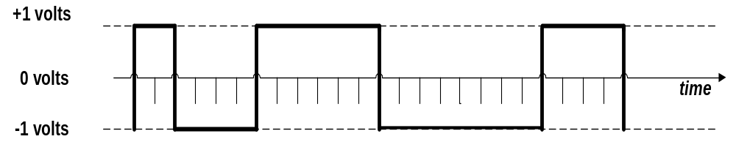
Illustration 2 : DC Component of polar code
There are 24 bit intervals shown.
In 12 of them the signal value is +1 volt.
In 12 of them the signal value is -1 volt.
The average of the signal values is 0 volts.
This is the DC component or bias on the line.
Carol Davids © 2015

Slide 66
Four different Polar Line Codes
There are 4 important polar line codes:
  NRZ - Non-Return to Zero
  RZ - Return to Zero
  Manchester
  Differential Manchester
Carol Davids © 2015

Slide 67

NRZ: Non Return to Zero
The value of the signal is either positive or negative.
The value of the signal is never zero.
Carol Davids © 2015

Slide 68
NRZ-L: Non Return to Zero-Level
NRZ-L: NRZ-Level:
  Positive voltage represents a ‘0’ bit
  Negative voltage represents a ‘1’ bit.
L refers to the fact that the polarity or level of the signal is dictated by the value of the bit it is being used to represent
Carol Davids © 2015

Slide 69

NRZ-L Code Book
Polar : NRZ-L (the signal’s polarity is dictated by the bit value)
Carol Davids © 2015

Slide 70
NRZ-I: Non Return to Zero - Invert
NRZ-I: NRZ-Invert:
  Transition in signal polarity at beginning of bit interval represents ‘1’ bit
  No voltage transition in signal polarity at beginning of bit interval represents ‘0’ bit.
Invert refers to the fact that the inversion or change of the polarity or level of the signal is used to represent a 1 bit.
Carol Davids © 2015

Slide 71
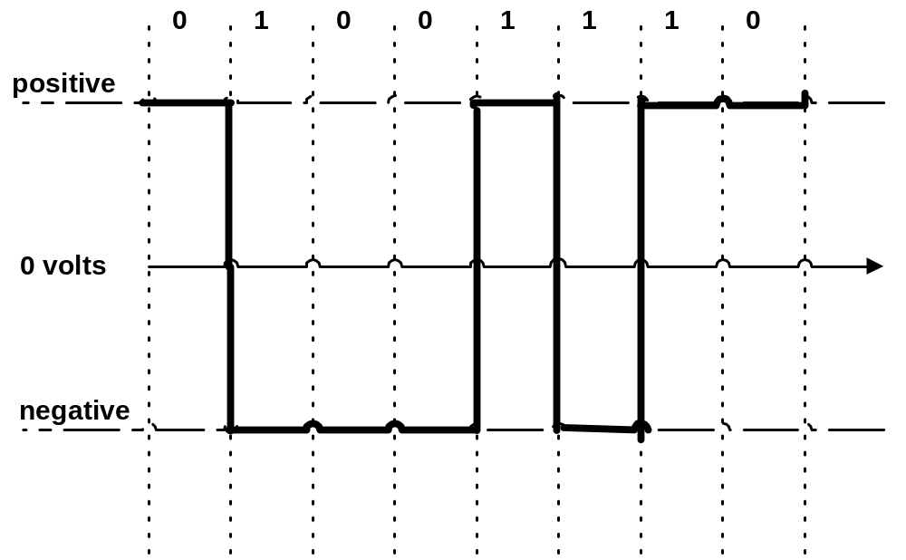
NRZ-I and synchronization
Carol Davids © 2015

Slide 72
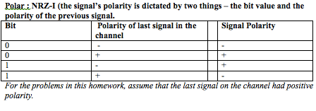
NRZ-I Code Book
Two pieces of information are needed to determine what signal to put on the line.
Carol Davids © 2015

Slide 73
NRZ-L and synchronization
NRZ-L does not provide self-synchronization.
The receiver could receive a long stream of 0’s or a long stream of 1’s and loose track of which bit it is decoding.
Carol Davids © 2015

Slide 74
NRZ-I and synchronization
NRZ-I does provide some self-synchronization.
Every time a 1 is encountered in the data stream, the polarity of the signal changes.
The change provides an ‘edge’ on which the receiver can synchronize.
A long string of zeros can still create a problem with synchronization.
Carol Davids © 2015

Slide 75
NRZ-L vs. NRZ-I
Carol Davids © 2015

Slide 76

Polar RZ (Return to Zero) Signals
The signal returns to the zero level at some time in the middle of every bit interval.
Carol Davids © 2015

Slide 77
A Return to Zero Scheme
Signal level changes during each bit interval.
There is a zero voltage in every bit interval
  ‘1’ is represented by the transition from positive voltage to zero voltage in the middle of the bit interval.
  ‘0’ is represented by the transition from negative voltage to zero voltage in the middle of the bit interval.
Carol Davids © 2015

Slide 78
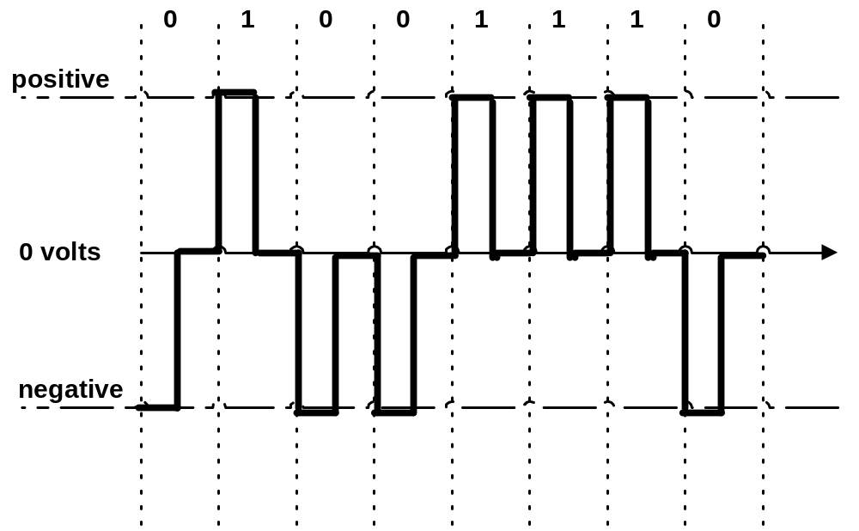
Return to Zero
1
0
Carol Davids © 2015

Slide 79
Return to Zero
RZ encoding requires two signal changes to encode one bit
But each signal change allows the receiver to synchronize
Carol Davids © 2015

Slide 80
Return to Zero – the balance sheet
Signal has high bandwidth
Sudden change in line’s polarity destroys your data – causes ‘1’ to be interpreted as ‘0’ and ‘0’ to be interpreted as ‘1’
There is no DC component
Carol Davids © 2015

Slide 81

Return to Zero – Code Book
Return to Zero (RZ) (signal is always 0 at the end of the bit interval)
Carol Davids © 2015

Slide 82
Manchester Encoding
  The line code used by Ethernet networks is called Manchester Encoding.
  The line state cannot be 0 volts.
  The line state can be a positive voltage or a negative voltage
Carol Davids © 2015

Slide 83
Manchester Encoding
In Manchester coding there is a transition between two voltage levels at the middle of each bit interval.
Negative-to-Positive transition represents ‘1’.
Positive-to-Negative transition represents ‘0’.
These transitions also provide an edge upon which the receiving clock can synchronize every time bit is sent.
Carol Davids © 2015

Slide 84
Bit rate vs. baud rate in Manchester encoding
The term bit interval was used in this definition
Remember a bit is a logical thing
The bit interval is the period it takes to send a bit
In this scenario it took two pulse intervals – that is to say – two symbols - to create a single bit
So it takes two pulse intervals to make one bit interval
So the baud rate is twice the bit rate: Or, the bit rate is half the baud rate. r = ½ (1 bit per 2 signals)
Carol Davids © 2015

Slide 85
Manchester Encoding
‘0’
‘1’
Carol Davids © 2015

Slide 86
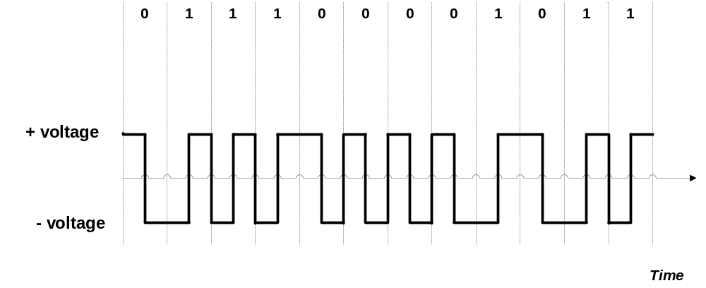
Manchester Encoding
Suppose 0.1
microseconds per bit
Low-to-High transition represents 1.
High-to-Low transition represents 0.
Carol Davids © 2015

Slide 87
Manchester Encoding Baud Rate vs. Bit Rate
Notice that the Baud rate (signal rate,pulse rate) is twice as fast as the data rate (bit rate).
Because it takes two pulses to represent one bit.
Carol Davids © 2015

Slide 88
Manchester – Code Book
Bit Pattern Signal Pattern
0 H to L at center
1 L ro H at center
Carol Davids © 2015

Slide 89
Differential Manchester
Differential Manchester resembles NRZ-I in that it is the inversion of the pulse level at the beginning of a bit interval that is used to encode a bit.
To encode a 1, don’t change the signal’s polarity
To encode a 0, do change the signal’s polarity
Carol Davids © 2015

Slide 90
Differential Manchester
In the case of Differential Manchester
An inversion or change of polarity at the beginning of the bit interval encodes a 0 bit
No inversion or change of polarity at the beginning of the bit interval encodes a 1 bit
Carol Davids © 2015

Slide 91
Differential Manchester
In differential Manchester encoding, a transition between the two signal states - AT THE BEGINNING OF A BIT INTERVAL - represents bit ‘0’
No transition AT THE BEGINNING OF A BIT INTERVAL - represents bit ‘1’
There is also a transition at the middle of the bit interval
The transition at the middle of a bit interval is used for synchronization only.
Carol Davids © 2015

Slide 92
Differential Manchester
VERY IMPORTANT TO REMEMBER! There is ALSO a transition at the middle of the bit interval
The transition at the middle of a bit interval is used for synchronization only.
Carol Davids © 2015

Slide 93
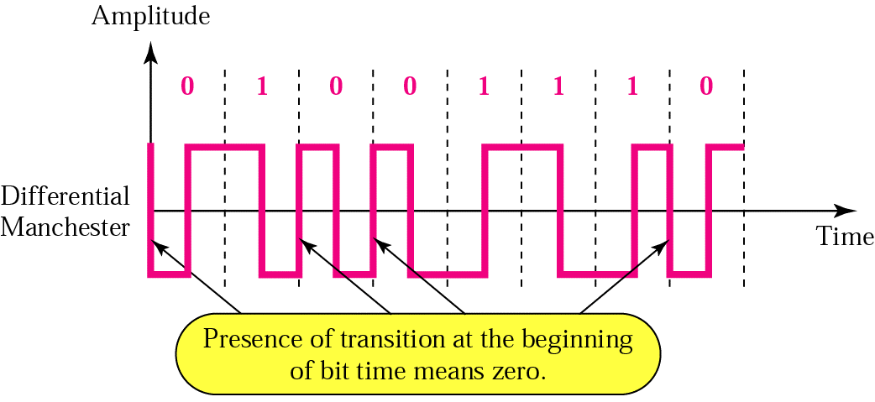
Differential Manchester
Illustration of differential Manchester encoding
Carol Davids © 2015

Slide 94
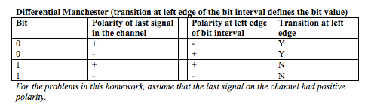
Differential Manchester- Code Book
Two pieces of information are needed to determine what signal to put onto the line.
Carol Davids © 2015

Slide 95
Differential Manchester- Code Book
Two pieces of information are needed to determine what signal to put onto the line.
Bit Pattern line polarity || Signal
0 + || Transition at left to -
0 _ || Transition at left to +
1 | + || No transition at left +
1 _ || No transition at left -
Carol Davids © 2015

Slide 96

Manchester Encoding
Illustration 4.8 shows that the bandwidth of this polar, biphase signal is smaller than the bandwidth of the polar RZ signal.
Carol Davids © 2015

Slide 97

Bipolar Line Codes
Use the 0 signal level to represent a bit (‘1’ or ‘0’).
Use alternating positive and negative polarities to represent the other bit (‘0’ or ‘1’).
Carol Davids © 2015

Slide 98
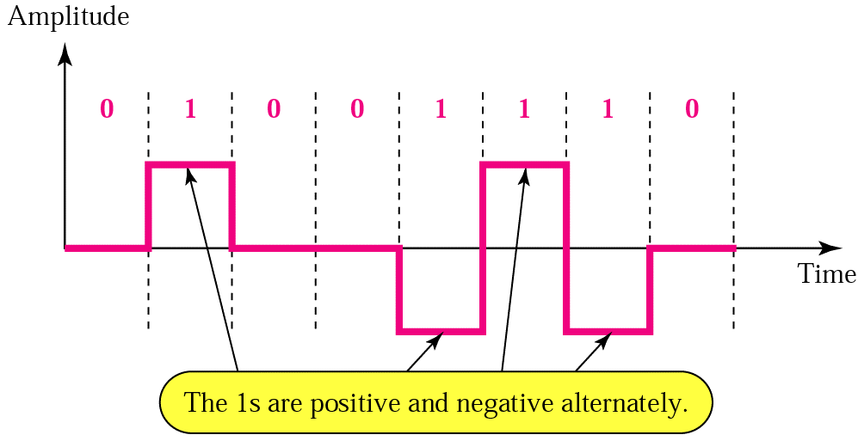
Bipolar Line Codes
‘1’ is encoded alternately as a positive voltage and as a negative voltage, depending upon the value of the signal used to encode the last ‘1’ bit that was sent.
Carol Davids © 2015

Slide 99
Bipolar Line Codes
Note the term ‘bipolar’ refers to the fact that one bit can be encoded with one of two different polarities - either positive or negative - depending on past history.
The term does not refer to the fact that there are two distinct polarities! The fact that there are two distinct polarities is described by the term ‘polar’ as distinct from unipolar! This is confusing.
Carol Davids © 2015

Slide 100
Bipolar Line Codes
Two common bipolar line codes are used in telecommunications applications:
AMI - Alternate Mark Inversion
B8ZS - Binary 8 Zeros Substitution
Carol Davids © 2015

Slide 101
Bipolar Line Codes
The first ‘1’ in the data is encoded as +V, the the second ‘1’ encountered in the data is encoded as -V, the third ‘1’ encountered in the data is encoded as +V, and so on.
Carol Davids © 2015

Slide 102
Bipolar violations
If two successive ‘1’s are encoded with the same polarity, the second event is called a ‘Bipolar Violation.’
Carol Davids © 2015

Slide 103
Bipolar Line Codes
Any line code that encodes ‘1’ bits as alternate positive and negative voltages is classified as AMI.
Carol Davids © 2015

Slide 104
Bipolar - AMI and Pseudoternary
r = 1
Synchronization - bad
DC bias - good
Carol Davids © 2015

Slide 105
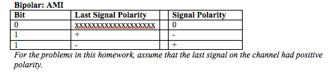
Bipolar - AMI and Pseudoternary
Two pieces of information are needed to determine what signal to put on the line.
Carol Davids © 2015

Slide 106
Scrambling
Scrambling is a method for substituting one bit pattern for a different bit pattern of the same length.
Like Block Encoding it is pre-processing, not really a line code.
After scrambling takes place, it is still necessary to apply a line code to get the new bit pattern onto the link.
Carol Davids © 2015

Slide 107
Scrambling or Substitution
This is a general method used to alter the signal you put onto the line without changing the information content
B8ZS and HDB3 are two examples
They alter the data stream in a pre-defined way in order to prevent signal degeneration
They do this by substituting different data patterns and then line-coding the substituted patterns
Carol Davids © 2015

Slide 108
B8ZS
Binary 8 Zero-bit Substitution uses the scrambling technique.
It is a particular variety of AMI (bipolar) line code that inserts intentional bipolar violations into the signals on the line.
Carol Davids © 2015

Slide 109
B8ZS
Why? Because it is possible to lose synchronization using an AMI code in case there is a long string of ‘0’s in the data.
So B8ZS encoding counts ‘0’s.
If 8 consecutive ‘0’s appear in the data, they are NOT SENT.
Carol Davids © 2015

Slide 110
B8ZS
Instead, a special bit pattern is substituted and encoded into signals on the wire.
When the far end receiver detects that pattern, it knows that the bits that were in the original data are a string of 8 ‘0’s.
So the receiver does not send up the phony bit pattern, it sends up 00000000 instead.
Carol Davids © 2015

Slide 111
B8ZS
The phony bit pattern that gets encoded and put onto the wire is :
0 0 0 V 1 0 V 1
Where V is a bipolar violations
Carol Davids © 2015

Slide 112
B8ZS
This means that if the last ‘1’ sent was encoded with a + signal value, then 00000000 will be encoded:
0 0 0 V 1 0 V 1
0 0 0 + - 0 - +
And, if the last ‘1’ sent was encoded as -, then 00000000 will be encoded:
0 0 0 - + 0 + -
Carol Davids © 2015

Slide 113
Transmission Mode
Transmission of binary data across a link can be done in one of two modes:
  Parallel
  Serial
Carol Davids © 2015

Slide 114
Parallel Transmission
Uses one conductor for each bit and sends all 8 bits out on the same clock tick.
This means all 8 bits arrive at the destination at the same time.
This makes it fast.
This also consumes a lot of conductors - so it is costly.
Carol Davids © 2015

Slide 115
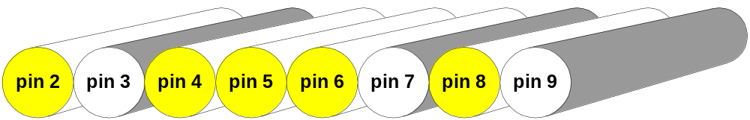
Parallel Transmission
KEY:
Yellow - encodes 1
White - encodes 0
All the voltage levels arrive simultaneously on different conductors.
Carol Davids © 2015

Slide 116
Parallel transmission
  Printers, scanners and other peripherals attached directly to a PC often use parallel communications.
  These are very fast, but cannot be transmitted over great distances.
  The standard parallel port is capable of sending 50 to 100 kilobytes of data per second.
  Parallel ports were originally developed by IBM as a way to connect a printer to your PC.
Carol Davids © 2015

Slide 117
Serial Transmission
  In serial transmission, only one conductor is used.
  One bit is sent on each clock tick.
  This makes serial transmission slower than parallel.
  But serial transmission costs less than parallel since only one conductor is needed.
Carol Davids © 2015

Slide 118
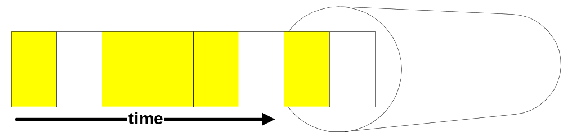
Serial Transmission
The voltage levels arrive over a period of time on the same conductor.
Carol Davids © 2015

Slide 119
Serial Transmission
  There are two types of serial transmission:
  Asynchronous
  Synchronous
Carol Davids © 2015

Slide 120
Asynchronous Serial Transmission
  Information is received and translated using patterns.
  Patterns are based on grouping bits into groups of 8 called bytes.
  The sending system handles bytes as a unit.
  It alerts the receiver that is about to receive a byte by sending a start bit - usually a ‘0’.
Carol Davids © 2015

Slide 121
Asynchronous Serial Transmission
  To inform the receiver that the byte has been sent, the sender will send a stop bit -usually a 1.
  The addition of the start bit and the stop bit, and possibly also a gap or period during which no bits are sent, causes asynchronous data transmission to be relatively slow.
Carol Davids © 2015

Slide 122
Asynchronous Serial Transmission
  When the receiver gets a start bit, it needs to start up its clock.
  The bytes are sent asynchronously.
  Within the byte it is necessary to use a clock to correctly interpret the voltage pattern being received.
Carol Davids © 2015

Slide 123
Asynchronous Serial Transmission
  The connection of a keyboard to a computer is well suited for asynchronous serial transmission.
  The data sent is naturally divided into 8 bit bytes representing letters and numbers.
  The data is sent very slowly since it is human input.
Carol Davids © 2015

Slide 124
Synchronous Serial Transmission
  Synchronous transmission contains multiple bytes combined into longer frames.
  There are no start and stop bits and no gaps that provide information as to where one byte ends and another begins.
  The receiver must distinguish between the bytes and bits without this overhead.
Carol Davids © 2015

Slide 125
Synchronous Serial Transmission
  If there a periods during which the sender has no data to put onto the line, the sender must still send data during these periods.
  The data is a special idle pattern.
  The receiver counts bits and groups them into 8-bit bytes.
  This means that the clock in the receiver needs to be synchronized with the clock in the sender.
Carol Davids © 2015

Slide 126
Synchronous Serial Transmission
  Synchronous data is faster than asynchronous since it does not rely on extra overhead bits and gaps.
  It is used for transmission of data from one computer to another.
  The bytes need to be synchronized.
  Byte synchronization is provided by the data link layer.
Carol Davids © 2015

Slide 127
Connectors
  A few physical connectors are pictured and described briefly on the next pages.
  Layer 1 issues associated with connecting data equipment to a data network include:
    the number of conductors on the cable
    the number of pins on the connector
    the use of each pin in the establishment of a physical connection.
Carol Davids © 2015

Slide 128
Connectors: RJ-45
  RJ-45 (Registered Jack - Type 45) is a physical interface often used for terminating twisted pair type cables.
  "RJ" stands for Registered Jack.
  It has eight “ pins" per connector.
  Standards such as TIA-568B define which wires to connect to which pin.
  Reference: http://en.wikipedia.org/wiki/RJ45
Carol Davids © 2015

Slide 129
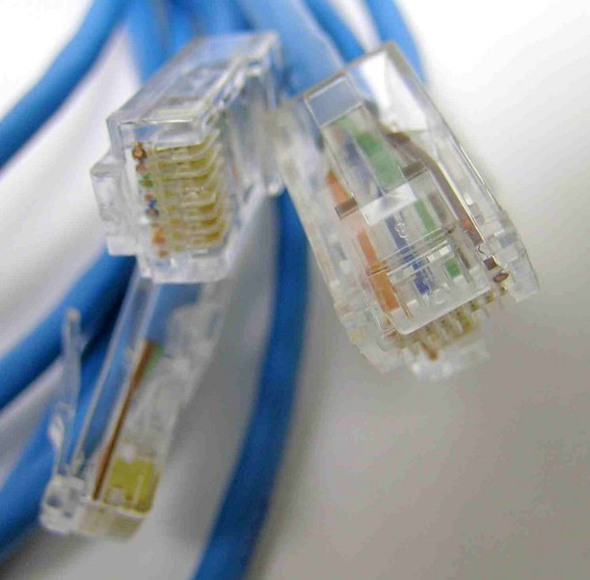
Connectors: RJ-45
Carol Davids © 2015

Slide 130
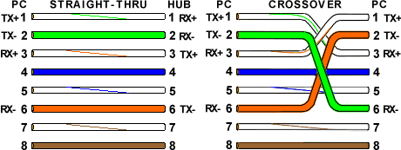
RJ-45: T-568A Straight-Through and Crossover Ethernet Cables – Use of the pins
This diagram tells you how each conductor is used.
Carol Davids © 2015

Slide 131
RJ-45: T-568A Straight-Through and Crossover Ethernet Cables – Use of the pins
This diagram tells you how each conductor is used.
Carol Davids © 2015

Slide 132
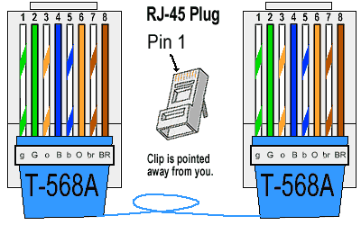
RJ-45: T-568A Straight-Through Ethernet Cable
  Pin-out associated with the T-568A standard.
Carol Davids © 2015

Slide 133
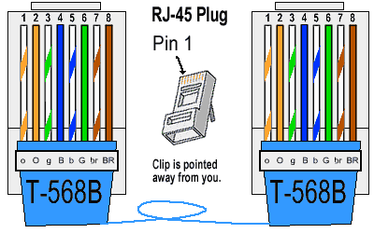
RJ-45: T-568B Straight-Through Ethernet Cable
  Pin-out associated with the T-568B standard.
Carol Davids © 2015

Slide 134
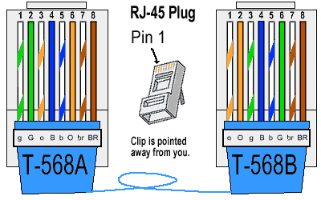
RJ-45: Crossover Cable
  Pin-out for a crossover cable – used to connect two ethernet devices without using a hub or switch.
Carol Davids © 2015

Slide 135
Connectors: V.35
  V.35 is an ITU standard for high-speed synchronous data exchange.
  Use V.35 to connect a Router to a T-1 carrier.
  Use V.35 to connect a Data Service Unit (DSU) to a T-1 carrier.
  http://www.webopedia.com/TERM/V/V_35.html
Carol Davids © 2015

Slide 136
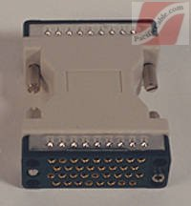
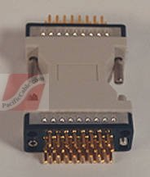
Connectors: V.35
http://www.pacificcable.com/
Carol Davids © 2015

Slide 137
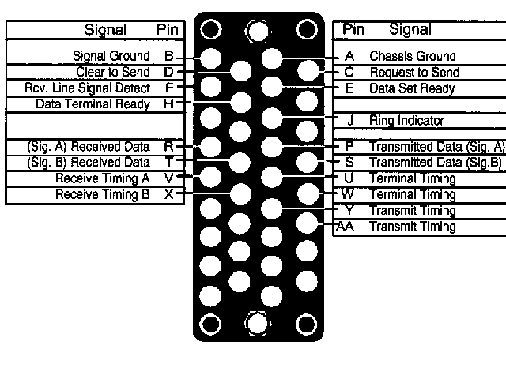
Connectors: V.35
http://www.arcelect.com/v35.htm
Carol Davids © 2015

Slide 138
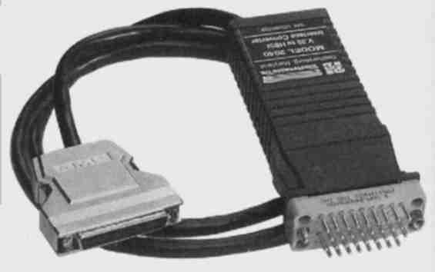
Converting V.35 to other formats
http://www.arcelect.com/V35_to_HSSI_CONVERTER-10MBPS.htm
Carol Davids © 2015

Slide 139
Connectors: RS-232
  Used as an electrical interface between Data Terminal Equipment (DTE) and Data Circuit-Terminating Equipment (DCE) such as modems or DSUs.
  RS-232 is used for both asynchronous data transfer and for synchronous links such as SDLC, HDLC, Frame Relay and X.25.
  http://www.camiresearch.com/Data_Com_Basics/RS232_standard.html
Carol Davids © 2015

Slide 140
Connectors: RS-232
  There is a standardized configuration of the pins for RS-232 on a DB25 connector, shown on the next page.
  On RS-232 the signals are carried as single voltages referred to a common ground on pin 7.
Carol Davids © 2015

Slide 141
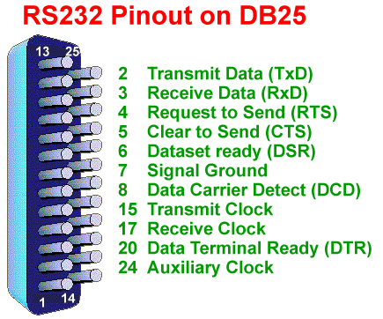
Carol Davids © 2015

Slide 142

http://www.winfordeng.com/products/con25.php
Carol Davids © 2015

Slide 143
Connectors: USB
  The USB standard uses a different logic - instantiated in hardware and software
Carol Davids © 2015

Slide 144
The End
Carol Davids © 2015

