Slide 1


ITM 540
Data Networks
The Data Link Layer
Ethernet II and IEEE 802.3
Professor: Carol Davids
Email: davids@iit.edu

Slide 2
Reading Assignment
Forouzan, Introduction to Part 3 – Introduction, Edition 4; Chapter 9, Edition 5
Forouzan, Error Control Sections related to CRC only; Chapter 10, Editions 4 and 5
Forouzan, CDMA/CD and CDMA/CA; Chapter 12, Edition 4; Chapter 12, Edition 5: Sections 12.1.1, 12.1.2, and 12.1.3.
Readings continue on next slide.

Slide 3
Reading Assignment
Forouzan, Wired LANs: Ethernet Sections only: Setions 13.1, 13.2, 13.3 in Edition 4; Ethernet Sections in Edition 5.
Forouzan, Connecting LANs, Backbone Networks and Virtual LANs: Chapter 15, Edition 4; Chapter 17, Edition 5

Slide 4
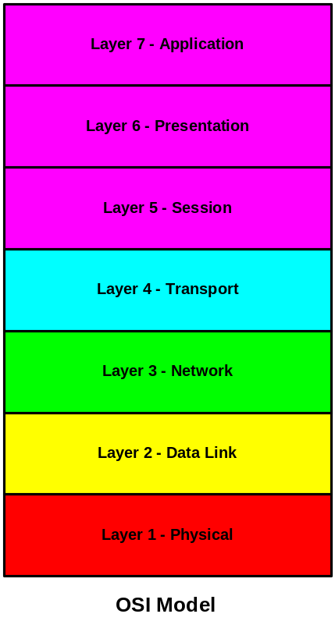
Layer 1 - Physical Layer - defines the physical characteristics of 1’s and 0’s, how to distinguish them from noise, and how to put them into frames to send them across the network.
Layer 2 - Data Link Layer - defines a connection between two different computing devices on the same physical medium.
Layer 3 - Network Layer - defines how to perform routing, congestion control, call set-up and disconnect using the connection created at layer2.

Slide 5
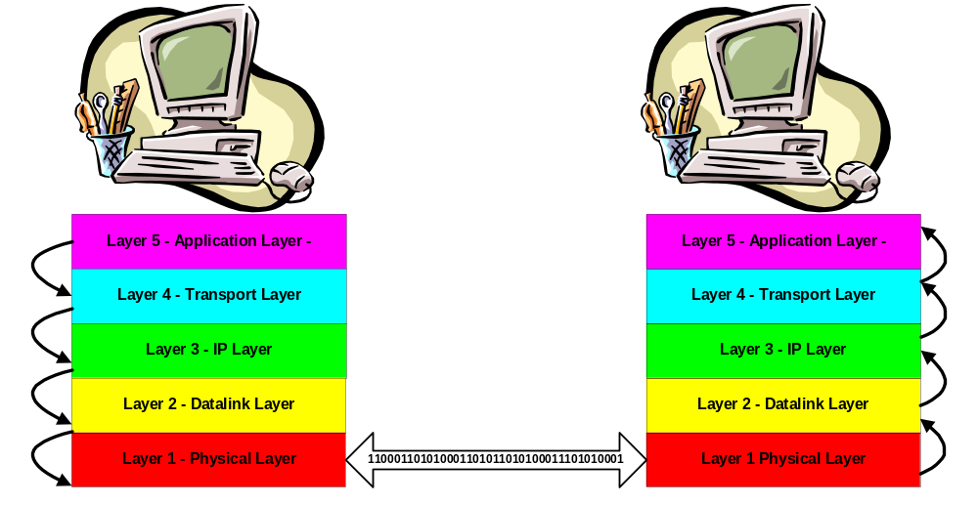
Layered communication
Applications appear to talk directly to each other.

Slide 6
Terminology
These terms are used interchangeably:
Layer 2
Data Link Layer
Link Layer

Slide 7
Function of the data link layer
The data link carries a packet of bytes from one computing device to another.
The term “hop” is applied to the trip between the two computing devices.
The term ‘hop by hop’ is distinct from ‘end-to-end’ communication
End-to-end implies ‘application’ to ‘application’

Slide 8
Functions of Data Link Layer
Framing (Packetization)
Addressing
Error Control
Flow Control
Medium Access Control

Slide 9
Framing (Packetization)
Framing or Packetization:
Creates packets (frames) of data.

Slide 10
Addressing
Addressing :
Defines the address of the “next hop”.
These are ‘layer 2’ addresses
The type of address is defined by the layer 2 protocol

Slide 11
Error Control
Error Control :
An error is a “flipped bit” - a ‘1’ that is interpreted as a ‘0’ or a ‘0’ that is interpreted as a ‘1’
Two types of error control:
  Detection
  Correction

Slide 12
Flow Control
Flow Control :
Ensures that the packets are sent at a rate that does not overwhelm the receiver.
Ensures that the packets are sent at a rate that optimizes the capabilities of the receiver to process information

Slide 13
Medium Access Control
Medium Access Control :
Ensures that all computing devices attached to the link can actually access the link to send data over it.
The Medium Access Control method is defined by the layer 2 protocol

Slide 14
Operation – Send Side
On the send side, the data link layer process receives a datagram from the network layer process.
The data link layer creates a frame of data, using the layer-3 datagram as its body and adding a header and trailer.

Slide 15
Packets or Frames
Layer 2 processor receives a datagram from layer 3.
Layer 2 processor puts a header in front of that datagram, and a trailer at the end of that datagram.
So, each frame has three distinct parts :
  Header
  Body
  Trailer

Slide 16
Operation – Receive Side
On receive side, the data link process receives a packet of data from the layer 1 process.
Part of that packet is intended to be used by the data link process: These are the header bits and the trailer bits.
Part of that packet is destined for the layer 3 process: That is the body of the message.

Slide 17
Operation – Receive Side
The data link layer reads the header and trailer bits and acts on the instructions and information it finds there.
The data link hands the body of the frame to the layer 3 process identified in the layer 2 header.

Slide 18
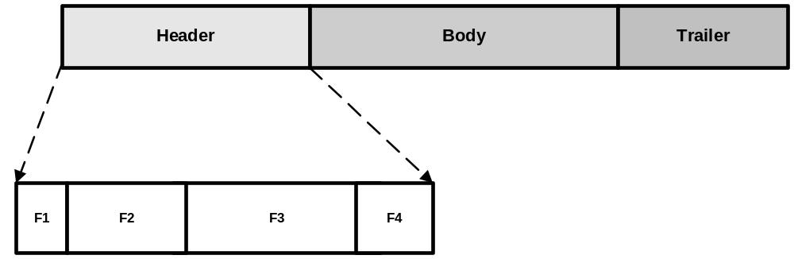
Header is divided into fields
The header is divided into a number of fields, shown in the illustration as F1, F2, F3 and F4.

Slide 19
Fields represent functions
Each field enables some function to be accomplished in the layer 2 processes at sending or receiving side of the communication.

Slide 20
Wireshark trace with Ethernet II data link
Frame 37 (581 bytes on wire, 581 bytes captured)
Ethernet II, Src: 00:0c:41:2b:a2:a6, Dst: 00:03:93:e5:13:52
Destination: 00:03:93:e5:13:52 (10.0.1.1)
Source: 00:0c:41:2b:a2:a6 (10.0.1.2)
Type: IP (0x0800)
Internet Protocol, Src Addr: 10.0.1.2 (10.0.1.2), Dst Addr: 65.208.228.223 (65.208.228.223)
Transmission Control Protocol, Src Port: 3348 (3348), Dst Port: http (80), Seq: 1590423275, Ack: 815030382, Len: 527
Hypertext Transfer Protocol
The text contained in the orange box tells us that:
The Data Link Framing Protocol is Ethernet II
The destination MAC address.
The source MAC address.
The type of data in the Payload field. (IP in this case.)

Slide 21
Functions of the Ethernet II header fields
Source Address - addressing
Destination Address - addressing
Type - indicates which layer-3 process should receive the body (payload) of this packet (frame).

Slide 22
Trailer
The trailer of the data-link layer provides information used for error control

Slide 23
Error Detection
The signals that represent the bits that make up the frame may be damaged in transit.
This means that a signal that represents a '1' or a '0' or a string of '1's and '0's may look like a different signal and so appear to represent a different bit pattern than the one that was sent.
  Values could have been reversed (bit flip)
  Values could have been lost
  Values could have been added
The data link is the first layer at which these bit errors can be detected and corrected.

Slide 24
Error Detection
  * Polarities could have been reversed ('bit flip')
  * Values could have been lost
  * Values could have been added
* The data link layer can be used to detect and correct bit errors

Slide 25
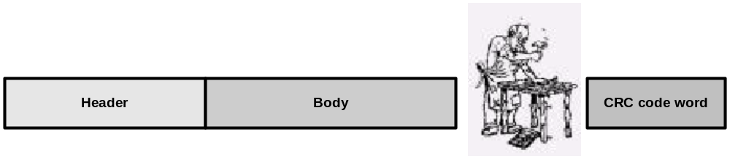
Trailer used for Error detection
The error detection method takes all the bits in the frame – including both the header and the body - and performs a calculation on them.

Slide 26
Trailer used for Error detection
The sending process operates on the frame it is sending in some way so as to produce a code word.
It sends the code word together with the frame to the receiver process.
The code word is sent in the Trailer of the frame.

Slide 27
Trailer used for Error Detection
  The receiver process operates on the frame in the same way that the sender did.
  If the receiver calculates the same code word, then it assumes the transmission was error free.

Slide 28
Trailer used for Error Detection
  If the code word it calculates is different from the one sent, the receiver assumes the frame contained errors.
  The method used on Ethernet II and 802 type LANs is called the Cyclic Redundancy Check (CRC). (Chapter 10, pp 249-256)
  Other methods for detection and correction of errors are described in Chapter 10.

Slide 29
How Ethernet II/802.3 frames get sent
  A warning is sent
  8 bytes that are not header or body or trailer
  The warning is divided into two parts
  7 bytes are called Preamble
  1 byte is called the Start Frame Delimiter (SFD)

Slide 30
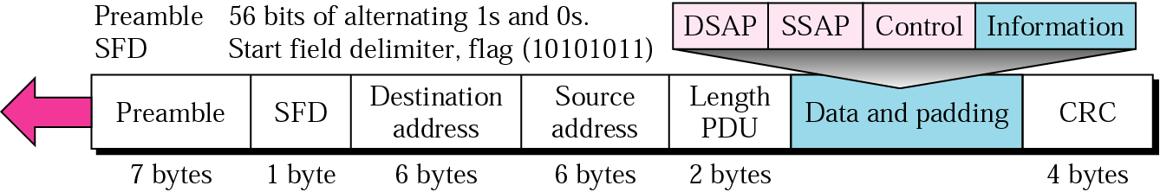
Identifying the start of a frame…
The 8 bytes preceding the frame are divided between 7 Preamble (alternating bits 1 and 0) and 1 Start Frame Delimiter (SFD).
The SFD is 10101011and signals the start of the frame.

Slide 31
Identifying the start of a frame…
The 8 bytes preceding the frame are divided between 7 Preamble and 1 Start Frame Delimiter (SFD).
The SFD is 10101011and signals the start of the frame.

Slide 32
Identifying the start of a frame…
The 7 bytes of preamble are alternating 1’s and 0’s .
They provide an alert that a frame will follow
They also allow the receiver to synchronize its clock.

Slide 33
Use of the Preamble
The preamble allows the receiver’s clock to synchronize with the sender’s.
The two clocks must remain in synch for the rest of the frame.

Slide 34
Preamble
The preamble is considered to be part of layer 1, the physical layer.

Slide 35
Length of Ethernet II Header
The length of the Ethernet header is 14 bytes.
  6 bytes for source address field
  6 bytes for destination address field
  2 bytes for Type field

Slide 36
Ethernet II Frame Format
6-byte destination address
6-byte source address
2-byte type field tells you what type of data is in the payload or body of the frame

Slide 37
Ethernet II Frame Format
The data or body of the frame can be as small as 46 bytes or as large as 1500 bytes.
Padding bytes are used to make the frame large enough.
The checksum is 4 bytes long and is the trailer. It is not part of the body.

Slide 38
Ethernet II Frame Format
This frame format is defined in RFC 894
There are three different types defined :
  0800 - IP Datagram in body
  0806 - ARP request/reply in body
  8035 - RARP request/reply in body

Slide 39
IEEE 802.3 Frame Format
6-byte destination address
6-byte source address
2-byte length field tells how many bytes follow - not including the CRC field (trailer)
3 bytes of LLC information
5 bytes of SNAP information (3 bytes of Org Code + 2 byte type field)

Slide 40
IEEE 802.3 Frame Format
802.3 body is smaller than Ethernet II body by 8 bytes
This is because the 802.3 frame borrows 8 bytes from the payload or body to allow the creation of different types of layer 2 services.
Using the 802.3 frame it is possible to create an acknowledged connectionless and a connection-oriented service.

Slide 41
Connections
We can classify data services into categories based on whether or not a connection is supported.
What is a connection?
(informal description) A connection is a relationship between two processes that resembles the relationship we can create by running a wire or a string between them.
That is, the connection creates the illusion that there is a point to point relationship between the processes

Slide 42
Connections
We can classify data services as:
Connectionless or
Connection-oriented
Among Connectionless services, some provide an acknowledgement service – to acknowledge the receipt of data packets – and others do not.

Slide 43
Connections
Connections are provided at a “cost”
To create the illusion of a connection, it is necessary to:
A) use some memory space to store the parameters that will be used to define the connection
B) use some processor time to process the information related to the connection

Slide 44
Connections and the 802.3 Frame
We have seen that the 802.3 frame uses 8 more bytes in its header than the Ethernet II frame.
The 8 bytes give us the option of defining a connection-oriented or an acknowledged connectionless service instead of a purely connectionless service.

Slide 45
Length of 802.3 header
802.3 header fields are:
  6 bytes for source address field
  6 bytes for destination address field
  2 bytes for Length field
  3 bytes for 802.2 LLC
  5 bytes for 802.2 SNAP

Slide 46
Length of 802.3 header
The IEEE 802.3 header is 22 bytes long
(14 + 8)
Of the 8 extra bytes
  3 bytes are used for 802.2 LLC
  5 bytes are used for 802.2 SNAP and

Slide 47
Logical Link Control - LLC
The logical link control layer of the 802 specification provides additional header fields that allow one to create as acknowledged connectionless or a connection-oriented service
This functionality is not much used today

Slide 48
Logical Link Control - LLC
The Logical Link Control protocol is the “top half” of the Data Link Layer used on the various 802.x LANs.
Specified in IEEE 802.2
The LLC provides error control and flow control for these networks.

Slide 49
Logical Link Control - LLC
The LLC also hides the differences between these networks from the Network Layer (IP)
LLC is very similar to HDLC.
RFC 1042

Slide 50
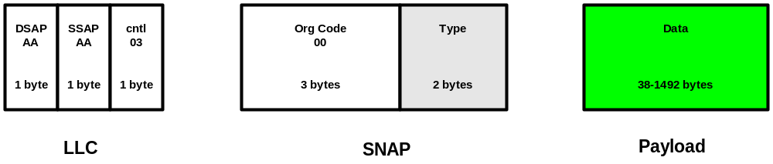
LLC header and its SNAP extension
LLC header fields are defined in the IEEE Layer 2 Standard.
These fields are the shown below:

Slide 51
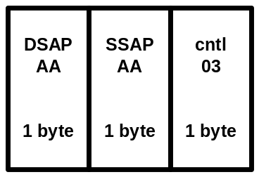
Logical Link Control - LLC
The LLC header fields describe a destination service access point and a source service access point.
For 802.3 communication, these are set to AA.
The LLC header includes a control field.
For 802.3 communication, this is always set to 03 (00000011).

Slide 52
Logical Link Control - LLC
You could, for example, use these service access points to multiplex a number of links onto a single physical link.

Slide 53
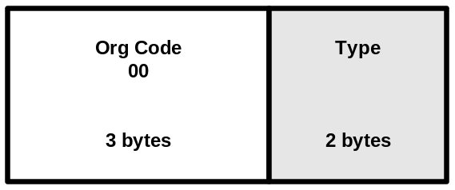
SNAP - 5 byte extension of the LLC header
SNAP is included in an extension of the Logic Link Control header.
SNAP == SubNetwork Access Control
Allows us to multiplex more services than are possible with the 1 byte Service Access Point identifiers that are available in the LLC headers.
The DSAP and the SSAP are each 1 byte long and that limited number of “address” bits is not enough to describe the location of services in a system.

Slide 54
SNAP - 5 byte extension of the LLC header
The LLC specification (802.2) defines three types of communication.
  Type 1: unacknowledged, connectionless
  Type 2: acknowledged, connectionless
  Type 3: connection-oriented

Slide 55
SNAP - 5 byte extension of the LLC header
Normally, all communication is performed using Type 1 communication.
Type 2 can be used if both sides of the communication agree to do so.
Type 1 communication is the recommended method at this time and must be supported by all implementations.
See new Appendix for additional references

Slide 56
Addresses
Each frame contains two addresses
Each address in the frame is 6 bytes long
One byte = 8 bits (also called an octet)
So each address is 48 bits long

Slide 57
Addresses
The two addresses describe:
  source of the frame
  destination of the frame

Slide 58
Structure of Addresses
Ethernet II,
Src: 00:0c:41:2b:a2:a6, Dst: 00:03:93:e5:13:52
The MAC address is normally displayed in the format above.
(Two MAC addresses taken from an ethereal trace)

Slide 59
Structure of Addresses
Twelve characters, divided into groups of two that are separated by colons.
00:0c:41:2b:a2:a6
Each group of two represents a byte of data.
The characters are hexadecimal numbers.
This representation is like a short-hand for the 8 binary units.

Slide 60
A very quick look at Hexadecimal
The hexadecimal number system uses 16 as its base instead of 10. (see example in class)
We only have 10 characters that represent numbers in the decimal system, 0-9.
So we borrow some characters from the alphabet to represent the values 10, 11, 12, 13, 14, and 15 using a single character.

Slide 61
A very quick look at Hexadecimal
A = 10 base 10 and 1010 base 2
B = 11 base 10 and 1011 base 2
C = 12 base 10 and 1100 base 2
D = 13 base 10 and 1101 base 2
E = 14 base 10 and 1110 base 2
F = 15 base 10 and 1011 base 2

Slide 62
Structure of Addresses
00:0c:41:2b:a2:a6 is hexadecimal for
00000000:00001100:01000001:00101011:10100010:10100110
Obviously the hexadecimal is easier for a human being to read!
The way to write the bits is to write each nibble in its binary representation using four bits – including all leading 0's.

Slide 63
Three types of MAC Address
We identify three types of address based upon the number of destinations the address can represent:
Unicast addresses identify a single computer on the link. Unicast addresses are the only ones that are actually 'burned into' the network interface card.
Multicast addresses identify a subset of all the computers on the link. The computers all have unique MAC addresses. But they are identified as members of a group. The identification is done by configuration.
Broadcast addresses identify all the computers on the link.

Slide 64
How to identify the type of address
A computer that is watching the link for frames whose destination MAC address is their own, needs to know right away if the destination address is unicast, multicast or broadcast.
It uses the first bit of the Destination MAC address as an indicator.

Slide 65
How to identify the type of address
If the first bit is a 0, the receiver knows that the address is unicast, and so it checks to see if it is its own address.
If the first bit is a 1, the receiver knows that the address is multicast or broadcast.
If all the bits in the address are 1's then the message is meant for it and for all other computers on the link.
If all the bits are not 1's, then the computer needs to check if it is configured to be part of the multicast group represented by that multicast address.

Slide 66
Order of data flow
Data is sent in byte order – highest numbered byte in the frame is sent first
But, within the byte, the lowest order bit is sent first
Thus, the first address bit to reach a station is the low order bit of the first byte.
Thus, the station knows at once if the frame is a multicast frame.

Slide 67
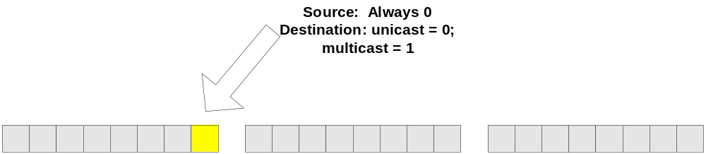
Single destination MAC address
Ordinary destination MAC addresses have a 0 in the low order bit of the first byte*.
If the first byte of the destination address is
‘1010 1010’, the low order bit is ‘0’ so the destination is unicast.

Slide 68
Group destination MAC address
If the destination of the frame is a group of stations, the destination address has a 1 in the low order bit of the first byte.
If the first byte of the destination address is 1010 1011, the low order bit is 1 so the destination is multicast.

Slide 69
Broadcast destination MAC Addresses
The address consisting of all 1’s is reserved for the broadcast address.
If the first byte of the destination address is 1111 1111, the low order bit of the first byte is 1 so the destination is multicast. This is a special case - a broadcast.

Slide 70
Access Methods
The method for gaining access to a link is related to the topology of the network.
  802.3 and Ethernet II use CSMA/CD* as their access method
  802.4 uses a token bus
  802.5 uses a token ring
  802.11 (wifi) uses CSMA/CA**
We will study 802.3 and ethernet II networks
*Carrier Sense Multiple Access with Collision Detection
** Carrier Sense Multiple Access with Collision Avoidance

Slide 71
Accessing a Shared Medium - CSMA/CD
In networks that use carrier sensed multiple access with collision detection the process works like this:
Each device listens to the line - in our case, the device senses voltage levels on the line (the medium).

Slide 72
Accessing a Shared Medium - CSMA/CD
The absence of a voltage indicates that no device is using the medium.
Sensing that the line is idle, the device puts a frame onto the line.

Slide 73
Accessing a Shared Medium - CSMA/CD
  The sending device continues to listen to the line for a collision.
  If it senses a collision it sends a jamming signal to warn other stations not to send.
  After sending or receiving a jamming signal, a station generates a random number that allows it to calculate a random time interval.
  After the random time interval has elapsed, the station is free to sense and send again.

Slide 74
Accessing a Shared Medium - CSMA/CD
The worst case scenario would be that just before the frame reaches the far end, the farthest device puts its own frame onto the wire.

Slide 75
Accessing a Shared Medium - CSMA/CD
If the sending device senses the collision it sends a jamming signal - which warns all devices to “back off.”

Slide 76
Accessing a Shared Medium - CSMA/CD
The reason a random time interval is chosen is to avoid synchronized re-sends.
The random time interval is referred to as a random back-off.

Slide 77
Accessing a Shared Medium - CSMA/CD
It is important that the sender not complete sending the frame before it is notified of the collision.
This allows the sender to resend the collided frame.

Slide 78
Minimum length of CSMA/CD frames
This requirement puts a minimum limit on the length of CSMA/CD frames.
They need to be long enough that the last bit has not left the sender before it receives a jamming signal from the farthest distant device.

Slide 79
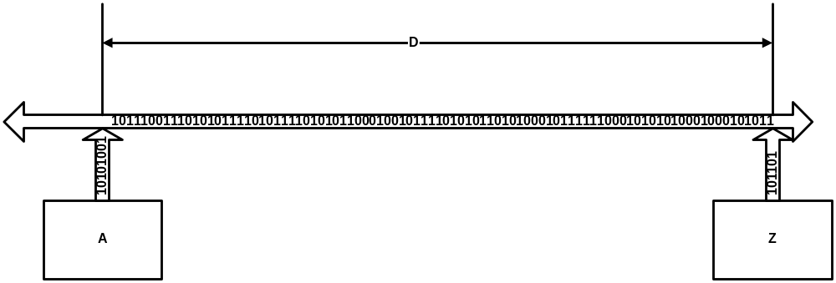
CSMA/CD minimum frame length
‘A’ senses the medium until it can be sure that no other CDMA/CD station has put signals onto the medium.
If ‘A’ detects a collision, it first sends a jamming signal to warn off others. Then waits a random time before sending again.

Slide 80
Minimum Length
The protocol standard defines the minimum frame length for a 10 Mbps Ethernet LAN to be :
512 bits
512 bits == 64 bytes
(512 bits x 1 byte/8 bits = 64 bytes)

Slide 81
Maximum Length
The protocol standard defines the largest frame length for a 10 Mbps Ethernet LAN to be :
1518 bytes == 12,144 bits

Slide 82
Minimum Length Discussion
The minimum length requirement arises because of the specifications of the bit rate and the maximum length of the link.
The sender must still be sending the frame in the worst case scenario in which a jamming signal is sent by the most distant point on the network.
See the calculation on pages 401 and 402 in the text.(Page numbers apply to edition 4 of the text.)

Slide 83
Minimum Length Discussion
These calculations illustrate why the minimum frame size is specified as 64 bytes.
That 64 bytes includes the 14 bytes of header and the 4 bytes of trailer.
64 bytes – 14 bytes – 4 bytes = (64 – 18) bytes = 46 bytes is the minimum number of bytes required to fill the body of an Ethernet II frame.

Slide 84
Minimum Length Discussion
If the body that the layer 2 process receives is smaller than 46 bytes, the layer 2 process needs to add padding to the body before encapsulating it into the layer 2 header and before adding the layer 2 trailer.
That is the reason the padding bytes are provided for in the frame format.
See the ARP messages for an example.

Slide 85

Figure 12.12 Collision of the first bit in CSMA/CD
'A 'sends at time t1. 'C' sends at time t2.
The energy sent by 'C' at time t2 moves toward both ends of the link simultaneously.
This energy collides with the energy sent by 'A' at the point indicated by the arrow.
'C' senses the collision at time t3 and stops sending its message
'A' senses the collision at time t4 and stops sending its message

Slide 86

Figure 12.13 Collision and abortion in CSMA/CD

Slide 87
Example 12.5
A network using CSMA/CD has a bandwidth of 10 Mbps. If the maximum propagation time (including the delays in the devices and ignoring the time needed to send a jamming signal, as we see later) is 25.6 μs, what is the minimum size of the frame?
Solution
The frame transmission time is T_{fr} = 2 × T_{p} = 51.2 μs. This means, in the worst case, a station needs to transmit for a period of 51.2 μs to detect the collision. The minimum size of the frame is 10 Mbps × 51.2 μs = 512 bits or 64 bytes. This is actually the minimum size of the frame for Standard Ethernet.

Slide 88
Explanation of Example
We are given the amount of time that it takes to send one bit from end to end. T_{p}== 25.6 x 10⁻⁶ seconds. (determined by the width of the pulse.)
We are given the speed at which the bit will travel. 10x10⁶ bits/second
We want the last bit of the frame to have been received at the far end and we want to now if there was a collision at any time while out bits are on the link before we release the copy of frame at our end.

Slide 89
Explanation of Example
We will be sure it has been received if we do not receive a jamming signal during a period twice as long as it would take a bit to travel the length of the link.

Slide 90
Explanation of Example
We send 10x10⁶ bits/second. Each bit is on the link for 25.6 x 10⁻⁶ seconds
So after we send 256 bits, last bit has reached the destination .
But if there was a collision at the far end, it we will not find out until the jamming signal travels all the way back to us. If the very last bit is the one that had the collision, then it will mean that we must send another 256 bits.
So the shortest frame we can send is 512 bits.

Slide 91

Figure 12.14 Flow diagram for the CSMA/CD

Slide 92
Persistence Methods – for Medium Access
The term persistence refers to whether or not the sending station is constantly (persistently) sensing the medium.
There are three types of persistence methods
  1-Persistent
  Non-Persistent
  p-Persistent

Slide 93
Persistence Methods – for Medium Access
1-Persistent means that if the station senses the medium is free, it sends with a probability of 1
Non-Persistent means that if the station senses the medium is free, it backs off for a period of time and does not sense the medium until that time has elapsed
P-Persistent means that if the station senses the medium is free, it may send or it may not send. It decides based upon generating a random number. If this results in a value greater than pm the staion sends, if it results in a vlue less than p, the station backs off for an additional time period
See Chapter 12 in both editions of the text book for more detail on the different 'persistence ' methods for determining when it is ok for you to send your frame.

Slide 94

Persistence Strategies

Slide 95
1-persistent
Sense continuously
If the station senses the link is idle, it sends right away. (The probability that the station will send is 1.)
This method has the highest chance of collision
Ethernet protocol uses this method

Slide 96
Non-persistent
Do not sense continuously
If the station senses the link is idle, it sends right away.
If it senses the link is busy, it waits a random time and senses again
Reduces chance of collision.

Slide 97
p-persistent
Sense continuously as long as the channel is busy
Used if the link uses time slots with length >= T_{p}
Sending device checks continuously for idle link
When the link is idle the station may or may not send.
The probability that it will send is p where p is a number between 0 and 1
In the case it decides not to send, it waits for the beginning of the next time slot and again checks for idleness
If the link is idle it sends with a probability of p
If the link is busy it backs off

Slide 98

Illustrations of three CSMA methods
Note that for both 1-persistent and non-persistent, when the link is idle, the station sends

Slide 99
Illustrations of three CSMA methods
For p-persistent, when the link is idle, the station may or may not send
It “decides” by generating a random number
If the random number is <= p, it sends
If the random number is > p, it waits another time slot and goes through the process again

Slide 100
CSMA/CD
CSMA with Collision Detection, CSMA/CD, adds functionality to CSMA
Specifically, it gives you something to do after you send a frame
You continue to sense the medium to see if your transmission was successful
If it succeeded, you are done
If you sense a collision occurred, you can retransmit

Slide 101
CSMA/CD
We define three states of the energy on the line:
  0 means it is ok to send
  Normal means a station is sending
  Abnormal means a collision has occurred - there is about double the energy of a normal transmission

Slide 102
CSMA/CA
Carrier Sensed Multiple Access with Collision Avoidance (CSMA/CA) is the Channel Access method used on wireless networks.
The devices are sensing the channel but sensing alone is not sufficient to prevent collisions.
Different persistence methods and more overhead messages (messages not carrying data) need to be sent to avoid as many collisions as possible.

Slide 103

Timing in CSMA/CA

Slide 104

Flow diagram for CSMA/CA

Slide 105
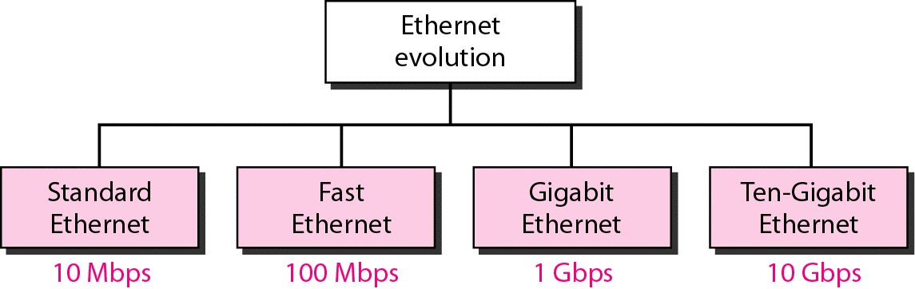
Ethernet Evolution
There are four distinct standards associated with Ethernet LANs
They were developed to meet different industry requirements and to make use of new hardware and software developments.
We identify them by their bit rate (digital bandwidth.)

Slide 106
Standard Ethernet (10 Mbps)
There are a number of different types of cables and topologies that can be used with Standard Ethernet.
  10Base5 - thick coaxial cable - Bus topology
  10Base2 - thin coaxial - Bus topology
  10Base-T- Unshielded Twisted Pair (UTP) - Star
  10Base-F- Fiber – Star
The 10 represents the bit rate in Mbps
The 5 and 2 designations represent the maximum length in 100 meters

Slide 107
Standard Ethernet
Standard Ethernet implementations use base band transmission
The lowest frequency in the signal can be 0 Hz

Slide 108

10 Base5 Implementation
Thick coaxial cable on a bus topology
Transceiver is a device separate from the computer and from the cable. It is connected to the cable by a tap and provides separate paths for transmitting and for receiving
If a collision takes place it takes place on the cable - not in the transceiver or the computer.
The signal can travel 500 m before the attenuation is unacceptable

Slide 109

10 Base2 Implementation
Thin coaxial cable on a bus topology
Transceiver is part of the NIC card
If a collision takes place it takes place on the cable
Thinner cable means segment lengths must be shorter because thin cable attenuates the signal faster - only ~185 m lengths are acceptable

Slide 110

10 Base-T Implementation
Twisted pair cables in a star topology
One twisted pair is used to transmit and the other to receive
Any collision happens in the hub
Maximum segment length is around 100 m due to the higher attenuation rate of the twisted pair

Slide 111

10 Base-F Implementation
Fiber optic cable in a star topology
One fiber optic cable is used to transmit and the other to receive
Any collision happens in the hub
Maximum segment length is 2000 m

Slide 112
Evolution of Standard Ethernet Architectures
As the demand for Ethernet LANs grew so did the demand to make them easy to install.
Thin twisted pair LANs are easy to install because the cables are light and flexible.
Specialized nodes are used to make connections - and these nodes have become standardized and productized.

Slide 113

Evolution of Standard Ethernet Architectures
Three distinct types of central specialized nodes have been developed
  Hub
  Bridge
  Switch (layer-2 switch)

Slide 114
Hub
A hub is a Functional Element that operates at layer 1.
It serves to ‘repeat’ the signals that enter it
It behaves like a ‘bus in a box’ - that is, the ports of a bridge allow you to plug computing devices (end systems) into a bus without needing special taps and transceivers.
The hub is a collision domain
The data from all the devices attached to a hub may have collisions in the hub, just as they could have collisions on the bus.

Slide 115

Hub
In the illustration below, the hub repeats the signals that enter it.
The hub can be used to connect LAN segments or individual devices.
It simply repeats what is sent to it. Every segment and device connected to the hub ‘sees’ every frame that enters the hub.

Slide 116

Repeater
The hub plays the role of a repeater.
A signal may come in that is deformed - it has lost some energy of different amounts at different frequencies
The repeater decides what signal was intended and then creates a new signal

Slide 117
Average bit rate per station on a hub
If the hub has 10 Mbps throughput, and there are two stations sharing the hub, then, on average, each station can send at 5 Mbps (10/2)
If the hub has 10 Mbps throughput, and there are four stations sharing the hub, then, on average, each station can send at 2.5 Mbps (10/4)
The more stations, the lower the average bit rate of each
The hub allows us to create a physical star topology but a logical bus topology

Slide 118
Probability of collisions on a hub
The hub allows us to create a physical star topology but a logical bus topology
On a bus, the more stations, the more likely it is that there will be a collision

Slide 119

Bridge
A bridge is a special functional element that operates at layers 1 and 2
It is used to divide one LAN into two or more LAN segments.

Slide 120
Bridge
Bridges contain a number of physical ports
A LAN segment can be connected to each port
The LAN segment is itself a bus (a collision domain)

Slide 121
Bridge Operation
The bridge learns which MAC addresses are associated with each port by reading the source MAC address of each frame that enters it.

Slide 122
Bridge Operation
A bridge also reads the destination MAC address in the layer 2 frame.
It uses this information to decide whether to forward the frame out a different port or to filter (throw away) the frame

Slide 123
Bridge Operation
If a frame comes in to port x from source address A and it has a destination address B - and if the bridge has already learned that B is also on the segment of the LAN connected to port x - then the bridge will filter (discard) the frame because the frame has already passed B

Slide 124
Bridge Operation
If a frame comes in to port x from source address A and it has a destination address B - and if the bridge has already learned that B is on the segment of the LAN connected to port y - then the bridge will forward the frame to the segment of the LAN on port y

Slide 125
Bridge Operation
If a frame comes in to port x from source address A and it has a destination address B - and if the bridge has not yet learned which port is connected to the segment of the LAN that contains address B - then the bridge will forward the frame out all of its ports - “flood” the network with the frame

Slide 126
Bridge
The bridge creates separate collision domains
In a., there is only one collision domain
In b., there are two collision domains

Slide 127
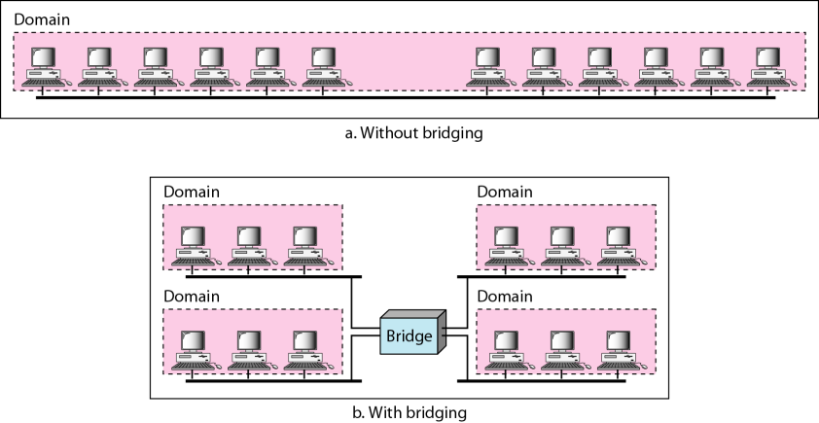
Bridge
In the illustration below we create 4 separate collision domains, each with three end systems
The average bit rate of the devices on each collision domain is higher than the average bit rate on the LAN with only a single collision domain.

Slide 128

Bridge
The bridge illustrated below connects two LANs

Slide 129

How Bridges Learn
A sends to D
So the bridge learns that address A is on the segment connected to port 1
A and D are not in the bridge’s forwarding table, so the bridge floods the frame out ports 2 and 3

Slide 130
How Bridges Learn
E sends to A
So the bridge learns that address E is on the segment connected to port 3
Since the bridge has mapped A to port 1, it forwards the frame only to port 1

Slide 131
Are there loops in this topology?
If A wants to send to F, how many different paths can the frame take?
After the forwarding table has been created, there is only one path.
The frame will enter port 1 and leave port 3

Slide 132
Are there loops in this topology?
In this example, there is only one bridge connecting LAN segment 1 and LAN segment 2
There is only one bridge connecting LAN segment 3 to LAN segment 1.
In fact, only one bridge connects each LAN segment to every other LAN segment.

Slide 133
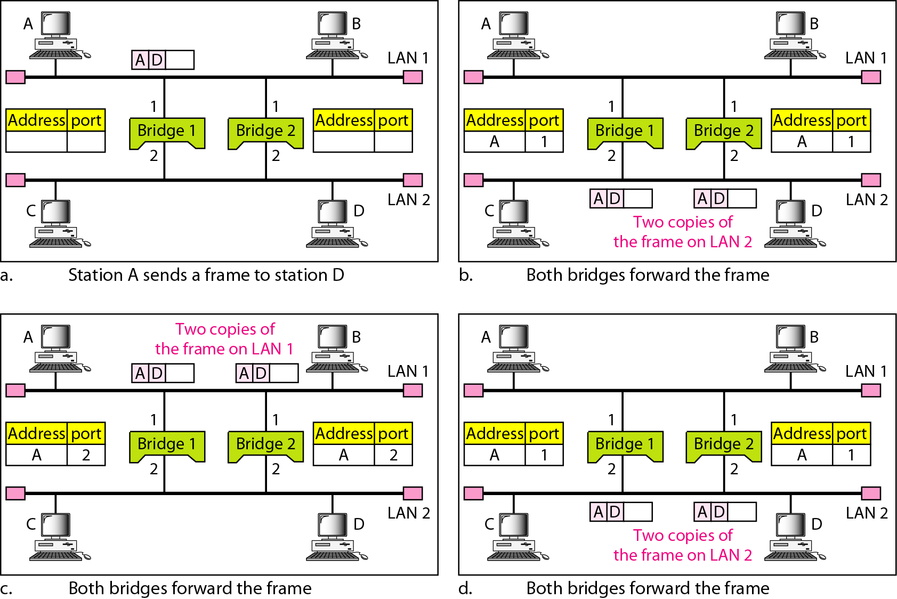
Redundant Bridges
LAN administrators generally use more than one bridge to connect two LAN segments
If one bridge fails, the other is still available

Slide 134
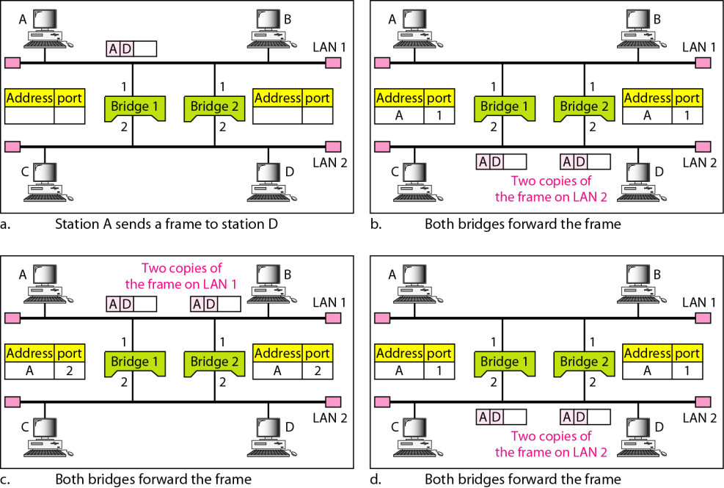
Loops
But, if you put redundant bridges into your network they can create forwarding loops
This is a bad thing and needs to be avoided

Slide 135
Loops
In this illustration, bridges 1 and 2 are redundant
They both connect LAN 1 and LAN2

Slide 136
Loops
If A sends to D, bridges 1 and 2 both update their forwarding tables to show that A is on LAN 1

Slide 137

Loops
Then Bridges 1 and 2 flood the frame onto LAN2 - so LAN 2 has two copies of the frame

Slide 138
Loops
Bridges 1 and 2 see the frames on LAN 2 and flood them on to LAN 1

Slide 139
Loops
Unnecessary circulation of frames - no new information - just more traffic

Slide 140
Preventing Loops
This process creates many extra frames and causes unnecessary traffic on the LANs
To prevent loops, LANs use the Spanning Tree Algorithm to create a single path between any two MAC addresses on the LAN
All the bridges on the LAN participate in creating the spanning tree.
They participate by exchanging STP – Spanning Tree Protocol - messages.

Slide 141
Spanning Tree Algorithm and Protocol
In the words of graph theory, a spanning tree is a graph that defines only one path between any two points.
The goal of the Spanning Tree algorithm is to create a virtual spanning tree by assigning special hierarchical identities to each bridge so that there is one and only one path for a frame to take to get from A to B

Slide 142
Spanning Tree Algorithm and Protocol
The spanning tree protocol carries the information needed by the bridges on the network so that they can determine what their identify is in the network and which ports to forward each frame out of.

Slide 143
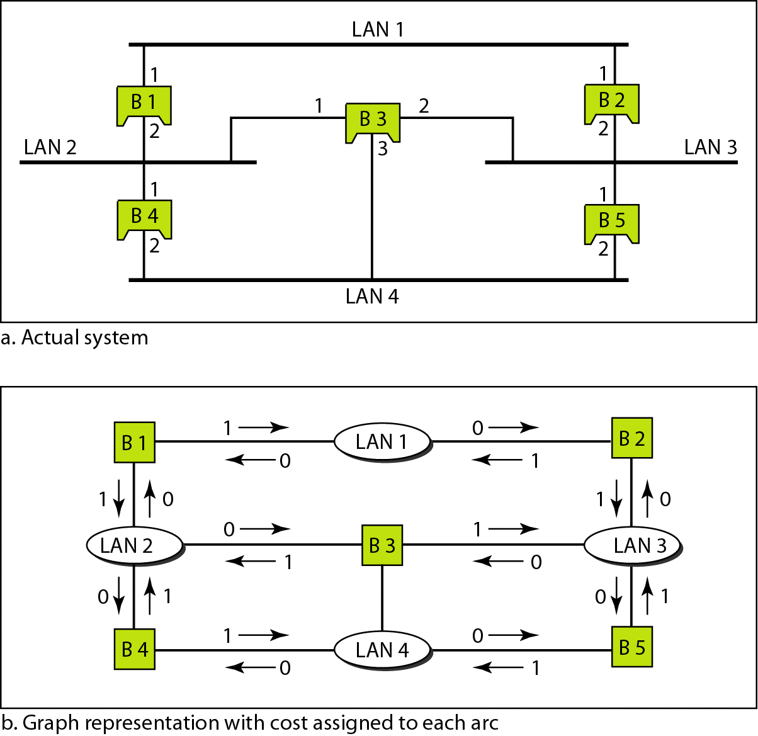
Spanning Tree Algorithm and Protocol
‘A’ shows the physical topology of the networks
‘B’ shows the logical hierarchy established by the operation of the Spanning Tree algorithm

Slide 144
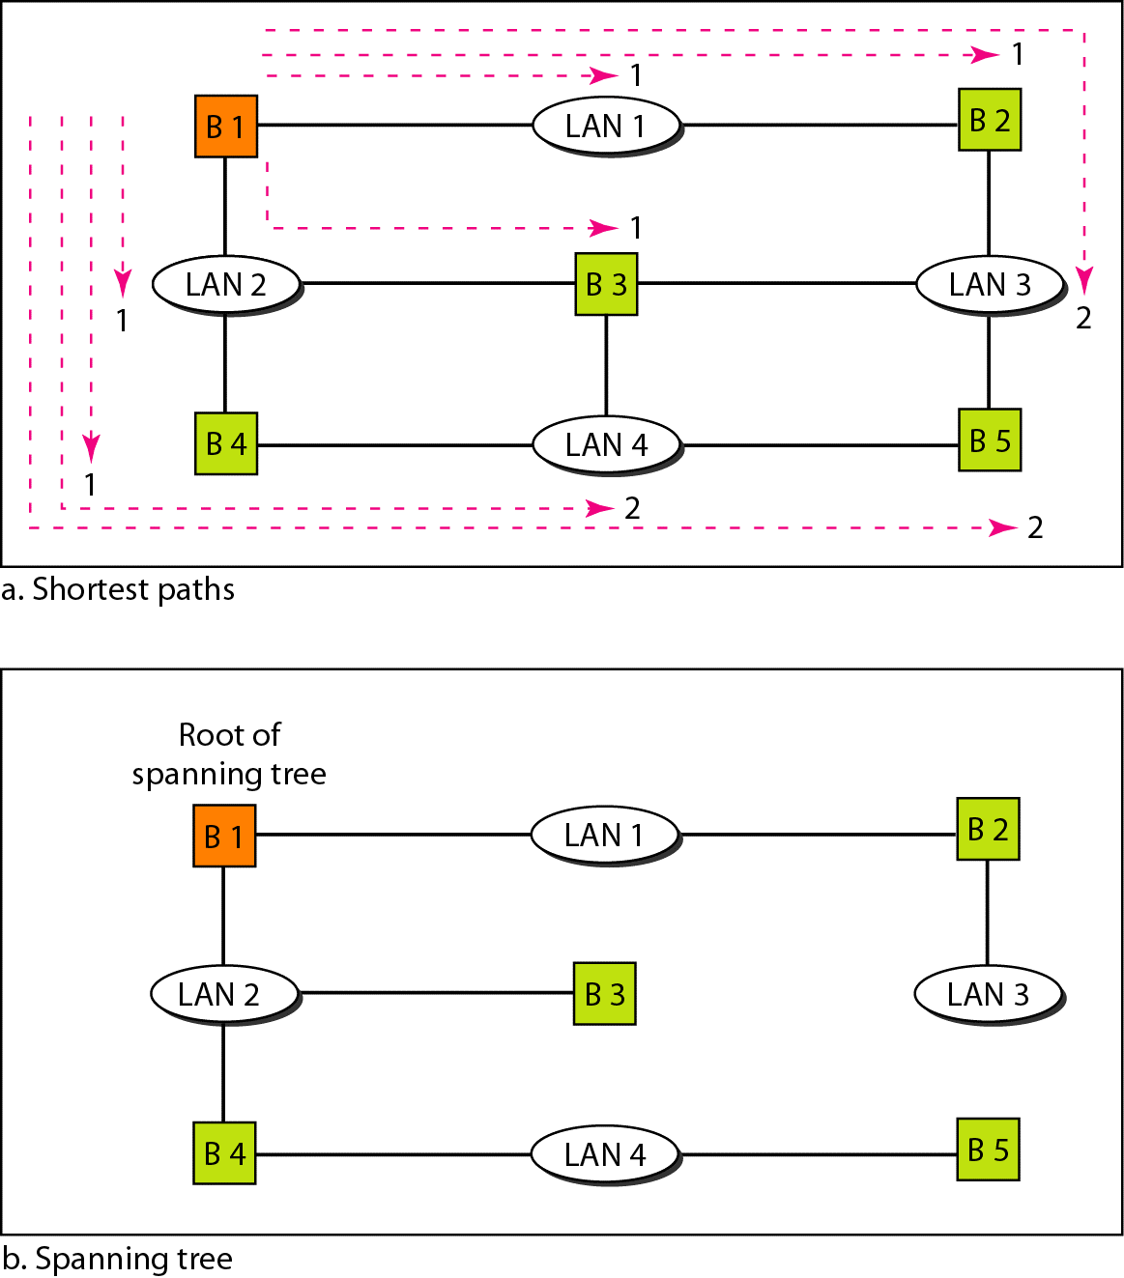
Spanning Tree Algorithm and Protocol
The algorithm works as follows:
The bridges identify a root bridge
The root calculates the shortest distance between itself and every other LAN
The path includes the ports taken

Slide 145
Spanning Tree Algorithm and Protocol
These bridge ports are then defined to be forwarding ports
The other bridge ports are defined to be blocking ports
The result is a unique path between the root and every LAN and between any two LANs
Carol Davids 2015

Slide 146
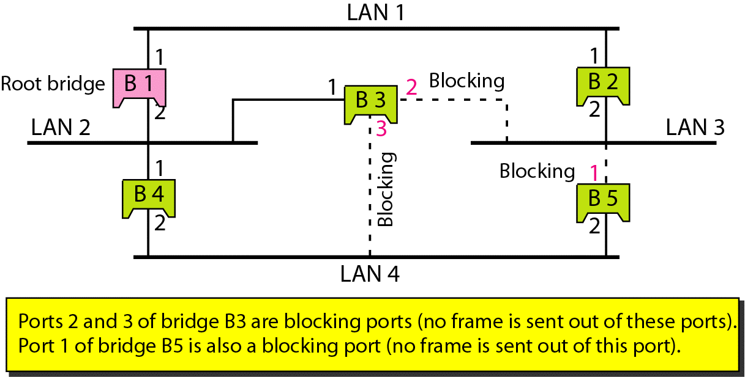
Spanning Tree Algorithm and Protocol
Forwarding and blocking ports are illustrated below.
Carol Davids 2015

Slide 147
Bridge Standardization
Bridge behaviors and parameters are standardized
Visit IETF web site and find the Managed Information Base (MIB) for bridges, RFC 4188.
The Spanning Tree Protocol describes a process and a set of messages that can be exchanged by a set of bridges on a network so that the bridges can cooperate to forward frames efficiently
The parameters used in the STP are among the many bridge parameters identified in the ‘Bridge MIB.’
The abbreviation 'MIB' stands for Managed Information Base.

Slide 148
Switched Ethernet
A switch is a bridge with N ports, where N represents the number of stations or end systems on the LAN.
Each port can be connected to an end system (computer)

Slide 149
Switched Ethernet
On switched ethernet networks, each port of the switch could operate in one of two modes:
  Half duplex – the station can either send or receive at any given time but cannot do both simultaneously
  Full duplex – the station can send and receive simultaneously

Slide 150
Half duplex
A single twisted pair can carry 10 Mbps bit rate
If you use 1 twisted pair for both the transmit direction and the receive direction of a device - so that the single twisted pair is either sending at 10 Mbps or receiving at 10 Mbps - then the device is never called upon to process more than 10 Mbps per port

Slide 151
Full duplex
A single twisted pair can carry 10 Mbps bit rate
If you use 2 twisted pairs - one for the transmit direction and one for the receive direction of the device - the device may be called upon to process 20 Mbps per port

Slide 152

Switched Ethernet - half duplex
If the port is half duplex then the device connected to it uses 1/2 the bandwidth that a full duplex connection would use.
A full duplex connection uses 20 Mbps on standard switched Ethernet
So a device connected in half duplex fashion uses on average10 Mbps.

Slide 153

Switched Ethernet - full duplex
If the cable connecting the station to the port allows 10 Mbps, and each station can simultaneously send and receive through the switch, each port has a total throughput (capacity) of 20 Mbps. (10 Mbps in each direction.)

Slide 154
Full Duplex Ethernet
10B5 and 10B2 use half duplex operation
10BT uses full duplex operation
10BT uses two twisted pairs of wires – one pair for transmit and one pair for receive
Each pair can carry 10 Mbps
Thus the port to which it is attached must be able to transfer 20 Mbps – 10 in each direction simultaneously

Slide 155
RJ45
RJ45 – Registered Jack 45
The use of the pins/conductors can vary with the application
See http://www.nullmodem.com/RJ-45.htm for a description of how the conductors are used for 10B-T and 100B-TX

Slide 156
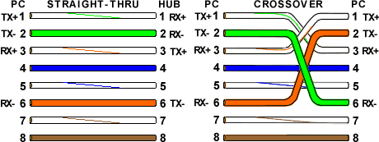
RJ-45: T-568A Straight-Through and Crossover Ethernet Cables – Use of the pins
This diagram tells you how each conductor is used.
Carol Davids 2015

Slide 157
Fast Ethernet
Fast ethernet was designed to transfer data 10 times faster than 10BT
There are three different types of fast ethernet, depending upon the type of layer 1 medium that is used
  100B-TX
  100B-FX
  100BT4

Slide 158
100B-TX
100B-TX
Uses 2 pairs of twisted pair cable – one to transmit and one to receive
Uses MLT-3 line code – review pp 113-114 chapter 4
A long string of 0’s in the data, will result in a long period during which there is no transition (no knife edge) and so can result in loss of synchronization
So, before the data stream is sent to the line, it is encoded using a block code – 4B/5B – review pp 115-116

Slide 159
100B-FX
100B-FX
Uses 2 pairs of fiber optic cable – one to transmit and one to receive
Uses NRZ-I line code – review chapter 4
A long string of 0’s in the data, will result in a long period during which there is no transition (no knife edge) and so can result in loss of synchronization
So, before the data stream is sent to the line, it is encoded using a block code – 4B/5B – review pp 115-116

Slide 160
100B-T4
100B-T4
Uses 4 pairs of twisted pair cable (cat 3)
Each pair can’t carry more than 25 Mbps
One pair is used alternately to send and to receive
The other three, combined can only carry 75 Mbps
Line code – 8B/6T takes 8 bits and maps them to 6 signal elements

Slide 161
Backbone Networks
A backbone network is a network that has no stations connected directly
Only other networks are connected to a backbone.
The architecture of a backbone can be either Bus or Star

Slide 162
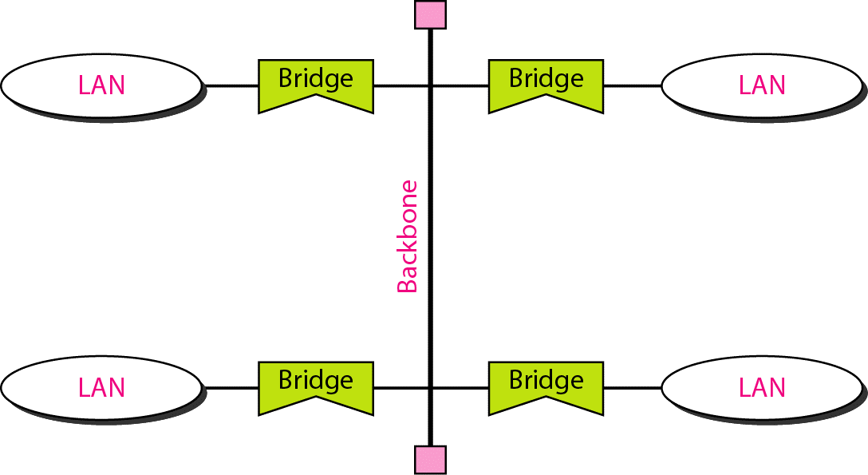
Bus Backbone
Illustration shows a bus backbone with four LANs attached
Identify the broadcast domain(s).
Identify the path taken by frames sent between devices on the same LAN and devices on different LANs

Slide 163
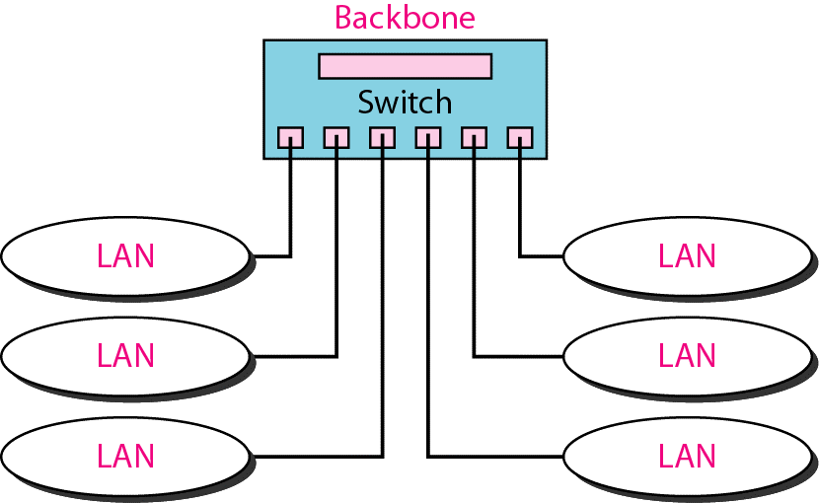
Switched Backbone
Illustration shows a switched backbone with six LANs attached
Identify the broadcast domain(s).
Identify the path taken by frames sent between devices on the same LAN and devices on different LANs

Slide 164
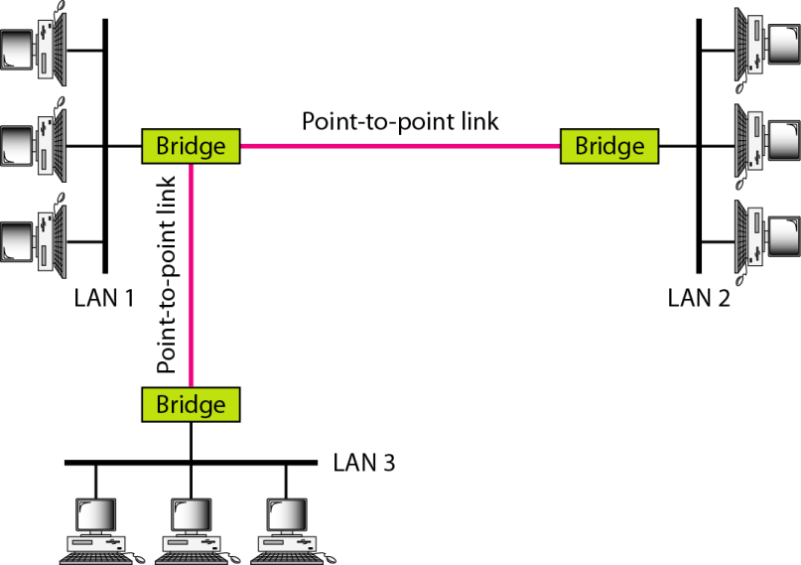
Connecting Remote LANs
Illustration shows three LANs connected by bridges to point-to-point links
Identify the broadcast domain(s).
Identify the path taken by frames sent between devices on the same LAN and devices on different LANs

Slide 165
Virtual LANS vs. Physical LANs
Physical LANs are identified by their physical connections to a physical link
Virtual LANs are identified by logical connections created in some table or database in a switch

Slide 166
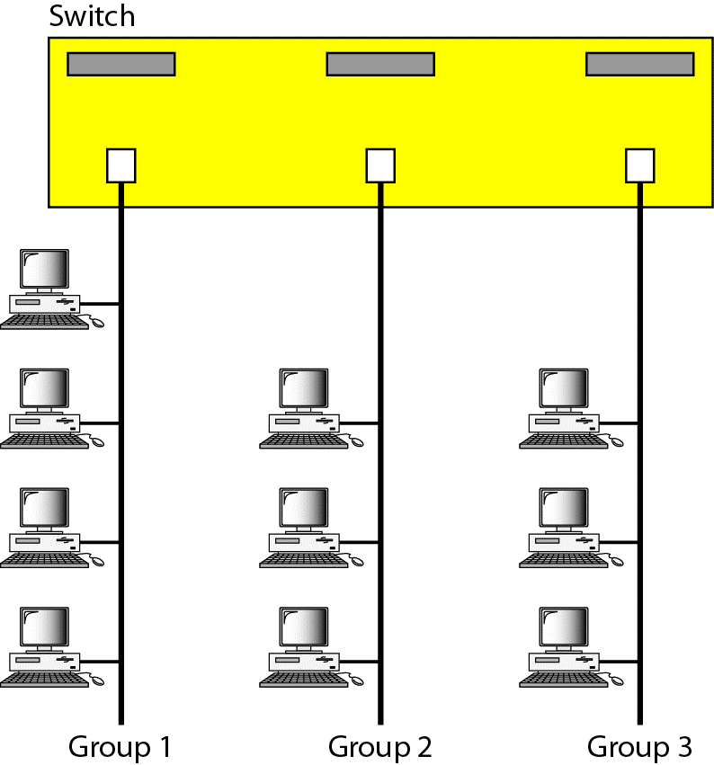
Physical LANs
The illustration shows three LANs, each one connected to a switch port
In this case, membership in the LAN segment is identified by the physical port on which it sends.
All hosts in LAN 1 are sending into the switch on port 1; all hosts in LAN 2 are sending into the switch on port 8; all hosts in LAN 3 are sending into the switch on port 16, for example.

Slide 167

Virtual LANs (VLANs)
The illustration shows three VLANs, identified by the grey rectangles.
In this case, membership in the LAN segment is provisioned using logic within the switch.

Slide 168
Virtual LANs (VLANs)
Thus, members of VLAN 1 send into the switch from different ports.
Here, the originating port does not identify the VLAN.
Instead there is a table in the switch that binds the VLAN identifier with a list of ports that are associated with that VLAN.

Slide 169

Virtual LANs (VLANs)
It is even possible to create Virtual LANs that extend across different switches.
There must be a table in the switches that binds Port 3, Switch A to the same VLAN that contains Port 1, Switch B, for example.

Slide 170
The End

