Slide 1


ITM 540
Data Networks
The Network Layer
Layer 3
ARP
Professor: Carol Davids
Email: davids@iit.edu
Carol Davids © 2014

Slide 2
Reading Assignment
Forouzan :
Chapter 21: Network Layer Protocols: ARP, ICMP
Carol Davids © 2014

Slide 3
Five Network Layer Protocols
In the Internet Model there are 5 network layer protocols:
  ARP
  RARP
  IP
  ICMP
  IGMP
Carol Davids © 2014

Slide 4
Five Network Layer Protocols
While IP is the main Layer 3 protocol in the Internet Model, the other 4 protocols are used for functions that support IP
Carol Davids © 2014

Slide 5
ARP
ARP stands for Address Resolution Protocol
Address Resolution Protocol sends queries and replies
These queries and replies supply the information to create a mapping between IP addresses and data link addresses.
Carol Davids © 2014

Slide 6
Why ARP?
Why not have a database somewhere on the LAN that maps IP Addresses to MAC Addresses?
Uses up time and is prone to errors
Carol Davids © 2014

Slide 7
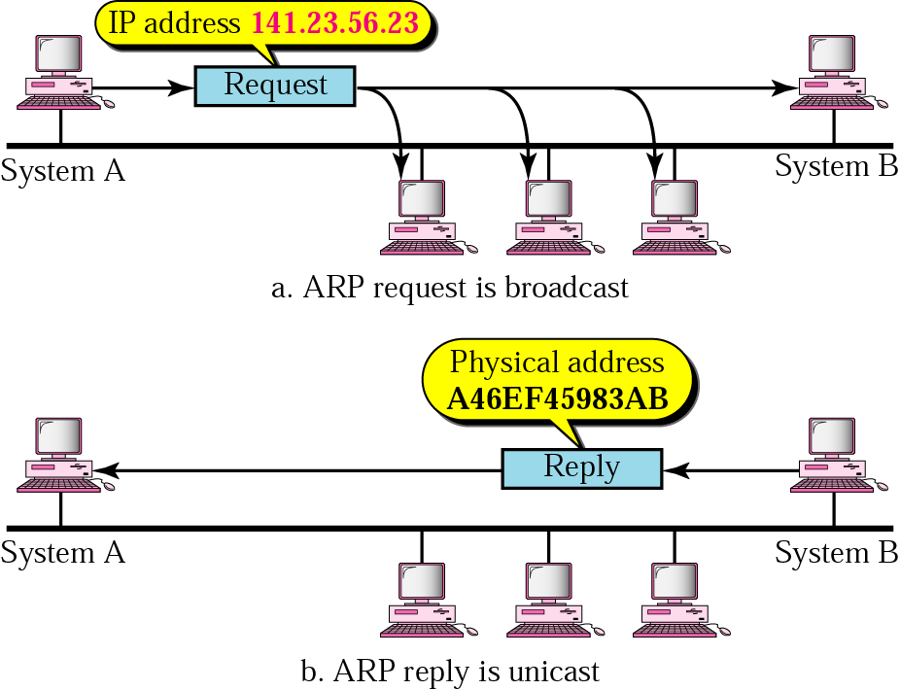
ARP Operation
ARP broadcasts the IP address asking for the MAC Address.
Carol Davids © 2014

Slide 8
ARP Operation
ARP sends a MAC layer broadcast
The ARP message is encapsulated in a MAC frame header
The source of the ARP frame is the MAC Address of the sender
The destination of the ARP frame is the MAC broadcast address, ff:ff:ff:ff:ff:ff
Carol Davids © 2014

Slide 9
ARP : Address Resolution Protocol
ARP is specified in RFC 826.
It was published in 1982.
ARP messages are encapsulated into the Ethernet Frame as shown below.
Ethernet Frame carrying ARP
Carol Davids © 2014

Slide 10
Padding the ARP Message
Why the 18 bytes of padding?
Because the ARP message is only 28 bytes long
Remember that the minimum length of a frame on an Ethernet II LAN is 64 bytes
If you subtract the 14 bytes of header and the 4 bytes of CRC (trailer) you get 64-18 = 46 bytes of Ethernet II body.
But the ARP message has only 28 bytes
It needs padding 46-28 = 18 bytes of padding
Carol Davids © 2014

Slide 11

ARP Packet Format
More than one row!
More than one row!
Carol Davids © 2014

Slide 12
ARP Packet Length
There are 28 bytes of data shown in this ARP packet.
The two top rows represent a total of 8 bytes
Rows 3 and 5 each represent 6 bytes
Rows 4 and 6 each represent 4 bytes
16 + 12 = 28 bytes
This is less than the minimum size allowed for the payload of an Ethernet II frame.
Carol Davids © 2014

Slide 13
ARP Packet Length
The minimum size of an Ethernet II frame is 64 bytes.
  Destination Address (6 bytes)
  Source Address (6 bytes)
  Frame Type (2 bytes)
  Data (the ARP packet)
  CRC Checksum (4 bytes)
Carol Davids © 2014

Slide 14
ARP Packet Length
The minimum number of bytes passed as data in an Ethernet II frame is 46 bytes.
If the size of the data to be passed is less than this, then padding bytes are added.
46 - 28 = 18 padding bytes are added
Carol Davids © 2014

Slide 15
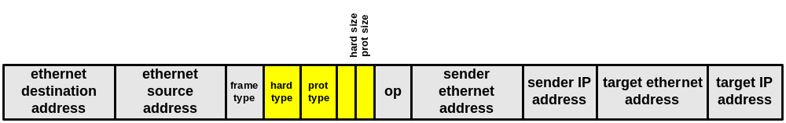
ARP Packet Format
HTYPE - Hardware type field -- type of MAC address - 1 for ethernet (16 bit field)
PTYPE - Protocol type field -- type of protocol address being mapped - 0x0800 for IP.
HLEN - Hardware length -- hardware address size in bytes - 6 for ethernet. (8 bit field) (8 bit field)
PLEN - Protocol length -- protocol address size in bytes - 4 for IPv4.
Carol Davids © 2014

Slide 16
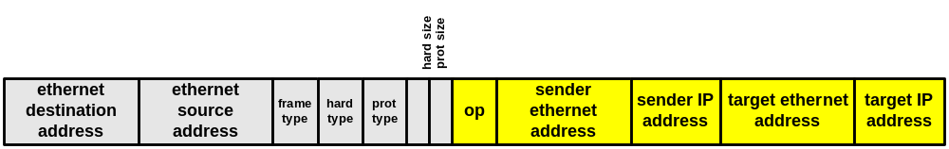
Operation field
Op field can have one of four values:
  1 = ARP Request
  2 = ARP Reply
  3 = RARP Request
  4 = RARP Reply
Carol Davids © 2014

Slide 17
Sender and Target hardware addresses
Sender hardware address is same as source MAC address in the data-link layer header.
Target hardware address is the MAC address that is being requested.
Carol Davids © 2014

Slide 18
Sender and Target protocol addresses
Sender protocol address is the source IP address.
Target protocol address is the IP address that the sender is trying to associate with a MAC address.
Carol Davids © 2014

Slide 19
Wireshark trace of an ARP message (L1)
Frame 5 (60 bytes on wire, 60 bytes captured)
Arrival Time: Sep 22, 2004 20:49:13.838227000
Time delta from previous packet: 0.704565000 seconds
Time since reference or first frame: 1.557922000 seconds
Frame Number: 5
Packet Length: 60 bytes
Capture Length: 60 bytes
Carol Davids © 2014

Slide 20
Wireshark trace continued …(L2)
Ethernet II, Src: 00:0b:46:cc:61:e1, Dst: ff:ff:ff:ff:ff:ff
Destination: ff:ff:ff:ff:ff:ff (Broadcast)
Source: 00:0b:46:cc:61:e1
Type: ARP (0x0806)
Padding: 00000000000000000000000000000000...
Carol Davids © 2014

Slide 21
Wireshark trace continued …(L3)
Address Resolution Protocol (request)
Hardware type: Ethernet (0x0001)
Protocol type: IP (0x0800)
Hardware size: 6
Protocol size: 4
Opcode: request (0x0001)
Sender MAC address: 00:0b:46:cc:61:e1
Sender IP address: 216.47.140.2
Target MAC address: 00:00:00:00:00:00
Target IP address: 216.47.140.97
Carol Davids © 2014

Slide 22
Layer 1 details
60 bytes on the wire
  14 bytes in the MAC header
  Leaves 46 bytes for the ARP packet
  But ARP packet only uses 28 bytes
  The other 18 bytes are padding.
Carol Davids © 2014

Slide 23
Layer 2 details
Destination is the broadcast hardware address ff:ff:ff:ff:ff:ff
Prot type is 0x0806 for ARP
Carol Davids © 2014

Slide 24
Layer 3 details
Target MAC address is 00:00:00:00:00:00
Means this is the information that is being requested. (fill in the blanks)
Carol Davids © 2014

Slide 25

Layer 3 details
The lines below are what Wireshark displays in the top third of its display window.
  216.47.140.2 is the router.
  The router has received a packet of data destined for IP address 216.47.140.97 and needs to know the MAC address associated with that IP address.
Carol Davids © 2014

Slide 26
Frame 1 (42 on wire, 42 captured)
Arrival Time: Apr 10, 2002 18:24:31.117741000
Frame Number: 1
Packet Length: 42 bytes
Capture Length: 42 bytes
Ethernet II
Destination: ff:ff:ff:ff:ff:ff (ff:ff:ff:ff:ff:ff)
Source: 00:01:02:48:52:18 (00:01:02:48:52:18)
Type: ARP (0x0806)
Address Resolution Protocol (request)
Hardware type: Ethernet (0x0001)
Protocol type: IP (0x0800)
Hardware size: 6
Protocol size: 4
Opcode: request (0x0001)
Sender MAC address: 00:01:02:48:52:18 (00:01:02:48:52:18)
Sender IP address: 172.16.1.169 (172.16.1.169)
Target MAC address: 00:00:00:00:00:00 (00:00:00:00:00:00)
Target IP address: 172.16.1.140 (172.16.1.140)
Carol Davids © 2014

Slide 27
Frame 2 (60 on wire, 60 captured)
Arrival Time: Apr 10, 2002 18:24:31.117904000
Frame Number: 2
Packet Length: 60 bytes
Capture Length: 60 bytes
Ethernet II
Destination: 00:01:02:48:52:18 (00:01:02:48:52:18)
Source: 00:01:02:3d:1a:4e (00:01:02:3d:1a:4e)
Type: ARP (0x0806)
Padding: 00000000000000000000000000000000...
Address Resolution Protocol (reply)
Hardware type: Ethernet (0x0001)
Protocol type: IP (0x0800)
Hardware size: 6
Protocol size: 4
Opcode: reply (0x0002)
Sender MAC address: 00:01:02:3d:1a:4e (00:01:02:3d:1a:4e)
Sender IP address: 172.16.1.140 (172.16.1.140)
Target MAC address: 00:01:02:48:52:18 (00:01:02:48:52:18)
Target IP address: 172.16.1.169 (172.16.1.169)
Carol Davids © 2014

Slide 28
ARP Resources - ARP Cache
The ARP process is associated with an ARP Cache - a database in which the association between IP Addresses and MAC addresses is stored.
Carol Davids © 2014

Slide 29
ARP Utility
Go to the command line prompt
Enter “arp”
You will learn the syntax and operation of a utility called arp
Carol Davids © 2014

Slide 30
ARP Utility commands for viewing ARP cache in Windows
  arp -a --- displays current entries in the ARP cache.
  arp -a <inet_addr> --- displays the current mapping between that address and it <eth_addr>
  arp -N <if_addr> --- displays the arp entries for the network interface specified by if_addr
Carol Davids © 2014

Slide 31
ARP Utility commands for changing ARP cache
  arp -d <inet_addr> --- Deletes the host specified in <inet_addr> ; use * to delete all
  arp -s <inet_addr> <eth_addr> --- Adds the address <inet_addr> and associates it with the hardware address <eth_addr>
Carol Davids © 2014

Slide 32
ARP Resources and Utilities
It is important to distinguish between :
ARP Protocol - used for inter-computer communication and
ARP Utilities - used to access information about the ARP resources on a given computer.
Carol Davids © 2014

Slide 33
Operation
The first time you perform arp -a you may get the reply “No arp entries found”
Then you can try pinging a host on your network “ping 10.0.1.1” for example
Then try the arp again
My results:
Interface: 10.0.1.3
Internet Address Physical Address Type
10.0.1.1 00-03-93-e5-13-52 dynamic
Carol Davids © 2014

Slide 34
ARP Cache
Before a device sends an ARP request it checks the ARP Cache.
There is a separate ARP Cache for each network interface on a device.
So a router will have several ARP Caches - one for each network interface.
ARP cache entries can be Dynamic (based on ARP Replies) or Static.
Carol Davids © 2014

Slide 35
Static ARP Cache Entries
Static ARP entries are permanent.
They are manually added using a utility application such as the ARP utility provided with Windows operating systems.
Carol Davids © 2014

Slide 36
Static ARP Cache Entries
You might use a Static ARP cache entry to prevent ARP Requests for local IP addresses that are used all the time - such as the addresses of routers and servers.
But, if there is a change in the network interface equipment, the static ARP entries have to be manually updated.
Carol Davids © 2014

Slide 37
Dynamic ARP Cache Entries
Dynamic ARP Cache entries are removed after a specified period of time - the time-out value.
For example, on Windows 2000 devices, Dynamic ARP cache entries are removed after a maximum time of 10 minutes.
Carol Davids © 2014

Slide 38
ARP Poisoning
‘Man in the middle’ security attacks can be launched based on corruption of the ARP cache.
In such an attack, an “evil” host on your network, can broadcast ARP responses giving another host’s IP address and its own MAC address.
All the hosts on your network will populate their ARP Caches with this information
Carol Davids © 2014

Slide 39
ARP Poisoning
The ‘evil’ computer now receives IP datagrams destined for the other host.
It has kept its own mapping so it knows where the real IP address is.
So it can now do whatever it wants with the information in the datagram, including send it along in either its original state or in an altered state to the true destination.
For a description of how these attacks work see:
http://www.cisco.com/en/US/products/hw/switches/ps4324/products_configuration_guide_chapter09186a008019d0ca.html#54805
Carol Davids © 2014

Slide 40

Four ARP cases
Host sends to host on the same network
Carol Davids © 2014

Slide 41
Four ARP cases
Host sends to host on another network
Carol Davids © 2014

Slide 42
Four ARP cases
Router sends to host on another network
Carol Davids © 2014

Slide 43
Four ARP cases
Router sends to host on same network.
Carol Davids © 2014

Slide 44
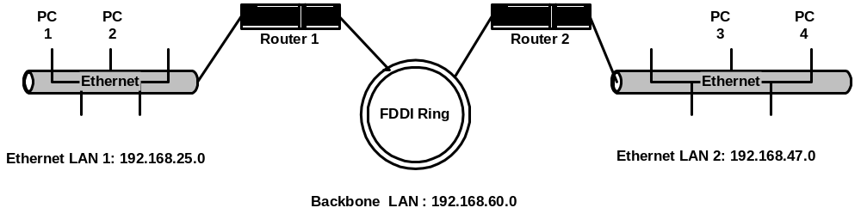
ARP Examples
Two ethernet LANs each connected via a router to a fiber ring network, labeled Backbone.
Carol Davids © 2014

Slide 45
ARP Examples
Each LAN has an IP address ending in 0.
Each router has two IP addresses - one IP address on each LAN to which it is connected.
Carol Davids © 2014

Slide 46
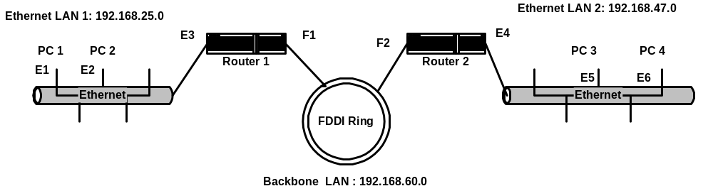
Gratuitous ARP
When PC 1 boots up it sends a gratuitous ARP - “Who has my IP address?”
Every PC on LAN 1 reads and records the correspondence MAC 1 <-> IP Address 1.
This builds every PC’s ARP Cache.
Carol Davids © 2014

Slide 47
Why Gratuitous ARP ?
Cuts down ARP traffic by filling up Cache tables at bootstrap time.
Prevents two PCs being given the same IP Address.
  Normally there is no response to a Gratuitous ARP.
  If a reply is received an error message is logged that reads: “Duplicate IP Address sent from Ethernet Address a:b:c:d:e:f.”
Carol Davids © 2014

Slide 48
Proxy ARP - Promiscuous ARP
PC 1 wants to send data to PC 4.
An ARP sent by PC 1 will fail, since Routers do not forward layer 2 broadcasts.
Carol Davids © 2014

Slide 49
Proxy ARP - Promiscuous ARP
Proxy or Promiscuous ARP Solution: Configure Router 1 to respond to ARP requests for network 192.168.47.0.
Note: The router is configured to operate in ‘proxy ARP’ mode
Carol Davids © 2014

Slide 50
Proxy ARP - Promiscuous ARP
‘Proxy ARP is the technique in which one device, usually a router, answers ARP requests intended for another machine.
By "faking" its identity, the router accepts responsibility for routing packets to the "real" destination.
Proxy ARP can help machines on a subnet reach remote subnets without configuring routing or a default gateway.
Proxy ARP is defined in RFC 1027.’
Source: http://www.cisco.com/warp/public/105/5.html
Carol Davids © 2014

Slide 51
RARP or DHCP
How does a computer system learn its IP address at boot time?
It reads its IP Address from a file stored on its disk.
What if the system has no disk?
Then it needs to get this information some other way
RARP - Reverse ARP was the first method devised.
DHCP - Dynamic Host Configuration Protocol is what we use today.
Carol Davids © 2014

Slide 52
How RARP Works
The diskless system reads its MAC address from its NIC card.
The system sends a RARP request.
A RARP server responds with information about the associated IP Address.
Carol Davids © 2014

Slide 53
Disadvantage of RARP
Disadvantage is that you need the RARP server.
RARP messages are sent via ethernet broadcast.
Routers do not forward these packets.
This procedure eats up bandwidth and processor time.
Carol Davids © 2014

Slide 54
BOOTP/DHCP instead of RARP
BOOTP / DHCP is an application layer protocol that gets around the limitations of RARP.
BOOTP /DHCP messages are carried in layer-4 (UDP) packets and so are forwarded by routers.
Carol Davids © 2014

Slide 55
BOOTP/DHCP instead of RARP
BOOTP / DHCP provide more information to the diskless system than just its IP Address.
They can also provide the IP Address where the systems configuration file is located.
BOOTP / DHCP is described in the text.
Carol Davids © 2014

Slide 56
The End
Carol Davids © 2014

