Slide 1


ITM 540
Data Networks
The Data Link Layer
Functions and Services
Error Detection and Correction
Professor: Carol Davids
Email: davids@iit.edu
Carol Davids © 2015

Slide 2
Reading Assignments
Forouzan: Chapter 10: Error Control – selected reading.
10.1
10.2
10.3 up to Table 10.3 on page 279
Carol Davids © 2015

Slide 3
Error Detection and Corrections
Concepts, terms and definitions
  Types of errors
  Redundancy
  Error Detection vs. Error Correction
  Forward Error Correction
  Block Coding
Carol Davids © 2015

Slide 4
Types of Errors
Single Bit Errors
Burst Errors
Carol Davids © 2015

Slide 5

Single Bit Error
Only one bit in the unit of bits is flipped
Carol Davids © 2015

Slide 6
Types of Errors
Single bit errors
  only one bit in the data packet is changed
  A single 1 becomes a 0 or a single 0 becomes a 1
  More likely on parallel connections
Carol Davids © 2015

Slide 7

Burst Errors
Two or more flipped bits exist within the unit of bits
The length of the errored burst is measured from the first to the last flipped bit.
Carol Davids © 2015

Slide 8
Burst Errors
Burst errors
  Two or more bits of the data packet change
  Normally occur as the result of noise
  Noise lasts more than one bit interval
Carol Davids © 2015

Slide 9
Example
A burst of noise lasts .01 seconds on a channel carrying data at 1200 bps. How many bits may be affected by this burst of noise?
Noise lasts 10⁻² sec = .01 sec
Data flows at 1200 bits/sec
1200 b/sec x .01 sec = 12 bits
Carol Davids © 2015

Slide 10
Redundancy (extra bits)
The key to error detection and error correction is redundancy
That is to say, we send extra (redundant) bits over and above the actual data we want to send
How many redundant bits - and what pattern of redundant bits - are the subject of this lecture.
Carol Davids © 2015

Slide 11
100 % Redundancy
Send every data unit twice
Do a bit-by-bit comparison at far end of the transmission
If the two bits are not the same, conclude there has been a bit error
That is, if the bit pattern we want to send is 01001100 then we actually put the following bit pattern onto the line: 01001100 01001100
Carol Davids © 2015

Slide 12

Block Codes and redundant bits
To detect or correct errors, it is necessary to send extra bits - referred to as REDUNDANT bits.
Carol Davids © 2015

Slide 13

Redundant bits in block codes
If you take your data k bits at a time and map each group of k bits to a group of n bits, where n > k, there are n-k redundant bits in each group of code words you put onto the channel.
Carol Davids © 2015

Slide 14
Redundant bits in block codes
Your code book contains 2^{k} data words, mapped to 2^{n} code words.
So there are 2^{n} - 2^{k} code words that do not correspond to data words.
Carol Davids © 2015

Slide 15
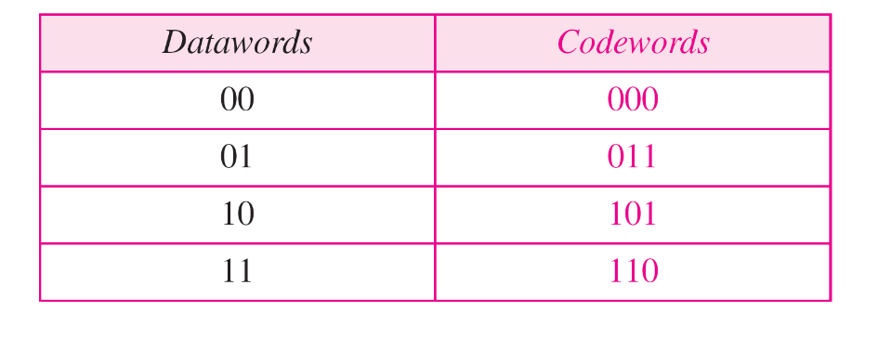
Example 1
Let k = 2 and n = 3 and use the code book below.
The pattern 01 is sent to the line coder as the bit pattern 011
Carol Davids © 2015

Slide 16
Example 1 - Case 1
Data to be sent is ’01’
Code word sent is 011 – no errors are introduced
The receiver receives 011, looks it up, realizes it is a valid code word decodes it as 01 and sends it up the stack
Carol Davids © 2015

Slide 17
Example 1 - Case 2
Data to be sent is ’01’
Code word sent is 011 - A single bit error is introduced during transmission
The receiver receives 111, looks it up, realizes it is an invalid code word
Carol Davids © 2015

Slide 18
Case 2 - continued
Can the receiver figure out what was sent?
If the receiver was told that a single bit had been flipped, it could look at the received pattern and say, this could have been 011, or 101, or 110. There is no way of telling which pattern was actually sent. The receiver discards the packet.
Carol Davids © 2015

Slide 19

Example 2
Data is divided into 2 bit blocks, and sent in 5 bit blocks
So there are 3 redundant bits added to each data block
k = 2; n = 5. There are 4 bit patterns and 32 possible code words to associate them with.
Carol Davids © 2015

Slide 20
Example 2
The association we chose is the codebook shown below.
If we want to send the bit pattern 01, we send the code word 01011
Carol Davids © 2015

Slide 21
Example 2 – Case 1
Assume a single bit error
Case 1: 01011 is sent but 01001 is received
Receiver notes that 01001 is not in the code book, but now tries to fix the error
Carol Davids © 2015

Slide 22
Example 2
It has been told to correct single bit errors – only one bit is flipped, so it compares the pattern 01001 to the good code words
Can’t be 00000 because that would imply 2 errors
Carol Davids © 2015

Slide 23
Example 2
Cant’ be 10101: compare 01001 (3 bit flips)
Can’t be 11110: compare 01001 (4 bit flips)
Could be 01011: compare 01001 (1 bit flip) since that differs from 01001 by only one bit
So, the receiver concludes that 01001 was the code word that the sender intended. The receiver decodes this as ’01’ and sends that bit pattern up.
Carol Davids © 2015

Slide 24
Note
In these examples, the number of potential code words is greater than the number of bit patterns that we need to send.
That allows us to select the code words using a method that lets us detect and correct errors.
There are different methods for selecting the code words.
We will consider only a few of them.
Some ways allow us to detect the fact that there was an error.
Others allow us to correct the error.
Carol Davids © 2015

Slide 25
Simple Parity Check
The Simple Parity Check is an example of a linear block code
Take your data k bits at a time and add a single bit
So n = k + 1, where n is the length of the code word
What is the method or algorithm that you will use to select the value of that redundant bit?
The bit is added in such a way as to make the parity of the code word even (even parity) or odd (odd parity.)
Carol Davids © 2015

Slide 26
Simple Parity Check
Exercise: Create a simple parity check block code that takes 3-bit blocks of data and maps them to 4-bit code words.
Carol Davids © 2015

Slide 27
Simple Parity Check
The code can detect single bit errors
The code cannot correct errors
Carol Davids © 2015

Slide 28
Parity Check Method
Add the 1’s and determine if the result is odd or even.
Then add an extra bit to the data unit - so that if the data unit originally had 3 bits it would now have 4.
The bit you add is a 1 or a 0 depending upon whether you want the resulting data unit to have odd parity or even
Carol Davids © 2015

Slide 29
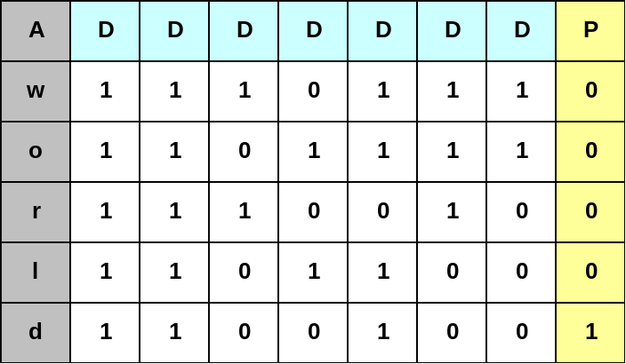
Parity Check
Example 1 from text:
To send the letter w, you send the data bits 1110111
There are an even number of 1’s
So, for even parity, the parity bit is 0
Carol Davids © 2015

Slide 30
Parity Check
Example 1, continued:
To send the letter o, you send the data bits 110111
There are an even number of 1’s
So, for even parity, the parity bit is 0
Carol Davids © 2015

Slide 31
Parity Check
Example 3:
Given even parity, if the receiver gets the following packet, will it declare an error?
11111110 - yes
11011110 - no
11101100 - yes
Carol Davids © 2015

Slide 32
How Good is the Parity Check Method?
Detects all single bit errors
Detects an odd number of bit errors
Cannot detect an even number of bit errors
That is to say, it only detects burst errors if the number of errored bits is odd
Carol Davids © 2015

Slide 33
Cyclic Codes
A Cyclic Code is a linear block code with the additional property that if a code word is cyclically shifted, the result is another code word
To cyclically shift one bit, take the left most bit and move it to become the right most bit.
If the code is cyclic, then the resulting bit pattern is also found in your code book.
Carol Davids © 2015

Slide 34

Cyclic Codes
Example of a Cyclic Code with 7 bit code words mapped to 4 bit data words C(7,4)
If you shift 0001011 left you get 0010110, which is also a code word, for example.
Carol Davids © 2015

Slide 35
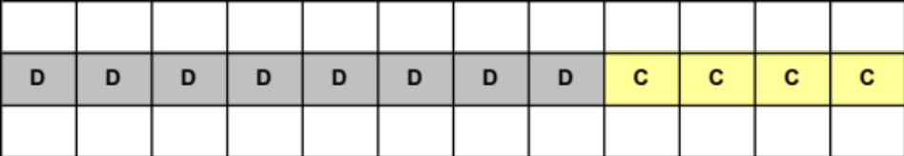
Cyclic Redundancy Check (CRC)
Parity check was based on addition
CRC is based on division
We add a set of bits to the end of the data bits.
The set of bits is called the ‘Cyclic Redundancy Check’ or the ‘CRC remainder’
Carol Davids © 2015

Slide 36
Generating the CRC bits – an example
In this example we take the data bits 4 at a time and we add 3 overhead bits to create an 7 bit code word.
First we set the 'C' bits to 0.
Then we divide that 7-bit code word by a 4 bit divisor that is defined specifically for our CRC code.
D | D | D | D | C | C | C
1 | 0 | 0 | 1 | 0 | 0 | 0
Carol Davids © 2015

Slide 37
Generating the CRC bits – an example
The result of the division will be a quotient and a remainder.
We discard the quotient and save the remainder, which will be 4 bits long.
We put the remainder, which will be 3-bits long, into the place held for the C bits.
D | D | D | D | R | R | R
Carol Davids © 2015

Slide 38
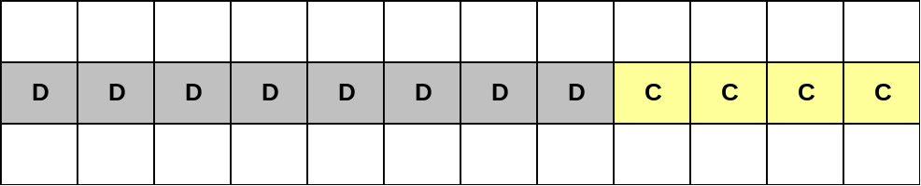
Cyclic Redundancy Check (CRC)
You create the CRC bits by dividing the code word by a pre-determined divisor.
The CRC bits are the remainder of the division.
Carol Davids © 2015

Slide 39
Cyclic Redundancy Check (CRC)
At the far end, the received packet is again divided by the pre-determined divisor.
There should be a remainder of 0 at this end if there were no bit errors.
Carol Davids © 2015

Slide 40
Cyclic Redundancy Check (CRC)
The Ethernet II and IEEE 802.3 datalink specifications define a CRC remainder that is 4 bytes long, that is, 32 bits long.
The CRC divisor must be 33 bits long in order to produce a 32 bit long remainder.
Carol Davids © 2015

Slide 41
Cyclic Redundancy Check (CRC) Process
Here is the process by which the CRC check is performed:
Add a string of 32 0’s to the end of the data packet you plan to send.
Divide by a well-know divisor of length 33
Replace the original string of 32 0’s with the remainder of the division
Send this extended data packet to the far end.
Carol Davids © 2015

Slide 42
Cyclic Redundancy Check (CRC)
The receiver treats the extended packet as a single unit and divides that unit by the well-known divisor
If the division yields a remainder of 0, the data has arrived without errors
If the division yields a non-0 remainder the arriving data contained errors.
Carol Davids © 2015

Slide 43
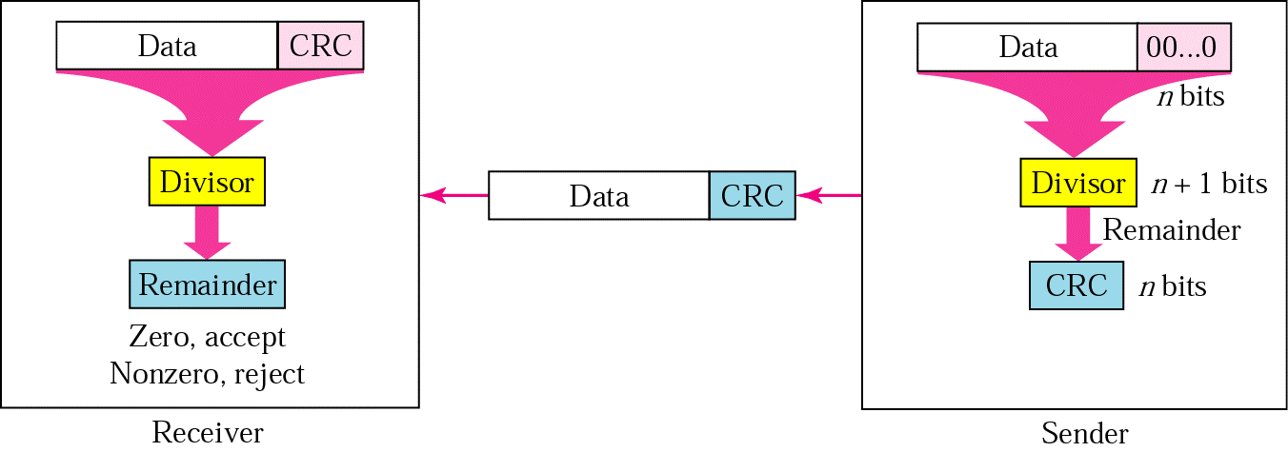
CRC Generator and CRC Checker
Illustration 10.7, from Forouzan edition 3
Data flows from right to left in the illustration.
Carol Davids © 2015

Slide 44

CRC Checker
In Illustration 10.16, edition 4, the right most example shows that an error has been detected.
Carol Davids © 2015

Slide 45
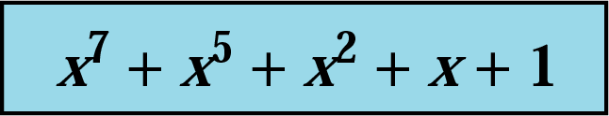
Polynomial Representation
It is convenient to express the divisor in the CRC generator as a polynomial.
In the illustration in the text, we see a 7th order polynomial. It is used to represent a string of 8 bits as follows:
(b8, b7, b6, b5, b4, b3, b2, b1, b0) where b8 is the coefficient of X⁷, b7 is the coefficient of X⁶,… b0 is the coefficient of X⁰
Carol Davids © 2015

Slide 46
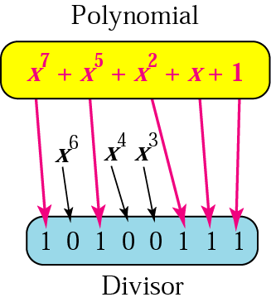
Polynomial Representation
Additional illustration of this way of representing the divisor is in figure 10.11 below.
Carol Davids © 2015

Slide 47
Selection of Divisor
The divisor can be selected in such a way that:
All burst errors of length equal to the polynomial’s degree are detected, AND
All burst errors that affect an odd number of bits are detected.
The proof is beyond the scope of this course
Carol Davids © 2015

Slide 48
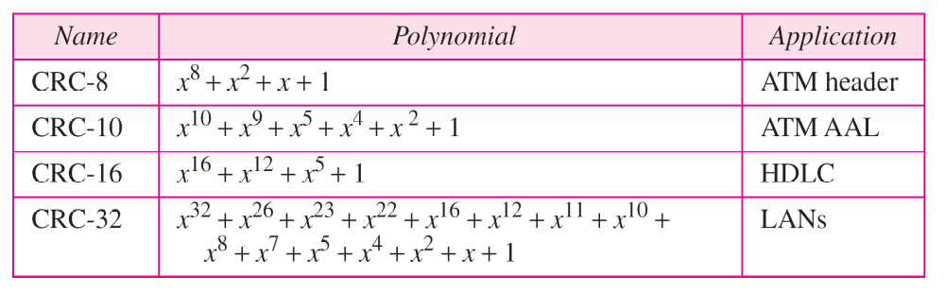
Standard Polynomials
Table 10.7 in Forouzan, edition 4.
Practice identifying the degree of the polynomials:
CRC-8: degree = 8
CRC-10: degree = 10
Carol Davids © 2015

Slide 49
CRC for Ethernet
http://www.relisoft.com/Science/CrcMath.html
The key used by the Ethernet is 0x04c11db7.
It corresponds to the polynomial:
x³² + x²⁶ + x²³ + x²² + x¹⁶ + x¹² + x¹¹ + x¹⁰ + x⁸ + x⁷ + x⁵ + x⁴ + x² + x + 1
0000 0100 1100 0001 0001 1101 1011 0111
Coefficient of x²⁶ = 1
Coefficient of x³¹ = 0
Coefficient of x¹² = 1
Coefficient of x⁰ = 1
***We know that the coefficient of x³² is 1 so we do not store (or show) it.
Carol Davids © 2015

Slide 50
CRC
http://www.relisoft.com/Science/CrcMath.html
The longer the key, the better error checking.
Ethernet packets use a 32-bit CRC corresponding to degree-31 remainder.
You need n + 1 coefficients for a degree-n polynomial.
Carol Davids © 2015

Slide 51
Other CRC Polynomials
CRC-12 : x¹² + x¹¹ + ... + x³ + x² + x¹ +1
Used for transmission of streams of 6-bit characters
Generates a 12 bit Frame Check Sequence
Carol Davids © 2015

Slide 52
Other CRC Polynomials
CRC-16 : x¹⁶ + x¹⁵ + ... + x² + 1
CRC-CCITT: x¹⁶ + x¹² + ... + x⁵ +1
Used for 8-bit characters in the US and Europe, respectively
Gives a 16 bit Frame Check Sequence.
Carol Davids © 2015

Slide 53
Other CRC Polynomials
CRC-32: x³² + x²⁶ + x²³ + x²² + x¹⁶ + x¹² + x¹¹ + x¹⁰ + x⁸ + x⁷ + x⁵ + x⁴ + x²+ x¹ +1
This is an option in some point to point synchronous transmission standards
It is used in IEEE 802 LAN standards as well.
We also saw it used on the Ethernet LAN.
Carol Davids © 2015

Slide 54
Checksum
A third method of error detection is the checksum.
It uses ones-complement addition to create string of bits to append to the original data
We will study the checksum method later in this course.
Carol Davids © 2015

Slide 55
The End
Carol Davids © 2015

