Slide 1


ITM 540
Data Networks
The Network Layer
Layer 3
The IPv4 Header Fields and their uses
Professor: Carol Davids
Email: davids@iit.edu
Carol Davids © 2015

Slide 2
Reading Assignment
Forouzan :
Chapter 20: TOS, Fragmentation, Checksum HLEN, and Protocol Type header fields
Pp 583-603
Carol Davids © 2015

Slide 3

IPv4 related to other protocols
IPv4 is one of several network layer protocols
Others are IGMP, ICMP, ARP and RARP
We will study ICMP, ARP and IPv4 this semester
Carol Davids © 2015

Slide 4
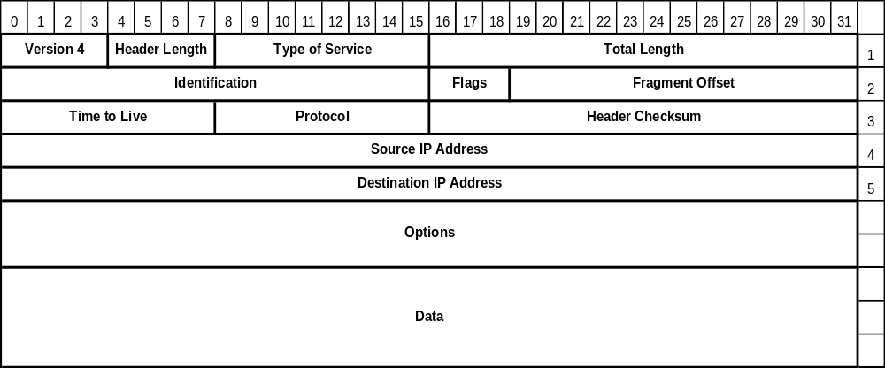
IP Protocol Datagram Format: top row
The fields in the top row of the IP datagram provide information about the datagram itself and the protocol that in encapsulates.
Carol Davids © 2015

Slide 5
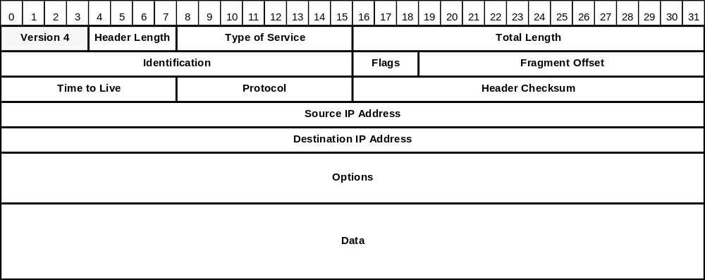
Version ( 4 bit field )
Indicates which version of the IP protocol was used to encode this datagram.
Enables the gradual adoption of new versions such as IP Version 6.
Carol Davids © 2015

Slide 6

Header Length ( 4 bit field)
The length of the header in 32-bit words
Its minimum value is 5: 5 words that are 4 bytes long = 20 bytes: The minimum header length is is 20 bytes.
Its maximum value is 15: 15 words that are 4 bytes long = 60 bytes: The maximum header length is 60 bytes.
Carol Davids © 2015

Slide 7
Example 1 of use of HLEN field:
If an IPv4 datagram arrives at a router with the first bytes as follows, what will the router do?
01000010…..
Answer: discard it
Why:
When the router parses the header it sees, 0100 = 4 for the version, that is good.
Then it reads 0010 = 2 for the HLEN. But the minimum value for HLEN is 0101 = 5, so the router discards the datagram.
Carol Davids © 2015

Slide 8
Example 2 of use of HLEN field:
If an IPv4 datagram arrives at a router with the first bytes as follows: How many options are carried in the packet?
01001000…..
Answer: The HLEN = 8, 4-byte words. The length without any options is 5, 4-byte words. So there are 3, 4-byte words that describe options. That is, 12 bytes of options
32 – 20 == 12
Carol Davids © 2015

Slide 9
Example use of HLEN plus total length
If an IPv4 datagram has HLEN = 5, and the total length field is 0x0028, how many bytes of data are carried in the datagram?
Answer:
The HLEN = 5 , so there is a 20 byte header;
Total length = 32 + 8 = 40 bytes (because 0x0028 == (2x16) + (8x1) )
40 - 20 = 20 bytes of data are carried in the datagram
Carol Davids © 2015

Slide 10
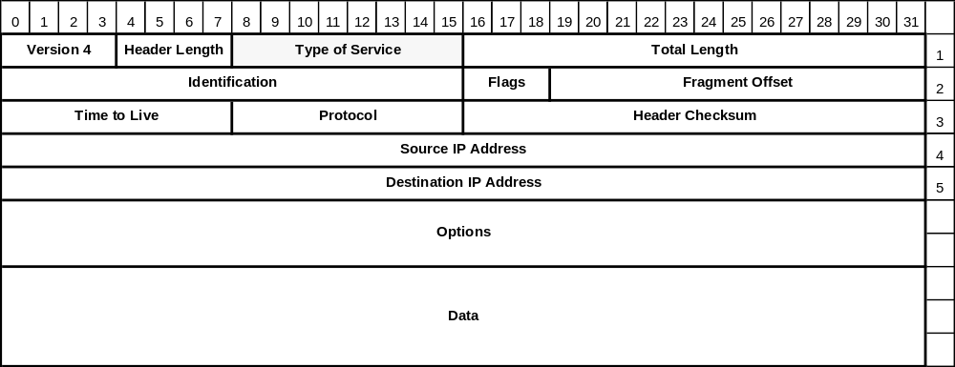
Type of Service (8 bits ) (TOS)
Distinguishes between different classes of service.
Classes of service can be defined by speed, reliability and priority.
Carol Davids © 2015

Slide 11
Type of Service (TOS) field – 8 bits long
This field is used to tell the router what priority to give to the delivery of this IP datagram.
The encoding of these 8 bits can use one of two methods.
Service Type or Differentiated Services Code Point
Service Type values are listed and described at http://www.iana.org/assignments/ip-parameters/ip-parameters.xhtml#ip-parameters-3
Carol Davids © 2015

Slide 12

'Service Type' or 'Differentiated Services'
The picture on the left shows how the 8 bits in the TOS field are used when the encoding is for Service Type. 4 of the bits have significance.
The picture on the right shows how the 8 bits in the TOS field are used when the encoding is for Differentiated Services Code Point or DSCP. 6 of them have significance. The other two are used for ECN.
Carol Davids © 2015

Slide 13

Service Type
The 8 bits of the TOS field are used as follows.
The first 3 are named the 'precedence bits' but are not used
Of the next 4, only one may be set .
Either
  minimize delay
  maximize throughput
  maximize reliability
  minimize monetary cost
The final bit is always set to zero
Carol Davids © 2015

Slide 14
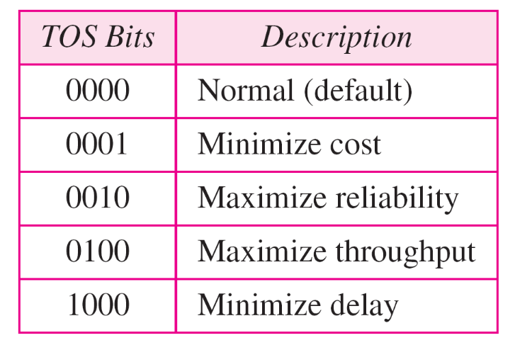
Service Type Codes
Service Type code interpretation:
Carol Davids © 2015

Slide 15

Default Service Types for well-known services
Carol Davids © 2015

Slide 16
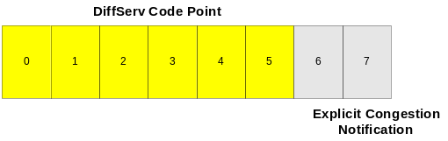
DiffServe in the TOS Field
DiffServ is a method, specified in RFC 2475 and 3260 that enables one application to receive more bandwidth than another.
The method involves redefining the TOS bits in the IP header and using different values there to represent different classes of service.
Carol Davids © 2015

Slide 17
DiffServe and TOS Field
Within the network the DSCP (DiffServ Code Point) is used to determine the Per Hop Behavior of the IP datagram.
This means that routers in the network core need to be able to read the DSCP and take the appropriate action.
Look at the traces on the next pages," cisco_OffToOn" and "skype" for examples of diffserve code point settings.
Carol Davids © 2015

Slide 18
Codepoints in diffserv field
IANA list of diffserv code points: http://www.iana.org/assignments/dscp-registry/dscp-registry.xhtml
http://tools.ietf.org/html/rfc2474
http://tools.ietf.org/html/rfc2597 (assured forwarding)
http://tools.ietf.org/html/rfc3246 (expedited forwarding)
http://tools.ietf.org/html/rfc5865 (voice-admit, for real-time traffic)
Carol Davids © 2015

Slide 19
Internet Protocol, Src Addr: 192.168.123.6 (192.168.123.6), Dst Addr: 192.168.123.1 (192.168.123.1)
Version: 4
Header length: 20 bytes
Differentiated Services Field: 0x68 (DSCP 0x1a: Assured Forwarding 31; ECN: 0x00)
Total Length: 52
Identification: 0x15fe (5630)
Flags: 0x00
Fragment offset: 0
Time to live: 64
Protocol: TCP (0x06)
Header checksum: 0xed05 (correct)
Source: 192.168.123.6 (192.168.123.6)
Destination: 192.168.123.1 (192.168.123.1)
Signaling data is carried using point code 0x68 which stands for Assured Forwarding
Carol Davids © 2015

Slide 20
Internet Protocol, Src Addr: 192.168.123.21 (192.168.123.21), Dst Addr: 192.168.123.3 (192.168.123.3)
Version: 4
Header length: 20 bytes
Differentiated Services Field: 0xb8 (DSCP 0x2e: Expedited Forwarding; ECN: 0x00)
Total Length: 200
Identification: 0x006b (107)
Flags: 0x00
Fragment offset: 0
Time to live: 254
Protocol: UDP (0x11)
Header checksum: 0x4398 (correct)
Source: 192.168.123.21 (192.168.123.21)
Destination: 192.168.123.3 (192.168.123.3)
RTP data is carried using point code 0x2e which stands for expedited forwarding
Carol Davids © 2015

Slide 21
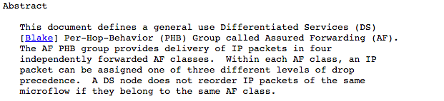
Assured Forwarding: RFC 2597
Carol Davids © 2015

Slide 22
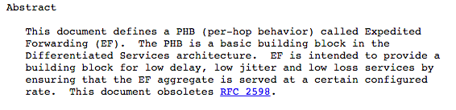
Expedited Forwarding: RFC 3246
Carol Davids © 2015

Slide 23
Explicit Congestion Notification (ECN)
Last (lowest) 2 bits of the 8-bit TOS field
Use of this 2-bit field is specified in RFC 3168
Optional feature
Only used when both endpoints signal they want to use it
Currently supported values:
  ECN-unaware Transport
  ECN-aware Transport
  Congestion Experienced
Requires the support of the Transport Layer process
Carol Davids © 2015

Slide 24

Total Length (16 bit field )
Length in bytes of the entire datagram - header and body. Header length + body length == total length
Current upper limit is 2¹⁶ or 65536. In the future, larger datagrams may be needed. (for gigabit networks)
Carol Davids © 2015

Slide 25

Fragmentation
The second row of the IP header is dedicated to fragmentation
Fragmentation is the process of breaking up the IP datagram into packets no larger than the Maximum Transfer Unit length of the particular LAN/WAN that must be traversed
Carol Davids © 2015

Slide 26
Fragmentation
Remember that Ethernet’s MTU is 1500 bytes
That is, Ethernet II cannot carry any payload larger than 1500 bytes long
Ethernet wraps the network layer datagram in a 14 byte header and a 4 byte trailer
Carol Davids © 2015

Slide 27
Fragmentation on entering an Ethernet II LAN
The total length of the layer two frame must be less than or equal to 1518 bytes
The total length of the body of the layer two frame must be less than or equal to 1500 bytes
That means, the total length of the IP datagram carried inside the Frame must be less than or equal to 1500 bytes.
Carol Davids © 2015

Slide 28

Maximum Transfer Units (MTU)
Examples of different WAN/LAN protocols and their MTUs
FDDI: Fiber Distributed Data Interface; Another layer 2 protocol
Hyperchannel: Another layer 2 protocol for use on thick coax and running 50 Mbps
Carol Davids © 2015

Slide 29
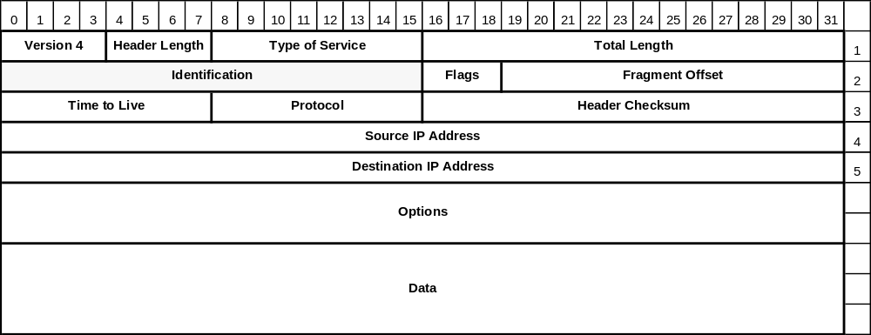
Identification (16 bit field )
Tells the receiving host which datagram this fragment belongs to.
All fragments of a datagram have the same Identification value.
Carol Davids © 2015

Slide 30
Flags (3 bit field - each bit is one flag)
First bit is unused.
Second bit is the DF bit - Don’t Fragment.
Third bit is the MF bit - More Fragments
Carol Davids © 2015

Slide 31

Detail on flags used for fragmentation
If the ‘do not fragment’ bit is set, then it is necessary to either discard the datagram or to send it un-fragmented
If the ‘more fragments’ bit is sent, then the datagram must be reassembled before being sent up to layer 4.
Carol Davids © 2015

Slide 32
Don’t Fragment
Tells the router not to fragment the datagram because the receiving system cannot put the fragments back together.
A datagram marked DF may be routed around small-packet networks, even though those networks might provide a quicker or less costly route.
Example of use: When a computer boots, its ROM may ask for a memory image to be sent in a single datagram
Carol Davids © 2015

Slide 33
More Fragments
Tells the receiving system that it has not gotten all the pieces of the datagram yet.
All fragments except the final fragment have the MF bit set.
Carol Davids © 2015

Slide 34
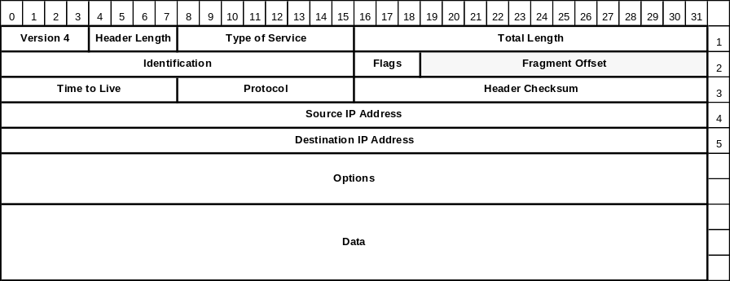
Fragment Offset (13 bit field )
Tells the receiving host where in the datagram this fragment belongs.( Helpful in case two fragments took different paths and the later one was received earlier.)
All fragment offsets except the last one must be a multiple of 8 bytes.
Carol Davids © 2015

Slide 35
Fragment Offset (13 bit field )
The shortest allowed fragment unit is 8 bytes long.
All fragments but the last fragment must be at least 8 bytes long.
All fragments but the last fragment must be multiples of 8 bytes in length
Since the field that identifies the fragment is 13 bits long, it is possible to identify 2¹³ different fragments.
That is, there can be up to 8,192 fragments to a datagram.
Carol Davids © 2015

Slide 36

Example 2
The original datagram is 4000 bytes long. It is divided into three fragments. The first fragment is 1400 bytes long. The second is also 1400 bytes long. The last is 1200 bytes long.
Carol Davids © 2015

Slide 37
Example 2
The original datagram is 4000 bytes long. It is divided into three fragments. The first fragment is 1400 bytes long. The second is also 1400 bytes long. The last is 1200 bytes long.
More fragments flag is set
Fragment offset = 0
More fragments flag is set
Fragment offset = 2800/8 = 350
More fragments flag is set
Fragment offset = 1400/8 = 175
Carol Davids © 2015

Slide 38

example 3
In this example, Fragment 2 is fragmented again.
Each datagram has a 20 byte header. If you sum the body lengths of the fragments they add up to the body length of the original datagram.
Carol Davids © 2015

Slide 39
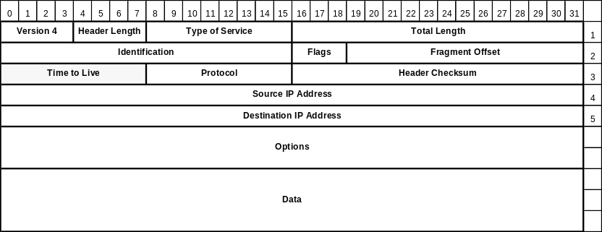
Time To Live (8 bit field )
This field is a counter. It is used to limit the number of routers a datagram may pass through.
It was designed to have units of seconds.
We use it to count “hops”, where each router is one hop.
Carol Davids © 2015

Slide 40
Time To Live (8 bit field )
Each router that handles the packet decreases the value in this field by 1.
When the counter reaches the value 0, the packet is discarded and a warning message is sent back to the source host.
The warning message is sent in an ICMP datagram. ICMP is the management protocol associated with the IP protocol.
Carol Davids © 2015

Slide 41
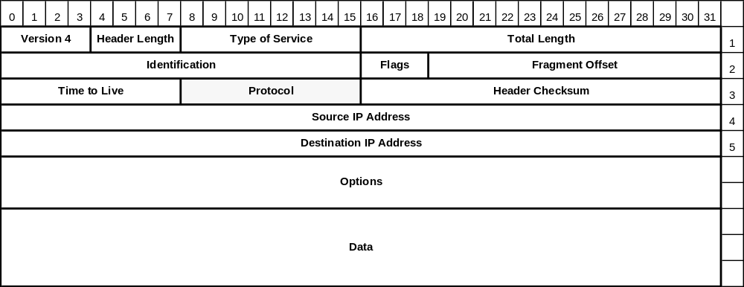
Protocol (8 bit field )
The protocol field tells the network layer where to deliver the datagram.
That is, which layer 4 process needs to receive this datagram.
Carol Davids © 2015

Slide 42
Protocol (8 bit field )
Possible layer 4 processes include UDP, encoded as 17, and TCP, encoded as 6.
These encodings are industry standard.
The current list can be found on-line at IANA’s web site http://www.iana.org/numbers.html
IANA is the Internet Assigned Numbers Authority.
Go to this document to learn the values that can be placed in the protocol field of an IP datagram: http://www.iana.org/assignments/protocol-numbers/protocol-numbers.xml
Carol Davids © 2015

Slide 43
Protocol (8 bit field )
More examples of protocols that can be used as a layer 4, transport layer, carried in the body of an IP datagram:
HIP, the Host Identity Protocol is 139
SCTP, the Streaming Control Transport Protocol is 132
MPLS in IP is 137
PIPE, Private IP Encapsulation within IP, is 131
Carol Davids © 2015

Slide 44
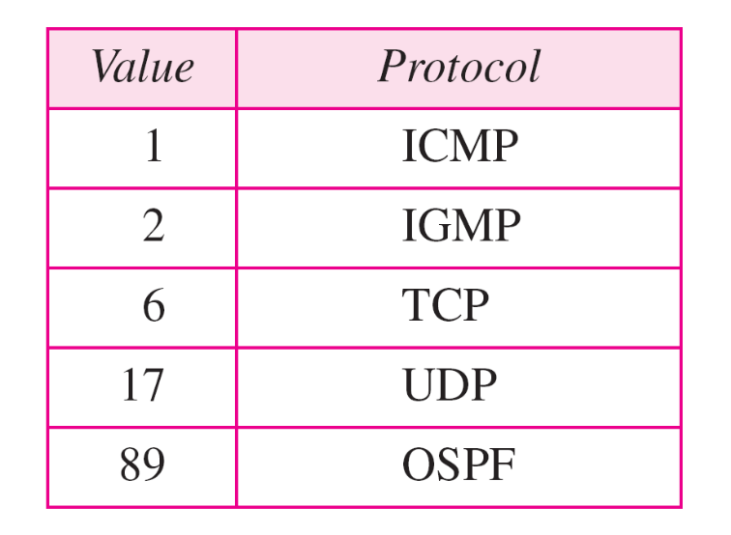
Values for Protocol Types
Carol Davids © 2015

Slide 45

Header Checksum (16 bit field )
The header checksum only verifies the header bits.
It is designed to detect bad memory words in the router.
Carol Davids © 2015

Slide 46
Header Checksum (16 bit field )
Each router needs to recalculate the checksum because at least one field changes with each hop - the TTL.
Carol Davids © 2015

Slide 47
Header Checksum (16 bit field )
  Sender sets the checksum value to 0.
    Adds up all the 16 bit half words
    Takes the 1’s complement of the result.
    Puts this value into the Checksum field
  The receiver adds up all the 16 bit words.
    Takes the 1’s complement of the result
    If answer is not 0, the datagram is discarded
  Refer to Section 10.5, Forouzan, ed.4
Carol Davids © 2015

Slide 48

Calculating the value of the header checksum
If you are creating the IP Datagram header:
Take the header bytes two at a time and stack them up into an addition problem.
Place two hexadecimal 0's in the place where you will put the checksum value.
Do 'Ones Complement' Addition.
Take the 'Ones Complement' of the result. That is the checksum.
Put the checksum value into the checksum field.
Send the IP Datagram.
Carol Davids © 2015

Slide 49
Ones Complement and Ones Complement Addition
How to take the ones complement of a binary number:
Turn all the 1's to 0's and all the 0's to 1's.
Examples:
7 = 0111. Its 1’s complement is 1000, which is 0x8 (hex 8)
4 = 0100. Its 1’s complement is 1011, which is 0xB (hex B)
E = 1110. Its 1's complement is 0001, which is 0x1
Carol Davids © 2015

Slide 50
Ones Complement and Ones Complement Addition
Ones complement addition is an operation on binary numbers that allows you to create a sum of the same length as the numbers you are adding. You wrap around any carry in the high order bit and add it to the least significant bit of the sum.
You are not required to do this addition for this course. You are required to know how to set up the problem.
You are also required to know how to take the ones complement of a binary number.
Carol Davids © 2015

Slide 51
Example header checksum
Frame 166: 396 bytes on wire (3168 bits), 396 bytes captured (3168 bits) on interface 0
Ethernet II, Src: D-Link_38:cd:51 (00:1e:58:38:cd:51), Dst: Apple_cf:fd:90 (04:0c:ce:cf:fd:90)
Internet Protocol Version 4, Src: 74.125.230.120 (74.125.230.120), Dst: 192.168.0.197 (192.168.0.197)
Version: 4
Header length: 20 bytes
Differentiated Services Field: 0x20 (DSCP 0x08: Class Selector 1; ECN: 0x00: Not-ECT (Not ECN-Capable Transport))
Total Length: 382
Identification: 0x878d (34701)
Flags: 0x00
Fragment offset: 0
Time to live: 51
Protocol: TCP (6)
Header checksum: 0x0c6a [correct]
Source: 74.125.230.120 (74.125.230.120)
Destination: 192.168.0.197 (192.168.0.197)
[Source GeoIP: Unknown]
[Destination GeoIP: Unknown]
Transmission Control Protocol, Src Port: http (80), Dst Port: 50096 (50096), Seq: 1, Ack: 547, Len: 330
Hypertext Transfer Protocol
0000 04 0c ce cf fd 90 00 1e 58 38 cd 51 08 00 45 20 ........X8.Q..E
0010 01 7e 87 8d 00 00 33 06 0c 6a 4a 7d e6 78 c0 a8 .~....3..jJ}.x..
0020 00 c5 00 50 c3 b0 25 df b5 6c 1f f1 de 38 80 18 ...P..%..l...8..
0030 01 55 e9 60 00 00 01 01 08 0a 84 93 f7 c8 32 c4 .U.`..........2.
0040 a8 1a 48 54 54 50 2f 31 2e 31 20 32 30 34 20 4e ..HTTP/1.1 204 N ………
Carol Davids © 2015

Slide 52
Example of how to set up the checksum
45 20
01 7e
87 8d
00 00
33 06
0c 6a
4a 7d
e6 78
c0 a8
00 c5
______
Add these numbers using ones complement arithmetic
Then take the ones complement of the result.
This ones complement is the checksum.
Carol Davids © 2015

Slide 53
Reference
http://www.netfor2.com/checksum.html
http://en.wikipedia.org/wiki/Ones'_complement
Carol Davids © 2015

Slide 54
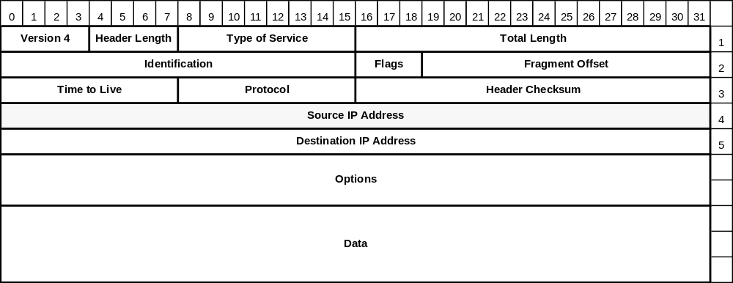
Source IP Address (32 bit field )
Indicates the IP address of the source of the datagram.
The 32 bit field allows us to identify over 4 billion (4.294967296 * 10**9) addresses.
Carol Davids © 2015

Slide 55
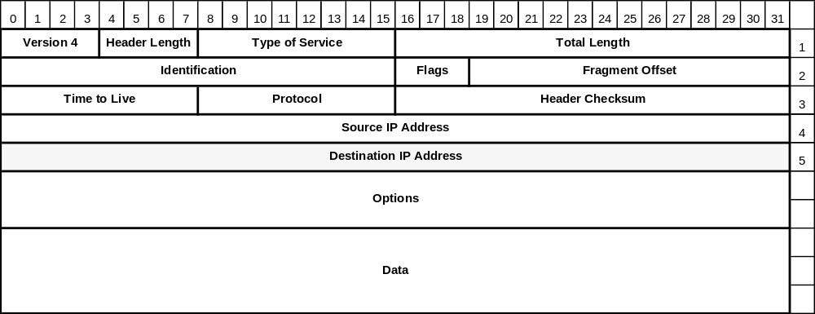
Destination IP Address (32 bit field )
Indicates the IP Address of the destination of the datagram.
The 32 bit field allows us to identify over 4 billion (4.294967296 * 10**9) addresses. (2³²)
Carol Davids © 2015

Slide 56
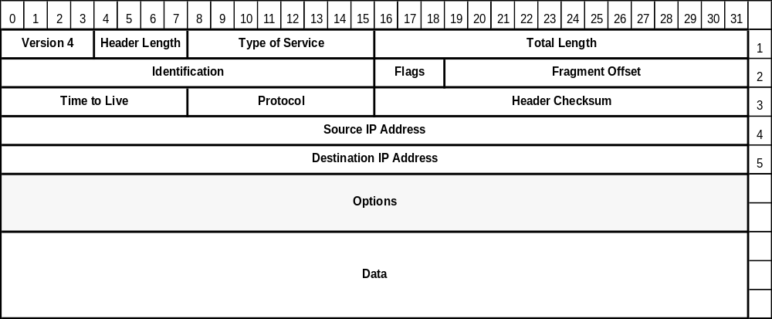
Options (varies )
The Options field serves to future-proof the IP protocol.
Carol Davids © 2015

Slide 57
Options (varies )
It allows experimenters to include information in the IP header that is not presently specified.
Designers can use this without burdening the specification with bits that will rarely be used.
Carol Davids © 2015

Slide 58
Options
An option can have variable length.
An option begins with a 1 byte code that identifies the option.
Following the option code there may be a length field telling how long the option is.
Following this optional length field is one or more data bytes.
The options field is always padded out to fill up 4 bytes – that is, one ‘line’ of the diagram, or one 4-byte word.
Carol Davids © 2015

Slide 59
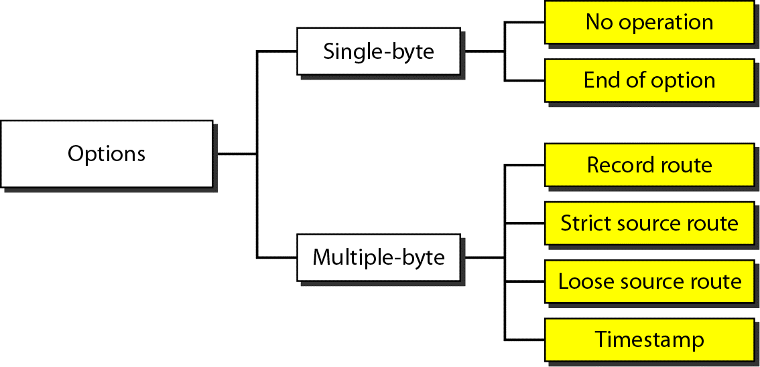
Taxonomy of options IPv4
This illustration helps understand the different possible options for IPv4.
Carol Davids © 2015

Slide 60
Options
The current complete list of Options is found at www.iana.org/assignments/ip-parameters.
We will look at 5 current options:
  Security
  Strict source routing
  Loose source routing
  Record route
  Timestamp
Carol Davids © 2015

Slide 61
Options
Security - Option Type 130
  Tells how sensitive the information is.
Carol Davids © 2015

Slide 62
Options
Strict Source Routing - Option Type 137
  Identifies the complete path from source to destination as a series of IP addresses
  The datagram must follow this exact route.
  Used by network managers to bypass routers with corrupted routing tables and also to make timing measurements
Carol Davids © 2015

Slide 63
Options
Loose Source Routing - Option Type 131
  Identifies a list of routers through which the datagram must pass.
  The datagram may in addition pass through other routers.
  Used to force a packet to go in one general direction or another (Go east rather than west, for example.)
Carol Davids © 2015

Slide 64
Options
Record Route - Option Type 7
  Tells a router to add its IP address to the option field.
  Enables network managers to track problems in their routing tables.
Carol Davids © 2015

Slide 65
Options
Timestamp - Option Type 68
  Tells a router to add a 32-bit time stamp .
  Enables network managers to track problems in their routing algorithms.
Carol Davids © 2015

Slide 66
Wireshark Traces
  Frame 87 (87 bytes on wire, 87 bytes captured)
  Ethernet II, Src: 00:a0:c9:82:e8:16, Dst: 00:0b:46:cc:61:e1
  Destination: 00:0b:46:cc:61:e1 (216.47.140.2)
  Source: 00:a0:c9:82:e8:16 (Intel-Hf_82:e8:16)
  Type: IP (0x0800)
  Internet Protocol, Src Addr: 216.47.140.180 (216.47.140.180), Dst Addr: 192.168.123.254 (192.168.123.254)
  Version: 4
  Header length: 20 bytes
  Differentiated Services Field: 0x00 (DSCP 0x00: Default; ECN: 0x00)
  Total Length: 73
  Identification: 0xe2e8 (58088)
  Flags: 0x00
  Fragment offset: 0
  Time to live: 128
  Protocol: UDP (0x11)
  Header checksum: 0xb630 (correct)
  Source: 216.47.140.180 (216.47.140.180)
  Destination: 192.168.123.254 (192.168.123.254)
  User Datagram Protocol, Src Port: 3104 (3104), Dst Port: domain (53)
  Domain Name System (query)
Carol Davids © 2015

Slide 67
Wireshark Traces
  Internet Protocol, Src Addr: 216.47.140.180 (216.47.140.180), Dst Addr: 192.168.123.254 (192.168.123.254)
  Version: 4
  Header length: 20 bytes
  Differentiated Services Field: 0x00 (DSCP 0x00: Default; ECN: 0x00)
  Total Length: 73
  Identification: 0xe2e8 (58088)
  Flags: 0x00
  Fragment offset: 0
  Time to live: 128
  Protocol: UDP (0x11)
  Header checksum: 0xb630 (correct)
  Source: 216.47.140.180 (216.47.140.180)
  Destination: 192.168.123.254 (192.168.123.254)
Carol Davids © 2015

Slide 68
WiresharkTraces
What is the version of the IP protocol?
What is the length of the header?
What is value in the TOS field?
What is the length of the protocol data unit?
What is the ID of this fragment?
Is this datagram fragmented?
What protocol is carried in the body of this datagram?
What are the source and destination IP Addresses?
Carol Davids © 2015

Slide 69
The End
Carol Davids © 2015

Slide 70
Big Endian vs. Little Endian
Big Endian method of sending data sends the “high order” bit first. That is the one in the version field.
Carol Davids © 2015

Slide 71
Big Endian vs. Little Endian
It is important that the receiving system uses this same method - or that it translate if it uses the other “Little Endian” method.
  SPARC systems are big endian
  Pentiums are little endian.
  Software conversion is necessary on both transmit and receive sides.
Carol Davids © 2015

Slide 72
Fragmentation
IP receives a message from layer 4
IP determines that the message needs to be fragmented.
IP fragments the message.
IP adds a header to each fragment before handing the three separate protocol data units down to layer 2.
Segment 1
Segment 2
Segment 3
Carol Davids © 2015

Slide 73
Fragmentation
IP adds a header to each fragment before handing the three separate protocol data units down to layer 2.
Header 1
Segment 1
Header 2
Segment 2
Header 3
Segment 3
Carol Davids © 2015

