Slide 1


ITM 540
Data Networks
The Network Layer
Layer 3
ICMP
Professor: Carol Davids
Email: davids@iit.edu
Carol Davids © 2014

Slide 2
Reading Assignment
Forouzan :
Chapter 21: ICMP, pages 621-630
Carol Davids © 2014

Slide 3
Internet control Message Protocol (ICMP)
ICMP compensates for lack of error control and management support in the IP protocol itself
Remember we have no flow control, no sequence numbers, no fields in the IP Datagram header itself that support these functions
So a companion protocol was designed to provide this support
Carol Davids © 2014

Slide 4
Internet control Message Protocol (ICMP)
IP is always configured with a companion protocol - Internet Control Message Protocol
ICMP defines a set of Error messages and a set of Control messages
Carol Davids © 2014

Slide 5
Internet control Message Protocol (ICMP)
ICMP messages are carried inside an IP header
ICMP message then has its own header
ICMP message then has its own body
IP header
ICMP header
ICMP body
IP body
Carol Davids © 2014

Slide 6
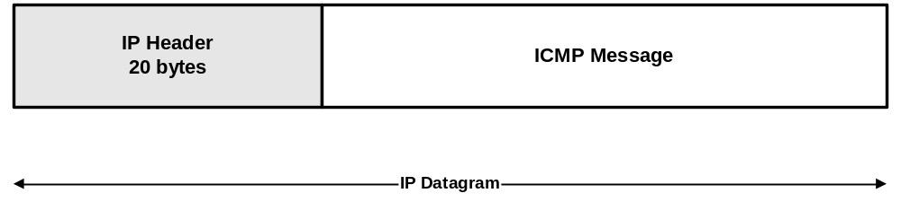
ICMP message within the IP Datagram
ICMP messages are transmitted following the IP header.
They are another type of layer 3 payload.
Carol Davids © 2014

Slide 7
ICMP is still a Layer 3 Protocol
ICMP Messages are transmitted inside IP datagrams
Remember that ARP and RARP are carried inside (encapsulated in) layer 2 frames and are considered to be layer 3 protocols.
Even though ICMP Messages are transmitted inside IP datagrams, they are still considered part of layer 3.
This would be called the ‘control plane’ of layer 3
Carol Davids © 2014

Slide 8
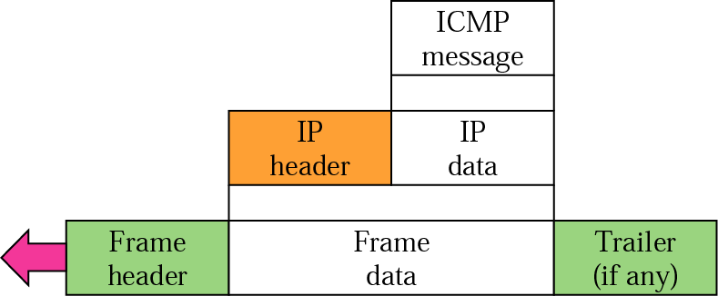
ICMP is still at layer 3
The body of the IP message encapsulated in the layer 2 frame below is an ICMP message.
Carol Davids © 2014

Slide 9
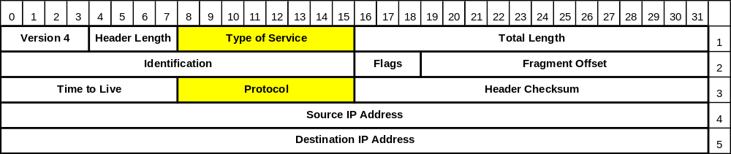
IP Header fields for ICMP Messages
The values in the IP header in front of an ICMP message are usually set as follows:
  TOS = 0
  Protocol = ICMP = 1
Carol Davids © 2014

Slide 10
ICMP specified in RFC 792
RFC 792 published in 1981 contains the ICMP specification.
Carol Davids © 2014

Slide 11
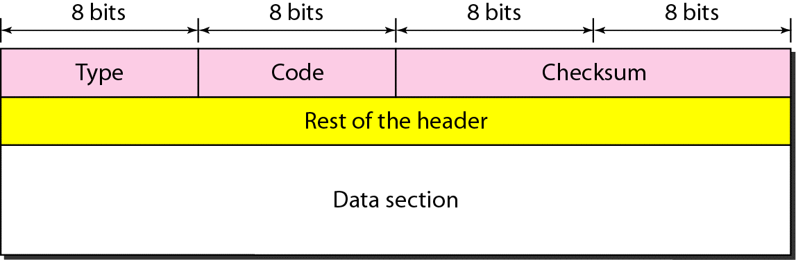
ICMP Message Format
Header is 8 bytes long
First four bytes - type, code, checksum - are common to all ICMP messages
Last 4 bytes vary depending on the type of ICMP message.
Carol Davids © 2014

Slide 12
Fields of the ICMP Message
There are three fields that are always present in an ICMP Message.
    Type field
    Code Field
    Checksum
Carol Davids © 2014

Slide 13
Type
Type field gives you a broad classification of the type of management information carried in the ICMP message
Carol Davids © 2014

Slide 14
Types of ICMP Messages
The Type describes the general category of network condition.
      Type 0 = Echo Reply (ping reply)
      Type 3 = Destination Unreachable
      Type 5 = Redirect
      Type 8 = Echo Request (ping)
      Type 11 = Time exceeded
      Type 12 = Parameter Problem
Identify which of the above are error messages and which are maintenance tools
Carol Davids © 2014

Slide 15
Code
Code field provides more detail about why that type of ICMP message is being sent.
Within each Type there are one or more Codes.
The Code describes a particular network condition in the general type category.
Carol Davids © 2014

Slide 16
Examples of Code field use in ICMP Messages
Type 3 Code 0 = Network Unreachable
Type 3 Code 4 = Fragmentation needed but don’t fragment bit set
Type 5 Code 2 = Redirect for type-of-service and network
Type 12 Code 1 = Required option missing
Carol Davids © 2014

Slide 17
Checksum
The 16-bit one's complement of the one's complement sum of the ICMP message, starting with the ICMP Type field.
When the checksum is computed, the checksum field should first be set to 0.
When the data packet is transmitted, the checksum is computed and inserted into this field.
Carol Davids © 2014

Slide 18
ICMP Checksum
When the data packet is received, the checksum is again computed and verified against the checksum field.
If the two checksums do not match then an error has occurred.
What to do about that is not specified in the ICMP RFC.
Carol Davids © 2014

Slide 19
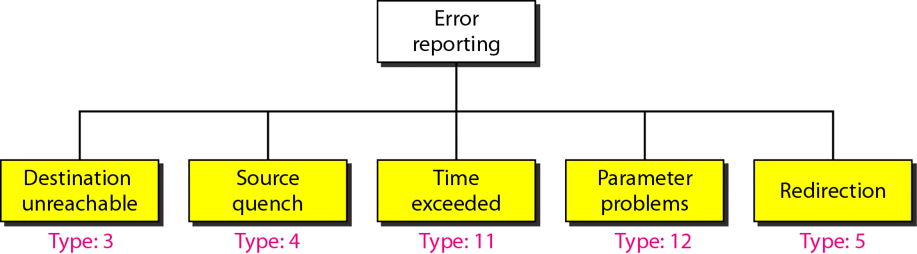
ICMP Error Messages
Error reports are always sent to the source of the IP datagram
There are 5 types of error reports - identified in diagram below
Carol Davids © 2014

Slide 20
What MUST be in an ICMP error message
ICMP error messages MUST contain
  IP Header of the IP datagram that caused the message to be sent
  First 8 bytes of IP datagram data that caused the ICMP message to be sent.
This allows the recipient of the ICMP module to associate the message with one particular protocol - either UDP or TCP.
Carol Davids © 2014

Slide 21
Example ICMP error message
Internet Control Message Protocol
Type: 3 (Destination unreachable)
Code: 1 (Host unreachable)
Checksum: 0x73f5 [correct] {{Below is the beginning of the body of the ICMP message. It is continued on the next page.}}
Internet Protocol, Src: 14.0.0.1 (14.0.0.1), Dst: 193.0.14.129 (193.0.14.129)
Version: 4
Header length: 20 bytes
Differentiated Services Field: 0x00 (DSCP 0x00: Default; ECN: 0x00)
{{Continued on the next page……..}}
Carol Davids © 2014

Slide 22
Example ICMP error message
Total Length: 67
Identification: 0x2593 (9619)
Flags: 0x00
Fragment offset: 0
Time to live: 127
Protocol: UDP (0x11)
Header checksum: 0x3895 [correct]
Source: 14.0.0.1 (14.0.0.1)
Destination: 193.0.14.129 (193.0.14.129)
User Datagram Protocol, Src Port: 1036 (1036), Dst Port: domain (53) {{This is the beginning of the layer 4 header.}}
Carol Davids © 2014

Slide 23
When NOT to send an ICMP error message
Never send an ICMP error report regarding an IP datagram that:
  Is itself carrying an ICMP message
  Is a fragment but not a first fragment
  Has a multicast address
  Has a special address such as 127.0.0.0
Carol Davids © 2014

Slide 24
Destination Unreachable
Sent by a router or host
When sent by a router it means that the router cannot find a path to the destination
When sent by a host it means that the host cannot deliver the datagram
Carol Davids © 2014

Slide 25
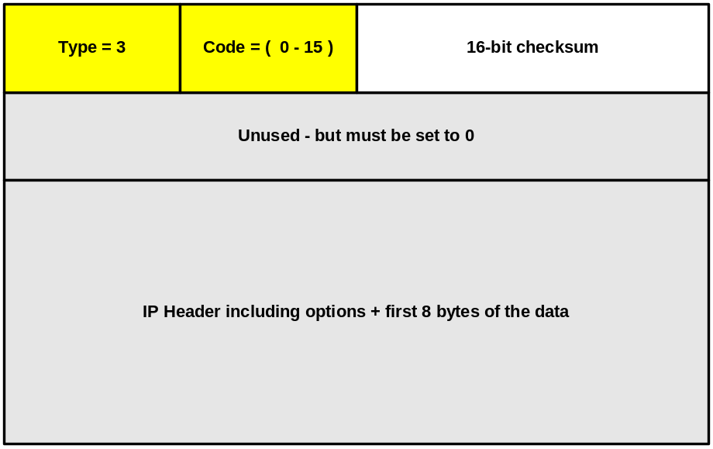
Type 3: Destination Unreachable
Carol Davids © 2014

Slide 26
Destination Unreachable
Destination may be unreachable for a variety of reasons.
Message includes the IP header plus the first 8 bytes of the original datagram data.
Carol Davids © 2014

Slide 27
Destination Unreachable
The host uses this 28 bytes of information to match the message to the appropriate process.
This is meant to assure that any higher layer port numbers are included in the first 64 data bits of the original datagram data. (They would be if the higher layer were UDP or TCP, for example.)
Carol Davids © 2014

Slide 28
Example: Port Unreachable
Hosts might use this as follows:
If host receives an IP datagram but cannot deliver it because the indicated protocol module or process port is not active, the destination host may send a destination unreachable message to the source host.
This is a port unreachable message with code = 3
Carol Davids © 2014

Slide 29
Destination Unreachable Codes
0 - Network unreachable error
1 - Host unreachable error
2 - Protocol unreachable error. When the designated transport protocol is not supported
Carol Davids © 2014

Slide 30
Destination Unreachable Codes
3 - Port unreachable error. When the designated transport protocol (e.g., UDP) is unable to de-multiplex the datagram but has no protocol mechanism to inform the sender.
4 - The datagram is too big. Packet fragmentation is required but the DF bit in the IP header is set.
5 - Source route failed error.
Carol Davids © 2014

Slide 31
Destination Unreachable Codes
6 - Destination network unknown error.
7 - Destination host unknown error.
8 - Source host isolated error. Obsolete.
9 - The destination network is administratively prohibited.
Carol Davids © 2014

Slide 32
Destination Unreachable Codes
10 -The destination host is administratively prohibited.
11 -The network is unreachable for Type Of Service.
12 -The host is unreachable for Type Of Service.
Carol Davids © 2014

Slide 33
Destination Unreachable Codes
13 -Communication Administratively Prohibited. This is generated if a router cannot forward a packet due to administrative filtering.
14 - Host precedence violation. Sent by the first hop router to a host to indicate that a requested precedence is not permitted for the particular combination of source/destination host or network, upper layer protocol, and source/destination port.
Carol Davids © 2014

Slide 34
Destination Unreachable Codes
15 - Precedence cutoff in effect. The network operators have imposed a minimum level of precedence required for operation, the datagram was sent with a precedence below this level.
Carol Davids © 2014

Slide 35
Source Quench
Assists in flow control
When host or router discards an IP datagram due to lack of buffer space it sends a source quench message
Carol Davids © 2014

Slide 36
Time Exceeded - usage by router
Usage by a router:
  I am a router
  I receive an IP datagram and decrement the TTL by 1.
  Then I test the TTL value, discover it is 0 and discard the datagram
  I also send an ICMP error message to the source of the IP datagram
Carol Davids © 2014

Slide 37
Time Exceeded - Usage by host
Usage by a host:
  I am a host
  I receive a fragment of a fragmented IP datagram and start a timer
  The timer expires and I still have not received all of the fragments
  I send a time exceeded message to the source of the IP datagram
Carol Davids © 2014

Slide 38
Parameter Problem
Sent by a destination host or by a router when it finds a missing field or a field containing ambiguous information
Carol Davids © 2014

Slide 39
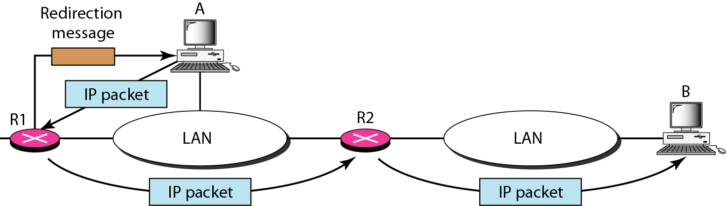
Redirection
Sent by a router to a host to update the host’s routing table
Hosts normally have statically configured routing tables - see illustration below.
Carol Davids © 2014

Slide 40
Redirection
Here, A’s default router for the address B is R1
But R1 needed to forward the datagram sent by A to B
R1 did forward the datagram - it also sent a redirection message to A causing A to change its routing table.
Carol Davids © 2014

Slide 41
Reminder
Remember that the IP protocol defines two types of functional element - Hosts and Routers
Notice that when we describe the operation of ICMP we need to identify how hosts behave and how routers behave
Carol Davids © 2014

Slide 42

ICMP query messages
ICMP queries are used to diagnose network problems – for maintenance purposes
Important ICMP queries are illustrated in the diagram below
Carol Davids © 2014

Slide 43
Example of ICMP query message – echo request (8) – ping request
Internet Protocol, Src: 13.0.0.4 (13.0.0.4), Dst: 14.0.0.1 (14.0.0.1)
Version: 4
Header length: 20 bytes
Differentiated Services Field: 0x00 (DSCP 0x00: Default; ECN: 0x00)
Total Length: 60
……………………(part of IP message removed)
Internet Control Message Protocol
Type: 8 (Echo (ping) request)
Code: 0
Checksum: 0x3f5c [correct]
Identifier: 0x0200
Sequence number: 3072 (0x0c00)
Data (32 bytes)
0000 61 62 63 64 65 66 67 68 69 6a 6b 6c 6d 6e 6f 70 abcdefghijklmnop
0010 71 72 73 74 75 76 77 61 62 63 64 65 66 67 68 69 qrstuvwabcdefghi
Carol Davids © 2014

Slide 44
Example of ICMP query message – echo reply (0) – ping reply
Internet Protocol, Src: 14.0.0.1 (14.0.0.1), Dst: 13.0.0.4 (13.0.0.4)
Version: 4
Header length: 20 bytes
Differentiated Services Field: 0x00 (DSCP 0x00: Default; ECN: 0x00)
Total Length: 60
………….
Internet Control Message Protocol
Type: 0 (Echo (ping) reply)
Code: 0
Checksum: 0x475c [correct]
Identifier: 0x0200
Sequence number: 3072 (0x0c00)
Data (32 bytes)
0000 61 62 63 64 65 66 67 68 69 6a 6b 6c 6d 6e 6f 70 abcdefghijklmnop
0010 71 72 73 74 75 76 77 61 62 63 64 65 66 67 68 69 qrstuvwabcdefghi
Carol Davids © 2014

Slide 45
Type 8/0: Echo Request / Echo Reply
Used to identify the source of problems on the network
Tests for continuity between source and destination
If you receive a reply to an echo request, you know that the IP layer at the destination is operational and that the routers in the path between source and destination are functional
Carol Davids © 2014

Slide 46
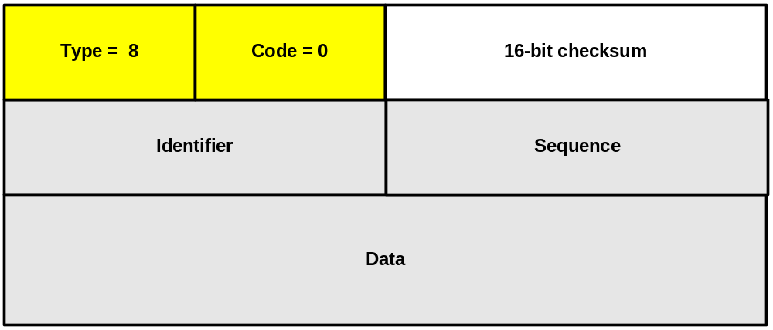
Type 8: Echo Request (ping)
Identifier - match echo requests to the associated reply. It may be set to zero.
Carol Davids © 2014

Slide 47
Type 8: Echo Request (ping)
Sequence number - match echo requests to the associated reply. It may be set to zero.
Carol Davids © 2014

Slide 48
Matching echo requests and replies
Identifier and sequence number are used by the sender to match requests to replies.
In the traces we will look at, the sender uses the same Identifier and changes only the sequence number.
Carol Davids © 2014

Slide 49
Type 8: Echo Request (ping)
Data field - is of variable length and depends on the implementation
Carol Davids © 2014

Slide 50
Type 8: Echo Request (ping) - Operation
The data received in the echo request message must be returned in the echo reply message.
The identifier and sequence number may be used by the echo sender to aid in matching the replies with the echo requests.
Carol Davids © 2014

Slide 51
Type 0 : Echo Reply (ping)
Same format as Ping Request.
Carol Davids © 2014

Slide 52
Type 13/14: Timestamp Request / Reply
Used to calculate round trip delay
Used to synchronize clocks
Carol Davids © 2014

Slide 53
Timestamp Request/Reply
Data received (a timestamp) in the message is returned in the reply together with an additional timestamp.
The timestamp is 32 bits of milliseconds since midnight UT.
Carol Davids © 2014

Slide 54
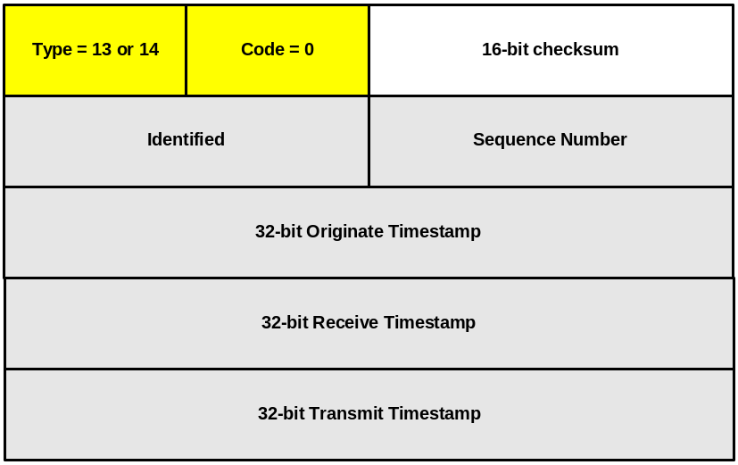
Timestamp Request/Reply
Originate Timestamp = time the sender last touched the message before sending it
Carol Davids © 2014

Slide 55
Timestamp Request/Reply
Receive Timestamp = time the echoer first touched it on receipt
Transmit Timestamp is the time the echoer last touched the message on sending it.
Carol Davids © 2014

Slide 56
Type 17/18: Address-mask Request / Reply
Sent by a host to a router on its LAN
If the host knows its default router, the host sends to that router
If the host does not know its default router, it will broadcast the request
Carol Davids © 2014

Slide 57
Address Mask Request / Reply
When a router receives an address mask request it returns the request with the address mask field set to the 32-bit mask of the bits identifying the subnet and network, for the subnet on which the request was received.
Carol Davids © 2014

Slide 58
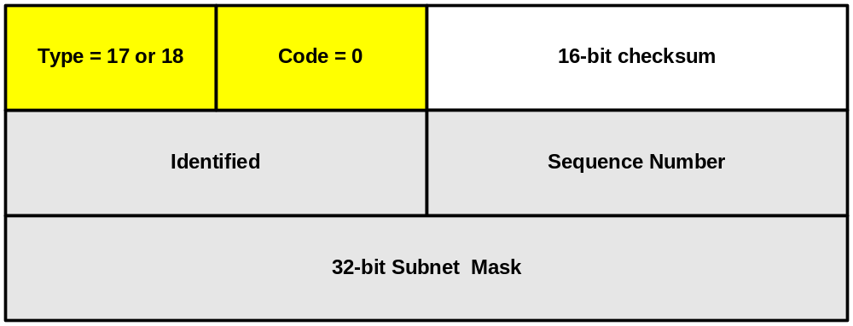
Address Mask Request / Reply
Identifier - used to match the request to the associated reply. It may be set to zero.
Carol Davids © 2014

Slide 59
Address Mask Request / Reply
Sequence number - used to match the request to the associated reply. It may be set to zero.
Subnet mask - the subnet mask of the requesting host.
Carol Davids © 2014

Slide 60
Router Solicitation and Advertisement
Solicitations are sent by a host to learn about the availability of routers on its LAN
Advertisements are sent by a router to announce its presence and availability
Carol Davids © 2014

Slide 61
Redirect Request
ICMP Redirect tells the source host that there is a better route to the destination.
A router may send this message to a host.
Carol Davids © 2014

Slide 62
ICMP Redirect Example
A host is connected to a network that has two routers attached to it. R1 and R2.
Host uses R1 as its default router.
Carol Davids © 2014

Slide 63
ICMP Redirect Example
If R1 receives a datagram from the host destined for an address that R2 could handle better, R1 sends a ICMP-Redirect back to the host instructing it to use R2 for all future datagrams addressed to that destination.
The host then adds this new route to its forwarding table.
Carol Davids © 2014

Slide 64
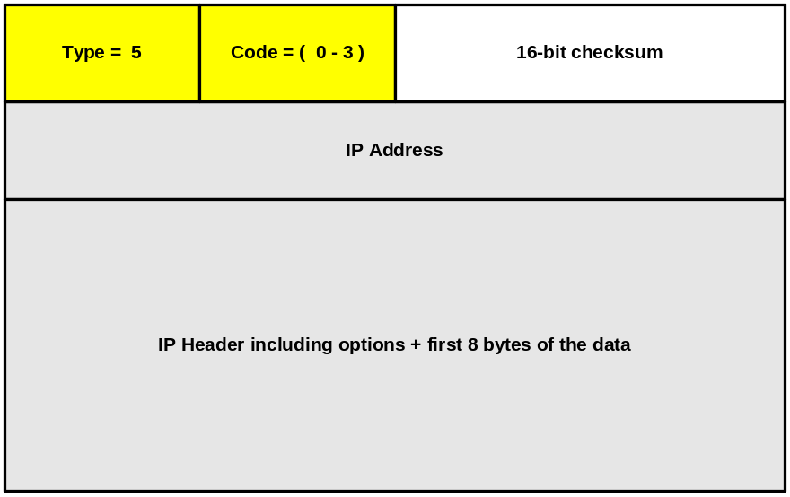
Redirect Message - Type 5
IP Address = IP Address of the new router
Carol Davids © 2014

Slide 65
Redirect Message - Type 5
IP Header and first 8 bytes of data : used by receiver to determine which message should be resent to the new Router.
Carol Davids © 2014

Slide 66
Codes
0 = Redirect for network error
1 = Redirect for host error
2 = Redirect for TOS and network error
3 = Redirect for TOS and host error.
Carol Davids © 2014

Slide 67
The End
Carol Davids © 2014

Slide 68
References
http://www.ietf.org/rfc/rfc0792.txt
http://www.ietf.org/rfc/rfc1122.txt - Requirements for IP Hosts
http://www.ietf.org/rfc/rfc1812.txt - Requirements for IPv4 Routers
Carol Davids © 2014

